Slide 1


Stream (hand-shake)
Notes:
<numéro>

Slide 2
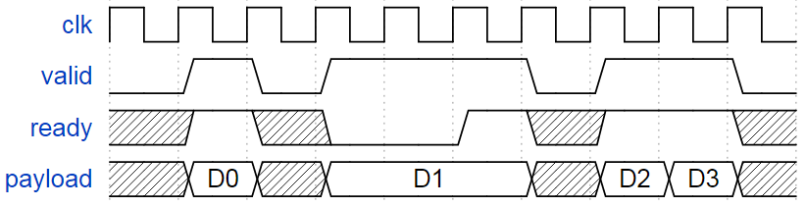
Introductoin
Stream in SpinalHDL is an simple handshake bus
valid/ready arbitration to carry the payload
Masters use valid to say “A transaction is present”
Slaves use ready to say “I take the transaction”
<numéro>
Notes:
<numéro>

Slide 3
Stream are important
They can be used in many places to carry transactions
They avoid the use of pulse based communications
They will make your design mutch more reusable and modifiable.
Provided with my usefull things:
  Pipelining / Buffering
  Arbitration / Join / Fork / Dispatcher / Throw / Halt
  Clock crossing (FIFO / Toogles)
<numéro>
Notes:
<numéro>

Slide 4
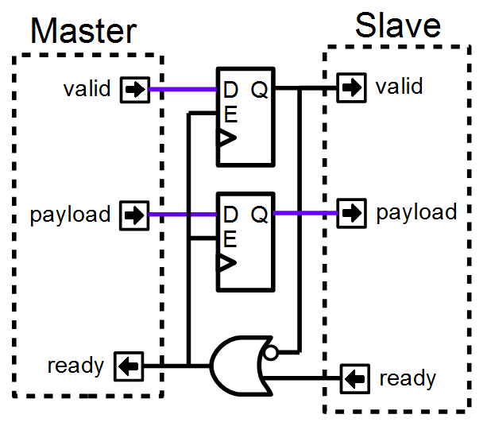

Buffer pattern
<numéro>
Slave
Slave
Slave
Master
Slave
Master
Master
Master
valid
valid
valid
valid
valid
valid
valid
valid
D
D
D
D
Q
Q
Q
Q
E
E
E
E
SET
SET
SET
SET
D
D
Q
Q
E
E
payload
payload
payload
payload
payload
payload
payload
payload
D
D
D
D
Q
Q
Q
Q
E
E
E
E
SET
SET
SET
SET
ready
ready
ready
ready
ready
ready
ready
ready
Notes:
<numéro>

