Slide 1
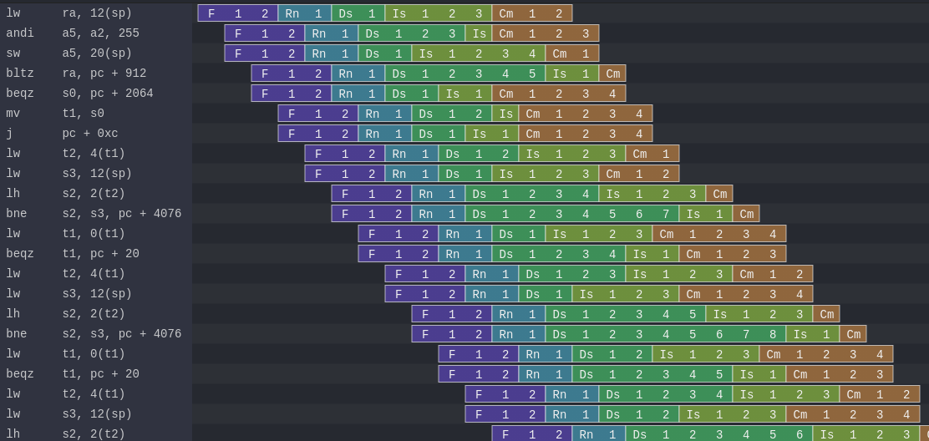
NaxRiscv : A OoO super-scalar CPU generator
simplescreenrecoder
ffmpeg -i video.mp4 -map_channel 0.1.0 -c:v copy mono.mp4

Slide 2
Background / whoami
Dolu1990 on github
Active on
  SpinalHDL
  VexRiscv
  NaxRiscv
Software / Hardware background

Slide 3

NaxRiscv in short
RV32/RV64 IMAFDCSU (Linux ready)
Out of order / superscalar
Not implemented in VHDL/[System]Verilog
Software elaboration and abstractions
Opensource : https://github.com/SpinalHDL/NaxRiscv
https://twitter.com/i/status/1493996880593887235

Slide 4

Architecture
2 decode, 3 issue (2 ALU, 1 shared EU)
64 physical register, 64 entry ROB
4KB GShare, 4KB BTB (both 1 way), RAS
10 cycles miss predicted branch penalty
Non-blocking D$
I$ D$ each have 16 KB (4 ways)
I$ D$ each have 192 TLB (2+4 ways)

Slide 5
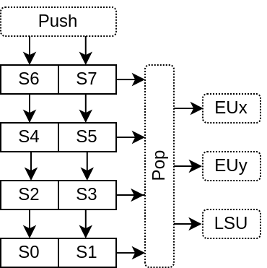
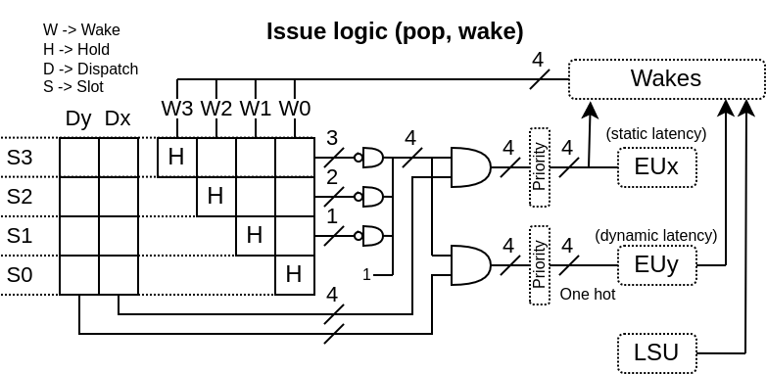
Issue Queue / Dispatch
Shared between execution units
32 entries, grouped by “wave”, (ex: 2x16)
Older first, no compression
Matrix design, removal on completion

Slide 6
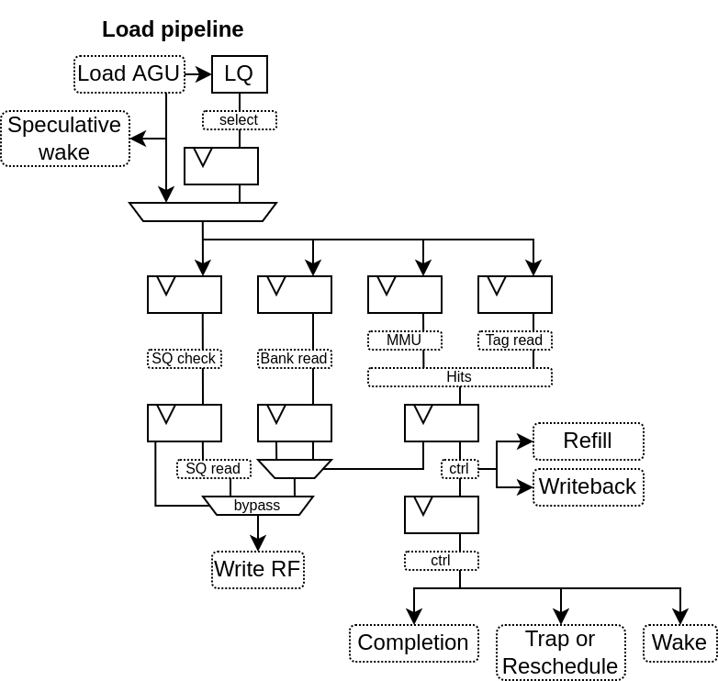
LSU (load)
Speculative wake (hit prediction)
load to use latency :
  3 cycle (hit predicted OK)
  6 cycle (miss predicted)
  Full flush (hit predicted KO)
AGU to D$ bypass
RF written 1 cycle before completion
SQ address hazard check
  4KB virtual (first pass)
  Full physical (second pass if first pass has 1 hit)
16 entries

Slide 7
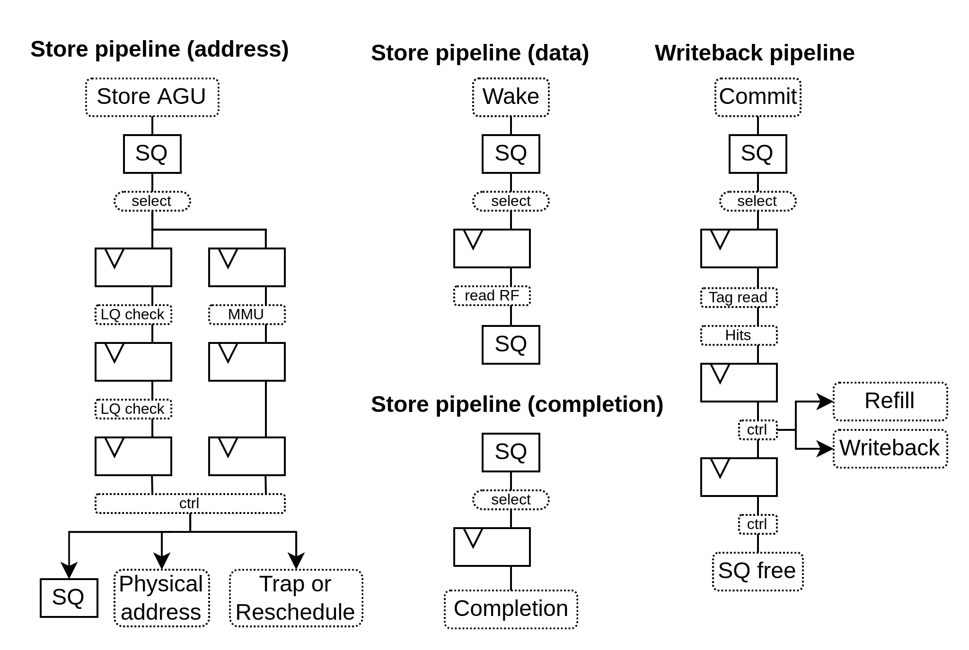
LSU (store)
4 pipelines
Dependencies
  Address through IQ
  Data directly read RF
LQ address hazard check
  4KB virtual
16 entries

Slide 8
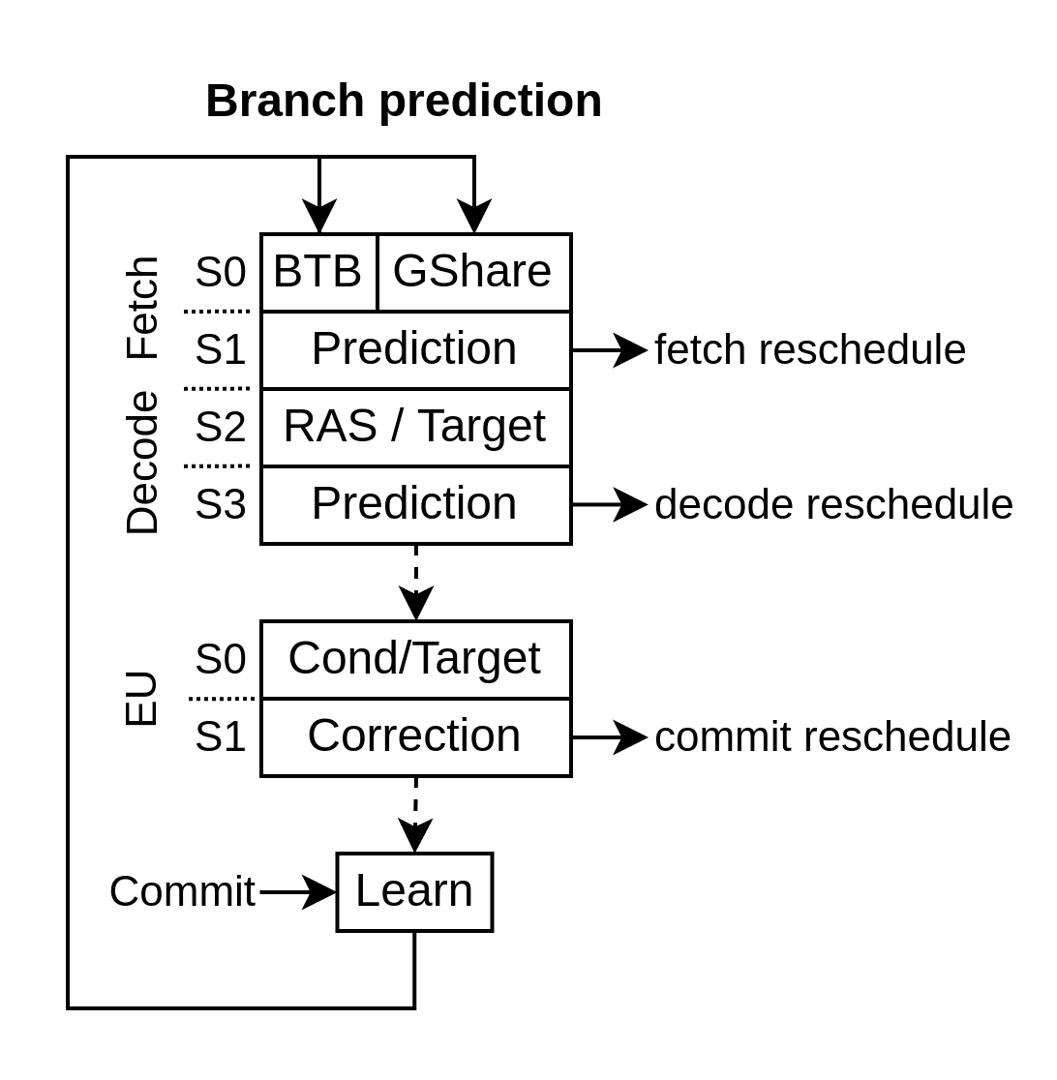
Branch prediction
Fetch (No instruction, No data)
  BTB : Instruction prediction
  Gshare : Data prediction
Decode (No data)
  Target : Instruction processing
  RAS : Data prediction
EU / Execution Unit
  Prediction correction

Slide 9
Abstraction != Overhead
RV32IMASU, 2 decode, 3 issue (Linux ready)
  Dhrystone : 2.94 DMIPS/Mhz 1.65 IPC (-O3 -fno-common -fno-inline)
  Coremark : 5.00 Coremark/Mhz 1.28 IPC
  Embench-iot : 1.68 baseline 1.42 IPC (baseline = Cortex M4)
On Artix 7 speed grade 3 :
  150 Mhz (360 Mhz on Kintex ultrascale+ grade 3)
  14.2 KLUT, 9.7 KFF, 11.5 BRAM, 4 DSP
NaxRiscv => https://spinalhdl.github.io/NaxRiscv-Rtd/main/NaxRiscv/performance/index.html

Slide 10
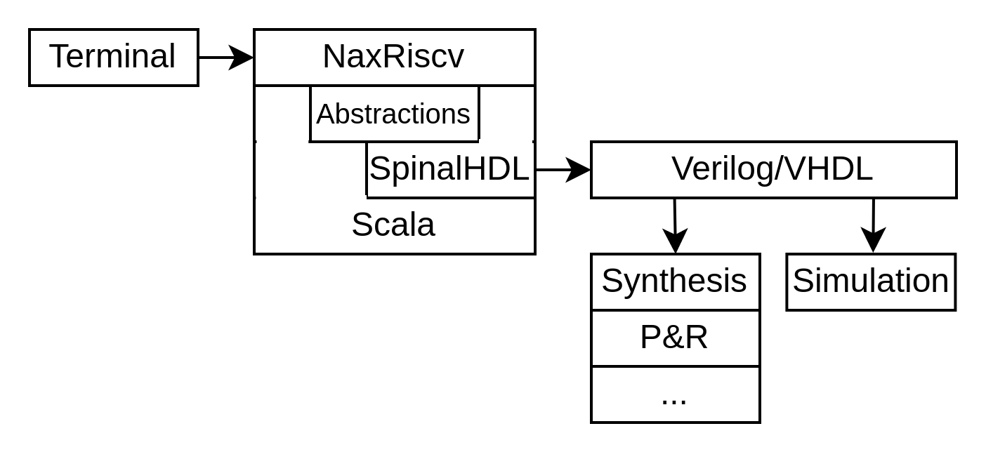
NaxRiscv elaboration
sbt "runMain naxriscv.Gen"

Slide 11
Scala in one slides
object Main extends App{
println("hello world")
}
object Main extends App{
val verilog = new PrintWriter(new File("toplevel.v"))
verilog.write("module miaou{\n")
verilog.write(" input clk,\n")
//...
verilog.close()
}

Slide 12
Scala in one slides
object Main extends App{
println("hello world")
}
object Main extends App{
val verilog = new PrintWriter(new File("toplevel.v"))
verilog.write("module miaou{\n")
verilog.write(" input clk,\n")
//...
verilog.close()
}

Slide 13
Scala in one slides
object Main extends App{
println("hello world")
}
object Main extends App{
val verilog = new PrintWriter(new File("toplevel.v"))
verilog.write("module miaou{\n")
verilog.write(" input clk,\n")
//...
verilog.close()
}

Slide 14
SpinalHDL in two slides
import spinal.core._
object Main extends App{
SpinalVerilog(
new Module{
val a,b = in UInt(8 bits)
val result = out(a + b)
}
)
}
module unamed (
input [7:0] a,
input [7:0] b,
output [7:0] result
);
assign result = (a + b);
endmodule

Slide 15
SpinalHDL in two slides
import spinal.core._
object Main extends App{
SpinalVerilog(
new Module{
val a,b = in UInt(8 bits)
val result = out(a + b)
}
)
}
module unamed (
input [7:0] a,
input [7:0] b,
output [7:0] result
);
assign result = (a + b);
endmodule

Slide 16
SpinalHDL – Scala interaction
new Module {
val a,b,c = out UInt(8 bits)
val array = ArrayBuffer[UInt]()
array += a // By reference !
array += b
array += c
for(element <- array){
element := 0
}
}
module unamed (
output [7:0] a,
output [7:0] b,
output [7:0] c
);
assign a = 8'h0;
assign b = 8'h0;
assign c = 8'h0;
endmodule

Slide 17
SpinalHDL – Scala interaction
new Module {
val a,b,c = out UInt(8 bits)
val array = ArrayBuffer[UInt]()
array += a // By reference !
array += b
array += c
for(element <- array){
element := 0
}
}
module unamed (
output [7:0] a,
output [7:0] b,
output [7:0] c
);
assign a = 8'h0;
assign b = 8'h0;
assign c = 8'h0;
endmodule

Slide 18
SpinalHDL – Scala interaction
new Module {
val a,b,c = out UInt(8 bits)
val array = ArrayBuffer[UInt]()
array += a // By reference !
array += b
array += c
for(element <- array){
element := 0
}
}
module unamed (
output [7:0] a,
output [7:0] b,
output [7:0] c
);
assign a = 8'h0;
assign b = 8'h0;
assign c = 8'h0;
endmodule

Slide 19
SpinalHDL – API side effects
new Module {
val a,b,c = out UInt(8 bits)
val array = ArrayBuffer[UInt]()
array += a // By reference !
array += b
array += c
for(element <- array){
element := 0
}
}
module unamed (
output [7:0] a,
output [7:0] b,
output [7:0] c
);
assign a = 8'h0;
assign b = 8'h0;
assign c = 8'h0;
endmodule

Slide 20
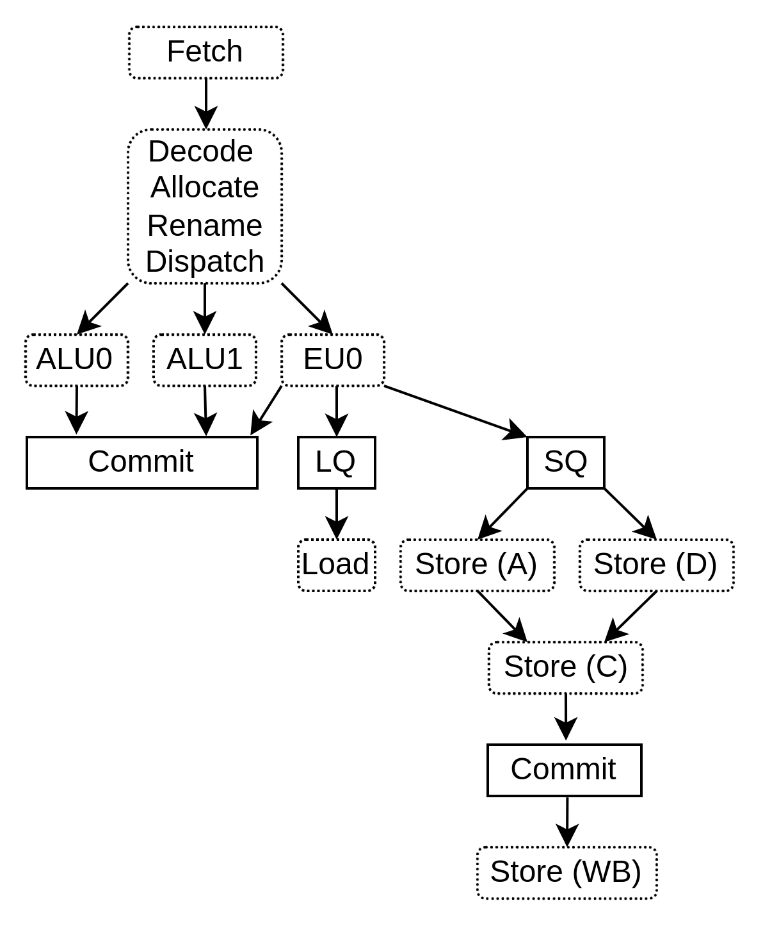
NaxRiscv : Many pipelines

Slide 21
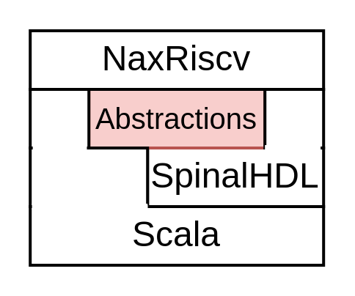
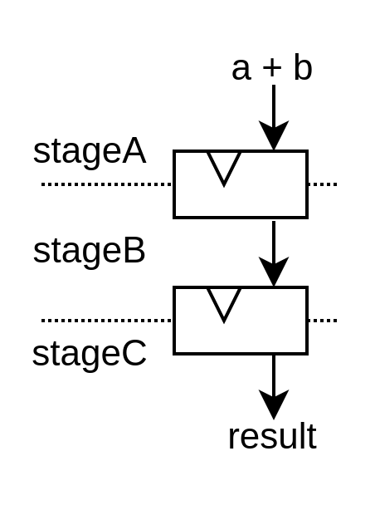
Pipeline API
new Module{
val a, b = in UInt(8 bits)
val result = out UInt(8 bits)
implicit val pip = new Pipeline
val stageA = new Stage()
val stageB = new Stage(connection = M2S())
val stageC = new Stage(connection = M2S())
val SUM = stageA.insert(a + b)
result := stageC(SUM)
pip.build()
}

Slide 22
Pipeline API
new Module{
val a, b = in UInt(8 bits)
val result = out UInt(8 bits)
implicit val pip = new Pipeline
val stageA = new Stage()
val stageB = new Stage(connection = M2S())
val stageC = new Stage(connection = M2S())
val SUM = stageA.insert(a + b)
result := stageC(SUM)
pip.build()
}

Slide 23
Pipeline API
new Module{
val a, b = in UInt(8 bits)
val result = out UInt(8 bits)
implicit val pip = new Pipeline
val stageA = new Stage()
val stageB = new Stage(connection = M2S())
val stageC = new Stage(connection = M2S())
val SUM = stageA.insert(a + b)
result := stageC(SUM)
pip.build()
}

Slide 24
Pipeline API
new Module{
val a, b = in UInt(8 bits)
val result = out UInt(8 bits)
implicit val pip = new Pipeline
val stageA = new Stage()
val stageB = new Stage(connection = M2S())
val stageC = new Stage(connection = M2S())
val SUM = stageA.insert(a + b)
result := stageC(SUM)
pip.build()
}

Slide 25
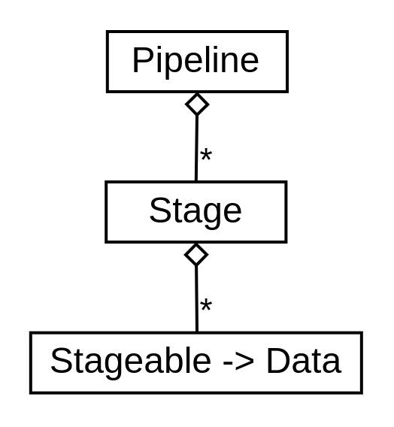
Pipeline internals
class Pipeline extends Area {
val stages = ArrayBuffer[Stage]()
//…
def build(): Unit = {
for(s <- stages){
for(... <- s.stageableToData){
}
}
}
}
class Stage extends Area {
val stageableToData = HashMap[Stageable, Data]()
//…
pip.stages += this
}
new Module{
val a, b = in UInt(8 bits)
val result = out UInt(8 bits)
implicit val pip = new Pipeline
val stageA = new Stage
val stageB = new Stage(connection = M2S())
val sum = stageA.insert(a + b)
result := stageC(sum)
pip.build()
}

Slide 26
Pipeline internals
class Pipeline extends Area {
val stages = ArrayBuffer[Stage]()
//…
def build(): Unit = {
for(s <- stages){
for(... <- s.stageableToData){
}
}
}
}
class Stage extends Area {
val stageableToData = HashMap[Stageable, Data]()
//…
pip.stages += this
}
new Module{
val a, b = in UInt(8 bits)
val result = out UInt(8 bits)
implicit val pip = new Pipeline
val stageA = new Stage
val stageB = new Stage(connection = M2S())
val sum = stageA.insert(a + b)
result := stageC(sum)
pip.build()
}

Slide 27
Pipeline internals
class Pipeline extends Area {
val stages = ArrayBuffer[Stage]()
//…
def build(): Unit = {
for(s <- stages){
for(... <- s.stageableToData){
}
}
}
}
class Stage extends Area {
val stageableToData = HashMap[Stageable, Data]()
//…
pip.stages += this
}
new Module{
val a, b = in UInt(8 bits)
val result = out UInt(8 bits)
implicit val pip = new Pipeline
val stageA = new Stage
val stageB = new Stage(connection = M2S())
val sum = stageA.insert(a + b)
result := stageC(sum)
pip.build()
}

Slide 28
val plugins = ArrayBuffer[Plugin]()
plugins ++= List(
new PcPlugin(),
new FetchCachePlugin(16 KB),
new DecoderPlugin(),
new DispatchPlugin(slotCount = 32),
new CommitPlugin()
...
)
plugins ++= List(
new ExecutionUnitBase("ALU0"),
new IntAluPlugin("ALU0"),
new ShiftPlugin("ALU0" ),
new BranchPlugin("ALU0")
new IntFormatPlugin("ALU0"),
new SrcPlugin("ALU0"),
)
new NaxRiscv(plugins)
Create NaxRiscv

Slide 29
val plugins = ArrayBuffer[Plugin]()
plugins ++= List(
new PcPlugin(),
new FetchCachePlugin(16 KB),
new DecoderPlugin(),
new DispatchPlugin(slotCount = 32),
new CommitPlugin()
...
)
plugins ++= List(
new ExecutionUnitBase("ALU0"),
new IntAluPlugin("ALU0"),
new ShiftPlugin("ALU0" ),
new BranchPlugin("ALU0")
new IntFormatPlugin("ALU0"),
new SrcPlugin("ALU0"),
)
new NaxRiscv(plugins)
Elaboration time list of Plugin

Slide 30
val plugins = ArrayBuffer[Plugin]()
plugins ++= List(
new PcPlugin(),
new FetchCachePlugin(16 KB),
new DecoderPlugin(),
new DispatchPlugin(slotCount = 32),
new CommitPlugin()
...
)
plugins ++= List(
new ExecutionUnitBase("ALU0"),
new IntAluPlugin("ALU0"),
new ShiftPlugin("ALU0" ),
new BranchPlugin("ALU0")
new IntFormatPlugin("ALU0"),
new SrcPlugin("ALU0"),
)
new NaxRiscv(plugins)
plugins ++= List(
new ExecutionUnitBase("ALU1"),
new IntAluPlugin("ALU1"),
new ShiftPlugin("ALU1" ),
new BranchPlugin("ALU1")
new IntFormatPlugin("ALU1"),
new SrcPlugin("ALU1"),
)
Wanna a second execution unit ?

Slide 31
Plugin - Inheritance
class BranchPlugin(euId : String) extends Plugin {
val setup = create early new Area{
// ...
}
val logic = create late new Area{
// ...
}
}

Slide 32
Plugin - Phases
class BranchPlugin(euId : String) extends Plugin {
val setup = create early new Area{
// ...
}
val logic = create late new Area{
// ...
}
}

Slide 33
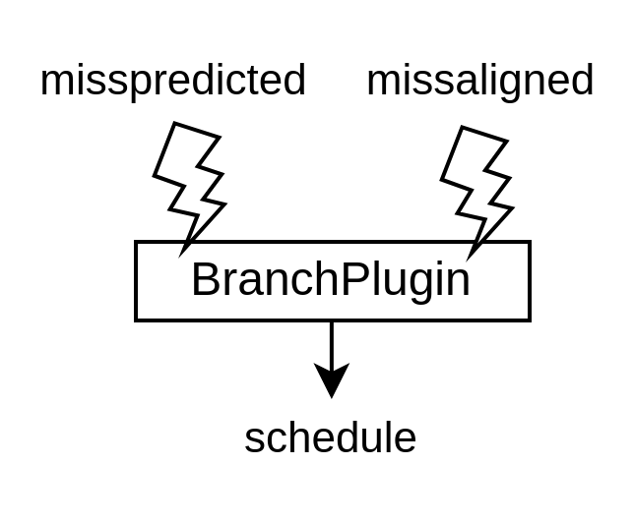
Plugin - Discovery
class BranchPlugin(euId : String) extends Plugin {
val setup = create early new Area{
// ...
val commit = getService[CommitService]
val schedule = commit.newSchedulePort(canJump = true, canTrap = true)
}
val logic = create late new Area{
// ...
setup.schedule.valid := isFireing && SEL && (MISSPREDICTED || MISSALIGNED)
setup.schedule.trap := MISSALIGNED
setup.schedule.pcTarget := target
}
}

Slide 34
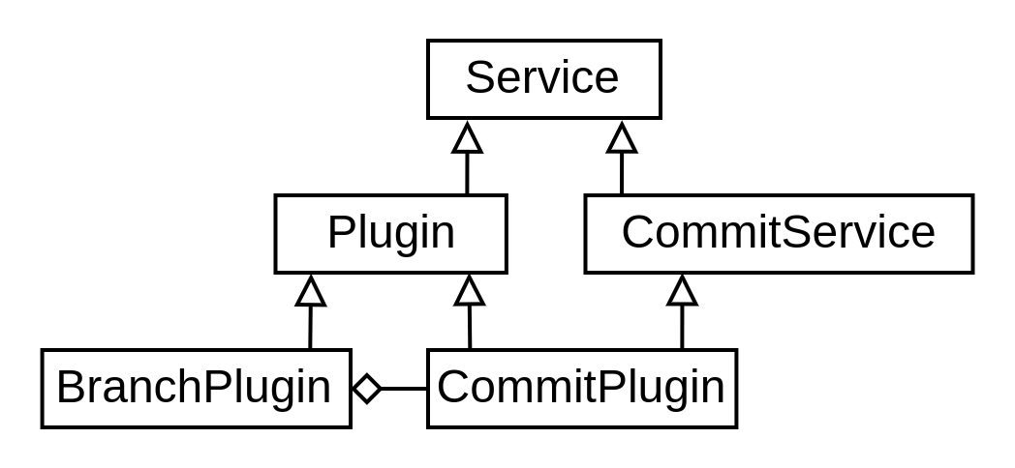
Plugin - Discovery
class BranchPlugin(euId : String) extends Plugin {
val setup = create early new Area{
// ...
val commit = getService[CommitService]
val schedule = commit.newSchedulePort(canJump = true, canTrap = true)
}
val logic = create late new Area{
// ...
setup.schedule.valid := isFireing && SEL && (MISSPREDICTED || MISSALIGNED)
setup.schedule.trap := MISSALIGNED
setup.schedule.pcTarget := target
}
}

Slide 35
Plugin – Software interface
class BranchPlugin(euId : String) extends Plugin {
val setup = create early new Area{
// ...
val commit = getService[CommitService]
val schedule = commit.newSchedulePort(canJump = true, canTrap = true)
}
val logic = create late new Area{
// ...
setup.schedule.valid := isFireing && SEL && (MISSPREDICTED || MISSALIGNED)
setup.schedule.trap := MISSALIGNED
setup.schedule.pcTarget := target
}
}

Slide 36
Plugin - Implementation
class BranchPlugin(euId : String) extends Plugin {
val setup = create early new Area{
// ...
val commit = getService[CommitService]
val schedule = commit.newSchedulePort(canJump = true, canTrap = true)
}
val logic = create late new Area{
// ...
setup.schedule.valid := isFireing && SEL && (MISSPREDICTED || MISSALIGNED)
setup.schedule.trap := MISSALIGNED
setup.schedule.pcTarget := target
}
}

Slide 37
Plugin – Instruction requirements
val BEQ = SingleDecoding(
opcode = M"-----------------000-----1100011",
resources = List(
IntRegFile -> RS1,
IntRegFile -> RS2,
PC_READ,
INSTRUCTION_SIZE
)
)
class BranchPlugin(euId : String) extends Plugin{
val setup = create early new Area{
val eu = findService[ExecutionUnitBase](_.euId == euId)
eu.add(BEQ)
// ...
}
//...
}

Slide 38
Plugin – Instruction registration
val BEQ = SingleDecoding(
opcode = M"-----------------000-----1100011",
resources = List(
IntRegFile -> RS1,
IntRegFile -> RS2,
PC_READ,
INSTRUCTION_SIZE
)
)
class BranchPlugin(euId : String) extends Plugin{
val setup = create early new Area{
val eu = findService[ExecutionUnitBase](_.euId == euId)
eu.add(BEQ)
// ...
}
//...
}

Slide 39
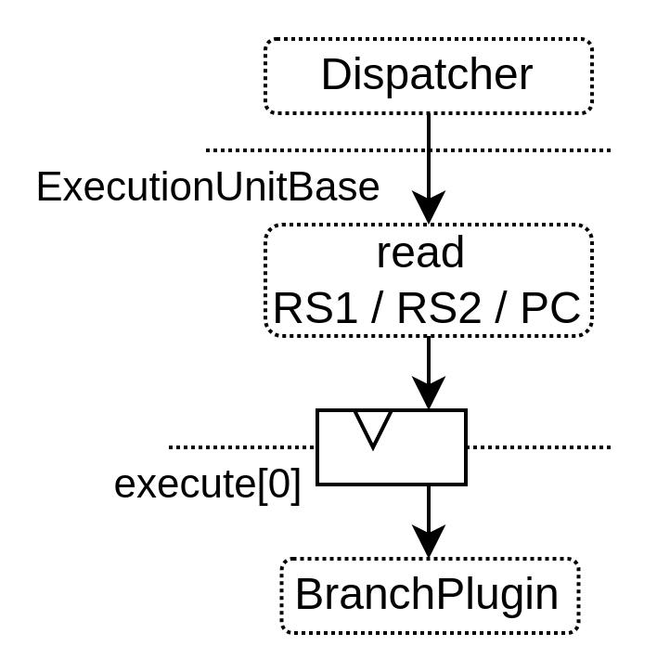
Plugin – Side effects
val BEQ = SingleDecoding(
opcode = M"-----------------000-----1100011",
resources = List(
IntRegFile -> RS1,
IntRegFile -> RS2,
PC_READ,
INSTRUCTION_SIZE
)
)
class BranchPlugin(euId : String) extends Plugin{
val setup = create early new Area{
val eu = findService[ExecutionUnitBase](_.euId == euId)
eu.add(BEQ)
// ...
}
//...
}

Slide 40
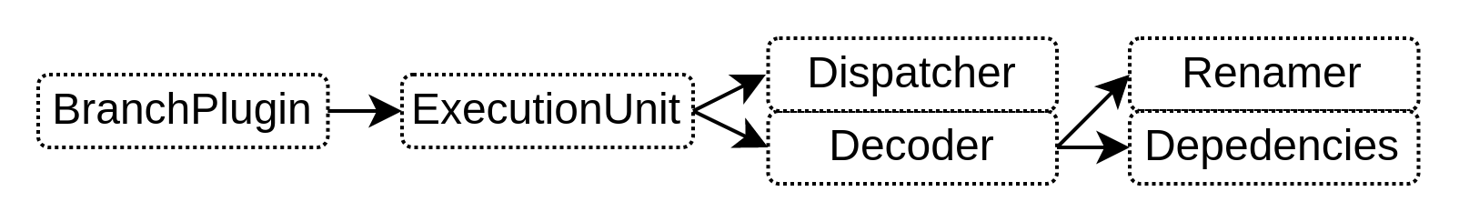
Plugin – Side effects
val BEQ = SingleDecoding(
opcode = M"-----------------000-----1100011",
resources = List(
IntRegFile -> RS1,
IntRegFile -> RS2,
PC_READ,
INSTRUCTION_SIZE
)
)
class BranchPlugin(euId : String) extends Plugin{
val setup = create early new Area{
val eu = findService[ExecutionUnitBase](_.euId == euId)
eu.add(BEQ)
// ...
}
//...
}

Slide 41
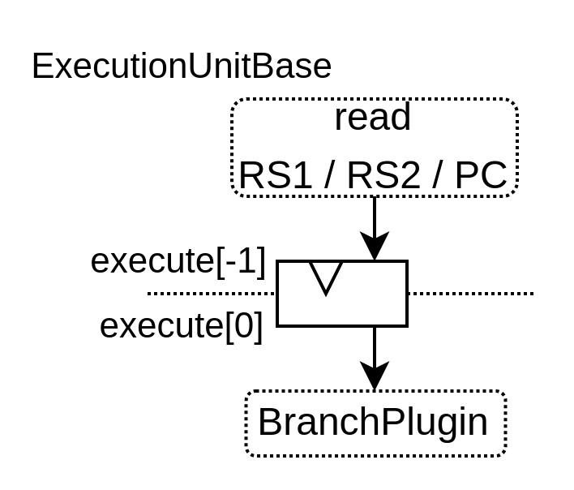
Plugin – Composable pipeline
class BranchPlugin(euId : String) extends Plugin{
//...
val logic = create late new Area{
val eu = findService[ExecutionUnitBase](_.euId == euId)
val stage = eu.getExecute(stageId = 0)
val target = stage(PC) + ???
// ...
setup.schedule.pcTarget := target
}
}

Slide 42
Plugin – Composable pipeline
class BranchPlugin(euId : String) extends Plugin{
//...
val logic = create late new Area{
val eu = findService[ExecutionUnitBase](_.euId == euId)
val stage = eu.getExecute(stageId = 0)
val target = stage(PC) + ???
// ...
setup.schedule.pcTarget := target
}
}

Slide 43
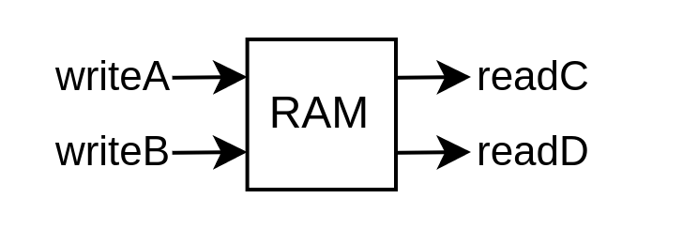
Memory inferation
new Module {
val ram = Mem.fill(256)(UInt(16 bits))
val writeA = slave(ram.writePort())
val writeB = slave(ram.writePort())
val readC = slave(ram.readAsyncPort())
val readD = slave(ram.readAsyncPort())
this.dslBody.walkDeclarations{
case mem : Mem[_] => {
println(s"found $mem")
mem.dlcForeach[Any]{
case write : MemWrite => println(s" found one write port")
case read : MemReadAsync => println(s" found one read port")
}
mem.removeStatement()
//...
}
case _ =>
}
}
found toplevel/ram : Mem[256*16 bits]
found one write port
found one write port
found one read port
found one read port

Slide 44
Memory inferation
new Module {
val ram = Mem.fill(256)(UInt(16 bits))
val writeA = slave(ram.writePort())
val writeB = slave(ram.writePort())
val readC = slave(ram.readAsyncPort())
val readD = slave(ram.readAsyncPort())
this.dslBody.walkDeclarations{
case mem : Mem[_] => {
println(s"found $mem")
mem.dlcForeach[Any]{
case write : MemWrite => println(s" found one write port")
case read : MemReadAsync => println(s" found one read port")
}
mem.removeStatement()
//...
}
case _ =>
}
}
found toplevel/ram : Mem[256*16 bits]
found one write port
found one write port
found one read port
found one read port

Slide 45
Memory inferation / Netlist inspection
new Module {
val ram = Mem.fill(256)(UInt(16 bits))
val writeA = slave(ram.writePort())
val writeB = slave(ram.writePort())
val readC = slave(ram.readAsyncPort())
val readD = slave(ram.readAsyncPort())
this.dslBody.walkDeclarations{
case mem : Mem[_] => {
println(s"found $mem")
mem.dlcForeach[Any]{
case write : MemWrite => println(s" found one write port")
case read : MemReadAsync => println(s" found one read port")
}
mem.removeStatement()
//...
}
case _ =>
}
}
found toplevel/ram : Mem[256*16 bits]
found one write port
found one write port
found one read port
found one read port

Slide 46
Memory inferation / Netlist inspection
new Module {
val ram = Mem.fill(256)(UInt(16 bits))
val writeA = slave(ram.writePort())
val writeB = slave(ram.writePort())
val readC = slave(ram.readAsyncPort())
val readD = slave(ram.readAsyncPort())
this.dslBody.walkDeclarations{
case mem : Mem[_] => {
println(s"found $mem")
mem.dlcForeach[Any]{
case write : MemWrite => println(s" found one write port")
case read : MemReadAsync => println(s" found one read port")
}
mem.removeStatement()
//...
}
case _ =>
}
}
found toplevel/ram : Mem[256*16 bits]
found one write port
found one write port
found one read port
found one read port

Slide 47
Memory inferation / Netlist inspection
new Module {
val ram = Mem.fill(256)(UInt(16 bits))
val writeA = slave(ram.writePort())
val writeB = slave(ram.writePort())
val readC = slave(ram.readAsyncPort())
val readD = slave(ram.readAsyncPort())
this.dslBody.walkDeclarations{
case mem : Mem[_] => {
println(s"found $mem")
mem.dlcForeach[Any]{
case write : MemWrite => println(s" found one write port")
case read : MemReadAsync => println(s" found one read port")
}
mem.removeStatement()
//...
}
case _ =>
}
}
found toplevel/ram : Mem[256*16 bits]
found one write port
found one write port
found one read port
found one read port

Slide 48
Memory inferation / Netlist inspection
new Module {
val ram = Mem.fill(256)(UInt(16 bits))
val writeA = slave(ram.writePort())
val writeB = slave(ram.writePort())
val readC = slave(ram.readAsyncPort())
val readD = slave(ram.readAsyncPort())
this.dslBody.walkDeclarations{
case mem : Mem[_] => {
println(s"found $mem")
mem.dlcForeach[Any]{
case write : MemWrite => println(s" found one write port")
case read : MemReadAsync => println(s" found one read port")
}
mem.removeStatement()
//...
}
case _ =>
}
}
found toplevel/ram : Mem[256*16 bits]
found one write port
found one write port
found one read port
found one read port

Slide 49
Memory inferation / Netlist inspection
new Module {
val ram = Mem.fill(256)(UInt(16 bits))
val writeA = slave(ram.writePort())
val writeB = slave(ram.writePort())
val readC = slave(ram.readAsyncPort())
val readD = slave(ram.readAsyncPort())
this.dslBody.walkDeclarations{
case mem : Mem[_] => {
println(s"found $mem")
mem.dlcForeach[Any]{
case write : MemWrite => println(s" found one write port")
case read : MemReadAsync => println(s" found one read port")
}
mem.removeStatement()
//...
}
case _ =>
}
}
found toplevel/ram : Mem[256*16 bits]
found one write port
found one write port
found one read port
found one read port

Slide 50
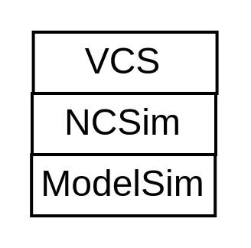
Simulation

Slide 51
Simulation

Slide 52
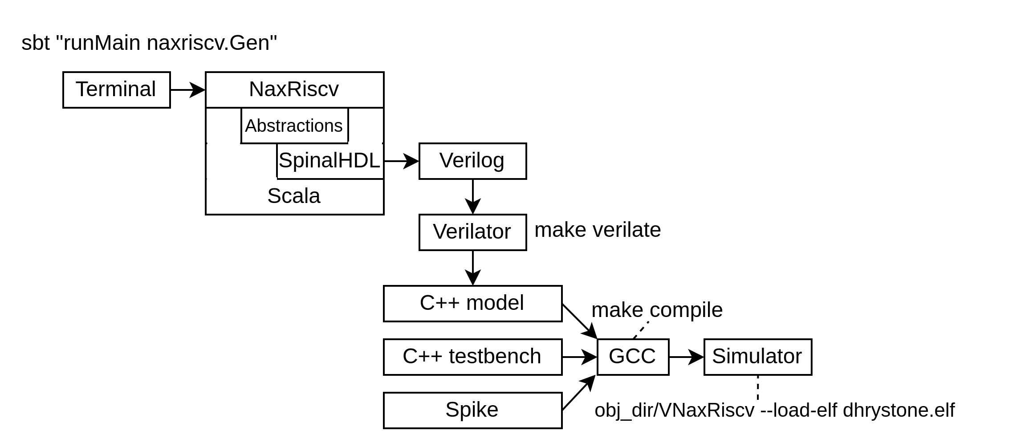
Simulation

Slide 53
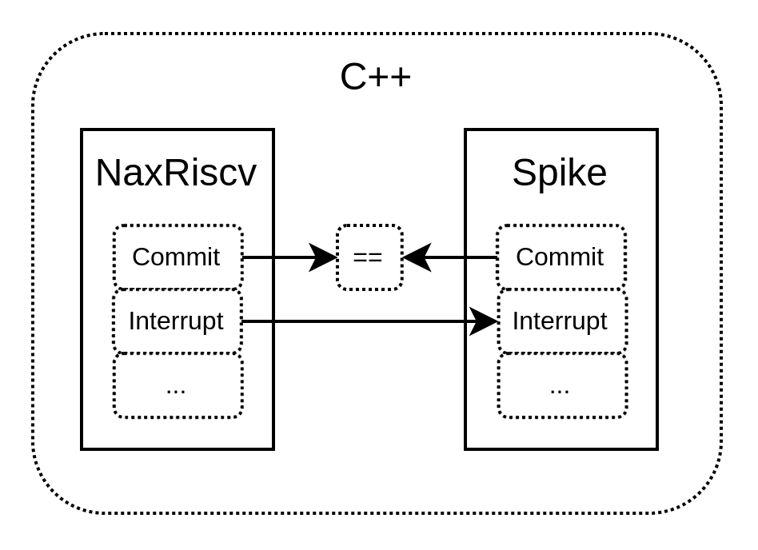
Simulation - Lockstep

Slide 54
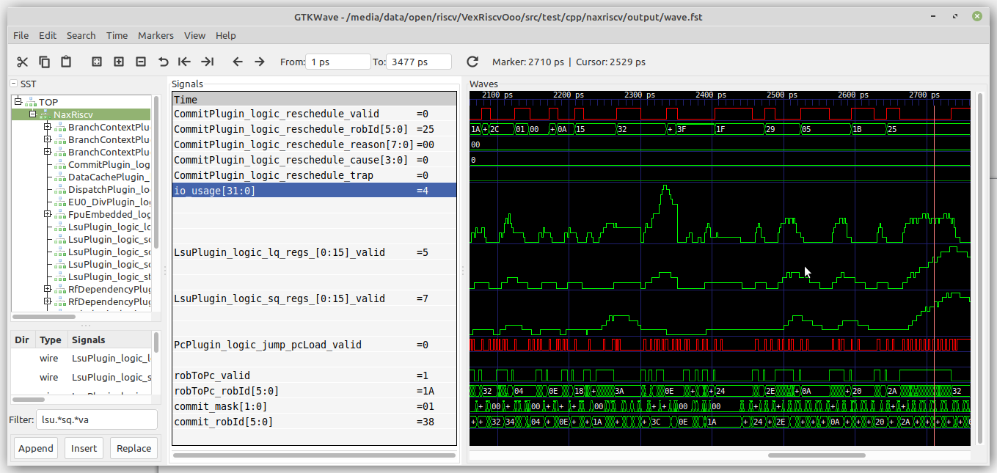
Simulation --trace

Slide 55
Simulation --trace-gem5 / Konata

Slide 56
Simulation - Linux
./obj_dir/VNaxRiscv \
--load-bin $LINUX_IMAGES/fw_jump.bin,0x80000000 \
--load-bin $LINUX_IMAGES/linux.dtb,0x80F80000 \
--load-bin $LINUX_IMAGES/Image,0x80400000 \
--load-bin $LINUX_IMAGES/rootfs.cpio,0x81000000

Slide 57
Questions
SpinalHDL : https://spinalhdl.github.io/SpinalDoc-RTD/master/index.html
NaxRiscv : https://github.com/SpinalHDL/NaxRiscv
Roadmap :
  Debian testing
  Memory coherency / multicore
  ASIC targeting ?
Thanks Nlnet for the funding

