Slide 1
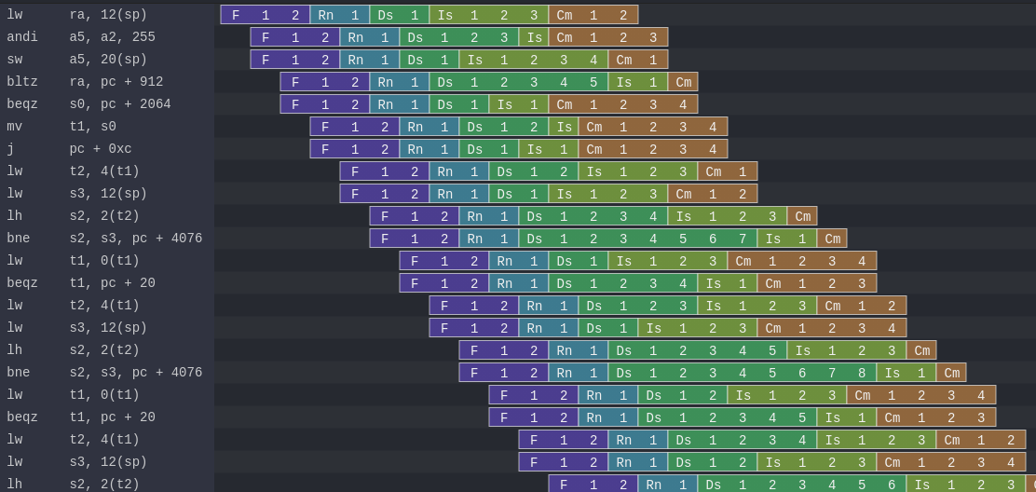
NaxRiscv : A Pipeline / Plugins / SpinalHDL / Scala mix

Slide 2

NaxRiscv in short
RV32/RV64 IMAFDCSU (Linux/Debian ready)
Out of order / superscalar
Free / Open source (MIT)
Many paradigm experimentation with alternative HDL
Target FPGA with distributed RAM
~75 FPS Chocolate-doom (@100Mhz / linux)
https://twitter.com/i/status/1493996880593887235

Slide 3
Performances / Area
RV32IMASU, 2 decode, 3 issue (Linux ready)
  Dhrystone : 2.93 DMIPS/Mhz 1.65 IPC (-O3 -fno-common -fno-inline)
  Coremark : 5.02 Coremark/Mhz 1.28 IPC
  Embench-iot : 1.67 baseline 1.42 IPC (baseline = Cortex M4)
On Artix 7 speed grade 3 :
  155 Mhz
  13.3 KLUT, 10.3 KFF, 12 BRAM, 4 DSP
RV64IMASU, same FPGA/config
  137 Mhz
  17.9 KLUT, 12.5 KFF, 12 BRAM, 16 DSP
https://spinalhdl.github.io/NaxRiscv-Rtd/main/NaxRiscv/performance/index.html

Slide 4

Architecture (from last slide)
2 decode, 3 issue (2 ALU, 1 shared EU)
64 physical register, 64 entry ROB
4KB GShare + 4KB BTB (both 1 way), RAS
10 cycles miss predicted branch penalty
Non-blocking D$
I$ D$ each have 16 KB (4 ways)
I$ D$ each have 192 TLB (2+4 ways)

Slide 5
Main topic of the talk :
Pipelining API
  HardType
  Naming
Non usual toplevel
  Plugins
  Software interface
  Multithreaded elaboration

Slide 6
Pipelining API live demo

Slide 7
Elaboration multithreading live demo

Slide 8
val plugins = ArrayBuffer[Plugin]()
plugins ++= List(
new PcPlugin(),
new FetchCachePlugin(16 KB),
new DecoderPlugin(),
new DispatchPlugin(slotCount = 32),
new CommitPlugin()
...
)
plugins ++= List(
new ExecutionUnitBase("ALU0"),
new IntAluPlugin("ALU0"),
new ShiftPlugin("ALU0" ),
new BranchPlugin("ALU0")
new IntFormatPlugin("ALU0"),
new SrcPlugin("ALU0"),
)
new NaxRiscv(plugins)

Slide 9
val plugins = ArrayBuffer[Plugin]()
plugins ++= List(
new PcPlugin(),
new FetchCachePlugin(16 KB),
new DecoderPlugin(),
new DispatchPlugin(slotCount = 32),
new CommitPlugin()
...
)
plugins ++= List(
new ExecutionUnitBase("ALU0"),
new IntAluPlugin("ALU0"),
new ShiftPlugin("ALU0" ),
new BranchPlugin("ALU0")
new IntFormatPlugin("ALU0"),
new SrcPlugin("ALU0"),
)
new NaxRiscv(plugins)
Create NaxRiscv

Slide 10
val plugins = ArrayBuffer[Plugin]()
plugins ++= List(
new PcPlugin(),
new FetchCachePlugin(16 KB),
new DecoderPlugin(),
new DispatchPlugin(slotCount = 32),
new CommitPlugin()
...
)
plugins ++= List(
new ExecutionUnitBase("ALU0"),
new IntAluPlugin("ALU0"),
new ShiftPlugin("ALU0" ),
new BranchPlugin("ALU0")
new IntFormatPlugin("ALU0"),
new SrcPlugin("ALU0"),
)
new NaxRiscv(plugins)
Elaboration time list of Plugin

Slide 11
val plugins = ArrayBuffer[Plugin]()
plugins ++= List(
new PcPlugin(),
new FetchCachePlugin(16 KB),
new DecoderPlugin(),
new DispatchPlugin(slotCount = 32),
new CommitPlugin()
...
)
plugins ++= List(
new ExecutionUnitBase("ALU0"),
new IntAluPlugin("ALU0"),
new ShiftPlugin("ALU0" ),
new BranchPlugin("ALU0")
new IntFormatPlugin("ALU0"),
new SrcPlugin("ALU0"),
)
new NaxRiscv(plugins)
plugins ++= List(
new ExecutionUnitBase("ALU1"),
new IntAluPlugin("ALU1"),
new ShiftPlugin("ALU1" ),
new BranchPlugin("ALU1")
new IntFormatPlugin("ALU1"),
new SrcPlugin("ALU1"),
)
Wanna a second execution unit ?

Slide 12
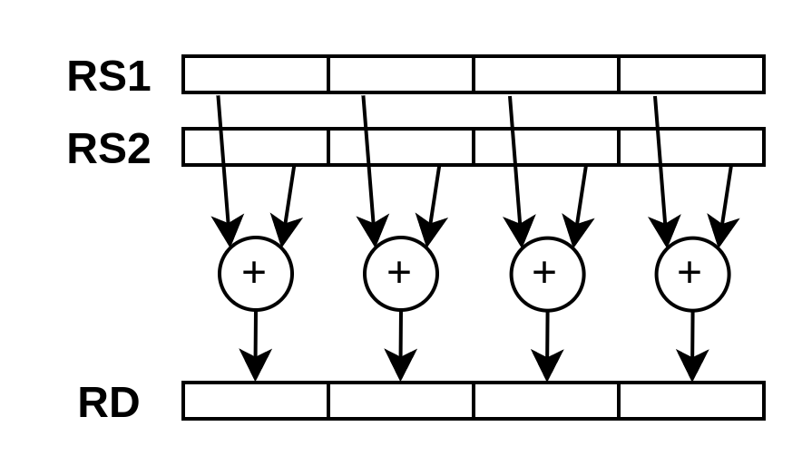
Plugin / SIMD ADD8
class SimdAddPlugin(euId : String) extends Plugin {
val setup = create early new Area{
// ...
}
val logic = create late new Area{
// ...
}
}

Slide 13
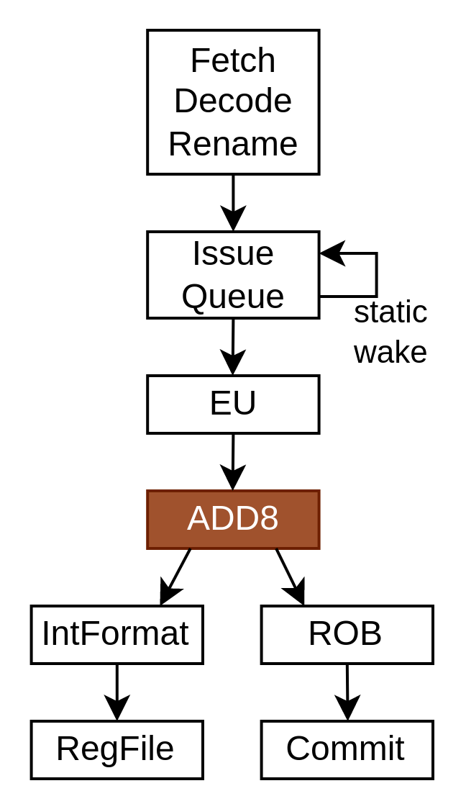
val setup = create early new Area{
val eu = findService[ExecutionUnitBase](_.euId == euId)
eu.retain()
val ADD8 = IntRegFile.TypeR(M"0000000----------000-----0001011")
eu.addMicroOp(ADD8)
eu.setCompletion(ADD8, stageId = 0)
eu.setStaticWake(ADD8, stageId = 0)
val intFormat = findService[IntFormatPlugin](_.euId == euId)
val writeback = intFormat.access(stageId = 0, writeLatency = 0)
val SEL = Stageable(Bool())
eu.setDecodingDefault(SEL, False)
eu.addDecoding(ADD8, SEL, True)
}

Slide 14
val setup = create early new Area{
val eu = findService[ExecutionUnitBase](_.euId == euId)
eu.retain()
val ADD8 = IntRegFile.TypeR(M"0000000----------000-----0001011")
eu.addMicroOp(ADD8)
eu.setCompletion(ADD8, stageId = 0)
eu.setStaticWake(ADD8, stageId = 0)
val intFormat = findService[IntFormatPlugin](_.euId == euId)
val writeback = intFormat.access(stageId = 0, writeLatency = 0)
val SEL = Stageable(Bool())
eu.setDecodingDefault(SEL, False)
eu.addDecoding(ADD8, SEL, True)
}

Slide 15
val setup = create early new Area{
val eu = findService[ExecutionUnitBase](_.euId == euId)
eu.retain()
val ADD8 = IntRegFile.TypeR(M"0000000----------000-----0001011")
eu.addMicroOp(ADD8)
eu.setCompletion(ADD8, stageId = 0)
eu.setStaticWake(ADD8, stageId = 0)
val intFormat = findService[IntFormatPlugin](_.euId == euId)
val writeback = intFormat.access(stageId = 0, writeLatency = 0)
val SEL = Stageable(Bool())
eu.setDecodingDefault(SEL, False)
eu.addDecoding(ADD8, SEL, True)
}

Slide 16
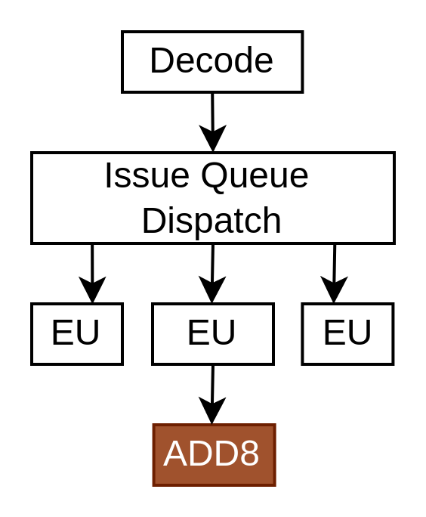
val setup = create early new Area{
val eu = findService[ExecutionUnitBase](_.euId == euId)
eu.retain()
val ADD8 = IntRegFile.TypeR(M"0000000----------000-----0001011")
eu.addMicroOp(ADD8)
eu.setCompletion(ADD8, stageId = 0)
eu.setStaticWake(ADD8, stageId = 0)
val intFormat = findService[IntFormatPlugin](_.euId == euId)
val writeback = intFormat.access(stageId = 0, writeLatency = 0)
val SEL = Stageable(Bool())
eu.setDecodingDefault(SEL, False)
eu.addDecoding(ADD8, SEL, True)
}

Slide 17
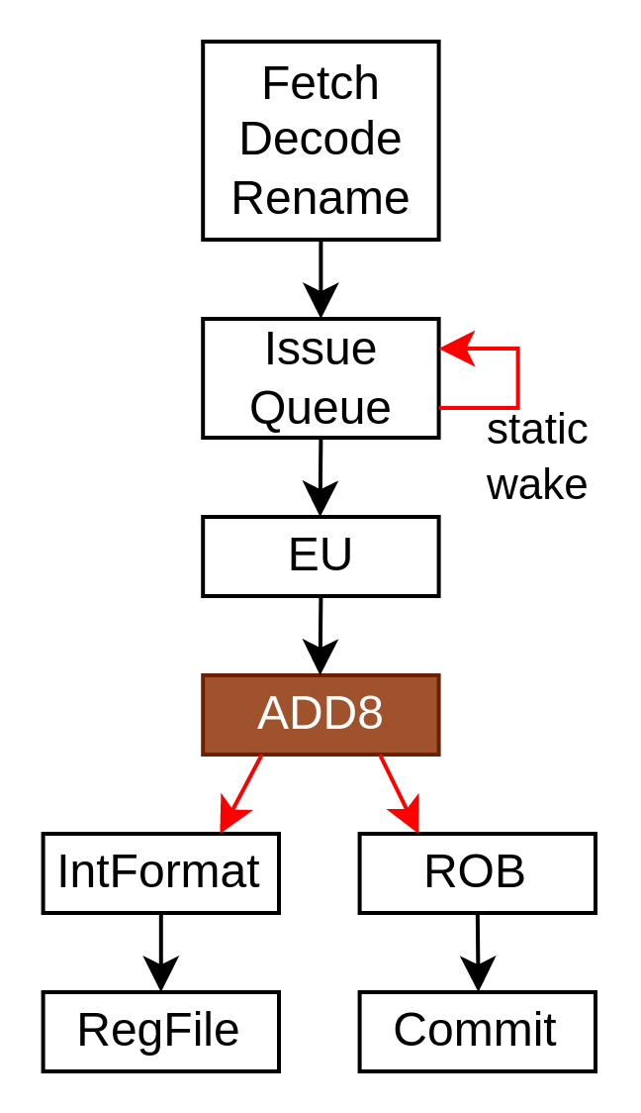
val setup = create early new Area{
val eu = findService[ExecutionUnitBase](_.euId == euId)
eu.retain()
val ADD8 = IntRegFile.TypeR(M"0000000----------000-----0001011")
eu.addMicroOp(ADD8)
eu.setCompletion(ADD8, stageId = 0)
eu.setStaticWake(ADD8, stageId = 0)
val intFormat = findService[IntFormatPlugin](_.euId == euId)
val writeback = intFormat.access(stageId = 0, writeLatency = 0)
val SEL = Stageable(Bool())
eu.setDecodingDefault(SEL, False)
eu.addDecoding(ADD8, SEL, True)
}

Slide 18
val setup = create early new Area{
val eu = findService[ExecutionUnitBase](_.euId == euId)
eu.retain()
val ADD8 = IntRegFile.TypeR(M"0000000----------000-----0001011")
eu.addMicroOp(ADD8)
eu.setCompletion(ADD8, stageId = 0)
eu.setStaticWake(ADD8, stageId = 0)
val intFormat = findService[IntFormatPlugin](_.euId == euId)
val writeback = intFormat.access(stageId = 0, writeLatency = 0)
val SEL = Stageable(Bool())
eu.setDecodingDefault(SEL, False)
eu.addDecoding(ADD8, SEL, True)
}

Slide 19
val logic = create late new Area{
val eu = setup.eu
val writeback = setup.writeback
val stage = eu.getExecute(stageId = 0)
val rs1 = stage(eu(IntRegFile, RS1)).asUInt
val rs2 = stage(eu(IntRegFile, RS2)).asUInt
val rd = UInt(32 bits)
rd( 7 downto 0) := rs1( 7 downto 0) + rs2( 7 downto 0)
rd(16 downto 8) := rs1(16 downto 8) + rs2(16 downto 8)
rd(23 downto 16) := rs1(23 downto 16) + rs2(23 downto 16)
rd(31 downto 24) := rs1(31 downto 24) + rs2(31 downto 24)
writeback.valid := stage(setup.SEL)
writeback.payload := rd.asBits
eu.release()
}
https://spinalhdl.github.io/NaxRiscv-Rtd/main/NaxRiscv/execution_units/index.html#custom-instruction

Slide 20
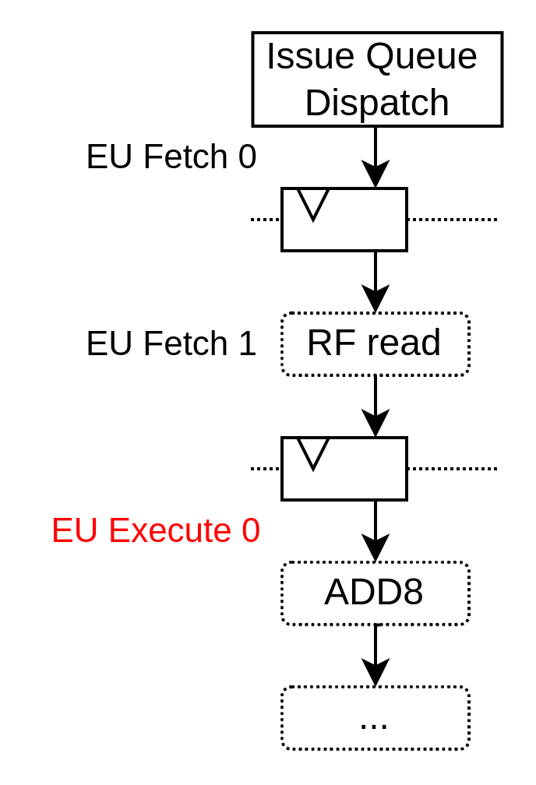
val logic = create late new Area{
val eu = setup.eu
val writeback = setup.writeback
val stage = eu.getExecute(stageId = 0)
val rs1 = stage(eu(IntRegFile, RS1)).asUInt
val rs2 = stage(eu(IntRegFile, RS2)).asUInt
val rd = UInt(32 bits)
rd( 7 downto 0) := rs1( 7 downto 0) + rs2( 7 downto 0)
rd(16 downto 8) := rs1(16 downto 8) + rs2(16 downto 8)
rd(23 downto 16) := rs1(23 downto 16) + rs2(23 downto 16)
rd(31 downto 24) := rs1(31 downto 24) + rs2(31 downto 24)
writeback.valid := stage(setup.SEL)
writeback.payload := rd.asBits
eu.release()
}
https://spinalhdl.github.io/NaxRiscv-Rtd/main/NaxRiscv/execution_units/index.html#custom-instruction

Slide 21
val logic = create late new Area{
val eu = setup.eu
val writeback = setup.writeback
val stage = eu.getExecute(stageId = 0)
val rs1 = stage(eu(IntRegFile, RS1)).asUInt
val rs2 = stage(eu(IntRegFile, RS2)).asUInt
val rd = UInt(32 bits)
rd( 7 downto 0) := rs1( 7 downto 0) + rs2( 7 downto 0)
rd(16 downto 8) := rs1(16 downto 8) + rs2(16 downto 8)
rd(23 downto 16) := rs1(23 downto 16) + rs2(23 downto 16)
rd(31 downto 24) := rs1(31 downto 24) + rs2(31 downto 24)
writeback.valid := stage(setup.SEL)
writeback.payload := rd.asBits
eu.release()
}
https://spinalhdl.github.io/NaxRiscv-Rtd/main/NaxRiscv/execution_units/index.html#custom-instruction

Slide 22
val logic = create late new Area{
val eu = setup.eu
val writeback = setup.writeback
val stage = eu.getExecute(stageId = 0)
val rs1 = stage(eu(IntRegFile, RS1)).asUInt
val rs2 = stage(eu(IntRegFile, RS2)).asUInt
val rd = UInt(32 bits)
rd( 7 downto 0) := rs1( 7 downto 0) + rs2( 7 downto 0)
rd(16 downto 8) := rs1(16 downto 8) + rs2(16 downto 8)
rd(23 downto 16) := rs1(23 downto 16) + rs2(23 downto 16)
rd(31 downto 24) := rs1(31 downto 24) + rs2(31 downto 24)
writeback.valid := stage(setup.SEL)
writeback.payload := rd.asBits
eu.release()
}
https://spinalhdl.github.io/NaxRiscv-Rtd/main/NaxRiscv/execution_units/index.html#custom-instruction

Slide 23
val logic = create late new Area{
val eu = setup.eu
val writeback = setup.writeback
val stage = eu.getExecute(stageId = 0)
val rs1 = stage(eu(IntRegFile, RS1)).asUInt
val rs2 = stage(eu(IntRegFile, RS2)).asUInt
val rd = UInt(32 bits)
rd( 7 downto 0) := rs1( 7 downto 0) + rs2( 7 downto 0)
rd(16 downto 8) := rs1(16 downto 8) + rs2(16 downto 8)
rd(23 downto 16) := rs1(23 downto 16) + rs2(23 downto 16)
rd(31 downto 24) := rs1(31 downto 24) + rs2(31 downto 24)
writeback.valid := stage(setup.SEL)
writeback.payload := rd.asBits
eu.release()
}
https://spinalhdl.github.io/NaxRiscv-Rtd/main/NaxRiscv/execution_units/index.html#custom-instruction

Slide 24
val plugins = ArrayBuffer[Plugin]()
...
plugins ++= List(
new ExecutionUnitBase("ALU0"),
new IntAluPlugin("ALU0"),
new ShiftPlugin("ALU0" ),
new BranchPlugin("ALU0")
new IntFormatPlugin("ALU0"),
new SrcPlugin("ALU0"),
)
plugins += new SimdAddPlugin("ALU0")
plugins += new SimdAddPlugin("ALU1")
new NaxRiscv(plugins)
plugins ++= List(
new ExecutionUnitBase("ALU1"),
new IntAluPlugin("ALU1"),
new ShiftPlugin("ALU1" ),
new BranchPlugin("ALU1")
new IntFormatPlugin("ALU1"),
new SrcPlugin("ALU1"),
)

Slide 25
Status / Future
JTAG / OpenOCD / GDB supported (RISCV External Debug Support 0.13.2)
Planning :
  Multicore / Memory coherency
GIT : https://github.com/SpinalHDL/NaxRiscv
Integrated in Litex for FPGA deployments
  python3 -m litex_boards.targets.digilent_nexys_video --cpu-type=naxriscv --with-video-framebuffer --with-spi-sdcard --with-ethernet --build –load
Thanks Nlnet for the funding

