Slide 1
SpinalHDL
Talk 24/02/22

Slide 2

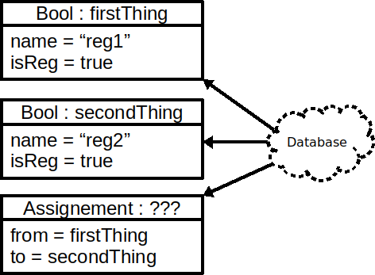
Internal domain specific language (iDSL)
val firstThing = Bool()
firstThing.setName("reg1")
firstThing.setAsReg()
val secondThing = Bool()
secondThing.setName("reg2")
secondThing.setAsReg()
secondThing.assignFrom(firstThing)
(Scala code using the SpinalHDL API)
val reg1, reg2 = Reg(Bool())
reg1 := reg2

Slide 3





The hardware flow
val reg1, reg2 = Reg(Bool())
reg1 := reg2

Slide 4
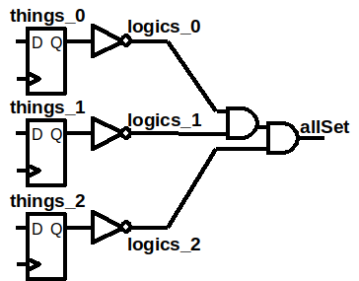
Host language as a elaboration tool
val things = ArrayBuffer[Bool]()
for(idx <- 0 to 2){
things += Reg(Bool())
}
val logics = things.map(r => !r)
val allSet = logics.reduce(_ && _)

Slide 5
Demo : Preserving names

Slide 6
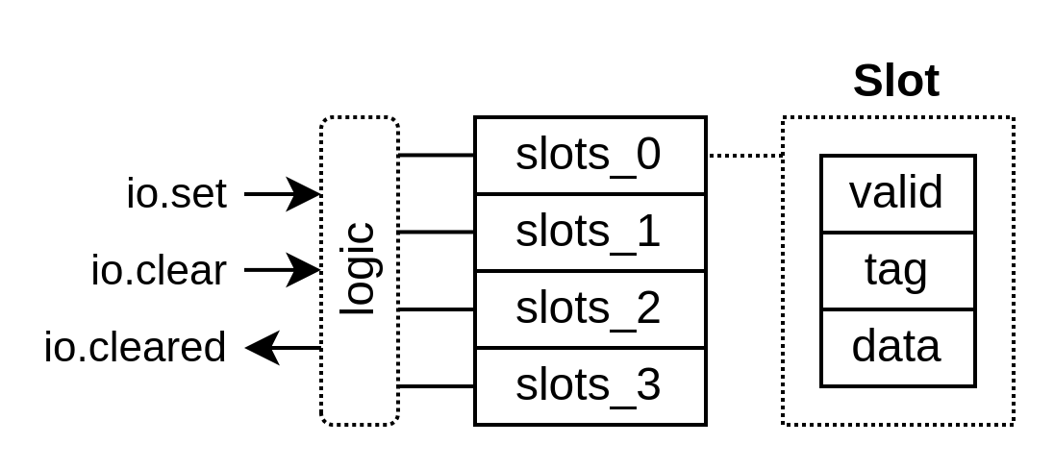
Demo : Slots logic

Slide 7
SpinalHDL Todo
More documentation
  To cover recently added API
  To provide more examples
  https://github.com/SpinalHDL/SpinalDoc-RTD
More Composite in the SpinalHDL lib
  https://github.com/SpinalHDL/SpinalHDL/commit/a1497439f72477781320b1b36057b953e1ccb23b
PR review
  Unify fixed-point into a single class - Rewrite :D
  https://github.com/SpinalHDL/SpinalHDL/pull/566
...

Slide 8
Links
SpinalHDL
  https://spinalhdl.github.io/SpinalDoc-RTD/index.html
  https://github.com/SpinalHDL/SpinalHDL
VexRiscv
  https://github.com/SpinalHDL/VexRiscv
SaxonSoc
  https://github.com/SpinalHDL/SaxonSoc

