Slide 1


Overview
Notes:
<numéro>

Slide 2
Summary
SpinalHDL introduction
Differences with VHDL/Verilog
Hardware description examples
<numéro>
Notes:
<numéro>

Slide 3

Context :
Elaborations features of VHDL/SV are weak
Hopeless VHDL/SV revisions
Simulation paradigm
Notes:
<numéro>

Slide 4
SpinalHDL introduction
Open source, started in December 2014
Focus on RTL description
Compatible with EDA tools
  It generates simples VHDL/Verilog files (as an output netlist)
  It can integrate VHDL/Verilog IP as blackbox
Paradigms :
  RTL description without behing event driven
  Embedded into a general purpose programming language
  General purpose programming paradigm used as an RTL elaboration tool
<numéro>
Notes:
<numéro>

Slide 5
Notice
Learning a new language is hard
Another language paradigm also mean
  another syntax layout
  another coding style
  another coding guidelines
<numéro>
Notes:
<numéro>

Slide 6

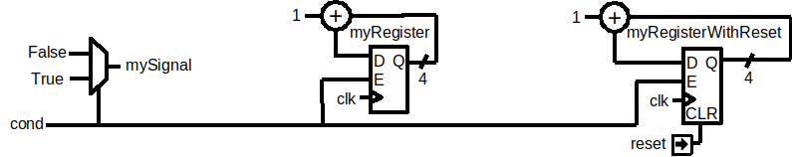
SpinalHDL basics
val mySignal = Bool()
val myRegister = Reg(UInt(4 bits))
val myRegisterWithReset = Reg(UInt(4 bits)) init(0)
mySignal := False
when(cond) {
mySignal := True
myRegister := myRegister + 1
myRegisterWithReset := myRegisterWithReset + 1
}
<numéro>
Notes:
In VHDL you need to split the logic between combinatoral / sequancial with reset / sequancial without reset
<numéro>

Slide 7
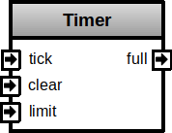
A timer implementation
class Timer(width : Int) extends Component{
val io = new Bundle{
val tick = in Bool()
val clear = in Bool()
val limit = in UInt(width bits)
val full = out Bool()
}
val counter = Reg(UInt(width bits))
when(io.tick && !io.full){
counter := counter + 1
}
when(io.clear){
counter := 0
}
io.full := counter === io.limit
}
<numéro>
Notes:
<numéro>

Slide 8
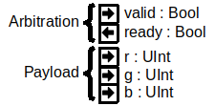

Having a Hand-shake bus of color and wanting to queue it ?
<numéro>
Notes:
In VHDL you need to split the logic between combinatoral / sequancial with reset / sequancial without reset
<numéro>

Slide 9
In standard VHDL-2002
fifo_inst : entity work.Fifo
generic map (
depth => 16,
payload_width => 16
)
port map (
clk => clk,
reset => reset,
push_valid => source_valid,
push_ready => source_ready,
push_payload(4 downto 0) => source_payload_r,
push_payload(10 downto 5) => source_payload_g,
push_payload(15 downto 11) => source_payload_b,
pop_valid => sink_valid,
pop_ready => sink_ready,
pop_payload(4 downto 0) => sink_payload_r,
pop_payload(10 downto 5) => sink_payload_g,
pop_payload(15 downto 11) => sink_payload_b
);
signal source_valid : std_logic;
signal source_ready : std_logic;
signal source_r : unsigned(4 downto 0);
signal source_g : unsigned(5 downto 0);
signal source_b : unsigned(4 downto 0);
signal sink_valid : std_logic;
signal sink_ready : std_logic;
signal sink_r : unsigned(4 downto 0);
signal sink_g : unsigned(5 downto 0);
signal sink_b : unsigned(4 downto 0);
<numéro>
Notes:
In VHDL you need to split the logic between combinatoral / sequancial with reset / sequancial without reset
<numéro>

Slide 10
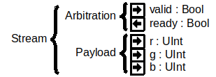
SpinalHDL
case class RGB(rw: Int, gw: Int, bw: Int) extends Bundle{
val r = UInt(rw bits)
val g = UInt(gw bits)
val b = UInt(bw bits)
}
val source , sink = Stream(RGB(5,6,5))
val fifo = StreamFifo(
dataType = RGB(5,6,5),
depth = 16
)
fifo.io.push << source
fifo.io.pop >> sink
<numéro>
Notes:
In VHDL you need to split the logic between combinatoral / sequancial with reset / sequancial without reset
<numéro>

Slide 11
About Stream
case class Stream[T <: Data](payloadType : HardType[T]) extends Bundle {
val valid = Bool
val ready = Bool
val payload = payloadType()
def >>(sink: Stream[T]): Unit ={
sink.valid := this.valid
this.ready := sink.ready
sink.payload := this.payload
}
def queue(size: Int): Stream[T] = {
val fifo = new StreamFifo(payloadType, size)
this >> fifo.io.push
return fifo.io.pop
}
}
Stream(RGB(5,6,5))
<numéro>
Notes:
In VHDL you need to split the logic between combinatoral / sequancial with reset / sequancial without reset
<numéro>

Slide 12
Queuing in SpinalHDL
val source, sink = Stream(RGB(5,6,5))
val fifo = StreamFifo(
dataType = RGB(5,6,5),
depth = 16
)
fifo.io.push << source
fifo.io.pop >> sink
val source, sink = Stream(RGB(5,6,5))
source.queue(16) >> sink
<numéro>
Notes:
In VHDL you need to split the logic between combinatoral / sequancial with reset / sequancial without reset
<numéro>

Slide 13
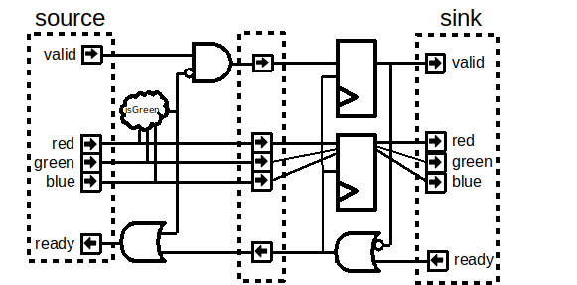
Abstract arbitration
val source = Stream(RGB(5,6,5))
val sink = source.throwWhen(source.payload.isGreen).stage()
<numéro>
Notes:
In VHDL you need to split the logic between combinatoral / sequancial with reset / sequancial without reset
<numéro>

Slide 14
Object Oriented Programming
val source = Stream(RGB(5,6,5))
val sink = source.throwWhen(source.payload.isGreen).stage()
class Stream … {
...
def throwWhen(cond: Bool): Stream[T] = {
val next = Stream(payloadType)
next << this
when(cond) {
next.valid := False
this.ready := True
}
next
}
def << (src : Stream[T]) = { …. }
}
<numéro>
Notes:
In VHDL you need to split the logic between combinatoral / sequancial with reset / sequancial without reset
<numéro>

Slide 15
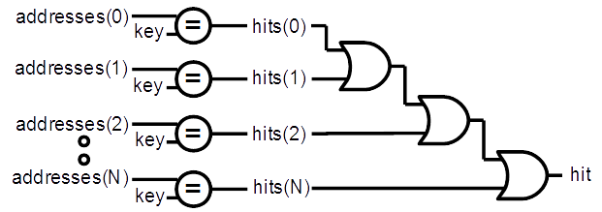
Functional programming
val addresses = Vec(UInt(8 bits), 4)
val key = UInt(8 bits)
val hits = addresses.map(address => address === key)
val hit = hits.reduce((a,b) => a || b)
<numéro>
Notes:
<numéro>

Slide 16
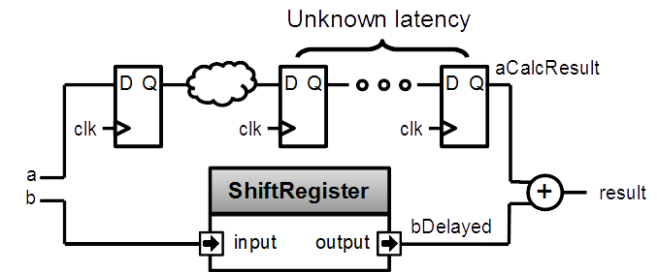
Design introspection
val a = UInt(8 bits)
val b = UInt(8 bits)
val aCalcResult = complicatedLogic(a)
val aLatency = LatencyAnalysis(a,aCalcResult)
val bDelayed = Delay(b,cycleCount = aLatency)
val result = aCalcResult + bDelayed
<numéro>
Notes:
Because spinal build a netlist in the memory, you can use it to extract some information, for example latency (in cycle) between some points of you design.
To do that, call LatencyAnalysis and give to it as argument some the start point, some check point and the end point of you path. It look for the shortest path and return how many cycle there is.
<numéro>

Slide 17
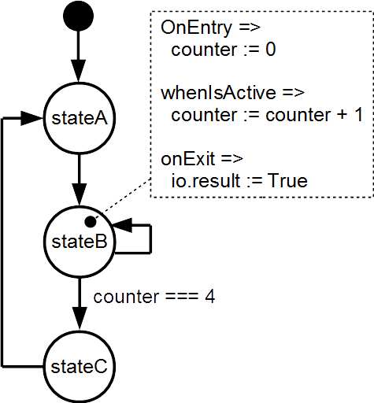
FSM
val fsm = new StateMachine{
val stateA = new State with EntryPoint
val stateB = new State
val stateC = new State
val counter = Reg(UInt(8 bits)) init (0)
io.result := False
stateA.whenIsActive (goto(stateB))
stateB.onEntry(counter := 0)
stateB.whenIsActive {
counter := counter + 1
when(counter === 4){
goto(stateC)
}
}
stateB.onExit(io.result := True)
stateC.whenIsActive (goto(stateA))
}
<numéro>
Notes:
<numéro>

Slide 18
Abstract bus mapping
//Create a new AxiLite4 bus
val bus = AxiLite4(addressWidth = 12, dataWidth = 32)
//Create the factory which is able to create some bridging logic between the bus and some hardware
val factory = new AxiLite4SlaveFactory(bus)
//Create 'a' and 'b' as write only register
val a = factory.createWriteOnly(UInt(32 bits), address = 0)
val b = factory.createWriteOnly(UInt(32 bits), address = 4)
//Do some calculation
val result = a * b
//Make 'result' readable by the bus
factory.read(result(31 downto 0), address = 8)
<numéro>
Notes:
<numéro>

Slide 19
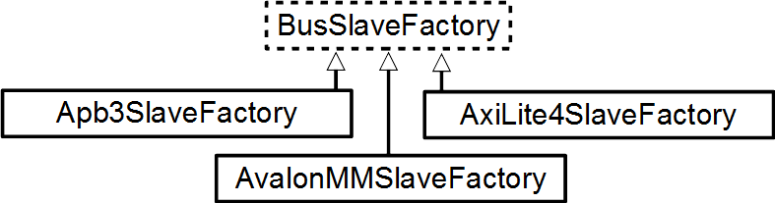
SlaveFactory
AxiLite4SlaveFactory is only a part of something bigger and more abstract.
class Something extends Bundle{
val a, b = UInt(32 bits)
def driveFrom(factory : BusSlaveFactory) = new Area {
factory.driveAndRead(a, address = 0x00)
factory.driveAndRead(b, address = 0x04)
}
}
<numéro>

Slide 20
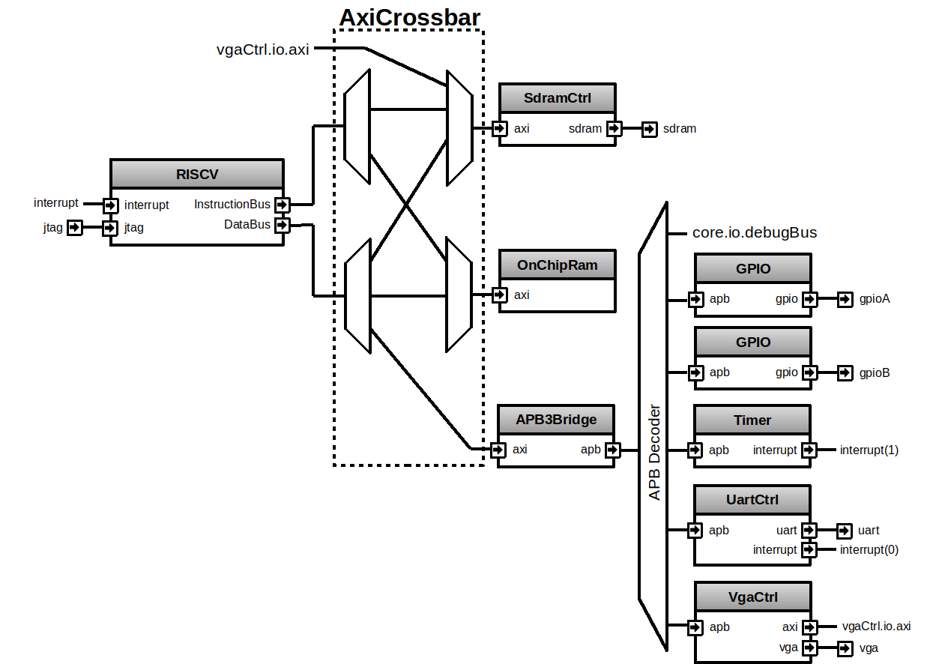
Briey SoC
Artix 7 -> 239 Mhz 3227 LUT 3410 FF
<numéro>
Notes:
<numéro>

Slide 21
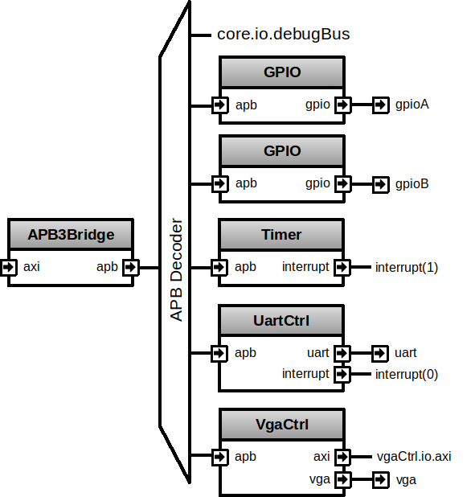
Peripheral side
val gpioACtrl = Apb3Gpio(gpioWidth = 32)
val gpioBCtrl = Apb3Gpio(gpioWidth = 32)
…
val apbDecoder = Apb3Decoder(
master = apbBridge.io.apb,
slaves = List(
gpioACtrl.io.apb -> (0x0000, 4 kB),
gpioBCtrl.io.apb -> (0x1000, 4 kB),
uartCtrl.io.apb -> (0x4000, 4 kB),
timerCtrl.io.apb -> (0x5000, 4 kB),
vgaCtrl.io.apb -> (0x6000, 4 kB)
)
)
<numéro>
Notes:
<numéro>

Slide 22
Peripheral side
val apbMapping = ArrayBuffer[(Apb3, SizeMapping)]()
val gpioACtrl = Apb3Gpio(gpioWidth = 32)
apbMapping += gpioACtrl.io.apb -> (0x0000, 4 kB)
val gpioBCtrl = Apb3Gpio(gpioWidth = 32)
apbMapping += gpioBCtrl.io.apb -> (0x1000, 4 kB)
…
val apbDecoder = Apb3Decoder(
master = apbBridge.io.apb,
slaves = apbMapping
)
<numéro>
Notes:
<numéro>

Slide 23
Parameters
val apbMapping = ArrayBuffer[(Apb3, SizeMapping)]()
val gpioACtrl = Apb3Gpio(gpioWidth = 32)
apbMapping += gpioACtrl.io.apb -> (0x0000, 4 kB)
// val gpioBCtrl = Apb3Gpio(gpioWidth = 32)
// apbMapping += gpioBCtrl.io.apb -> (0x01000, 4 kB)
val gpioC = if(genGpioC) new Area{
val ctrl = Apb3Gpio(gpioWidth = 32)
apbMapping += peripheral.io.apb -> (0x1000, 4 kB)
}
val gpioX = for(i <- 0 until gpioXCtrlCount) yield new Area{
val ctrl = Apb3Gpio(gpioWidth = 32)
apbMapping += ctrl.io.apb -> (0x3000 + i * 0x2000, 4 kB)
}
val apbDecoder = Apb3Decoder(
master = apbBridge.io.apb,
slaves = apbMapping
)
<numéro>
Notes:
<numéro>

Slide 24
CPU pipelined over 5 stages
<numéro>
Notes:
<numéro>

Slide 25
Modular CPU framework
val plugins = List(
new PcManagerSimplePlugin(resetVector = 0x00000000l),
new IBusSimplePlugin(catchAccessFault = false),
new DBusSimplePlugin(catchAccessFault = false),
new DecoderSimplePlugin(catchIllegalInstruction = false),
new RegFilePlugin,
new IntAluPlugin,
new FullBarrielShifterPlugin,
new HazardSimplePlugin(
bypassExecute = false,
bypassMemory = false,
bypassWriteBack = false
),
new MulPlugin,
new DivPlugin,
new MachineCsr(...),
new BranchPlugin(
catchAddressMisaligned = false,
prediction = DYNAMIC
)
)
val cpu = new Cpu5Stage(plugins)
<numéro>
Notes:
<numéro>

Slide 26
CPU framework - Connections
//Global definition of the Programm Counter concept
object PC extends Stageable(UInt(32 bits))
//Somewere in the PcManager plugin
fetch.insert(PC) := X
//Somewere in the MachineCsr plugin
Y := writeBack.input(PC)
<numéro>
Notes:
<numéro>

Slide 27
CPU framework - Connections
//Somewhere in the Branch plugin
val jumpInterface = pcPlugin.createJumpInterface(stage = execute)
//Later in the branch plugin
jumpInterface.valid := wannaJump
jumpInterface.payload := execute.input(PC) + execute.input(INSTRUCTION)(31 downto 20)
<numéro>
Notes:
<numéro>

Slide 28


Some links
Compiler sources :
    https://github.com/SpinalHDL/SpinalHDL
Online documentation :
    https://spinalhdl.github.io/SpinalDoc-RTD/
Ready to use base project :
    https://github.com/SpinalHDL/SpinalTemplateSbt
Communication channels :
    spinalhdl@gmail.com
    https://gitter.im/SpinalHDL/SpinalHDL
    https://github.com/SpinalHDL/SpinalHDL/issues
<numéro>
Slides : https://github.com/SpinalHDL/SpinalDoc/tree/master/presentation/en/workshop
Notes:
<numéro>

