Slide 1


An alternative hardware description language
Notes:
<numéro>

Slide 2
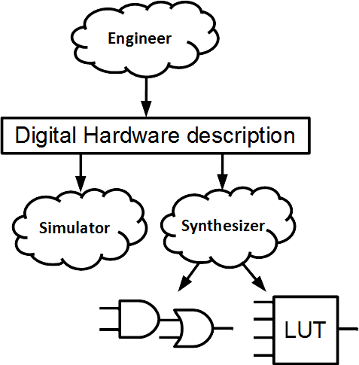
The Digital hardware flow
<numéro>
Notes:
<numéro>

Slide 3
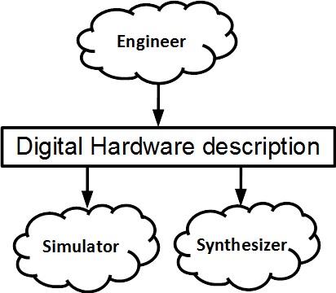

Issue
The digital hardware description is done by using VHDL or Verilog
  They are relatively low level
  They are very verbose
  They were not designed for this purpose
<numéro>
Notes:
<numéro>

Slide 4
Solution Idea
Using an intermediate hardware description language which
  Generates VHDL/Verilog
  Is dedicated for this purpose
  Introduces new description paradigms
  Is free and open source
<numéro>
Notes:
<numéro>

Slide 5
SpinalHDL introduction
Open source , started in december 2014
Focus on RTL description
Thinked to be interoperable with existing tools
  It generates VHDL/Verilog files
  Existing IPs can be integrated as blackboxes
Abstraction level :
  You can design things similarly to VHDL/Verilog
  If you want to, you can use many abstraction utilities and also define new ones
<numéro>
Notes:
<numéro>

Slide 6

Dedicated syntax
val mySignal = Bool
val myRegister = Reg(UInt(4 bits))
val myRegisterWithReset = Reg(UInt(4 bits)) init(0)
mySignal := False
when(cond) {
mySignal := True
myRegister := myRegister + 1
myRegisterWithReset := myRegisterWithReset + 1
}
False
mySignal
True
cond
1
+
myRegister
D
Q
cond
E
4
clk
1
+
myRegisterWithReset
D
Q
cond
E
4
clk
CLR
reset
SpinalHDL => 10 lines
VHDL => 30 lines
<numéro>
Notes:
In VHDL you need to split the logic between combinatoral / sequancial with reset / sequancial without reset
<numéro>

Slide 7
Interface support
signal axiBus_aw_valid : std_logic;
signal axiBus_aw_ready : std_logic;
signal axiBus_aw_addr : unsigned(31 downto 0);
signal axiBus_aw_id : unsigned(3 downto 0);
signal axiBus_aw_region : std_logic_vector(3 downto 0);
signal axiBus_aw_len : unsigned(7 downto 0);
signal axiBus_aw_size : unsigned(2 downto 0);
signal axiBus_aw_burst : std_logic_vector(1 downto 0);
signal axiBus_aw_lock : std_logic_vector(0 downto 0);
signal axiBus_aw_cache : std_logic_vector(3 downto 0);
signal axiBus_aw_qos : std_logic_vector(3 downto 0);
signal axiBus_aw_prot : std_logic_vector(2 downto 0);
signal axiBus_w_valid : std_logic;
signal axiBus_w_ready : std_logic;
signal axiBus_w_data : std_logic_vector(31 downto 0);
signal axiBus_w_strb : std_logic_vector(3 downto 0);
signal axiBus_w_last : std_logic;
signal axiBus_b_valid : std_logic;
signal axiBus_b_ready : std_logic;
signal axiBus_b_id : unsigned(3 downto 0);
signal axiBus_b_resp : std_logic_vector(1 downto 0);
signal axiBus_ar_valid : std_logic;
signal axiBus_ar_ready : std_logic;
signal axiBus_ar_addr : unsigned(31 downto 0);
signal axiBus_ar_id : unsigned(3 downto 0);
signal axiBus_ar_region : std_logic_vector(3 downto 0);
signal axiBus_ar_len : unsigned(7 downto 0);
signal axiBus_ar_size : unsigned(2 downto 0);
signal axiBus_ar_burst : std_logic_vector(1 downto 0);
signal axiBus_ar_lock : std_logic_vector(0 downto 0);
signal axiBus_ar_cache : std_logic_vector(3 downto 0);
signal axiBus_ar_qos : std_logic_vector(3 downto 0);
signal axiBus_ar_prot : std_logic_vector(2 downto 0);
signal axiBus_r_valid : std_logic;
signal axiBus_r_ready : std_logic;
signal axiBus_r_data : std_logic_vector(31 downto 0);
signal axiBus_r_id : unsigned(3 downto 0);
signal axiBus_r_resp : std_logic_vector(1 downto 0);
signal axiBus_r_last : std_logic;
val config = Axi4Config(addressWidth = 32,
dataWidth = 32,
idWidth = 4)
val axiBus = Axi4(config)
SpinalHDL => 4 lines
VHDL => 39 lines
<numéro>
Notes:
In VHDL you need to split the logic between combinatoral / sequancial with reset / sequancial without reset
<numéro>

Slide 8
Other features
A proper support of
  Design parameterization
  Functions definition
Many integrated checks
  No latch
  No combinatorial loops
  No unwanted clock domain crossing
And also
  Object Oriented programming
  Functional programming
  Possibility to define new abstraction level
  Meta-hardware description capabilities
  Free IDE to make things easier
<numéro>
Notes:
<numéro>

Slide 9

The technology
SpinalHDL is an internal DSL (Domain Specific Language)
Advantages
  All feature the host language are inherited
  All tools the host language are inherited
  It makes the SpinalHDL compiler simpler
Scala as host programming language
  Flexible enough to have a natural syntax
How it works
  You compile and run your SpinalHDL hardware description
  Each usage of SpinalHDL syntax contribute to build a netlist
  Then this netlist go through some transformation and checks
  Finally it is flushed into a VHDL or a Verilog file
<numéro>
Notes:
<numéro>

Slide 10
Our buisness model
No fees to use the language
  No licence
  No royalties
We provide the commercial support
  Presentation
  Training
  Consulting
<numéro>
Notes:
<numéro>

Slide 11


Some links
Completely open source :
    https://github.com/SpinalHDL/SpinalHDL
Online documentation :
    https://spinalhdl.github.io/SpinalDoc/
Ready to use base project :
    https://github.com/SpinalHDL/SpinalBaseProject
Communication channels :
    spinalhdl@gmail.com
    https://gitter.im/SpinalHDL/SpinalHDL
    https://github.com/SpinalHDL/SpinalHDL/issues
<numéro>
Notes:
<numéro>

