Slide 1


An Scala internal DSL for digital designs
Notes:
<numéro>

Slide 2
Glossary
HDL : Hardware Description Language
FPGA : Field-Programmable Gate Array
SoC : System on Chip
GPL : General Purpose Language
DSL : Domain Specific Language
<numéro>
Notes:
<numéro>

Slide 3
Summary
DSL ? HDL ?
SpinalHDL + examples
Internal DSL tricks
SoC in Scala !
<numéro>
Notes:
<numéro>

Slide 4
DSL : Kinds
External DSL
  Dedicated syntax
  Dedicated compiler/interpreter
  Instances : HTML, make, …
Internal DSL (or Embedded DSL)
  Inherited syntax
  Inherited compiler/interpreter
  Instances : Embedded BASIC, Chisel, SpinalHDL, …
<numéro>
<numéro>
Notes:
<numéro>

Slide 5
Internal DSL
♥
  Reuse features of the host language
  Reuse tools of the host language
  Easy and fast to implement
=(
  Host language syntax limitations
Example :
val orders = List[Order](
new Order to buy(100 sharesOf "IBM")
maxUnitPrice 300
using premiumPricing
)
<numéro>
Notes:
<numéro>

Slide 6
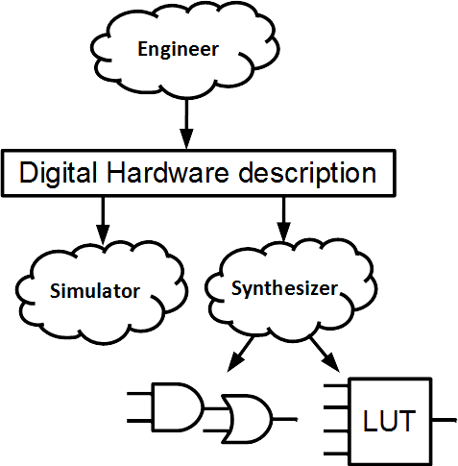
HDL : The Digital hardware flow
<numéro>
Notes:
<numéro>

Slide 7


HDL : Example
entity TopLevel is
port(
a : in std_logic;
b : in std_logic;
c : in std_logic;
result : out std_logic
);
end TopLevel;
architecture arch of TopLevel is
begin
result <= (a and b) or (not c);
end arch;
<numéro>
Notes:
<numéro>

Slide 8
HDL : Misc
Instances : VHDL, Verilog
  Low level, Verbose
  Pain level between assembly and C
Diferences with software programming
  Mapped into gates and register
  Massively parallel
  Cycle dimension
<numéro>
Notes:
<numéro>

Slide 9

SpinalHDL introduction
Open source , started in december 2014
Focus on hardware description
Generates VHDL/Verilog files
!!! Is an Scala Internal DSL !!!
<numéro>
Notes:
<numéro>

Slide 10

Language flow
Describe your RTL
Generate the VHDL/Verilog
Simulate and synthesize
<numéro>
Notes:
<numéro>

Slide 11
Keywords
Types :
  Bool / Bits / UInt / SInt / SpinalEnum
  Bundle / Vec
Hierarchy :
  Component
  Area
Misc :
  Reg / RegInit
  in / out / master / slave
<numéro>
Notes:
<numéro>

Slide 12
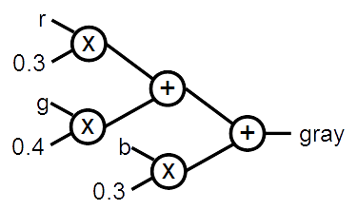

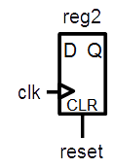
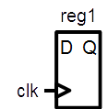

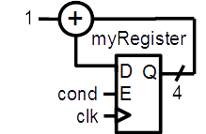
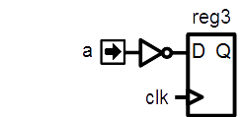
Simple examples
<numéro>
Notes:
<numéro>

Slide 13
A simple component
class MyComponent extends Component {
val io = new Bundle {
val a = in Bool
val result = out Bool
}
io.result := io.a
}
<numéro>
Notes:
It’s scala, but with some pretty things (in Bool in this case)
New Bundle is the definition of a new datatype, a little bit like records in VHDL or struct in Verilog, but with individual element direction specification
This code wire io.a to io.output
<numéro>

Slide 14
Combinatorial logic
class MyComponent extends Component {
val io = new Bundle {
val a = in Bool
val b = in Bool
val c = in Bool
val result = out Bool
}
io.result := (io.a && io.b) || (!io.c)
}
<numéro>
Notes:
Like in VHDL you can do combinatorial things.
Anyway you can read the value each out signal, like a VHDL buffer.
<numéro>

Slide 15
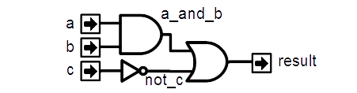
Signals
class MyComponent extends Component {
val io = new Bundle {
val a = in Bool
val b = in Bool
val c = in Bool
val result = out Bool
}
val a_and_b = Bool
a_and_b := io.a && io.b
val not_c = ! io.c
io.result := a_and_b || not_c
}
<numéro>
Notes:
Declare what you need where you need and directly affect the value that you want (not_c signal).
For example if you don’t assigne a_and_b to any value, spinalHDL tell you.
<numéro>

Slide 16
Generated VHDL
library ieee;
use ieee.std_logic_1164.all;
use ieee.numeric_std.all;
entity MyComponent is
port(
io_a : in std_logic;
io_b : in std_logic;
io_c : in std_logic;
io_result : out std_logic
);
end MyComponent;
architecture arch of MyComponent is
signal a_and_b : std_logic;
signal not_c : std_logic;
begin
io_result <= (a_and_b or not_c);
a_and_b <= (io_a and io_b);
not_c <= (not io_c);
end arch;
import spinal.core._
class MyComponent extends Component {
val io = new Bundle {
val a = in Bool
val b = in Bool
val c = in Bool
val result = out Bool
}
val a_and_b = io.a & io.b
val not_c = !io.c
io.result := a_and_b | not_c
}
def main(args: Array[String]) {
SpinalVhdl(new MyComponent)
}
<numéro>
Notes:
As you can see you can avoid the split between the signal declaration and the signal logic.
<numéro>

Slide 17

How that stuff work
<numéro>
Notes:
<numéro>

Slide 18
Self build graph
class Node{
val inputs = ArrayBuffer[Node]()
}
class Bool extends Node{
def &&(right : Bool) : Bool = ???
def ||(right : Bool) : Bool = ???
}
class And extends Node
class Or extends Node
class Not extends Node
class MyComponent extends Component {
val io = new Bundle {
val a = in Bool
val b = in Bool
val c = in Bool
val result = out Bool
}
io.result := (io.a && io.b) || (!io.c)
}
<numéro>
Notes:
<numéro>

Slide 19
Self build graph
val bools = List.fill(3)(in Bool)
var boolsAnd = bools.head
for(bool <- bools.tail){
boolsAnd = boolsAnd && bool
}
val output = out Bool()
output := boolsAnd
<numéro>
Notes:
<numéro>

Slide 20
PML => Pimp My Library
implicit class StringPimper(pimped : String){
def countUpperCases() : Int = pimped.count(_.isUpper)
}
"ChewBacca".countUpperCases() //2
<numéro>
Notes:
<numéro>

Slide 21
PML : Postfixes
case class BitCount(value : Int)
implicit class IntPimper(pimped : Int){
def bits = BitCount(pimped)
}
class UInt(width : Int)
object UInt{
def apply(width : BitCount) = new UInt(width.value)
}
val a,b = UInt(4 bits)
<numéro>
Notes:
<numéro>

Slide 22
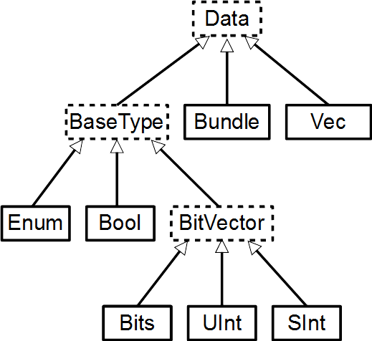

Prefix
class BaseType extends Data{
def asInput() : this.type = ???
}
class Bool extends BaseType
class UInt(width : Int) extends BaseType
object in{
def Bool =
new Bool().asInput()
def UInt(width : BitCount) =
new UInt(width.value).asInput()
}
val a = in Bool
val b = in UInt(4 bits)
val c = Bool().asInput()
<numéro>
Notes:
<numéro>

Slide 23
Registers
class MyComponent extends Component {
val io = new Bundle {
val a = in Bool
}
val reg1 = Reg(Bool)
val reg2 = Reg(Bool) init (False)
val reg3 = Reg(Bool)
reg3 := ! io.a
}
<numéro>
Notes:
You don’t need for each register to specify his clock, it’s implicit (next clock)
There is no process !
Reg1 is a simple register with no reset
Reg2 is a register with a reset value at false
Reg3 is the same than Reg2 with a more compact syntax
Reg4 is a register that take the io.a value at each clock. You can add the init(XXX) to specify a reset value.
<numéro>

Slide 24

Conditional assignments
False
mySignal
val mySignal = Bool
val myRegister = Reg(UInt(4 bits))
val myRegisterWithReset = Reg(UInt(4 bits)) init(0)
mySignal := False
when(cond) {
mySignal := True
myRegister := myRegister + 1
myRegisterWithReset := myRegisterWithReset + 1
}
True
cond
1
+
myRegister
D
Q
cond
E
4
clk
1
+
myRegisterWithReset
D
Q
cond
E
4
clk
CLR
reset
<numéro>
Notes:
In VHDL you need to split the logic between combinatoral / sequancial with reset / sequancial without reset
<numéro>

Slide 25
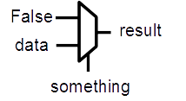
Currying and blocks
object when {
def apply(cond: Bool)(block: => Unit): Unit = {
//...
block
//...
}
}
val something, data, result = Bool
result := False
when(something){
result := data
}
<numéro>
Notes:
<numéro>

Slide 26
Chaining
class When(context : Bool){
def otherwise(block : => Unit) : Unit = {
//...
block
//...
}
}
object when {
def apply(cond: Bool)(block: => Unit): When = {
//...
block
//...
new When(cond)
}
}
when(???){
//...
} otherwise {
//...
}
<numéro>
Notes:
<numéro>

Slide 27
Context
object when {
var context = List[Bool]()
def apply(cond: Bool)(block: => Unit): Unit = {
context = cond :: context
block
context = context.tail
}
}
class Node
class Bool extends Node{
def := (that : Bool): Unit ={
// use when.context
}
}
<numéro>
Notes:
<numéro>

Slide 28
Function
// Input RGB color
val r,g,b = UInt(8 bits)
// Define a function to multiply a UInt by a scala Float value.
def coefMul(value : UInt,by : Float) : UInt = (value * U((255*by).toInt,8 bits) >> 8)
//Calculate the gray level
val gray = coefMul(r, 0.3f) +
coefMul(g, 0.4f) +
coefMul(b, 0.3f)
<numéro>
Notes:
In VHDL you can’t create a function that assign combinatoral and sequancial logic
<numéro>

Slide 29
Bundle and Function
case class Color(channelWidth: Int) extends Bundle {
val r,g,b = UInt(channelWidth bits)
def +(that: Color): Color = {
val result = Color(channelWidth)
result.r := this.r + that.r
result.g := this.g + that.g
result.b := this.b + that.b
return result
}
}
val a,b = Color(8)
val c = a + b
val d = Color(8)
d := c
<numéro>
Notes:
You can extend a bundle definition with all user function that you want. Here is a example where the plus operator is provided for Color Bundle(with overflow protection).
You can define inner function (channelAdd)
AdderAndCarry return 2 things, the sum of 2 Uint and the carry value. (scala allow return mutiple value in the same type by using Tuple)
<numéro>

Slide 30
Self typed function
class Data
class Bundle extends Data{
type T <: Bundle
def := (that : T) : Unit = ???
}
class RGB extends Bundle{
override type T = RGB
val r,g,b = UInt(8 bits)
}
class Data
class Bundle[T] extends Data{
def := (that : T) : Unit = ???
}
class RGB extends Bundle[RGB]{
val r,g,b = UInt(8 bits)
}
<numéro>
Notes:
<numéro>

Slide 31
PML : Self typed function
implicit class BundlePimper[T <: Bundle](pimped : T){
def :=(that : T) = ???
}
class RGB extends Bundle{
val r,g,b = UInt(8 bits)
}
val a,b = new RGB
a := b //It is strongly typed and only accept RGB := RGB
<numéro>
Notes:
<numéro>

Slide 32
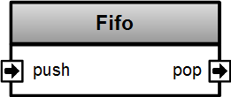
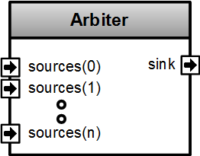
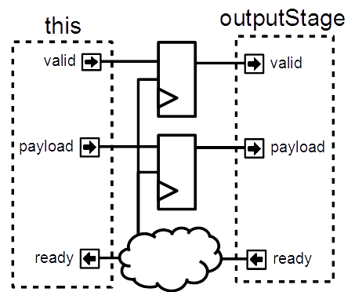

Advanced examples
<numéro>
Notes:
<numéro>

Slide 33
Functional programming
val addresses = Vec(UInt(8 bits),4)
val key = UInt(8 bits)
val hits = addresses.map(address => address === key)
val hit = hits.reduce((a,b) => a || b)
<numéro>
Notes:
<numéro>

Slide 34
Basic abstractions
val timeout = Timeout(1000)
when(timeout){ //implicit conversion to Bool
timeout.clear() //Clear the flag and the internal counter
}
//Create a counter of 10 states (0 to 9)
val counter = Counter(10)
counter.clear() //When called it reset the counter. It's not a flag
counter.increment() //When called it increment the counter. It's not a flag
counter.value //current value
counter.valueNext //Next value
counter.willOverflow //Flag that indicate if the counter overflow this cycle
when(counter === 5){ …}
<numéro>
Notes:
Some basics abstraction are defined in the Spinal Lib.
<numéro>

Slide 35
Stream
case class Stream[T <: Data](payloadType: T) extends Bundle {
val valid = Bool
val ready = Bool
val payload = cloneOf(payloadType)
}
val myStreamOfRGB = Stream(RGB(8,8,8))
<numéro>
Notes:
<numéro>

Slide 36
Stream components
class Fifo[T <: Data](payloadType: T, depth: Int) extends Component {
val io = new Bundle {
val push = slave Stream (payloadType)
val pop = master Stream (payloadType)
}
//…
}
<numéro>
Notes:
<numéro>

Slide 37

Design introspection
val a = UInt(8 bits)
val b = UInt(8 bits)
val aCalcResult = complicatedLogic(a)
val aLatency = LatencyAnalysis(a,aCalcResult)
val bDelayed = Delay(b,cycleCount = aLatency)
val result = aCalcResult + bDelayed
<numéro>
Notes:
Because spinal build a netlist in the memory, you can use it to extract some information, for example latency (in cycle) between some points of you design.
To do that, call LatencyAnalysis and give to it as argument some the start point, some check point and the end point of you path. It look for the shortest path and return how many cycle there is.
<numéro>

Slide 38
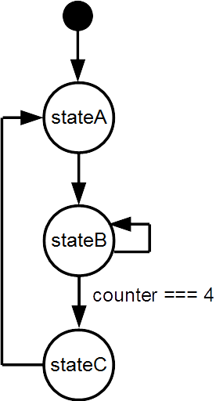
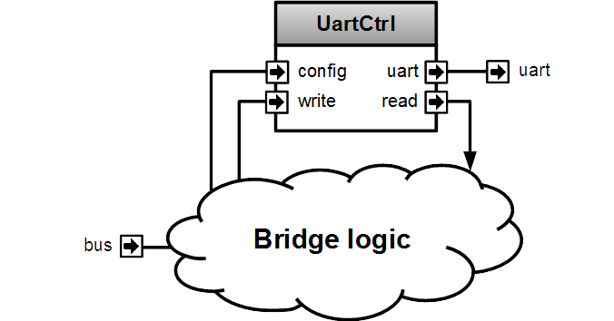
Meta-hardware description examples
<numéro>
Notes:
<numéro>

Slide 39
FSM
They could be defined with regular syntax (Enum,Switch)
You can also use a much more friendly syntax, fully integrated, with following features :
  onEntry / onExit / whenIsActive / whenIsNext blocs
  State with inner FSM
  State with multiple inner FSM (parallel execution)
  Delay state
  You can extends the syntax by defining new state types
<numéro>
Notes:
<numéro>

Slide 40

FSM style
val fsm = new StateMachine{
val stateA = new State with EntryPoint
val stateB = new State
val stateC = new State
val counter = Reg(UInt(8 bits)) init (0)
io.result := False
stateA
.whenIsActive (goto(stateB))
stateB
.onEntry(counter := 0)
.whenIsActive {
counter := counter + 1
when(counter === 4){
goto(stateC)
}
}
.onExit(io.result := True)
stateC
.whenIsActive (goto(stateA))
}
val io = new Bundle{
val result = out Bool
}
<numéro>
Notes:
<numéro>

Slide 41
PML : String interpolation
implicit class LiteralBuilder(sc: StringContext) {
def x(args: Any*): BigInt = BigInt(args(0).asInstanceOf[String].replace("_",""),16)
}
val literal = x"CAFE_F00D"
<numéro>
Notes:
<numéro>

Slide 42
Var operator
case class MegaInt(value : Int){
def +(that : MegaInt) = MegaInt(this.value + that.value)
}
var a = MegaInt(666)
a += MegaInt(22) //a = MegaInt(666 + 22)
<numéro>
Notes:
<numéro>

Slide 43

SpinalHDL is not a joke
<numéro>
Notes:
<numéro>

Slide 44
Pinsec SoC
<numéro>
Notes:
<numéro>

Slide 45
Peripheral side
val timerCtrl = PinsecTimerCtrl()
val apbBridge = Axi4SharedToApb3Bridge(
addressWidth = 20,
dataWidth = 32,
idWidth = 4
)
val apbDecoder = Apb3Decoder(
master = apbBridge.io.apb,
slaves = List(
gpioACtrl.io.apb -> (0x00000, 4 kB),
gpioBCtrl.io.apb -> (0x01000, 4 kB),
uartCtrl.io.apb -> (0x10000, 4 kB),
timerCtrl.io.apb -> (0x20000, 4 kB),
vgaCtrl.io.apb -> (0x30000, 4 kB),
core.io.debugBus -> (0xF0000, 4 kB)
)
)
<numéro>
Notes:
<numéro>

Slide 46
Master side
val axiCrossbar = Axi4CrossbarFactory()
axiCrossbar.addSlaves(
ram.io.axi -> (0x00000000L, onChipRamSize),
sdramCtrl.io.axi -> (0x40000000L, sdramLayout.capacity),
apbBridge.io.axi -> (0xF0000000L, 1 MB)
)
axiCrossbar.addConnections(
core.io.i -> List(ram.io.axi, sdramCtrl.io.axi),
core.io.d -> List(ram.io.axi, sdramCtrl.io.axi, apbBridge.io.axi),
jtagCtrl.io.axi -> List(ram.io.axi, sdramCtrl.io.axi, apbBridge.io.axi),
vgaCtrl.io.axi -> List( sdramCtrl.io.axi)
)
axiCrossbar.build()
<numéro>
Notes:
<numéro>

Slide 47


Some links
Completely open source :
    https://github.com/SpinalHDL/SpinalHDL
Online documentation :
    https://spinalhdl.github.io/SpinalDoc/
Ready to use base project :
    https://github.com/SpinalHDL/SpinalBaseProject
Communication channels :
    spinalhdl@gmail.com
    https://gitter.im/SpinalHDL/SpinalHDL
    https://github.com/SpinalHDL/SpinalHDL/issues
<numéro>
Notes:
<numéro>

