Slide 1
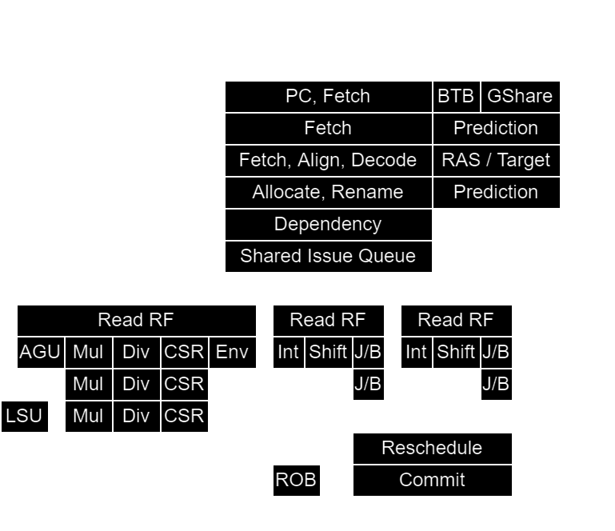
NaxRiscv
An open-source OoO superscalar softcore

Slide 2
Background / whoami
Dolu1990 on github
Active on
  SpinalHDL
  VexRiscv
  NaxRiscv
Software / Hardware background

Slide 3

NaxRiscv in short
RV32/RV64 IMACSU (Linux ready)
Out of order / superscalar
Free / Open source (MIT)
Many paradigm experimentation with alternative HDL
Target FPGA with distributed RAM
~75 FPS Chocolate-doom (@100Mhz / linux)
https://twitter.com/i/status/1493996880593887235

Slide 4
Performances / Area
RV32IMASU, 2 decode, 3 issue
  Dhrystone : 2.64 DMIPS/Mhz 1.48 IPC (-O3 -fno-common -fno-inline)
  Coremark : 4.70 Coremark/Mhz 1.19 IPC
  Embench-iot : 1.59 baseline 1.35 IPC
On Artix 7 speed grade 3 :
  145 Mhz (360 Mhz on Kintex ultrascale+ grade 3)
  14.6 KLUT, 9.8 KFF, 12.5 BRAM, 4 DSP
RV64IMASU, same FPGA/config
  140 Mhz
  19.5 KLUT, 12.0 KFF, 12.5 BRAM, 16 DSP
NaxRiscv => https://spinalhdl.github.io/NaxRiscv-Rtd/main/NaxRiscv/performance/index.html
RSD => https://github.com/rsd-devel/rsd

Slide 5

Architecture (as configured in the last slide)
2 decode, 3 issue (2 ALU, 1 shared EU)
10 cycles miss predicted branch penalty
64 physical register, 64 entry ROB
4KB GShare, 4KB BTB (both 1 way), RAS
Non-blocking D$
I$ D$ each have 16 KB (4 ways)
I$ D$ each have 192 TLB (2+4 ways)

Slide 6
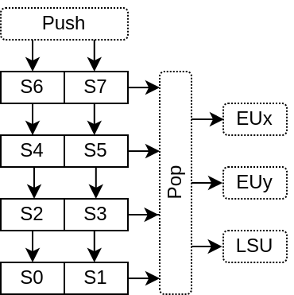
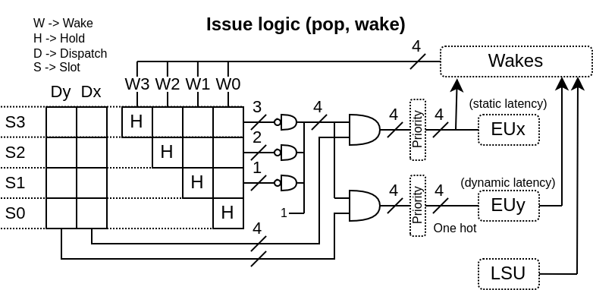
Dispatch / Issue Queue
Shared between execution units
32 entries, grouped by “wave”, (ex: 2x16)
Older first, no compression
Matrix design, removal on completion

Slide 7
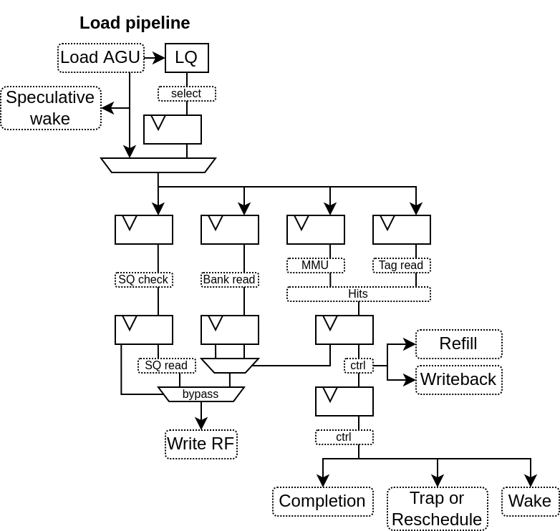
LSU (load)
Speculative wake (hit prediction)
load to use latency :
  3 cycle (hit predicted OK)
  6 cycle (miss predicted)
  Full flush (hit predicted KO)
AGU to D$ bypass
RF written 1 cycle before completion
SQ address hazard check
  4KB virtual (first pass)
  Full physical (second pass if first pass has 1 hit)
16 entries

Slide 8
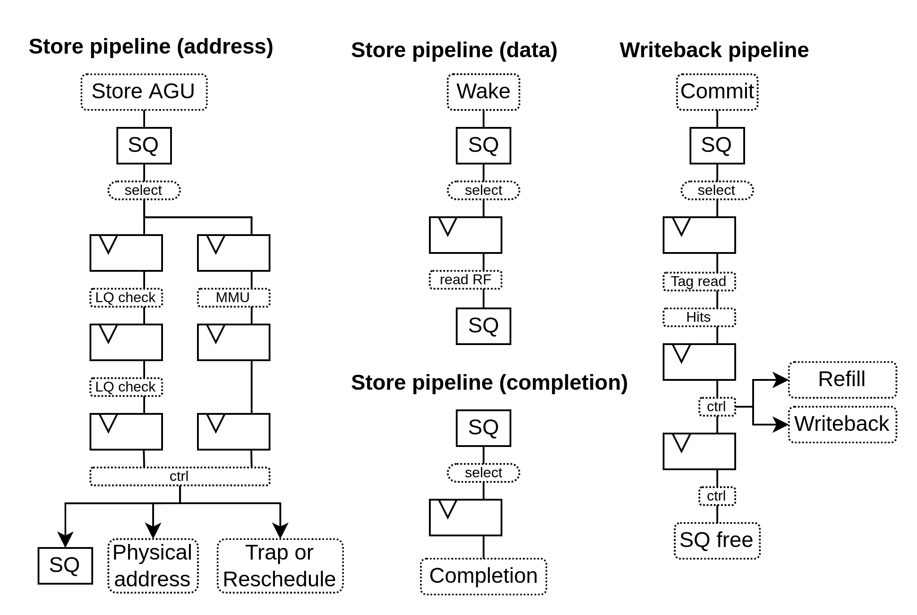
LSU (store)
4 pipelines
Dependencies
  Address through IQ
  Data directly read RF
LQ address hazard check
  4KB virtual
16 entries

Slide 9
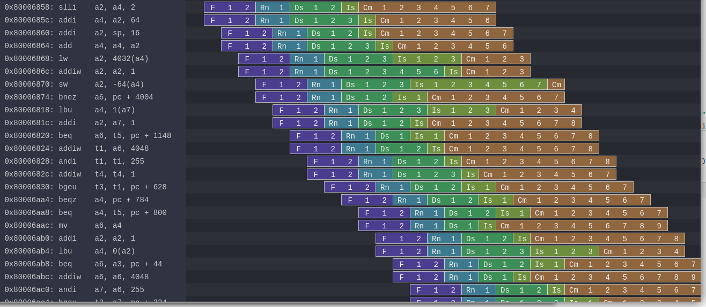
Simulation
Based on Verilator (~150-200 Khz on Ryzen 3900)
Lock-step checks against Spike (life saver)
Can emit Gem5-O3 / Konata traces

Slide 10
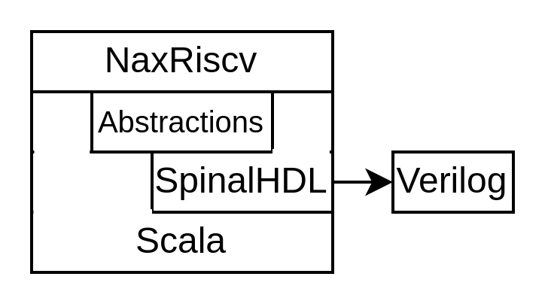
Exploring hardware description paradigms
A few things first
  Stopped writing VHDL/[System]Verilog in 2016
  NaxRiscv => Scala + SpinalHDL
  Paradigm : You write software which use an API that generate hardware
    SpinalHDL / Chisel / Migen / Amaranth HDL / …
4 key concepts in NaxRiscv
  Composable toplevel
  Multithreaded elaboration
  Pipelining framework
  Software engineering

Slide 11
val plugins = ArrayBuffer[Plugin]()
plugins ++= List(
new PcPlugin(),
new FetchCachePlugin(16 KB),
new DecoderPlugin(),
new DispatchPlugin(slotCount = 32),
new CommitPlugin()
...
)
plugins ++= List(
new ExecutionUnitBase("ALU0"),
new IntAluPlugin("ALU0"),
new ShiftPlugin("ALU0" ),
new BranchPlugin("ALU0")
new IntFormatPlugin("ALU0"),
new SrcPlugin("ALU0"),
)
new NaxRiscv(plugins)

Slide 12
val plugins = ArrayBuffer[Plugin]()
plugins ++= List(
new PcPlugin(),
new FetchCachePlugin(16 KB),
new DecoderPlugin(),
new DispatchPlugin(slotCount = 32),
new CommitPlugin()
...
)
plugins ++= List(
new ExecutionUnitBase("ALU0"),
new IntAluPlugin("ALU0"),
new ShiftPlugin("ALU0" ),
new BranchPlugin("ALU0")
new IntFormatPlugin("ALU0"),
new SrcPlugin("ALU0"),
)
new NaxRiscv(plugins)
Create NaxRiscv

Slide 13
val plugins = ArrayBuffer[Plugin]()
plugins ++= List(
new PcPlugin(),
new FetchCachePlugin(16 KB),
new DecoderPlugin(),
new DispatchPlugin(slotCount = 32),
new CommitPlugin()
...
)
plugins ++= List(
new ExecutionUnitBase("ALU0"),
new IntAluPlugin("ALU0"),
new ShiftPlugin("ALU0" ),
new BranchPlugin("ALU0")
new IntFormatPlugin("ALU0"),
new SrcPlugin("ALU0"),
)
new NaxRiscv(plugins)
Elaboration time list of Plugin

Slide 14
val plugins = ArrayBuffer[Plugin]()
plugins ++= List(
new PcPlugin(),
new FetchCachePlugin(16 KB),
new DecoderPlugin(),
new DispatchPlugin(slotCount = 32),
new CommitPlugin()
...
)
plugins ++= List(
new ExecutionUnitBase("ALU0"),
new IntAluPlugin("ALU0"),
new ShiftPlugin("ALU0" ),
new BranchPlugin("ALU0")
new IntFormatPlugin("ALU0"),
new SrcPlugin("ALU0"),
)
new NaxRiscv(plugins)
plugins ++= List(
new ExecutionUnitBase("ALU1"),
new IntAluPlugin("ALU1"),
new ShiftPlugin("ALU1" ),
new BranchPlugin("ALU1")
new IntFormatPlugin("ALU1"),
new SrcPlugin("ALU1"),
)
Wanna a second execution unit ?

Slide 15
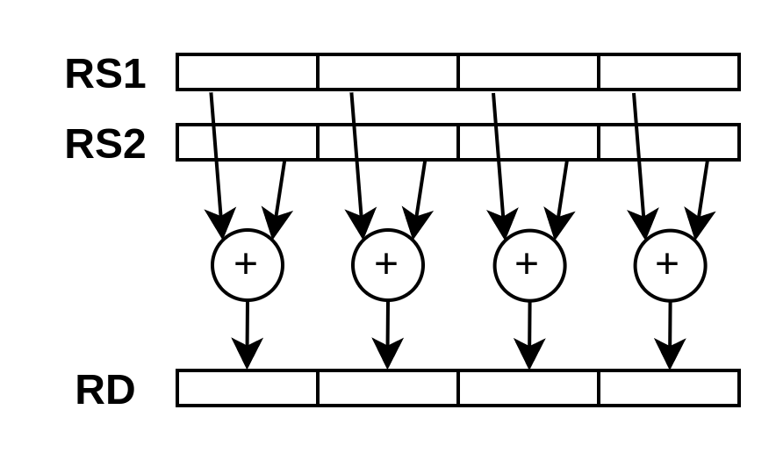
Plugin / SIMD ADD8
class SimdAddPlugin(euId : String) extends Plugin {
val setup = create early new Area{
// ...
}
val logic = create late new Area{
// ...
}
}

Slide 16
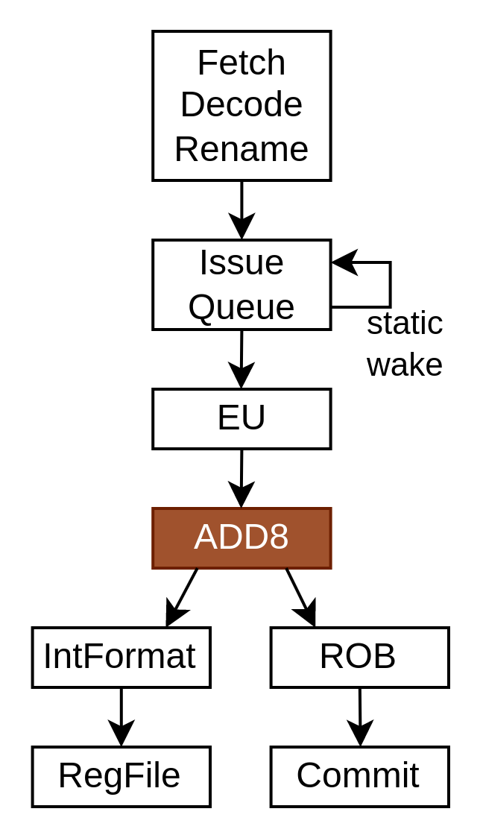
val setup = create early new Area{
val eu = findService[ExecutionUnitBase](_.euId == euId)
eu.retain()
val ADD8 = IntRegFile.TypeR(M"0000000----------000-----0001011")
eu.addMicroOp(ADD8)
eu.setCompletion(ADD8, stageId = 0)
eu.setStaticWake(ADD8, stageId = 0)
val intFormat = findService[IntFormatPlugin](_.euId == euId)
val writeback = intFormat.access(stageId = 0, writeLatency = 0)
val SEL = Stageable(Bool())
eu.setDecodingDefault(SEL, False)
eu.addDecoding(ADD8, SEL, True)
}

Slide 17
val setup = create early new Area{
val eu = findService[ExecutionUnitBase](_.euId == euId)
eu.retain()
val ADD8 = IntRegFile.TypeR(M"0000000----------000-----0001011")
eu.addMicroOp(ADD8)
eu.setCompletion(ADD8, stageId = 0)
eu.setStaticWake(ADD8, stageId = 0)
val intFormat = findService[IntFormatPlugin](_.euId == euId)
val writeback = intFormat.access(stageId = 0, writeLatency = 0)
val SEL = Stageable(Bool())
eu.setDecodingDefault(SEL, False)
eu.addDecoding(ADD8, SEL, True)
}

Slide 18
val setup = create early new Area{
val eu = findService[ExecutionUnitBase](_.euId == euId)
eu.retain()
val ADD8 = IntRegFile.TypeR(M"0000000----------000-----0001011")
eu.addMicroOp(ADD8)
eu.setCompletion(ADD8, stageId = 0)
eu.setStaticWake(ADD8, stageId = 0)
val intFormat = findService[IntFormatPlugin](_.euId == euId)
val writeback = intFormat.access(stageId = 0, writeLatency = 0)
val SEL = Stageable(Bool())
eu.setDecodingDefault(SEL, False)
eu.addDecoding(ADD8, SEL, True)
}

Slide 19
val setup = create early new Area{
val eu = findService[ExecutionUnitBase](_.euId == euId)
eu.retain()
val ADD8 = IntRegFile.TypeR(M"0000000----------000-----0001011")
eu.addMicroOp(ADD8)
eu.setCompletion(ADD8, stageId = 0)
eu.setStaticWake(ADD8, stageId = 0)
val intFormat = findService[IntFormatPlugin](_.euId == euId)
val writeback = intFormat.access(stageId = 0, writeLatency = 0)
val SEL = Stageable(Bool())
eu.setDecodingDefault(SEL, False)
eu.addDecoding(ADD8, SEL, True)
}

Slide 20
val logic = create late new Area{
val eu = setup.eu
val writeback = setup.writeback
val stage = eu.getExecute(stageId = 0)
val rs1 = stage(eu(IntRegFile, RS1)).asUInt
val rs2 = stage(eu(IntRegFile, RS2)).asUInt
val rd = UInt(32 bits)
rd( 7 downto 0) := rs1( 7 downto 0) + rs2( 7 downto 0)
rd(16 downto 8) := rs1(16 downto 8) + rs2(16 downto 8)
rd(23 downto 16) := rs1(23 downto 16) + rs2(23 downto 16)
rd(31 downto 24) := rs1(31 downto 24) + rs2(31 downto 24)
writeback.valid := stage(setup.SEL)
writeback.payload := rd.asBits
eu.release()
}
https://spinalhdl.github.io/NaxRiscv-Rtd/main/NaxRiscv/execution_units/index.html#custom-instruction

Slide 21
val logic = create late new Area{
val eu = setup.eu
val writeback = setup.writeback
val stage = eu.getExecute(stageId = 0)
val rs1 = stage(eu(IntRegFile, RS1)).asUInt
val rs2 = stage(eu(IntRegFile, RS2)).asUInt
val rd = UInt(32 bits)
rd( 7 downto 0) := rs1( 7 downto 0) + rs2( 7 downto 0)
rd(16 downto 8) := rs1(16 downto 8) + rs2(16 downto 8)
rd(23 downto 16) := rs1(23 downto 16) + rs2(23 downto 16)
rd(31 downto 24) := rs1(31 downto 24) + rs2(31 downto 24)
writeback.valid := stage(setup.SEL)
writeback.payload := rd.asBits
eu.release()
}
https://spinalhdl.github.io/NaxRiscv-Rtd/main/NaxRiscv/execution_units/index.html#custom-instruction

Slide 22
val logic = create late new Area{
val eu = setup.eu
val writeback = setup.writeback
val stage = eu.getExecute(stageId = 0)
val rs1 = stage(eu(IntRegFile, RS1)).asUInt
val rs2 = stage(eu(IntRegFile, RS2)).asUInt
val rd = UInt(32 bits)
rd( 7 downto 0) := rs1( 7 downto 0) + rs2( 7 downto 0)
rd(16 downto 8) := rs1(16 downto 8) + rs2(16 downto 8)
rd(23 downto 16) := rs1(23 downto 16) + rs2(23 downto 16)
rd(31 downto 24) := rs1(31 downto 24) + rs2(31 downto 24)
writeback.valid := stage(setup.SEL)
writeback.payload := rd.asBits
eu.release()
}
https://spinalhdl.github.io/NaxRiscv-Rtd/main/NaxRiscv/execution_units/index.html#custom-instruction

Slide 23
val logic = create late new Area{
val eu = setup.eu
val writeback = setup.writeback
val stage = eu.getExecute(stageId = 0)
val rs1 = stage(eu(IntRegFile, RS1)).asUInt
val rs2 = stage(eu(IntRegFile, RS2)).asUInt
val rd = UInt(32 bits)
rd( 7 downto 0) := rs1( 7 downto 0) + rs2( 7 downto 0)
rd(16 downto 8) := rs1(16 downto 8) + rs2(16 downto 8)
rd(23 downto 16) := rs1(23 downto 16) + rs2(23 downto 16)
rd(31 downto 24) := rs1(31 downto 24) + rs2(31 downto 24)
writeback.valid := stage(setup.SEL)
writeback.payload := rd.asBits
eu.release()
}
https://spinalhdl.github.io/NaxRiscv-Rtd/main/NaxRiscv/execution_units/index.html#custom-instruction

Slide 24
val plugins = ArrayBuffer[Plugin]()
...
plugins ++= List(
new ExecutionUnitBase("ALU0"),
new IntAluPlugin("ALU0"),
new ShiftPlugin("ALU0" ),
new BranchPlugin("ALU0")
new IntFormatPlugin("ALU0"),
new SrcPlugin("ALU0"),
)
plugins += new SimdAddPlugin("ALU0")
plugins += new SimdAddPlugin("ALU1")
new NaxRiscv(plugins)
plugins ++= List(
new ExecutionUnitBase("ALU1"),
new IntAluPlugin("ALU1"),
new ShiftPlugin("ALU1" ),
new BranchPlugin("ALU1")
new IntFormatPlugin("ALU1"),
new SrcPlugin("ALU1"),
)

Slide 25
Status / Future
RV32/RV64 IMACSU configs seems stable so far
  Linux / FreeRTOS / riscv-tests / riscv-arch-test OK
JTAG / OpenOCD / GDB supported (RISCV External Debug Support 0.13.2)
Planning :
  FPU → Debian support
  Multicore / Memory coherency
GIT : https://github.com/SpinalHDL/NaxRiscv
Integrated in Litex for FPGA deployments
  python3 -m litex_boards.targets.digilent_nexys_video --cpu-type=naxriscv --with-video-framebuffer --with-spi-sdcard --with-ethernet --build --load

Slide 26
Miaou

Slide 27
Wuff

Slide 28
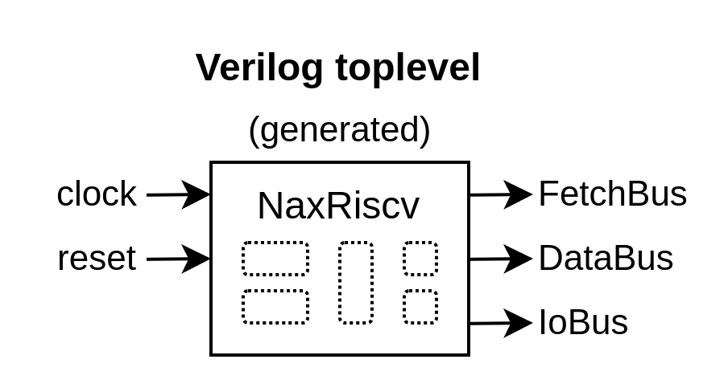
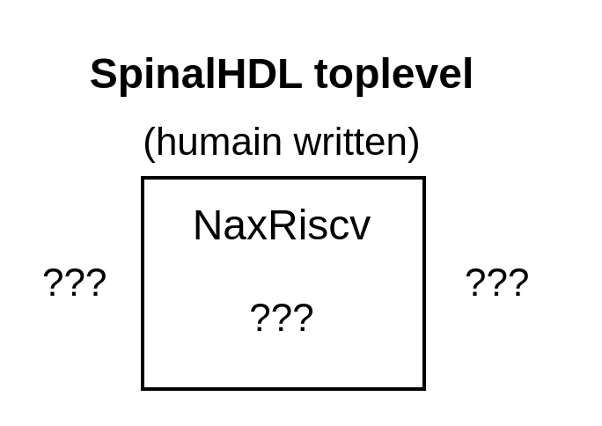
class NaxRiscv(plugins : Seq[Plugin]) extends Component{
val database = new DataBase
val framework = NaxScope(database) on new Framework(plugins)
}

Slide 29
class SimdAddPlugin(val euId : String) extends ExecutionUnitElementSimple(euId, staticLatency = true) {
override def euWritebackAt = 0
override val setup = create early new Setup{
add(SimdAddPlugin.ADD4)
}
override val logic = create late new Logic{
val process = new ExecuteArea(stageId = 0) {
val rs1 = stage(eu(IntRegFile, RS1)).asUInt
val rs2 = stage(eu(IntRegFile, RS2)).asUInt
val rd = UInt(32 bits)
rd( 7 downto 0) := rs1( 7 downto 0) + rs2( 7 downto 0)
rd(16 downto 8) := rs1(16 downto 8) + rs2(16 downto 8)
rd(23 downto 16) := rs1(23 downto 16) + rs2(23 downto 16)
rd(31 downto 24) := rs1(31 downto 24) + rs2(31 downto 24)
wb.payload := rd.asBits
}
}
}

Slide 30
Rawrrrr
class CommitPlugin extends Plugin {
val setup = create early new Area {
val jump = getService[JumpService].newJumpPort(10)
}
val logic = create late new Area {
setup.jump.valid := ???
setup.jump.payload := ???
}
}
trait JumpService extends Service{
def newJumpPort(priority : Int) : Flow[UInt]
}
class PcPlugin extends Plugin with JumpService{
override def newJumpPort(priority: Int) = {...}
val logic = create late new Area {
val pc = Reg(UInt(32 bits))
...
}
}

Slide 31
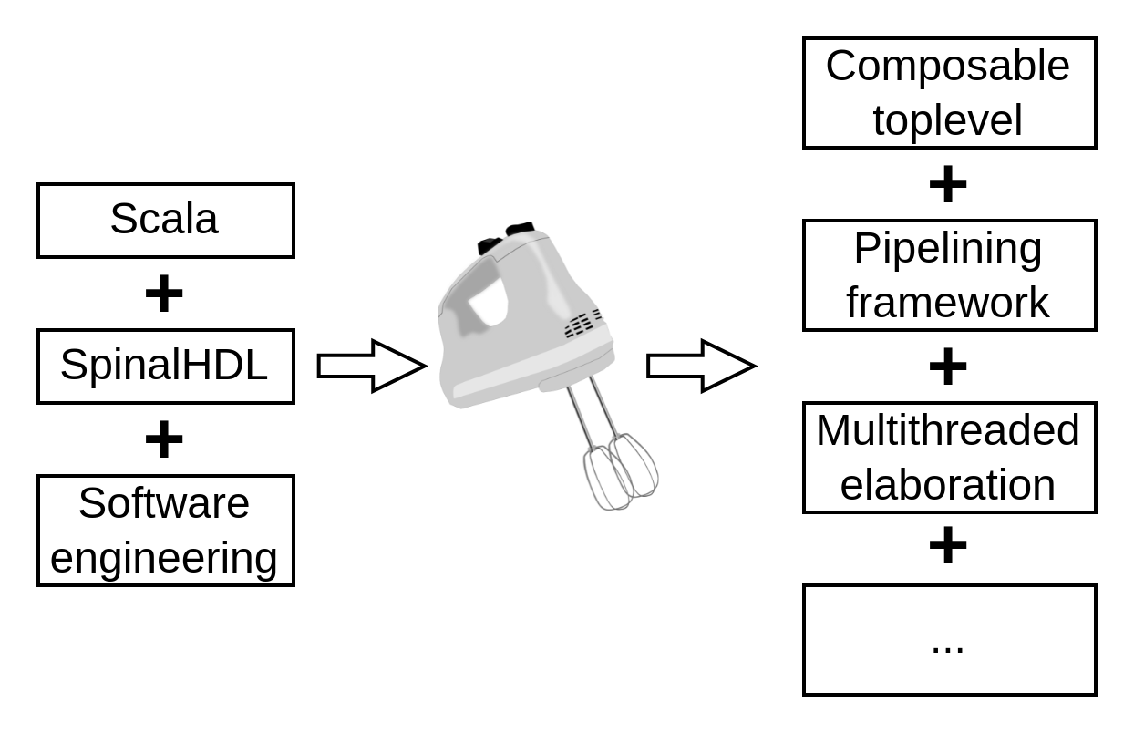
Likely to be applicable to other alternative HDL

Slide 32
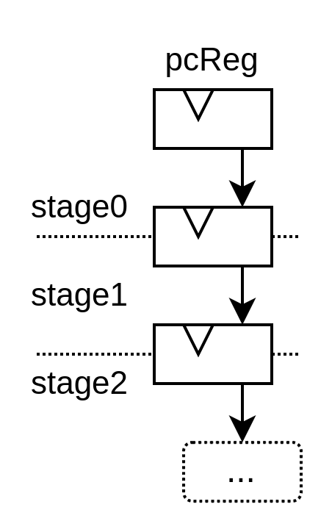
class PcPlugin extends Plugin {
val logic = ...{
val pcReg = Reg(UInt(32 bits))
getService[FetchPlugin].pipeline.stages(0)(PC) := pcReg
}
}
class FetchCachePlugin extends Plugin{
val logic = ...{
getService[FetchPlugin].pipeline.stages(2)(PC) === wayTag
}
}
object PC extends Stageable(UInt(32 bits))

Slide 33
class FetchCachePlugin extends Plugin{
val logic = ...{
getService[FetchPlugin].pipeline.stages(2)(PC) === wayTag
}
}
class FetchPlugin() extends Plugin {
val pipeline = create early new Pipeline {
val stages = Array.fill(3)(newStage())
...
}
val lock = Lock()
val builder = create late new Area{
lock.await()
pipeline.build()
}
}

