Slide 1
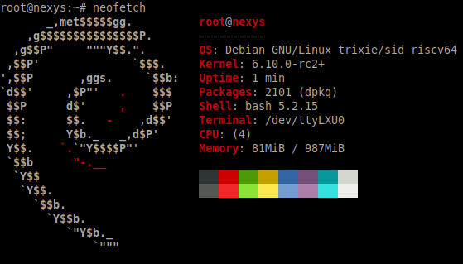
VexiiRiscv : A Debian demonstration
Charles Papon

Slide 2
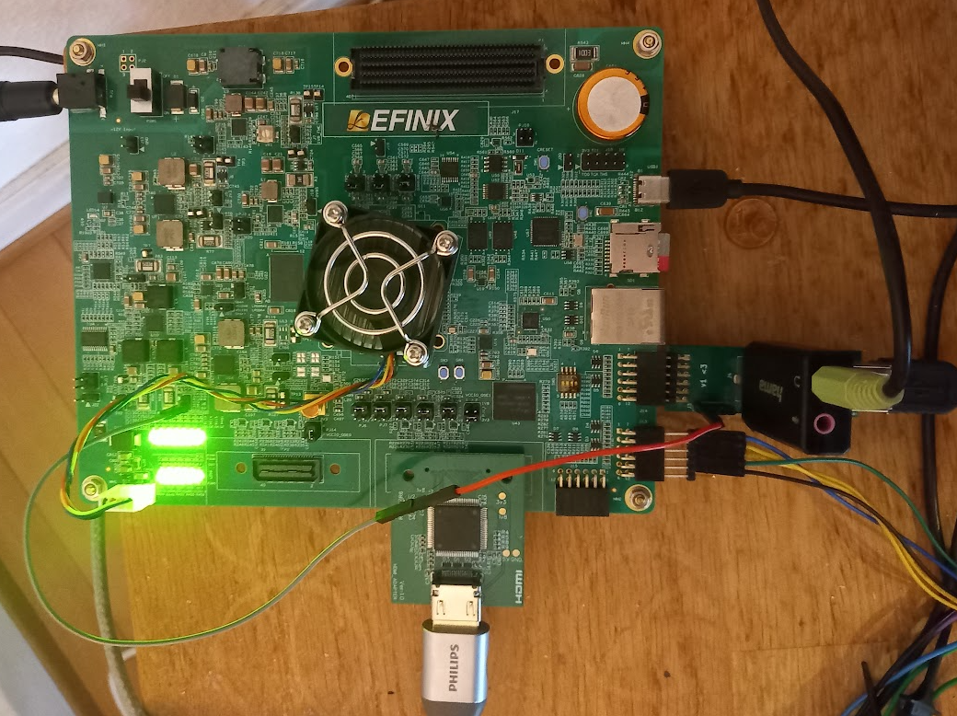
Whoami (FPGA + Board)
Efinix Titanium Ti375 C529 Development Kit
https://github.com/SpinalHDL/VexiiRiscv/issues/24

Slide 3
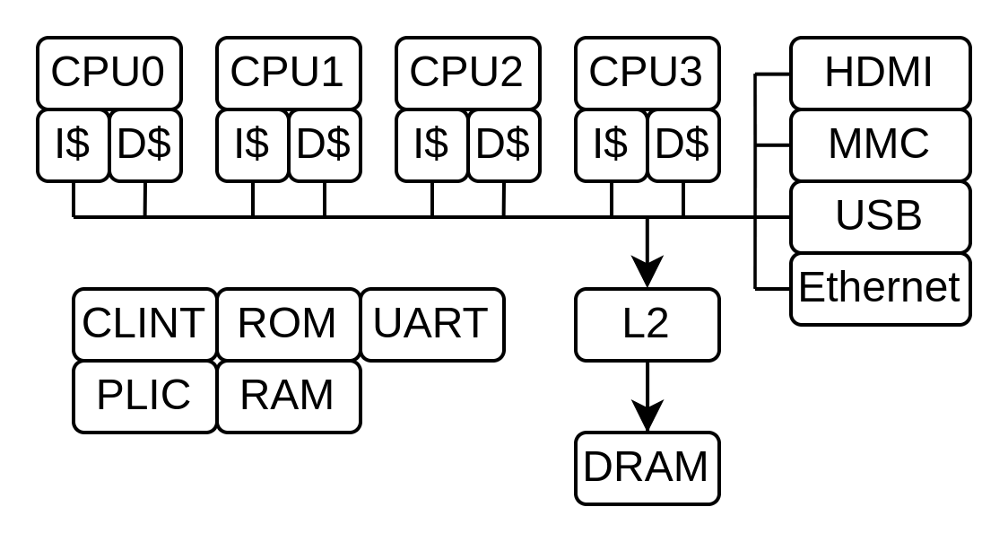
Whoami (SoC)
4x VexiiRiscv @ 200MHz
  RV64IMAFDCSU...
  Single issue / in-order
L2 (512KB)
DMA
  HDMI / MMC / USB / Ethernet
~ 100 KLUT (4 inputs)
SpinalHDL + Litex → Verilog
  All open-source

Slide 4
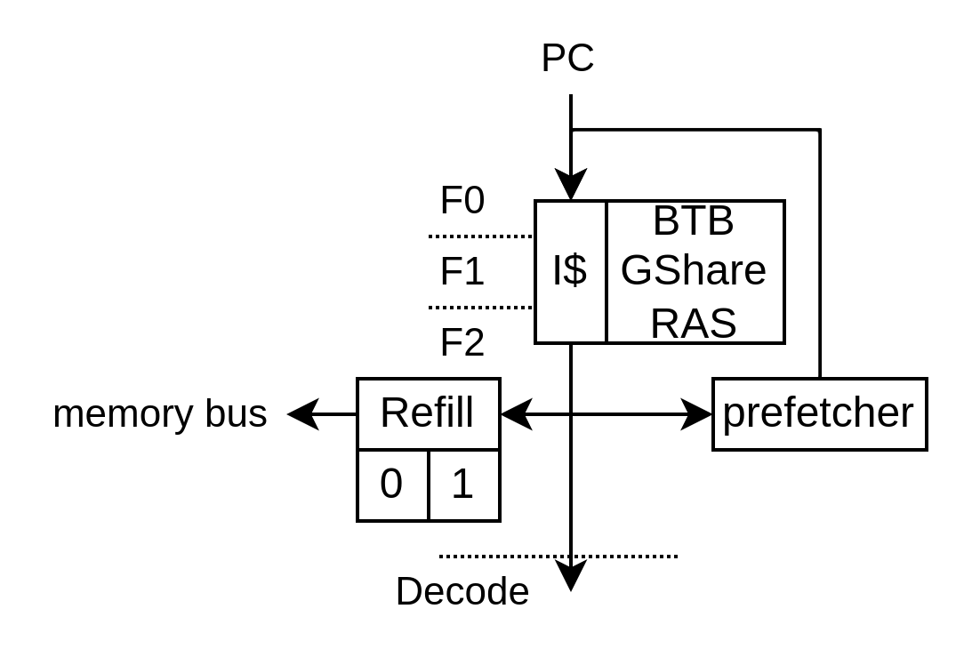
Fetch
Branch prediction
  BTB / GShare / RAS
I$
  16KB / 4 ways
  Non blocking
  Nextline prefetcher

Slide 5
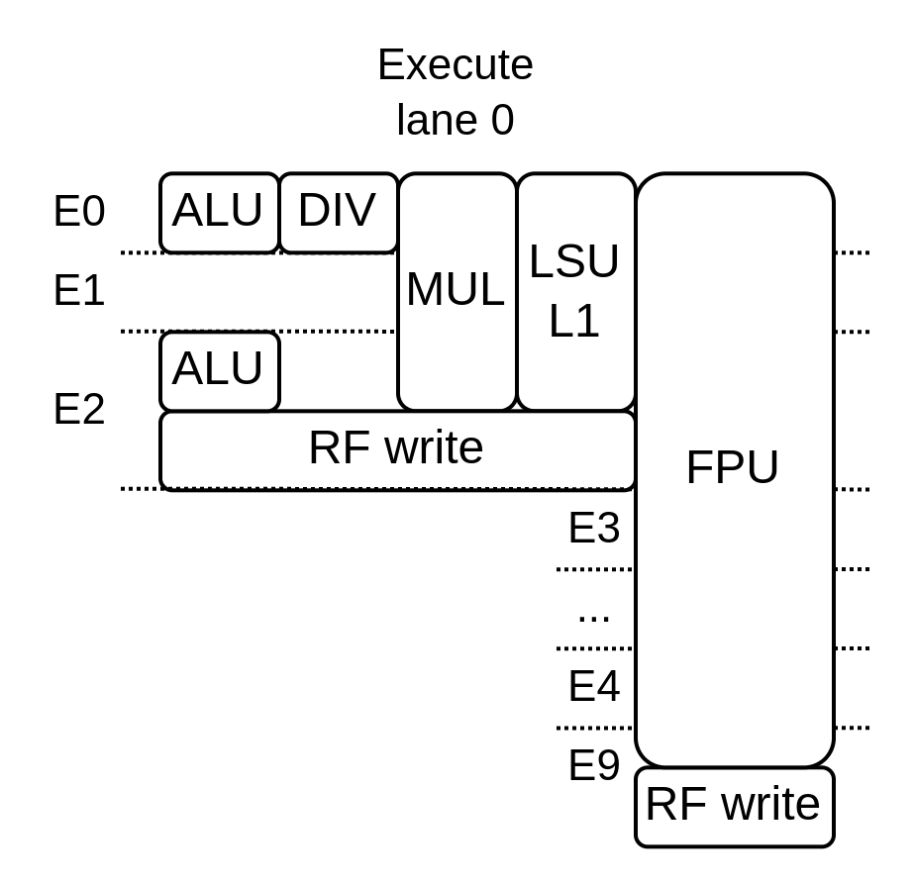
Execute (this demo)

Slide 6
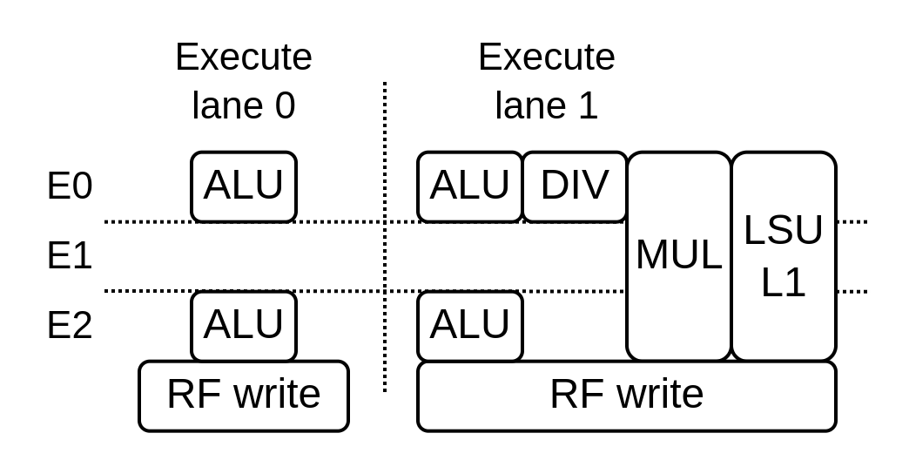
Execute [option]
Single / Dual issue
Early / Late ALU
5.24 coremark/Mhz 2.50 dhystone/Mhz

Slide 7
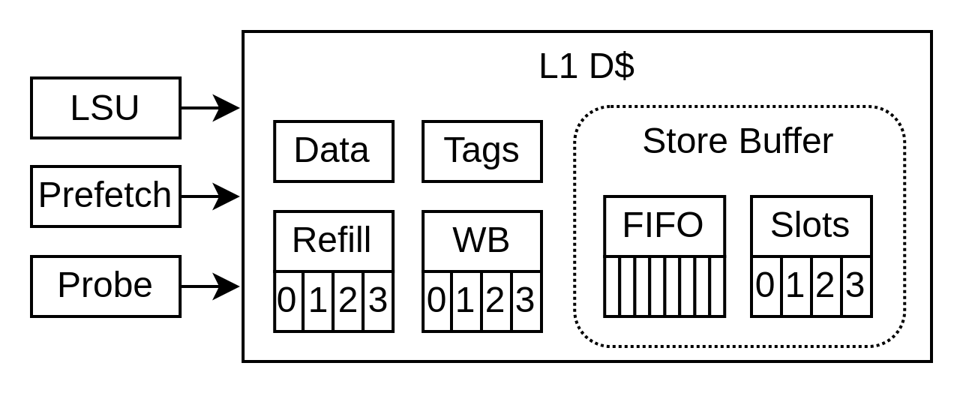
Load / Store
D$
  16KB / 4 ways / write-back
  Store buffer (FPGA friendly)
  Non blocking
  Memory coherence (MESI)
  Stride prefetcher

Slide 8
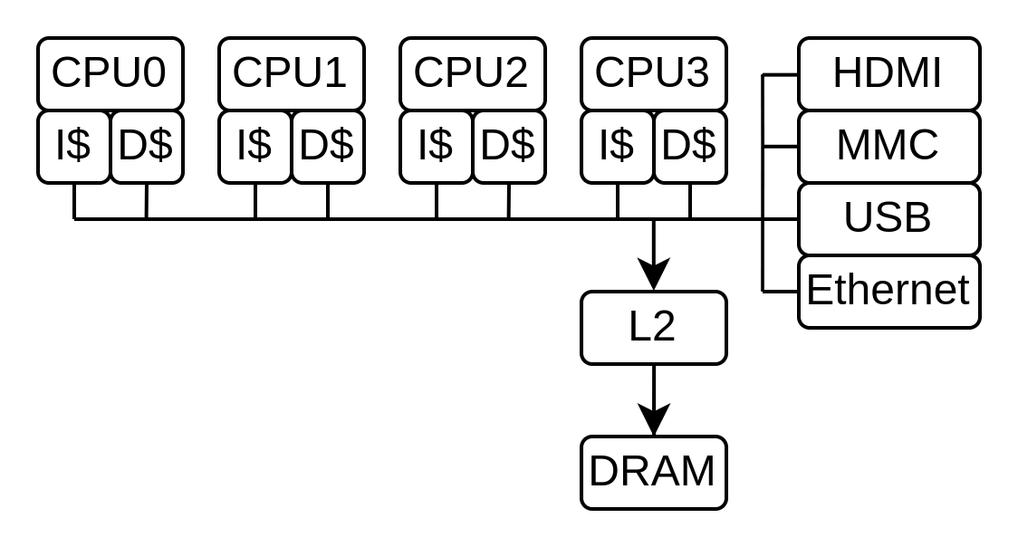
Memory system
Tilelink based / 128 bits width
Multiple DMA
L2 :
  512 KB / 4 ways / Write-back
  Non-blocking / Out of order
Memory coherent (excepted L1)

Slide 9
Contributions
Already a few
  RVB (Andreas Wallner)
  Compact divider (Thomas Kramer)
Looking for help
  Features additions
  Alternative implementations
  Performance improvements
  Testing
  targeted implementations (ASIC)
  …
https://github.com/SpinalHDL/VexiiRiscv
Thanks NLnet

Slide 10
Why VexiiRiscv
VexRiscv limits
  Missing features : Multi-issue / RV64 / Writeback cache
  Could have been better : Branch prediction / framework
  The legacy : Technical debt / Ossification
Open-source gap between single-issue in-order / out-of-order
Expending the CPU design space you get from one design

Slide 11
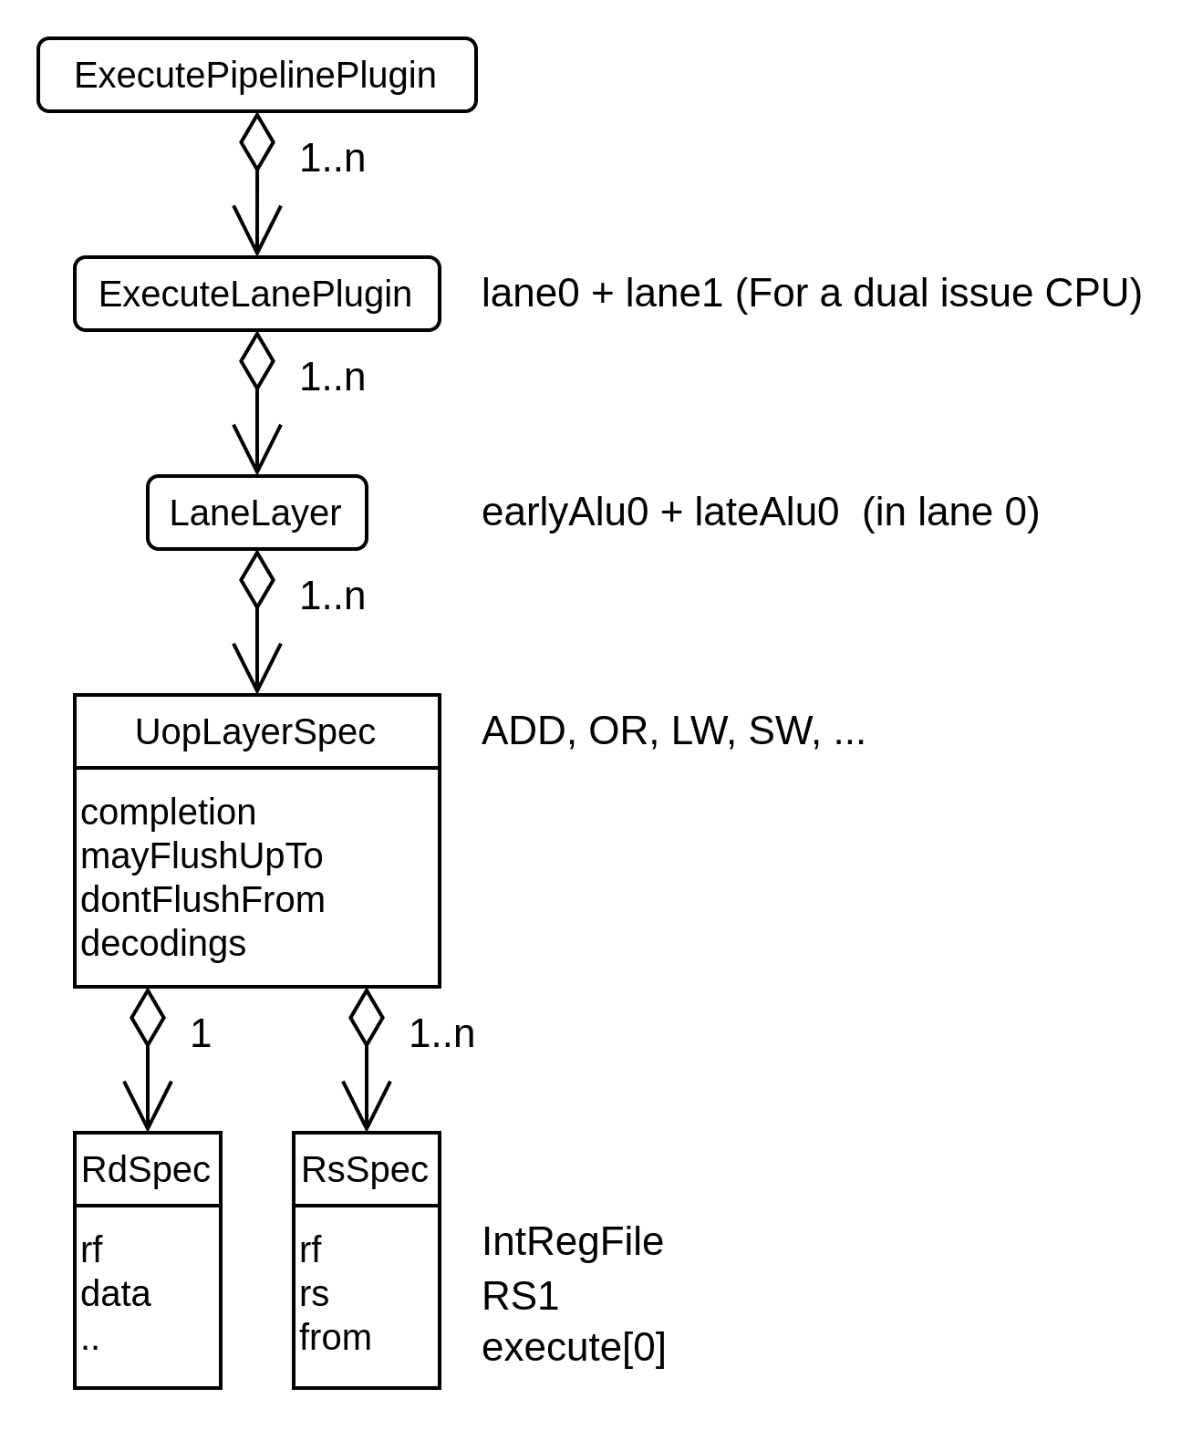
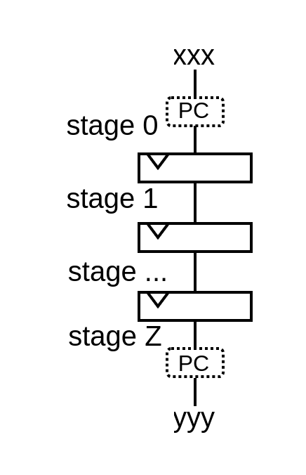
Hardware description
stage(0)(PC) := xxx
yyy := stage(Z)(PC)
plugins += new execute.fpu.FpuSqrtPlugin(early0)

