Slide 1
Moving toward VexiiRiscv
Charles Papon

Slide 2
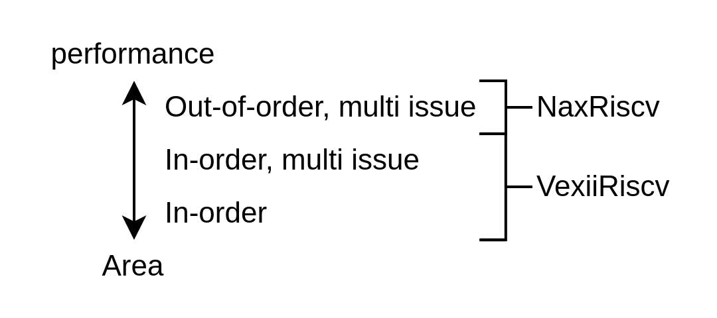
Why VexiiRiscv
VexRiscv limits
  Missing features : Multi-issue / RV64 / Writeback cache
  Could have been better : Branch prediction / framework
  The legacy : Technical debt / Ossification
Open-source gap between single-issue in-order / out-of-order
Expending the CPU design space you get from one design

Slide 3
VexiiRiscv design

Slide 4
VexiiRiscv feature set
Mainly :
  RV32/RV64, optional MAFDCBSU
  Can run linux / buildroot / Debian
  Optional multi-issue
  Optional late-ALU
  Up to 5.24 coremark/Mhz 2.50 dhystone/Mhz
Aswell :
  Optional I$ D$
  Optional BTB / RAS / Gshare branch prediction
  RISC-V official jtag debug

Slide 5
SoC / Interconnect
Coherent interconnect via Tilelink, optional L2
SoC and peripherals via Litex
  python3 -m litex_boards.targets.digilent_nexys_video --cpu-type=vexiiriscv --cpu-variant=debian --with-jtag-tap --bus-standard axi-lite --vexii-args="--performance-counters 9 --regfile-async --lsu-l1-store-buffer-ops=32 --lsu-l1-refill-count 2 --lsu-l1-writeback-count 2 --lsu-l1-store-buffer-slots=2" --cpu-count=4 --with-jtag-tap --with-video-framebuffer --with-sdcard --with-ethernet --with-coherent-dma --l2-byte=262144 --sys-clk-freq 100000000 --build --load
USB host via OHCI
  https://spinalhdl.github.io/SpinalDoc-RTD/master/SpinalHDL/Libraries/Com/usb_ohci.html
  3.3V GPIO (x2) @ 48Mhz + X*12Mhz

Slide 6
VexiiRiscv Hardware description

Slide 7
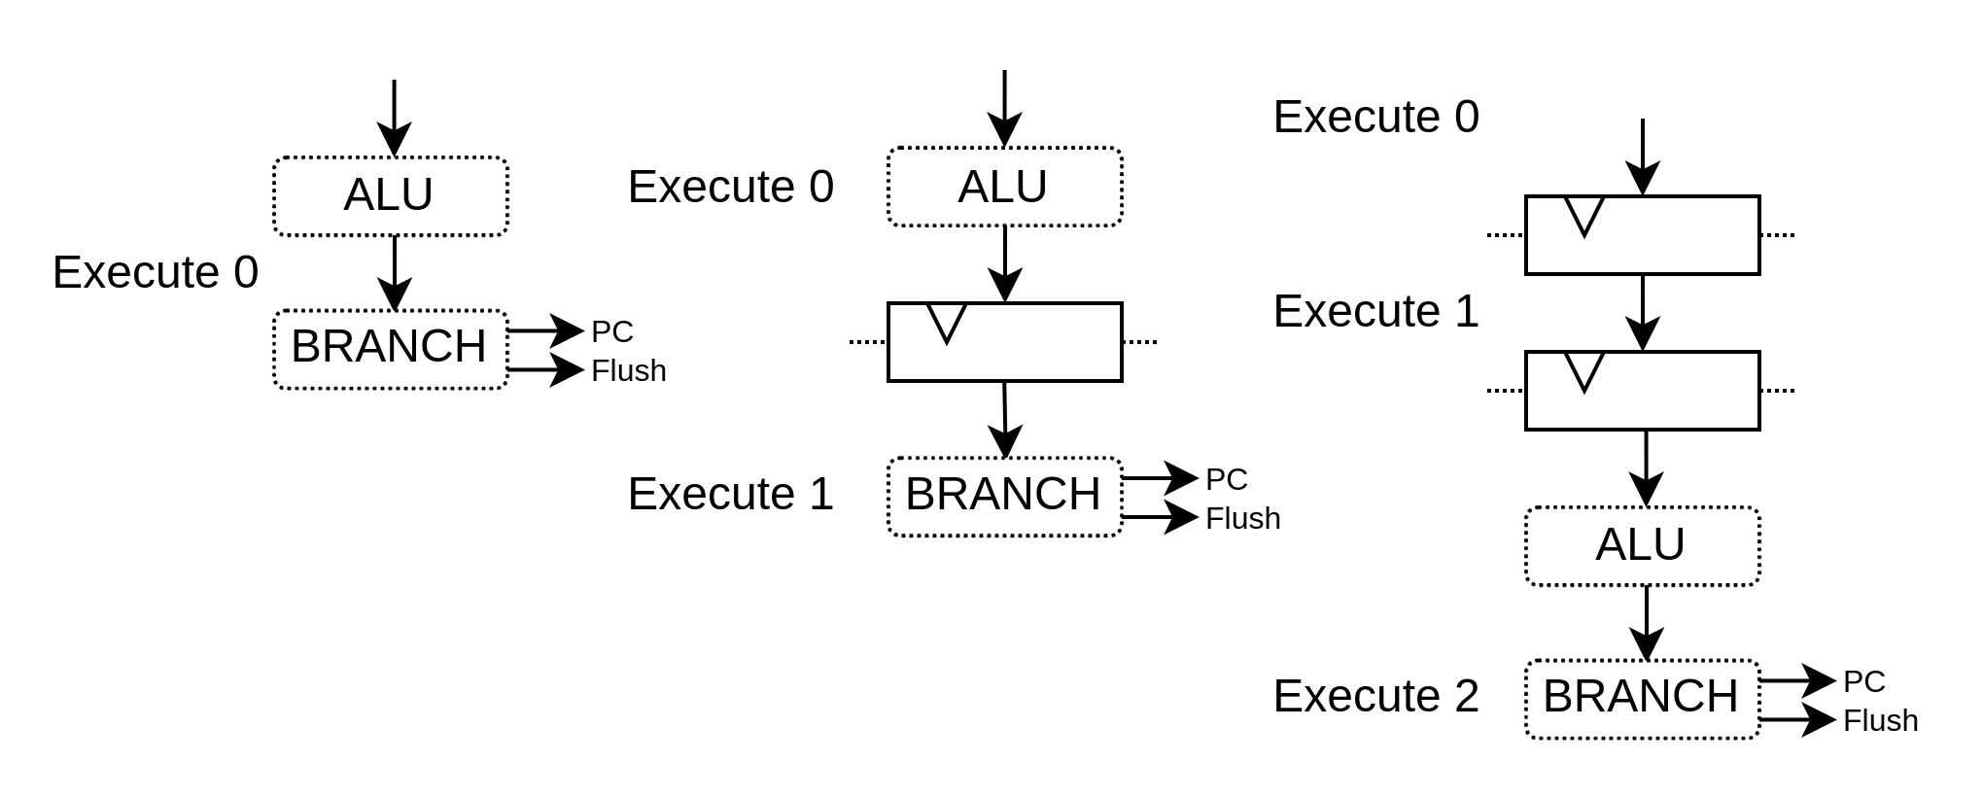
VexiiRiscv : Pipeline API

Slide 8
VexiiRiscv : Pipeline API
val alu = new pipeline.Execute(0) {
val TAKEN = insert(RS1 === RS2);
}

Slide 9
VexiiRiscv : Pipeline API
val alu = new pipeline.Execute(0) {
val TAKEN = insert(RS1 === RS2);
}
val branch = new pipeline.Execute(1) {
flushPort.valid := alu.TAKEN
pcPort.valid := alu.TAKEN
pcPort.pc := ..
}

Slide 10
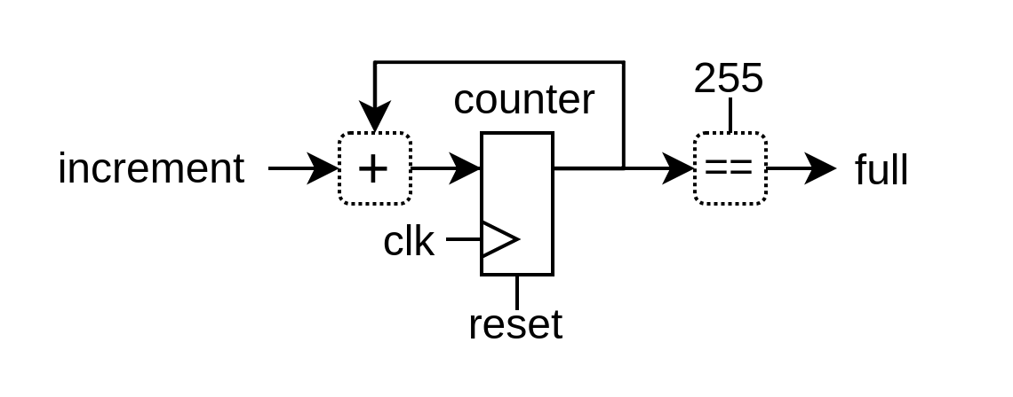
Let’s use an hardware description library
import spinal.core._
object Main extends App{
SpinalVerilog(new Timer)
}
class Timer extends Component {
val increment = in(Bool())
val counter = Reg(UInt(8 bits)) init(0)
val full = out(counter === 255)
when(increment){
counter := counter + 1
}
}
module Timer (
input wire increment,
output wire full,
input wire clk,
input wire reset
);
reg [7:0] counter;
assign full = (counter == 8'hff);
always @(posedge clk or posedge reset) begin
if(reset) begin
counter <= 8'h00;
end else begin
if(increment) begin
counter <= (counter + 8'h01);
end
end
end
endmodule

Slide 11
VexiiRiscv : Pipeline API

Slide 12
VexiiRiscv : Pipeline API
val aluAt = 0
val branchAt = 1
...
val alu = new pipeline.Execute(aluAt) {
val TAKEN = insert(RS1 === RS2);
}
val branch = new pipeline.Execute(branchAt) {
flushPort.valid := alu.TAKEN
pcPort.valid := alu.TAKEN
pcPort.pc := ..
}

Slide 13
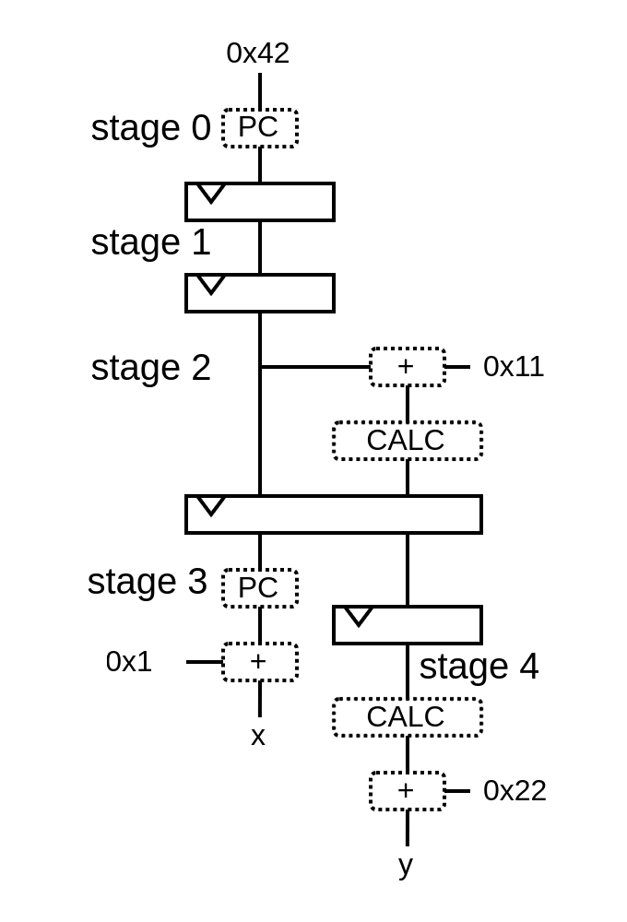
Pipeline API

Slide 14
Pipeline API
val pip = new Pipeline()

Slide 15
Pipeline API
val pip = new Pipeline()
val PC = NamedType(UInt(32 bits))
pip(PC, 0) := 0x42

Slide 16
Pipeline API
val pip = new Pipeline()
val PC = NamedType(UInt(32 bits))
pip(PC, 0) := 0x42
val CALC = NamedType(UInt(32 bits))
pip(CALC, 2) := pip(PC, 2) + 0x11

Slide 17
Pipeline API
val pip = new Pipeline()
val PC = NamedType(UInt(32 bits))
pip(PC, 0) := 0x42
val CALC = NamedType(UInt(32 bits))
pip(CALC, 2) := pip(PC, 2) + 0x11
val x = pip(PC, 3) + 1
val y = pip(CALC, 4) + 0x22

Slide 18
Pipeline API
val pip = new Pipeline()
val PC = NamedType(UInt(32 bits))
pip(PC, 0) := 0x42
val CALC = NamedType(UInt(32 bits))
pip(CALC, 2) := pip(PC, 2) + 0x11
val x = pip(PC, 3) + 1
val y = pip(CALC, 4) + 0x22
pip.build()

Slide 19
Pipeline API
wire [31:0] PC_0;
wire [31:0] PC_3;
wire [31:0] x;
wire [31:0] CALC_2;
wire [31:0] PC_2;
wire [31:0] CALC_4;
wire [31:0] y;
wire [31:0] PC_1;
reg [31:0] PC_0_regNext;
reg [31:0] PC_1_regNext;
reg [31:0] PC_2_regNext;
wire [31:0] CALC_3;
reg [31:0] CALC_2_regNext;
reg [31:0] CALC_3_regNext;
assign PC_0 = 32'h00000042;
assign x = (PC_3 + 32'h00000001);
assign CALC_2 = (PC_2 + 32'h00000011);
assign y = (CALC_4 + 32'h00000022);
assign PC_1 = PC_0_regNext;
assign PC_2 = PC_1_regNext;
assign PC_3 = PC_2_regNext;
assign CALC_3 = CALC_2_regNext;
assign CALC_4 = CALC_3_regNext;
always @(posedge clk) begin
PC_0_regNext <= PC_0;
PC_1_regNext <= PC_1;
PC_2_regNext <= PC_2;
CALC_2_regNext <= CALC_2;
CALC_3_regNext <= CALC_3;
end
val pip = new Pipeline()
val PC = NamedType(UInt(32 bits))
pip(PC, 0) := 0x42
val CALC = NamedType(UInt(32 bits))
pip(CALC, 2) := pip(PC, 2) + 0x11
val x = pip(PC, 3) + 1
val y = pip(CALC, 4) + 0x22
pip.build()

Slide 20
Pipeline API
class Pipeline{
//Define the pipeline data model
val specs = LinkedHashMap[NamedType[Data], LinkedHashMap[Int, Data]]()
//Define how we can access the pipeline
def apply[T <: Data](what: NamedType[T], stageId: Int) = {
val spec = specs.getOrElseUpdate(
what.asInstanceOf[NamedType[Data]],
new LinkedHashMap[Int, Data]
)
spec.getOrElseUpdate(
stageId,
what().setName(what.getName + "_" + stageId)
).asInstanceOf[T]
}
//Translate specs into hardware
def build(): Unit = {
for ((what, nodes) <- specs) {
for (i <- nodes.keys.min until nodes.keys.max) {
apply(what, i + 1) := RegNext(apply(what, i))
}
}
}
}

Slide 21
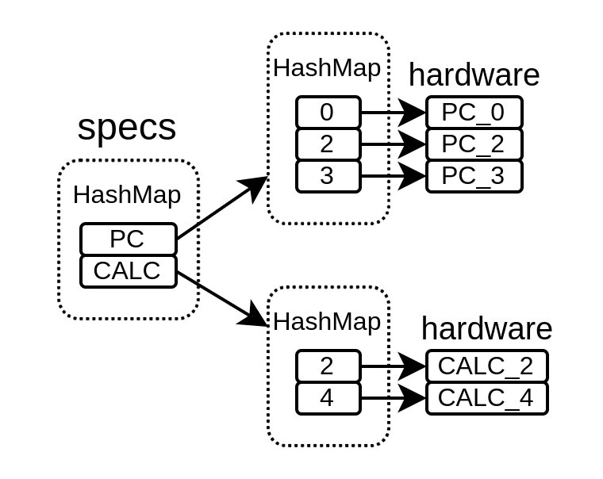
Pipeline API
class Pipeline{
//Define the pipeline data model
val specs = LinkedHashMap[NamedType[Data], LinkedHashMap[Int, Data]]()
//Define how we can access the pipeline
def apply[T <: Data](what: NamedType[T], stageId: Int) = {
val spec = specs.getOrElseUpdate(
what.asInstanceOf[NamedType[Data]],
new LinkedHashMap[Int, Data]
)
spec.getOrElseUpdate(
stageId,
what().setName(what.getName + "_" + stageId)
).asInstanceOf[T]
}
//Translate specs into hardware
def build(): Unit = {
for ((what, nodes) <- specs) {
for (i <- nodes.keys.min until nodes.keys.max) {
apply(what, i + 1) := RegNext(apply(what, i))
}
}
}
}

Slide 22
Pipeline API
class Pipeline{
//Define the pipeline data model
val specs = LinkedHashMap[NamedType[Data], LinkedHashMap[Int, Data]]()
//Define how we can access the pipeline
def apply[T <: Data](what: NamedType[T], stageId: Int) = {
val spec = specs.getOrElseUpdate(
what.asInstanceOf[NamedType[Data]],
new LinkedHashMap[Int, Data]
)
spec.getOrElseUpdate(
stageId,
what().setName(what.getName + "_" + stageId)
).asInstanceOf[T]
}
//Translate specs into hardware
def build(): Unit = {
for ((what, nodes) <- specs) {
for (i <- nodes.keys.min until nodes.keys.max) {
apply(what, i + 1) := RegNext(apply(what, i))
}
}
}
}

Slide 23
Pipeline API
class Pipeline{
//Define the pipeline data model
val specs = LinkedHashMap[NamedType[Data], LinkedHashMap[Int, Data]]()
//Define how we can access the pipeline
def apply[T <: Data](what: NamedType[T], stageId: Int) = {
val spec = specs.getOrElseUpdate(
what.asInstanceOf[NamedType[Data]],
new LinkedHashMap[Int, Data]
)
spec.getOrElseUpdate(
stageId,
what().setName(what.getName + "_" + stageId)
).asInstanceOf[T]
}
//Translate specs into hardware
def build(): Unit = {
for ((what, nodes) <- specs) {
for (i <- nodes.keys.min until nodes.keys.max) {
apply(what, i + 1) := RegNext(apply(what, i))
}
}
}
}

Slide 24
Pipeline API
wire [31:0] PC_0;
wire [31:0] PC_3;
wire [31:0] x;
wire [31:0] CALC_2;
wire [31:0] PC_2;
wire [31:0] CALC_4;
wire [31:0] y;
wire [31:0] PC_1;
reg [31:0] PC_0_regNext;
reg [31:0] PC_1_regNext;
reg [31:0] PC_2_regNext;
wire [31:0] CALC_3;
reg [31:0] CALC_2_regNext;
reg [31:0] CALC_3_regNext;
assign PC_0 = 32'h00000042;
assign x = (PC_3 + 32'h00000001);
assign CALC_2 = (PC_2 + 32'h00000011);
assign y = (CALC_4 + 32'h00000022);
assign PC_1 = PC_0_regNext;
assign PC_2 = PC_1_regNext;
assign PC_3 = PC_2_regNext;
assign CALC_3 = CALC_2_regNext;
assign CALC_4 = CALC_3_regNext;
always @(posedge clk) begin
PC_0_regNext <= PC_0;
PC_1_regNext <= PC_1;
PC_2_regNext <= PC_2;
CALC_2_regNext <= CALC_2;
CALC_3_regNext <= CALC_3;
end
val pip = new Pipeline()
val PC = NamedType(UInt(32 bits))
pip(PC, 0) := 0x42
val CALC = NamedType(UInt(32 bits))
pip(CALC, 2) := pip(PC, 2) + 0x11
val x = pip(PC, 3) + 1
val y = pip(CALC, 4) + 0x22
pip.build()
https://spinalhdl.github.io/SpinalDoc-RTD/master/SpinalHDL/Libraries/Pipeline/introduction.html

Slide 25
Composable toplevel
plugins += new WriteBackPlugin(lane0, FloatRegFile, writeAt = 9)
plugins += new FpuFlagsWritebackPlugin(lane0, pipTo = intWritebackAt)
plugins += new FpuCsrPlugin(List(lane0), intWritebackAt)
plugins += new FpuUnpackerPlugin(early0)
plugins += new FpuAddSharedPlugin(lane0)
plugins += new FpuAddPlugin(early0)
plugins += new FpuMulPlugin(early0, withFma = .., fmaFullAccuracy = ..)
plugins += new FpuSqrtPlugin(early0)
plugins += new FpuClassPlugin(early0)
plugins += new FpuCmpPlugin(early0)
plugins += new FpuF2iPlugin(early0)
plugins += new FpuMvPlugin(early0, floatWbAt = 2)
plugins += new FpuXxPlugin(early0)
plugins += new FpuDivPlugin(early0)
plugins += new FpuPackerPlugin(lane0)

Slide 26
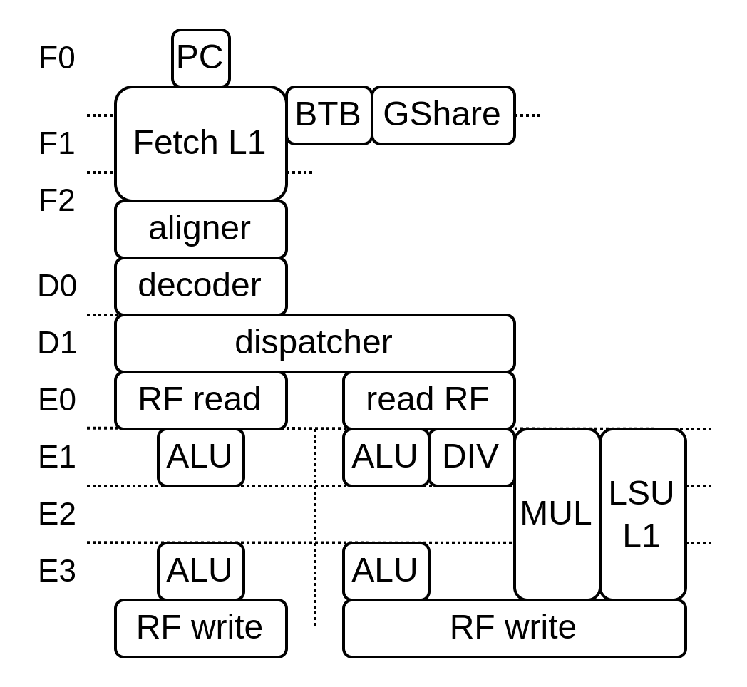
No more toplevel / design space
class VexiiRiscv(...) extends Component{
val database = ...
val host = ...
}
val plugins = ArrayBuffer[Hostable]()
plugins += new fetch.FetchPipelinePlugin()
plugins += new fetch.PcPlugin(resetVector)
plugins += new fetch.FetchL1Plugin(...)
plugins += new prediction.BtbPlugin(...)
plugins += new prediction.GSharePlugin (...)
plugins += new prediction.HistoryPlugin(...)
...
plugins += new execute.SimdAddPlugin(...)
val cpu = VexiiRiscv(plugins)

Slide 27
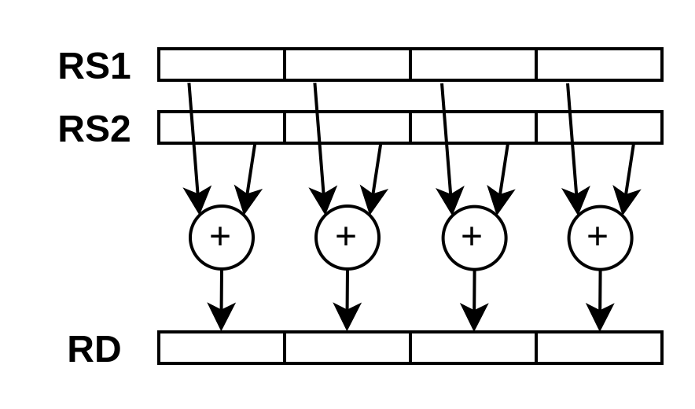
class SimdAddPlugin(val layer : LaneLayer) extends FiberPlugin{
... // Lock dependencies
awaitBuild()
... // Specify requirements
earlyLock.release()
... // Generate hardware
lateLock.release()
...
}

Slide 28
class SimdAddPlugin(val layer : LaneLayer) extends FiberPlugin{
...
awaitBuild()
val add4 = layer.add(
IntRegFile.TypeR(M"0000000----------000-----0001011")
)
add4.addRsSpec(RS1, executeAt = 0)
add4.addRsSpec(RS2, executeAt = 0)
add4.setCompletion(0)
// add4.mayFlushUpTo(0)
// add4.dontFlushFrom(0)
// add4.reserve(something, at=0)
val wb = wbp.createPort(at = 0)
wbp.addMicroOp(wb, add4)
val SEL = Payload(Bool())
layer.lane.setDecodingDefault(SEL, False)
add4.addDecoding(SEL -> True)
earlyLock.release()
...
lateLock.release()
...
}
Scheduler
Writeback
Decoder

Slide 29
class SimdAddPlugin(val layer : LaneLayer) extends FiberPlugin{
...
awaitBuild()
...
earlyLock.release()
val process = new layer.Execute(id = 0) {
//Get the RISC-V RS1/RS2 values from the register file
val rs1 = layer.lane(IntRegFile, RS1).asUInt
val rs2 = layer.lane(IntRegFile, RS2).asUInt
//Do some computation
val rd = UInt(32 bits)
rd( 7 downto 0) := rs1( 7 downto 0) + rs2( 7 downto 0)
rd(16 downto 8) := rs1(16 downto 8) + rs2(16 downto 8)
rd(23 downto 16) := rs1(23 downto 16) + rs2(23 downto 16)
rd(31 downto 24) := rs1(31 downto 24) + rs2(31 downto 24)
//Provide the computation value for the writeback
wb.valid := isValid && SEL
wb.payload := rd.asBits
}
lateLock.release()
...
}

Slide 30
SIMD add plugin

Slide 31
class SimdAddPlugin(val layer : LaneLayer) extends FiberPlugin{
...
val add4 = layer.add(
IntRegFile.TypeR(M"0000000----------000-----0001011")
)
add4.addRsSpec(RS1, executeAt = 0)
add4.addRsSpec(RS2, executeAt = 0)
add4.setCompletion(0)
//add4.mayFlushUpTo(0)
//add4.dontFlushFrom(0)
//add4.reserve(something, at=0)
val wbp = host.find[WriteBackPlugin](p =>
p.rf == IntRegFile && p.lane == layer.lane
)
val wb = wbp.createPort(at = 0)
wbp.addMicroOp(wb, add4)
val SEL = Payload(Bool())
layer.lane.setDecodingDefault(SEL, False)
add4.addDecoding(SEL -> True)
...
}
Scheduler
Writeback
Decoder

Slide 32
class SimdAddPlugin(val layer : LaneLayer) extends FiberPlugin{
...
val process = new layer.Execute(id = 0) {
//Get the RISC-V RS1/RS2 values from the register file
val rs1 = layer.lane(IntRegFile, RS1).asUInt
val rs2 = layer.lane(IntRegFile, RS2).asUInt
//Do some computation
val rd = UInt(32 bits)
rd( 7 downto 0) := rs1( 7 downto 0) + rs2( 7 downto 0)
rd(16 downto 8) := rs1(16 downto 8) + rs2(16 downto 8)
rd(23 downto 16) := rs1(23 downto 16) + rs2(23 downto 16)
rd(31 downto 24) := rs1(31 downto 24) + rs2(31 downto 24)
//Provide the computation value for the writeback
wb.valid := isValid && SEL
wb.payload := rd.asBits
}
...
}

Slide 33
Looking for contributions
Already a few
  RVB (Andreas Wallner)
  Compact divider (Thomas Kramer)
Looking for help
  Features additions
  Alternative implementations
  Performance improvements
  Testing
  ASIC port
  …
https://github.com/SpinalHDL/VexiiRiscv

Slide 34
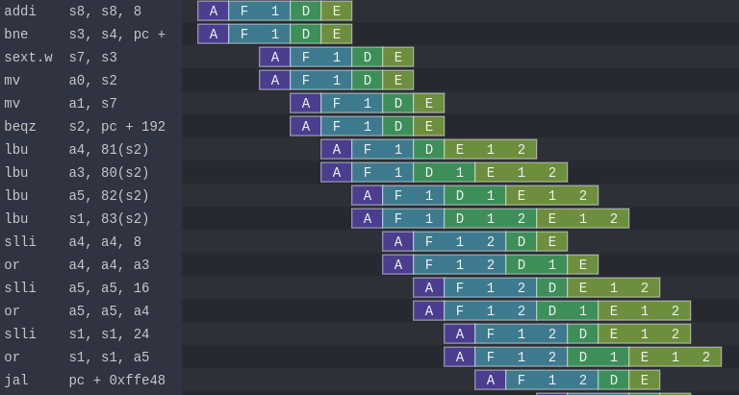
Tooling
SpinalHDL / Scala : Hardware generation
Litex : SoC generation and deployment
Spike / RVLS : RISC-V golden model and lock-step checker
Verilator : Fast simulation
Konata : CPU pipeline visualisation

Slide 35
class SimdAddSimdPlugin(val layer : LaneLayer) extends FiberPlugin {
...
val wbp = host.find[WriteBackPlugin](p =>
p.rf == IntRegFile && p.lane == layer.el
)
val earlyLock = retains(layer.el.uopLock, wbp.elaborationLock)
val lateLock = retains(layer.el.pipelineLock)
awaitBuild()
...
earlyLock.release()
...
lateLock.release()
...
}

