Slide 1
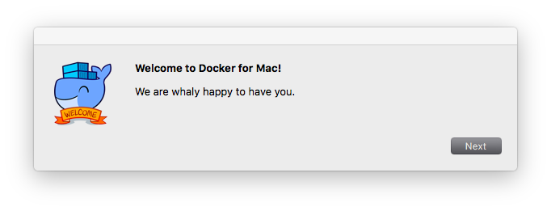
Docker

Slide 2
What is Docker and why would I use it?
Docker is a container platform that automates setting up development environments
Containers
isolate software from its surroundings, for example differences between development and staging environments
help reduce conflicts between teams running different software on the same infrastructure

Slide 3
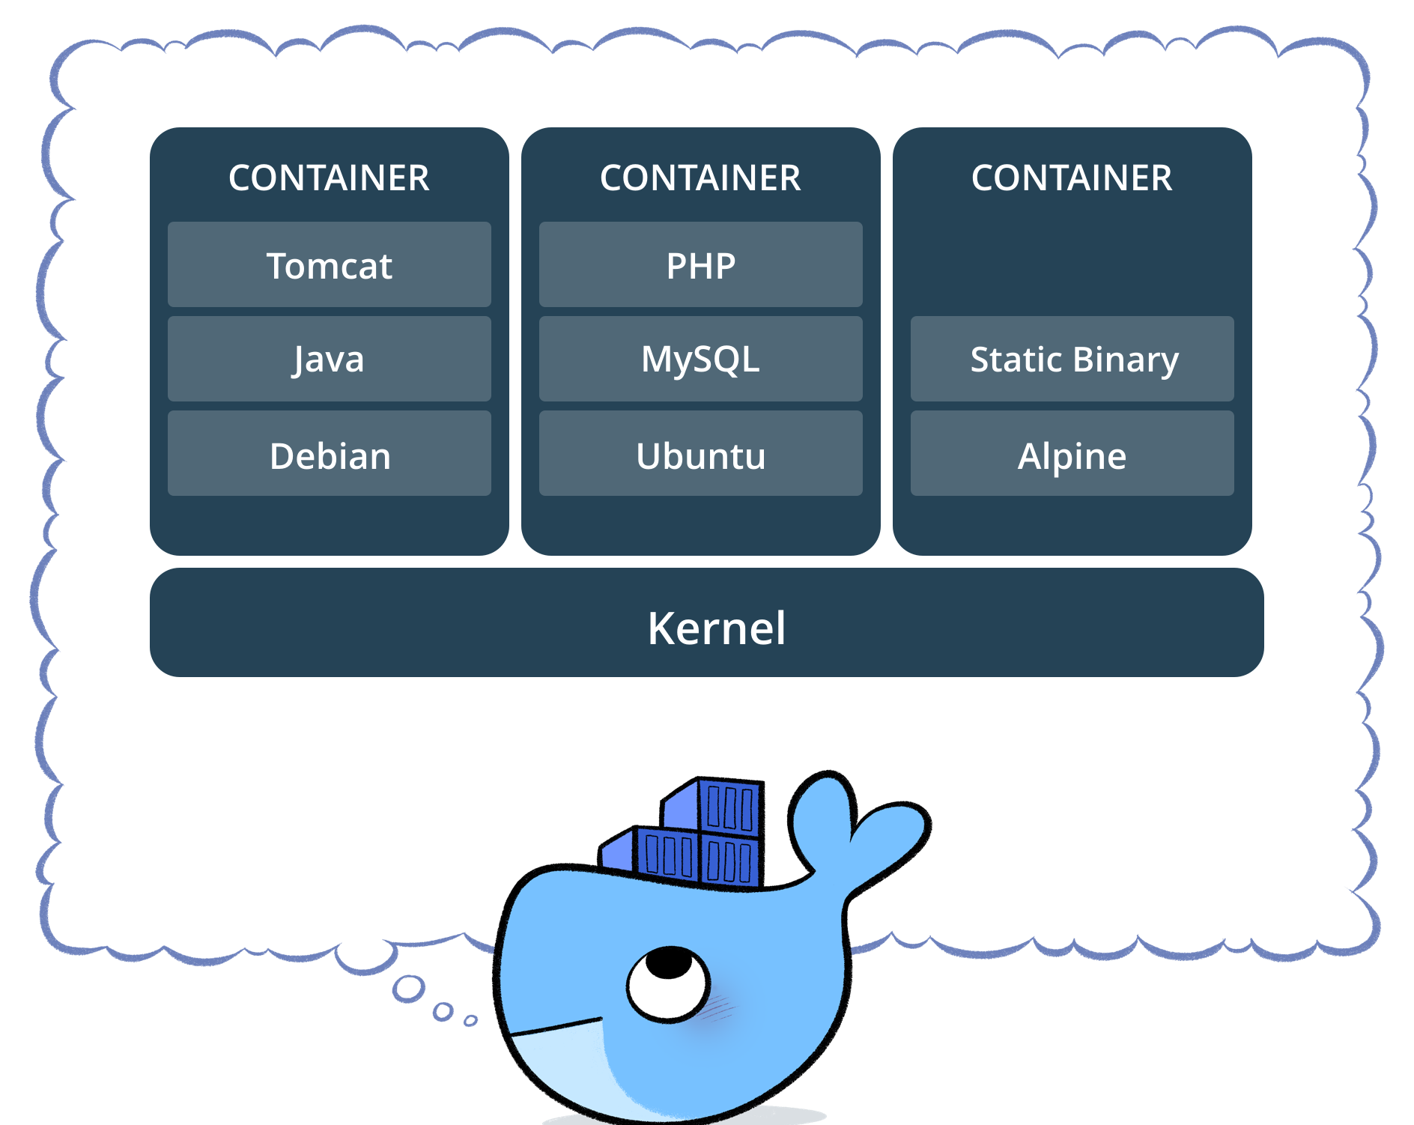

Slide 4
Creating an image
We’ll create a Python Flask app that displays random images
We need 4 files:
app.py
requirements.txt
templates/index.html
Dockerfile

Slide 5
Creating an image, part 2
Build the image: docker build -t conleek/myfirstapp
Run the image: docker run -p 8888:5000 --name myfirstapp conleek/myfirstapp
App will be live here: http://localhost:8888

