Slide 1
Design and Implement a Weather Station
Presented by
Christopher Tsoi

Slide 2
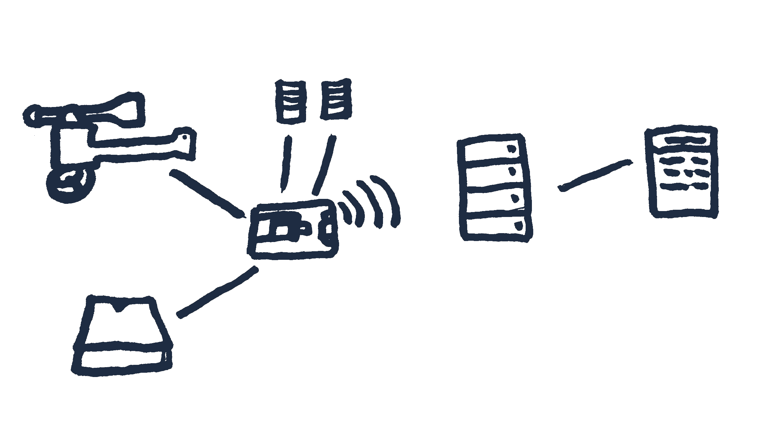
Project Overview
Involves a number of a parts:
Retrieval of weather data
Dealt with via use of a micro-controller
Server established
Information sent to database from ESP8266
Website displays the data
Provide a direct feed
Requires use of multiple technologies in order to produce a successful product
System overview:
Anemometer
DHT22s
Database
Website
ESP8266
Rain Gauge

Slide 3
Accomplishments
Completed prototype of the entire system:
Micro-controller has been set-up, some additions through development
Each meteorological instrument has been installed and debugged
Server established • XAMPP
Database set-up • MariaDB
Wi-Fi connection from ESP8266 allows connection to database and SQL insertion
Data displayed on simple web-page along with chart
RSS Feed created
Few extra additions to project

Slide 4
Future Work
Define methodology [FDD Development]
Further investigation such as in providing a direct feed for others
Full scale development
  Website Design
  Testing
  Maintenance
Set-up at intended location
Final Report
Future scenarios regarding extensions to this project such as combining this work with multiple weather stations for greater effect

