Slide 1



Team Tunnel
Programming Competition
CEC 2024

Slide 2

AGENDA
Our Team Members
Objectives
Challenges
Our Initial Plan
Problems Encountered
Solution
Interface
Results
Design Timeline
Conclusion

Slide 3








OUR TEAM MEMBERS
CAMILLE GRANADE
CHLOE LAW
JACK SPIRATOS
BEN MARCOTTE
4th Year Computer Engineering
4th Year Software Engineering
3rd Year Software Engineering
5th Year Software Engineering

Slide 4
OBJECTIVES
Create a solution for offshore drilling around F.I.N, considering biodiversity and preservation priorities.
Use suitable datasets.
Develop an efficient algorithm.
Make a user-friendly interface.
Present and demonstrate the solution.

Slide 5
OBJECTIVES
Datasets
Different behaviors and values, some static, some moving
Some for collecting, some for preserving, some for informational purposes
Informative datasets were not useful, but they were “neat”
Selecting at least one set for collecting and one set for preserving. Bonuses awarded for using more sets

Slide 6
CHALLENGES
Balance resource extraction and marine protection.
Mitigate ecological and climatic impacts of mining.
Manage the growing difficulty and cost of oceanic mining.
Adhere to F.I.N's preservation priorities.

Slide 7
OUR INITIAL PLAN
Using Unity for visualization and user interface
Using some pathfinding algorithm (likely A*) to find the most efficient path for yield
Ask questions for clarifications on Discord

Slide 8
PROBLEMS ENCOUNTERED
Unity compatibility with a forked repo → issues, switched to pyGame
Long computation time when using algorithms → Focus on smaller areas
Many assumptions to be made
Strange and unclear data set
Focusing on and around the Helium zone → they are worth the most & they do not move (by evaluating the given dataset)
Assume the minimum value of the dataset is zero → no resources at that location
Assume that the values are 1:1 between resources → e.g., 1pts oil = 1pts metal
Compiling the total values of a tile into one singular .csv file
Find the area which yields the highest value to retrieve resources

Slide 9
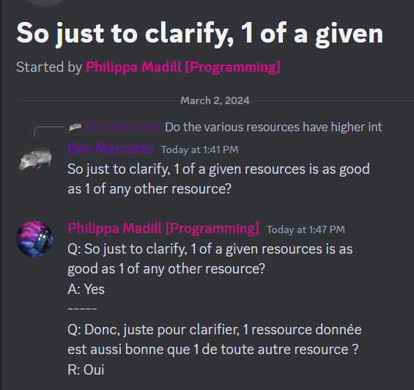
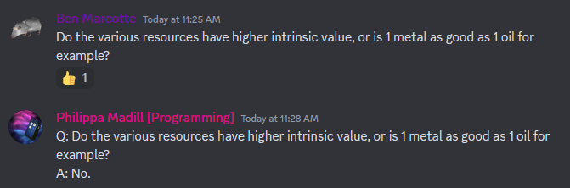
PROBLEMS ENCOUNTERED
Data sets have different max and min, with widely different ranges
Helium has a range of 2700, oil has a range of around 8
2700 helium is far better than 8 oil

Slide 10
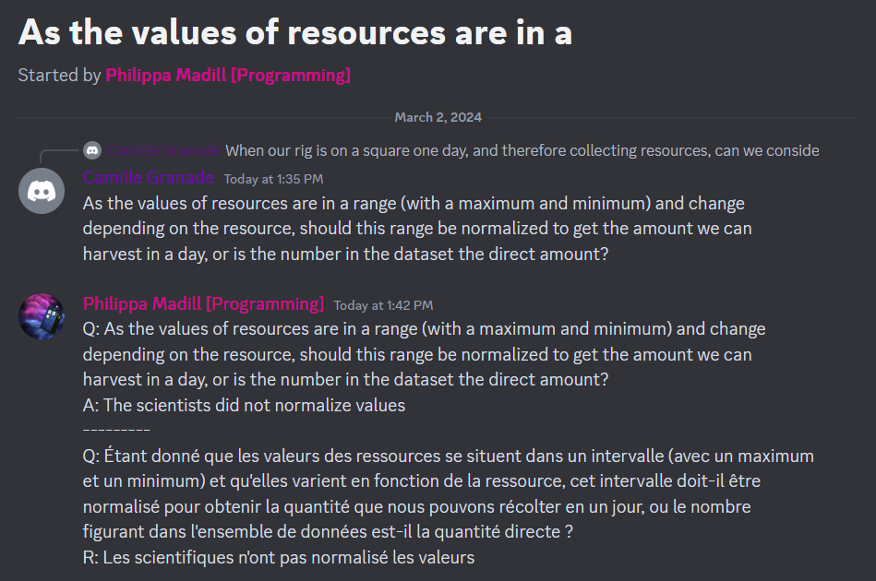
PROBLEMS ENCOUNTERED
Conclusion: Helium is by far the best resource, by a factor of nearly 3000

Slide 11
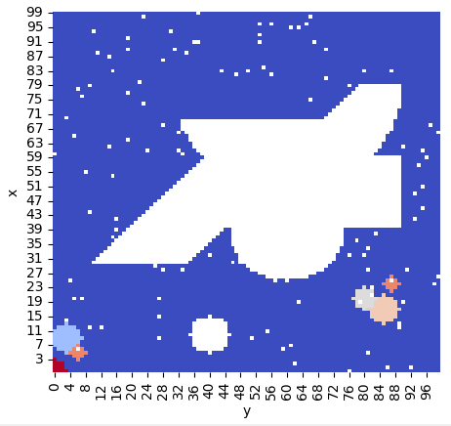
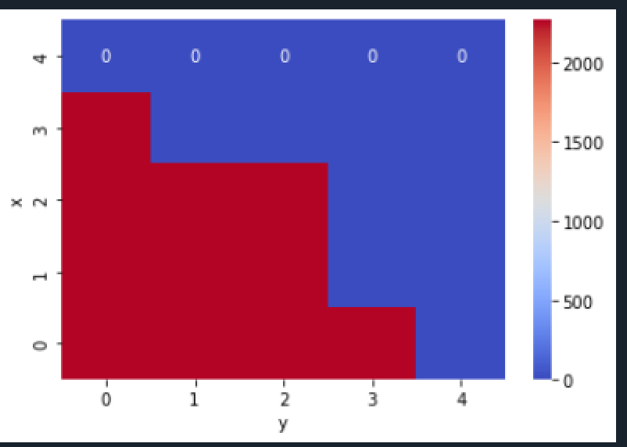

Solution
First Rig
Focusing on the high helium zone
Selecting the square with the least amount of ecological impact for both coral and species
All tiles always within range, no pathfinding necessary
The best corner

Slide 12
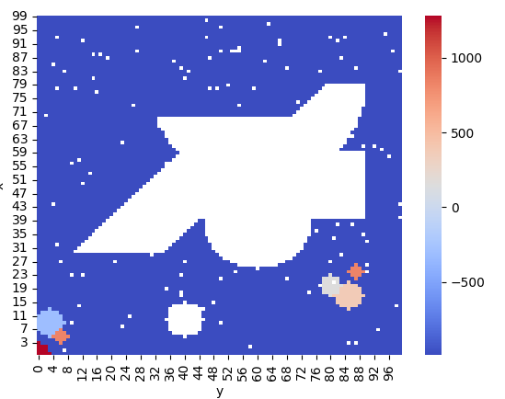
Solution
Second Rig
Find the “second” best area
Proceed with the same strategy as the first rig

Slide 13
Solution
Other Notes:
Oil, metal and shipwrecks were not considered
Metal does not coincide with helium
Oil not worth anything significant compared to helium, similarly for shipwrecks
Missing data was simply ignored

Slide 14
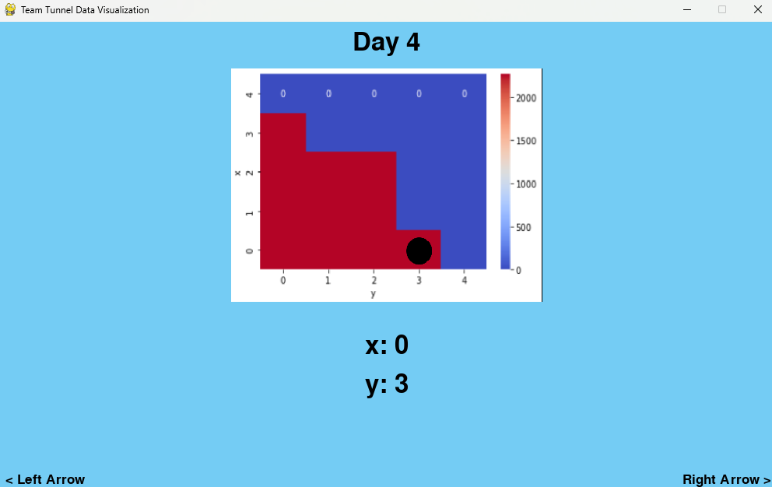
Interface
Using pygame library, developed application
Reads images from output of algorithm
Divides by day, allowing user to scroll with arrow keys

Slide 15
Results
First Rig over 30 days:
68100 Helium collected
2.14 total ecological damage
Second Rig over 30 days:
54480 Helium collected
3.95 total ecological damage
We elect to not use a second rig, as it brings in less helium for more damage.
GRAND TOTAL:
68100 Helium collected
2.14 total ecological damage

Slide 16
DESIGN TIMELINE
Celebrate the excellent individual and collective achievements of your team here.
Bouncing through solutions, organizing datasets, started presentation slides
Finalizing and submitting the solution
11:00-13:00
16:00-17:30
9:30-11:00
13:00-16:00
Testing, brainstorming, selecting priorities
Idea of using a unique solution for each rig

Slide 17
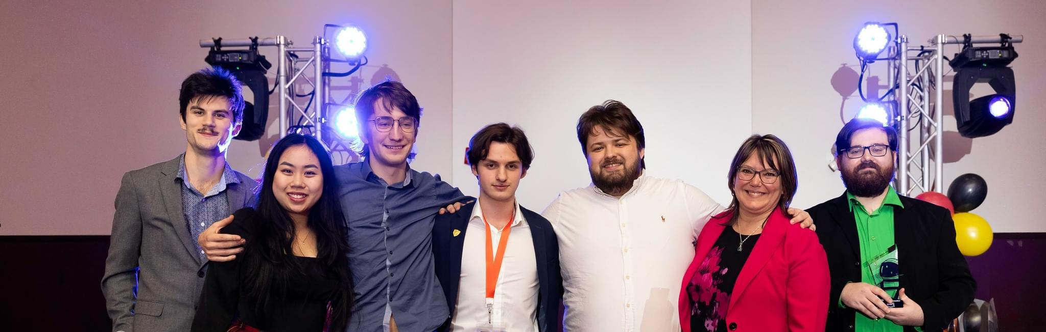
THANK YOU!

