Slide 1
MACHINE LEARNING LAB · FINAL PROJECT PRESENTATION
A Multimodal Deep Learning Framework for Explainable, Multi-Horizon Load-Shedding Risk Early Warning in Bangladesh
Calibrated Low / Medium / High risk alerts for the next 1 and 3 days, for the national grid and 9 zones
Low
Medium
High
Uncertain
Swagoto Utsab Singha Roy
Lamiya Zaman
Jannatul Ferdoushi Islam
ID: 23101124
ID: 23101132
ID: 23101119
Department of Computer Science and Engineering · University of Asia Pacific · Dhaka, Bangladesh
Load-shedding risk early warning · ML Lab · Dept. of CSE, University of Asia Pacific
1
Notes:
[Swagoto] Assalamu alaikum / good morning. We are Swagoto, Lamiya and Jannatul. Our project is an early-warning system for load shedding in Bangladesh: instead of forecasting how much electricity is needed, it warns whether the next day and the third day ahead will be Low, Medium or High risk, for the national grid and nine BPDB zones, with a confidence and an 'Uncertain' option. I will introduce the problem, Lamiya will explain the data and the model, Jannatul will present the results, and at the end we will show the live demo.

Slide 2
Contents
1
Introduction & problem statement
5
Methodology: multimodal GRU + trust layer
Swagoto
Lamiya
2
Objectives & contributions
6
Results & lab experiments
Swagoto
Jannatul
3
Literature review & research gap
7
Live demo: Streamlit + Kaggle
Swagoto
Swagoto
4
Dataset & preprocessing
8
Conclusion, future work & references
Lamiya
Jannatul
Load-shedding risk early warning · ML Lab · Dept. of CSE, University of Asia Pacific
2
Notes:
[Swagoto] This is the plan of the talk. The colour of each number shows who presents that part.

Slide 3
INTRODUCTION
Load shedding is rising, yet planners only see the past
21,075
25%
43%+
2.4% → 27%
mmcf domestic gas output in FY2024, down from 24,993 in FY2020
of the gas supply was imported LNG in FY2025, up from 7.3% in FY2020
of electricity still comes from gas-fired plants that are hit by fuel shortages
High-risk unit-days in our data: 87 of 3,630 in 2025 vs 812 of 2,980 in 2026
Why existing work is not enough
Who is affected
Bangladeshi studies forecast demand (a number in MW) — a regression task
BPDB publishes a daily report, but it describes yesterday
Planners need: how risky are the next days, why, and how sure is the model?
Homes, factories, hospitals, schools
Fuel scheduling and maintenance planning
Climate: heat-driven demand peaks (SDG 7, SDG 13)
Source: Khatun et al., The Financial Express (2025); our dataset (BPDB reports).
Load-shedding risk early warning · ML Lab · Dept. of CSE, University of Asia Pacific
3
Notes:
[Swagoto] Bangladesh often needs more electricity than it can supply. Gas output fell from about 25 thousand to 21 thousand mmcf in four years, imported LNG rose from 7 to 25 percent of the gas supply, and gas plants still make more than 43 percent of our electricity. In our own data, High-risk days were 2.4 percent of 2025 but 27 percent of 2026. Existing studies forecast demand in megawatts. A planner needs something else: a warning of how risky the next days are, the reason, and how confident the model is.

Slide 4
PROBLEM STATEMENT
Our task: predict the risk of load shedding, not the demand
Input
10 units
Output
the last 14 days of
grid, weather and
context data
national grid +
9 BPDB zones
risk class at
T+1 and T+3
Low
Med
High
How a day is labelled (for each unit u and day t)
shedding ratio r = load shed (MW) / demand (MW)
Low
no load shedding on that day
Medium
0 < r ≤ θ (θ = 7.6% for zones, 1.9% for the national grid)
High
r > θ θ = median of the non-zero ratios in the training years only
Load-shedding risk early warning · ML Lab · Dept. of CSE, University of Asia Pacific
4
Notes:
[Swagoto] Formally: for each of ten units and each day, the model reads the previous 14 days and predicts a risk class for tomorrow (T+1) and for the third day ahead (T+3). Low means no shedding, Medium means shedding up to a threshold and High above it. The threshold is the median of the non-zero shedding ratios in the training years only — 7.6 percent of demand for zones, 1.9 percent for the national grid — so the test period never influences the labels.

Slide 5
OBJECTIVE
Objectives and contributions
1
Risk warning, not demand forecasting
2
Multimodal fusion with modality attention
One multi-task network: Low / Medium / High at T+1 and T+3 for 10 units
Grid, weather and context encoders; ablations show which source matters
3
Trustworthy, explainable output
4
Extended, reusable dataset
Temperature-scaled probabilities, an 'Uncertain' option, SHAP + main driver
Public 2019–2024 data extended to 28 Oct 2026 with our own BPDB PDF parser
5
Honest evaluation + lab experiments
6
Working system
Strict 2025–26 test, PR-AUC, fusion & task ablations, walk-forward validation
Streamlit dashboard (live alert, time machine, what-if) + Kaggle notebook
Load-shedding risk early warning · ML Lab · Dept. of CSE, University of Asia Pacific
5
Notes:
[Swagoto] Our objectives: first, change the question from demand to risk. Second, fuse three kinds of data with a learned attention layer and test which one really matters. Third, make the output trustworthy: calibrated probabilities and the right to say 'Uncertain'. Fourth, build a dataset up to October 2026 with our own parser. Fifth, evaluate honestly, and for this lab we added PR-AUC, two ablations and walk-forward validation that we had promised in the proposal. Finally, a working dashboard and a Kaggle notebook.

Slide 6
LITERATURE REVIEW
Literature review: prior work forecasts demand, not risk
Work | Task | Method / data | Limitation for our goal
Roy et al. (2021) | demand forecast | LSTM, hourly smart-grid data, 1.22% MAPE | regression, no risk class
Akhter et al. (2024) | Dhaka demand | CNN + stacked BiLSTM, 1.64% MAPE | one city, no warning
Islam et al. (2025) | national demand | LSTM, Prophet, RF + weather/holidays | demand only, no zones
Hossain et al. (2025) | dataset | daily BPDB data 2019–2024 (we extend it) | ends Dec 2024
Lim et al. TFT (2021) | multi-horizon | attention, interpretable | not for risk classes
Guo / Hendrickx | trust | temperature scaling, reject option | not applied to the grid
This project | risk early warning | multimodal GRU + attention, calibrated, abstains | —
Research gap: no study predicts a zone-level risk class at several horizons, fuses grid + weather + context, reports calibration and abstains, and tests on unseen divisions and a later period.
Load-shedding risk early warning · ML Lab · Dept. of CSE, University of Asia Pacific
6
Notes:
[Swagoto] Previous work in Bangladesh forecasts demand: Roy et al. with LSTM, Akhter et al. for Dhaka with CNN-BiLSTM, Islam et al. nationally with LSTM and Prophet. Hossain et al. published the dataset we extend. From general ML we borrow attention for interpretable multi-horizon forecasting (TFT), temperature scaling for calibration and the reject option. The gap: nobody predicts zone-level risk classes at two horizons with fusion, calibration and abstention, tested on unseen divisions. Now Lamiya will explain the data and the model.

Slide 7
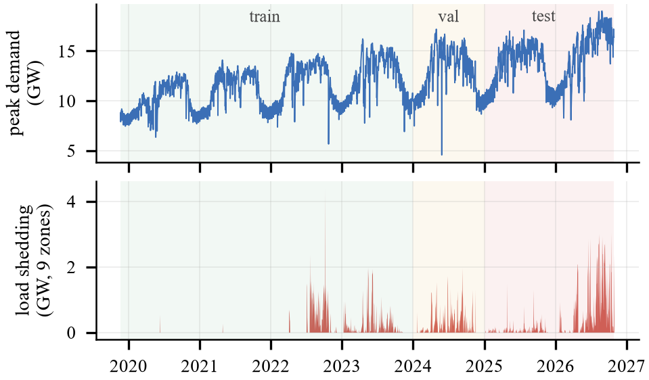
DATASET
Dataset: public data extended to October 2026
2,515
daily records (21 Nov 2019 – 28 Oct 2026)
10
units: national grid + 9 BPDB zones
24,920
leakage-safe 14-day samples
Mendeley V4 (2019–2024): demand, supply, shedding, fuel limits
BPDB / NLDC PDF reports (2024–2026): own scraper + parser
NASA POWER weather for 9 zones · calendar (holidays, Ramadan, Eid)
Top: national peak demand. Bottom: total load shedding of the 9 zones. Shaded: train / validation / test.
Load-shedding risk early warning · ML Lab · Dept. of CSE, University of Asia Pacific
7
Notes:
[Lamiya] Our base is the public Mendeley dataset, version 4, which ends in December 2024. We chose V4 because V3 has zero-demand days and V5 smooths the peaks. To reach 2026 we wrote a scraper for about 690 pages of BPDB's archive and a parser for its two report layouts. Weather comes from NASA POWER for each zone, and the calendar from holidays and Ramadan/Eid dates. In total 2,515 days, ten units, and 24,920 training samples. Look at the bottom plot: almost no shedding before 2022, then a lot — this change over time is the hardest part of the problem.

Slide 8
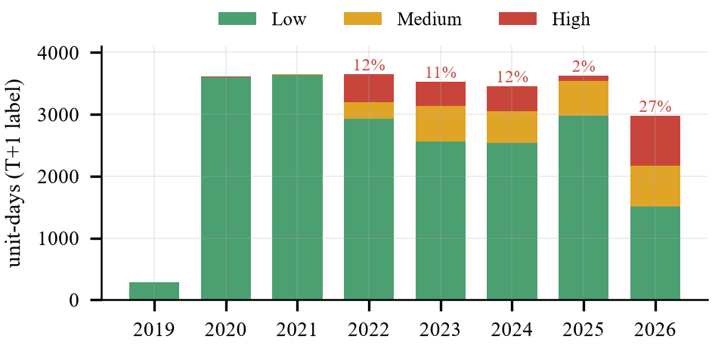
DATASET
Preprocessing, quality control and leakage protection
1
Parse & date-check
printed date vs file name; parser matches V4 on 99.3–100% of zone values
2
Repair & merge
PDF value wins over V4 on overlap; demand rebuilt as evening-peak gen. + shedding (0.08% error)
3
No future leakage
forward-fill ≤ 3 days, labels never filled, scaling and θ from training rows only
Chronological split (by the T+3 target date)
Automatic tests
Train: Dec 2019 – Dec 2023 · 14,770 samples · 5.8% High
Validation: 2024 · 3,480 samples · 12.0% High
Test: 2025 – Oct 2026 · 6,660 samples · 13.5% High
4
scramble all test-period data → train/val features, labels, thresholds must not change
Load-shedding risk early warning · ML Lab · Dept. of CSE, University of Asia Pacific
8
Notes:
[Lamiya] Quality control: we check each report's printed date against its file name, the parser agrees with V4 on more than 99 percent of zone values, and where V4 interpolated a value we trust the PDF. To avoid leakage we only fill from the past, never fill labels, and compute scaling and thresholds from training rows only. A test suite scrambles all future data and proves that the training samples don't change. The split is chronological: train up to 2023, validate on 2024, test on 2025 and 2026. Notice the test period has more High days than training.

Slide 9
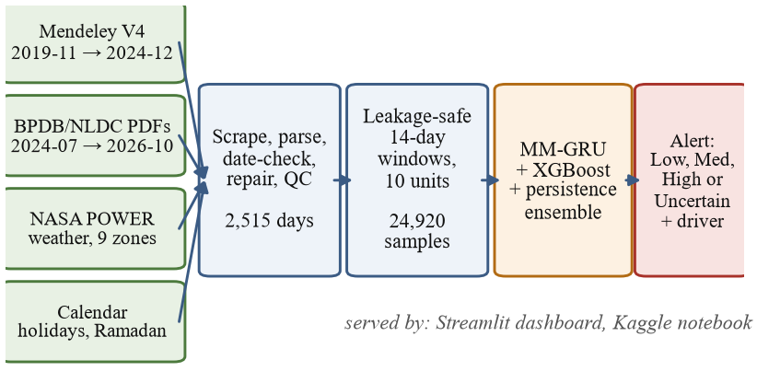
METHODOLOGY
Methodology: end-to-end workflow
Models compared
Persistence: tomorrow = today (hard to beat!)
BPDB rule: depth-2 tree on reserve margin
Logistic regression, Random forest
XGBoost on 107 flattened features
Multimodal GRU (ours), 3 seeds
Ensemble: GRU + XGBoost + persistence, weights chosen on validation
Same inputs and the same chronological split for every model.
Every choice (early stopping, temperature, τ, ensemble weights) is made on validation; the test period is used once.
Load-shedding risk early warning · ML Lab · Dept. of CSE, University of Asia Pacific
9
Notes:
[Lamiya] The workflow: four sources are parsed and checked, turned into 14-day windows for ten units, scored by the models, and delivered as an alert. We compare against strong baselines: persistence, a rule on BPDB's reserve margin, logistic regression, random forest and XGBoost, all on the same data and split. Every decision is made on validation data; the 2025–2026 test is touched only once.

Slide 10
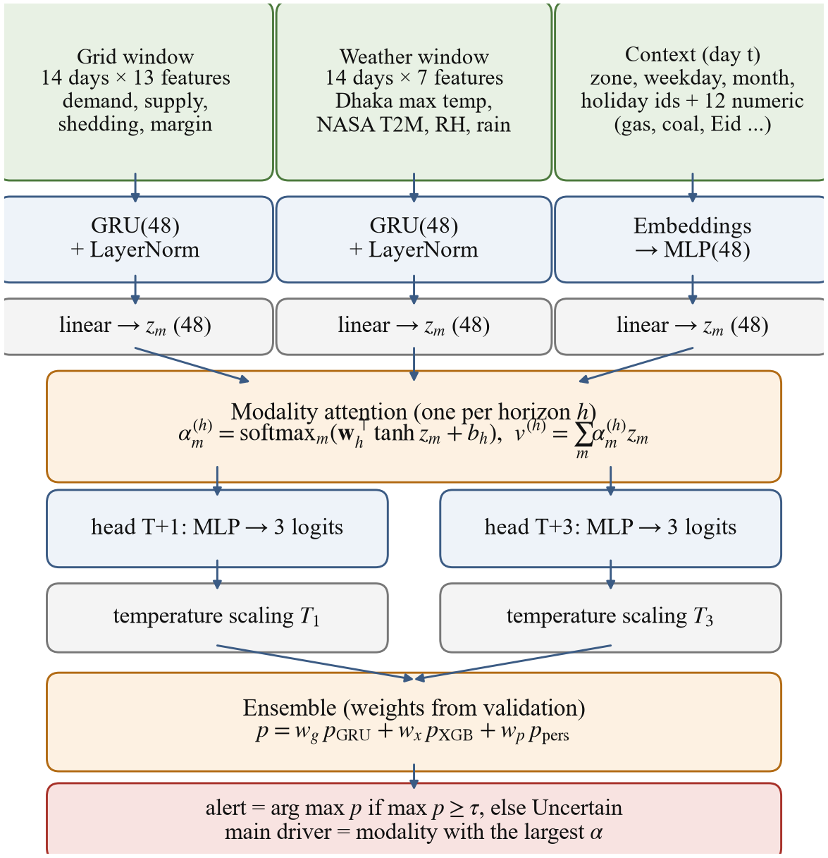
METHODOLOGY
Multimodal GRU with modality attention
Three encoders
GRU(48) for the 14×13 grid window, GRU(48) for the 14×7 weather window, embeddings + MLP for context
Modality attention
one attention layer per horizon weighs grid / weather / context; the largest weight = main driver
Two heads, one network
multi-task: T+1 and T+3 heads share the encoders; only 31,780 parameters
Training
class-weighted cross-entropy (High days are rare), AdamW, early stopping on validation macro-F1, 3 seeds
Load-shedding risk early warning · ML Lab · Dept. of CSE, University of Asia Pacific
10
Notes:
[Lamiya] This is our model. Each modality has its own encoder: a GRU with 48 units for grid data, another for weather, and embeddings for zone, weekday, month and holidays. The three embeddings go into an attention layer — one per horizon — that decides how much each source counts; the biggest weight is reported as the main driver of the alert. Two heads predict T+1 and T+3 from one shared network. It is small, about 32 thousand parameters, because we only have about 2,500 days. We use class-weighted cross-entropy because High days are rare, AdamW, early stopping and three seeds.

Slide 11
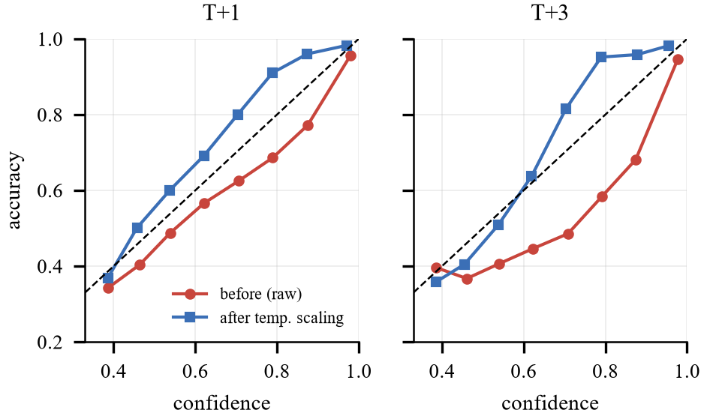
METHODOLOGY
Trust layer: calibration, abstention and the ensemble
Temperature scaling
1
p = softmax(z / T)
one T per horizon, fitted on validation → confidence matches accuracy
Abstain option
2
if max p < τ → “Uncertain”
τ chosen on validation (answer ≥ 70%), shows the best guess
Ensemble
ECE (calibration error) of the GRU
T+1: 0.123 → 0.040
T+3: 0.184 → 0.061
after temperature scaling the curve lies on the diagonal
3
p = w_g·GRU + w_x·XGB + w_p·persistence
weights on validation: T+1 0.1/0.6/0.3, T+3 0.3/0.5/0.2
Load-shedding risk early warning · ML Lab · Dept. of CSE, University of Asia Pacific
11
Notes:
[Lamiya] Three things make the output trustworthy. Temperature scaling: one number T per horizon divides the logits so that a 70 percent confidence really means 70 percent accuracy — the calibration error drops from 0.12 to 0.04. Abstention: if the top probability is below a threshold tau, the system says 'Uncertain' instead of forcing a class. And the final ensemble mixes the GRU, XGBoost and persistence with weights chosen on validation. Now Jannatul will present the results.

Slide 12
RESULTS
Results: the ensemble ties persistence at T+1 and wins at T+3
0.701 vs 0.701
T+1 macro-F1: ensemble vs persistence (a tie)
0.619 vs 0.606
T+3 macro-F1: the ensemble beats persistence
0.77 vs 0.69
High-risk recall at T+1: the GRU catches more High days than persistence (but more false alarms)
Load-shedding risk early warning · ML Lab · Dept. of CSE, University of Asia Pacific
12
Notes:
[Jannatul] These are the test results on 2025 and 2026, never seen during training. Persistence — 'tomorrow will be like today' — is very strong, 0.701 macro-F1, because risk carries over from day to day. The GRU alone does not beat it on macro-F1, but it catches more High-risk days: 77 percent against 69. Refitting on recent data improves both XGBoost and the GRU. The validation-tuned ensemble ties persistence at T+1, 0.701 against 0.701, with fewer missed High days, and beats it at T+3, 0.619 against 0.606.

Slide 13
RESULTS
Ranking and abstention: where the learned models really help
With the abstain option (ensemble, refit)
62%
of unit-days answered at T+1 (the rest: 'Uncertain')
0.786
macro-F1 on answered days at T+1 (T+3: 0.720)
88%
PR-AUC ignores the decision threshold and asks: are risky days ranked above safe days? Persistence cannot rank: LogReg, RF, XGBoost, the GRU and the ensemble all beat it.
of High-risk days caught at T+1 on answered days
Load-shedding risk early warning · ML Lab · Dept. of CSE, University of Asia Pacific
13
Notes:
[Jannatul] Macro-F1 only checks the final class. PR-AUC checks the ranking: does the model give higher risk scores to really risky days? This is a lab experiment we added. Here every model trained on our full features clearly beats persistence — only the simple two-feature BPDB rule is below it — and the ensemble is best at both horizons, 0.73 against 0.58 at T+1. On the right, the abstain option: the system answers about 62 percent of unit-days, and on those its macro-F1 rises to 0.79 and it catches 88 percent of High-risk days. The other days are honestly marked 'Uncertain'.

Slide 14
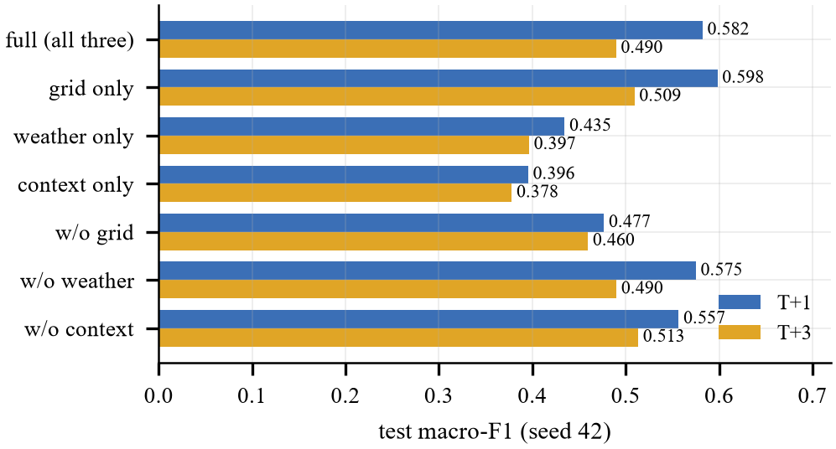
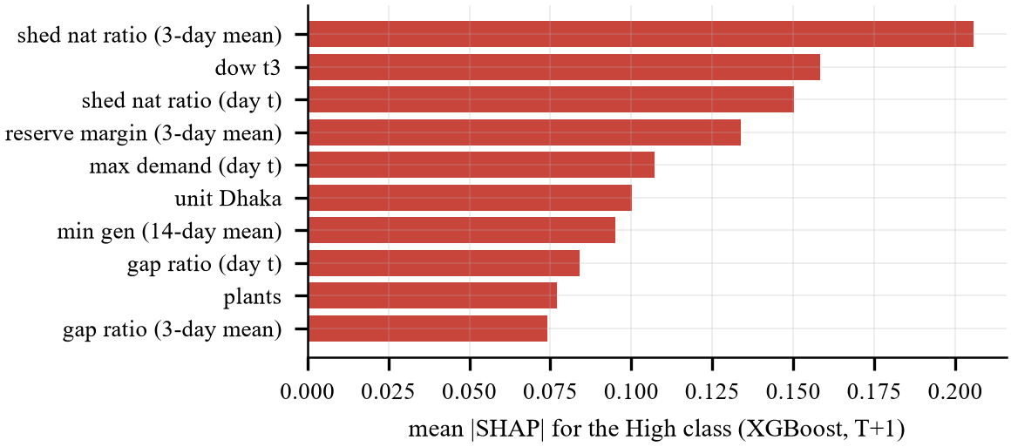
RESULTS
What drives the risk? Grid data, then context and weather
Ablation
grid only 0.598 ≈ full 0.582; without grid 0.477
SHAP share (XGBoost, High)
grid 65% · context 19% · weather 16%
Attention ≠ importance
attention favours context (0.53) — it shows where the network looks, not what adds accuracy
Load-shedding risk early warning · ML Lab · Dept. of CSE, University of Asia Pacific
14
Notes:
[Jannatul] Which data source matters? When we keep only one modality, grid data alone is as good as the full model, and removing the grid hurts most. SHAP on XGBoost agrees: 65 percent of the attribution comes from grid features — the recent national shedding ratio, the weekday of the target day, the reserve margin and maximum demand. Interestingly the attention weights favour context. Attention shows where the network routes information, not how much each source improves accuracy, so we base importance on ablation and SHAP.

Slide 15
LAB EXPERIMENTS
Lab experiments: fusion, multi-task and walk-forward
Fusion & task (T+1): attention 0.593 · concatenation 0.596 · single-task 0.606 — within seed noise. Walk-forward: persistence is best on average (0.656 vs ensemble 0.626), but the ensemble's gap closes every year and it leads in 2026 (0.691 vs 0.671); on PR-AUC the ensemble and the GRU beat persistence in every year.
Load-shedding risk early warning · ML Lab · Dept. of CSE, University of Asia Pacific
15
Notes:
[Jannatul] Two lab ablations, both promised in our proposal. First, we replaced the attention layer with simple concatenation, and second, we trained one network per horizon instead of one shared network. Three seeds each. The macro-F1 values at T+1 are 0.593, 0.596 and 0.606: the differences are smaller than the variation between seeds, so neither attention nor multi-task learning improves accuracy measurably. We keep attention because it explains each alert, and multi-task because one model is half the cost. On the right, walk-forward validation: we retrain on all earlier years and test on 2023, 2024, 2025 and 2026 in turn, with the ensemble weights tuned on each fold's own validation quarter. Averaged over the four years at T+1, persistence is still best on macro-F1, 0.656 against 0.626 for the ensemble. But look at the red line: the gap closes every year, and in 2026 — the year with the longest shedding history — the ensemble wins, 0.691 against 0.671. And on PR-AUC the ensemble and the GRU beat persistence in every single year. So learning pays off more as the history grows.

Slide 16
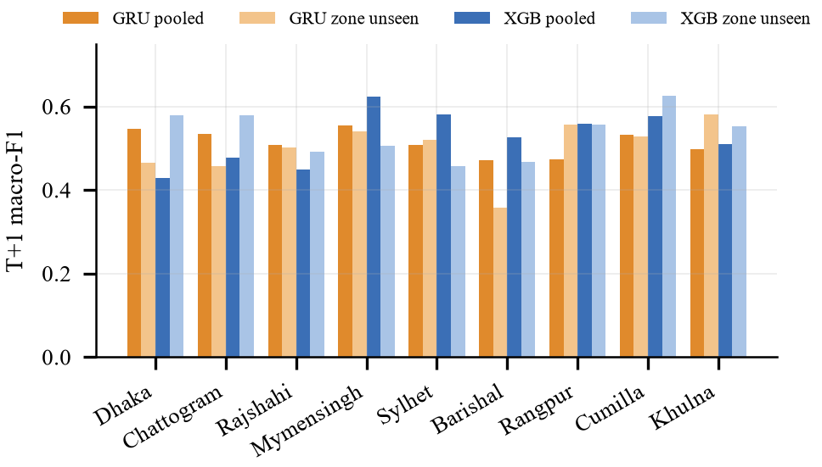
RESULTS
Unseen zones and the live alert of 28 October 2026
Unit | T+1 (2026-10-29) | T+3 (2026-10-31)
National | High 0.63 | High 0.52
Dhaka | Medium 0.73 | Medium 0.64
Chattogram | Medium 0.56 | Medium 0.49
Rajshahi | Medium 0.57 | Uncertain (→Med)
Mymensingh | Uncertain (→Med) | Uncertain (→Med)
Sylhet | Medium 0.58 | Medium 0.49
Barishal | Uncertain (→Med) | Uncertain (→Med)
Rangpur | Medium 0.57 | Uncertain (→Med)
Cumilla | Medium 0.57 | Medium 0.50
Khulna | Uncertain (→Med) | Uncertain (→Med)
Leave-one-division-out
A zone is removed from training and tested with an 'unknown zone' id. GRU mean macro-F1: 0.514 → 0.500 (T+1), 0.420 → 0.399 (T+3): it transfers to new zones.
Deployed ensemble, refitted on all labelled data; number = confidence
Load-shedding risk early warning · ML Lab · Dept. of CSE, University of Asia Pacific
16
Notes:
[Jannatul] Two more checks. Leave-one-division-out: we remove a zone from training and test on it as an unknown zone. The GRU loses very little, so it can be used for zones with short histories. On the right is the real alert the deployed system produced with data up to 28 October 2026: the national grid is High risk for 29 and 31 October, Dhaka is Medium, and zones whose confidence is below the threshold are shown as Uncertain with their best guess. Now Swagoto will show the live demo.

Slide 17
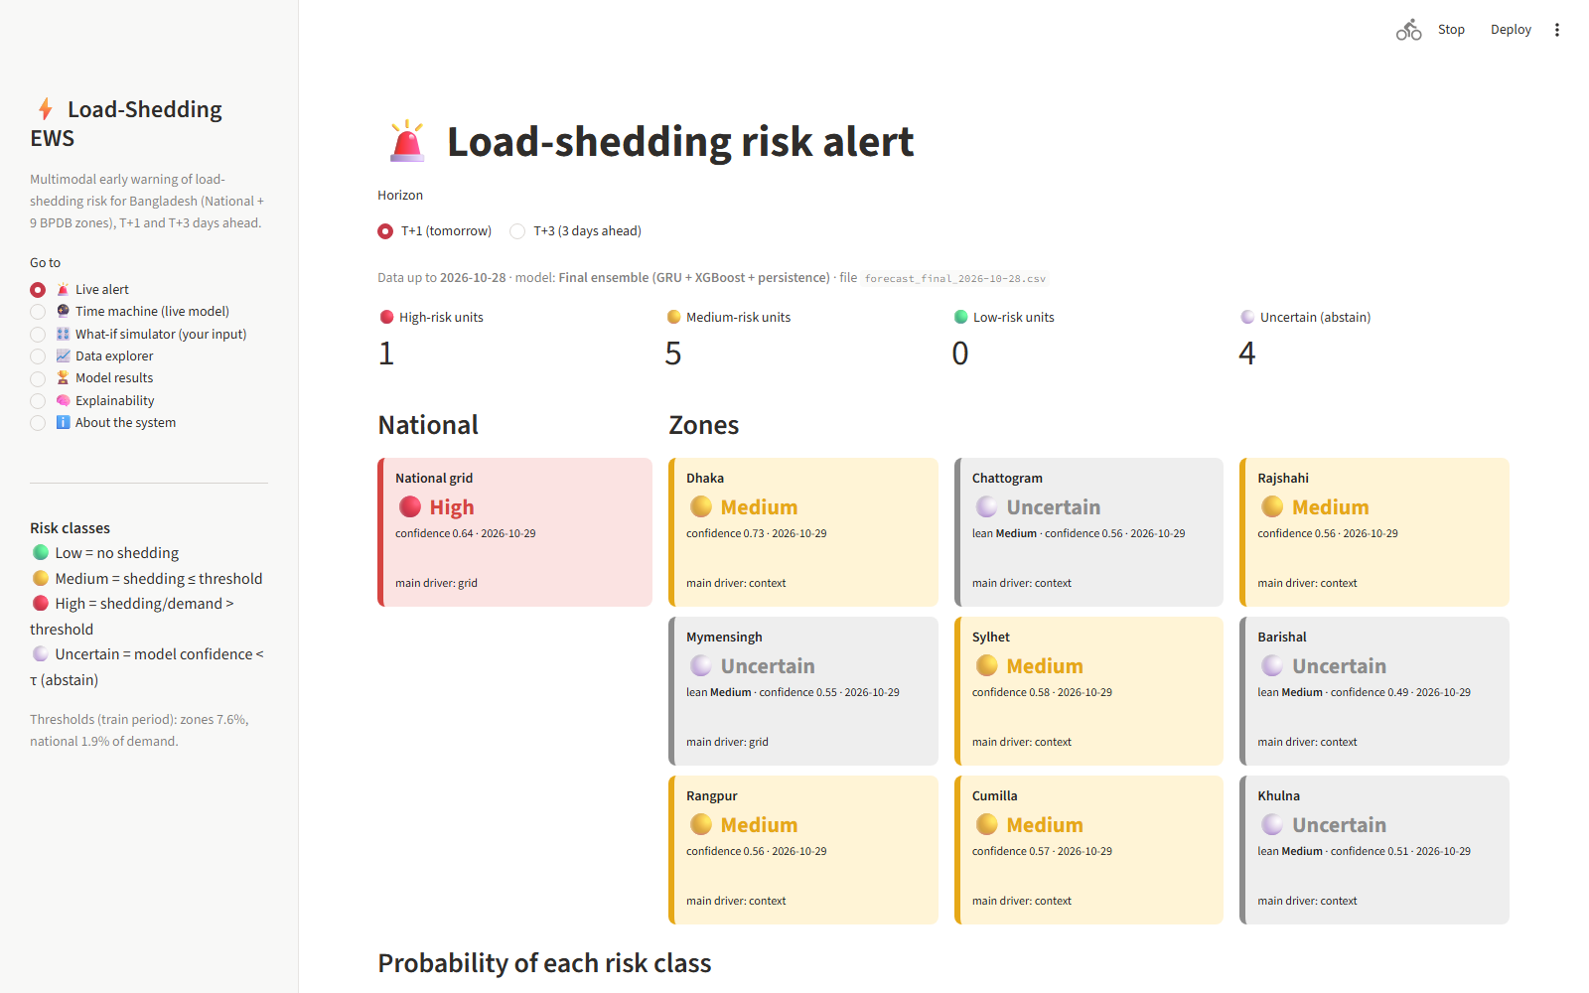
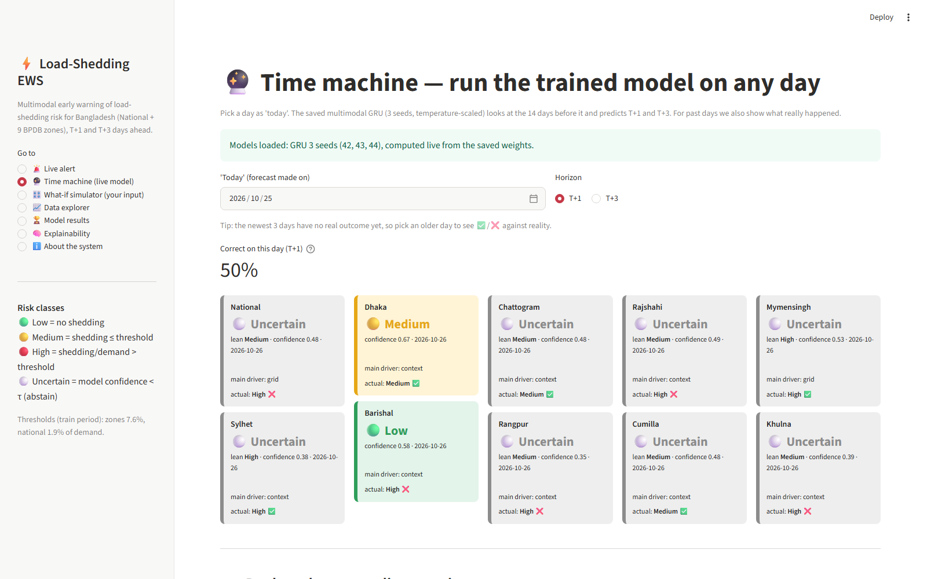
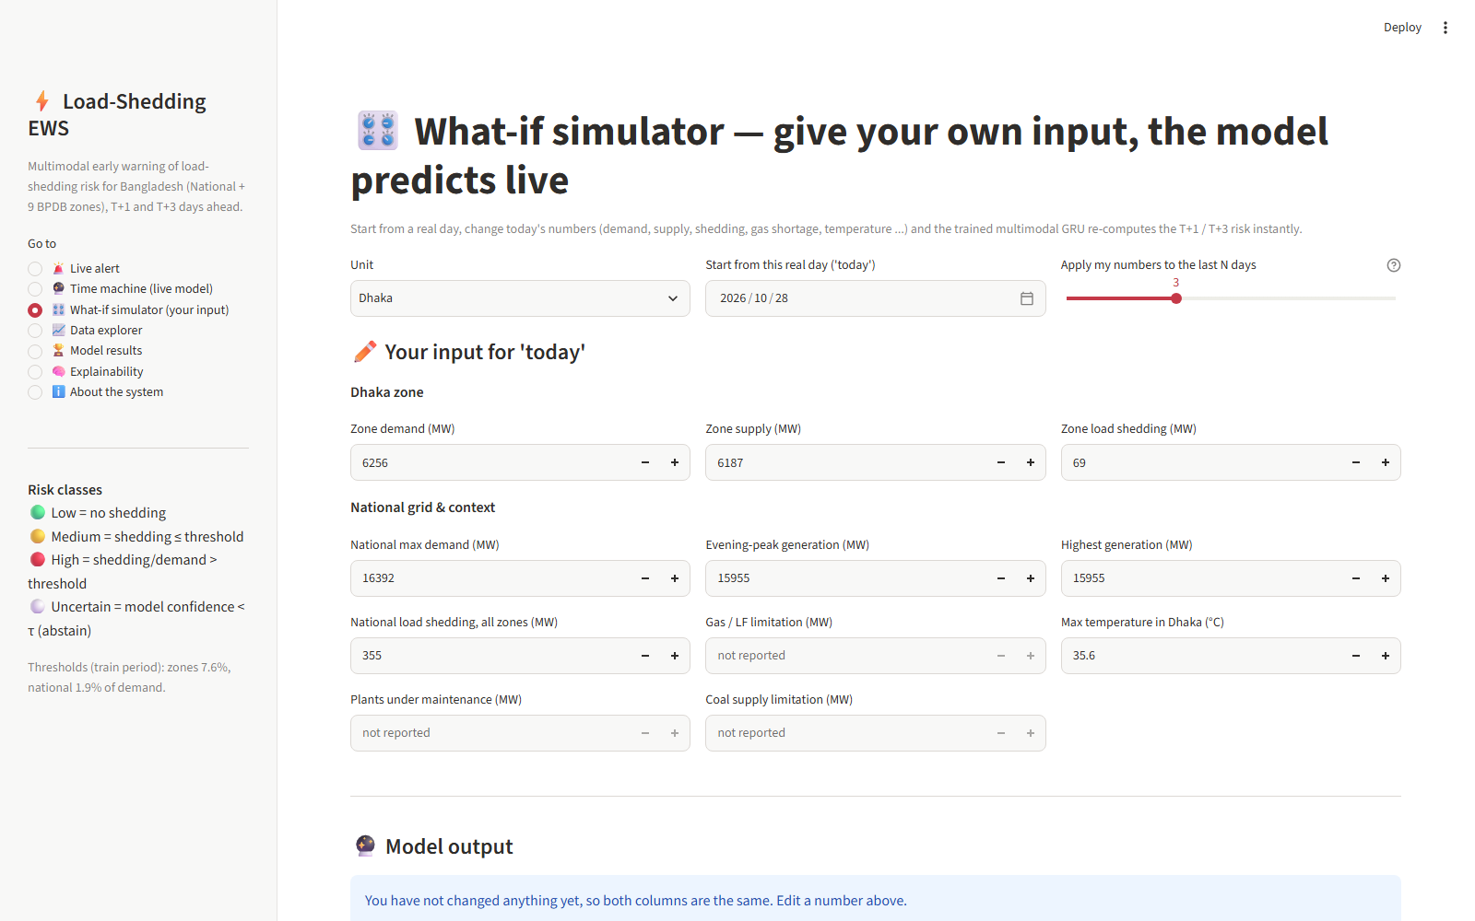
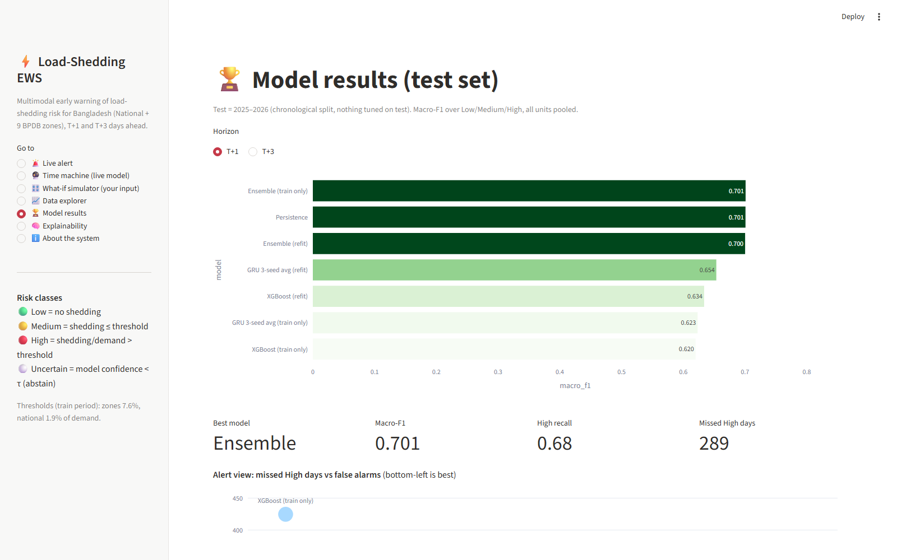
DEMO
Live demo: Streamlit dashboard and Kaggle notebook
Streamlit dashboard (dashboard/app.py)
Kaggle notebook
1
2
notebooks/kaggle_loadshed_pipeline.ipynb
clones the GitHub repo, runs the leakage tests
retrains baselines, GRU, ensemble, lab experiments
shows every table and figure + a ‘time machine’ cell
Live alert
Time machine
3
4
Demo script (2–3 min)
1. Live alert → switch T+1 / T+3
2. Time machine → 15 Jul 2026, Mymensingh replay
3. What-if → Mymensingh shedding 300 MW for 3 days
4. Kaggle → show the finished run and outputs
What-if simulator
Results & explainability
Load-shedding risk early warning · ML Lab · Dept. of CSE, University of Asia Pacific
17
Notes:
[Swagoto] Demo, 2 to 3 minutes. 1) Open the Streamlit app: the Live alert page shows all ten units; switch between T+1 and T+3. 2) Time machine: pick a past day, e.g. 15 July 2026 — the saved GRU models run live in the browser and we see if they were right; scroll to the replay chart for Mymensingh. 3) What-if: choose Mymensingh, set zone load shedding to 300 MW for the last 3 days — the risk moves towards High; set it to 0 and supply = demand — it moves to Low. 4) Switch to Kaggle and show the notebook that ran the full pipeline from GitHub, with the tables and figures.

Slide 18
CONCLUSION
A calibrated, explainable load-shedding risk warning for Bangladesh's grid and nine zones
Tie / win
0.73 vs 0.58
0.79 / 0.72
0.040
vs persistence at T+1 / T+3
macro PR-AUC: much better ranking
macro-F1 on the days it answers
ECE at T+1 after scaling
Future work
Limitations we report honestly
same-day grid feeds instead of late PDF reports
weather forecasts instead of reanalysis
ordinal / cost-sensitive loss against severe misses
regular walk-forward retraining
persistence is very hard to beat on macro-F1
strong distribution shift (2.4% → 27% High days)
data-driven label threshold; late, imperfect reports
attention/multi-task gave no accuracy gain
Load-shedding risk early warning · ML Lab · Dept. of CSE, University of Asia Pacific
18
Notes:
[Jannatul] To conclude: we built a working early-warning system. It ties persistence at T+1 and beats it at T+3, ranks risky days much better, is calibrated, and reaches 0.79 and 0.72 macro-F1 on the days it answers. We are honest about the limits: persistence is hard to beat, the data shift strongly over time, and the labels depend on a threshold. Next steps are same-day data, weather forecasts, a loss that punishes severe misses, and regular retraining.

Slide 19
References
[1] F. Khatun et al., “Power and energy crisis in Bangladesh,” The Financial Express, 2025.
[2] M. I. Hossain et al., “Multi-year dataset on daily electricity demand, generation, load shedding … in Bangladesh,” Data in Brief, vol. 62, 2025.
[3] K. Roy, A. Ishmam, K. A. Taher, “Demand forecasting in smart grid using LSTM,” ACMI, 2021.
[4] K. F. B. Akhter et al., “Short-term electricity demand forecasting of Dhaka city using CNN with stacked BiLSTM,” arXiv:2406.06651, 2024.
[5] M. T. Islam, S. A. Turja, A. Habib, “Enhanced power demand forecasting for Bangladesh,” J. Data, Inf. Manag., 2025.
[6] K. Cho et al., “Learning phrase representations using RNN encoder–decoder,” EMNLP, 2014.
[7] B. Lim et al., “Temporal fusion transformers for interpretable multi-horizon time series forecasting,” Int. J. Forecast., 2021.
[8] C. Guo et al., “On calibration of modern neural networks,” ICML, 2017.
[9] K. Hendrickx et al., “Machine learning with a reject option: a survey,” Mach. Learn., 2024.
[10] S. M. Lundberg et al., “From local explanations to global understanding with explainable AI for trees,” Nat. Mach. Intell., 2020.
[11] T. Chen, C. Guestrin, “XGBoost: a scalable tree boosting system,” KDD, 2016.
[12] T. Saito, M. Rehmsmeier, “The precision-recall plot is more informative than the ROC plot …,” PLoS ONE, 2015.
[13] BPDB daily generation archive, misc.bpdb.gov.bd · NASA POWER, power.larc.nasa.gov (accessed Oct. 2026).
Load-shedding risk early warning · ML Lab · Dept. of CSE, University of Asia Pacific
19
Notes:
[Jannatul] These are our main references; the full list of 32 is in the report.

Slide 20
Thank you
Questions and suggestions are welcome
Swagoto Utsab Singha Roy
ID: 23101124
Lamiya Zaman
ID: 23101132
Jannatul Ferdoushi Islam
ID: 23101119
Code, data, dashboard and notebook: see repo.txt (public GitHub repository)
Load-shedding risk early warning · ML Lab · Dept. of CSE, University of Asia Pacific
20
Notes:
[All] Thank you. Likely questions: why is persistence so strong; how did you prevent leakage; how is tau chosen; why does attention favour context while SHAP favours grid; why no gain from attention or multi-task; what would change with real-time data. See TUTORIAL.md, section 'Viva questions'.

