Slide 1

MET 356: SYNOPTIC ANALYSIS AND NOWCASTING
Jeffrey N. A. Aryee (PhD)
Meteorology & Climate Science Programme
Department of Physics, KNUST, Ghana
e-mail: jeff.jay8845@gmail.com
Google Classroom Code: zxxe7d3
https://github.com/jeffjay88/MET356_SYNOPTIC_ANALYSIS_AND_NOWCASTING_LECTURE_SERIES

Slide 2
Course Content (Overview)
Air mass analysis: Upper and mid-level humidity, Tephigrams; Local wind system: Thunderstorms and mesoscale convection systems, Analysis, prediction, nowcasting and observation of mesoscale weather, Interpretation of satellite and radar images, Nowcasting techniques under operational conditions;
Definitions: ITD, Monsoon, African Easterly Jet (AEJ); Extratropical interactions and upper level analysis, African Easterly Wave (AEW) diagnostics
Ghana Meteorological Agency (GMET) forecasting techniques: Current tools: model wind profiles and surface charts, Radiosondes; Satellite imagery, Climatology, Kelvin waves/Rossby waves, Teleconnections, ENSO, MJO.

Slide 3
Second Semester Highlights
February 24 – 28, 2020 - Quiz 1
March 16 – 20, 2020 - Mid-Semester Examination Week
March 23 – 27, 2020 - Mid-Semester Break
April 20 – 24, 2020 - Quiz 2
May 4 – 15, 2020 - Second Semester Examinations
May 16, 2020 - End of Second Semester
7 Lecture Series (2 to 3 Student Presentations)
5 Assignments (To Be Given After Every Lecture Series & Submitted At Start of Next Lecture or As Specified by Lecturer)
2 Quizzes

Slide 4
LECTURE 2

Slide 5

Brainstorm
(Components of WAM)

Slide 6
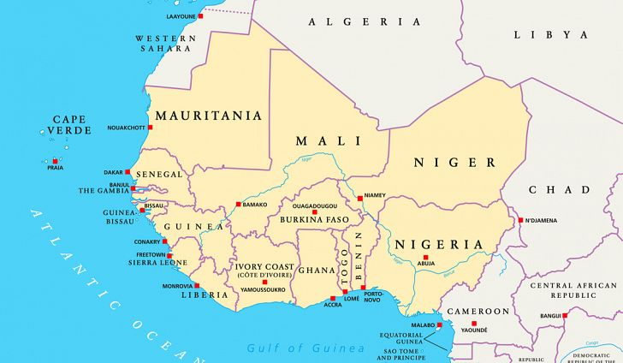
The West African Monsoon
The West African summer monsoon is characterized by a large-scale inflow of warm, very humid, conditionally and convectively unstable airstreams from the equatorial Atlantic across the entire sub region from March to October/November. It is generally a period of widespread and prolonged precipitation.
The winter monsoon is a similar large-scale flow but in the reverse direction i.e. from land to the ocean from the subtropical (Sahara) high-pressure system. Unlike the summer component, the winter monsoon is a period of near total dryness. It is also the period of the harmattan
Important components of the West African monsoon flow include:
Inter- Tropical Discontinuity (ITD),
Subtropical anticyclones and their associated heat lows
Subtropical Jet (STJ)
Troughs extending from mid-latitudes (MLT)
The African Easterly Jet (AEJ),
The Tropical Easterly Jet (TEJ),
African Easterly Waves (AEW),
Types and distribution of vegetation cover and
the soil types.
Orography

Slide 7
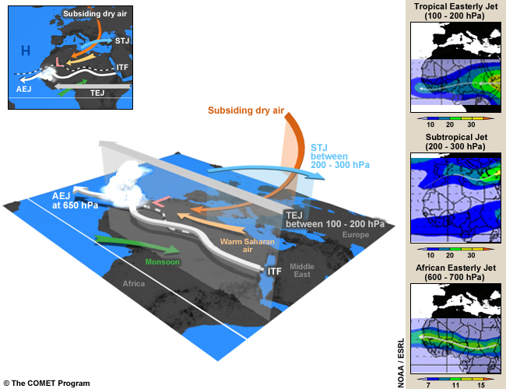
Key Features of the West African Monsoon
Monsoon: The humid and relatively cool southwest monsoon (green arrow) forms when southeasterly flow from the St. Helena High veers to the right after crossing the equator.
The monsoon flow is the main source of moisture for the development of convection over West and part of Central Africa during the rainy season.
Note that a monsoon depth of 1000 to 2000m is required for the initiation of deep convection. The monsoon converges with the Saharan dry air around the intertropical front.

Slide 8
Warm Saharan Air: This is the dry, hot wind (the yellow arrow) from the north that crosses the Sahara and converges with the monsoon over West and part of Central Africa. The dry air forms a dome 4 to 5 km high over the Sahara desert, creating the Saharan heat low. The intensity and location of the heat low affects water vapor transport and convection in West Africa. For example, as the low becomes more intense, the pressure gradient increases between the heat low and the cool Atlantic. This leads to enhanced moisture convergence inland (northward) and more favorable conditions for moist convection.
Intertropical Front (ITF): The ITF, also known as the Intertropical Discontinuity, is the separation zone between the dry Saharan air and the monsoon flow over West Africa. It is generally associated with Saharan heat lows. Convective systems do not develop along the convergence line due to the weak thickness of the monsoon layer in the zone and subsidence in the mid-troposphere. Deep convection is found 3 to 5 degrees south of the ITF

Slide 9
Heat Low: A heat low is an area of high surface temperatures and low surface pressures. (Note that the threshold for pressure values varies throughout the day due to the intense diurnal heat cycle.) Heat lows exist throughout the year and occur where insolation is high and evaporation is low. During the summer, the West African heat low is generally positioned over the Sahara and is often referred to as the Saharan heat low. During this period, the heat low is one of the major dynamic elements of the West African monsoon system.
African Easterly Jet (AEJ): The AEJ is a mid-tropospheric easterly wind maximum located between 700 and 600 hPa over Sahelian Africa during the northern hemispheric summer. The AEJ has mean maximum speeds of 10-13 m/s. The jet is the easterly geostrophic flow response to the strong temperature gradient between warm Saharan air layer and cool monsoon air to the south. African easterly waves, which produce severe thunderstorms, have their maximum amplitude close to the level of the AEJ but south of the AEJ.

Slide 10
African Easterly Waves (AEWs): These are the dominant synoptic weather systems of the summertime West African Monsoon. AEWs are associated with convective heating in the Intertropical Convergence Zone (ITCZ) and instabilities in the AEJ. Africa easterly waves commonly have two vorticity maxima, one at the low-levels in the vicinity of the ITF and one at the AEJ level in the rainy zone south of the jet. Easterly waves are often identified by meridional oscillations in the AEJ.
Tropical Easterly Jet (TEJ): The TEJ is a strong easterly wind flow between 200 and 100 hPa that extends from the Tibetan mountains to Africa and generally exits over the Gulf of Guinea. During the rainy season, it helps reinforce deep convection in the southern branch of the diverging anticyclonic flow on top of MCSs over West and part of Central Africa. When the jet is weak, it can inhibit deep convection.

Slide 11
Subtropical Jet (STJ): This jet, sometimes called the subtropical westerly jet, is a strong westerly wind over the Sahara desert between 200 and 300 hPa. When the STJ is strong, it helps reinforce deep convection in the northern branch of the diverging anticyclonic flow at the top of MCSs over West and part of Central Africa during the rainy season. On the equatorial side of the jet, there’s an area of dry stratospheric subsiding air, which maintains strong stability over the Sahara desert in the mid-troposphere.
Subsidence or Dry Air Intrusion: This is a dry, cold air mass, known as a dry air intrusion in West Africa, which originates from the polar jet. It is transported eastward up to around 0 degrees longitude where it starts to subside and feed into the mid-troposphere over West Africa. A dry air intrusion is identified as a cold air trough that sometimes forms over the northern part of the continent and the Sahara desert. The dry, cold air flow accelerates monsoon inflow into West Africa and plays a key role in the development of strong convective systems in the region.

Slide 12

WEST AFRICAN THUNDERSTORMS AND SQUALL LINES
Squall lines are belts of intense thunderstorms, 100- 500km long, oriented roughly N-S, about 50km wide(E – W) and moving from east to West at approximately 15m/s
Occur in an environment with a relatively drier and cooler 800-600mb layer (low Ɵe air), underlain by a moist, warm and conditionally unstable air below 850mb.
Depend very critically on the vertical wind shear associated with the African Easterly Jet, AEJ, located between 600 and 700mb levels.
Develop and move almost always within the area between the AEJ and the upper tropospheric Tropical Easterly Jet (TEJ) located between 200 -150mb levels.
Together deliver more than 80% of the annual West African precipitation(> 95% in the Sahel; > 70% on the coast)
Occur only from March to October/November and are very destructive!

Slide 13
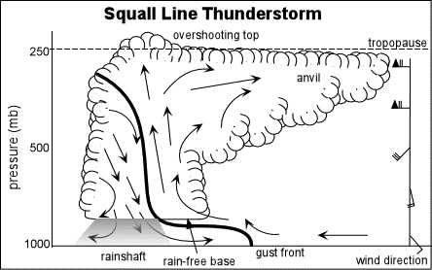
Dynamical and thermo-dynamical parameters in the maintenance of squall lines.
The downdrafts originate at the level of the AEJ. The downward rushing evaporative downdrafts undercut and force the warm moist boundary layer air (southwest monsoon) to ascend (updraft) into the closed system, thus providing the much-needed energy for the maintenance of the squall line.
Afternoon thunderstorms have a life span of less than an hour, whiles some severe thunderstorms persist for several hours. The reason is organization.
Thunderstorms develop and thrive on strong updrafts of air. It also produces tremendous downdraft with the onset of precipitation.
These downdrafts are very effective in cutting off the warm, moist air supplied to the storm. Once its warm inflow is cut off, the storm begins to dissipate.
Hence, updraft and downdraft separation is the key to sustaining an intense thunderstorm.

Slide 14
Severe thunderstorm possesses an internal wind structure that maintains that separation, so the storms downdraft does not choke off its life sustaining updraft.

Slide 15


Class Discussion
What is wind shear?
What are veering and backing winds?
http://www.theweatherprediction.com/habyhints/48/

Slide 16
Wind shear, the key to severe thunderstorm organization.
Definition of wind shear: the change in the speed and or direction of the wind with height.
SE wind near the surface
SW wind around 700mb
Westerly wind at 300mb
Note that in addition to the change in wind direction with height, the wind also increases in speed with height as shown (in next slides) by the increasing length of the vectors.
A veering or backing of the wind with height is called directional shear and an increase in the speed of the wind with height is a vertical wind shear.

Slide 17
When there is a high degree of directional shear or vertical speed shear (or both), air near the surface takes on a rotational tendency about a horizontal axis.
Vertical Speed Shear: winds that increase dramatically with height can create a “tube” of air which rotates about a horizontal axis.
Directional Shear: winds that change direction with height can also cause air to rotate on a horizontal axis.

Slide 18
With favourable wind shear, a horizontal rotating ‘tube’ of air is formed near the earth’s surface (a).
Updrafts from a thunderstorm developing in this region tilt the rotating tube of air vertically forming two vertical rotating vortices, a northern anticyclonic vortex and a southern cyclonic vortex (b).

Slide 19

Thunderstorm Type
Single cell T-storm (Pulse storm)
isolated, away from weather fronts
in weak vertical wind shear environment
short-lived, (20-30 minute);
moderately severe weather;
seldom spawn tornado.
mid-latitude , mainly in summer,
most are in the tropics all year around;
commonly triggered by unequal strong surface heating
https://www.youtube.com/watch?v=U8X5u2KDpHU

Slide 20
3 stages of a single cell Thunderstorm
(1) cumulus stage:
initial cloud element,
making environment more favorable for successive taller/larger elements
(3) dissipating stage :
little moisture left,
ppt induces downdraft,
some rain drops evaporate before they reach ground, virga;
evaporative cooling further enhances downdraft;
light precipitation
(2) mature stage :
development time ~ 20 minutes; lasting for 15 to 30 minutes
a warm core
large updraft (w up to ~ 30 m/s)
producing large raindrops/ hail
strong updraft electrifies water droplets
thunder and lightning
ppt : a sign of maturity
downdrafts appear & coexist with updraft; could sustain one another
lateral spreading downdraft at surface causes strong surface gusts

Slide 21


Slide 22
RECAP OF LECTURE 1
The West African Monsoon
Thunderstorm and Squall Lines

Slide 23
ASSESSMENT 2
Give a detailed description of thunderstorm types and their respective formative mechanisms.
To be presented next week

