Slide 1
Chapter 14: File System Implementation

Slide 2
Outline大纲
File-System Structure.文件系统结构
File-System Operations.文件系统操作
Directory Implementation.目录实现。
Allocation Methods.分配方法。
Free-Space Management.空闲空间管理
Efficiency and Performance.效率和性能
Recovery.恢复
Example: WAFL File System.示例：WAFL文件系统

Slide 3
Objectives目标
Describe the details of implementing local file systems and directory structures.描述实现本地文件系统和目录结构的细节。
Discuss block allocation and free-block algorithms and trade-offs.讨论块分配和空闲块算法以及权衡。
Explore file system efficiency and performance issues.探索文件系统效率和性能问题。
Look at recovery from file system failures.查看从文件系统故障中恢复。
Describe the WAFL file system as a concrete example.以WAFL文件系统为例进行说明。

Slide 4
File-System Structure文件系统结构
File structure文件结构
Logical storage unit.逻辑存储单元
Collection of related information.相关信息的收集
File system resides on secondary storage (disks).文件系统驻留在辅助存储（磁盘）上
Provided user interface to storage, mapping logical to physical.提供存储的用户界面，将逻辑映射到物理。
Provides efficient and convenient access to disk by allowing data to be stored, located retrieved easily.通过允许轻松存储和定位数据，提供对磁盘的高效便捷访问。
Disk provides in-place rewrite and random access.磁盘提供就地重写和随机访问
I/O transfers performed in blocks of sectors (usually 512 bytes).以扇区块（通常为 512 字节）执行的 I/O 传输。
File control block (FCB) – storage structure consisting of information about a file.文件控制块 (FCB) – 由有关文件的信息组成的存储结构。
Device driver controls the physical device.设备驱动程序控制物理设备
File system organized into layers.文件系统组织成层。

Slide 5
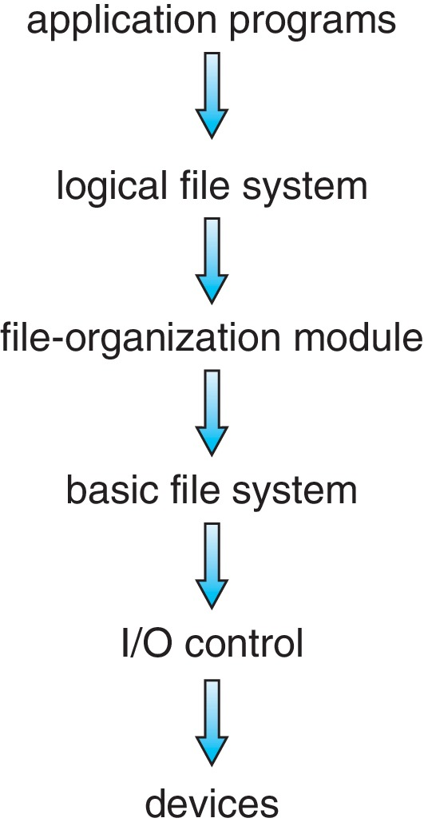
Layered File System分层文件系统

Slide 6
File System Layers文件系统层
Device drivers manage I/O devices at the I/O control layer.设备驱动程序在 I/O 控制层管理 I/O 设备。
Given commands like
read drive1, cylinder 72, track 2, sector 10, into memory location 1060
Outputs low-level hardware specific commands to hardware controller.向硬件控制器输出低级硬件特定命令.
Basic file system given command like “retrieve block 123” translates to device driver.基本文件系统给定的命令（如“检索块 123”）转换为设备驱动程序。
Also manages memory buffers and caches (allocation, freeing, replacement).还管理内存缓冲区和缓存（分配、释放、替换）。
Buffers hold data in transit.缓冲区保存传输中的数据
Caches hold frequently used data.缓存保存经常使用的数据。
File organization module understands files, logical address, and physical blocks.文件组织模块了解文件、逻辑地址和物理块。
Translates logical block # to physical block #.将逻辑块 # 转换为物理块 #。
Manages free space, disk allocation.管理可用空间、磁盘分配。

Slide 7
File System Layers (Cont.)
Logical file system manages metadata information.逻辑文件系统管理元数据信息。
Translates file name into file number, file handle, location by maintaining file control blocks (inodes in UNIX).通过维护文件控制块（UNIX中的inode）将文件名转换为文件编号、文件句柄、位置.
Directory management.目录管理。
Protection.保护
Layering useful for reducing complexity and redundancy, but adds overhead and can decrease performance.分层有助于降低复杂性和冗余，但会增加开销并降低性能。
Logical layers can be implemented by any coding method according to OS designer.根据操作系统设计者的要求，逻辑层可以通过任何编码方法来实现。

Slide 8
File System Layers (Cont.)
Many file systems, sometimes many within an operating system.许多文件系统，有时在一个操作系统中有许多文件系统.
Each with its own format:每个都有自己的格式：
CD-ROM is ISO 9660;
Unix has UFS, FFS;
Windows has FAT, FAT32, NTFS as well as floppy, CD, DVD Blu-ray.Windows 具有 FAT、FAT32、NTFS 以及软盘、CD、DVD 蓝光
Linux has more than 130 types, with extended file system ext3 and ext4 leading; plus distributed file systems, etc.).Linux有130多种，扩展文件系统ext3和ext4领先； 加上分布式文件系统等）.
New ones still arriving – ZFS, GoogleFS, Oracle ASM, FUSE.新的还在到来——ZFS、GoogleFS、Oracle ASM、FUSE

Slide 9
File-System Operations文件系统操作
We have system calls at the API level, but how do we implement their functions?我们在 API 级别有系统调用，但是我们如何实现它们的功能呢？
On-disk and in-memory structures.磁盘和内存结构
Boot control block contains info needed by system to boot OS from that volume.引导控制块包含系统从该卷引导操作系统所需的信息
Needed if volume contains OS, usually first block of volume.如果卷包含操作系统则需要，通常是卷的第一个块。
Volume control block (superblock, master file table) contains volume details.卷控制块（超级块、主文件表）包含卷详细信息。
Total # of blocks, # of free blocks, block size, free block pointers or array.总块数、空闲块数、块大小、空闲块指针或数组。
Directory structure organizes the files.目录结构组织文件。
Names and inode numbers, master file table.名称和inode编号，主文件表

Slide 10
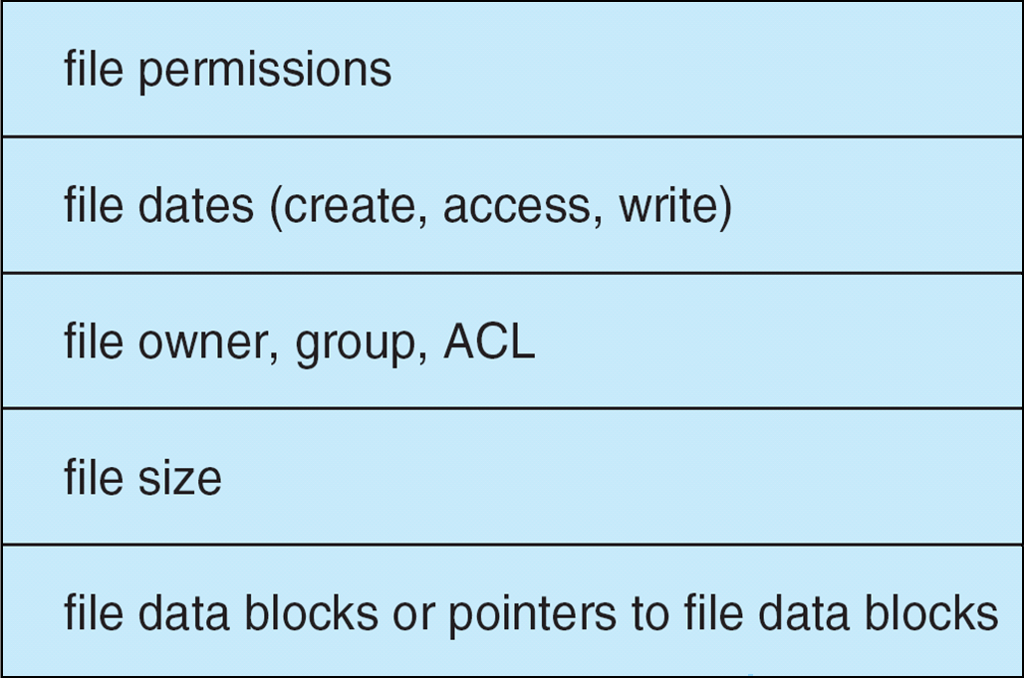
File Control Block (FCB)文件控制块
OS maintains FCB per file, which contains many details about the file.操作系统为每个文件维护FCB，其中包含有关文件的许多详细信息。
Typically, inode number, permissions, size, dates.通常，inode编号、权限、大小、日期
Example

Slide 11
In-Memory File System Structures内存文件系统结构
Mount table storing file system mounts, mount points, file system types.挂载表存储文件系统挂载、挂载点、文件系统类型.
System-wide open-file table contains a copy of the FCB of each file and other info.系统范围的打开文件表包含每个文件的FCB副本和其他信息
Per-process open-file table contains pointers to appropriate entries in system-wide open-file table as well as other info.每个进程的打开文件表包含指向系统范围打开文件表中适当条目的指针以及其他信息

Slide 12
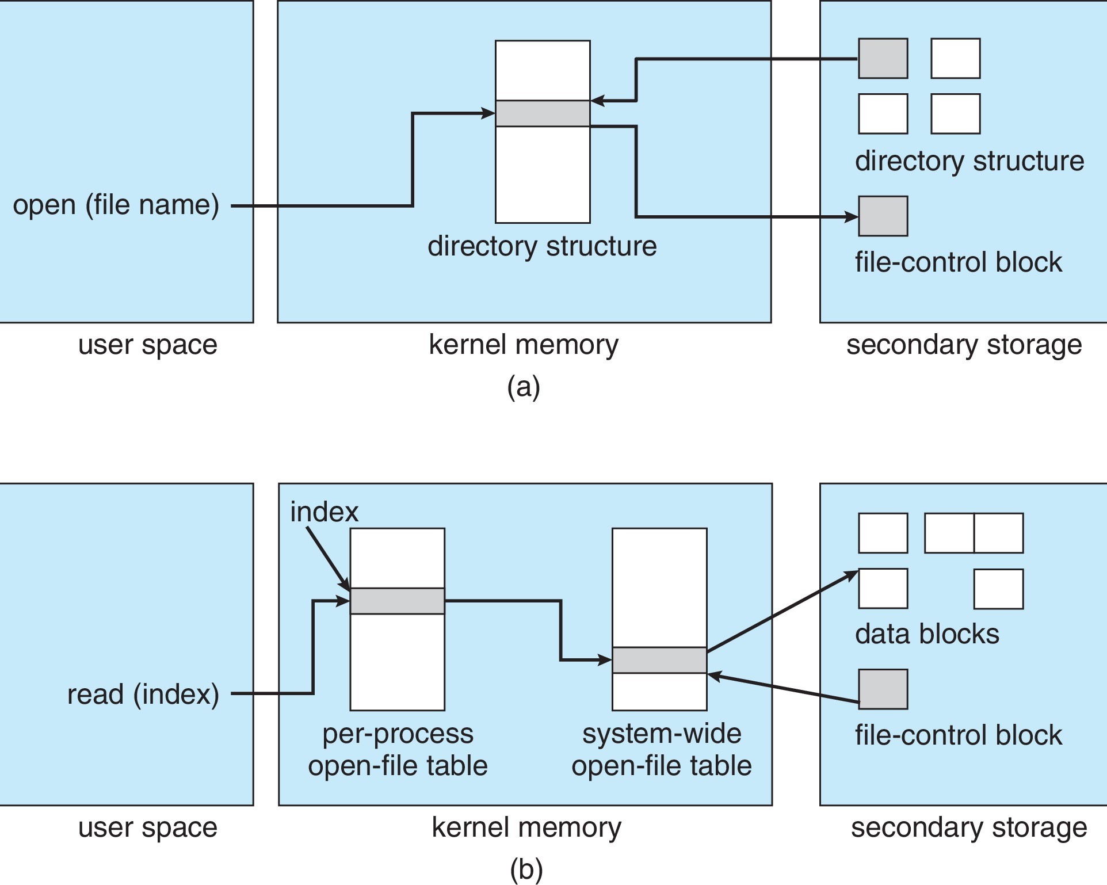
In-Memory File System Structures (Cont.)
Figure 12-3(a) refers to opening a file.图12-3(a)指的是打开一个文件
Figure 12-3(b) refers to reading a file.图12-3(b)指的是读取一个文件

Slide 13
Directory Implementation目录实现
Linear list of file names with pointer to the data blocks.带有指向数据块的指针的文件名的线性列表.
Simple to program.编程简单
Time-consuming to execute.执行耗时
Linear search time.线性搜索时间
Could keep ordered alphabetically via linked list or use B+ tree.可以通过链表按字母顺序排列或使用B+树
Hash Table – linear list with hash data structure.哈希表——具有哈希数据结构的线性列表.
Decreases directory search time.减少目录搜索时间
Collisions – situations where two file names hash to the same location.冲突 - 两个文件名散列到同一位置的情况。
Only good if entries are fixed size, or use chained-overflow method.仅当条目是固定大小或使用链式溢出方法时才好。

Slide 14
Allocation Method分配方法
An allocation method refers to how disk blocks are allocated for files:分配方法是指如何为文件分配磁盘块：
Contiguous.连续的
Linked.链表式的
File Allocation Table (FAT).文件分配表 (FAT)

Slide 15
Contiguous Allocation Method连续分配方法
An allocation method refers to how disk blocks are allocated for files:分配方法是指如何为文件分配磁盘块：
Each file occupies set of contiguous blocks.每个文件占据一组连续的块。
Best performance in most cases.大多数情况下的最佳性能
Simple – only starting location (block #) and length (number of blocks) are required.简单——只需要起始位置（块#）和长度（块数）
Problems include:问题包括：
Finding space on the disk for a file.在磁盘上为文件寻找空间.
Knowing file size.知道文件大小。
External fragmentation, need for compaction off-line (downtime) or on-line.外部碎片，需要离线（停机）或在线压缩。

Slide 16
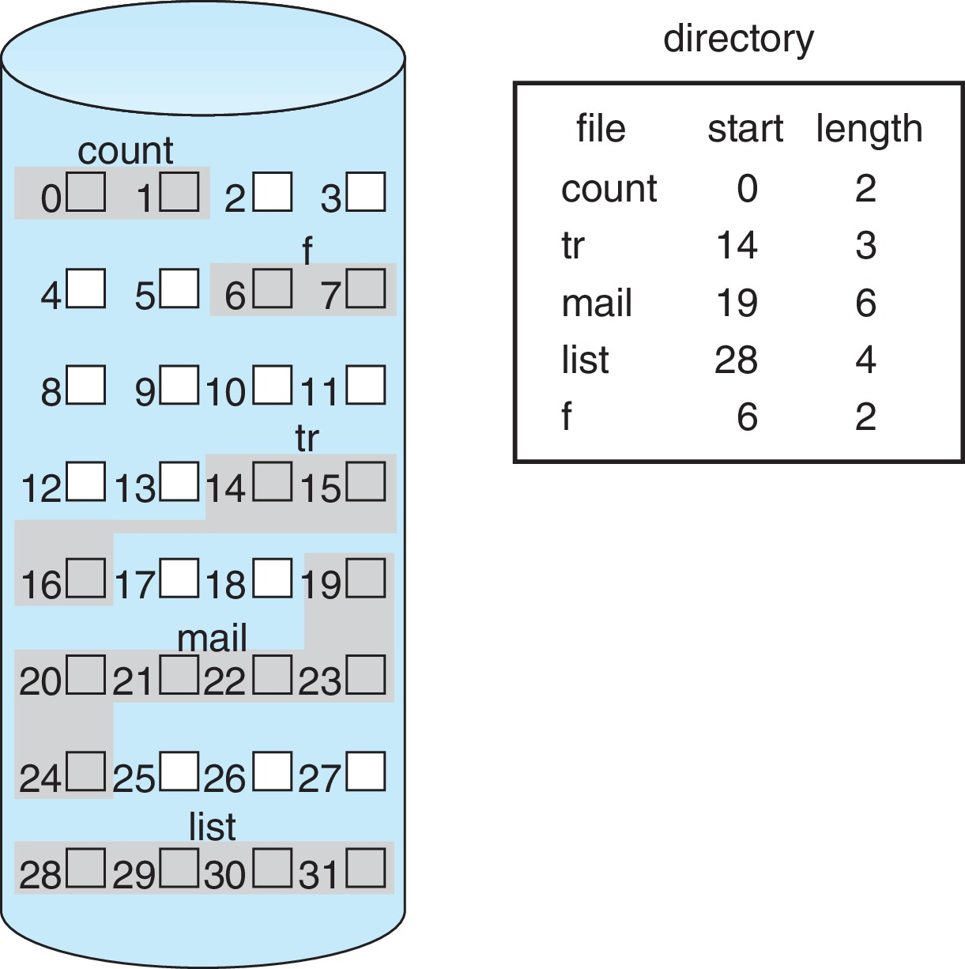
Contiguous Allocation (Cont.)
Mapping from logical to physical (block size =512 bytes).从逻辑到物理的映射（块大小=512 字节）
Block to be accessed = starting address + Q.要访问的块 = 起始地址 + Q
Displacement into block = R.位移到块 = R
Q
LA/512
R

Slide 17
Extent-Based Systems基于范围的系统
Many newer file systems (i.e., Veritas File System) use a modified contiguous allocation scheme.许多较新的文件系统（即 Veritas File System）使用修改后的连续分配方案.
Extent-based file systems allocate disk blocks in extents.基于盘区的文件系统在盘区中分配磁盘块
An extent is a contiguous block of disks.盘区是一个连续的磁盘块。
Extents are allocated for file allocation.区段用于文件分配。
A file consists of one or more extents.一个文件由一个或多个区组成。

Slide 18
Linked Allocation链表式分配
Each file is a linked list of blocks.每个文件都是一个块的链表
File ends at nil pointer.文件以nil指针结束。
No external fragmentation.没有外部碎片。
Each block contains pointer to next block.每个块都包含指向下一个块的指针.
No compaction, external fragmentation.无压缩，外部碎片化.
Free space management system called when new block needed.需要新块时调用空闲空间管理系统
Improve efficiency by clustering blocks into groups but increases internal fragmentation.通过将块聚集成组来提高效率，但会增加内部碎片。
Reliability can be a problem.可靠性可能是个问题。
Locating a block can take many I/Os and disk seeks.定位一个块可能需要很多I/O和磁盘寻道。

Slide 19
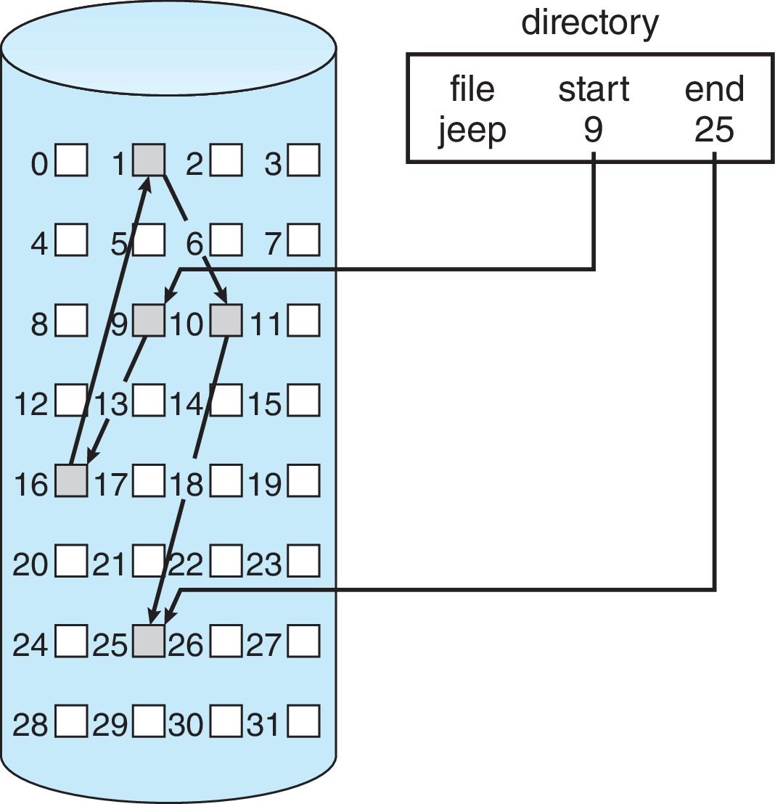
Linked Allocation Example
Each file is a linked list of disk blocks: blocks may be scattered anywhere on the disk.每个文件都是一个磁盘块的链表：块可能分散在磁盘的任何地方.
Scheme.格式

Slide 20
Linked Allocation (Cont.)
Mapping
Block to be accessed is the Q^{th} block in the linked chain of blocks representing the file.要访问的块是表示文件的块链接链中的第 Q 个块。
Displacement into block = R + 1.位移到块 = R + 1
Q
LA/511
R

Slide 21
FAT Allocation Method文件分配表分配方法
Beginning of volume has table, indexed by block number.卷开头有表，按块号索引
Much like a linked list, but faster on disk and cacheable.很像链表，但在磁盘上速度更快且可缓存.
New block allocation simple.新块分配简单

Slide 22
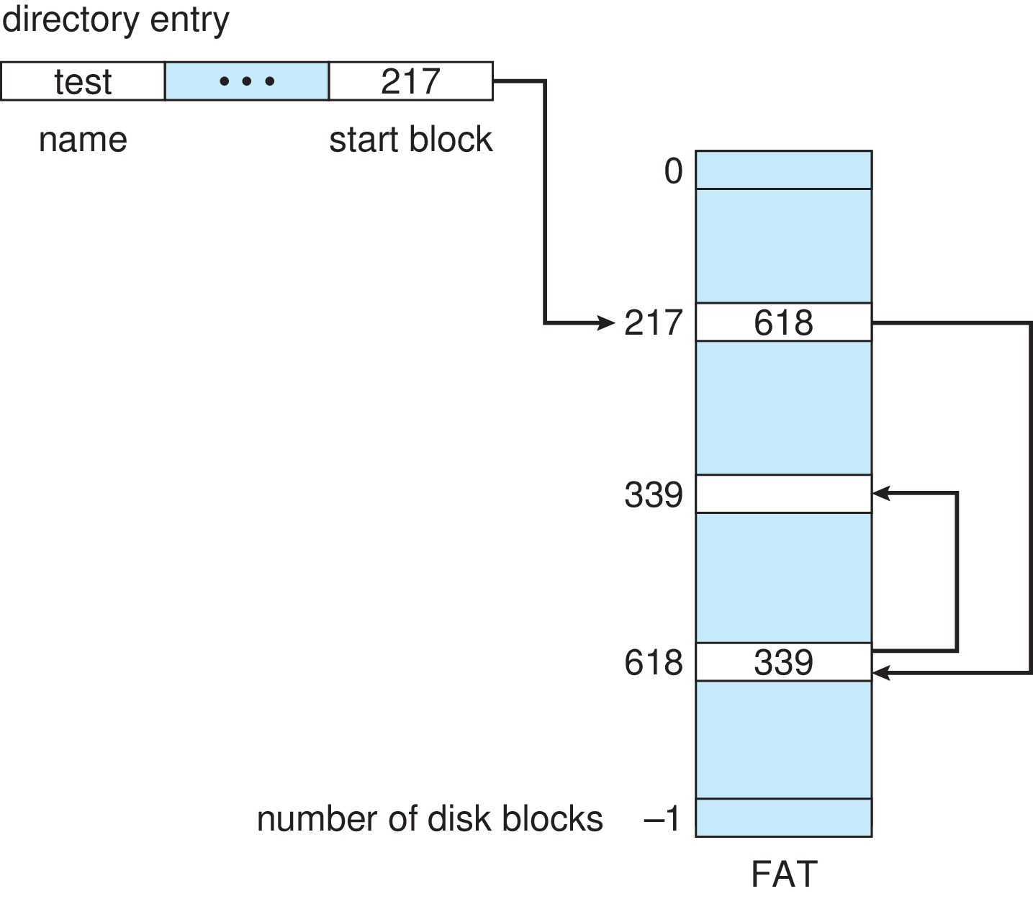
File-Allocation Table文件分配表

Slide 23
Indexed Allocation Method索引分配方法
Each file has its own index block(s) of pointers to its data blocks.每个文件都有自己的指向其数据块的指针的索引块.
Logical view.逻辑视图

Slide 24
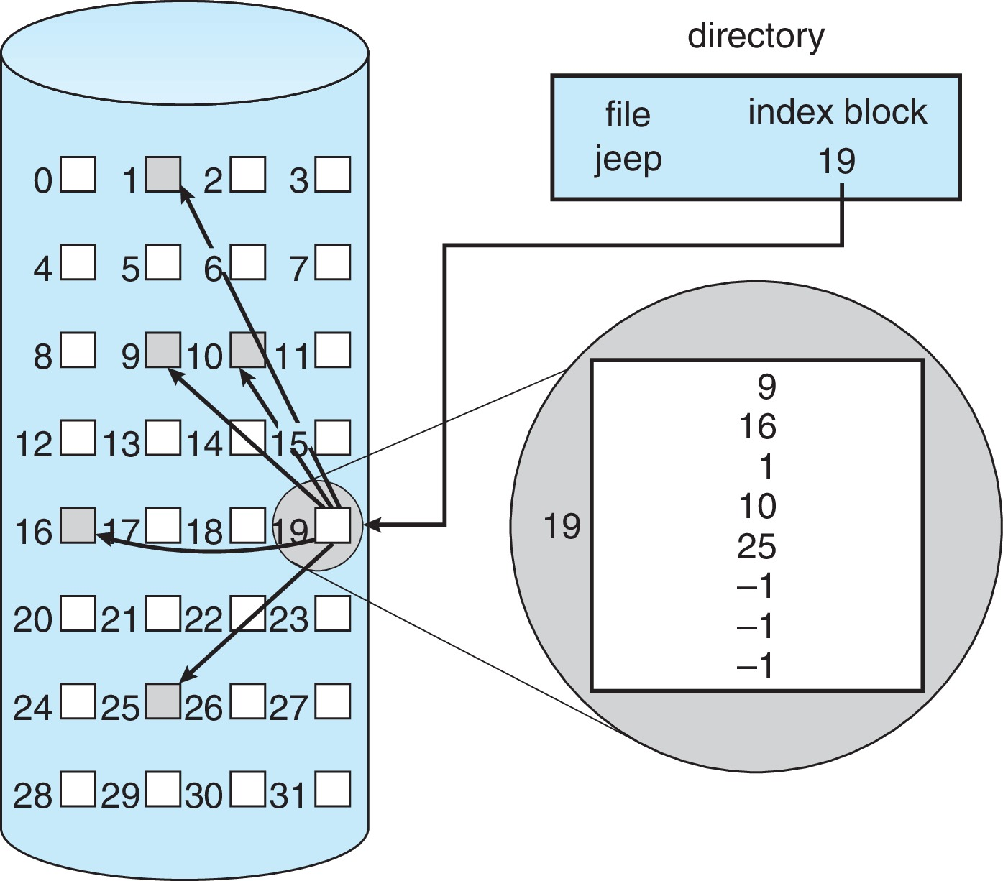
Example of Indexed Allocation

Slide 25
Indexed Allocation – Small Files索引分配——小文件
Need index table.需要索引表
Random access.随机访问
Dynamic access without external fragmentation, but have overhead of index block.没有外部碎片的动态访问，但有索引块的开销.
Mapping from logical to physical in a file of maximum size of 256K bytes and block size of 512 bytes. We need only 1 block for index table.在最大大小为256K字节和块大小为512字节的文件中从逻辑映射到物理。 索引表只需要1个块.
Calculation:计算：
Q = displacement into index table.Q = 移入索引表
R = displacement into block.R = 位移到块中
Q
LA/512
R

Slide 26
Indexed Allocation – Large Files索引分配——大文件
Mapping from logical to physical in a file of unbounded length (block size of 512 words).无限长度文件中从逻辑到物理的映射（块大小为 512 个字）.
Linked scheme – Link blocks of index table (no limit on size).链接方案——链接索引表的块（大小没有限制）
Multi-level indexing.多级索引。

Slide 27
Indexed Allocation – Linked Scheme索引分配 - 链接方案
Link blocks of index table (no limit on size).索引表的链接块（大小没有限制）
Outer-level mapping scheme.外层映射方案
Q₁ = block of index table.Q1 = 索引表块
R₁ is used as follows.R1的用法如下
Inner-level mapping scheme.内层映射方案
Q₂ = displacement into block of index table.Q2 = 位移到索引表的块中。
R₂ displacement into block of file.R2 位移到文件块中
Q₁
LA / (512 x 511)
R₁
Q₂
R₁ / 512
R₂

Slide 28
Indexed Allocation – Two-level Scheme索引分配——两级方案
Two-level index (4K blocks could store 1,024 four-byte pointers in outer index -> 1,048,567 data blocks and file size of up to 4GB).二级索引（4K 块可以在外层索引中存储 1,024 个四字节指针 -> 1,048,567 个数据块和最大 4GB 的文件大小）
Mapping scheme for outer-index:外层索引的映射方案：
Q₁ = displacement into outer-index.Q1 = 位移到外指数
R₁ is used as follows:R1 的用法如下：
Mapping scheme for index level:索引级别的映射方案：
Q₂ = displacement into block of index table.Q2 = 位移到索引表的块中。
R₂ displacement into block of file.R2 位移到文件块中
Q₁
LA / (512 x 512)
R₁
Q₂
R₁ / 512
R₂

Slide 29
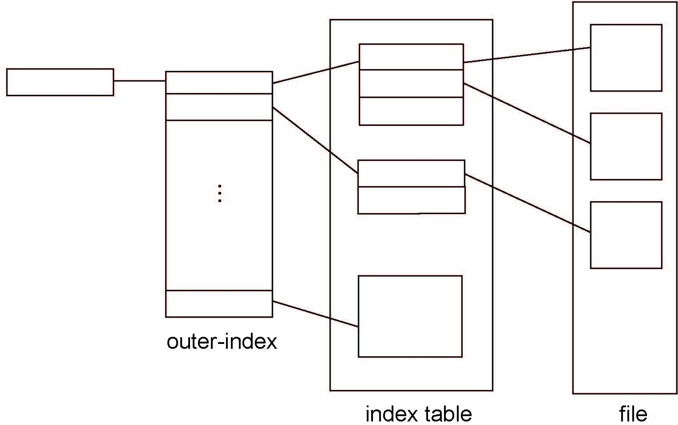
Indexed Allocation – Two-Level Scheme索引分配——两级方案

Slide 30
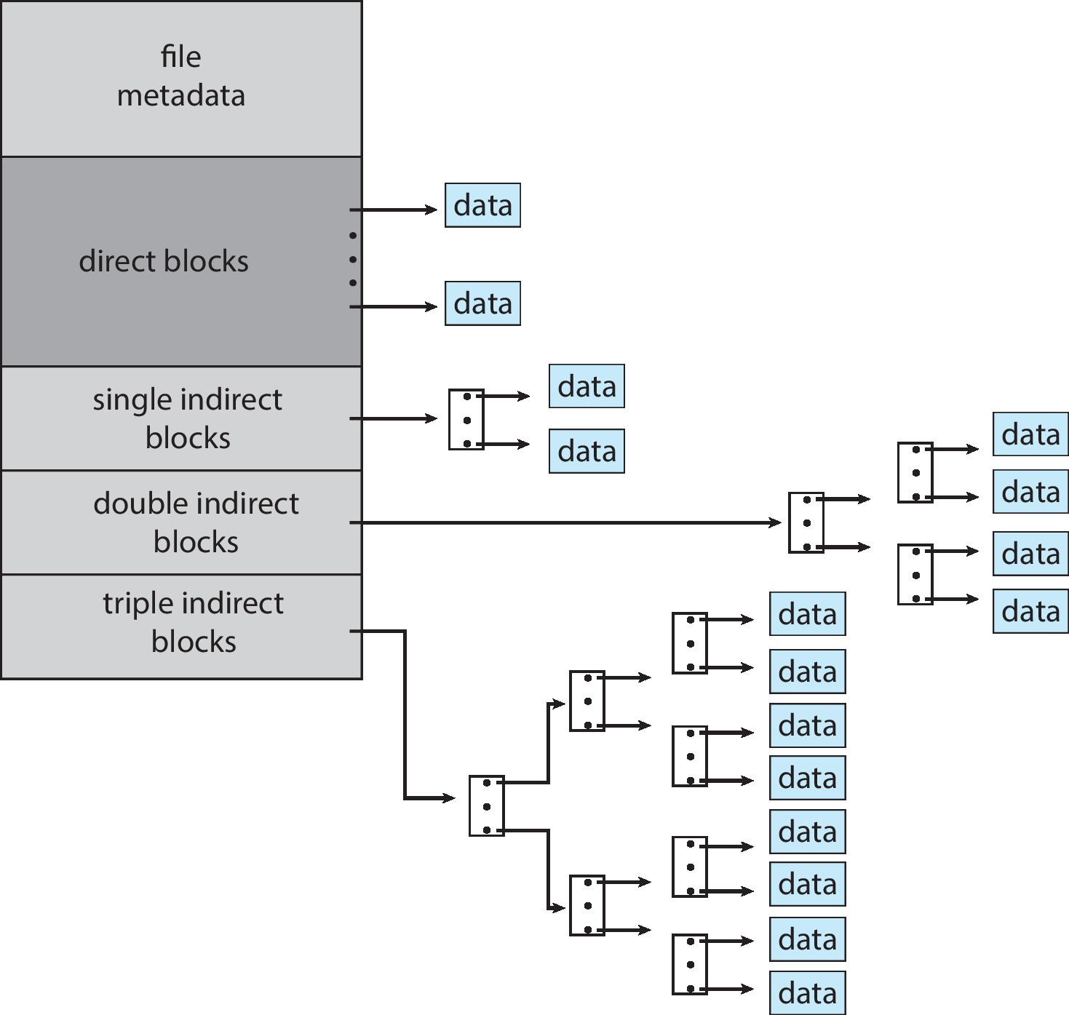
Combined Scheme : UNIX UFS组合方案：UNIX UFS
4K bytes per block, 32-bit addresses.每块 4K 字节，32 位地址
More index blocks than can be addressed with 32-bit file pointer.比 32 位文件指针可寻址的索引块更多

Slide 31
Performance性能
Best method depends on file access type.最佳方法取决于文件访问类型.
Contiguous great for sequential and random.连续非常适合顺序和随机.
Linked good for sequential, not random.链接有利于顺序，而不是随机.
Declare access type at creation.在创建时声明访问类型.
Select either contiguous or linked.选择连续或链接.
Indexed more complex.索引比较复杂。
Single block access could require 2 index block reads then data block read.单块访问可能需要2个索引块读取然后数据块读取.
Clustering can help improve throughput, reduce CPU overhead.集群有助于提高吞吐量，减少CPU开销.
For NVM, no disk head so different algorithms and optimizations needed.对于 NVM，没有磁头，因此需要不同的算法和优化
Using old algorithm uses many CPU cycles trying to avoid non-existent head movement.使用旧算法使用许多CPU周期试图避免不存在的头部移动。
Goal is to reduce CPU cycles and overall path needed for I/O.目标是减少 I/O 所需的 CPU 周期和整体路径.

Slide 32
Performance (Cont.)
Adding instructions to the execution path to save one disk I/O is reasonable.在执行路径中添加指令以节省一次磁盘I/O是合理的.
Intel Core i7 Extreme Edition 990x (2011) at 3.46Ghz = 159,000 MIPS.英特尔酷睿 i7 至尊版 990x (2011) at 3.46Ghz = 159,000 MIPS.
http://en.wikipedia.org/wiki/Instructions_per_second
Typical disk drive at 250 I/Os per second.每秒 250 个 I/O 的典型磁盘驱动器.
159,000 MIPS / 250 = 630 million instructions during one disk I/O.159,000 MIPS / 250 = 一次磁盘 I/O 期间的 6.3 亿条指令.
Fast SSD drives provide 60,000 IOPS.快速 SSD 驱动器提供 60,000 IOPS。
159,000 MIPS / 60,000 = 2.65 millions instructions during one disk I/O.159,000 MIPS / 60,000 = 265 万条磁盘 I/O 期间的指令

Slide 33
Free-Space Management可用空间管理
File system maintains free-space list to track available blocks/clusters.文件系统维护可用空间列表以跟踪可用块/集群.
(Using term “block” for simplicity).（为简单起见，使用术语“块”）
Bit vector or bit map (n blocks).位向量或位图（n 个块）
0
1
2
n-1
…
1 ⇒ block[i] free
0 ⇒ block[i] occupied
bit[i] =

Block number calculation.块数计算
(number of bits per word) *
(number of 0-value words) +
offset of first 1 bit
CPUs have instructions to return offset within word of first “1” bit.CPU有指令返回第一个“1”位字内的偏移量

Slide 34
Free-Space Management可用空间管理
File system maintains free-space list to track available blocks.文件系统维护可用空间列表以跟踪可用块.
Bit vector or bit map (n blocks).位向量或位图（n 个块）
Bit map requires extra space.位图需要额外的空间
Example:
block size = 4KB = 2¹² bytes
disk size = 2⁴⁰ bytes (1 terabyte)
n = 2⁴⁰/2¹² = 2²⁸ bits (or 32MB)
if clusters of 4 blocks -> 8MB of memory
Easy to get contiguous files.轻松获取连续文件
0
1
2
n-1
…
bit[i] =
1 ⇒ block[i] free
0 ⇒ block[i] occupied


Slide 35
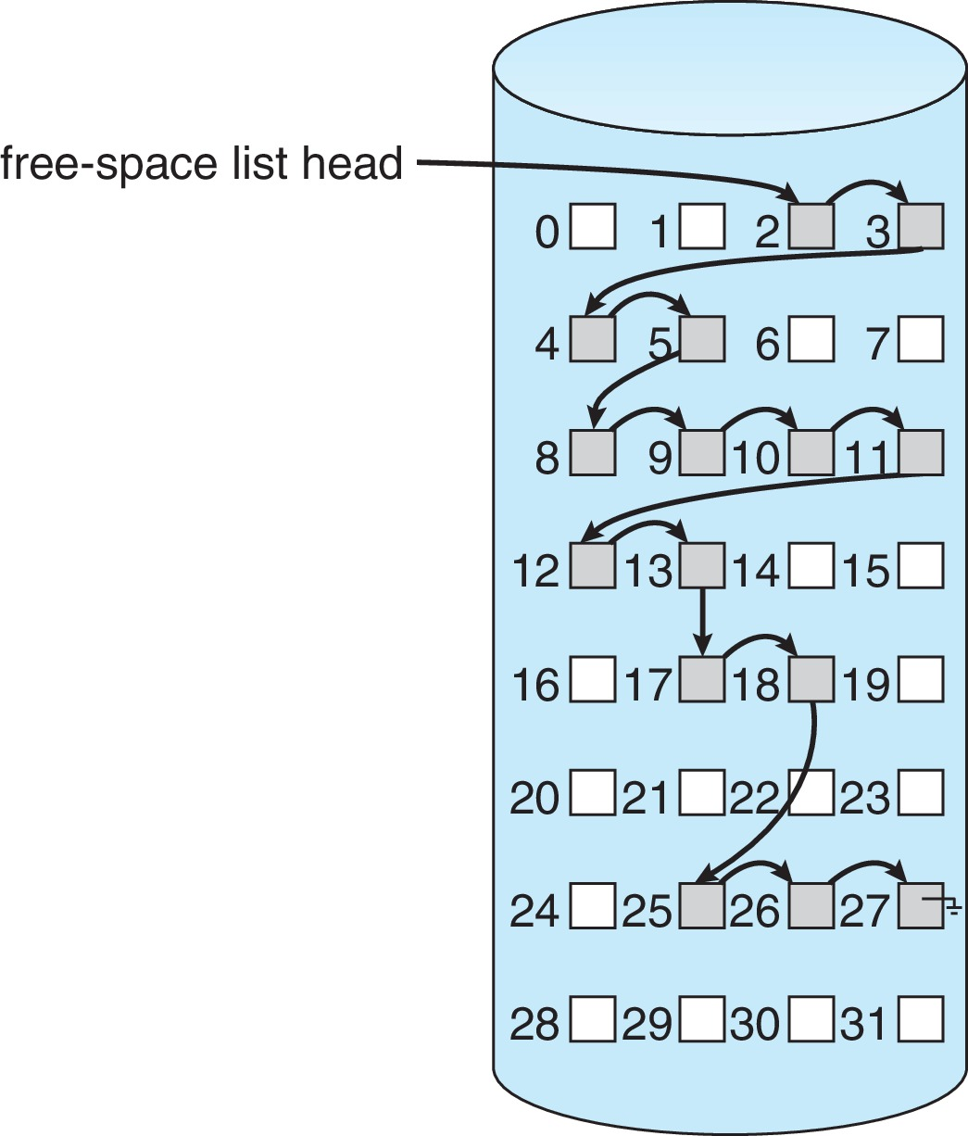
Linked Free Space List on Disk磁盘上的链接可用空间列表
Linked list (free list).链表（空闲列表）.
Cannot get contiguous space easily.无法轻易获得连续空间.
No waste. Linked Free Space List on Disk of space.没有浪费。 空间磁盘上的链接可用空间列表
No need to traverse the entire list (if # free blocks recorded).无需遍历整个列表（记录的 # 个空闲块）。

Slide 36
Free-Space Management (Cont.)
Grouping分组
Modify linked list to store address of next n-1 free blocks in first free block, plus a pointer to next block that contains free-block-pointers (like this one).修改链表以在第一个空闲块中存储下 n-1 个空闲块的地址，加上一个指向包含空闲块指针的下一个块的指针（像这个）.
Counting计数
Because space is frequently contiguously used and freed, with contiguous-allocation allocation, extents, or clustering.因为空间经常连续使用和释放，具有连续分配、范围或集群
Keep address of first free block and count of following free blocks.保留第一个空闲块的地址和后续空闲块的计数.
Free space list then has entries containing addresses and counts.可用空间列表然后包含地址和计数的条目.

Slide 37
Free-Space Management (Cont.)
Space Maps
Used in ZFS
Consider meta-data I/O on very large file systems.考虑超大文件系统上的元数据 I/O.
Full data structures like bit maps cannot fit in memory ➔ thousands of I/Os.像位图这样的完整数据结构无法放入内存中——数千个 I/O。
Divides device space into metaslab units and manages metaslabs.将设备空间划分为元实验室单元并管理元实验室.
Given volume can contain hundreds of metaslabs.给定的卷可以包含数百个 metaslab.
Each metaslab has associated space map.每个元实验室都有关联的空间图.
Uses counting algorithm.使用计数算法。
But records to log file rather than file system.但是记录到日志文件而不是文件系统
Log of all block activity, in time order, in counting format.所有区块活动的日志，按时间顺序，以计数格式。
Metaslab activity ➔ load space map into memory in balanced-tree structure, indexed by offset.Metaslab活动 → 以平衡树结构将空间映射加载到内存中，按偏移量索引.
Replay log into that structure.重播日志到该结构。
Combine contiguous free blocks into single entry.将连续的空闲块合并为单个条目

Slide 38
TRIMing Unused Blocks修剪未使用的块
HDDS overwrite in place so need only free list.HDDS就地覆盖，因此只需要空闲列表.
Blocks not treated specially when freed.释放时未特别处理的块。
Keeps its data but without any file pointers to it, until overwritten.保留其数据但没有任何文件指针指向它，直到被覆盖。
Storage devices not allowing overwrite (like NVM) suffer badly with same algorithm.不允许覆盖的存储设备（如 NVM）使用相同的算法受到严重影响.
Must be erased before written, erases made in large chunks (blocks, composed of pages) and are slow.必须在写入前擦除，以大块（块，由页面组成）进行擦除并且速度很慢.
TRIM is a newer mechanism for the file system to inform the NVM storage device that a page is free.TRIM是一种较新的机制，用于文件系统通知 NVM 存储设备页面空闲。
Can be garbage collected or if block is free, now block can be erased.可以被垃圾收集或者如果块是空闲的，现在块可以被擦除

Slide 39
Efficiency and Performance效率和性能
Efficiency dependent on:效率取决于：
Disk allocation and directory algorithms.磁盘分配和目录算法.
Types of data kept in file’s directory entry.保存在文件目录项中的数据类型.
Pre-allocation or as-needed allocation of metadata structures.元数据结构的预分配或按需分配.
Fixed-size or varying-size data structures.固定大小或可变大小的数据结构

Slide 40
Efficiency and Performance (Cont.)
Performance
Keeping data and metadata close together.将数据和元数据紧密结合在一起.
Buffer cache – separate section of main memory for frequently used blocks.缓冲区缓存 – 常用块的主内存的单独部分.
Synchronous writes sometimes requested by apps or needed by OS.同步写入有时由应用程序请求或操作系统需要。
No buffering / caching – writes must hit disk before acknowledgement.无缓冲/缓存 - 写入必须在确认之前命中磁盘.
Asynchronous writes more common, buffer-able, faster.异步写入更常见、可缓冲、速度更快.
Free-behind and read-ahead – techniques to optimize sequential access.Free-behind 和 read-ahead – 优化顺序访问的技术。
Reads frequently slower than writes.读取经常比写入慢.

Slide 41
Page Cache页面缓存
A page cache caches pages rather than disk blocks using virtual memory techniques and addresses.页面缓存使用虚拟内存技术和地址缓存页面而不是磁盘块.
Memory-mapped I/O uses a page cache.内存映射 I/O 使用页面缓存.
Routine I/O through the file system uses the buffer (disk) cache.通过文件系统的例行 I/O 使用缓冲区（磁盘）缓存
This leads to the following figure.这导致了下图。

Slide 42
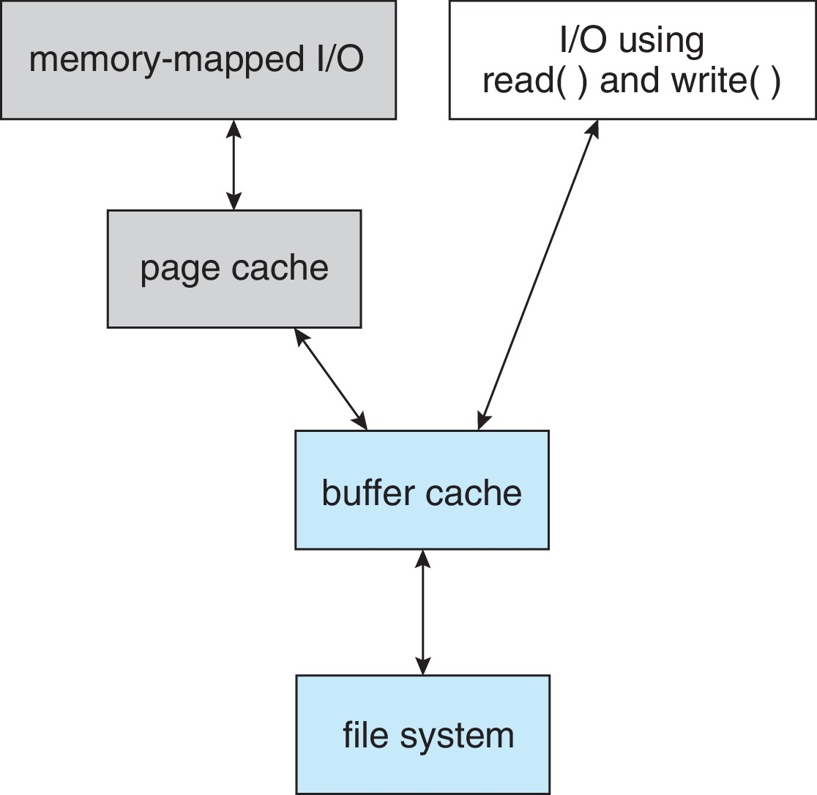
I/O Without a Unified Buffer Cache没有统一缓冲区缓存的 I/O

Slide 43
Unified Buffer Cache统一缓冲区缓存
A unified buffer cache uses the same page cache to cache both memory-mapped pages and ordinary file system I/O to avoid double caching.统一的缓冲区缓存使用相同的页面缓存来缓存内存映射页面和普通文件系统 I/O 以避免双重缓存.
But which caches get priority, and what replacement algorithms to use?但是哪些缓存获得优先权，以及使用哪些替换算法？

Slide 44
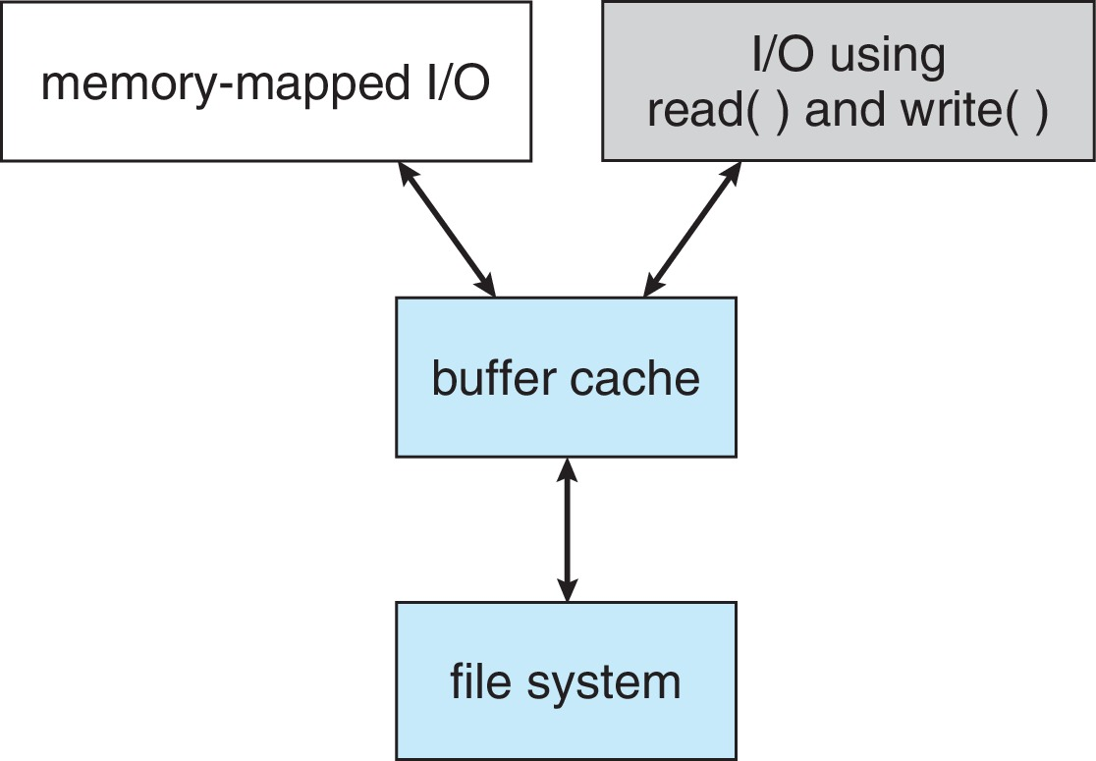
I/O Using a Unified Buffer Cache使用统一缓冲区缓存的 I/O

Slide 45
Recovery恢复
Consistency checking – compares data in directory structure with data blocks on disk, and tries to fix inconsistencies.一致性检查——将目录结构中的数据与磁盘上的数据块进行比较，并尝试修复不一致之处.
Can be slow and sometimes fails.可能很慢，有时会失败。
Use system programs to back up data from disk to another storage device (magnetic tape, other magnetic disk, optical).使用系统程序将数据从磁盘备份到另一个存储设备（磁带、其他磁盘、光盘）.
Recover lost file or disk by restoring data from backup.通过从备份中恢复数据来恢复丢失的文件或磁盘.

Slide 46
Log Structured File Systems日志结构化文件系统
Log structured (or journaling) file systems record each metadata update to the file system as a transaction.日志结构化（或日志）文件系统将文件系统的每个元数据更新记录为一个事务.
All transactions are written to a log.所有事务都写入日志。
A transaction is considered committed once it is written to the log (sequentially).一旦将事务写入日志（按顺序），就认为它已提交.
Sometimes to a separate device or section of disk.有时到单独的设备或磁盘部分.
However, the file system may not yet be updated.但是，文件系统可能尚未更新。
The transactions in the log are asynchronously written to the file system structures.日志中的事务异步写入文件系统结构.
When the file system structures are modified, the transaction is removed from the log.当文件系统结构被修改时，事务从日志中删除.
If the file system crashes, all remaining transactions in the log must still be performed.如果文件系统崩溃，日志中所有剩余的事务仍必须执行.
Faster recovery from crash, removes chance of inconsistency of metadata.更快地从崩溃中恢复，消除元数据不一致的可能性。

Slide 47
Example: WAFL File System
Used on Network Appliance “Filers” – distributed file system appliances.用于网络设备“文件管理器”——分布式文件系统设备.
“Write-anywhere file layout”.“随处写入文件布局”。
Serves up NFS, CIFS, http, ftp.提供 NFS、CIFS、http、ftp.
Random I/O optimized, write optimized.随机 I/O 优化，写入优化。
NVRAM for write caching.用于写缓存的 NVRAM
Similar to Berkeley Fast File System, with extensive modifications.类似于伯克利快速文件系统，经过大量修改。

Slide 48
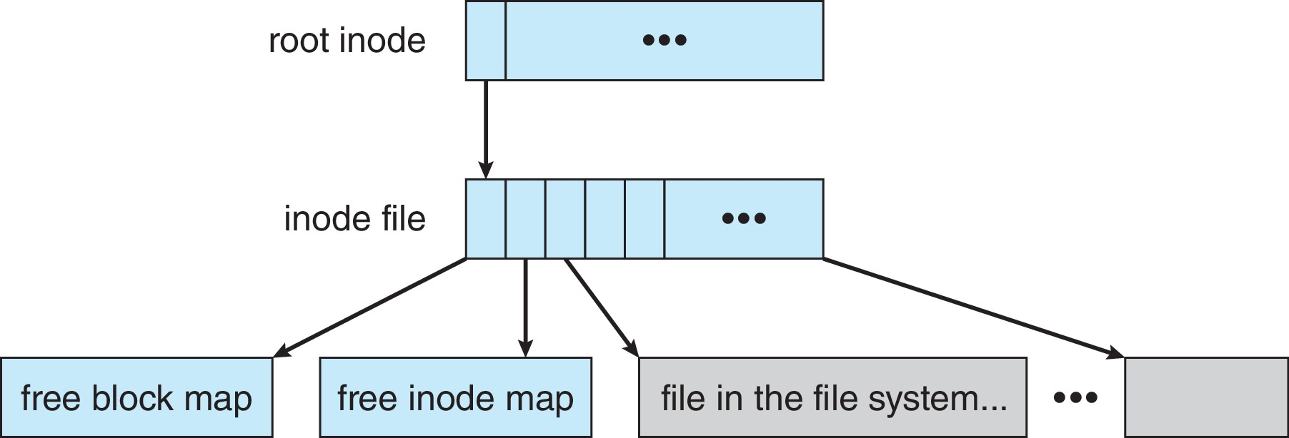
The WAFL File Layout

Slide 49
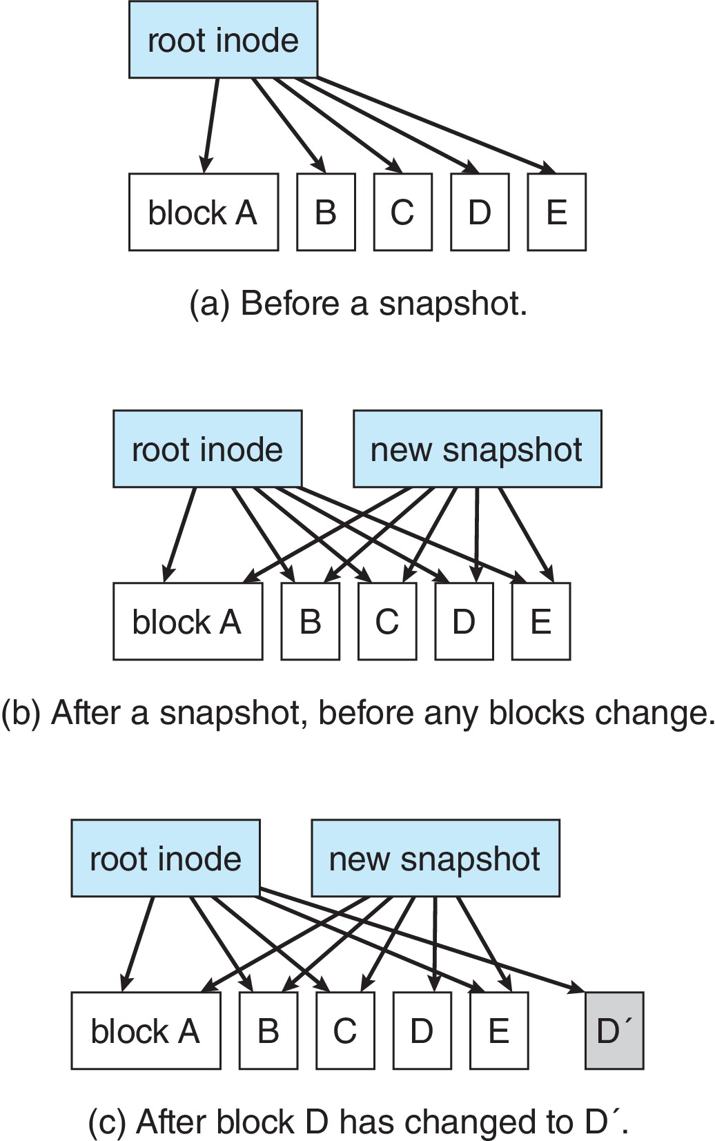
Snapshots in WAFL

Slide 50
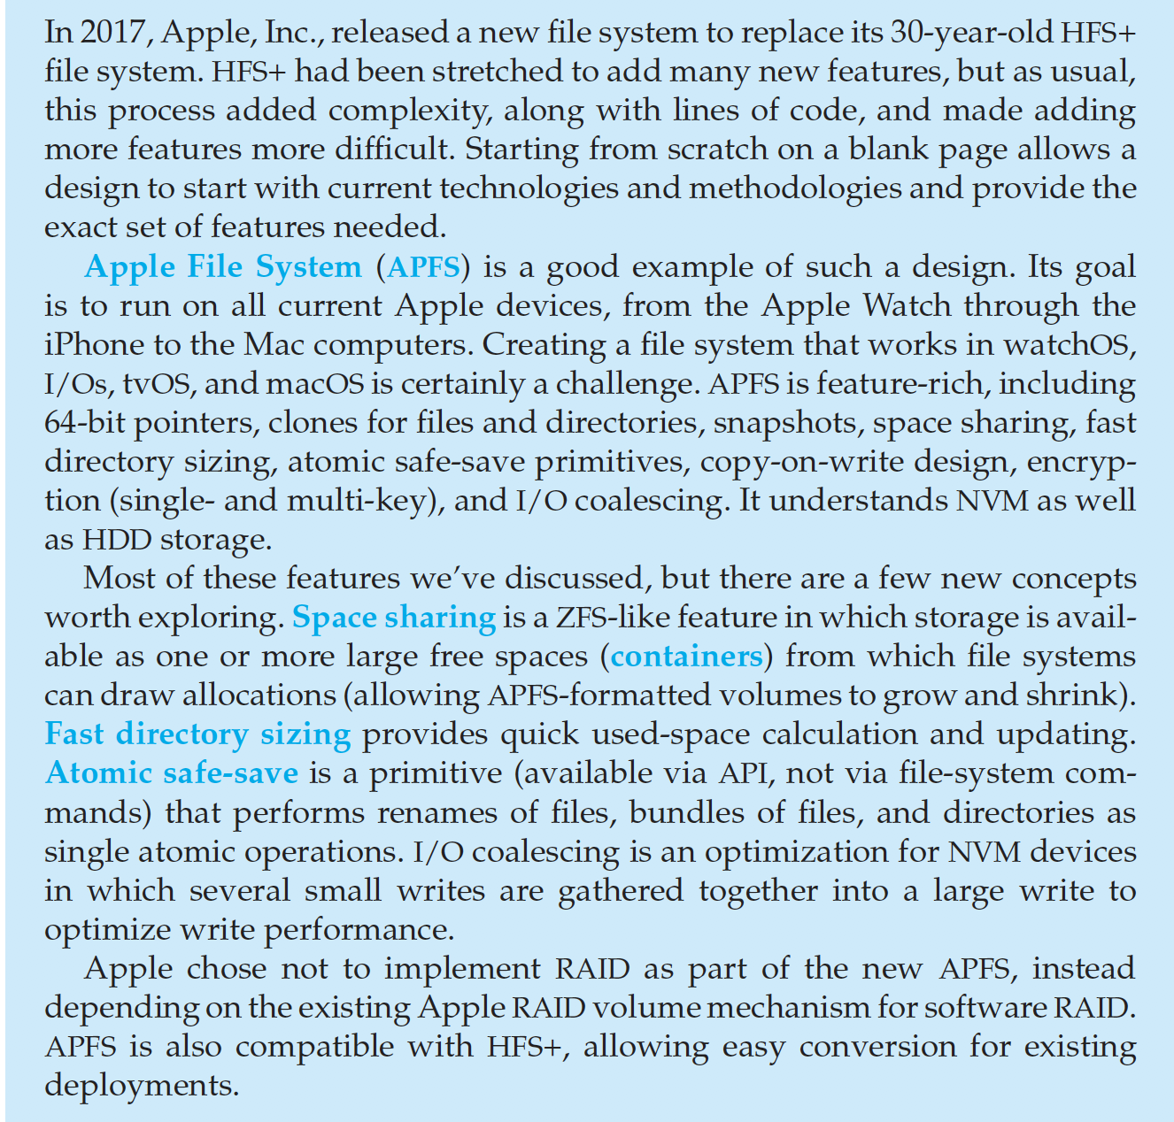
The Apple File System

Slide 51
End of Chapter 14

