Slide 1
Chapter 15: File System Internals

Slide 2
Outline大纲
File Systems
File-System Mounting.文件系统挂载
Partitions and Mounting.分区和安装
File Sharing.文件共享
Virtual File Systems.虚拟文件系统
Remote File Systems.远程文件系统
Consistency Semantics.一致性语义
NFS.网络文件系统

Slide 3
Objectives目标
Delve into the details of file systems and their implementation.深入了解文件系统及其实现的细节.
Explore booting and file sharing.探索启动和文件共享。
Describe remote file systems, using NFS as an example.描述远程文件系统，以 NFS 为例。

Slide 4
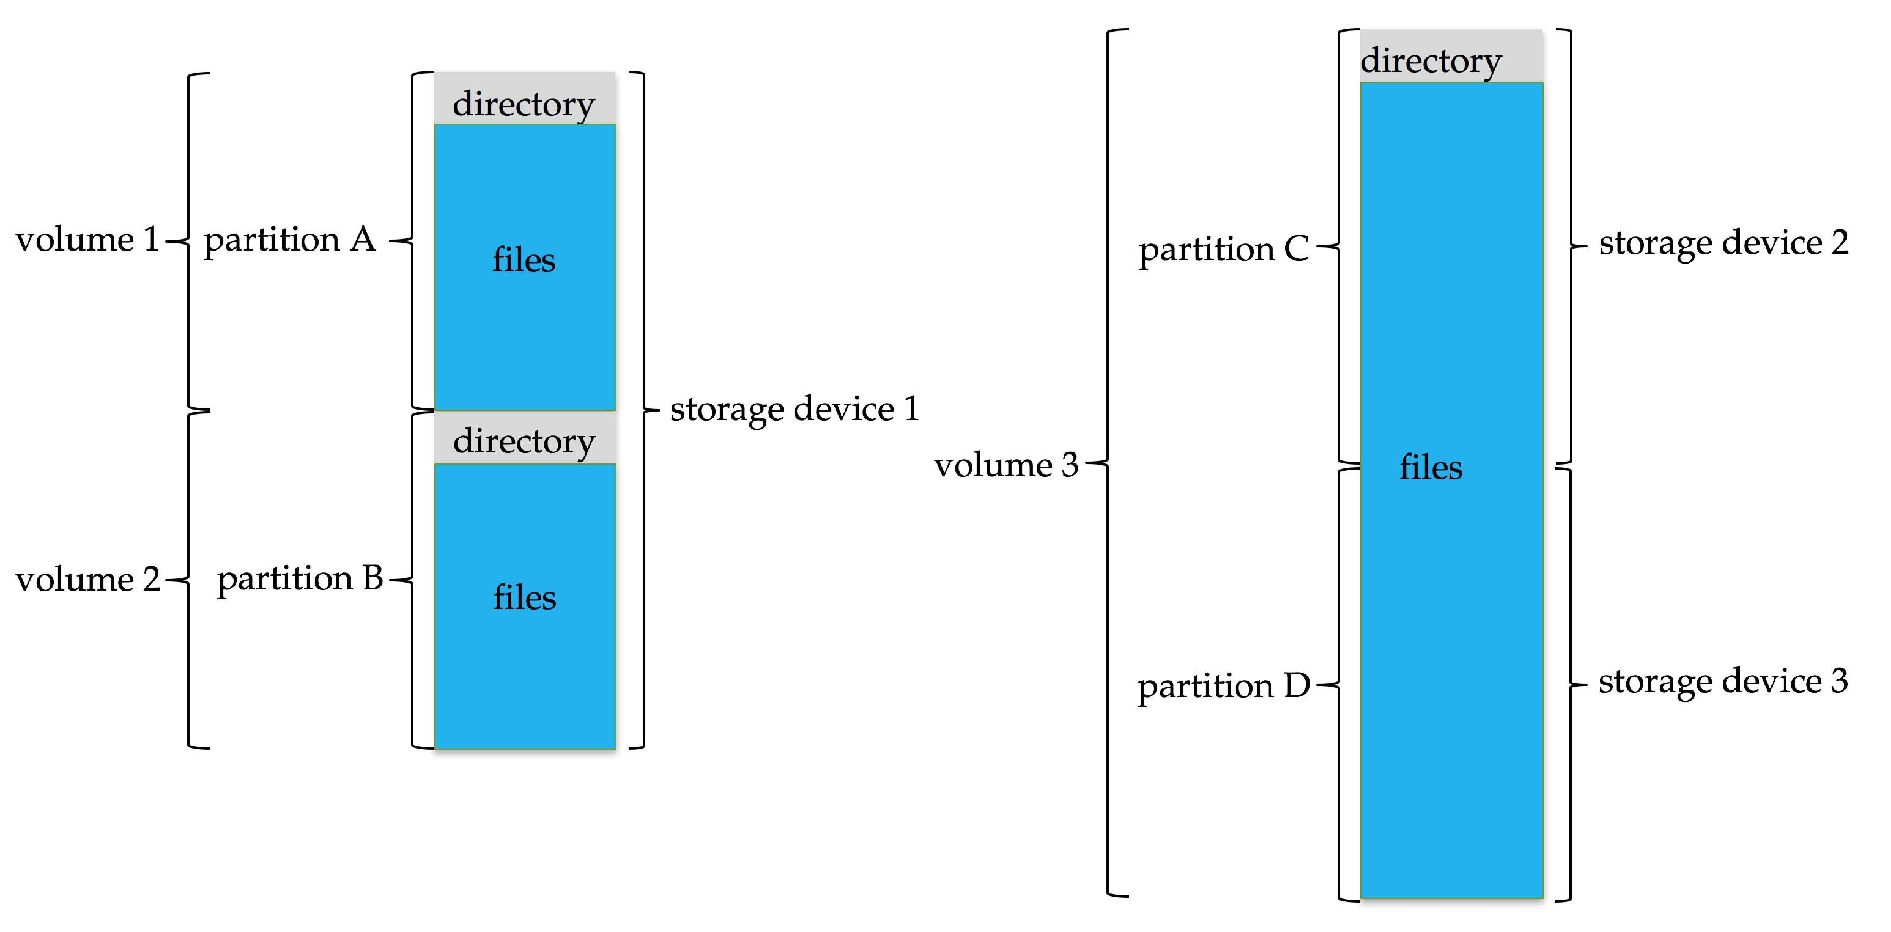
File System
General-purpose computers can have multiple storage devices.通用计算机可以有多个存储设备。
Devices can be sliced into partitions, which hold volumes.设备可以分成多个分区，这些分区包含卷.
Volumes can span multiple partitions.卷可以跨越多个分区。
Each volume usually formatted into a file system.每个卷通常都格式化为一个文件系统。
# of file systems varies, typically dozens available to choose from
Typical storage device organization:典型的存储设备组织：

Slide 5
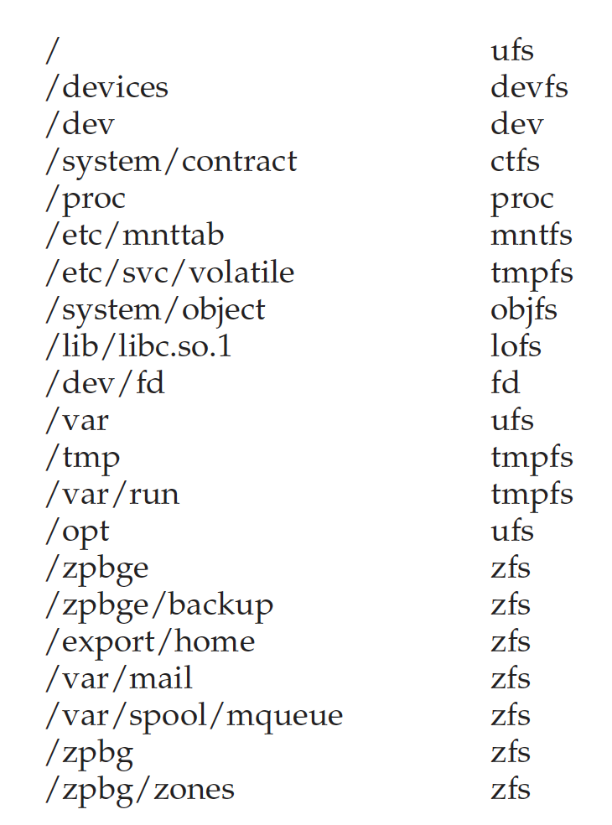
Solaris File Systems

Slide 6
Partitions and Mounting分区和安装
Partition can be a volume containing a file system (“cooked”) or raw – just a sequence of blocks with no file system.分区可以是一个包含文件系统的卷（“cooked”）或原始卷——只是一个没有文件系统的块序列.
Boot block can point to boot volume or boot loader set of blocks that contain enough code to know how to load the kernel from the file system.引导块可以指向引导卷或引导加载程序块，这些块包含足够的代码以了解如何从文件系统加载内核.
Or a boot management program for multi-os booting.或者多操作系统启动的启动管理程序.
Root partition contains the OS, other partitions can hold other OSes, other file systems, or be raw.根分区包含操作系统，其他分区可以保存其他操作系统、其他文件系统，或者是原始分区。
Mounted at boot time.启动时挂载.
Other partitions can mount automatically or manually on mount points – location at which they can be accessed.其他分区可以在挂载点上自动或手动挂载 - 可以访问它们的位置.
At mount time, file system consistency checked.在挂载时，检查文件系统一致性.
Is all metadata correct?所有元数据都正确吗？
If not, fix it, try again.如果没有，请修复它，然后再试一次。
If yes, add to mount table, allow access.如果是，添加到挂载表，允许访问

Slide 7
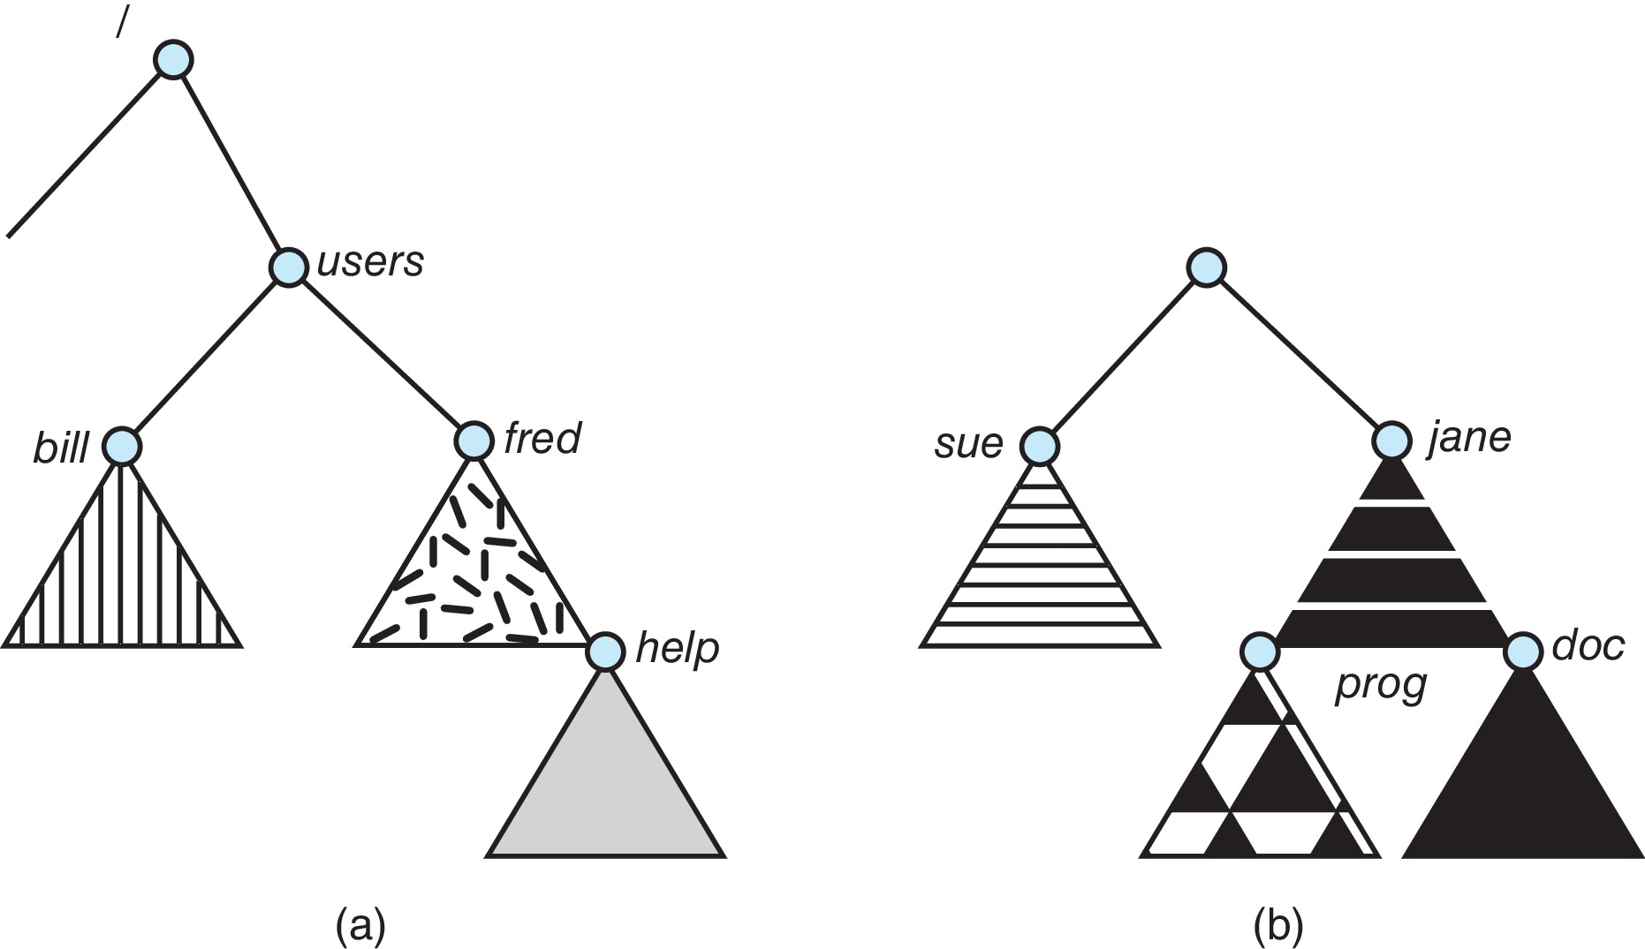
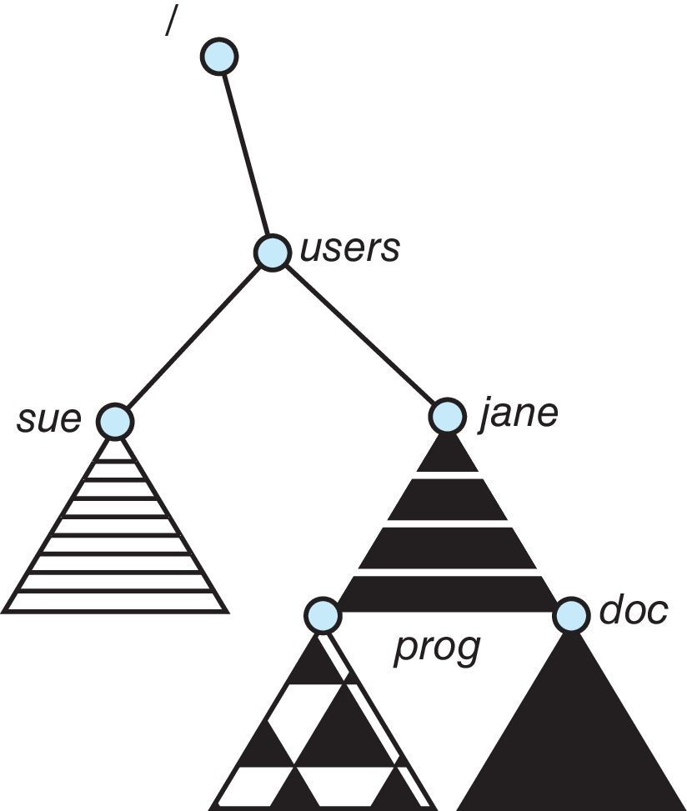
File Systems and Mounting文件系统和挂载
Unix-like file
system directory
tree.类 Unix 文件
系统目录树.
Unmounted file
system.卸载文件
系统.
After mounting (b) into the existing directory tree.挂载 (b) 到现有目录树后

Slide 8
File Sharing文件共享
Allows multiple users / systems access to the same files.允许多个用户/系统访问相同的文件.
Permissions / protection must be implemented and accurate.权限/保护必须实施且准确.
Most systems provide concepts of owner, group member.大多数系统提供所有者、组成员的概念.
Must have a way to apply these between systems.必须有办法在系统之间应用这些.

Slide 9
Virtual File Systems虚拟文件系统
Virtual File Systems (VFS) on Unix provide an object-oriented way of implementing file systems.Unix上的虚拟文件系统 (VFS) 提供了一种实现文件系统的面向对象的方式.
VFS allows the same system call interface (the API) to be used for different types of file systems.VFS允许将相同的系统调用接口API用于不同类型的文件系统.
Separates file-system generic operations from implementation details.将文件系统通用操作与实现细节分开.
Implementation can be one of many file systems types, or network file system.实现可以是多种文件系统类型中的一种，也可以是网络文件系统。
Implements vnodes which hold inodes or network file details.实现保存 inode或网络文件详细信息的vnode。
Then dispatches operation to appropriate file system implementation routines.然后将操作分派到适当的文件系统实现例程。

Slide 10
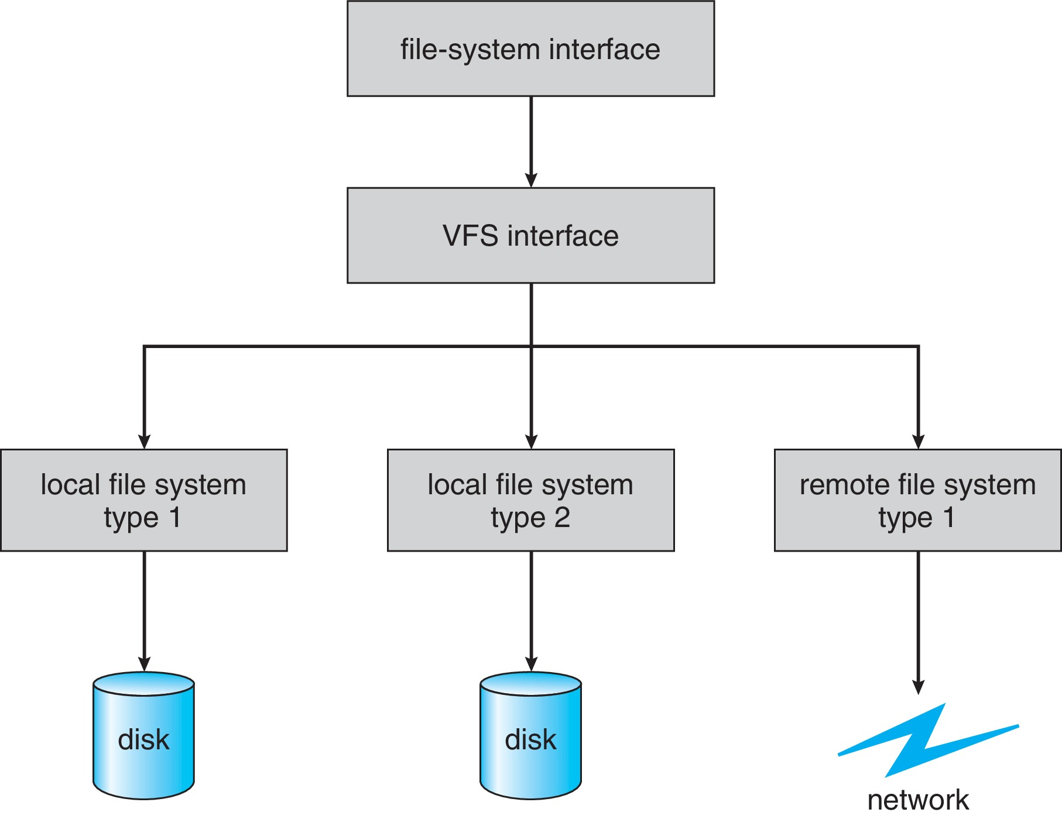
Virtual File Systems (Cont.)
The API is to the VFS interface, rather than any specific type of file system.API是针对VFS接口的，而不是任何特定类型的文件系统.
Example

Slide 11
Virtual File System Implementation
For example, Linux has four object types:例如，Linux 有四种对象类型：
inode, file, superblock, dentry
VFS defines set of operations on the objects that must be implemented.VFS定义了对必须实现的对象的一组操作.
Every object has a pointer to a function table.每个对象都有一个指向函数表的指针.
Function table has addresses of routines to implement that function on that object.函数表具有在该对象上实现该函数的例程地址。
For example:
• int open(. . .)—Open a file
• int close(. . .)—Close an already-open file
• ssize t read(. . .)—Read from a file
• ssize t write(. . .)—Write to a file
• int mmap(. . .)—Memory-map a file

Slide 12
Remote File Systems远程文件系统
Sharing of files across a network.通过网络共享文件.
First method involved manually sharing each file – programs like ftp.第一种方法涉及手动共享每个文件 - 诸如ftp之类的程序.
Second method uses a distributed file system (DFS).第二种方法使用分布式文件系统 (DFS).
Remote directories visible from local machine.从本地机器可见的远程目录.
Third method – World Wide Web.第三种方法——万维网.
A bit of a revision to first method.对第一种方法的一些修改.
Use browser to locate file/files and download /upload.使用浏览器定位文件/文件并下载/上传.
Anonymous access doesn’t require authentication.匿名访问不需要身份验证.

Slide 13
Client-Server Model客户端-服务器模型
Sharing between a server (providing access to a file system via a network protocol) and a client (using the protocol to access the remote file system).在服务器（通过网络协议提供对文件系统的访问）和客户端（使用协议访问远程文件系统）之间共享.
Identifying each other via network ID can be spoofed, encryption can be performance expensive.通过网络ID相互识别可能会被欺骗，加密可能会导致性能昂贵.
NFS an example
User auth info on clients and servers must match (UserIDs for example).客户端和服务器上的用户身份验证信息必须匹配（例如用户ID）.
Remote file system mounted, file operations sent on behalf of user across network to server.远程文件系统挂载，代表用户跨网络向服务器发送文件操作.
Server checks permissions, file handle returned.服务器检查权限，返回文件句柄.
Handle used for reads and writes until file closed.用于读取和写入直到文件关闭的句柄.

Slide 14
Distributed Information Systems分布式信息系统
Aka distributed naming services, provide unified access to info needed for remote computing.Aka分布式命名服务，提供对远程计算所需信息的统一访问.
Domain name system (DNS) provides host-name-to-network-address translations for the Internet.域名系统 (DNS) 为 Internet 提供主机名到网络地址的转换.
Others like network information service (NIS) provide user-name, password, userID, group information.其他如网络信息服务 (NIS) 提供用户名、密码、用户ID、组信息.
Microsoft’s common Internet file system (CIFS) network info used with user auth to create network logins that server uses to allow to deny access.微软的通用互联网文件系统 (CIFS) 网络信息与用户身份验证一起用于创建服务器用于拒绝访问的网络登录.
Active directory distributed naming service.Active directory分布式命名服务.
Kerberos-derived network authentication protocol.Kerberos-derived派生的网络身份验证协议.
Industry moving toward lightweight directory-access protocol (LDAP) as secure distributed naming mechanism.行业转向轻量级目录访问协议 (LDAP) 作为安全的分布式命名机制.

Slide 15
Consistency Semantics一致性语义
Important criteria for evaluating file sharing-file systems.评估文件共享文件系统的重要标准.
Specify how multiple users are to access shared file simultaneously.指定多个用户如何同时访问共享文件.
When modifications of data will be observed by other users.当其他用户会观察到数据的修改时.
Directly related to process synchronization algorithms, but atomicity across a network has high overhead (see Andrew File System).与进程同步算法直接相关，但跨网络的原子性开销很高（参见 Andrew File System）.
The series of accesses between file open and closed called file session.文件打开和关闭之间的一系列访问称为文件会话。
UNIX semantics.UNIX语义.
Writes to open file immediately visible to others with file open.写入打开的文件，其他人在打开文件时立即可见.
One mode of sharing allows users to share pointer to current I/O location in file.一种共享模式允许用户共享指向文件中当前I/O位置的指针.
Single physical image, accessed exclusively, contention causes process delays.单一物理映像，独占访问，争用导致进程延迟.
Session semantics (Andrew file system (OpenAFS)).会话语义.
Writes to open file not visible during session, only at close.写入会话期间不可见的打开文件，仅在关闭时.
Can be several copies, each changed independently.可以多份，每份独立修改.

Slide 16
The Sun Network File System (NFS)
An implementation and a specification of a software system for accessing remote files across LANs (or WANs).跨局域网（或广域网）访问远程文件的软件系统的实现和规范.
The implementation originally part of SunOS operating system, now industry standard / very common.实现原本是SunOS操作系统的一部分，现在是行业标准/很常见.
Can use unreliable datagram protocol (UDP/IP) or TCP/IP, over Ethernet or other networks.可以通过以太网或其他网络使用不可靠的数据报协议 (UDP/IP) 或 TCP/IP.

Slide 17
NFS (Cont.)
Interconnected workstations viewed as a set of independent machines with independent file systems, which allows sharing among these file systems in a transparent manner.互连工作站被视为一组具有独立文件系统的独立机器，允许以透明方式在这些文件系统之间共享.
A remote directory is mounted over a local file system directory.远程目录挂载在本地文件系统目录上.
The mounted directory looks like an integral subtree of the local file system, replacing the subtree descending from the local directory.挂载的目录看起来像是本地文件系统的一个完整的子树，替换了从本地目录降序的子树.
Specification of the remote directory for the mount operation is nontransparent; the host name of the remote directory has to be provided.指定挂载操作的远程目录是不透明的； 必须提供远程目录的主机名.
Files in the remote directory can then be accessed in a transparent manner.然后可以以透明的方式访问远程目录中的文件.
Subject to access-rights accreditation, potentially any file system (or directory within a file system), can be mounted remotely on top of any local directory.根据访问权限认证，可能任何文件系统（或文件系统中的目录）都可以远程安装在任何本地目录之上.

Slide 18
NFS (Cont.)
NFS is designed to operate in a heterogeneous environment of different machines, operating systems, and network architectures; the NFS specifications independent of these media.NFS旨在在不同机器、操作系统和网络架构的异构环境中运行； 独立于这些媒体的NFS规范.
This independence is achieved through the use of RPC primitives built on top of an External Data Representation (XDR) protocol used between two implementation-independent interfaces.这种独立性是通过使用建立在两个独立于实现的接口之间的外部数据表示 (XDR) 协议之上的RPC原语来实现的.
The NFS specification distinguishes between the services provided by a mount mechanism and the actual remote-file-access services.NFS 规范区分了挂载机制提供的服务和实际的远程文件访问服务.

Slide 19
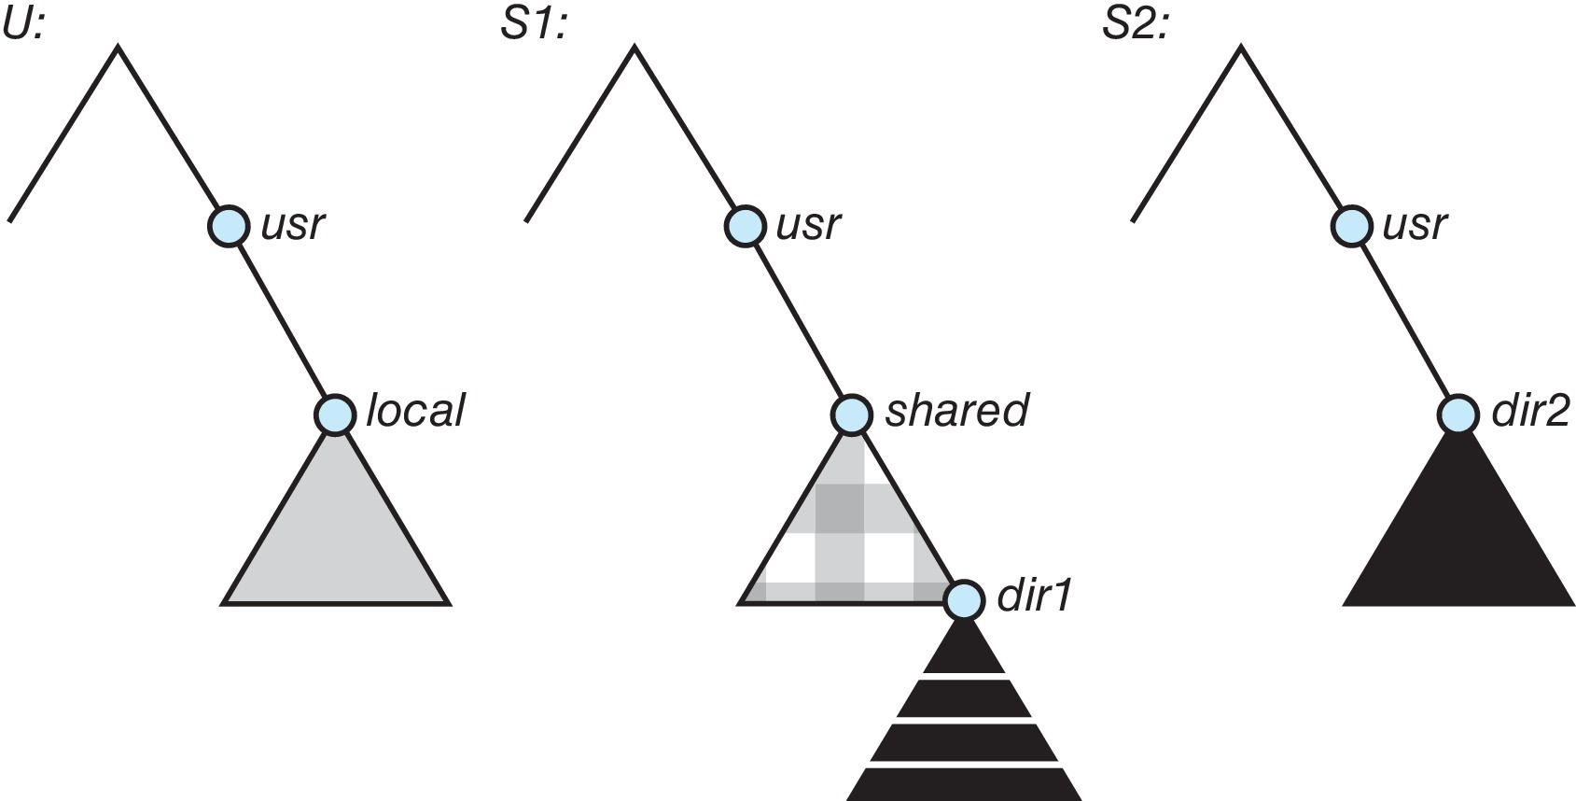
NFS Mounting Example
Three independent file systems.三个独立的文件系统

Slide 20
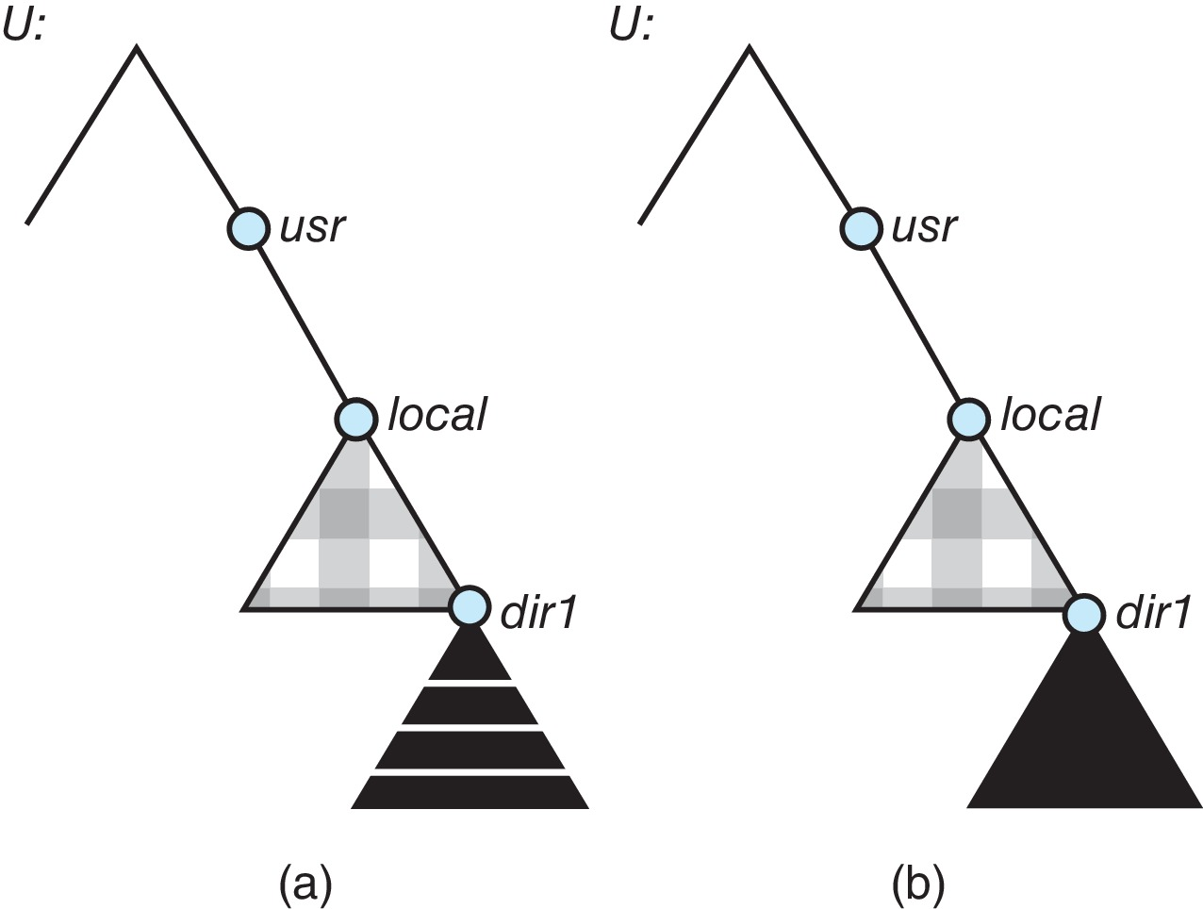
NFS Mounting Example (Cont.)
Mounts and cascading mounts.安装和级联安装
Mounts
Cascading mounts

Slide 21
NFS Mount Protocol.NFS挂载协议
Establishes initial logical connection between server and client.在服务器和客户端之间建立初始逻辑连接.
Mount operation includes name of remote directory to be mounted and name of server machine storing it.挂载操作包括要挂载的远程目录名称和存储它的服务器机器名称.
Mount request is mapped to corresponding RPC and forwarded to mount server running on server machine.挂载请求被映射到相应的RPC并转发到运行在服务器机器上的挂载服务器.
Export list – specifies local file systems that server exports for mounting, along with names of machines that are permitted to mount them.导出列表 - 指定服务器导出用于挂载的本地文件系统，以及允许挂载它们的机器名称.
Following a mount request that conforms to its export list, the server returns a file handle—a key for further accesses.在符合其导出列表的挂载请求之后，服务器返回一个文件句柄——用于进一步访问的密钥.
File handle – a file-system identifier, and an inode number to identify the mounted directory within the exported file system.文件句柄 – 文件系统标识符和inode编号，用于标识导出文件系统中的挂载目录.
The mount operation changes only the user’s view and does not affect the server side.挂载操作只改变用户的视图，不影响服务器端.

Slide 22
NFS Protocol.NFS协议
Provides a set of remote procedure calls for remote file operations. The procedures support the following operations:提供一组用于远程文件操作的远程过程调用。 这些过程支持以下操作：
searching for a file within a directory.在目录中搜索文件.
reading a set of directory entries.读取一组目录条目.
manipulating links and directories.操作链接和目录.
accessing file attributes.访问文件属性.
reading and writing files.读取和写入文件.
NFS servers are stateless; each request has to provide a full set of arguments (NFS V4 is newer, less used – very different, stateful).NFS服务器是无状态的； 每个请求都必须提供完整的参数集（NFS V4 更新，使用较少——非常不同，有状态）.
Modified data must be committed to the server’s disk before results are returned to the client (lose advantages of caching).修改后的数据必须提交到服务器的磁盘，然后才能将结果返回给客户端（失去缓存的优势）
The NFS protocol does not provide concurrency-control mechanisms.NFS协议不提供并发控制机制.

Slide 23
Three Major Layers of NFS ArchitectureNFS架构的三个主要层
UNIX file-system interface (based on the open, read, write, and close calls, and file descriptors).UNIX文件系统接口（基于打开、读取、写入和关闭调用以及文件描述符）.
Virtual File System (VFS) layer – distinguishes local files from remote ones, and local files are further distinguished according to their file-system types.虚拟文件系统（VFS）层——区分本地文件和远程文件，本地文件根据文件系统类型进一步区分.
The VFS activates file-system-specific operations to handle local requests according to their file-system types.VFS激活特定于文件系统的操作以根据其文件系统类型处理本地请求.
Calls the NFS protocol procedures for remote requests.为远程请求调用NFS协议过程.
NFS service layer – bottom layer of the architecture.NFS 服务层——架构的底层.
Implements the NFS protocol.实现 NFS 协议.

Slide 24
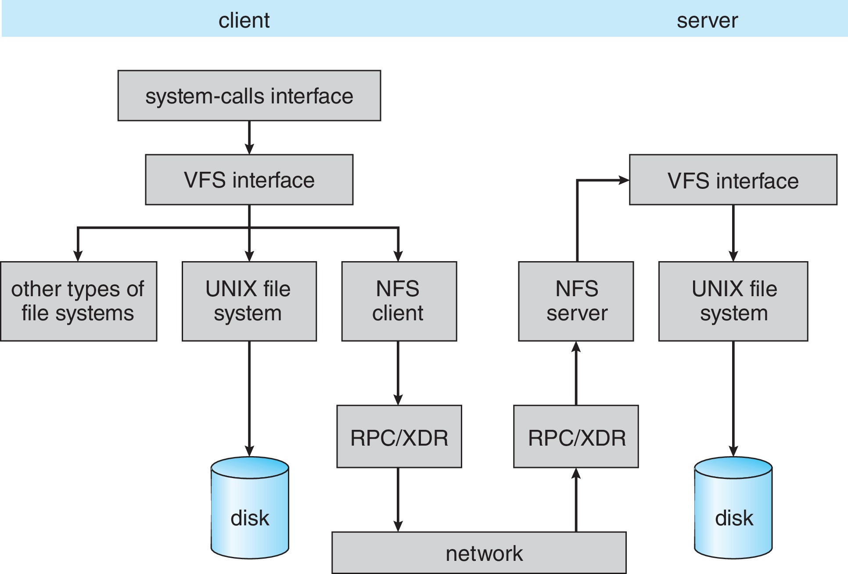
Schematic View of NFS Architecture.NFS架构示意图

Slide 25
NFS Path-Name Translation.NFS路径名转换
Performed by breaking the path into component names and performing a separate NFS lookup call for every pair of component name and directory vnode.通过将路径分解为组件名称并对每对组件名称和目录vnode执行单独的NFS查找调用来执行.
To make lookup faster, a directory name lookup cache on the client’s side holds the vnodes for remote directory names.为了加快查找速度，客户端的目录名称查找缓存保存远程目录名称的 vnode.

Slide 26
NFS Remote Operations.NFS远程操作
Nearly one-to-one correspondence between regular UNIX system calls and the NFS protocol RPCs (except opening and closing files).常规 UNIX 系统调用和 NFS 协议 RPC 之间几乎一一对应（打开和关闭文件除外）.
NFS adheres to the remote-service paradigm, but employs buffering and caching techniques for the sake of performance.NFS遵循远程服务范式，但为了性能而采用缓冲和缓存技术.
File-blocks cache – when a file is opened, the kernel checks with the remote server whether to fetch or revalidate the cached attributes.文件块缓存——当一个文件被打开时，内核与远程服务器一起检查是获取还是重新验证缓存的属性.
Cached file blocks are used only if the corresponding cached attributes are up to date.仅当相应的缓存属性是最新的时才使用缓存文件块.
File-attribute cache – the attribute cache is updated whenever new attributes arrive from the server.文件属性缓存——每当新属性从服务器到达时，属性缓存就会更新.
Clients do not free delayed-write blocks until the server confirms that the data have been written to disk.在服务器确认数据已写入磁盘之前，客户端不会释放延迟写入块.

Slide 27
End of Chapter 15

