Slide 1
Chapter 13: File-System Interface

Slide 2
Outline大纲
File Concept.文件概念。
Access Methods.访问方法。
Disk and Directory Structure.磁盘和目录结构。
Protection.保护。
Memory-Mapped Files.内存映射文件。

Slide 3
Objectives目标
To explain the function of file systems.解释文件系统的功能。
To describe the interfaces to file systems.描述文件系统的接口。
To discuss file-system design tradeoffs, including access methods, file sharing, file locking, and directory structures.讨论文件系统设计权衡，包括访问方法、文件共享、文件锁定和目录结构。
To explore file-system protection.探索文件系统保护。

Slide 4
File Concept文件概念
Contiguous logical address space.连续的逻辑地址空间。
Types:
Data
Numeric
Character
Binary
Program
Contents defined by file’s creator
Many types
text file,
source file,
executable file

Slide 5
File Attributes文件属性
Name – only information kept in human-readable form.名称 - 仅以人类可读形式保存的信息。
Identifier – unique tag (number) identifies file within file system.标识符 – 唯一标签（编号）标识文件系统中的文件。
Type – needed for systems that support different types.类型 - 支持不同类型的系统需要。
Location – pointer to file location on device.位置 - 指向设备上文件位置的指针。
Size – current file size
Protection – controls who can do reading, writing, executing.保护——控制谁可以读、写、执行。
Time, date, and user identification – data for protection, security, and usage monitoring.时间、日期和用户标识——用于保护、安全和使用监控的数据。
Information about files are kept in the directory structure, which is maintained on the disk.有关文件的信息保存在磁盘上维护的目录结构中。
Many variations, including extended file attributes such as file checksum.许多变体，包括扩展文件属性，例如文件校验和。
Information kept in the directory structure.信息保存在目录结构中。

Slide 6
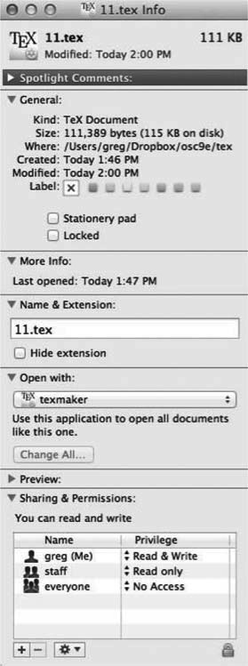
File info Window on Mac OS X

Slide 7
Directory Structure目录结构
A collection of nodes containing information about all files.包含所有文件信息的节点集合。
Both the directory structure and the files reside on disk.目录结构和文件都驻留在磁盘上。

Slide 8
File Operations文件操作
Create
Write – at write pointer location.写——在写指针位置
Read – at read pointer location
Reposition within file - seek.在文件中重新定位 - 查找
Delete
Truncate.截断
Open (F_{i}) – search the directory structure on disk for entry F_{i}, and move the content of entry to memory.Open (Fi) – 在磁盘上的目录结构中搜索条目 Fi，并将条目的内容移动到内存中。
Close (F_{i}) – move the content of entry F_{i} in memory to directory structure on disk.Close (Fi) – 将内存中条目 Fi 的内容移动到磁盘上的目录结构。

Slide 9
Open Files
Several pieces of data are needed to manage open files:管理打开的文件需要几条数据：
Open-file table: tracks open files.打开文件表：跟踪打开的文件。
File pointer: pointer to last read/write location, per process that has the file open.文件指针：指向打开文件的每个进程的最后读/写位置的指针。
File-open count: counter of number of times a file is open – to allow removal of data from open-file table when last processes closes it.文件打开计数：文件打开次数的计数器 - 允许在最后一个进程关闭打开文件表时从打开文件表中删除数据。
Disk location of the file: cache of data access information.文件的磁盘位置：数据访问信息的缓存。
Access rights: per-process access mode information.访问权限：每个进程的访问模式信息。

Slide 10
File Locking
Provided by some operating systems and file systems.由一些操作系统和文件系统提供。
Similar to reader-writer locks.类似于读写锁。
Shared lock similar to reader lock – several processes can acquire concurrently.共享锁类似于读锁——多个进程可以同时获取。
Exclusive lock similar to writer lock.排他锁类似于写锁。
Mediates access to a file.调解对文件的访问。
Mandatory or advisory:强制性或咨询性：
Mandatory – access is denied depending on locks held and requested.强制 - 根据持有和请求的锁拒绝访问。
Advisory – processes can find status of locks and decide what to do.咨询 - 进程可以找到锁的状态并决定要做什么。

Slide 11
File Locking Example – Java API
import java.io.*;
import java.nio.channels.*;
public class LockingExample {
public static final boolean EXCLUSIVE = false;
public static final boolean SHARED = true;
public static void main(String arsg[]) throws IOException {
FileLock sharedLock = null;
FileLock exclusiveLock = null;
try {
RandomAccessFile raf = new RandomAccessFile("file.txt", "rw");
// get the channel for the file
FileChannel ch = raf.getChannel();
// this locks the first half of the file - exclusive
exclusiveLock = ch.lock(0, raf.length()/2, EXCLUSIVE);
/** Now modify the data . . . */
// release the lock
exclusiveLock.release();

Slide 12
File Locking Example – Java API (Cont.)
// this locks the second half of the file - shared
sharedLock = ch.lock(raf.length()/2+1, raf.length(), SHARED);
/** Now read the data . . . */
// release the lock
sharedLock.release();
} catch (java.io.IOException ioe) {
System.err.println(ioe);
}finally {
if (exclusiveLock != null)
exclusiveLock.release();
if (sharedLock != null)
sharedLock.release();
}
}
}

Slide 13
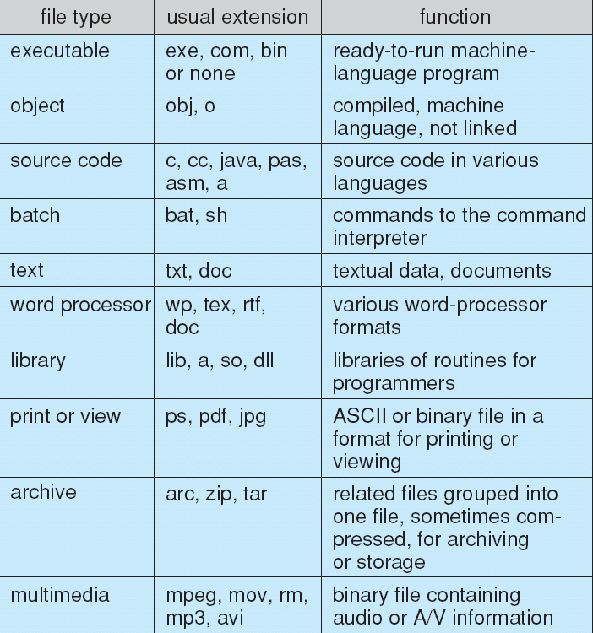
File Types – Name, Extension

Slide 14
File Structure
None - sequence of words, bytes
Simple record structure
Lines
Fixed length
Variable length
Complex Structures
Formatted document
Relocatable load file
Can simulate last two with first method by inserting appropriate control characters
Who decides:
Operating system
Program

Slide 15
Access Methods
A file is fixed length logical records
Sequential Access
Direct Access
Other Access Methods

Slide 16
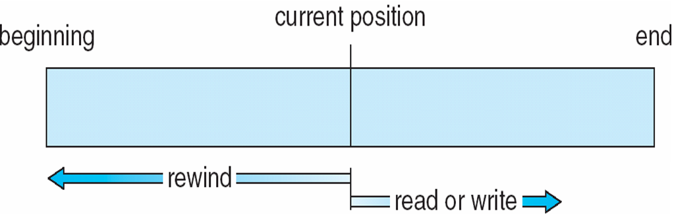
Sequential Access
Operations
read next
write next
Reset
no read after last write (rewrite)
Figure

Slide 17
Direct Access
Operations
read n
write n
position to n
read next
write next
rewrite n
n = relative block number
Relative block numbers allow OS to decide where file should be placed

Slide 18
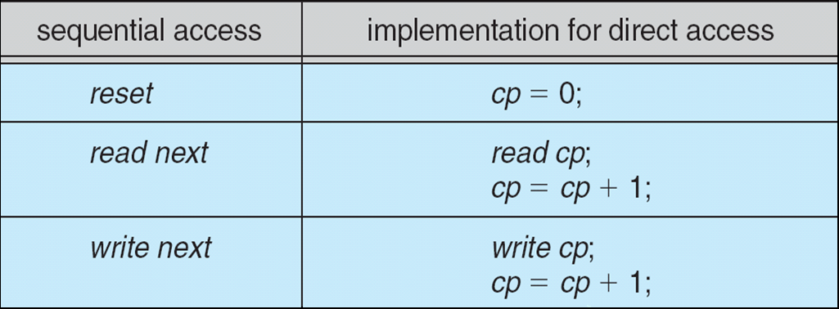
Simulation of Sequential Access on Direct-access File

Slide 19
Other Access Methods
Can be other access methods built on top of base methods
General involve creation of an index for the file
Keep index in memory for fast determination of location of data to be operated on (consider Universal Produce Code (UPC code) plus record of data about that item)
If the index is too large, create an in-memory index, which an index of a disk index
IBM indexed sequential-access method (ISAM)
Small master index, points to disk blocks of secondary index
File kept sorted on a defined key
All done by the OS
VMS operating system provides index and relative files as another example (see next slide)

Slide 20
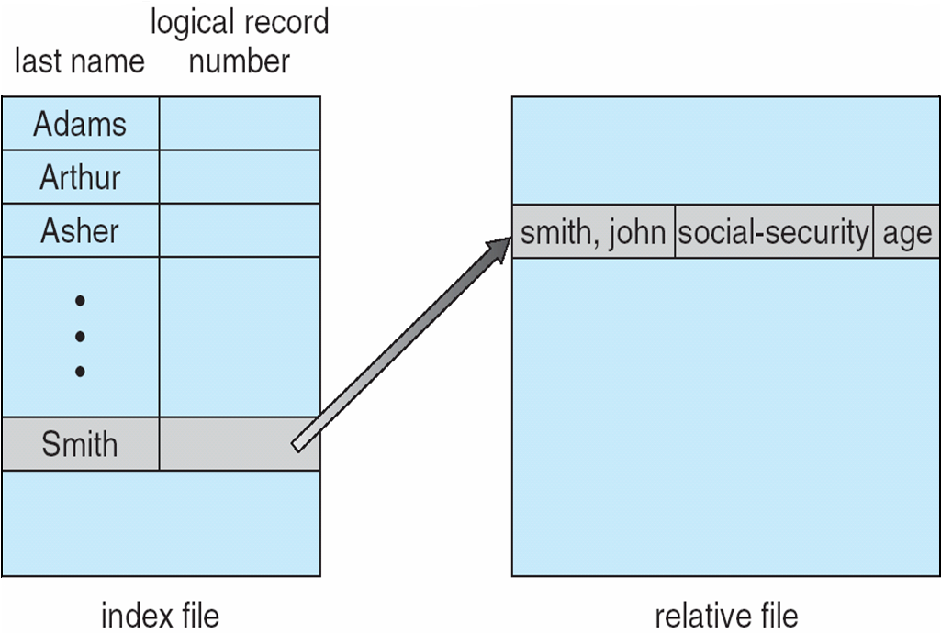
Example of Index and Relative Files

Slide 21
Disk Structure
Disk can be subdivided into partitions
Disks or partitions can be RAID protected against failure
Disk or partition can be used raw – without a file system, or formatted with a file system
Partitions also known as minidisks, slices
Entity containing file system is known as a volume
Each volume containing a file system also tracks that file system’s info in device directory or volume table of contents
In addition to general-purpose file systems there are many special-purpose file systems, frequently all within the same operating system or computer

Slide 22
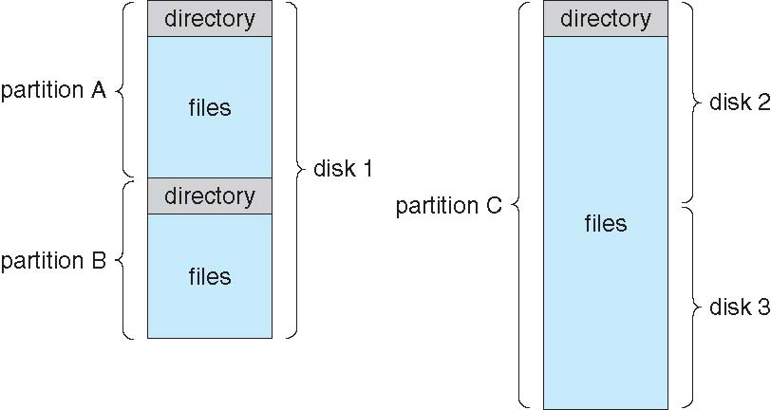
A Typical File-system Organization

Slide 23
Types of File Systems
We mostly talk of general-purpose file systems
But systems frequently have may file systems, some general- and some special- purpose
Consider Solaris has
tmpfs – memory-based volatile FS for fast, temporary I/O
objfs – interface into kernel memory to get kernel symbols for debugging
ctfs – contract file system for managing daemons
lofs – loopback file system allows one FS to be accessed in place of another
procfs – kernel interface to process structures
ufs, zfs – general purpose file systems

Slide 24
Directory Structure
A collection of nodes containing information about all files
Both the directory structure and the files reside on disk

Slide 25
Operations Performed on Directory
Search for a file
Create a file
Delete a file
List a directory
Rename a file
Traverse the file system

Slide 26
Directory Organization
The directory is organized logically to obtain
Efficiency – locating a file quickly
Naming – convenient to users
Two users can have same name for different files
The same file can have several different names
Grouping – logical grouping of files by properties, (e.g., all Java programs, all games, …)

Slide 27
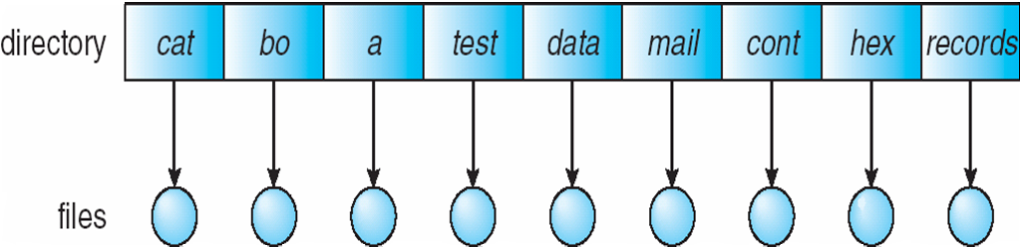
Single-Level Directory
A single directory for all users
Naming problem
Grouping problem

Slide 28
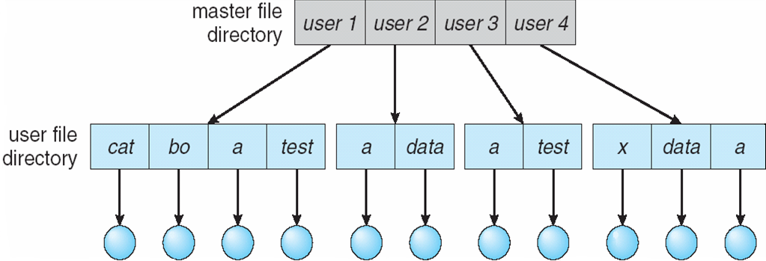
Two-Level Directory
Separate directory for each user
Path name
Can have the same file name for different user
Efficient searching
No grouping capability

Slide 29
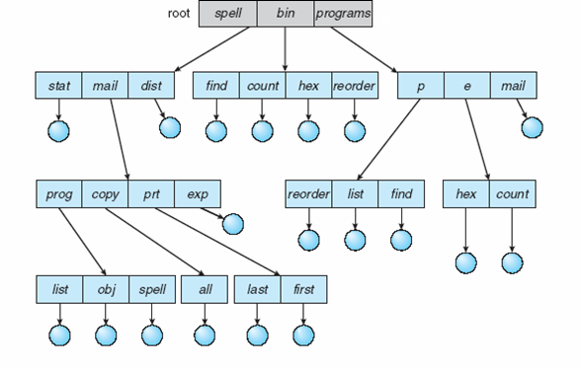
Tree-Structured Directories

Slide 30
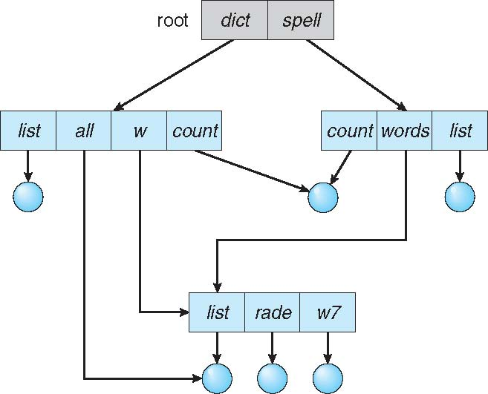
Acyclic-Graph Directories
Have shared subdirectories and files
Example

Slide 31
Acyclic-Graph Directories (Cont.)
Two different names (aliasing)
If dict deletes w/list ⇒ dangling pointer
Solutions:
Backpointers, so we can delete all pointers.
Variable size records a problem
Backpointers using a daisy chain organization
Entry-hold-count solution
New directory entry type
Link – another name (pointer) to an existing file
Resolve the link – follow pointer to locate the file

Slide 32
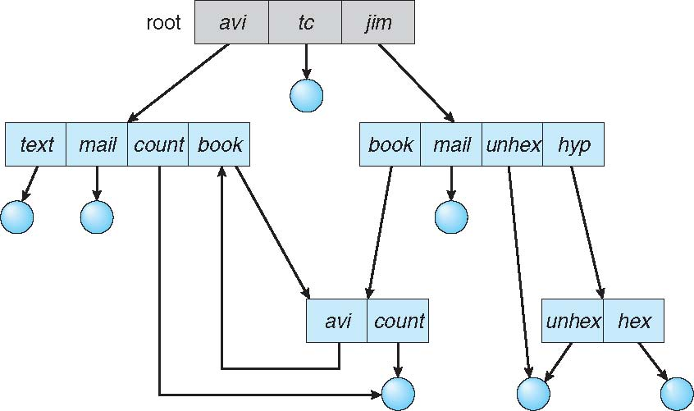
General Graph Directory

Slide 33
General Graph Directory (Cont.)
How do we guarantee no cycles?
Allow only links to files not subdirectories
Garbage collection
Every time a new link is added use a cycle detection algorithm to determine whether it is OK

Slide 34
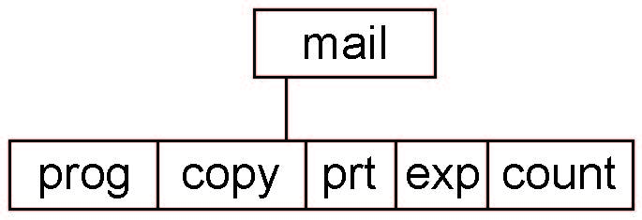
Current Directory
Can designate one of the directories as the current (working) directory
cd /spell/mail/prog
type list
Creating and deleting a file is done in current directory
Example of creating a new file
If in current directory is /mail
The command
mkdir <dir-name>
Results in:
Deleting “mail” ⇒ deleting the entire subtree rooted by “mail”

Slide 35
Protection
File owner/creator should be able to control:
What can be done
By whom
Types of access
Read
Write
Execute
Append
Delete
List

Slide 36
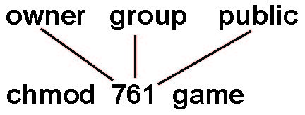
Access Lists and Groups in Unix
Mode of access: read, write, execute
Three classes of users on Unix / Linux
RWX
a) owner access 7 ⇒ 1 1 1 RWX
b) group access 6 ⇒ 1 1 0
RWX
c) public access 1 ⇒ 0 0 1
Ask manager to create a group (unique name), say G, and add some users to the group.
For a file (say game) or subdirectory, define an appropriate access.
Attach a group to a file
chgrp G game

Slide 37
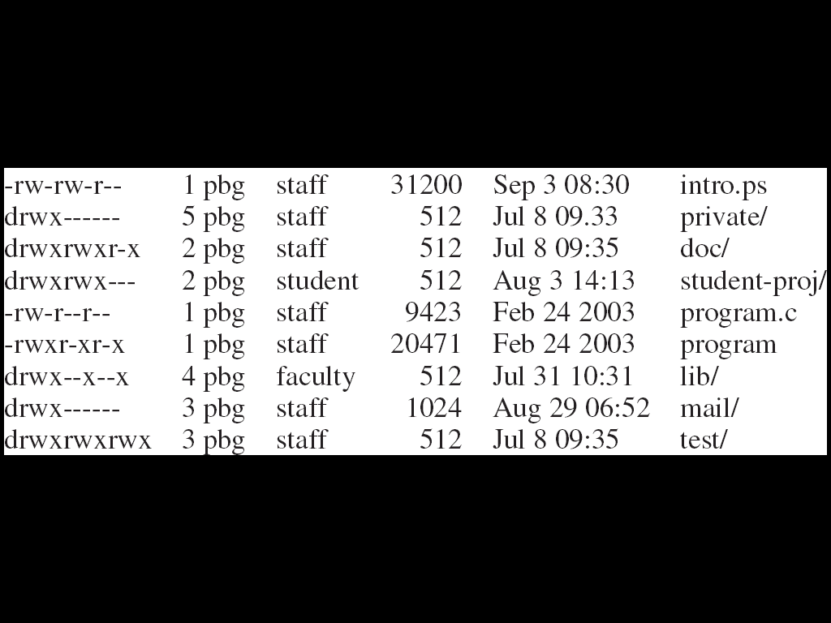
A Sample UNIX Directory Listing

Slide 38
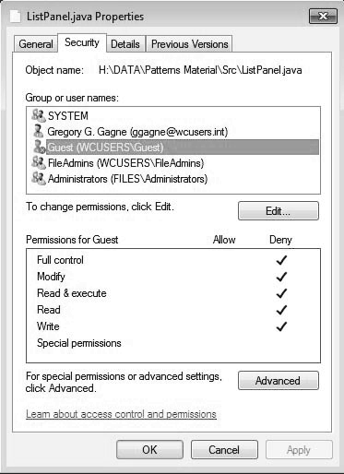
Windows 7 Access-Control List Management

Slide 39
Memory-Mapped Files

Slide 40
End of Chapter 13

