Slide 1
Chapter 13: File-System Interface

Slide 2
Outline大纲
File Concept.文件概念。
Access Methods.访问方法。
Disk and Directory Structure.磁盘和目录结构。
Protection.保护。
Memory-Mapped Files.内存映射文件。

Slide 3
Objectives目标
To explain the function of file systems.解释文件系统的功能。
To describe the interfaces to file systems.描述文件系统的接口。
To discuss file-system design tradeoffs, including access methods, file sharing, file locking, and directory structures.讨论文件系统设计权衡，包括访问方法、文件共享、文件锁定和目录结构。
To explore file-system protection.探索文件系统保护。

Slide 4
File Concept文件概念
Contiguous logical address space.连续的逻辑地址空间。
Types: 类型:
Data.数据
Numeric.数字
Character.字符
Binary.二进制
Program.程序
Contents defined by file’s creator.由文件的创建者定义的内容
Many types
text file,
source file,
executable file

Slide 5
File Attributes文件属性
Name – only information kept in human-readable form.名称 - 仅以人类可读形式保存的信息。
Identifier – unique tag (number) identifies file within file system.标识符 – 唯一标签（编号）标识文件系统中的文件。
Type – needed for systems that support different types.类型 - 支持不同类型的系统需要。
Location – pointer to file location on device.位置 - 指向设备上文件位置的指针。
Size – current file size
Protection – controls who can do reading, writing, executing.保护——控制谁可以读、写、执行。
Time, date, and user identification – data for protection, security, and usage monitoring.时间、日期和用户标识——用于保护、安全和使用监控的数据。
Information about files are kept in the directory structure, which is maintained on the disk.有关文件的信息保存在磁盘上维护的目录结构中。
Many variations, including extended file attributes such as file checksum.许多变体，包括扩展文件属性，例如文件校验和。
Information kept in the directory structure.信息保存在目录结构中。

Slide 6
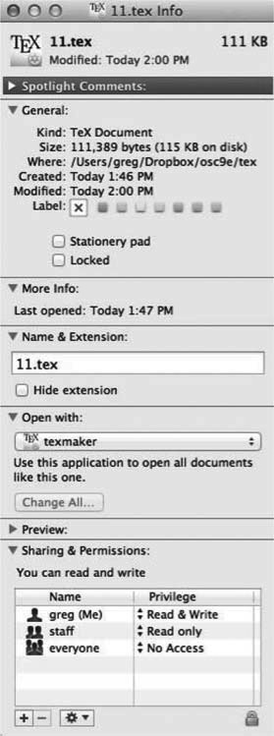
File info Window on Mac OS X

Slide 7
Directory Structure目录结构
A collection of nodes containing information about all files.包含所有文件信息的节点集合。
Both the directory structure and the files reside on disk.目录结构和文件都驻留在磁盘上。

Slide 8
File Operations文件操作
Create
Write – at write pointer location.写——在写指针位置
Read – at read pointer location
Reposition within file - seek.在文件中重新定位 - 查找
Delete
Truncate.截断
Open (F_{i}) – search the directory structure on disk for entry F_{i}, and move the content of entry to memory.Open (Fi) – 在磁盘上的目录结构中搜索条目 Fi，并将条目的内容移动到内存中。
Close (F_{i}) – move the content of entry F_{i} in memory to directory structure on disk.Close (Fi) – 将内存中条目 Fi 的内容移动到磁盘上的目录结构。

Slide 9
Open Files
Several pieces of data are needed to manage open files:管理打开的文件需要几条数据：
Open-file table: tracks open files.打开文件表：跟踪打开的文件。
File pointer: pointer to last read/write location, per process that has the file open.文件指针：指向打开文件的每个进程的最后读/写位置的指针。
File-open count: counter of number of times a file is open – to allow removal of data from open-file table when last processes closes it.文件打开计数：文件打开次数的计数器 - 允许在最后一个进程关闭打开文件表时从打开文件表中删除数据。
Disk location of the file: cache of data access information.文件的磁盘位置：数据访问信息的缓存。
Access rights: per-process access mode information.访问权限：每个进程的访问模式信息。

Slide 10
File Locking
Provided by some operating systems and file systems.由一些操作系统和文件系统提供。
Similar to reader-writer locks.类似于读写锁。
Shared lock similar to reader lock – several processes can acquire concurrently.共享锁类似于读锁——多个进程可以同时获取。
Exclusive lock similar to writer lock.排他锁类似于写锁。
Mediates access to a file.调解对文件的访问。
Mandatory or advisory:强制性或咨询性：
Mandatory – access is denied depending on locks held and requested.强制 - 根据持有和请求的锁拒绝访问。
Advisory – processes can find status of locks and decide what to do.咨询 - 进程可以找到锁的状态并决定要做什么。

Slide 11
File Locking Example – Java API
import java.io.*;
import java.nio.channels.*;
public class LockingExample {
public static final boolean EXCLUSIVE = false;
public static final boolean SHARED = true;
public static void main(String arsg[]) throws IOException {
FileLock sharedLock = null;
FileLock exclusiveLock = null;
try {
RandomAccessFile raf = new RandomAccessFile("file.txt", "rw");
// get the channel for the file
FileChannel ch = raf.getChannel();
// this locks the first half of the file - exclusive
exclusiveLock = ch.lock(0, raf.length()/2, EXCLUSIVE);
/** Now modify the data . . . */
// release the lock
exclusiveLock.release();

Slide 12
File Locking Example – Java API (Cont.)
// this locks the second half of the file - shared
sharedLock = ch.lock(raf.length()/2+1, raf.length(), SHARED);
/** Now read the data . . . */
// release the lock
sharedLock.release();
} catch (java.io.IOException ioe) {
System.err.println(ioe);
}finally {
if (exclusiveLock != null)
exclusiveLock.release();
if (sharedLock != null)
sharedLock.release();
}
}
}

Slide 13
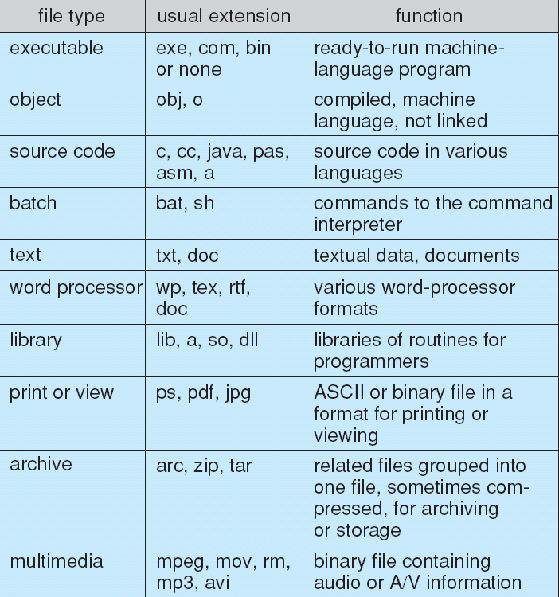
File Types – Name, Extension

Slide 14
File Structure
None - sequence of words, bytes
Simple record structure
Lines
Fixed length
Variable length
Complex Structures
Formatted document
Relocatable load file
Can simulate last two with first method by inserting appropriate control characters.可以通过插入适当的控制字符用第一种方法模拟后两个.
Who decides:谁来决定：
Operating system
Program

Slide 15
Access Methods访问方法
A file is fixed length logical records.一个文件是定长的逻辑记录。
Sequential Access.顺序访问
Direct Access.直接访问
Other Access Methods.其他访问方法

Slide 16
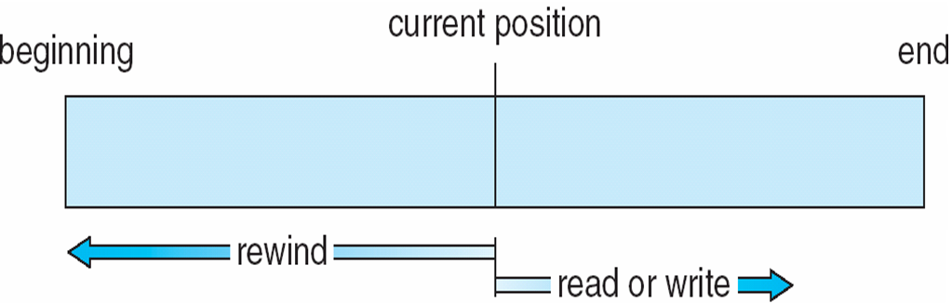
Sequential Access顺序访问
Operations
read next
write next
Reset
no read after last write (rewrite).上次写入后没有读取（重写）
Figure图解
rewind倒带

Slide 17
Direct Access直接访问
Operations
read n
write n
position to n
read next
write next
rewrite n
n = relative block number.相对块号
Relative block numbers allow OS to decide where file should be placed.相对块号允许操作系统决定文件应该放置的位置。

Slide 18
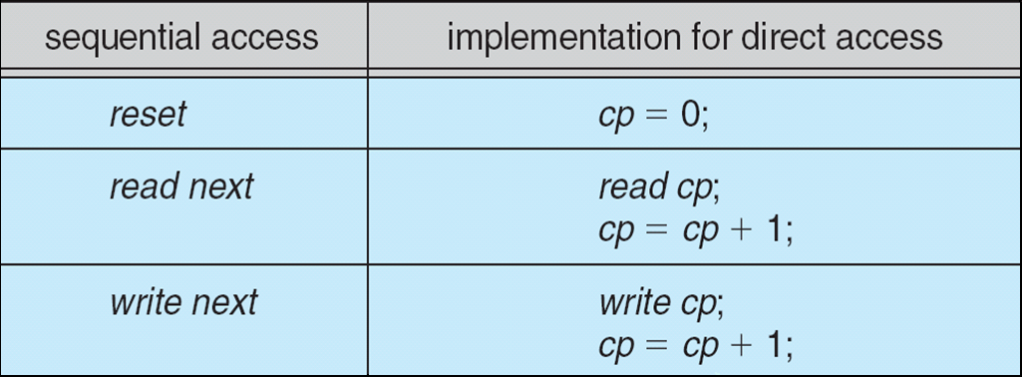
Simulation of Sequential Access on Direct-access File直接访问文件的顺序访问模拟

Slide 19
Other Access Methods其他访问方法
Can be other access methods built on top of base methods.可以是建立在基本方法之上的其他访问方法。
General involve creation of an index for the file.一般涉及为文件创建索引。
Keep index in memory for fast determination of location of data to be operated on (consider Universal Produce Code (UPC code) plus record of data about that item).将索引保存在内存中，以便快速确定要操作的数据的位置（考虑通用生产代码（UPC 代码）加上有关该项目的数据记录）。
If the index is too large, create an in-memory index, which an index of a disk index.如果索引太大，创建一个内存索引，它是一个磁盘索引的索引。
IBM indexed sequential-access method (ISAM).IBM 索引顺序访问方法 (ISAM)。
Small master index, points to disk blocks of secondary index.小的主索引，指向二级索引的磁盘块。
File kept sorted on a defined key.文件按定义的键排序。
All done by the OS.全部由操作系统完成。
VMS operating system provides index and relative files as another example (see next slide).VMS 操作系统提供索引和相关文件作为另一个例子（见下一张幻灯片）

Slide 20
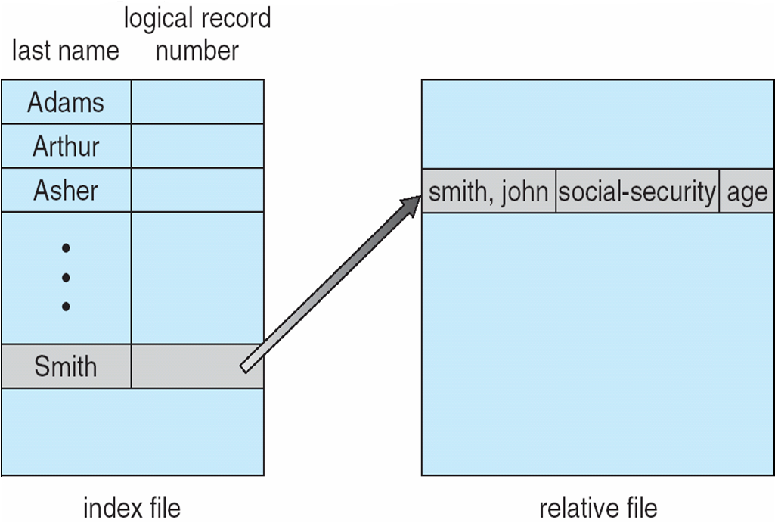
Example of Index and Relative Files

Slide 21
Disk Structure磁盘结构
Disk can be subdivided into partitions.磁盘可以细分为分区。
Disks or partitions can be RAID protected against failure.磁盘或分区可以进行RAID保护以防止出现故障。
Disk or partition can be used raw – without a file system, or formatted with a file system.磁盘或分区可以原始使用——没有文件系统，或者用文件系统格式化。
Partitions also known as minidisks, slices.分区也称为微型磁盘、切片。
Entity containing file system is known as a volume.包含文件系统的实体称为卷。
Each volume containing a file system also tracks that file system’s info in device directory or volume table of contents.每个包含文件系统的卷还会在设备目录或卷目录中跟踪该文件系统的信息。
In addition to general-purpose file systems there are many special-purpose file systems, frequently all within the same operating system or computer.除了通用文件系统之外，还有许多专用文件系统，通常都在同一操作系统或计算机中。

Slide 22
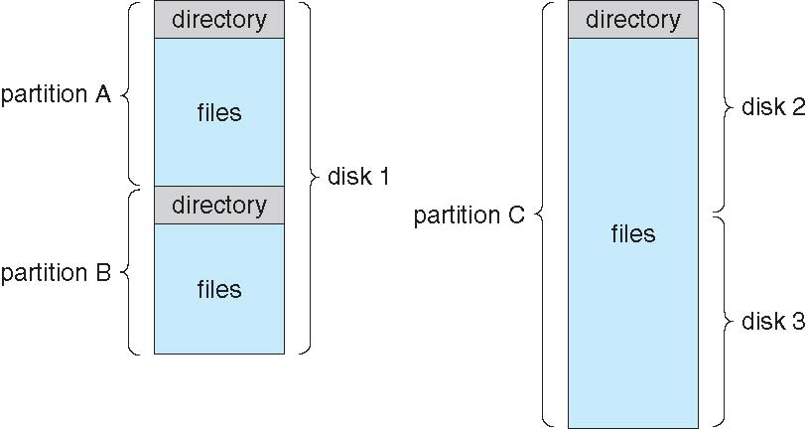
A Typical File-system Organization典型的文件系统组织

Slide 23
Types of File Systems文件系统的类型
We mostly talk of general-purpose file systems.我们主要谈论通用文件系统。
But systems frequently have may file systems, some general- and some special- purpose.但是系统经常有多个文件系统，有些是通用的，有些是特殊用途的。
Consider Solaris has.考虑Solaris了
tmpfs – memory-based volatile FS for fast, temporary I/O.tmpfs – 用于快速临时I/O的基于内存的易失性 FS。
objfs – interface into kernel memory to get kernel symbols for debugging.objfs – 与内核内存的接口以获取内核符号以进行调试。
ctfs – contract file system for managing daemons. ctfs – 用于管理守护进程的合约文件系统。
lofs – loopback file system allows one FS to be accessed in place of another.lofs – 环回文件系统允许访问一个FS来代替另一个。
procfs – kernel interface to process structures.procfs – 进程结构的内核接口。
ufs, zfs – general purpose file systems.ufs、zfs——通用文件系统。

Slide 24
Directory Structure目录结构
A collection of nodes containing information about all files
包含所有文件信息的节点集合
Both the directory structure and the files reside on disk
目录结构和文件都驻留在磁盘上

Slide 25
Operations Performed on Directory对目录执行的操作
Search for a file
Create a file
Delete a file
List a directory
Rename a file
Traverse the file system.遍历文件系统

Slide 26
Directory Organization目录组织
The directory is organized logically to obtain.该目录按逻辑组织以获取。
Efficiency – locating a file quickly.效率 ——快速定位文件。
Naming – convenient to users.命名——方便用户。
Two users can have same name for different files.两个用户可以为不同的文件使用相同的名称。
The same file can have several different names.同一个文件可以有多个不同的名称。
Grouping – logical grouping of files by properties, (e.g., all Java programs, all games, …).分组——按属性对文件进行逻辑分组（例如，所有Java 程序、所有游戏……）。

Slide 27
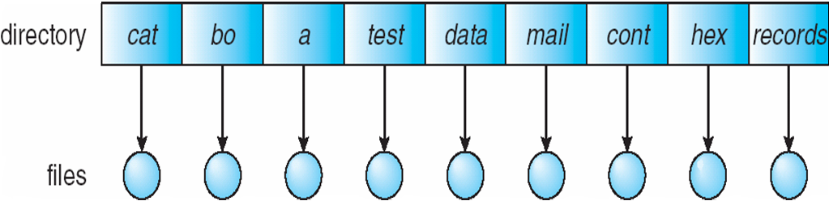
Single-Level Directory单级目录
A single directory for all users.所有用户共用单一目录
Naming problem.命名问题。
Grouping problem.分组问题

Slide 28
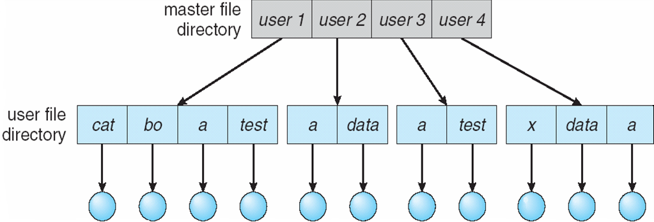
Two-Level Directory两级目录
Separate directory for each user.每个用户一个单独的目录
Path name.路径名
Can have the same file name for different user.不同用户可以有相同的文件名
Efficient searching.高效搜索
No grouping capability.没有分组功能

Slide 29
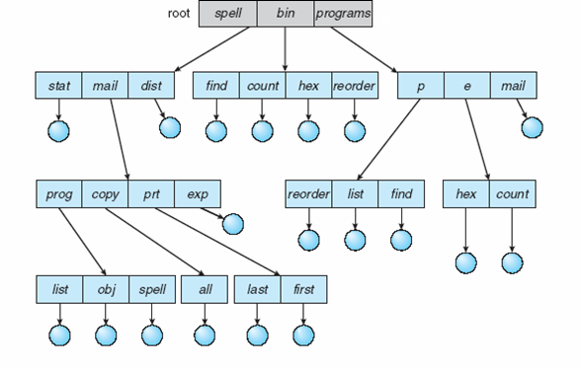
Tree-Structured Directories树结构目录

Slide 30
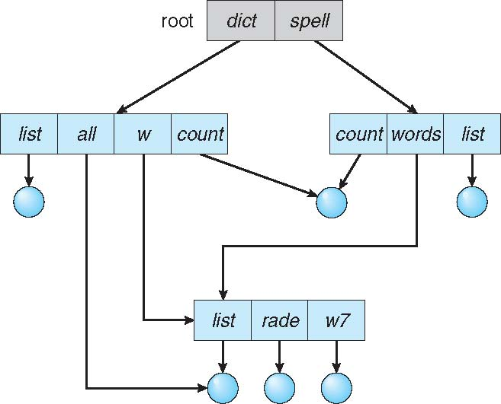
Acyclic-Graph Directories无环图目录
Have shared subdirectories and files.有共享的子目录和文件。
Example

Slide 31
Acyclic-Graph Directories (Cont.)
Two different names (aliasing).两个不同的名称（别名）。
If dict deletes w/list ⇒ dangling pointer.如果 dict 删除 w/list ⇒ 悬空指针
Solutions:解决方案：
Backpointers, so we can delete all pointers.反向指针，因此我们可以删除所有指针。
Variable size records a problem.可变大小记录了一个问题。
Backpointers using a daisy chain organization.使用串级链组织的反向指针。
Entry-hold-count solution.进入保留计数解决方案。
New directory entry type.新的目录条目类型。
Link – another name (pointer) to an existing file.链接 – 指向现有文件的另一个名称（指针）。
Resolve the link – follow pointer to locate the file.解析链接 - 按照指针定位文件。

Slide 32
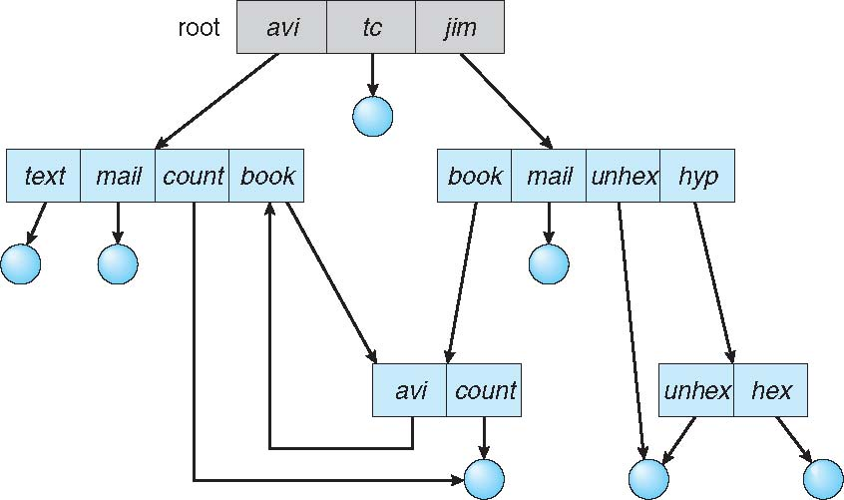
General Graph Directory通用图目录

Slide 33
General Graph Directory (Cont.)
How do we guarantee no cycles?我们如何保证没有循环？
Allow only links to files not subdirectories.只允许链接到文件而不是子目录。
Garbage collection.垃圾回收
Every time a new link is added use a cycle detection algorithm to determine whether it is OK.每次添加新链接时，使用循环检测算法来确定它是否正常。

Slide 34
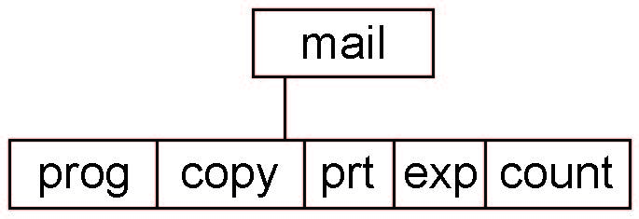
Current Directory当前目录
Can designate one of the directories as the current (working) directory.可以将目录之一指定为当前（工作）目录。
cd /spell/mail/prog
type list
Creating and deleting a file is done in current directory.创建和删除文件在当前目录中完成。
Example of creating a new file
If in current directory is /mail
The command
mkdir <dir-name>
Results in:
Deleting “mail” ⇒ deleting the entire subtree rooted by “mail”.删除“mail” ⇒ 删除以“mail”为根的整个子树

Slide 35
Protection保护
File owner/creator should be able to control:文件所有者/创建者应该能够控制：
What can be done.可以做什么。
By whom.由谁
Types of access.访问类型。
Read
Write
Execute
Append
Delete
List

Slide 36
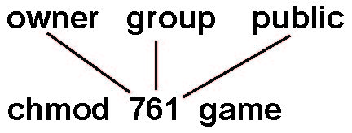
Access Lists and Groups in Unix.Unix中的访问列表和组
Mode of access: read, write, execute.访问方式：读、写、执行
Three classes of users on Unix / Linux.Unix / Linux 上的三类用户。
RWX
a) owner access 7 ⇒ 1 1 1 RWX
b) group access 6 ⇒ 1 1 0
RWX
c) public access 1 ⇒ 0 0 1
Ask manager to create a group (unique name), say G, and add some users to the group.请管理员创建一个组（唯一名称），比如说 G，然后将一些用户添加到该组中。
For a file (say game) or subdirectory, define an appropriate access.对于文件（例如游戏）或子目录，定义适当的访问权限。
Attach a group to a file.将组附加到文件
chgrp G game

Slide 37
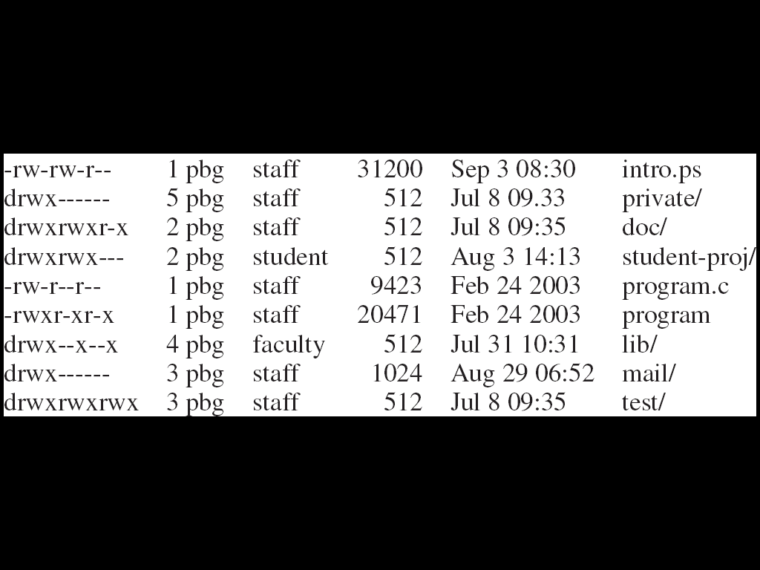
A Sample UNIX Directory Listing.UNIX目录列表示例

Slide 38
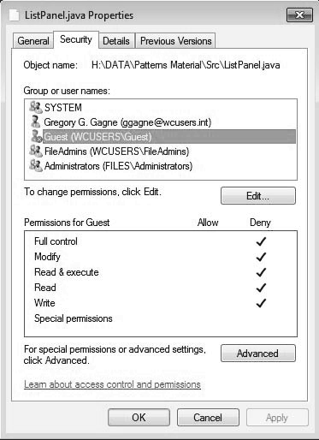
Windows 7 Access-Control List Management.Windows 7访问控制清单管理

Slide 39
Memory-Mapped Files 内存映射文件

Slide 40
End of Chapter 13

