Slide 1
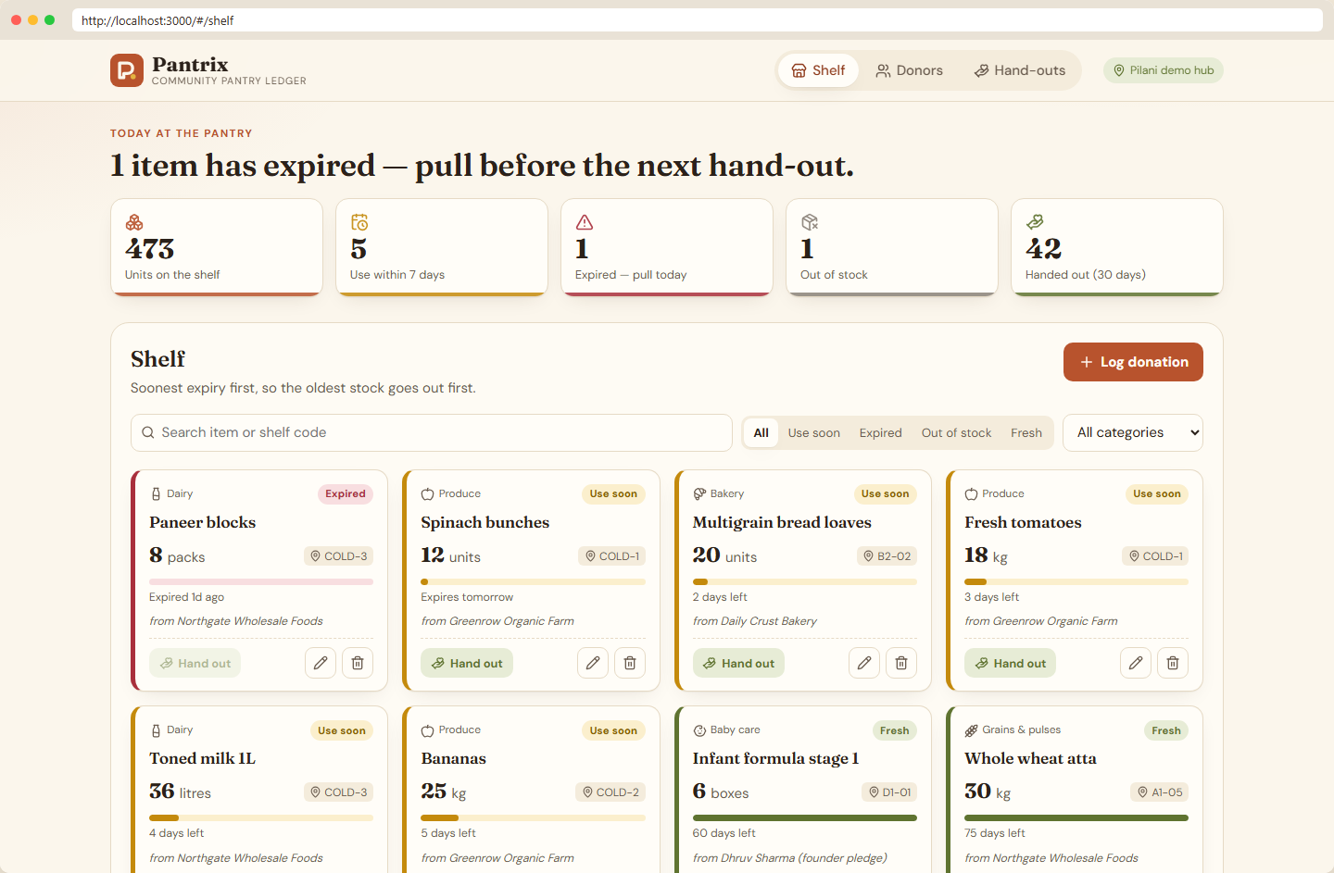
Pantrix
Donated stock and expiry tracking for community food banks, taken from a laptop to a monitored Kubernetes cluster
DevSecOps capstone · Dhruv Sharma · @Spiritsfuse · github.com/spiritsfuse
Notes:
Hi, I am Dhruv Sharma (GitHub Spiritsfuse). This is Pantrix, my DevSecOps capstone. Pantrix helps a community food bank track donated stock and its expiry dates so food goes out before it spoils. In this talk I cover the app, the architecture, testing, Docker, the CI/CD pipeline with security gates, Terraform for AWS, Kubernetes with Helm and Argo CD, observability, and the troubleshooting drills. After the slides I switch to a live walkthrough.

Slide 2
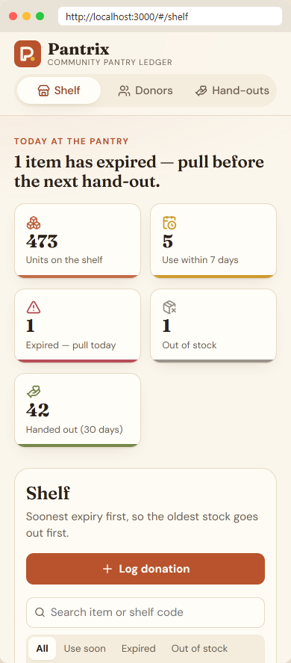
Food banks lose donated food to expiry, not to demand
Know what expires first
Every item has an expiry date; the shelf is sorted soonest-first and flagged Use soon (7 days), Expired or Out of stock.
Record every hand-out
Distributions decrement stock in one transaction; expired or over-asked stock is refused with HTTP 409.
Credit donors
Farms, kitchens and neighbours are tracked with the items they gave.
Shelf view served by Docker Compose (localhost:3000)
390 px mobile layout
Notes:
The problem: donated food is often lost because nobody knows what expires first. Pantrix sorts the shelf by expiry, flags items that should go out this week, records every hand-out and credits donors. The screenshots are the real app running in Docker Compose, on desktop and at 390 pixels on mobile.

Slide 3
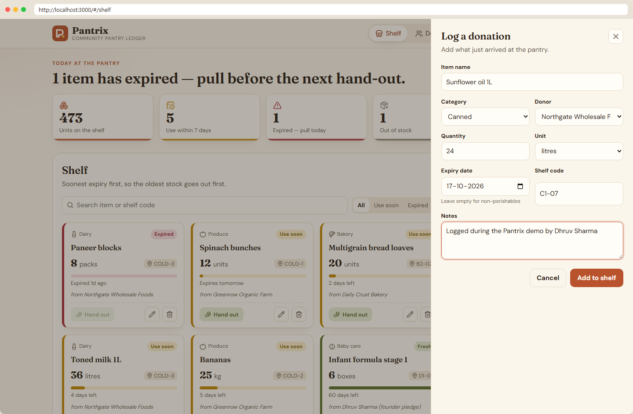
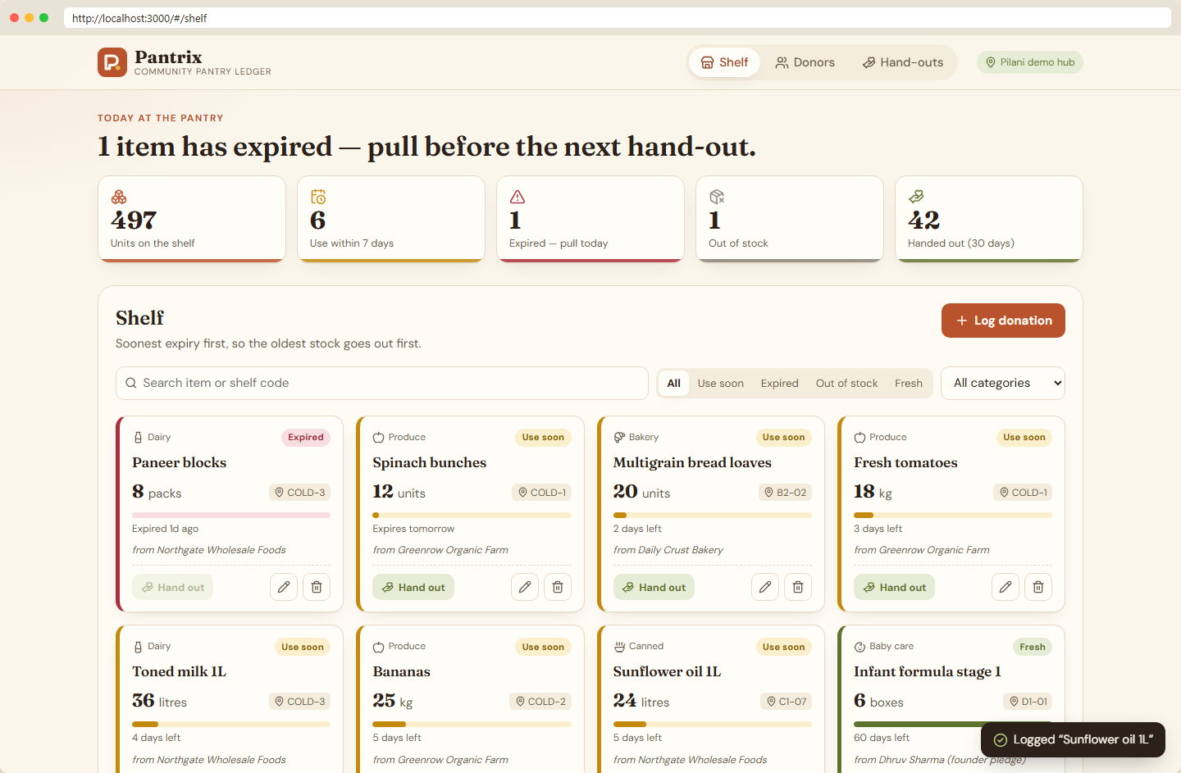
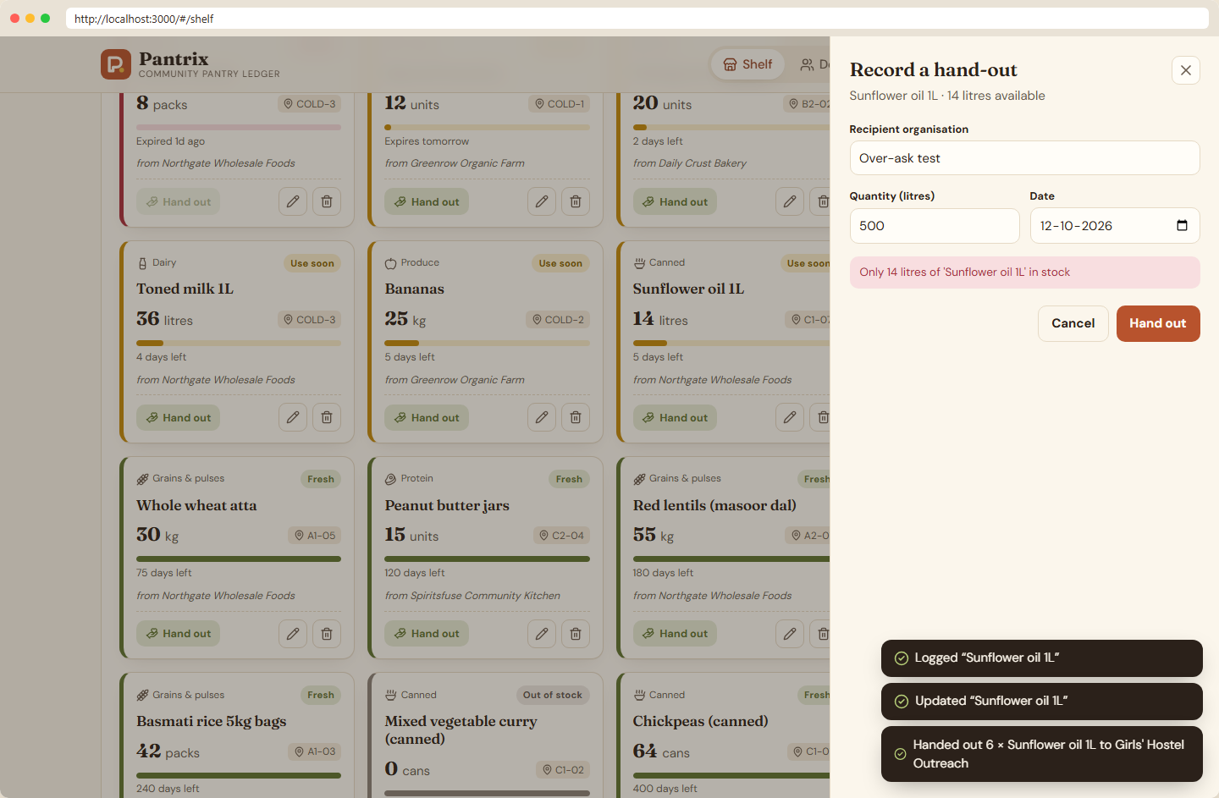
Real CRUD through the API, validation users can see
Create: log a donation in the slide-in form
Created: toast, KPI strip and shelf update
API rule: cannot hand out more than in stock (409)
React 19 + Vite frontend calls relative /api paths, so the same build works behind Vite, Nginx and the Ingress
Every screen has loading skeletons, empty states, error banners with retry, and success toasts
Captured with Playwright against the live stack: create, edit, hand out, API conflict, delete (docs/evidence/crud-*.png)
Notes:
These are screenshots of a real create, update, hand-out and delete flow captured with Playwright against the running stack. The third one shows a domain rule enforced by the API: you cannot hand out more stock than exists, and the API answers 409 with a message that the form shows to the user.

Slide 4
Tech stack
Application
Quality gates
Containers
React 19 · Vite 8 · FastAPI · SQLAlchemy 2 · Alembic · PostgreSQL 17 · Pydantic validation
pytest + coverage · Vitest + Testing Library · Ruff · ESLint · Prettier · Bandit · pip-audit · npm audit
Multi-stage Dockerfiles · non-root users · nginx-unprivileged · Docker Compose with health checks
CI/CD and security
Platform
Operations
GitHub Actions · Trivy (images + IaC) · Gitleaks · CycloneDX SBOM · GHCR with commit-SHA tags · provenance
Terraform (AWS VPC + EKS) · kind · Helm · ingress-nginx · HPA + metrics-server · NetworkPolicy
Argo CD (GitOps) · Prometheus Operator · Grafana · JSON logs · five troubleshooting drills
Notes:
The stack follows a standard reference architecture: React and Vite, FastAPI, PostgreSQL with SQLAlchemy and Alembic, pytest, Docker, GitHub Actions, Trivy, GHCR, Terraform for AWS VPC and EKS, Kubernetes with Helm, Ingress and HPA, Prometheus and Grafana. On top of that I added Gitleaks, SBOMs, provenance attestations, Argo CD for GitOps, network policies and troubleshooting drills.

Slide 5
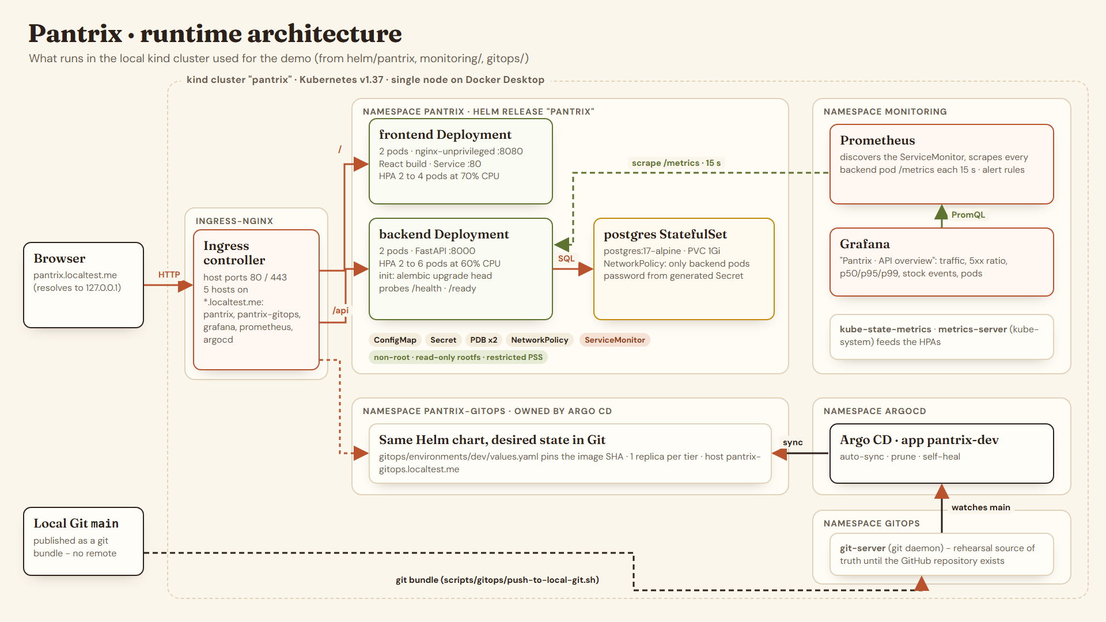
Runtime architecture on the local kind cluster
Notes:
Traffic enters through ingress-nginx. Slash goes to the frontend Nginx pods, slash api goes straight to the FastAPI pods. The backend runs Alembic in an init container, talks to PostgreSQL in a StatefulSet with a persistent volume, and only backend pods may reach the database because of a NetworkPolicy. Prometheus scrapes every backend pod through a ServiceMonitor and Grafana shows the dashboard. A second copy of the same chart in pantrix-gitops is owned by Argo CD, which watches a Git server in the cluster for the local rehearsal.

Slide 6
Data model and REST API
donors
Method | Path | Purpose
GET | /api/items | list; filter by category, status, search
GET | /api/items/stats | KPIs: units, expiring, expired, hand-outs
GET · PUT · DELETE | /api/items/{id} | read, partial update, remove (404 if missing)
POST | /api/items | create, 201; 422 on invalid input
GET · POST | /api/donors | list with item counts; create (409 on duplicate)
GET · PUT · DELETE | /api/donors/{id} | read, update, delete (items kept)
GET · POST | /api/distributions | history; hand out (409 if short or expired)
GET | /health · /ready · /metrics | liveness, DB readiness, Prometheus
name (unique) · donor_type · contact_email · city
stock_items
name · category · quantity >= 0 · unit · expiry_date · location · donor_id (SET NULL)
distributions
item_id · quantity > 0 · recipient · distributed_on; creating one decrements stock under a row lock
Created by Alembic migration 0001_initial_schema
Notes:
Three tables, all created by an Alembic migration: donors, stock items and distributions. The API has full CRUD for items and donors plus distributions, statistics, and the health, readiness and metrics endpoints. Validation errors return 422, missing records 404, and business rule conflicts such as handing out more than is in stock return 409.

Slide 7
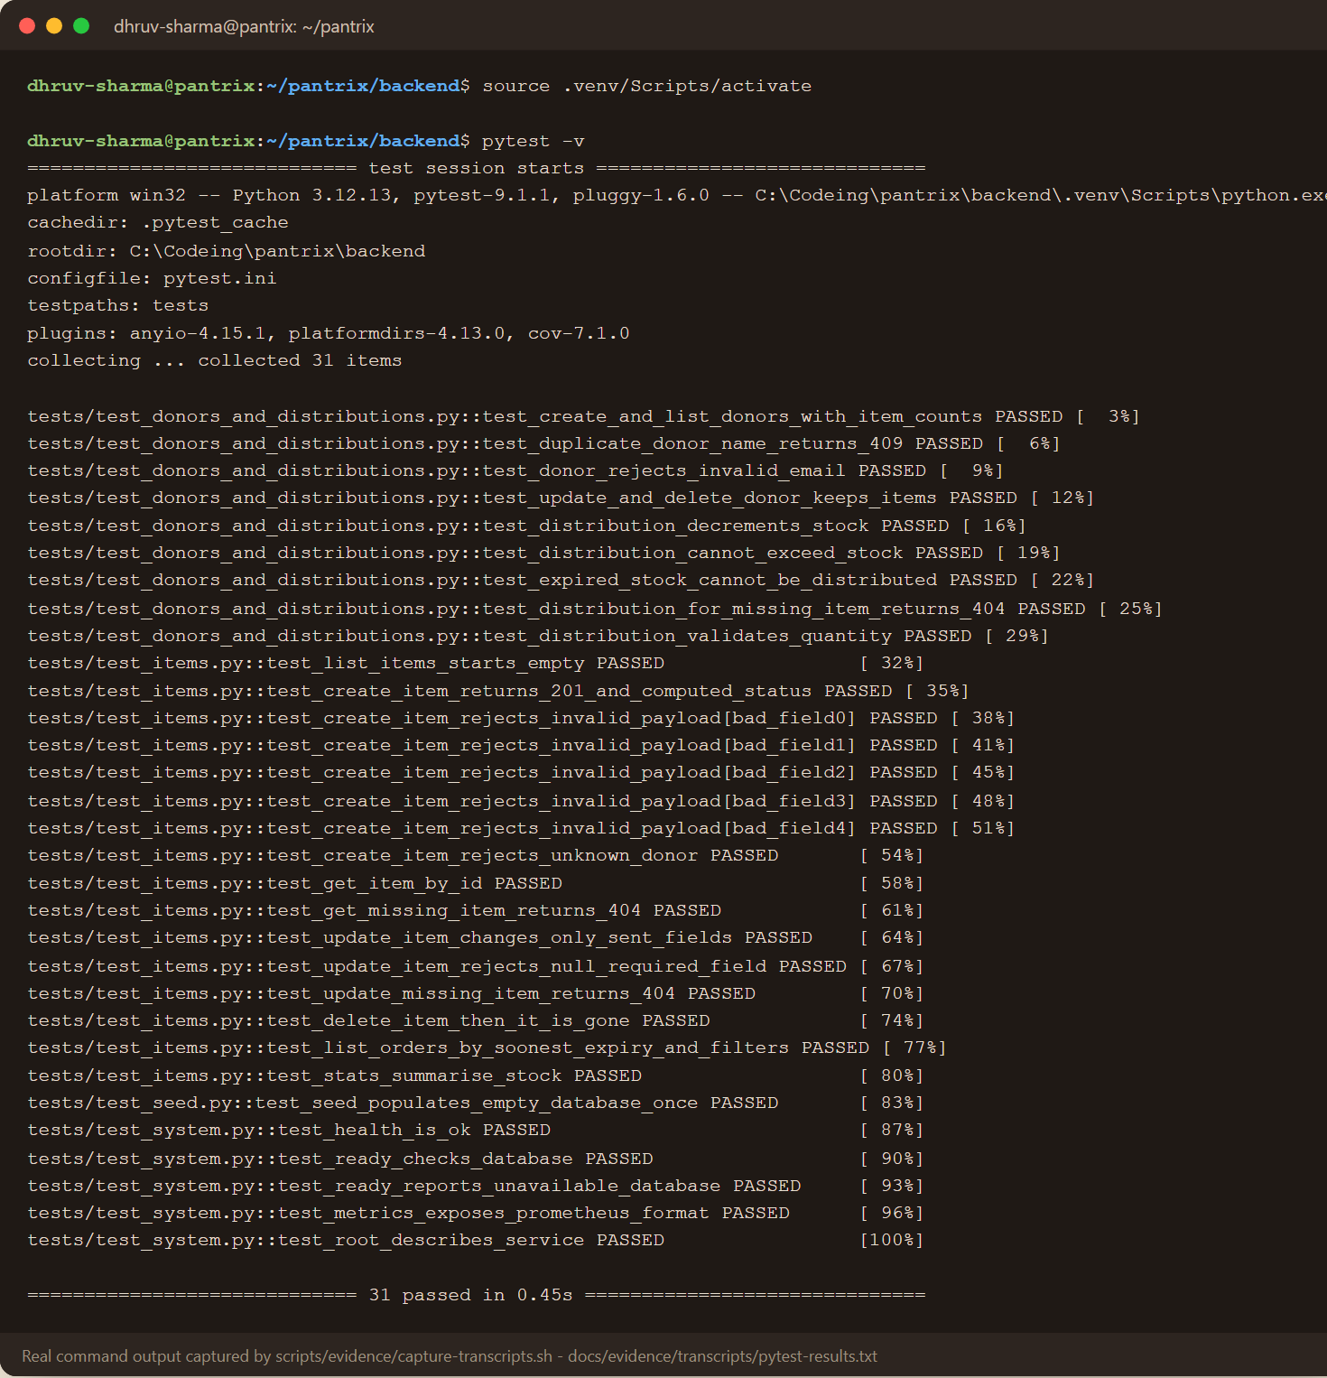
Tests are the first gate: nothing builds until they pass
31
96%
backend tests, pytest -v
API line coverage (CI floor: 85%)
10
0
frontend tests with Vitest
findings: Ruff, Bandit, pip-audit, npm audit
Tests run against a throw-away SQLite database built by the real Alembic migrations, never the Compose or cluster PostgreSQL
Cover success, validation (422), missing records (404), conflicts (409), readiness failure and the /metrics format
pytest -v: 31 passed (real output)
Notes:
The backend has 31 pytest tests with 96 percent coverage, and CI fails below 85 percent. They run against a temporary SQLite database created by the real Alembic migrations, and conftest refuses to run against anything else. The frontend has 10 Vitest tests, and Ruff, Bandit, pip-audit and npm audit report no findings.

Slide 8
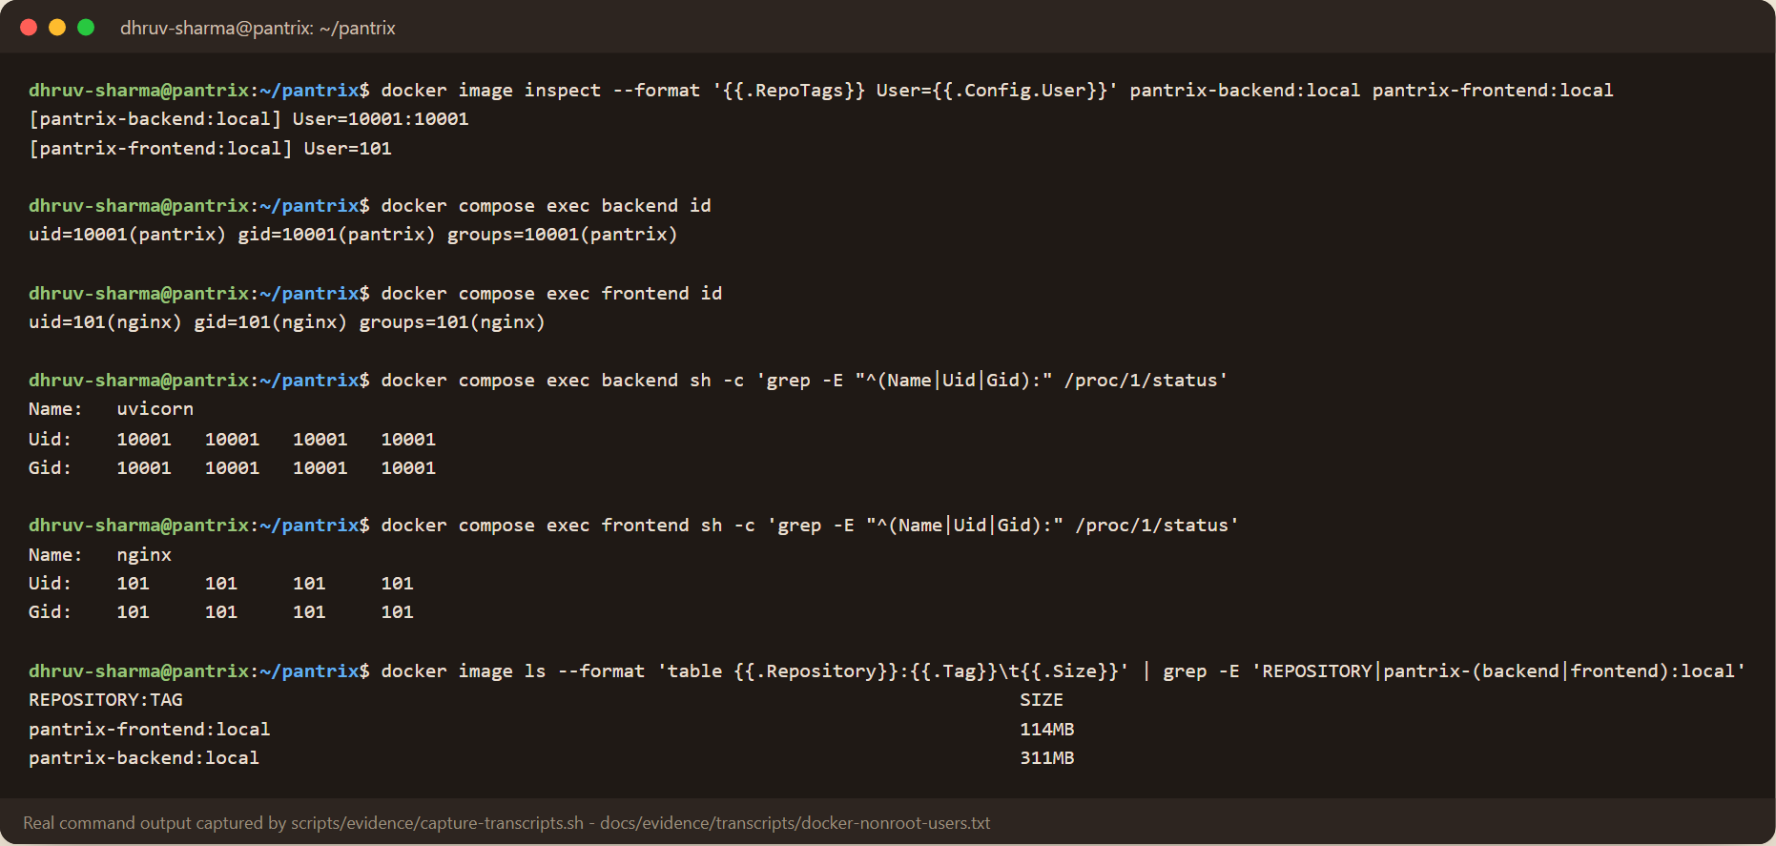
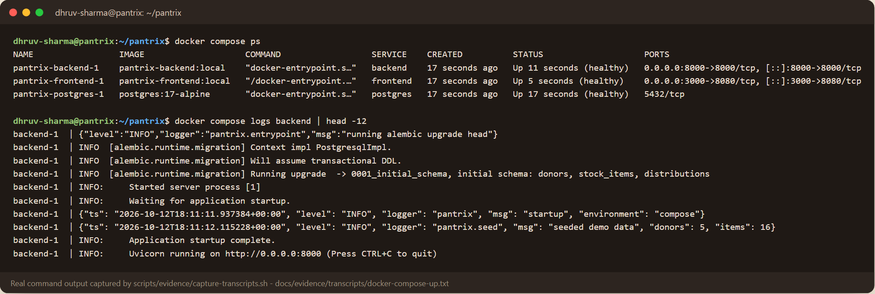
Containers: multi-stage, non-root, one command to run
uid 10001
uid 101
backend runs as pantrix
frontend runs as nginx
311 / 114 MB
backend / frontend image size
Image user and PID 1 user inside both containers
Backend: build stage resolves a virtualenv; runtime has no pip, no compiler, migrates then serves
Frontend: Node build stage, then nginx-unprivileged on 8080 proxying /api
docker compose up --build: PostgreSQL, API and UI with health checks, a named volume and dropped capabilities
All three Compose services healthy
Notes:
Both images are multi-stage. The backend runtime image has no pip and no compiler and runs as uid 10001; the frontend runs on unprivileged Nginx as uid 101. The terminal shows the configured image users and the real PID 1 user inside each running container. One docker compose up --build starts PostgreSQL, the API and the UI with health checks and a persistent volume.

Slide 9
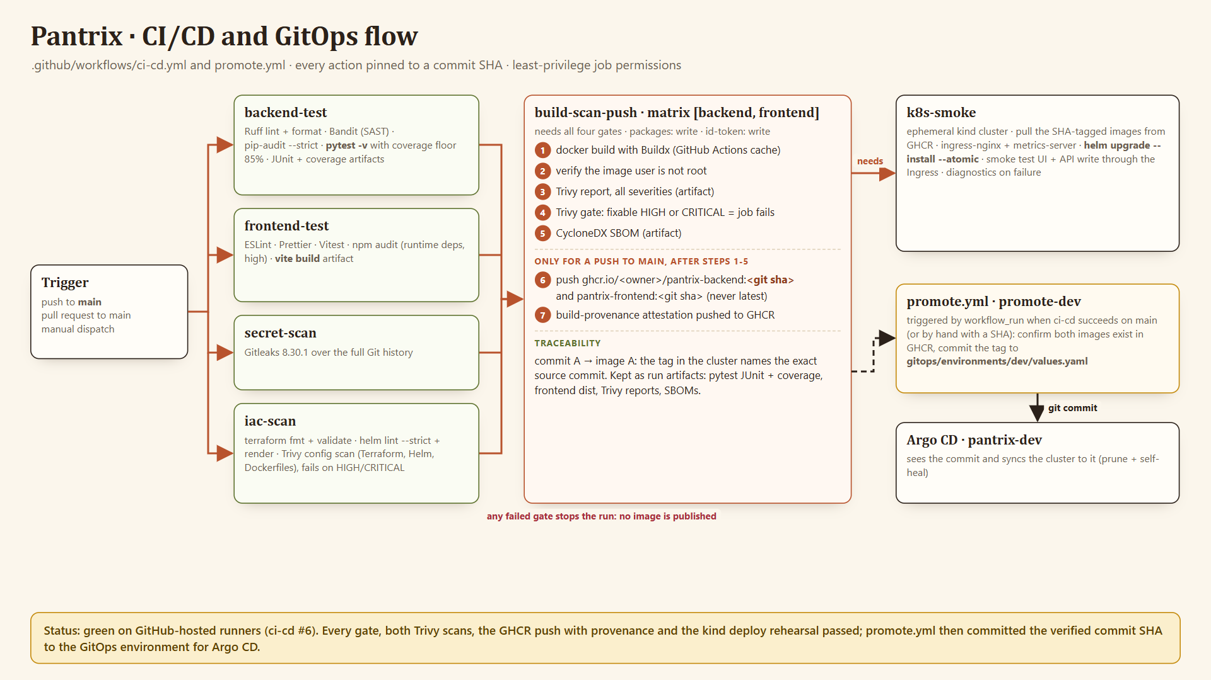
CI/CD: gates first, then build, scan, publish by SHA
Notes:
The pipeline triggers on every push to main. Four gates run in parallel: backend tests and SAST, frontend lint, tests and build, a Gitleaks scan of the full history, and infrastructure checks. Only if all pass are the two images built, checked for a non-root user, scanned by Trivy, given an SBOM, and pushed to GHCR tagged with the commit SHA, never latest. A kind job rehearses the Helm deploy through the Ingress, and promote.yml commits the new tag for Argo CD. Status: the latest run on GitHub is green. Every gate, both Trivy scans, the registry push with provenance and the kind deploy passed, and promote.yml then committed the SHA for Argo CD.

Slide 10
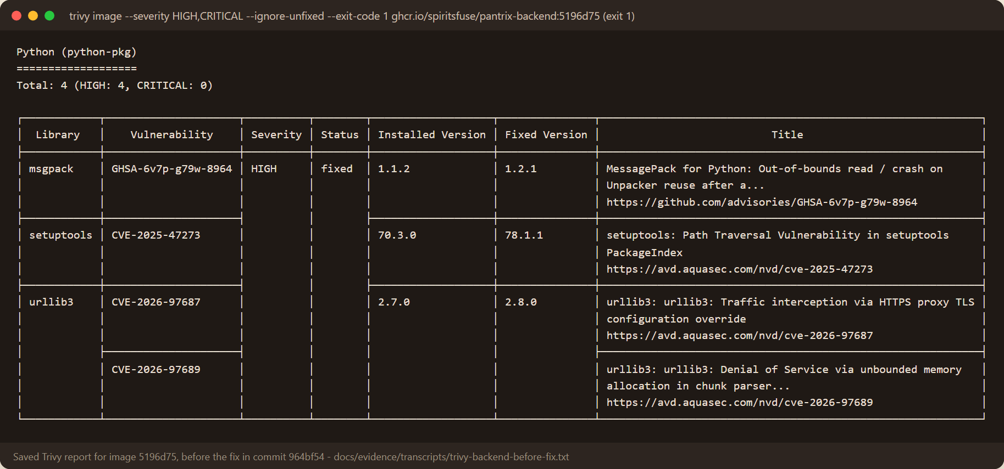
DevSecOps: Trivy found real issues, and we fixed them
Infrastructure scan
Trivy flagged a public EKS API open to 0.0.0.0/0 (AWS-0040/0041): now private unless you pass your own CIDR. AWS-0104 (node egress) is a documented exception.
Secrets
Gitleaks over the full Git history: no leaks found. .env, state and kubeconfigs are git-ignored.
Before: image 5196d75 failed the gate with 4 fixable HIGH CVEs
Findings came from pip's vendored urllib3 and msgpack and the ensurepip setuptools wheel, which the API never imports
Fix in commit 964bf54: remove pip from the runtime image. Gate now passes; nothing suppressed
Policy: fail on fixable HIGH or CRITICAL. Unfixed Debian CVEs are reported, not blocking
Supply chain
Every action pinned to a commit SHA. CycloneDX SBOMs: 119 components (backend), 71 (frontend). Provenance attestation on push.
Notes:
Here is a CVE I can explain. Trivy failed the backend image with four fixable HIGH vulnerabilities in msgpack, urllib3 and setuptools. They came from pip's own vendored copies and the ensurepip wheels, which the API never uses. Instead of ignoring them, I removed pip from the runtime image in commit 964bf54, and the gate passed. Trivy's config scan also caught a public Kubernetes API open to the world, which I fixed, and node egress is a documented, justified exception.

Slide 11
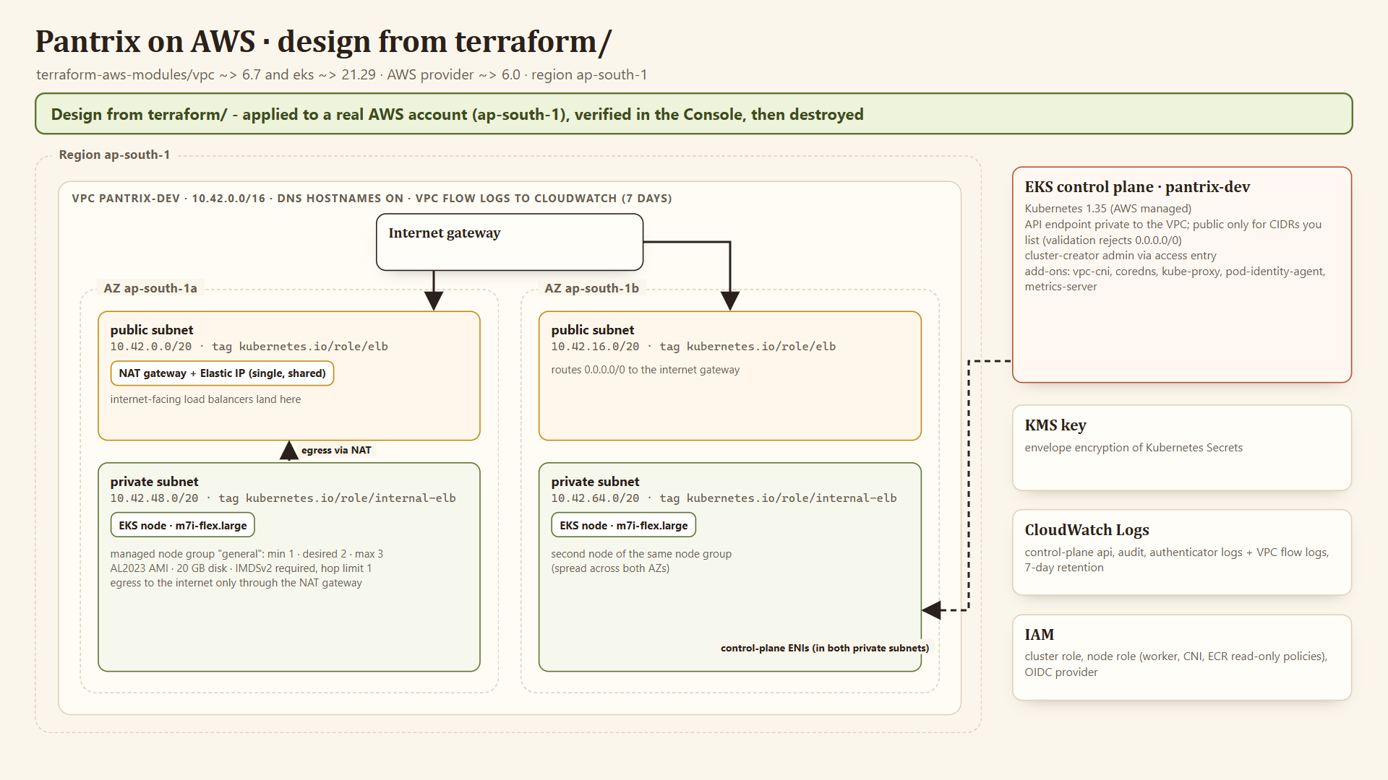
Terraform: VPC and EKS as code, applied and destroyed on real AWS
62
resources in terraform plan (real AWS)
62 / 62
created by two applies; the first node group needed a Free-plan eligible type
62
destroyed by terraform destroy; nothing left
Provisioned in a real AWS account (ap-south-1), then destroyed: two m7i-flex.large nodes Ready on EKS 1.35, with Console and kubectl proof. The first apply stopped because t3.medium is not Free-plan eligible. fmt, init and validate pass; Trivy IaC scan passes.
Notes:
The Terraform creates a VPC with two public and two private subnets across two availability zones in ap-south-1, a single NAT gateway, and an EKS 1.35 cluster with one managed node group in the private subnets, KMS-encrypted secrets and control-plane logs. I ran it against a real AWS account: the plan had 62 resources and the apply created them. The first apply stopped at the node group because the account is on the Free plan and rejects t3.medium; with an eligible type the two nodes became Ready, and I captured the Console pages and kubectl output. Then I ran terraform destroy: 62 destroyed and nothing left.

Slide 12
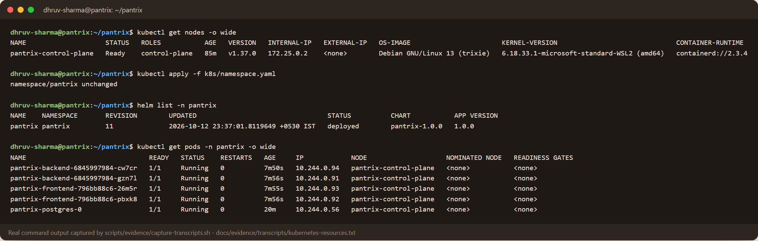
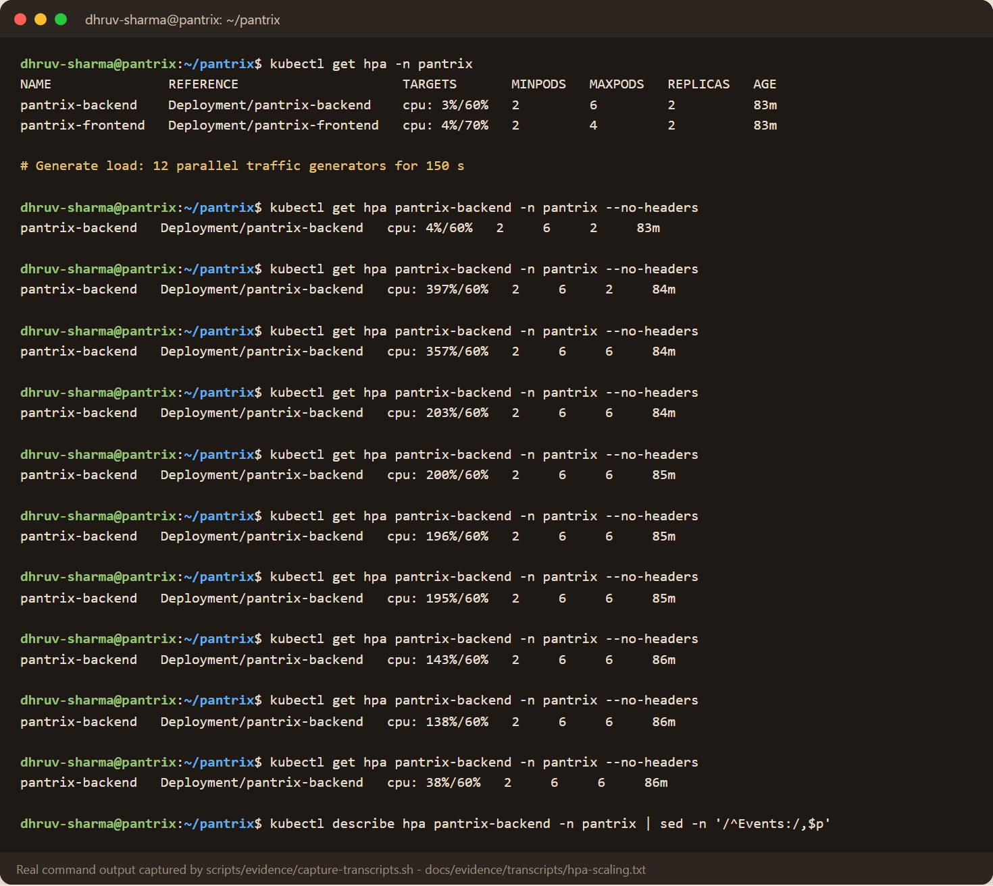
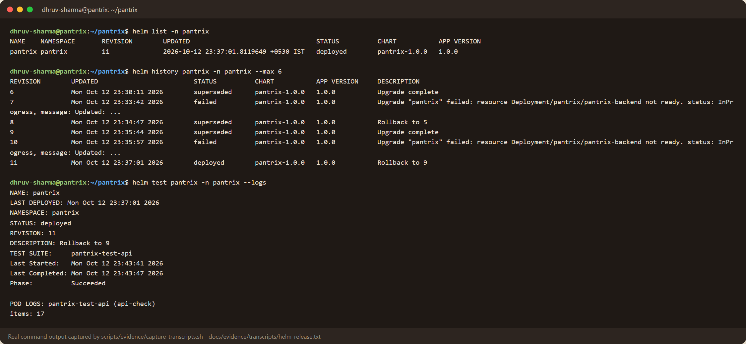
Kubernetes and Helm: hardened pods, Ingress, HPA
kubectl get pods: 2 frontend + 2 backend + PostgreSQL, all Running
Under load the HPA went from 2 to 6 backend pods
Ingress: / to the frontend, /api to the backend (pantrix.localtest.me)
Restricted Pod Security: non-root, read-only root filesystem, no capabilities
helm list, history and helm test (passed)
Notes:
The Helm chart deploys two frontend and two backend replicas behind ClusterIP services, PostgreSQL as a StatefulSet, an Ingress that routes slash to the UI and slash api to FastAPI, HPAs, disruption budgets and a network policy. Every pod meets the restricted Pod Security profile. Under generated load, CPU reached about four times the target and the HPA scaled the backend from two to six pods, which is what this terminal shows.

Slide 13
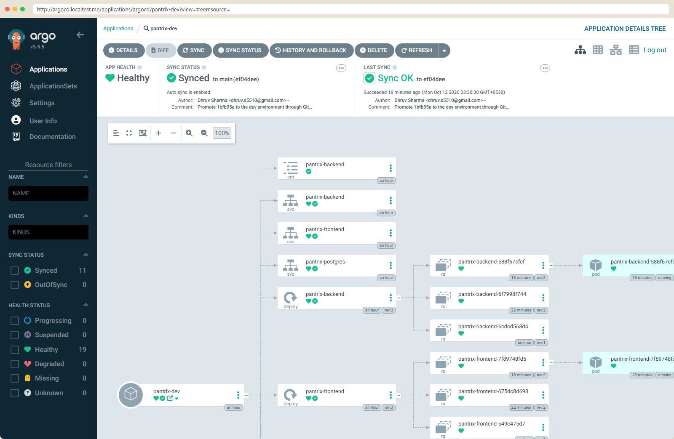
GitOps with Argo CD: Git is the desired state
1
CI builds and scans images tagged with the commit SHA
2
A promotion commit changes image.tag in gitops/environments/dev/values.yaml
3
Argo CD sees the commit, syncs, prunes and self-heals
4
Rollback = revert the commit; history is the audit log
Argo CD: pantrix-dev Synced and Healthy at the promotion commit
CI pushes to GitHub (ci-cd #6, then promote.yml). The local demo cluster watches an in-cluster git daemon.
Notes:
Build and deployment are separate. CI only builds, scans and publishes images. Deployment is a Git commit that changes the image tag in the GitOps values file, and Argo CD reconciles the cluster to it with prune and self-heal. I promoted a real fix this way and Argo CD went to Synced and Healthy at that commit. On GitHub the promote workflow commits the same change, for example d311f11; the local demo cluster reads from a Git server inside it.

Slide 14
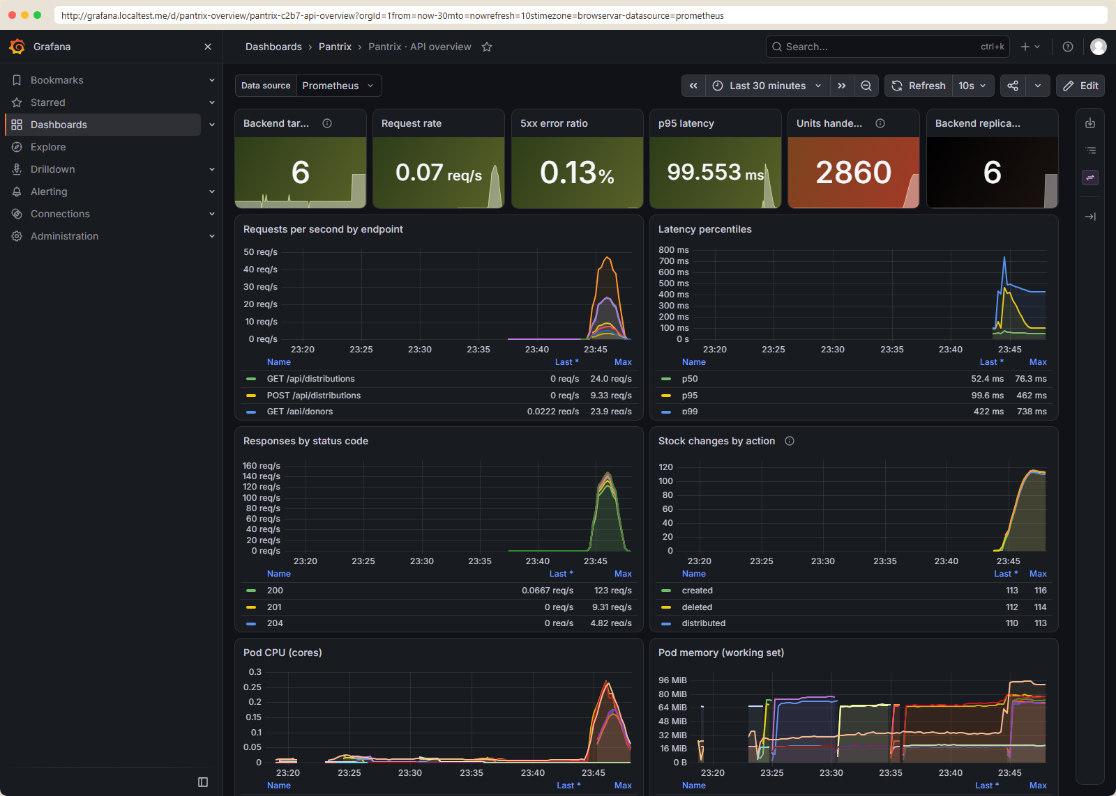
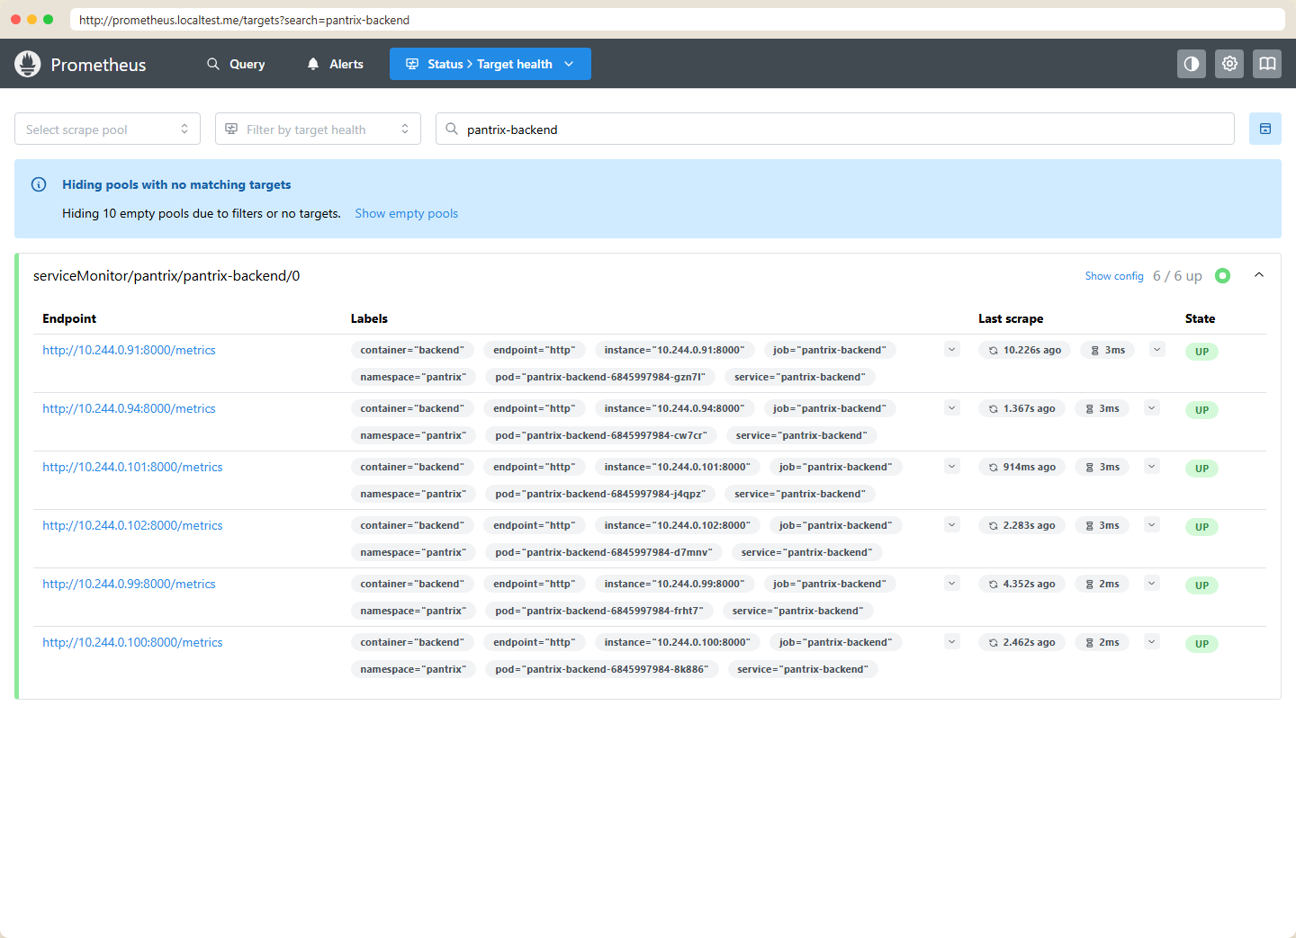
Observability: every pod scraped, live Grafana
Prometheus: pantrix-backend 6/6 UP
/metrics from prometheus-fastapi-instrumentator plus Pantrix counters
ServiceMonitor scrape every 15 s; alert rules for down, 5xx and slow p95
Structured JSON access logs from the API
Grafana: request rate, 5xx ratio, p95 latency, stock events, pod CPU/memory
Notes:
FastAPI exposes Prometheus metrics, and the Prometheus Operator scrapes every backend pod through a ServiceMonitor. During the load test all six pods were UP. The Grafana dashboard shows request rate by endpoint, error ratio, latency percentiles, business counters such as units handed out, and pod CPU and memory, all from real traffic.

Slide 15
Five troubleshooting drills, run for real
Drill | Symptom | Diagnosis | Fix
1 Broken image | ImagePullBackOff | tag v9.9.9-typo was never published | deploy the Git-SHA tag
2 Broken Service | no endpoints, connection refused | selector app=shelf-frontend matches no pods | correct the selector
3 Readiness | Running but 0/1 Ready | /health 200, /ready 503: DB password wrong | use the right Secret
4 Migration | Init:Error | Alembic cannot resolve lab-postgresql | fix the database host
5 Bad release | new pods ImagePullBackOff | old pods still serve (maxUnavailable 0) | helm rollback, zero downtime
A drill found a real bug
Nginx resolved the /api upstream only at start-up, so the UI crash-looped when the backend Service did not exist yet. It now resolves at request time and the UI starts on its own (commit 1bfb95a).
Notes:
I scripted five break, diagnose, fix drills and ran all of them: a wrong image tag, a Service selector that matches nothing, a pod that is alive but not ready because of a wrong database password, a failing migration init container, and a bad Helm release rolled back with zero downtime. Running drill two exposed a real bug: the lab frontend crash-looped because Nginx only resolved the backend at start-up, so I fixed it to resolve at request time, in the real app too.

Slide 16
What I learned and what is verified
Key learnings
Verified here
Also verified
Scanners are useful only if you fix the cause, not silence the finding
Liveness and readiness answer different questions
Separate build from deploy: CI publishes, Git decides what runs
Drills find real bugs before users do
App, CRUD, 41 tests, Compose stack, non-root images
Trivy, Gitleaks, SBOMs, IaC scan
Helm on kind, Ingress, HPA 2 to 6, Argo CD Synced
Prometheus 6/6 UP, Grafana with live traffic
GitHub Actions run green, GHCR packages, GitOps promotion
Real AWS VPC + EKS plan, apply, Console proof, destroy
Thank you · Dhruv Sharma · github.com/spiritsfuse
Notes:
To wrap up: the biggest lessons were fixing the cause of a scanner finding instead of suppressing it, the difference between liveness and readiness, separating build from deployment with GitOps, and how much drills reveal. Everything on the middle column is verified with real output in docs/evidence. The GitHub Actions run with its registry packages, and the AWS apply and destroy, are verified too. Thank you. Now the live walkthrough.

