Slide 1
Pratirup
A glucose digital twin for type 2 diabetes care teams
प्रतिरूप (pratirūp): counterpart, likeness
Team Aflatoon · Scaler School of Technology, Bengaluru
Dhruv Sharma · Pratyush Mishra · Anushika Chauhan
Happiest Health Digital Twin Challenge 2026
Research prototype. Not a medical device. All results are retrospective, on open research data.
Notes:
Introduce the team and the product. Pratirup keeps a continuously updated model of each patient that combines the clinical record with the CGM stream, forecasts the next 30 to 60 minutes, warns of excursions with measured uncertainty, and scores itself against what actually happens. Say up front that it is a research prototype.

Slide 2
What we built and what it achieves
−26%
81%
83%
60-min forecast error vs last value carried forward on 20 unseen patients (95% CI -6.30 to -4.12 mg/dL)
of outcomes fell inside the 80% prediction interval (60 min): the stated uncertainty is honest
of hypoglycaemia episodes flagged in advance, with 1.9 alerts per patient-day in total (v1: 7.9)
A per-patient twin: clinical record + CGM + medication and meal logs, updated on every reading, scoring every forecast when its outcome arrives; v2 is robust to sensor noise
A clinician worklist, an explainable patient view, a forecast ledger, a what-if labelled as associational, live streaming, FHIR R4 records
Validated twice: held-out ShanghaiT2DM patients (scored once, locked) and an external US cohort (CGMacros): 60-min MAE 17.2 vs 22.4 mg/dL in T2D
Open: code, trained models, data pipeline and the scripts that regenerate every number on these slides
Notes:
This is the whole story on one slide. The three numbers are from the locked test set. Everything on the following slides supports or qualifies these claims.

Slide 3
Diabetes in India is common and poorly controlled
101 M
136 M
36%
< 25%
adults with diabetes in India (ICMR-INDIAB-17, 2023)
with prediabetes (same survey)
of people with diagnosed diabetes reach HbA1c < 7% (ICMR-INDIAB-13, 2022)
consensus target for time above 180 mg/dL (Battelino 2019)
How CGM is reviewed today
The gap we address
CGM use is growing in India through clinic-placed and short-term sensors. Clinicians review an ambulatory glucose profile after the fact, at a visit, separately from labs, complications and the drug regimen.
Nothing in a typical review combines the record with the live stream, tells the care team who is likely to go high or low in the next hour, or shows how trustworthy such a forecast has been for this patient.
Notes:
Sources: Anjana et al., Lancet Diabetes Endocrinol 2023 and 2022; Battelino et al., Diabetes Care 2019. The ADA 2026 Standards (Rec 7.15) recommend CGM for people with T2D on insulin, and for T2D on other drugs where CGM helps management.

Slide 4
Forecasting already exists. What is still missing
Product | What it predicts | Who sees it | Uses clinical record?
Dexcom G7 | Urgent low within 20 min | Patient | No
Medtronic Guardian | High / low up to 60 min | Patient | No
Roche Accu-Chek SmartGuide | Low in 30 min, 2-h trajectory, night low | Patient | No (CGM + logged carbs, insulin)
LibreView, Dexcom Clarity, Glooko | Retrospective reports | Clinician | No
Pratirup | +30 / +60 min (+120 exploratory), P(>180, >250, <70 in 60 min) | Care team, ranked panel | Yes, plus own error history
We do not claim forecasting as our novelty. What we did not find is a clinician-facing view that fuses the record, ranks a panel by imminent risk, explains each forecast and keeps a running score of its own accuracy.
Sources: vendor documentation (Dexcom, Medtronic, Roche, Glooko), read Oct 2026. Vendor claims are not independent evidence of clinical benefit.
Notes:
Be explicit with the jury: Roche already ships a 2-hour forecast to patients. Our contribution is the clinician-facing twin with record fusion, triage, explanations and a self-scoring ledger.

Slide 5
Use case: a care team running a 14-day CGM programme
1
2
3
4
5
Wear
Update
Triage
Act
Review
Adult with T2D wears a CGM for 14 days; readings sync every 15 min
The twin updates its state on every reading and logged meal or dose
The worklist ranks patients: low now, predicted low, predicted > 180 or > 250
The educator reviews the forecast and its reasons, and calls the patient if needed
At the visit, the doctor replays any moment: what the twin expected vs what happened
Outputs
Boundaries
Primary: glucose at +30 and +60 min with an 80% prediction interval (+120 min exploratory). Secondary: calibrated probability of crossing 180 or 250, or falling below 70 mg/dL within 60 min (≥ 2 consecutive readings).
Clinicians make every decision. No dosing, diet or treatment advice. Whether triage improves outcomes is a hypothesis that needs a prospective study.
Notes:
Event thresholds come from the international consensus on time in range and were fixed before any model was trained.

Slide 6
What makes it a twin: a state that updates on every reading
Clinical context
Glycaemic state
Event context
observed
estimated
observed
Age, BMI, duration, HbA1c, C-peptide, eGFR, complications, drug classes (FHIR R4)
Kalman level, rate of change and their uncertainty; grows during sensor gaps
Time since meals and fast insulin, insulin on board, oral agents, pump rate
Personal profile
Model trust
Data quality
estimated
estimated
observed
Time in range so far; what this person's glucose usually does at this hour
Running mean of this patient's own resolved forecast errors
Readings in the last 3 h, age of last reading: abstain instead of guessing
Update loop on each reading: validate → Kalman update → resolve forecasts whose time has come → rebuild features from the past only → forecast + interval + risk → write to ledger → re-rank worklist. The streaming twin and the evaluated replay give identical outputs (parity test).
Notes:
A dashboard with a model computes a score once. The twin keeps state, updates it every 15 minutes, and learns how wrong it has been for this specific patient. The parity test in the repo checks that the streaming implementation reproduces the benchmarked one exactly.

Slide 7
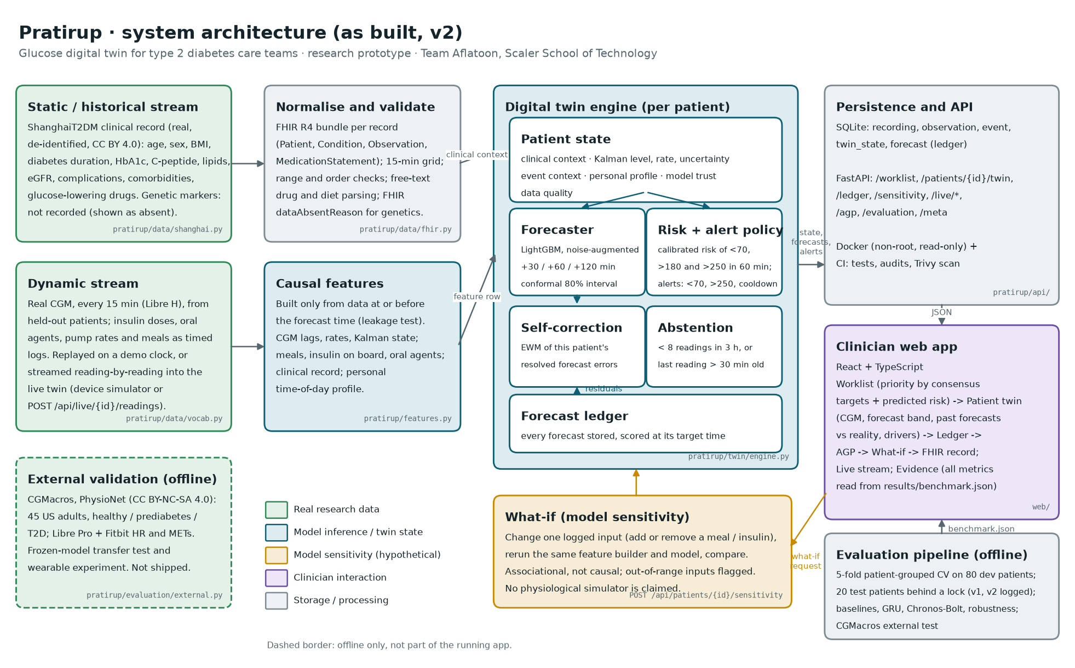
Architecture (as built)
Notes:
Static stream: the de-identified clinical record as FHIR R4. Dynamic stream: real CGM and timed logs, replayed or streamed. The engine holds the state; FastAPI and SQLite persist it; the React app is the clinician interface. Evaluation and CGMacros external validation are offline.

Slide 8
Data: the two streams belong to the same patients
ShanghaiT2DM: train, test and demo
CGMacros: external validation only
100 adults with T2D, 109 recordings of 3–14 days. Libre H CGM every 15 min (112,462 readings). Linked clinical record (33 fields) plus timed insulin, oral-agent, pump and diet logs. Zhao et al., Scientific Data 2023. CC BY 4.0.
45 US adults (15 healthy, 16 prediabetes, 14 T2D), Libre Pro, Fitbit heart rate and activity, meal times. Free-living. Das et al., Scientific Data 2025 (PhysioNet). CC BY-NC-SA 4.0, not redistributed.
Rejected
Honest gaps
Synthea + an unrelated CGM dataset: records and readings would belong to different people
UCI Diabetes #34: type 1 diabetes, finger-prick readings, around 1991
AI-READI: no redistribution right; fully synthetic physiology: tests only our own assumptions
No open Indian CGM dataset exists: Chinese hospital cohort, partly in-hospital
No genetic markers anywhere: shown as 'not recorded', never invented
Diet is food weight, not nutrients (carbohydrate-dense-weight heuristic)
Notes:
The brief allows simulated EHRs, but a real linked record is stronger evidence of fusion than a synthetic record joined to a stranger's CGM.

Slide 9
Models and an evaluation protocol fixed before testing
Compared models
1
Patient-level split
80 development patients (5 folds, stratified by insulin) and 20 test patients
Last value carried forward (persistence)
Kalman damped trend
Linear autoregression (ridge)
GRU sequence network (tuned on development data)
LightGBM ladder: CGM → + logs → + clinical record → + personal history = Pratirup
Pratirup + online self-correction
Average of LightGBM and GRU (reported, not deployed)
Served: LightGBM. It ties the GRU and gives exact per-feature attributions, conformal intervals and fast CPU inference.
2
Every choice on development data
Kalman, hyperparameters, GRU, conformal adjustment, calibration, alert thresholds
3
No leakage
Early stopping on held-out dev patients; a test proves features use only the past
4
Test scored once
Locked file records when; reruns need a logged reason
5
Uncertainty of results
Patient-level bootstrap 95% CIs for every comparison
Notes:
This protocol is what makes the numbers believable. Nothing was tuned on the test patients.

Slide 10
Forecast accuracy on 20 unseen patients
vs last value carried forward
+30 min: -3.24 mg/dL (95% CI -3.87 to -2.62)
+60 min: -5.17 mg/dL (95% CI -6.30 to -4.12)
+120 min: -9.68 mg/dL (95% CI -11.68 to -7.99)
Clinical safety
Parkes type-2 error grid, zones A+B: 100.0% / 100.0% / 99.4% at 30 / 60 / 120 min
GRU and foundation model
Tuned GRU vs Pratirup at 60 min: 0.19 mg/dL (95% CI 0.02 to 0.35), about 1%: we serve the model we can explain. Chronos-Bolt zero-shot: 18.7 mg/dL.
Notes:
Negative differences mean Pratirup is better. The 120-minute horizon answers the brief's '2 hours in advance' example directly: it is better than the baselines, but its error is large, so we keep it exploratory.

Slide 11
What each data stream adds, including what did not help
Helped most: the patient's own history
What this person's glucose usually does at this time of day, learned from their previous days. That is the twin's personal state at work.
Did not help measurably
Clinical-record fields beyond CGM and logs; online self-correction (-0.02 mg/dL, CI crosses 0); Fitbit heart rate and activity in CGMacros (0.06 mg/dL, CI crosses 0). We report this rather than hide it.
Notes:
The y-axis starts at 13 mg/dL so the differences are visible; the values are labelled. The record still drives triage, display and subgroup context, but it did not improve short-horizon accuracy here.

Slide 12
Honest uncertainty: the 80% band holds about 80% of the time
80.8%
81.1%
82.9%
of outcomes inside the 80% interval at +30 min (mean width 27.7 mg/dL)
of outcomes inside the 80% interval at +60 min (mean width 46.7 mg/dL)
of outcomes inside the 80% interval at +120 min (mean width 66.5 mg/dL)
How the interval is built
Why it matters clinically
Quantile models give a raw band; conformal calibration on out-of-fold predictions from development patients widens it just enough to reach 80%. The test patients were never used.
A care team can trust the band, not just the line. It held on CGMacros too: 78% in T2D, 81% in prediabetes. Under heavy sensor noise coverage falls (71% at ±10 mg/dL), a known limitation.
Notes:
Coverage is the share of real outcomes that fell inside the stated 80% interval on unseen patients. Close to 80% means the uncertainty shown on screen is honest.

Slide 13
Alerts a care team can live with
Cohort | Alerts / patient-day | False / day | PPV | < 70 caught (≥ 30 min) | > 250 caught (≥ 30 min)
Development (CV) | 1.54 | 1.00 | 36% | 78% (45%) of 280 | 73% (40%) of 434
Held-out test | 1.89 | 1.38 | 27% | 83% (57%) of 76 | 78% (52%) of 54
CGMacros T2D (external) | 1.78 | 1.23 | 31% | 88% (56%) of 34 | 75% (39%) of 71
The policy
The honest trade-off
One stream per patient, only for predicted < 70 or > 250 mg/dL within 60 min. At most one alert per hour; a predicted low may override. Rising above 180 is expected in T2D (target is < 25% of the time, not zero), so it ranks the worklist instead of interrupting.
v1 tuned each event alone: 7.9 alerts per patient-day. v2: 1.89. The price is sensitivity (each classifier alone catches more). Thresholds were set on development data for ≤ 1 false alert per day; test overshot to 1.38. The budget is a dial clinicians should set.
Notes:
Alarm fatigue is a documented safety problem in monitoring. A care team that ignores alerts gets nothing from even a perfect model, so we optimised for a usable alert load, not maximum sensitivity.

Slide 14
v2: what we fixed after the first test
 | v1 | v2
MAE 60 min (clean) | 14.76 | 14.90
MAE 30 min, SD-10 noise | 19.6 | 13.5
Last value, SD-10 noise | 15.1 | 15.1
Alerts per patient-day | 7.9 | 1.89
How we did it without cheating: both changes were chosen on development patients with a rule written before the experiment. The test set was re-scored once, the reason is logged, and v1 results are kept unchanged.
Notes:
The v1 test exposed two weaknesses: sensitivity to sensor noise and an unusable alert load. We fixed both using development data only, then re-scored the test set once and logged why. Clean accuracy dropped 1 to 2.4 percent depending on horizon; noisy accuracy improved about 30 percent.

Slide 15
It transfers: external validation on a US cohort
Different country, sensor and setting
Free-living US adults, Libre Pro, no refitting. Interval coverage stays at 78% in T2D. Rise-above-180 alerts in T2D: 91.4% sensitivity, 58% PPV, 1.07 false alerts per day.
Where it does not help
In healthy participants the gain over last value is close to zero: expected for a model trained on T2D. Medications and most labs are missing in CGMacros and were passed as missing, never as zero.
Notes:
The model was frozen; CGMacros was never used to train or tune it. CGMacros is CC BY-NC-SA and is downloaded by script, not redistributed.

Slide 16
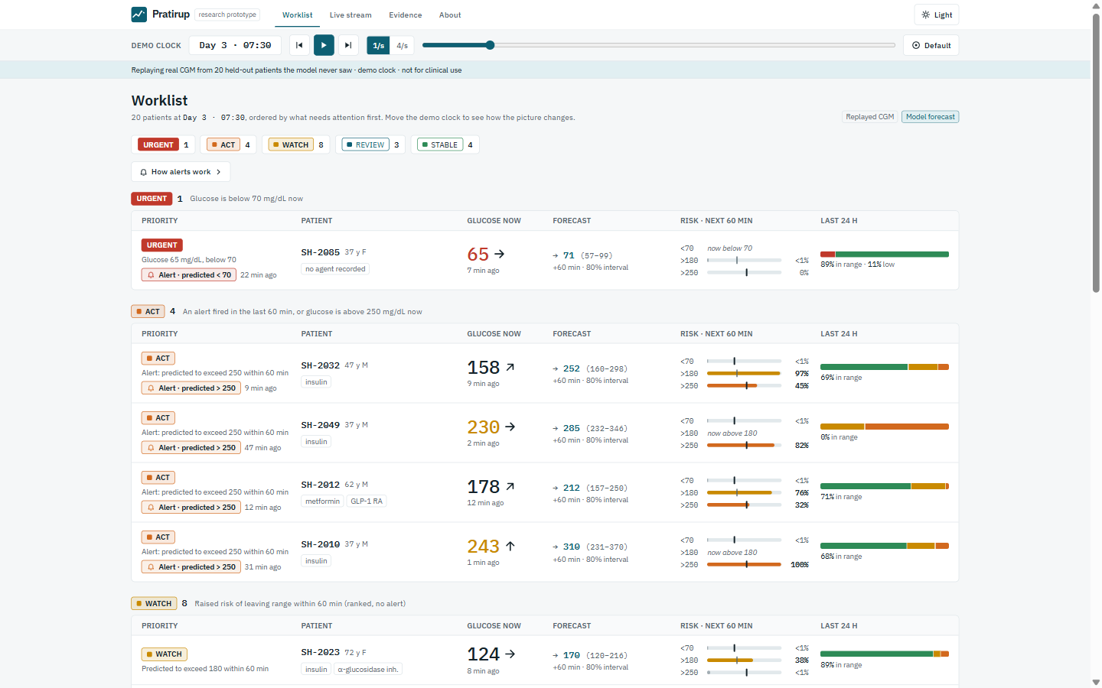
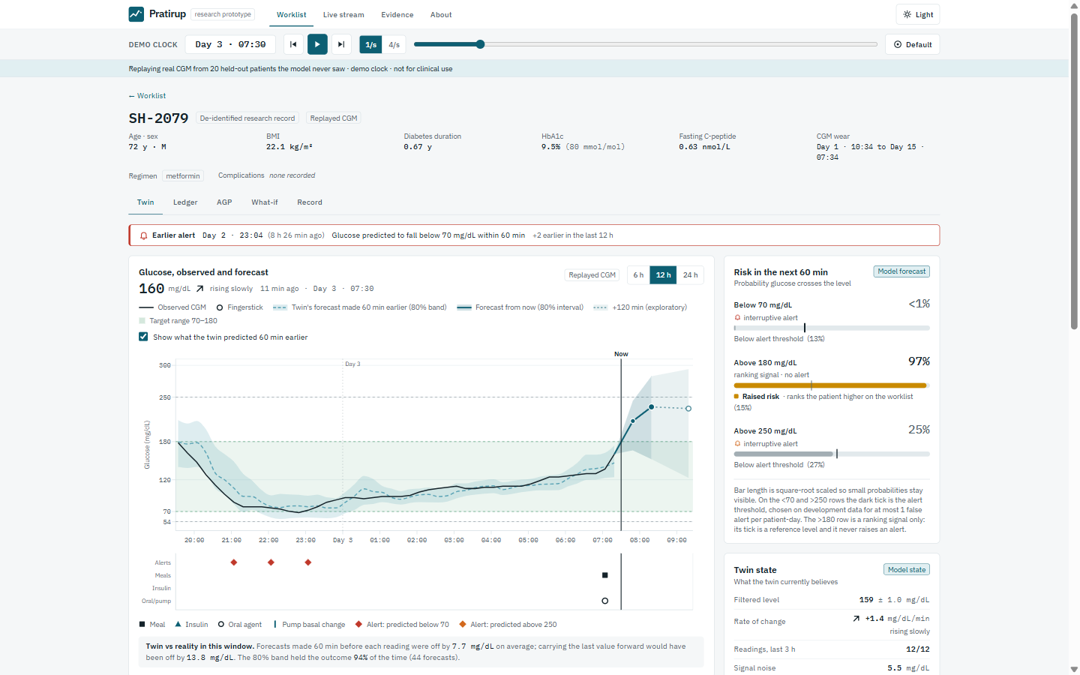
The product: what a care team sees
Worklist: panel ranked by consensus targets and predicted risk
Patient twin: forecast band, past forecasts vs reality, drivers
Research record
Replayed CGM
Model forecast
Sensitivity · not causal
LIVE stream
Also: forecast ledger · what-if · FHIR R4 record · live streaming · evidence page
Notes:
Show the live demo here. Every value on screen carries its provenance: research record, replayed CGM, model forecast, sensitivity, or live stream.

Slide 17
Limitations we want the jury to know
Population
Size
Chinese hospital cohort, 2019–2021, partly in-hospital with regular meal times. Not Indian. External check covers the US, not India.
100 patients, 3–14 days each; 20 test patients. Hence bootstrap CIs on every claim.
Alert budget
Test reuse
1.38 false alerts per patient-day on test vs a development budget of 1.0; fewer alerts means some episodes are missed.
The test set was scored twice (v1, v2). v2 choices used development data only, but were motivated by what the v1 test revealed; both results are reported.
Causality
Evidence level
The what-if shows model sensitivity, not the effect of eating or dosing.
Retrospective only. No prospective, real-time or outcome study.
Notes:
Saying this ourselves is part of the pitch: every limitation here was found by our own tests.

Slide 18
Path to a real product
Who would use and buy it (to validate)
What a buyer would require
Regulation and privacy
Diabetes clinic chains and digital-therapeutics programmes already running connected-CGM coaching. Value: triage of coach and educator time. Willingness to pay is untested.
Validation on Indian patients and diets, a prospective pilot with outcome measures, integration with sensor clouds and the clinic EHR (ABDM FHIR).
Likely software as a medical device under India's Medical Devices Rules 2017 (CDSCO draft guidance, Oct 2025). Real data falls under the DPDP Act 2023 and Rules 2025.
Next steps
Let clinicians set the alert budget per programme; add escalation for unacknowledged alerts
Device-specific noise models (autocorrelated error) and validation on noisier sensors
A prospective, observation-only pilot with an Indian diabetes clinic (forecasts hidden from care until validated)
Interoperability: CGM vendor APIs and ABDM-compliant FHIR exchange
Notes:
Customer demand and willingness to pay are hypotheses. The next step is evidence, not scale.

Slide 19
Thank you
Everything shown is in the public repository: code, trained models, the locked test results and the scripts that regenerate every number.
github.com/Spiritsfuse/pratirup
Team Aflatoon · Dhruv Sharma · Pratyush Mishra · Anushika Chauhan · Scaler School of Technology, Bengaluru
Notes:
Invite questions on the protocol, the twin state, or the limitations.

