Slide 1
Magic The Gathering
Machine Learning Project
The game is based on balance. It is crucial that there will not be a set of cards that can form a playable deck and be able to beat all others (or nearly). As a company’s rule, in the rare cases that one or more cards “prove” to be way more powerful than the rest, they are either restricted or banned.
The first goal of this project is to check whether there is a correlation between certain attributes of the cards that can lead to an unbalanced game. Minimising this, will minimise the need for bans and provide more playable cards to future players
The second goal of this project is to check whether there is correlation between the price of a card and certain attributes of it that can lead to potential exploitation of this fact in the secondary card market.

Slide 2
For this project, I used the data that I scraped with the mtg_scraper from the first project that contains all attributes of a card and an estimation of their current value in the card market.
Further data cleaning was necessary:
-Change the float values into strings for the categorical data
-remove columns that were not important (land cards have no real impact with the rest of the attributes)
The first 2 sets that I tested were:
Rarity of a card – Converted Mana Cost (to check for balance)
Rarity of a card – Market Price (to check if there is a connection)
I run 14 different models and the results are presented in the next slides:

Slide 3
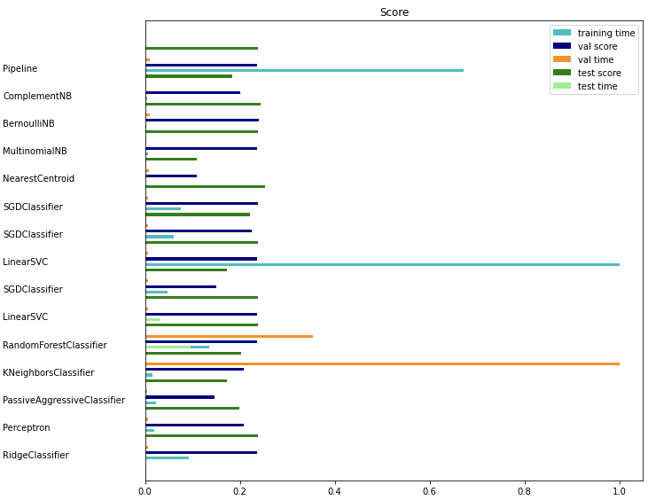
Rarity – Converted Mana Cost (visual)
The comparison of the Pipeline with the other models shows that the benchmark works on par with most of the models but it is way slower.
There does not seem to be a model that performs significantly better than the others.
-I need to check with more parameters to see if any of the models will improve.
-If the result does not change significantly, it can be derived that these 2 features are not strongly correlated which represents a balance for the game (most converted mana costs can be found in cards of all rarities.)

Slide 4
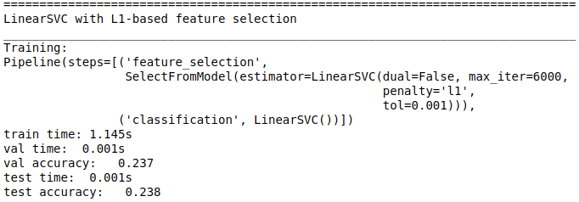
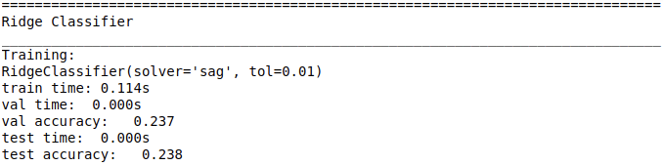
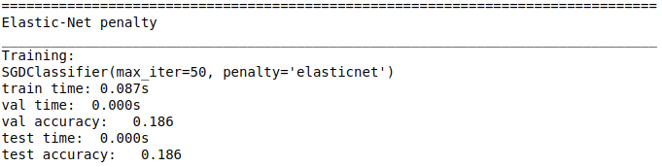
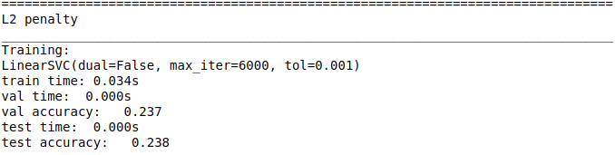
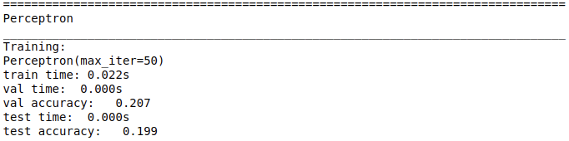
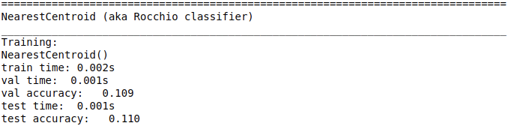
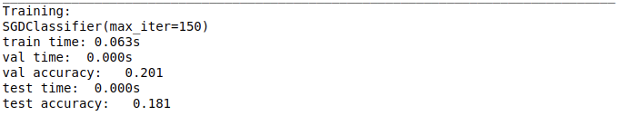
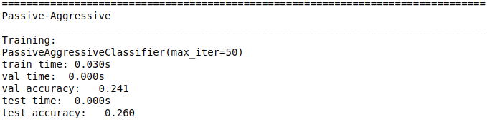
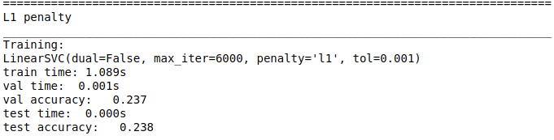
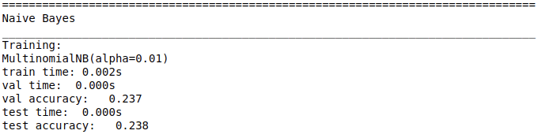
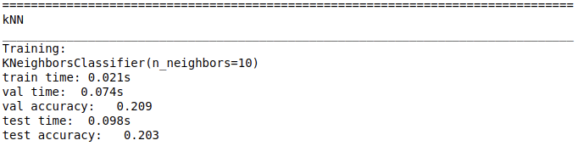
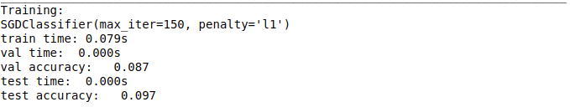
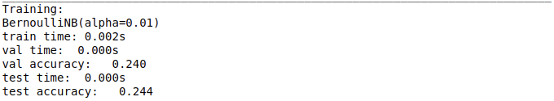
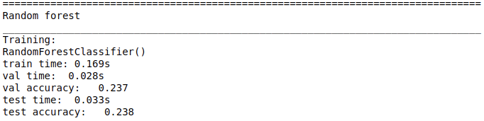
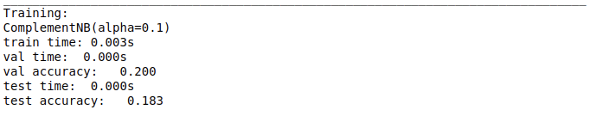
Rarity – Converted Mana Cost (the data)

Slide 5
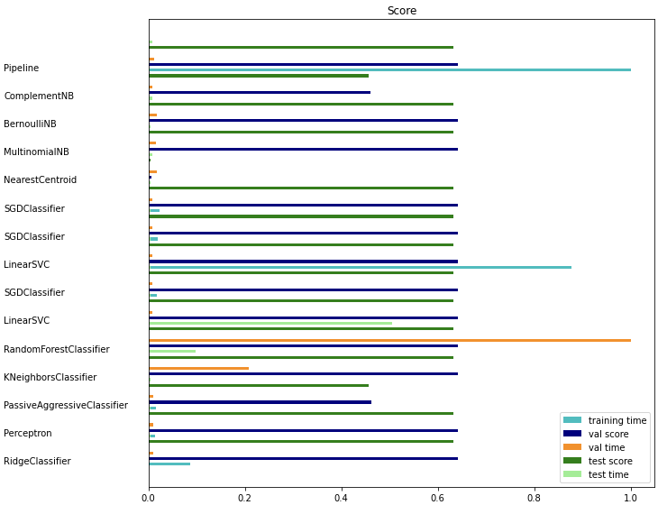
Rarity – Market Price ($) (visual)
The comparison of the Pipeline with the other models shows that the benchmark works on par with most of the models but it is way slower.
-There does not seem to be a model that performs significantly better than the others.
-There seems to be a correlation between the Rarity of a card and its value.
-I need to check with more parameters to see if any of the models will improve.

Slide 6

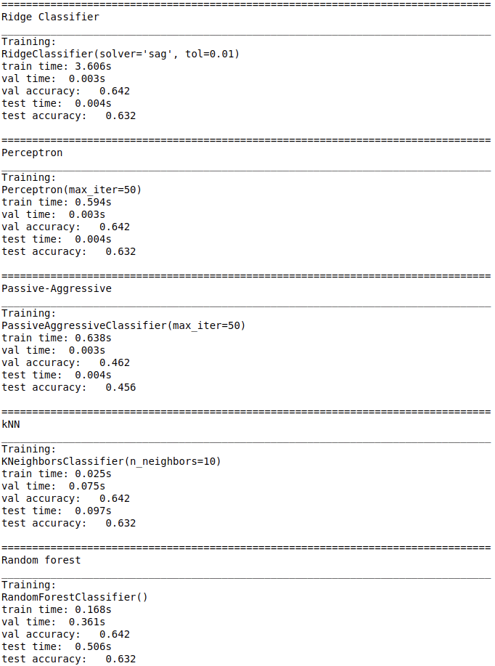
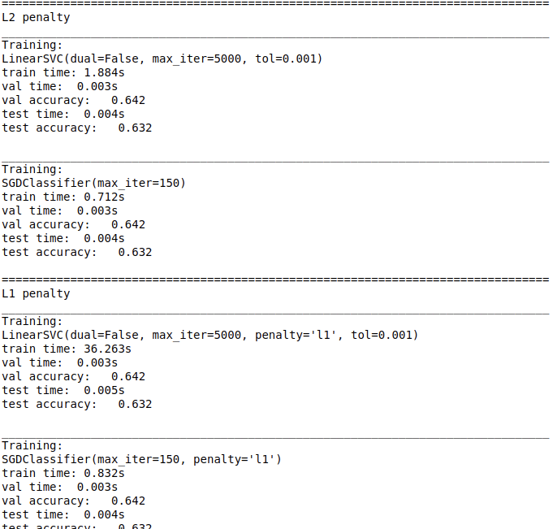
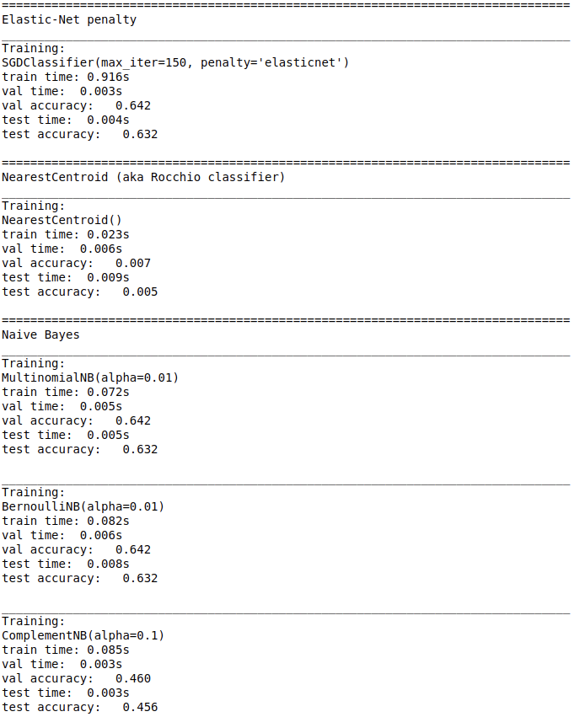
Rarity – Market Price ($)
(the data)

