Slide 1
Magic The Gathering scraper
Task: To create a database with all the cards that have been created for this game,
their atributes and their current value.
Purpose: To use this database in order to estimate the cost of a new playing deck, make estimations on future values of new cards, etc.
Method: Scrape the company’s website for the attributes of the cards and then use them,
(the names) to a second website that presents the current value of every card.

Slide 2
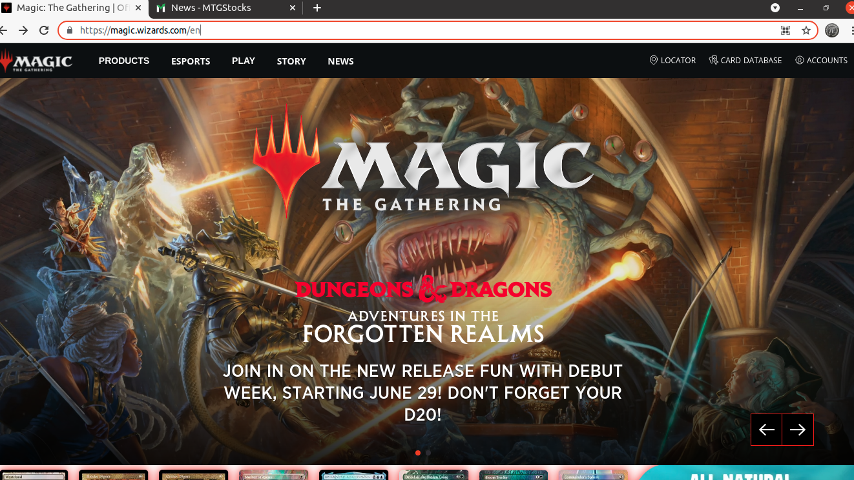
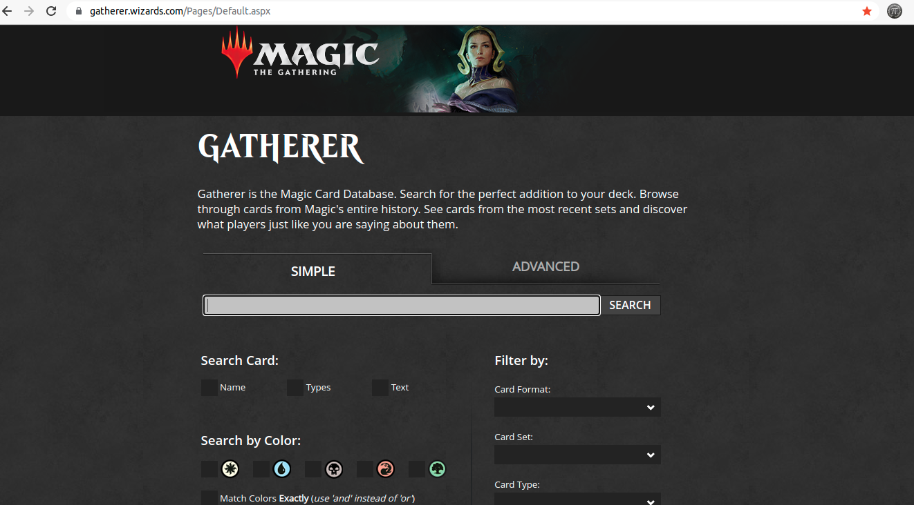
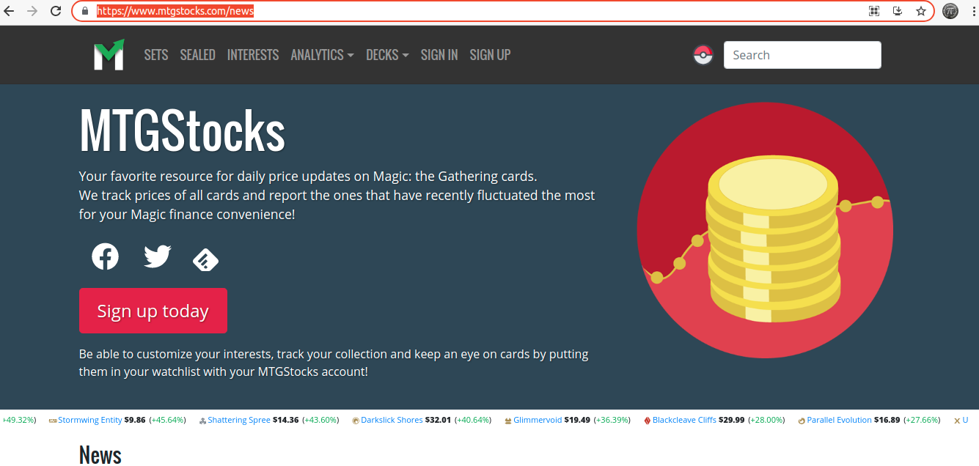
Magic The Gathering website:
https://magic.wizards.com/en
Magic The Gathering card database:
https://gatherer.wizards.com/Pages/Default.aspx
Card prices’ market website:
https://www.mtgstocks.com/news

Slide 3
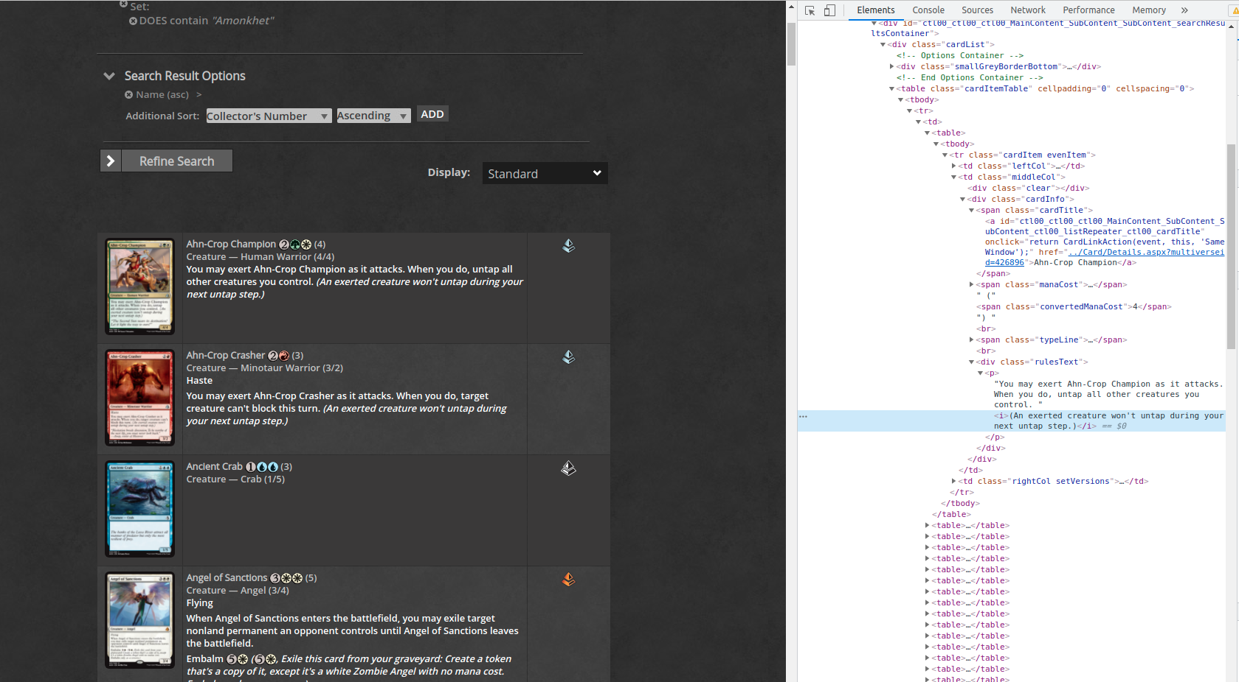
Card abilities scraping:
Due to the nature of the game (cards that are banned from different types of games etc),
I decided to use the Card Set as my driver as all cards appear there whether they are
banned from a game or not.

Slide 4
How it works:
Firstly gathers all the card sets that exist.
Then, for every set, the scraper gathers the total number of the cards, the number of the cards
on a page, divides these two numbers and rounds up to find the number of the pages this set has.
(currently there are 100 cards in each page but I chose to do it like this just in case anything
changes in the future)
Once it has this info, it starts gathering all info for every card on page 1 before moving on to the
next page. Once it finishes with the cards in this set, it goes back at the beginning to choose the
next set and start again.

Slide 5
More for the code:
For the tables, I use the absolute path.
For all the cards’ abilities I use relative paths
(extensive use of “contains(@…)” format) to make the code more solid to small changes
that might happen to the webpage.
Once it gets all the cards that were asked of it, creates a list of the names and uses it on
the second website to gather the prices
(Quick Demo)

Slide 6
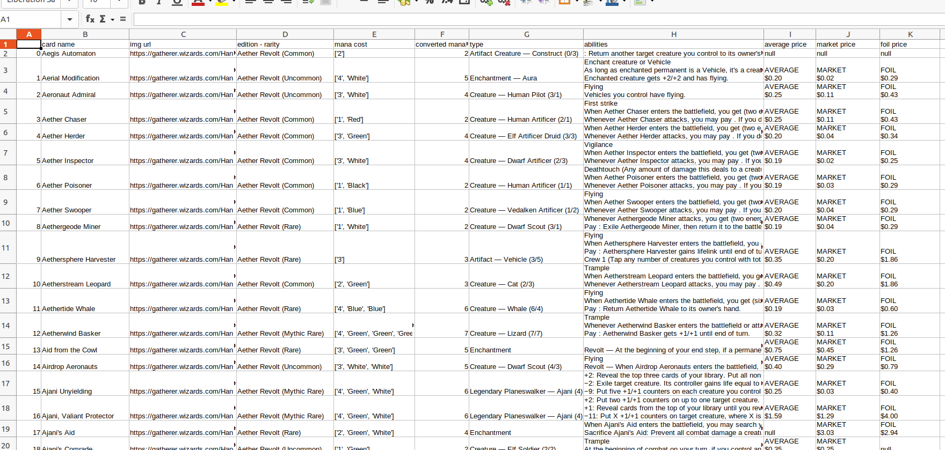
Outcome:
Once finished, the data looks like this:

Slide 7
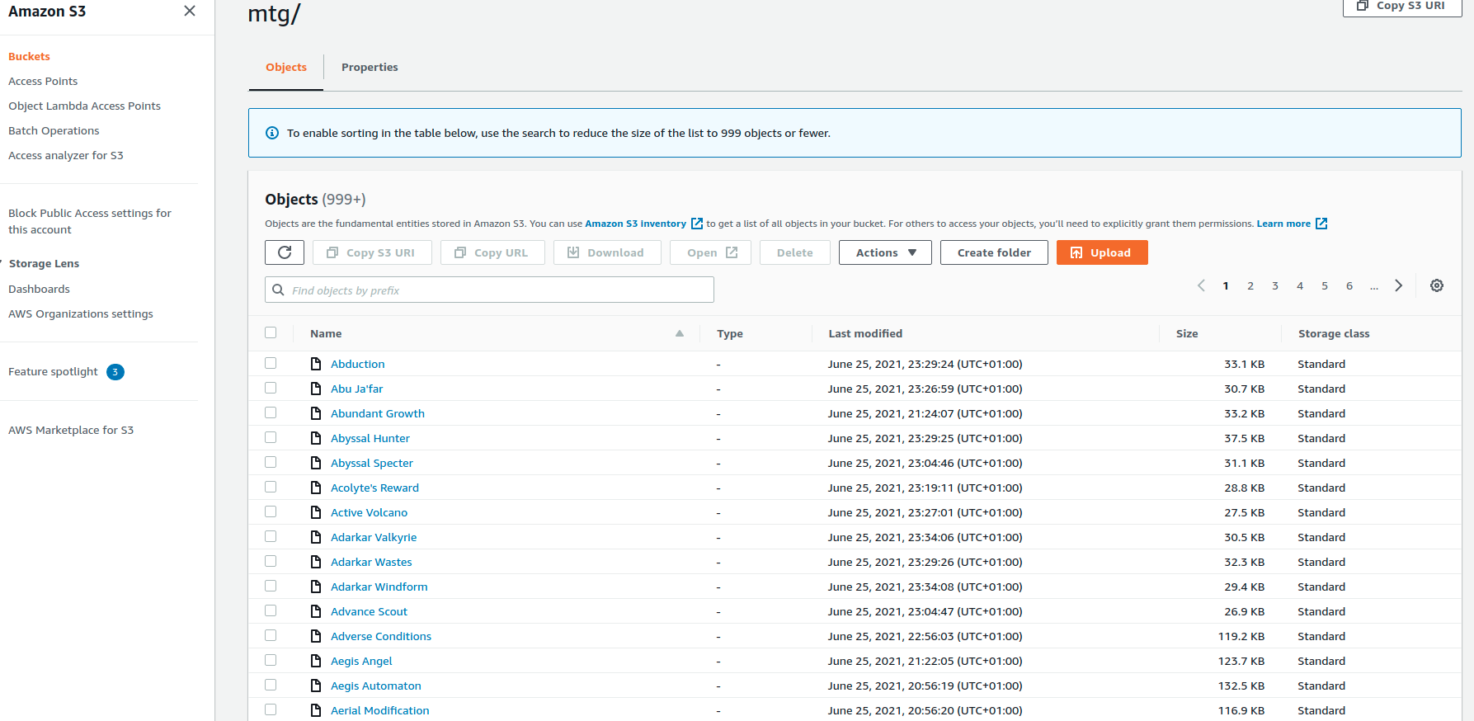
Next moves:
After we get the file with the final data from the scraper, we can run the second file, the
‘mtg_img_sraper.py’ that will use all the urls gathered so far to download the images and save
them in a data lake (currently in an S3 bucket on AWS). All images are named after their card
Name (with the exception of dual cards – cards whose name is eg. ‘commit // memory’ which
are named after just the first name.

Slide 8
Final step:
Magic The Gathering cards have quite a lot of duplicates in names. This is because most cards
are being reprinted after a few years. From a collector’s point of view, they are not the same as
They belong to different sets. However, if we plan to create a database of the unique cards that
have been printed and their price, having the same card more than once is not necessary.
So, to clean our data, we need to run the ‘data_cleaning.py’ file that will split the columns that
have multiple variables and remove all the duplicates based on the card name. We did not
change the Nan values as they have a meaning in this database (eg. no price available, no
mana of this type etc.)

Slide 9
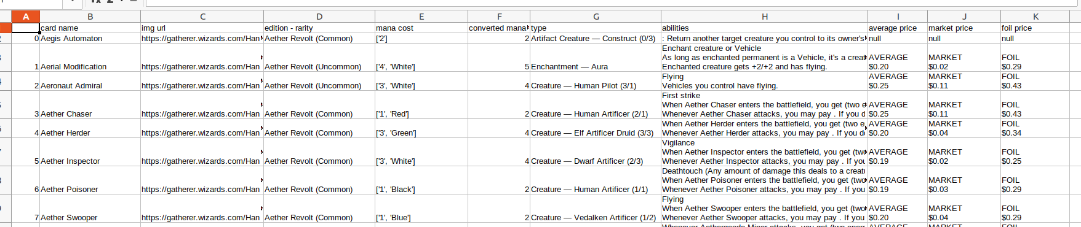
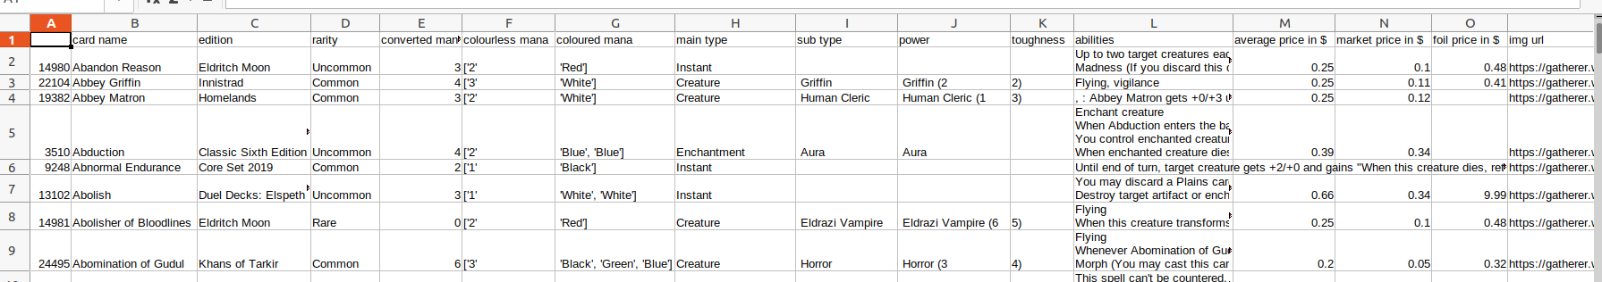
Before:
After:

Slide 10
Next Steps:
* Create a database for this dataset
* Improve the scraper by creating functions
* Add more card info (artist, flavour text, collector’s number etc.)
* Add more info about how often each card is used in a deck
* Improve the cleaning of the data
* Improve the scraping of the prices by using an alternative path in the same website that allows
for having 50 cards on a single page

