Slide 1
Geomlab: Exploring Computer Science
Michael Spivey
Computer Science Tutor,
Oriel College

Slide 2
What's programming like?
The old-fashioned view:
A program is a list of instructions.
Algorithms designed with flowcharts.
Computer memory is boxes containing numbers.
It's all ones and zeros!

Slide 3
What's it really like?
A modern view:
A program is an artificial world.
Objects behave according to precise rules.
By combining simple behaviours, a complex whole emerges.
We can use things without knowing how they are made.

Slide 4



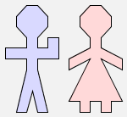
The algebra of pictures
man
woman
man $ woman
man & man

Slide 5
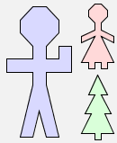

The algebra of pictures
man $ (woman & tree)
(man $ woman) & tree

Slide 6

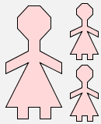
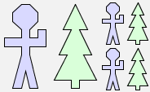
Defining functions
define f(x) = x $ (x & x)
f(man)
f(woman)
f(man $ tree)

Slide 7
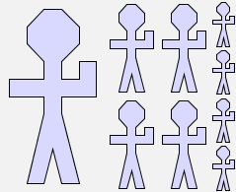
Composing functions
f(f(man))
f(f(f(man)))

Slide 8
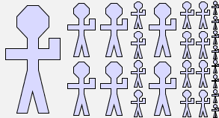
Composing functions
f(f(man))
f(f(f(man)))

Slide 9



Recurrence and recursion
define row(1, p) = p
| row(n, p) = p $ row(n-1, p) when n > 1
row(4, man)
row(6, man)
row(10, man)

Slide 10

More recursive patterns
define spiral(1) = bend
| spiral(n) = arm(n)
& (rot(arm(n-1)) $ rot2(spiral(n-1))) when n > 1

Slide 11

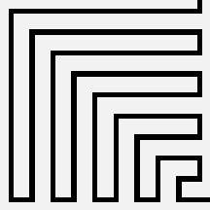
The results
spiral(10)
zagzig(10)

Slide 12
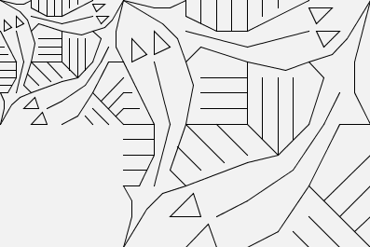
The big challenge
Suppose we have a tile that fits next to itself at half scale:
(T & blank) $ T

Slide 13
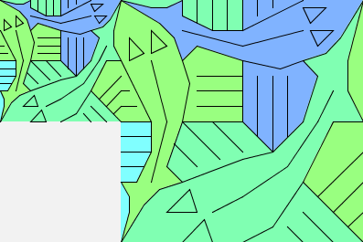
The big challenge
Suppose we have a tile that fits next to itself at half scale:
(T & blank) $ T

Slide 14
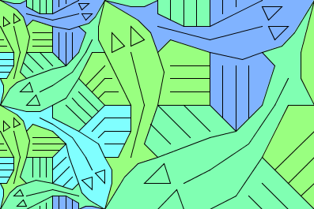
The big challenge
... and another copy fits here:
(T & rot(T)) $ T

Slide 15
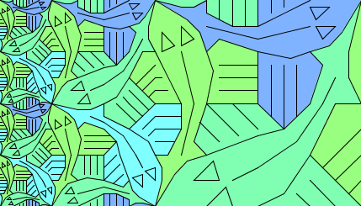
The big challenge
Then we can add another layer:
side(2) $ T

Slide 16
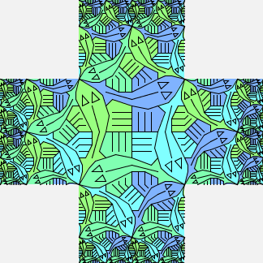
The big challenge
... and arrange four copies around a central square:
frame(blank, side(2), U)

Slide 17
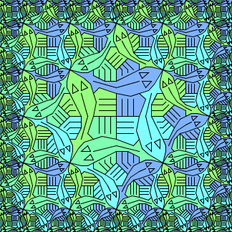
The big challenge
Finally, find something to fill in the corners:
frame(corner(2), side(2), U)
(a picture that Escher drew – and one that he didn't)

Slide 18
Functional programming
No 'programming' variables – use mathematical variables instead
No loop commands – use recursion instead
Two benefits:
Easier to make programs from independent pieces
Easier to reason about them mathematically

Slide 19
Abstract data types
A set of values with operations
The operations obey rules that can be specified algebraically.
The computer representation of values is hidden.

Slide 20
Abstract data types
Example: pictures with $, &, rot
rot(p $ q) = rot(q) & rot(p)
aspect(rot(p)) = 1/aspect(p)
Pictures are represented using coordinates and transformation matrices in a way that is hidden.

Slide 21
Enriching school mathematics
There's more to algebra than “x is the unknown”
There's more to recurrences than “guess the next number”.
May we dream of a world where survival depends on mathematics?

Slide 22
The GeomLab site
http://web.comlab.ox.ac.uk/geomlab
The software:
runs from the web page
Java-based – no installation required
Teaching materials:
full set of worksheets for a 1-2 day activity

