Slide 1

SEMANTIC ANALYZER
Presented By,
S P Jagrit(RA2011033010121)
Ankit Murarka(RA2011033010122)

Slide 2
Table of Contents
Introduction
Structure & Algorithm
Actions
Implementation
Conclusion
References

Slide 3
Introduction
It uses a syntax tree and symbol table to check whether the given program is semantically consistent with the language definition. It gathers and stores type information in either a syntax tree or a symbol table. This type of information is subsequently used by the compiler during intermediate-code generation.
Semantic Analysis makes sure that declarations and statements of the program are semantically correct.
It is a collection of procedures which is called by the parser as and when required by the grammar. Both the syntax tree of the previous phase and the symbol table are used to check the code's consistency.
Type checking is an important part of semantic analysis where the compiler makes sure that each operator has matching operands.

Slide 4
Errors
Semantic errors, also called logic errors are errors that arise when a statement used in a program is not meaningful, that is, it does not correspond to the set of rules(semantics) for that language being used. These can be,
Type mismatch.
Multiple declarations of variables in scope.
Undeclared variables.
Access of an out-of-scope variable.
Actual and formal parameter mismatch.
Misuse of reserved identifier.

Slide 5
Types of Declarations
Base Types
These are primitive types provided directly by the hardware such as int, float, double, char, and bool.
Compound types
These are types constructed as aggregations of the base types and simple compound types. They include arrays, records, structs, unions, pointers, and classes.
Complex types
These are abstract data types, a high-level language may or may not support these types, in the case they are not supported, a programmer may opt to construct the needed type. They include lists, queues, trees, heaps, tables, and stacks.

Slide 6
Actions
Type Checking
Label Checking
Flow Control Checks
Scope Resolution
Array-bound Checking

Slide 7
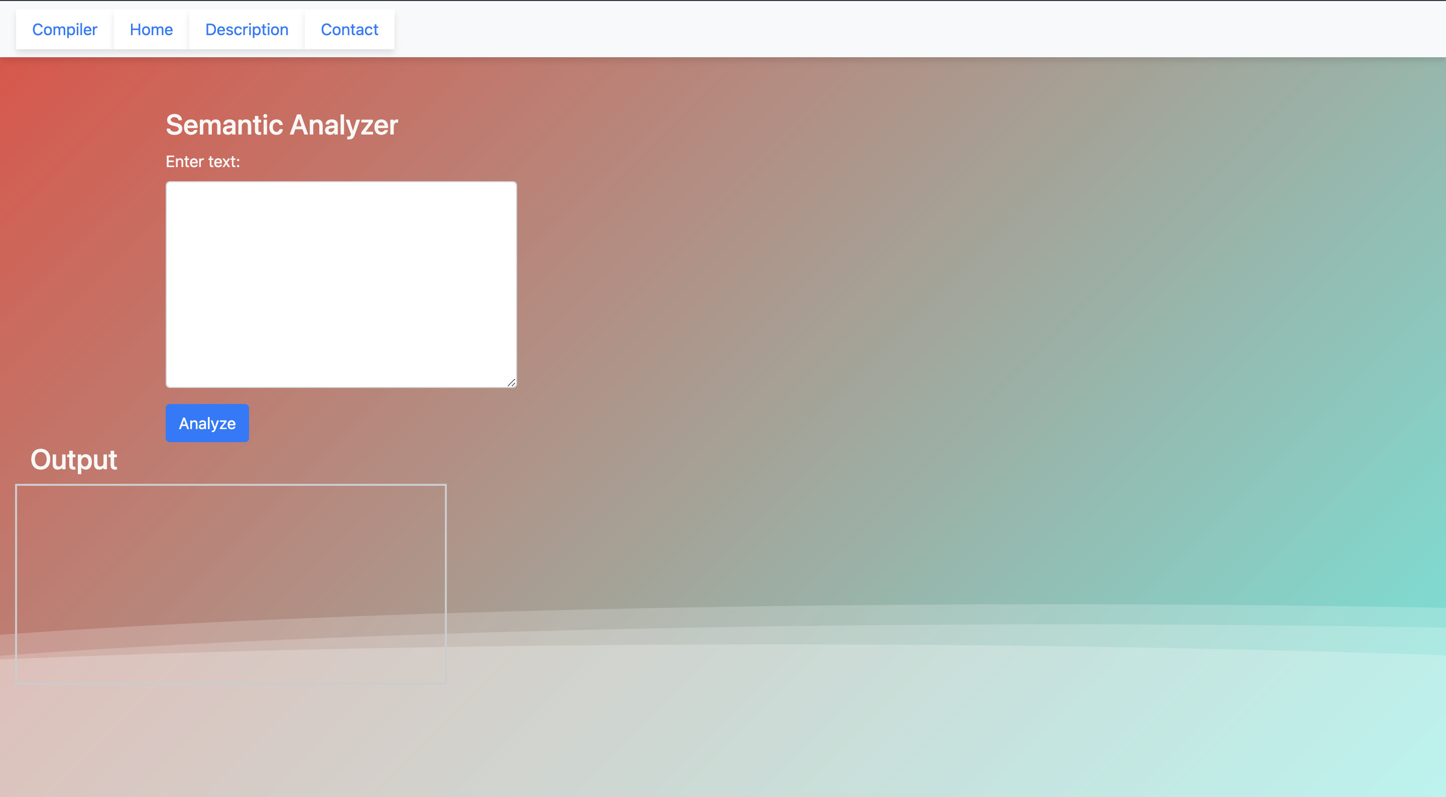
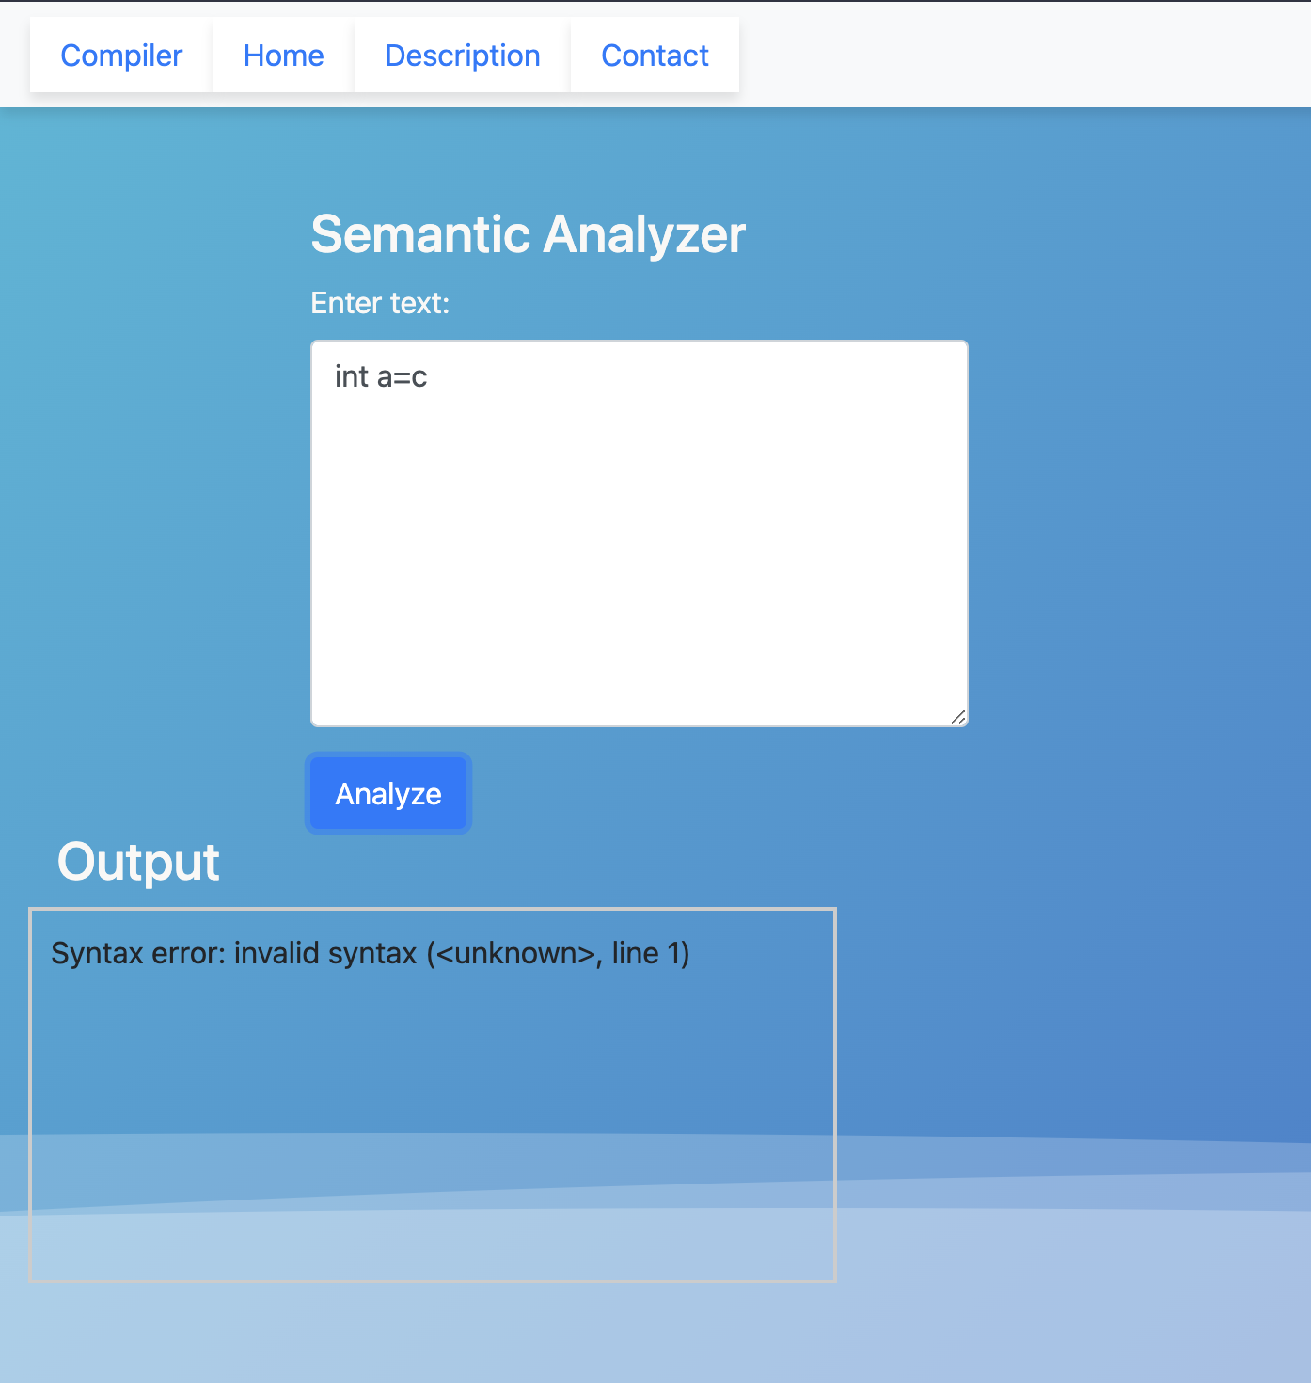
Implementation

Slide 8
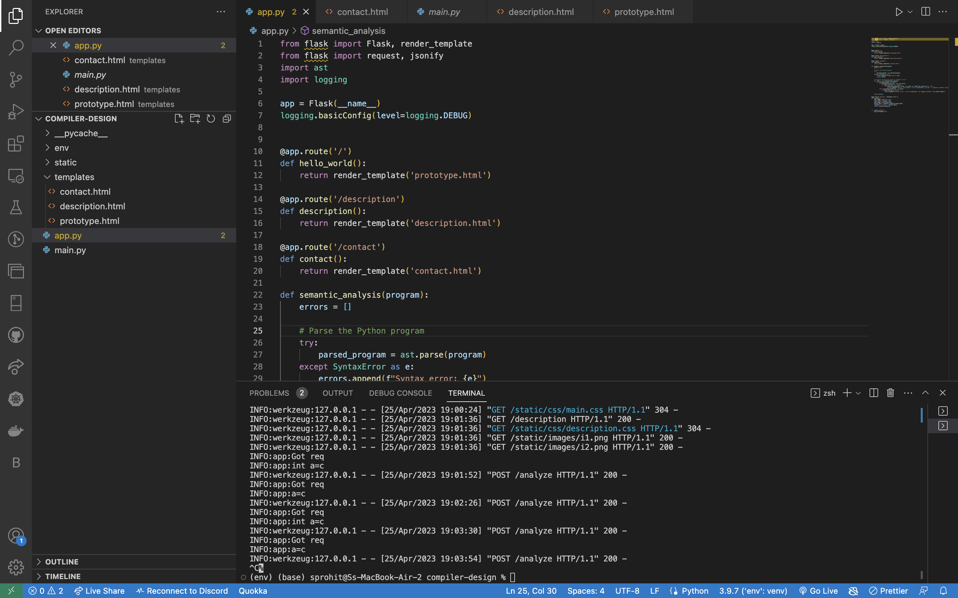
Backend Configuration

Slide 9
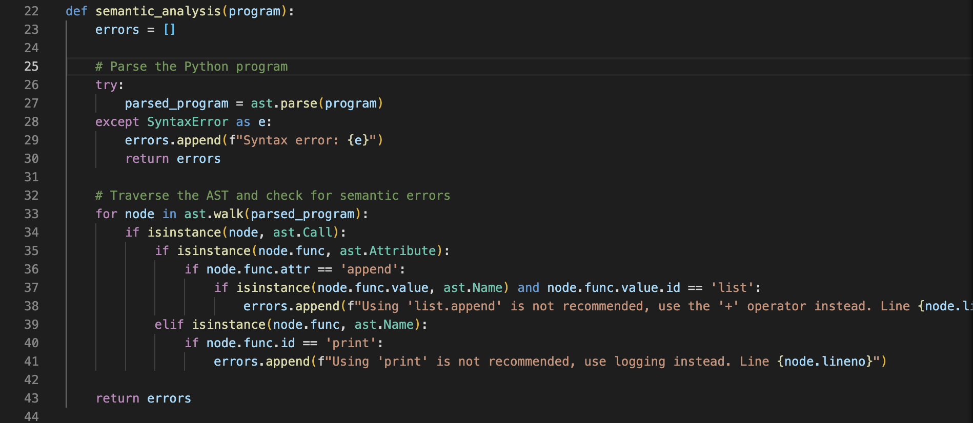
Function Declaration

Slide 10
Conclusion
In conclusion, the semantic analyzer plays a crucial role in the compiler design process. Its primary objective is to ensure that the source code complies with the rules of the language, which involves analyzing and verifying the meaning of the program's constructs and identifying any potential errors or inconsistencies.
The semantic analyzer works in tandem with the lexical analyzer and syntax analyzer to complete the front-end processing phase of the compiler. It takes the output from the syntax analyzer and generates an intermediate representation, which is later used by the code generator to produce the target code.
The semantic analyzer's job is challenging, as it must be able to understand the programmer's intentions and context to ensure that the program operates as expected. Furthermore, it must also handle complex features, such as type checking and type conversion, variable scoping, and function overloading.
Overall, the semantic analyzer is an essential component of the compiler design process, and its accuracy and efficiency are critical in producing high-quality code. It helps in detecting errors and inconsistencies, improves code quality, and ultimately results in better software.

Slide 11
References
https://www.geeksforgeeks.org/semantic-analysis-in-compiler-design/
https://pgrandinetti.github.io/compilers/page/what-is-semantic-analysis-in-compilers/
https://monkeylearn.com/blog/semantic-analysis/

Slide 12
Thank You

