Slide 1

2014.11.20
2014.12.03
2014.12.03
Project Name
Project Name
2021.11.12
Project Name
BG3-PTI NDA WebFlow SOP v1.0
By Your Name
By Your Name
By Your Name
By BG3-BU1-FPM

Slide 2
Before
Template shared everywhere
Didn't signed by managers
NDA search difficulty
After
Process Standardization
Need Dept. manager approval in system
The unique QR Code for everyone

Slide 3
Process
Application
Apply: Reserves 1 DRI to application form for each dept (Need distinguish the project name)
Link: http://fip.pegatroncorp.com/FIP2/Apply -->PTI BPM --> HGND
Signing off
DRI: Function Sec. manager --> Dept. manager
Activity: Check the name list is reasonable or not
Paper
Review
DRI: Overall NDA window (Currently PTI DRI: FPM Gowri)
Activity: Check the signature name is identify clearly and match with the system form. The system will automatically record [Signed] after review is passed. (otherwise it will be rejected and the signature will not be established)

Slide 4
SOP

Slide 5
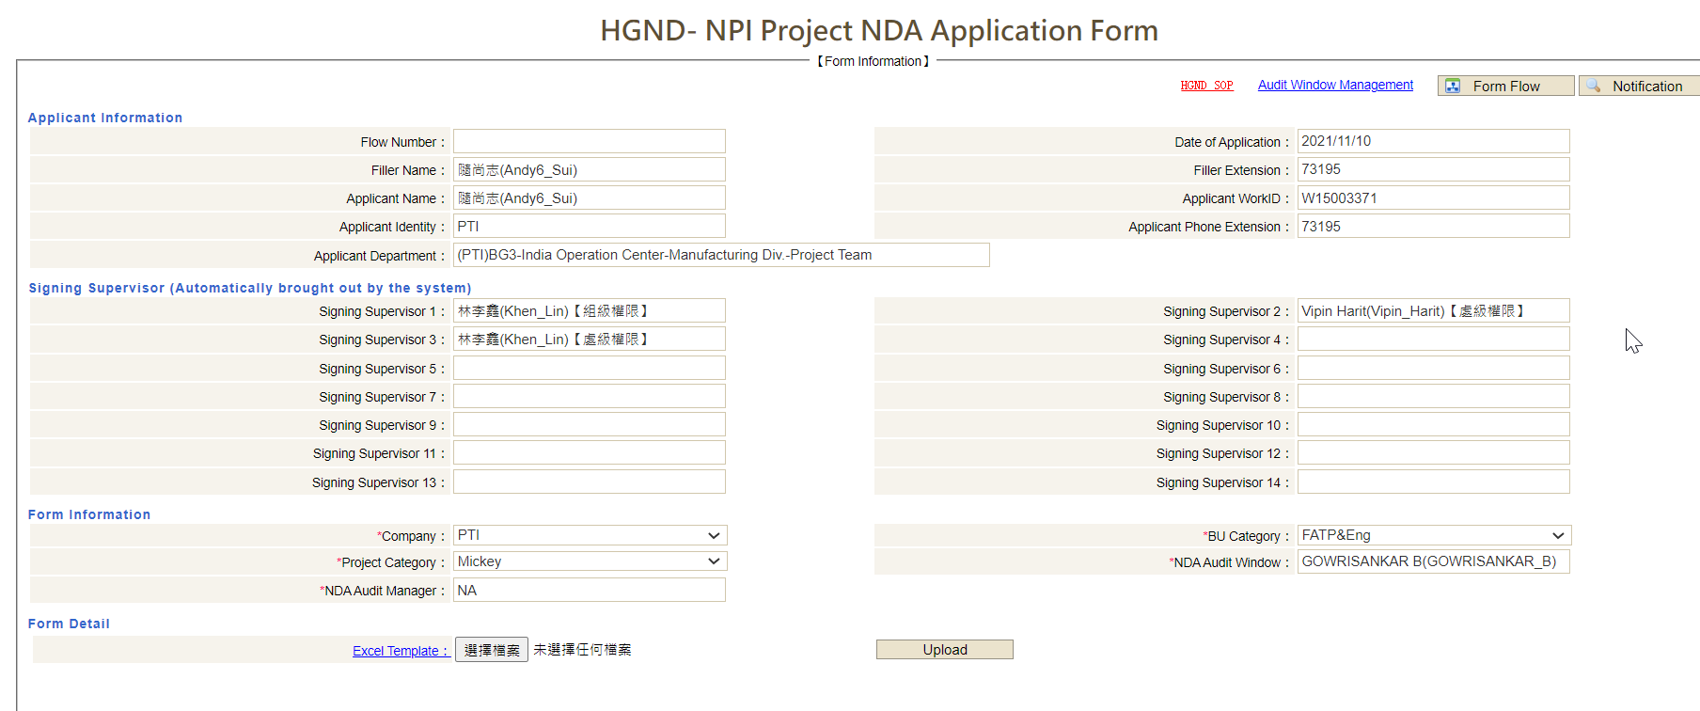
1. Application -- Filer
FIP Portal -->HGND- NPI Project NDA Application Form
Select and apply only 1 project at a time
Template Download
Overall NDA DRI

Slide 6
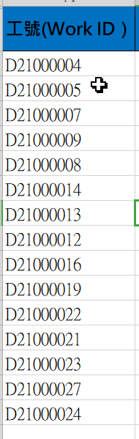
2. File upload Template -- Filer
1. Need fill the working ID ( (Note: No empty space allowed!!)
2. Save it and upload to system form.

Slide 7
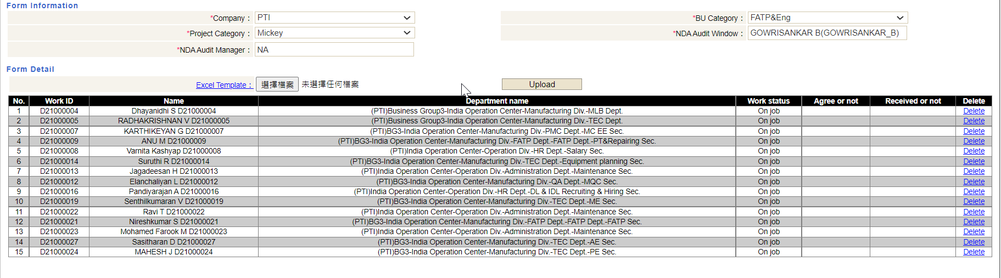
3. Check again before submit
Could be delete if needed

Slide 8
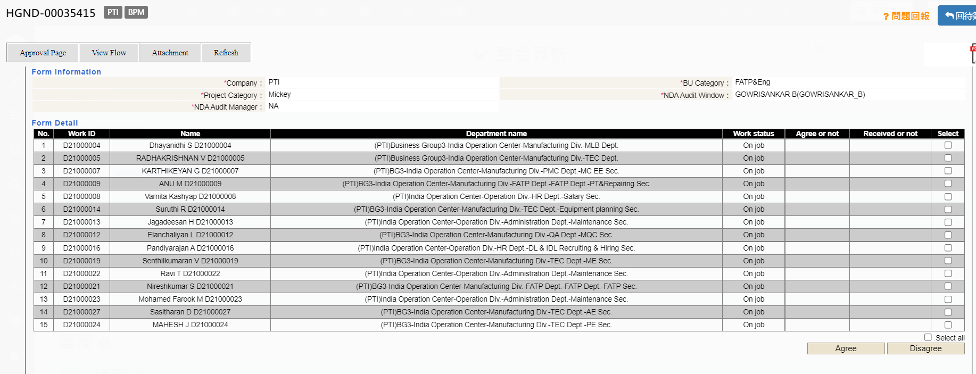
4. Sec&Dept Manager Review/Signing
Check Name List → [Select] Necessary → Agree(Disagree) → Approve(Reject)
Need “select” and “Agree”
Approve

Slide 9
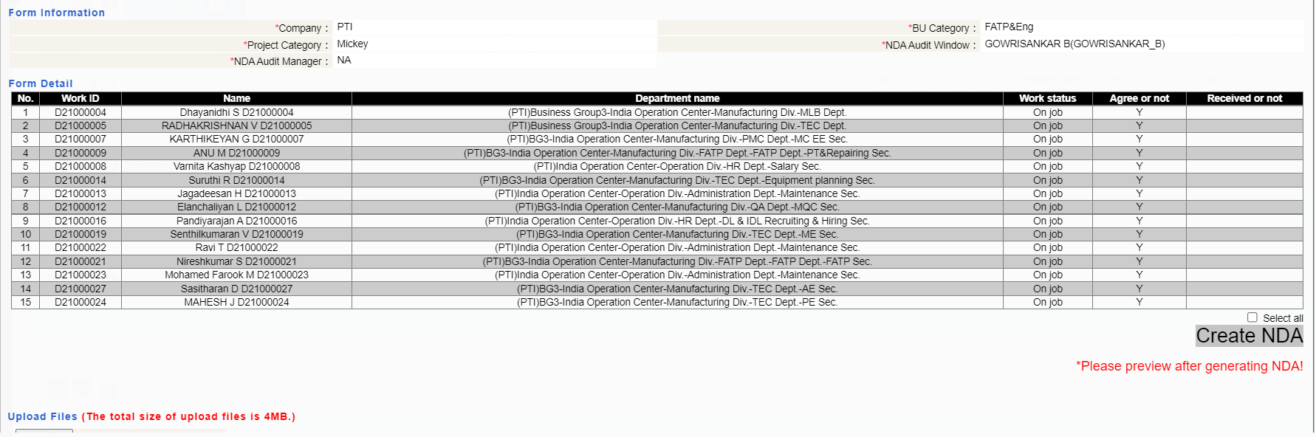
5. Print Customized NDA(1/3) -- Filer
After approved by managers, applicant need check the name and create customized NDA
Create NDA

Slide 10
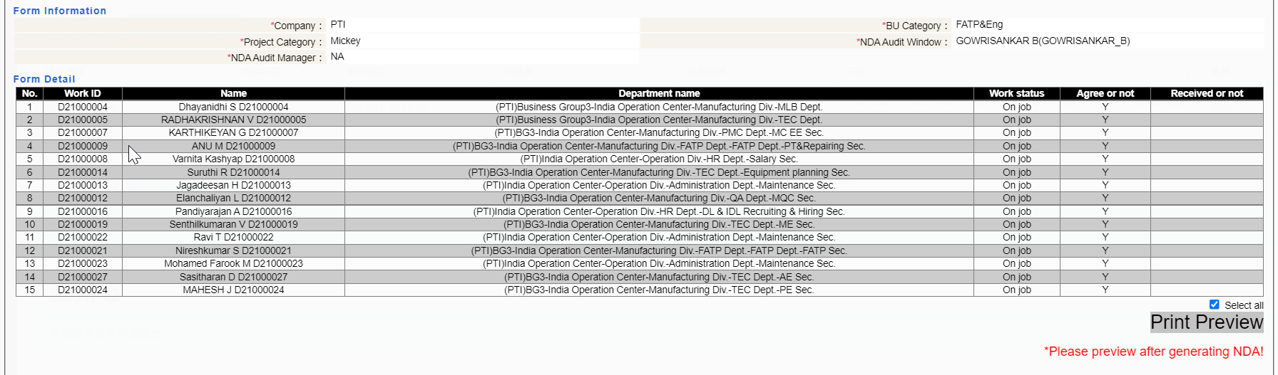
5. Print Customized NDA(2/3) -- Filer
After approved by managers, applicant need check the name and print customized NDA
Print Preview

Slide 11
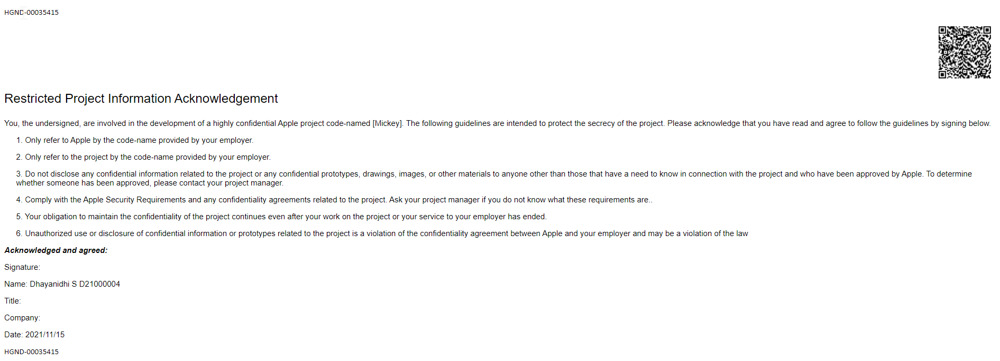
5. 5. Print Customized NDA(3/3) -- Filer
QR Code
After approved by managers, applicant need check the name and print customized NDA
HGND No#

Slide 12
6. Paper NDA send to DRI
Based on the NDA DRI request to follow up the time/Location
BG3-PTI
Location | India
Project | BG3-BU1&TEC
 | DRI | Location | Time | Request
Mickey | Gowrisankar_B | OB-2F-Office | Every Thursday Afternoon (2:00PM-5:00PM) | Fix the paper clips with the form as the unit, label it (Form number, Sender number, Number of copies)

Slide 13
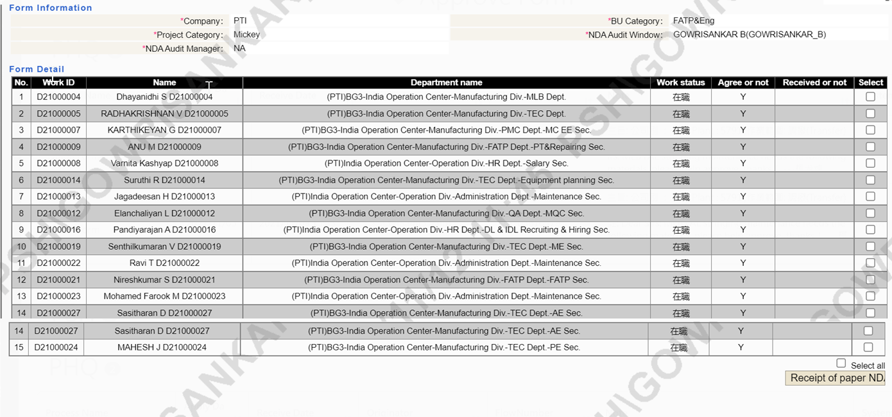
7. Review and approval -- NDA DRI
NDA DRI(For example: Gowri) Need check the Paper NDA if writing norms or not
if okay -->Receipt of paper NDA/Approve
if NG --> Reject
Need “select” after check okay
Click on “Receipt of Paper NDA”

Slide 14
Need Update
8. 紙本移往法務建檔
根據[表單編號]用夾子夾好紙本(如果沒有將直接退件), 以[成箱]形式, 送到法務, 收件後法務刷二維條碼確認建檔
地理位置 | 送到 | 部門 | 收件者
台北 | 台北總部 | 法務中心 | Queenie Wang(王姿月_Pegatron)
上海&其他 | 上海昌碩-RDA辦公大樓-六樓法務部 | 一般法務一課 | Lemon2 Tao(陶丹_PSH)
崑山 | 崑山-(醫務室旁邊)FU新大樓-二樓 | 一般法務四課 | Aimee Que(卻佳潔_PKS)

Slide 15
Thanks!

Slide 16


