Slide 1
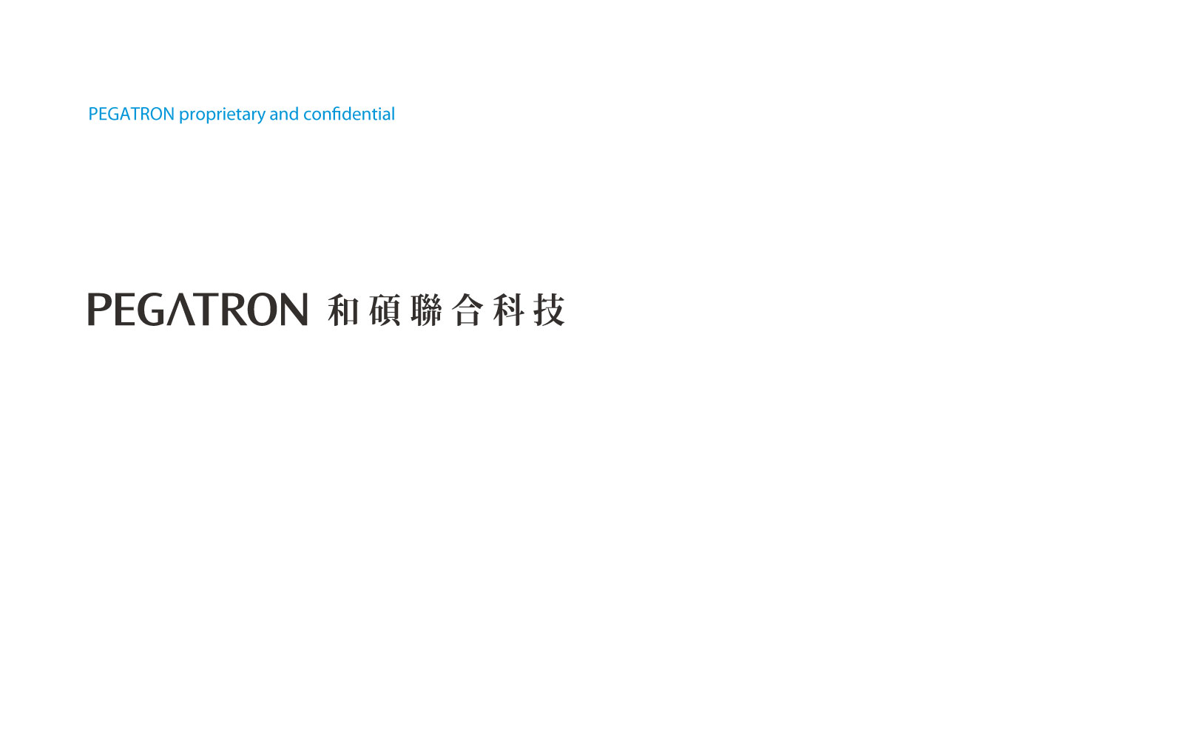
X-MES-table
By Your Name
By Your Name

Slide 2
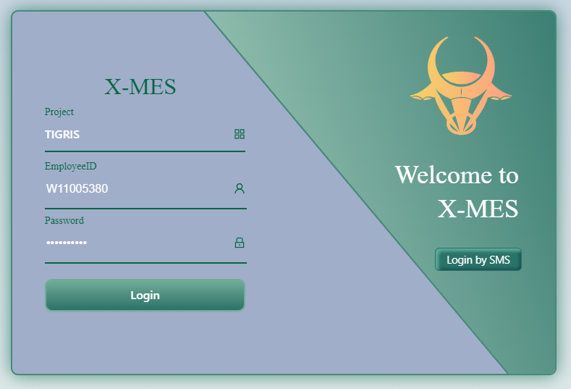
login Page
This is the X-MES login Page
Verify your permissions through Project, Employee ID, and Password

Slide 3
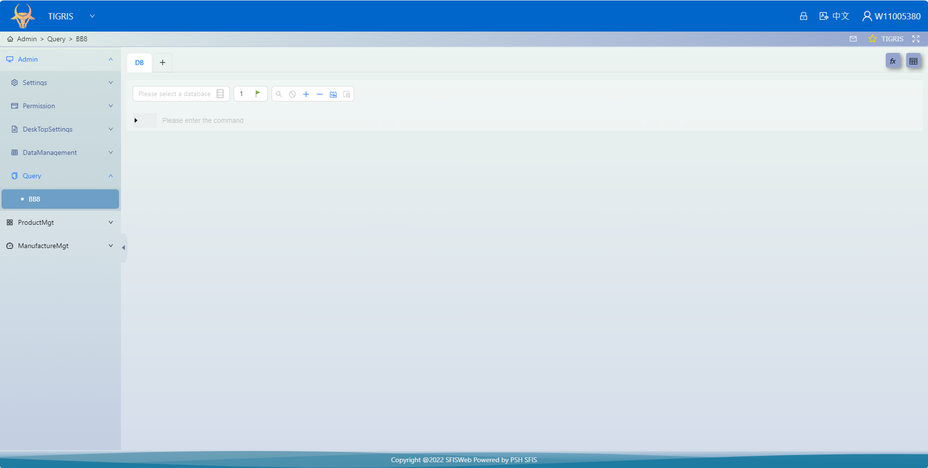
Path to BB8
step1
step2
step3

Slide 4
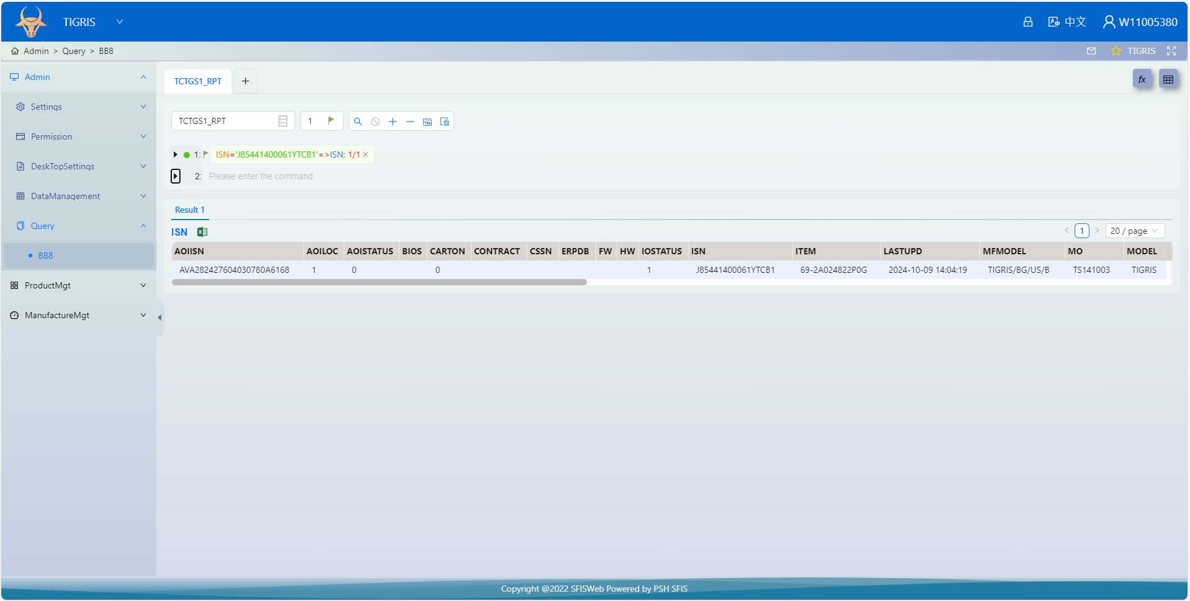
BB8 Area Description
1.Select a DataBase
2.Query method
3.Execute query
4.Query results
TCTGP1: sfis basic setting TCTGS1: mlb sn data
TCTGF1: fatp sn data TCTGG1: bobcatlog & clonetrooper log

Slide 5
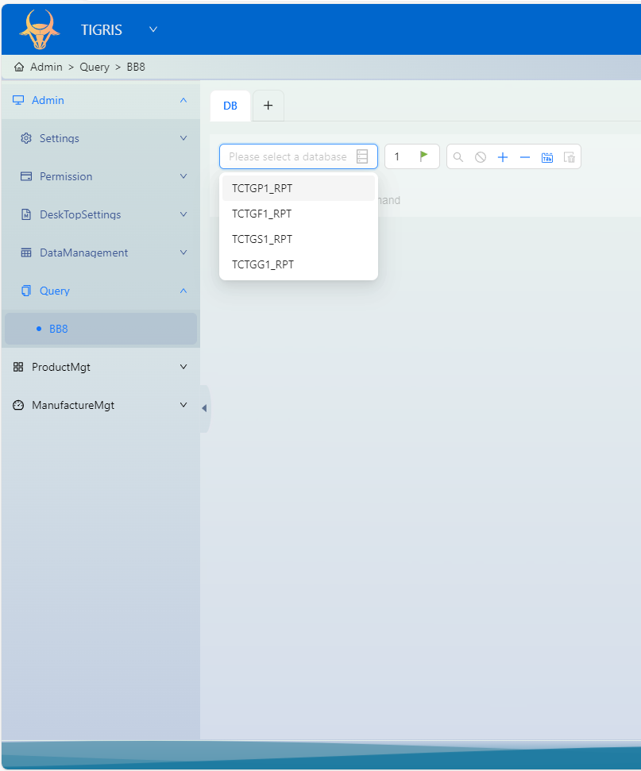
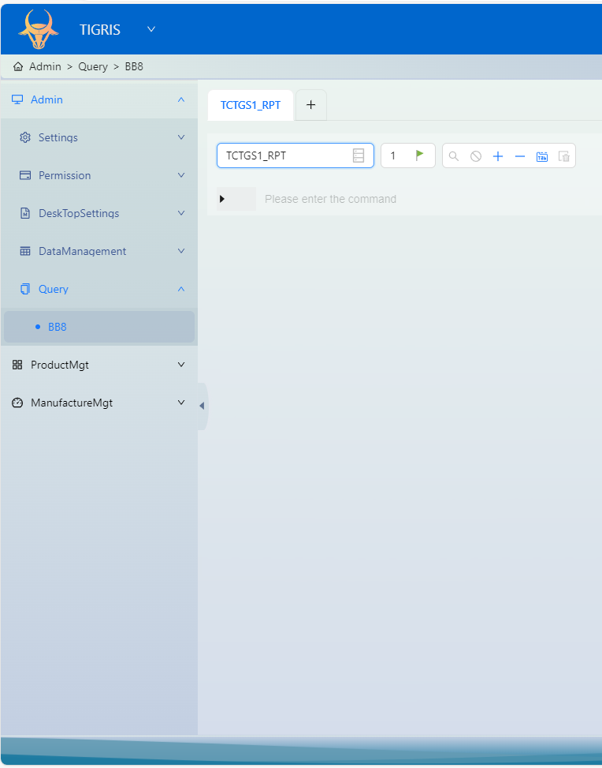
BB8 Operation step1
Selected a DataBase
Select a DataBase

Slide 6
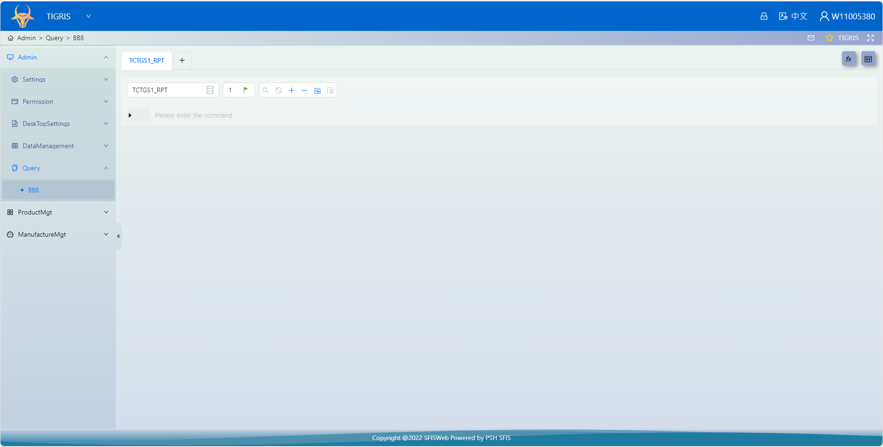
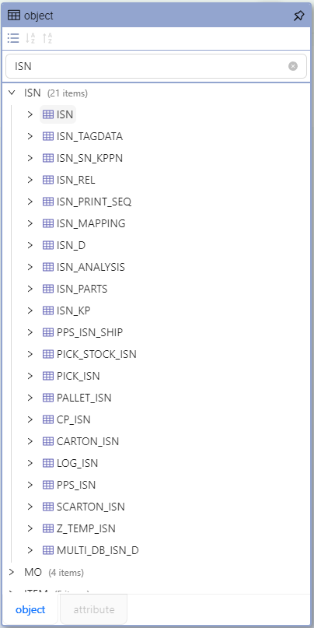

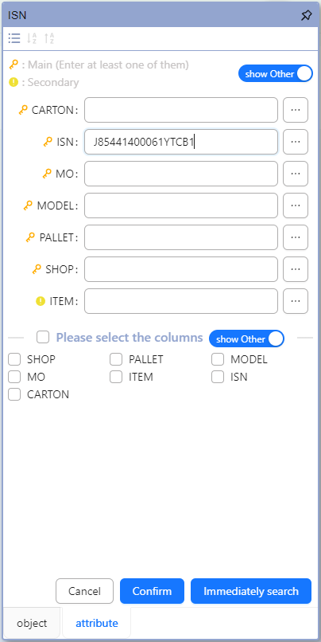
BB8 Operation step2
Click
1.Select a table
2.Enter key information
5.Click the button to get Data
4.The system automatically generates an execution statement
3.Click the Confrim button

Slide 7
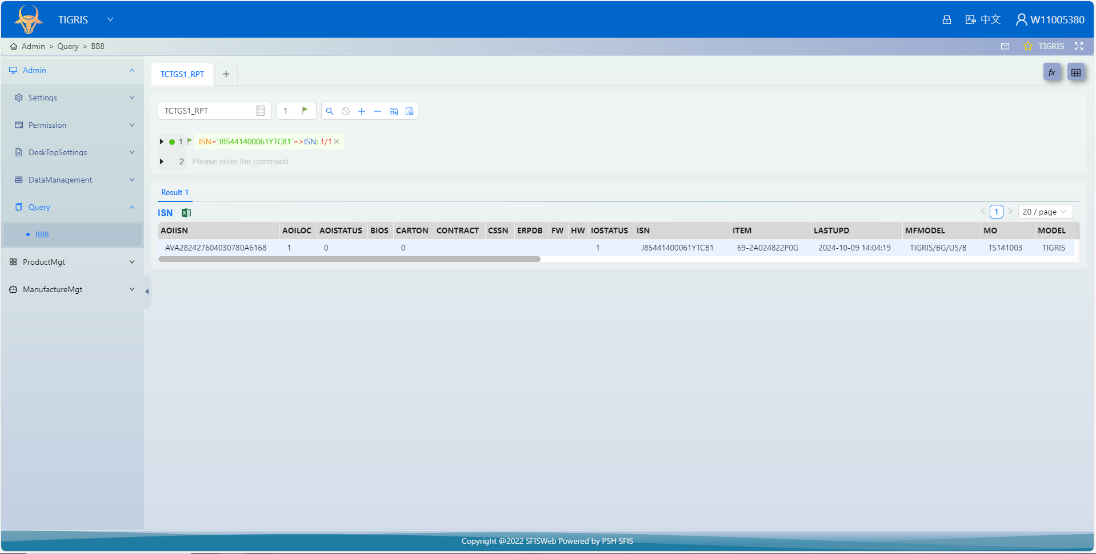
BB8 Operation step3
Query results

Slide 8
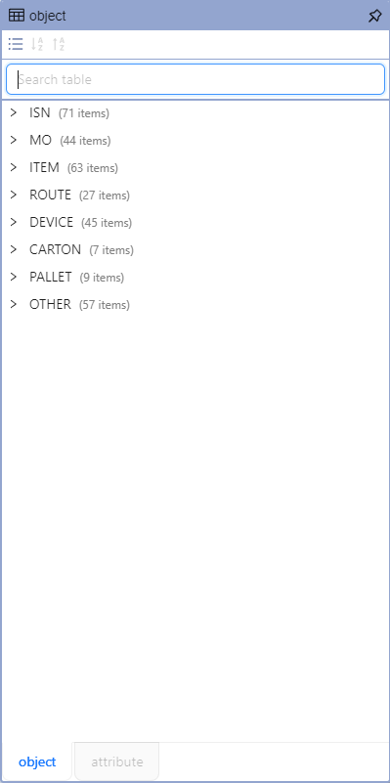
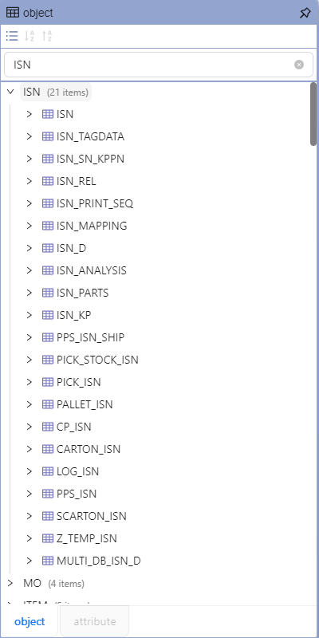
BB8 more about tables
Click
You can search By table keyword
Default classification
By ISN
By MO
By ITEM
By …

Slide 9
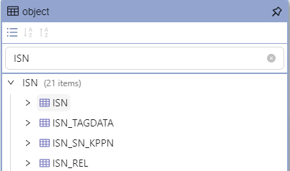
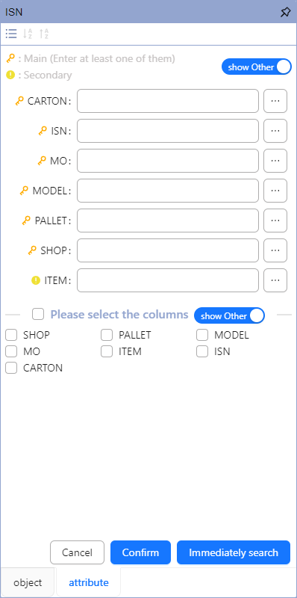
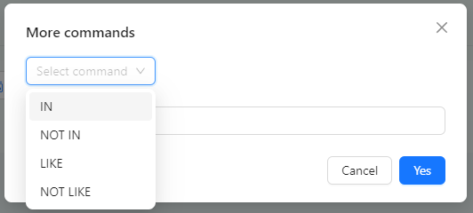
BB8 more about tables
Click
Click
It will show a new window
Query conditions
->Allow multiple selections
Choice the command type
Select the fields to display if you need
->Allow multiple selections

Slide 10
Main table list
ROUTE
ROUTE_STEP
LINE
DEVICE
ALLDEV
DEVICE_CFG
MO
ISN
ITEM
MO_ITEM
MOKP
CHKRULE_D
MOKP_D
MOKP_DD
ISN_KP
MO_ROUTE
MO_D
SNERR
CARRIER_SN_D
MLB_STORE_STATUS
MLB_STORE_HS

Slide 11
Main table list
MO_ROUTE_PDCA
MO_ROUTE_UOP
MO_ROUTE_OWNER
MO_ROUTE_OWNER_D
KPSN_TRACK
KPSN_TRACK_HIS
AUTHENTIC_HOLD
AUTHENTIC_HOLD_D
REWORK
REWORK_D
CARTON_ISN
SCARTON_ISN
PALLET_ISN
ROUTE_STEP_CHECK
AP_INI
MODEL_D

Slide 12
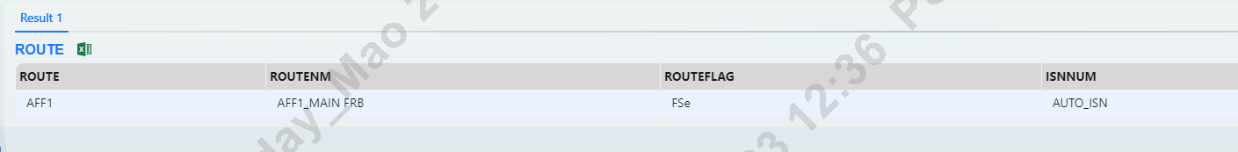
ROUTE
ROUTE='AFF1'=>ROUTE.ROUTE.ROUTENM.ROUTEFLAG.ISNNUM;
KEY Field Description
ROUTE: SFIS route name
ROUTENM: Description of ROUTE
ROUTEFLAG: F, S are fixed; e determines whether the route requires config
ISNNUM: FATP fixed use AUTO_ISN;MLB fixed use TIGRIS_PCBA_SN

Slide 13
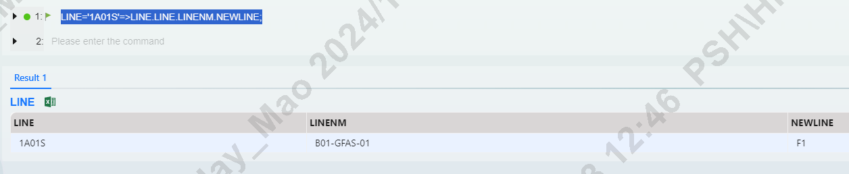
LINE
LINE='1A01S'=>LINE.LINE.LINENM.NEWLINE;
KEY Field Description
LINE: SFIS line name
LINENM: Description of line
NEWLINE: Will be used in AUTOGR

Slide 14
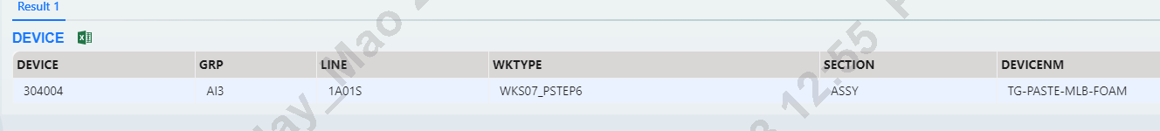
DEVICE
DEVICE='304004'=>DEVICE.DEVICE.GRP.LINE.WKTYPE.SECTION.DEVICENM;
KEY Field Description
DEVICE: Devices used by CloneTrooper and test sites
GRP: This device is assigned to a specific station
LINE: This device assigns a specific line
WKTYPE: Control how CloneTrooper scans codes ; The test site is fixed to use WKS07_1
SECTION: GRP has its own section
DEVICENM: Describe the location of the device to facilitate confirmation by the IT team

Slide 15
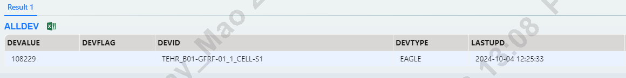
ALLDEV
DEVID='TEHR_B01-GFRF-01_1_CELL-S1'=>ALLDEV;
KEY Field Description
DEVALUE: Maintain devices that need to be bound
DEVID: Test station and AE automation station stationid in MACMINI

Slide 16
DEVICE_CFG
DEVICE='304001'=>DEVICE_CFG.DEVICE.DEVID.SID.IP.APID.PAGEID;
KEY Field Description
DEVICE: Maintain devices that need to be bound
DEVID: stationid in CloneTrooper
SID: FATP use TCTGF1;MLB use TCTGS1
IP: R2D2 Webservice URL
APID: Main program name
PAGEID: Program pages

Slide 17
MO
MO=PF147003'=>MO.MO.ITEM.ROUTE.TQTY.IQTY.OQTY.APPROVE.STATUS;
KEY Field Description
MO: Work order content
ITEM: Pega ITEM
ROUTE: The route used by MO
TQTY: The target amount of MO
IQTY : Number of MOs that have started the process
OQTY: Number of MOs that have completed the process
APPROVE: PMMO approve status (0.no approve;1.approve)
STATUS: MO status(0.no extant ;1.MO extant ; 2 MO already input; 3.MO closed)

Slide 18
ISN
ISN='J85HAN0000300003R2'=>ISN.ISN.ITEM.MO.AOIISN.AOILOC.AOISTATUS.IOSTATUS;
KEY Field Description
ISN: Product serial number
ITEM: Pega ITEM
MO: MO number
AOIISN: only SMT product ,panel isn
AOILOC: board location
AOISTATUS: 1.board link aoiisn; -1 board delink aoiisn
IOSTATUS: 0.no input ;1 already ; 2 finished process

Slide 19
ITEM
ITEM='70A0611M1900'=>ITEM.ITEM.ITEMNM.CUSTITEM.CUSTITEMSP.CUSTVENDOR;
KEY Field Description
ITEM: Pega ITEM
ITEMNM: ITEM description
CUSTITEM: coco item
CUSTITEMSP: EEEE CODE
CUSTVENDOR: Vendor description

Slide 20
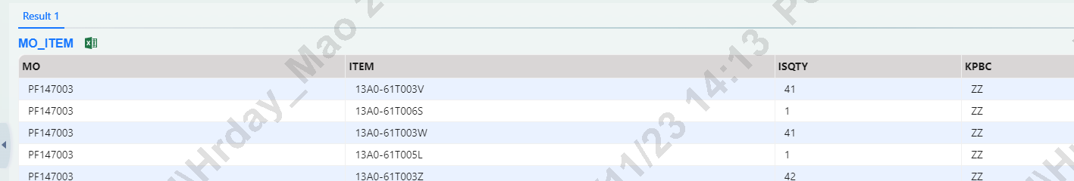
MO_ITEM (The information here all comes from SAP and is transferred to SFIS through SAP.)
MO='PF147003'=>MO_ITEM.MO.ITEM.ISQTY.KPBC;
KEY Field Description
MO: MO number
ITEM: Pega ITEM
ISQTY: Quantity of material used
KPBC: SFIS Key Part Name
(Main line: MBM;LD1;DM2;DM;CABM1;BT;BC1;AN16;AN11;AN10;AN13)
(MLBCG line: RFID)

Slide 21
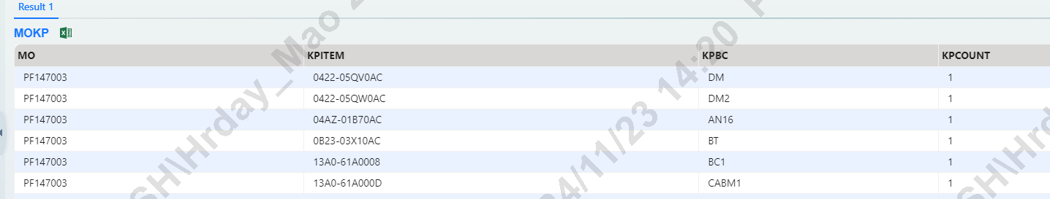
MOKP (MOKP is transferred to PMMO after sorting out the mo_item data. Here are the main materials needed for production.)
MO='PF147003'=>MOKP.MO.KPITEM.KPBC.KPCOUNT;
KEY Field Description (MOKP is transferred to PMMO after sorting out the mo_item data. Here are the main materials needed for production.)
MO: MO number
KPITEM: Pega KPITEM
KPBC: SFIS Key Part Name
KPCOUNT:The quantity of this material that needs to be used during production(1.link one ;2.link two)
(Main line: MBM;LD1;DM2;DM;CABM1;BT;BC1;AN16;AN11;AN10;AN13)
(MLBCG line: RFID)

Slide 22
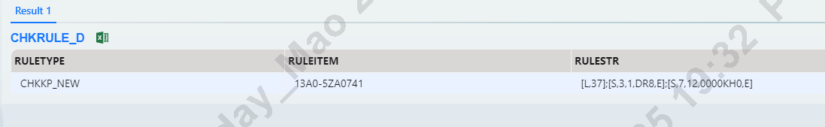
CHKRULE_D (query kpsn rule )
RULEITEM='13A0-5ZA0741'=>CHKRULE_D.RULETYPE.RULEITEM.RULESTR;
KEY Field Description
RULETYPE: (CHKKP_NEW for LINK KP; CHKMK_VSN for MTK scan ; CHKKP_LOTCODE for lotcode scan )
RULEITEM: vendor item (kpitem from mokp)
RULESTR: KPSN rule

Slide 23
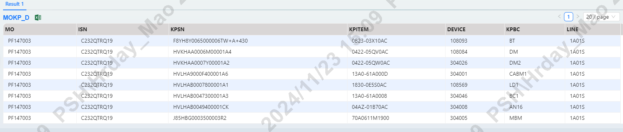
MOKP_D (query ISN current LINK KP information)
ISN='C232QTRQ19'=>MOKP_D.MO.ISN.KPSN.KPITEM.DEVICE.KPBC.LINE;
KEY Field Description (ISN current LINK KP information)
MO: ISN MO
ISN: UNIT ISN
KPSN: KEY PART VSN
KPITEM: KYE PART pega KPITEM
DEVICE: Which CloneTrooper link material VSN
KPBC: material KEPPART sfis name
LINE: Which line link material VSN

Slide 24
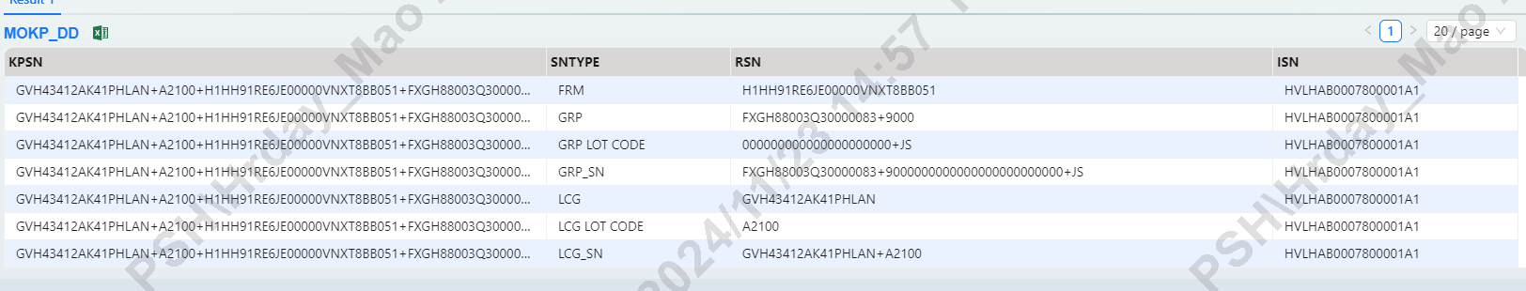
MOKP_DD(Here is the information of CG splitting)
ISN='HVLHAB0007800001A1'=>MOKP_DD.KPSN.SNTYPE.RSN.ISN;
KEY Field Description
KPSN: full of CGS
sntype:
RSN: Split CGS data
ISN: CG MODULE SN

Slide 25
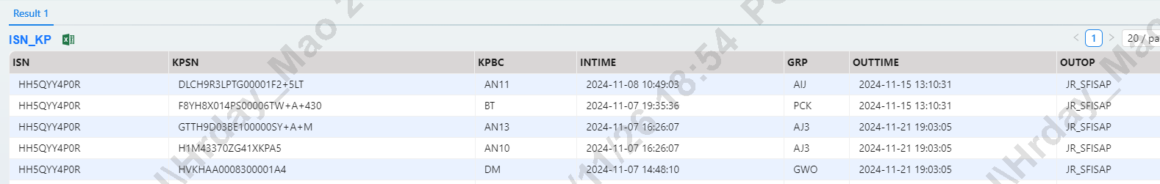
ISN_KP (ISN historical LINK records and current LINK records)
ISN='HH5QYY4P0R'=>ISN_KP.ISN.KPSN.KPBC.INTIME.GRP.OUTTIME.OUTOP;
KEY Field Description
ISN: UNIT ISN
KPSN: KEY PART VSN
KPBC: material KEPPART sfis name
INTIME: What time CloneTrooper link material VSN
GRP: link station GRP
OUTTIME: Delink time (If there is time, it means that this KP is delinked)
OUTOP: delink opid (JR_SFISAP is the smart delink)

Slide 26
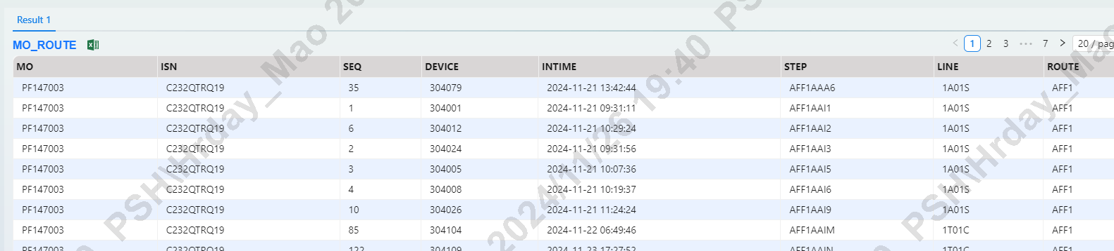
MO_ROUTE (ISN FLOW)
ISN='C232QTRQ19'=>MO_ROUTE.MO.ISN.SEQ.DEVICE.INTIME.STEP.LINE.ROUTE;
KEY Field Description
MO: MO number
ISN: ISN number
SEQ: ISN flow sort
DEVICE: pass station deviceid
INTIME: pass time
STEP: pass step
LINE: pass line
ROUTE: isn route

Slide 27
MO_D (isn current status&step)
ISN='C232QTRQ19'=>MO_D.MO.ISN.DEVICE.STEP.INTIME.OP.STATUS;
KEY Field Description
MO: MO number
ISN: ISN number
DEVICE: deviceid
STEP: current station
INTIME: pass current station time
OP: scan opid
Status: (0.no error ; 1.unit have error )

Slide 28
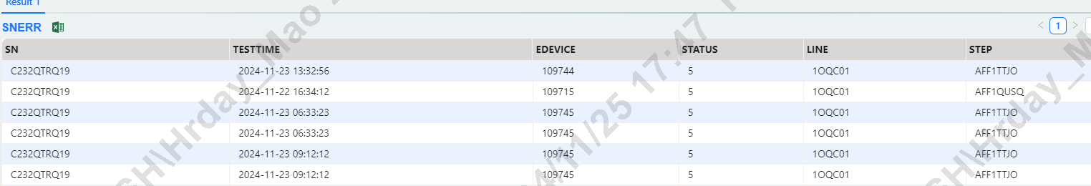
SNERR (query MLBSN and FATPISN if there is an error in the system)
SN='C232QTRQ19'=>SNERR.SN.TESTTIME.EDEVICE.STATUS.LINE.STEP;
KEY Field Description(MLBSN and FATPISN if there is an error in the system)
SN: mlb&fatp ISN
TESTTIME: Upload error time
EDEVICE: Upload error use what application device
STATUS: (0.have error ;2.error repaired ;5.error auto repaired by retest)
LINE: Device line
STEP: Upload error step

Slide 29
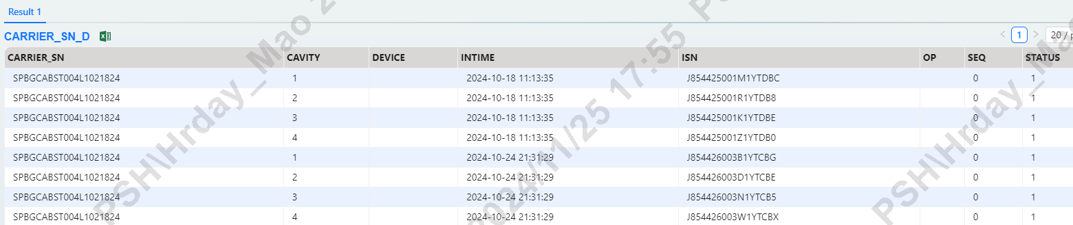
CARREIR_SN_D (Query where MLBSN and FATPISN are bound to the carrier)
CARRIER_SN='SPBGCABST004L1021824' && SEQ='0'=>CARRIER_SN_D;
KEY Field Description
CARRIER_SN: CARRIER number
CAVITY: board location
INTIME: What time carrier be linked
ISN: What ISN carrier linked
SEQ: (0.current link )
STATUS: (1. linked ;0.delink)

Slide 30
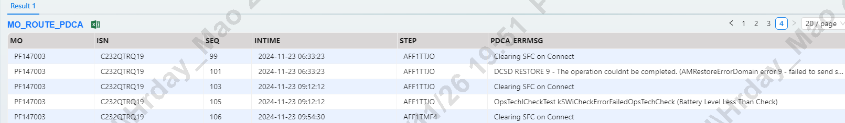
MO_ROUTE_PDCA
ISN='C232QTRQ19'=>MO_ROUTE_PDCA.MO.ISN.SEQ.INTIME.STEP.PDCA_ERRMSG;
KEY Field Description
MO: MO number
ISN: ISN number
SEQ: pass station order
INTIME: test station time
STEP: test step
PDCA_ERRMSG: test fail message

Slide 31
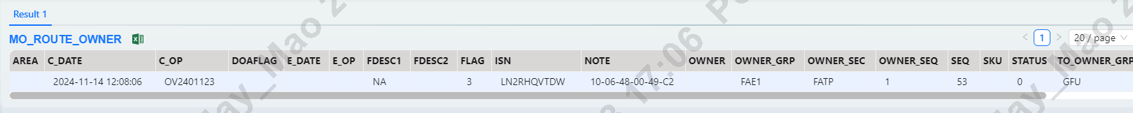
MO_ROUTE_OWNER ( Query FAE CHECK IN & OUT log)
ISN='LN2RHQVTDW'=>MO_ROUTE_OWNER;
KEY Field Description
C_DATE:CHECK IN TIME
C_OP: SCAN CHECK IN OP
ISN: UNIT NUMBER
OWNER_GRP: FAE AREA(FATP:FAE1 ; MLB: MFAE)
OWNER_SEC: FATP OR MLB
STATUS: 0.FATP UNIT CHECK IN ; 9.CHECK OUT ;5.MLB BOARD CHECK IN
TO_OWNER_GRP: ISN current station

Slide 32
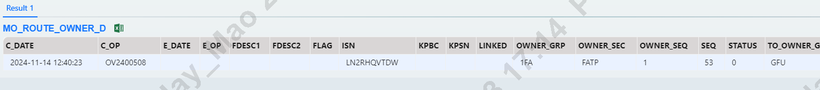
MO_ROUTE_OWNER_D (Sub-areas within the FAE area ,only for FATP isn)
ISN='LN2RHQVTDW'=>MO_ROUTE_OWNER_D;
KEY Field Description
C_DATE:CHECK IN TIME
C_OP: SCAN CHECK IN OP
ISN: UNIT NUMBER
OWNER_GRP: FAE AREA(1DIS ;1FA )
OWNER_SEC: FATP
STATUS: 0.CHECK IN ; 9.CHECK OUT
TO_OWNER_GRP: ISN current station

Slide 33
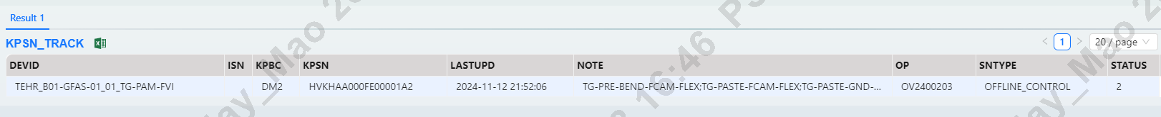
KPSN_TRACK (SKD module off-line test records)
KPSN='HVKHAA000FE00001A2'=>KPSN_TRACK;
KEY Field Description
DEVID:MACMINI stationid
KPBC: KEYPART NAME
KPSN: SKD MODULE SN
NOTE: Successfully tested sites
OP: tester
STATUS: Number of completed stations

Slide 34
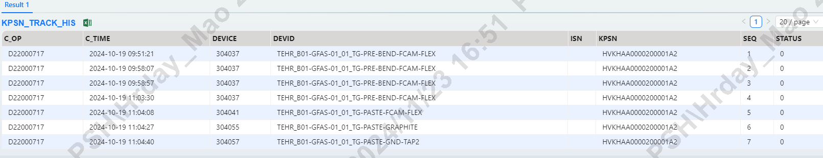
KPSN_TRACK_HIS (SKD module off-line test records history log)
KPSN='HVKHAA0000200001A2'=>KPSN_TRACK_HIS;
KEY Field Description
DEVID:MACMINI stationid
C_TIME: TEST TIME
KPSN: SKD MODULE SN
C_OP: tester

Slide 35
AUTHENTIC_HOLD (HOLD NUMBER)
BATCHNO='BHTCTGP124B12000005'=>AUTHENTIC_HOLD;
KEY Field Description (HOLD's specific ISN)
AOBJECT:
AUFLAG: 0.NO HOLD ; 2. HOLD
BATCHNO: HOLD order number
AOBJECT&AUTHTYPE: KPSN or ISN
TYPED: (GRP—HOLD this GRP ; ALL- HOLD all GRP)
AUDESC: hold describe

Slide 36
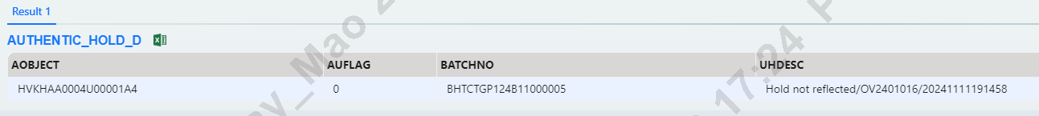
AUTHENTIC_HOLD_D (HOLD's specific ISN)
AOBJECT='HVKHAA0004U00001A4 '=>AUTHENTIC_HOLD_D;
KEY Field Description
AOBJECT: ISN
AUFLAG: 0.NO HOLD ; 2. HOLD
BATCHNO: HOLD order number
UHDESC:Description of releasing HOLD

Slide 37
REWORK (REWORK NUMBER)
RWNO='RTCTGS14B1500001_TCTGF1'=>REWORK;
KEY Field Description
RWMO: rework number
OP: rework OPID
RQTY: How many units in this reworkno
RWKP: Remove what KP list
RWTIME: rework time

Slide 38
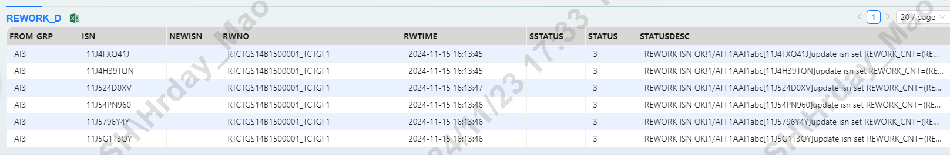
REWORK_D (The specific ISN is recorded by rework)
RWNO='RTCTGS14B1500001_TCTGF1'=>REWORK_D;
KEY Field Description
FROM_GRP: rework step
ISN: UNIT NUMBER
RWNO: REWORKNO
RWTIME:REWORK TIME
STATUS: 2. REWORK in progress ;3 REWORK CLOSED
STATUSDESC: REWORK record of everything done

Slide 39
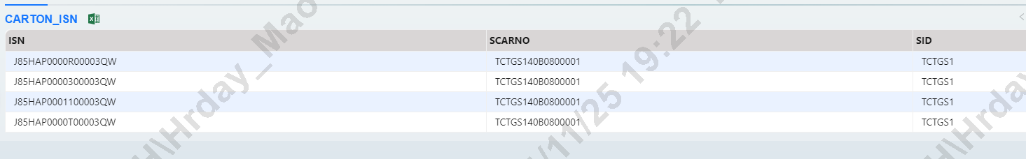
CARTON_ISN (query MLB carton number and MLBSN list)
SCARNO='TCTGS140B0800001'=>CARTON_ISN;
KEY Field Description
ISN: MLBsn list
SCARNO: carton number

Slide 40
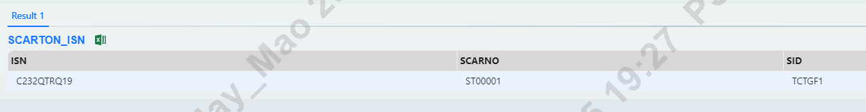
SCARTON_ISN (query FATP GB STOCK carton and ISN list)
SCARNO='ST00001'=>SCARTON_ISN;
KEY Field Description
ISN: MLBsn list
SCARNO: carton number

Slide 41
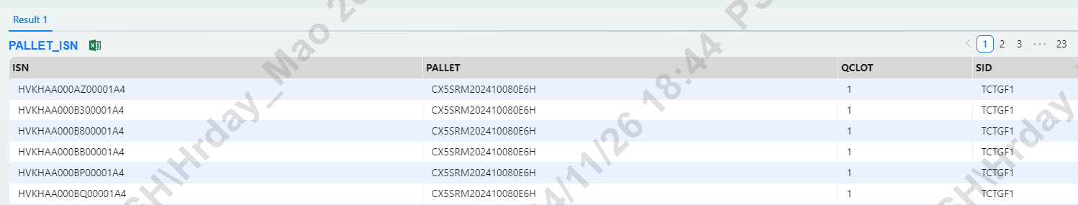
PALLET_ISN (query FATP 90WH pallet and ISN list)
PALLET='CX5SRM202410080E6H'=>PALLET_ISN;
KEY Field Description
ISN: FATPsn list
PALLET: PALLET number

Slide 42
AP_INI
1.CHK_ITEM.exe (APID='CHK_ITEM.EXE'=>AP_INI;)
2.AUTHENTIC.HOLD.exe (APID='AUTHENTIC.HOLD'=>AP_INI;)
3.FAERegion_Tigris.exe (APID='FAEREGION_TIGRIS.EXE'=>AP_INI;)
4.MLB.STOCK.exe (APID='MLB.STOCK.EXE'=>AP_INI;)
5.SFIS.Offline.exe (APID='SFIS.OFFLINE.EXE'=>AP_INI;)
6.SFIS.TIGRIS.exe (APID='SFIS.TIGRIS.EXE'=>AP_INI;)
7.SFIS.SCRAP.exe (APID='SFIS.SCRAP.EXE'=>AP_INI;)
8.SFIS.PM_MO.exe (APID='SFIS.PM_MO.EXE'=>AP_INI;)
9.SFIS.REPAIR.exe (APID='SFIS.REPAIR.EXE'=>AP_INI;)
10.SFIS.RETURN.exe (APID='SFIS.RETURN.EXE'=>AP_INI;)
11.SDS system (APID='SFIS_OP_SKILL'=>AP_INI;)
12.STOCK_SFIS_TIGRIS.exe (APID='STOCK_SFIS_TIGRIS.EXE'=>AP_INI;)
13.TIGRIS.LABEL.exe (APID='TIGRIS.LABEL.EXE'=>AP_INI;)

Slide 43
MODEL_D
1. Tigris.PQA_Report.exe (MODELID='AFF1'=>MODEL_D;)
2. FAERegion_Tigris.exe (MODELID='FAE_REGION'=>MODEL_D;)
3. Kanban.Tigris.exe (MODELID='Kanban.Tigris'=>MODEL_D;)

