Slide 2
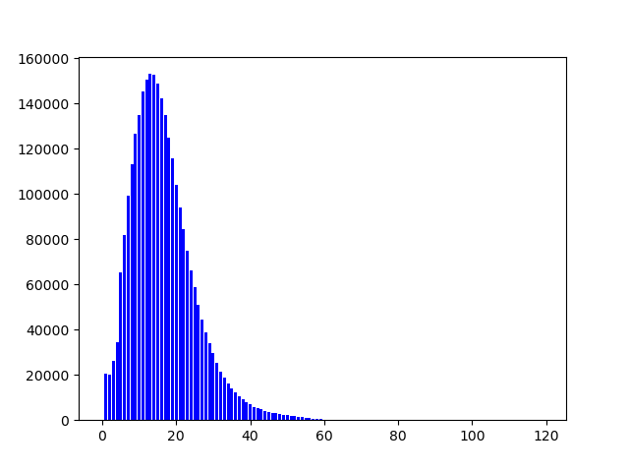
Corpus stats – (2016/05~2019/08)
Total words : 53327458 using nltk tokenizer
Total entries : 2858937
Average words/ Submission:
18.65
Word distribution:

Slide 3
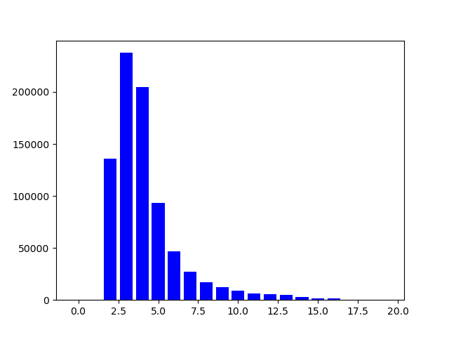
Corpus stats – (2016/05~2019/08)
Average upvotes : 82.64760013949241
Upvotes distribution:

Slide 4
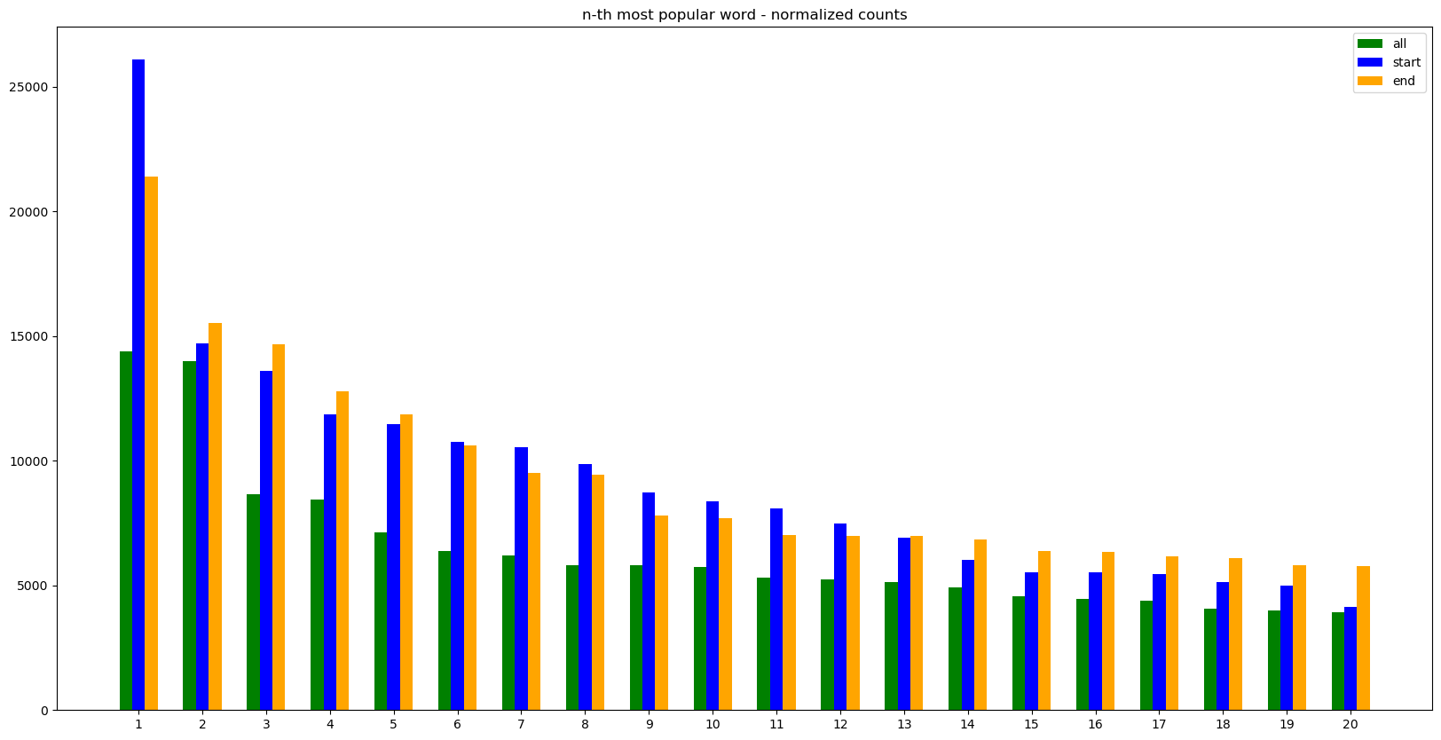
Word frequency

Slide 5
Word frequency
Parameters
  “all” : all words in the showerthought corpus
  “start” : all starting words in the showerthought corpus
  “end” : all ending words in the showerthought corpus
  X-axis : top 20 words
  Y-axis : number of occurrences of the top 20 words (all value is normalized by a factor equal to the average sentence length)
Observation :
  Prominent occurences : start > end > all

Slide 6
['people', 'would', 'like', 'one', 'time', 'get', 'someone', 'never', 'life', 'probably', 'could', 'think', 'know', 'really', 'make', 'every', 'world', 'day', 'person', 'see', 'actually', 'us', 'ever', 'way', 'something', 'say', 'much', 'years', 'first', 'go', 'good', 'always', 'thing', 'reddit', 'going', 'everyone', 'even', 'many', 'wonder', 'things', 'still', 'called', 'lot', 'new', 'shower', 'use', 'want', 'humans', 'made', 'real', 'back', 'water', 'earth', 'must', 'look', 'without', 'right', 'human', 'old', 'ca', 'thought', 'different', 'year', 'kids', 'bad', 'feel', 'take', 'name', 'word', 'future', 'used', 'getting', 'game', 'better', 'basically', 'food', 'instead', 'saying', 'two', 'money', 'movie', 'work', 'best', 'need', 'around', 'less', 'makes', 'become', 'last', 'since', 'today', 'long', 'yet', 'post', 'car', 'live', 'trump', 'everything', 'man', 'phone', 'die', 'internet', 'put', 'universe', 'call', 'means', 'eat', 'find', 'come', 'got', 'also', 'end', 'enough', 'video', 'body', 'show', 'shit', 'point', 'mean', 'sex', 'movies', 'dogs', 'dog', 'born', 'nothing', 'maybe', 'love', 'tell', 'else', 'another', 'big', 'might', 'place', 'able', 'thoughts', 'trying', 'start', 'seen', 'anything', 'making', 'great', 'using', 'school', 'parents', 'technically', 'women', 'away', 'give', 'times', 'pretty', 'read', 'next', 'equivalent', 'version', 'men', 'gets', 'weird', 'reason', 'guy', 'music', 'death', 'watch', 'living', 'anyone', 'black', 'sounds', 'stop', 'literally', 'tv', 'number', 'part', 'space', 'little', 'games', 'animals', 'cars', 'watching', 'words', 'hard', 'high', 'song', 'change', 'already', 'likely', 'buy', 'dead', 'may', 'kid', 'sound', 'history', 'play', 'children', 'almost', 'whole', 'age', 'house', 'imagine', 'looking', 'past', 'white']

Slide 7
Word frequency - ALL
Assumption – would, could, probably
Emphasis – really
Never – never

Slide 8
['people', 'every', 'maybe', 'one', 'someone', 'everyone', 'since', 'reddit', 'whenever', 'life', 'imagine', 'humans', 'saying', 'sometimes', 'even', 'technically', 'would', 'getting', 'everything', 'dogs', 'today', 'kids', 'nothing', 'trump', 'whoever', 'instead', 'somewhere', 'nobody', 'deleted', 'years', 'time', 'women', 'water', 'many', 'shower', 'going', 'watching', 'using', 'donald', 'google', 'men', 'anyone', 'eating', 'almost', 'considering', 'everytime', 'facebook', 'taking', 'netflix', 'despite', 'youtube', 'calling', 'thanks', 'everybody', 'cats', 'sleeping', 'given', 'ever', 'seeing', 'telling', 'black', 'memes', 'putting', 'could', 'new', 'elon', 'someday', 'jesus', 'parents', 'social', 'growing', 'somebody', 'god', 'never', 'making', 'america', 'trying', 'human', 'apple', 'buying', 'thanos', 'eventually', 'good', 'cars', 'old', 'due', 'without', 'looking', 'reading', 'money', 'pokemon', 'porn', 'aliens', 'right', 'two', 'animals', 'earth', 'according', 'girls', 'music', 'think', 'asking', 'children', 'back', 'sex', 'thinking', 'let', 'santa', 'drinking', 'driving', 'showerthoughts', 'future', 'anything', 'blind', 'ice', 'movies', 'video', 'school', 'living', 'pizza', 'food', 'dreams', 'sleep', 'babies', 'playing', 'amazon', 'everyday', 'finding', 'death', 'nsfw', 'half', 'walking', 'coffee', 'soon', 'white', 'something', 'giving', 'love', 'car', 'hot', 'pretty', 'first', 'things', 'fuck', 'dog', 'remember', 'christmas', 'guys', 'im', 'americans', 'baby', 'modern', 'companies', 'although', 'wearing', 'probably', 'birds', 'next', 'tv', 'fish', 'working', 'perhaps', 'american', 'movie', 'cheese', 'farts', 'tinder', 'disney', 'history', 'big', 'john', 'unless', 'game', 'showers', 'nowadays', 'oh', 'suicide', 'deaf', 'real', 'thank', 'hitler', 'man', 'michael', 'posting', 'teachers', 'based', 'doctors', 'halloween', 'instagram', 'gay', 'bill', 'wonder', 'true', 'april', 'phones', 'high', 'snapchat', 'whether', 'internet', 'dating']

Slide 9
Word frequency - Start
Topics
  Gerenal People – People, men, women, babies……
  Famous People/Characters/God – Elon, Trump, Jesus, Thalnos……
  Animals – Cats, Dogs, Birds
  Social Media – Facebook, Instagram, Snapchat……
  Aspects of Life – Sex, Dating, Death, Suicide……
Presentation
  Assumption : Technically speaking, imagine……

Slide 10
['time', 'life', 'people', 'day', 'world', 'shower', 'thing', 'one', 'us', 'years', 'water', 'like', 'earth', 'know', 'year', 'person', 'die', 'reddit', 'today', 'work', 'game', 'humans', 'future', 'shit', 'things', 'universe', 'food', 'money', 'name', 'death', 'anymore', 'internet', 'place', 'something', 'exist', 'ago', 'thoughts', 'way', 'ever', 'else', 'thought', 'yet', 'movie', 'body', 'back', 'right', 'sex', 'car', 'away', 'head', 'history', 'dead', 'space', 'kids', 'wrong', 'good', 'alive', 'user', 'phone', 'language', 'well', 'night', 'house', 'old', 'planet', 'job', 'bad', 'better', 'games', 'enough', 'age', 'word', 'around', 'anything', 'etc', 'mouth', 'home', 'go', 'lives', 'movies', 'music', 'days', 'man', 'first', 'school', 'sleep', 'post', 'eyes', 'past', 'face', 'times', 'children', 'together', 'hands', 'born', 'words', 'weird', 'hair', 'point', 'friends', 'nothing', 'cars', 'porn', 'show', 'mind', 'instead', 'president', 'air', 'adults', 'human', 'everything', 'forever', 'different', 'much', 'room', 'poop', 'possible', 'end', 'memes', 'toilet', 'ones', 'ass', 'real', 'sense', 'others', 'war', 'animals', 'hand', 'system', 'true', 'bed', 'see', 'gay', 'dogs', 'trump', 'dog', 'milk', 'song', 'reality', 'brain', 'idea', 'america', 'god', 'someone', 'free', 'teeth', 'country', 'button', 'light', 'story', 'paper', 'happen', 'men', 'birthday', 'number', 'later', 'alone', 'problem', 'change', 'parents', 'long', 'cold', 'died', 'stuff', 'morning', 'child', 'media', 'meaning', 'happened', 'eat', 'phones', 'experience', 'asleep', 'say', 'hot', 'kid', 'week', 'karma', 'anyway', 'mode', 'society', 'posts', 'feet', 'page', 'women', 'cleaner', 'called', 'tv', 'generation', 'think', 'want', 'moment', 'sun', 'guy', 'hell', 'dreams', 'cool', 'done', 'opposite', 'left']

Slide 11
Word frequency - End
Time : every time, at the same time
Live : whole life, in ones life
Day : *no substantial collocations*
World : in the world
Shower : *play on words on the sub*
years : in (int) years, for (int)+ years

Slide 12
TFIDF (w.r.t all)

Slide 13
Comparison between good and bad entries

Slide 14
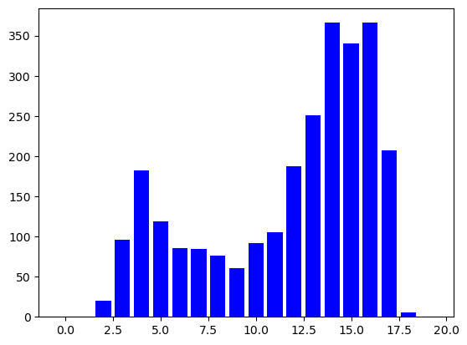
Upvote distribution
Select upvotes > 64 as a marker : 88751 entries
Select those with reddit rewards as a marker : 2859 entries (2018)

Slide 15
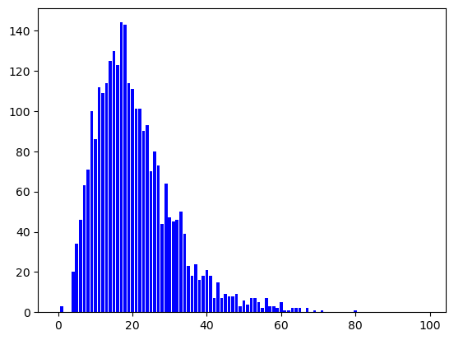
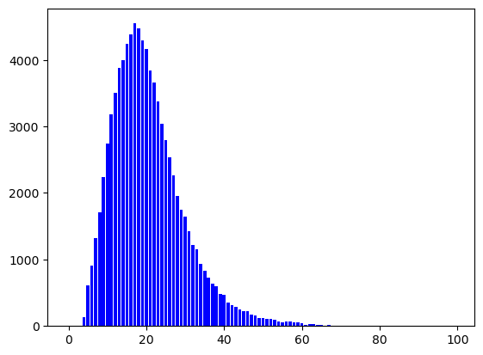
Word distribution
Upvoted
  Average Upvotes : 2535
  Total words : 1821637
  Average words/ Submission:
  20.52
  Word distribution:
Awarded
  Average Upvotes : 17586
  Average words/ Submission:
  20.64
  Word distribution:

Slide 16
TFIDF (w.r.t all)

Slide 17
Sentence structure

Slide 18
Analogy

Slide 19
Examples

Slide 20
Extraction

Slide 21
Metaphor and body

