Slide 1
SPEECH EMOTION RECOGNITON
Presented By AJIN VIJAYAN,
FARSEEN AHAMMED

Slide 2
INTRODUCTION
Emotions play a crucial role in comprehending human interactions. Ongoing research seeks to develop methods that mimic human abilities in recognizing emotions conveyed through facial expressions, vocal tone variations, and more. One such field is Speech Emotion Recognition (SER), which leverages deep learning and machine learning algorithms to create an automated system for emotion recognition.
In this project, our primary objective is to construct a model that effectively replicates the innate human ability to perceive and categorize emotions from audio sources. By leveraging advanced algorithms, we aspire to impart this model with the capacity to distinguish and classify emotions accurately, paralleling the intuitive comprehension exhibited by humans.

Slide 3

Dataset Description
The dataset is built using 5252 samples from:
The Ryerson Audio-Visual Database of Emotional Speech and Song (RAVDESS) dataset.
The Toronto emotional speech set (TESS) dataset.
1440 speech files and 1012 Song files from RAVDESS. This dataset includes recordings of 24 professional actors (12 female, 12 male), vocalizing two lexically-matched statements in a neutral North American accent. Speech includes calm, happy, sad, angry, fearful, surprise, and disgust expressions, and song contains calm, happy, sad, angry, and fearful emotions.
2800 files from TESS. A set of 200 target words were spoken in the carrier phrase "Say the word _____' by two actresses (aged 26 and 64 years) and recordings were made of the set portraying each of seven emotions (anger, disgust, fear, happiness, pleasant surprise, sadness, and neutral). There are 2800 stimuli in total. Two actresses were recruited from the Toronto area. Both actresses speak English as their first language, are university educated, and have musical training. Audiometric testing indicated that both actresses have thresholds within the normal range.

Slide 4
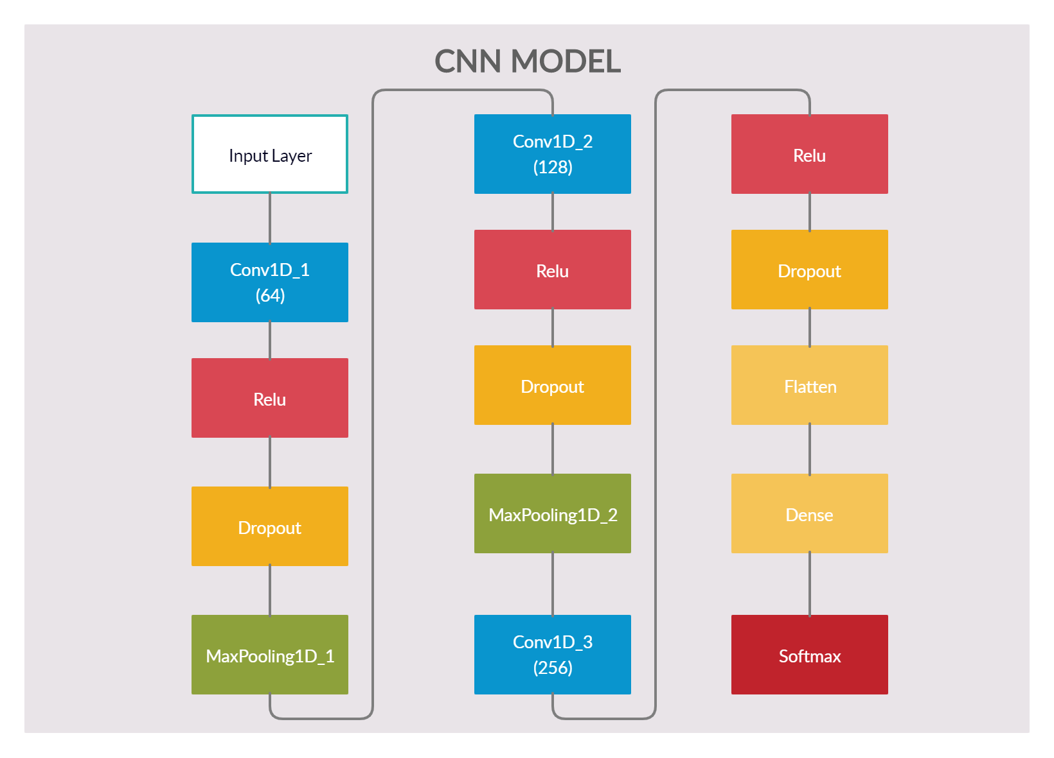
Model Summary

Slide 5
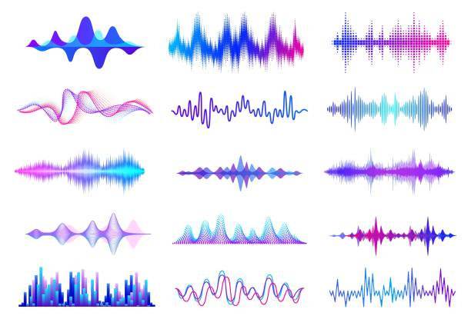
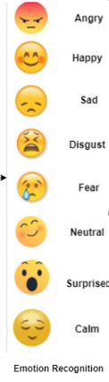
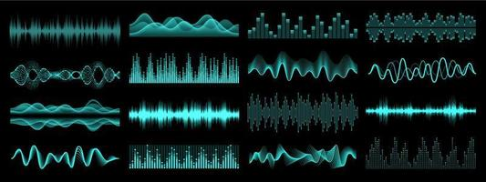
Pipeline
Feature Extraction
RAVDESS dataset
Splitting into Training & Test sets
Training
Deep learning models
Testing
TESS dataset
Selecting best model
Saving model as h5 file
Connecting model to Tkinter

Slide 6
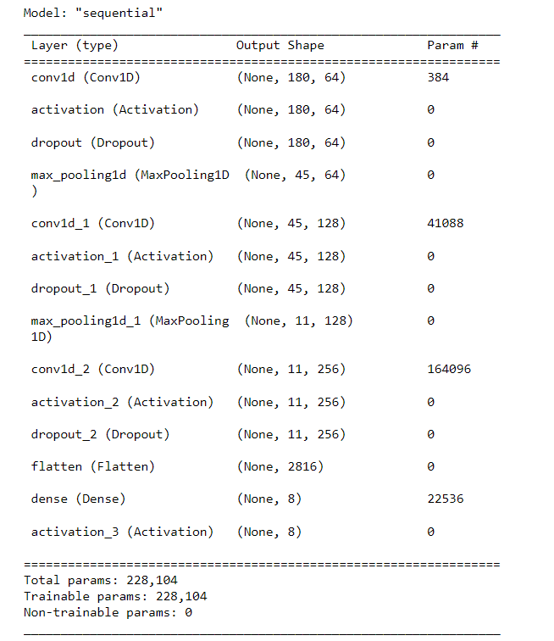
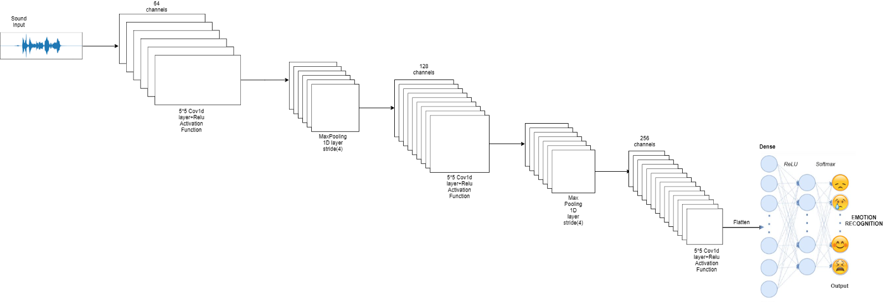
CNN Layer Description

Slide 7
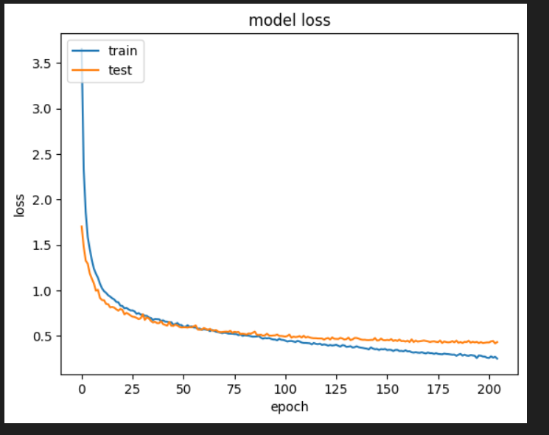
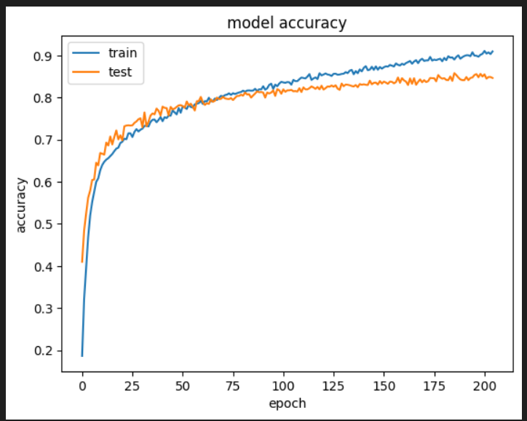
CLASS | MLP | CNN
SAD | 0.81 | 0.93
ANGRY | 0.89 | 0.90
HAPPY | 0.82 | 0.92
DISGUST | 0.80 | 0.90
SURPRISE | 0.80 | 0.93
NEUTRAL | 0.89 | 0.90
CALM | 0.75 | 0.93
FEAR | 0.84 | 0.93
F1-score for each class compared to the baselines.

Slide 8
Future Scope
Mental Health Monitoring: SER could play a pivotal role in monitoring and assessing mental health conditions. By analyzing speech patterns, tone, and emotional cues, it could provide insights into an individual's emotional well-being, potentially aiding in early detection and intervention.
Education and Training: Emotion recognition technology could be integrated into educational tools to provide real-time feedback to learners. It could identify signs of confusion, frustration, or engagement, helping educators tailor their approach and content accordingly.
Customer Service and Sales: Emotion-aware systems could revolutionize customer service interactions. Call centers, for example, could use SER to gauge customer satisfaction and adapt their responses in real-time, leading to more effective and personalized customer interactions.
Language Learning: Emotion recognition could assist language learners in understanding and mimicking native speakers' emotional nuances, improving pronunciation, and overall language acquisition.

Slide 9
Conclusions
Approaches based on deep neural networks are an excellent basis for solving the task.
Model is general enough to work in a real application context correctly
Combining the two datasets, RAVDESS & TESS, increased accuracy
Removed audio collected from video files from RAVDESS dataset as it caused overfitting
Further Improvement: More data can be collected to increase model accuracy and performance on all emotion classes. Can improve the model further by predicting emotions on real time data. Also can incorporate other learning mechanisms to compute the percentage of emotions for audio with mixed emotion.

