Slide 1

Tournament Scheduler

Slide 2

Philosophical Inquiry: Through Tournament Schedulers
Fairness….a concept we often assume holds weight in reality but today we are going to prove so otherwise. We will use tournament schedulers as an example to visualize this phenomenon. While also exploring different tournament formats, the algorithms behind them, and how we can develop solutions that meet both fairness and efficiency in competitive environments.

Slide 3
What is a Tournament Scheduler?
Definition
Key Disciplines
A tournament scheduler organizes matches among participants to identify a winner systematically.
Combinatorics – Match arrangement and probability calculations.
Graph Theory – Representing participants and matches.
Optimization Techniques – Reducing redundant matches.

Slide 4
Types of Tournament Formats
Round Robin
Single Elimination
Double Elimination
Everyone plays everyone.
One loss eliminates a participant.
Two losses result in elimination. This format offers a second chance for players to bounce back.
Swiss System
Pyramid
Players are paired based on their performance. This ensures more balanced matches as the tournament progresses.
Participants face off in a hierarchical structure, ultimately leading to a final match.

Slide 5
Round Robin Tournament Format
Concept
Formula
Each participant competes with every other participant. Represented as a complete graph where: Nodes = Players. Edges = Matches.
Total matches = n(n−1)/2.

Slide 6
PLAYER | PLAYER
Algorithm for scheduling the matches
VS
A
B
Players are divided into 2 columns
Each row represents a match
Each instance of the table represents a round
A is kept fixed, while others are rotated.
C
D
E
F

Slide 7
PLAYER | PLAYER
ROUND 1
A | B
C | D
E | F
ROUND 2
A | D
B | F
C | E
ROUND 3
A | F
D | E
B | C
VS
A
B
C
D
ROUND 4
A | E
F | C
D | B
ROUND 5
A | C
E | B
F | D
E
F

Slide 8
PLAYER | PLAYER
ROUND 1
A | B
C | D
E | Bye
ROUND 2
A | D
B | Bye
C | E
ROUND 3
A | Bye
D | E
B | C
VS
A
B
C
D
ROUND 4
A | E
Bye | C
D | B
ROUND 5
A | C
E | B
Bye | D
E
Bye

Slide 9

Single Elimination Tournament Format
1
Concept
Participants are eliminated after one loss. Visualized as a tournament tree.
2
Strengths
Efficient for large groups with fewer matches.
3
Limitations
One bad performance can result in elimination, reducing fairness.

Slide 10
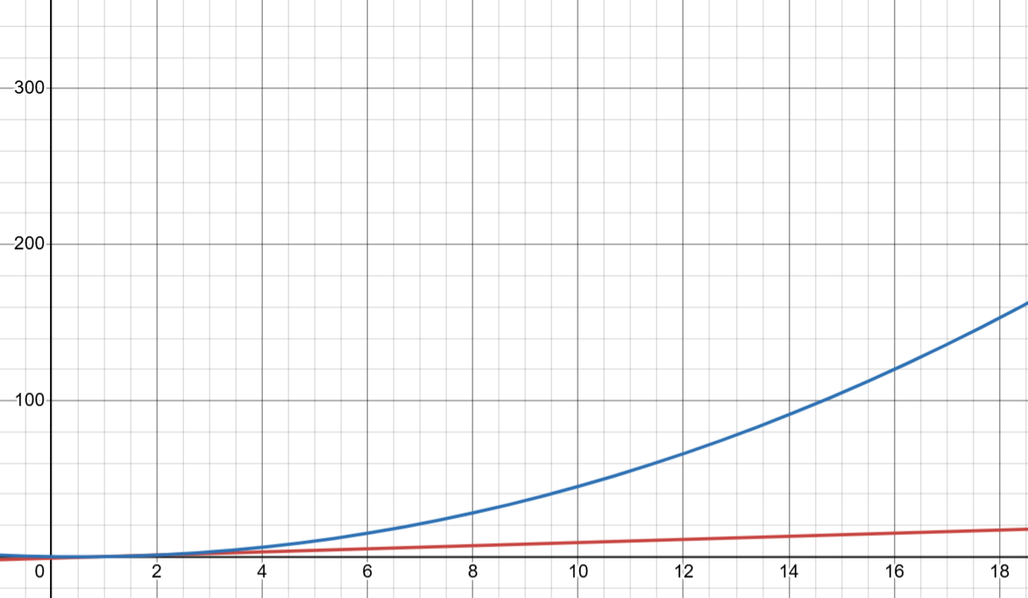

Slide 11



Combining Round Robin and Single Elimination
1
Hybrid System
2
Round Robin Groups
3
Single Elimination Phase
Divide participants into smaller groups for Round Robin matches. Group winners advance to a Single Elimination phase. Fairness checks: Equal skill-level distribution across groups. Example: FIFA uses group stages followed by knockout rounds.

Slide 12
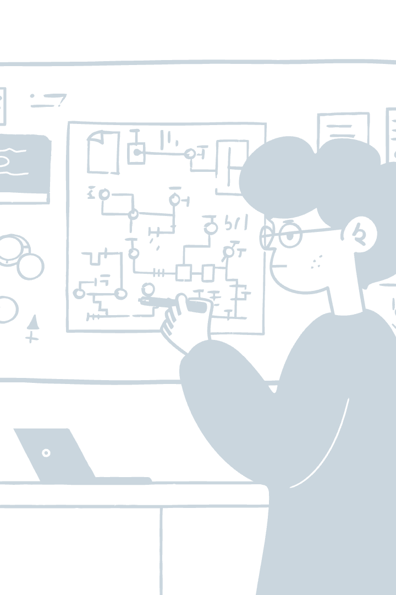



Hybrid Tournament Scheduler Algorithm – The Core Logic
Step 1
Create Round Robin groups with fairness checks.
Step 2
Identify group winners for Single Elimination.
Step 3
Continue elimination rounds until a final winner is determined.

Slide 13

Code: Generating Round Robin Matches
def round_robin_schedule(participants):
""" Generates a round-robin schedule for a given list of participants.
Adds a 'bye' if the number of participants is odd.
"""
if len(participants) % 2 != 0:
participants.append("Bye")
n = len(participants)
schedule = []
for round_number in range(n - 1):
matches = []
for i in range(n // 2):
matches.append((participants[i], participants[n - 1 - i]))
participants = [participants[0]] + [participants[-1]] + participants[1:-1]
schedule.append(matches)
return schedule
Adds a "bye" for odd participants. Uses a rotation algorithm to create matches for every round. Round Robin ensures all players face each other.

Slide 14
Code: Visualizing Round Robin Matches
import matplotlib.pyplot as plt
import math
def visualize_round_robin(participants, schedule):
""" Visualizes the round-robin schedule in a circular graph. """
num_participants = len(participants)
angle_step = 2 * math.pi / num_participants
positions = [(math.cos(i * angle_step), math.sin(i * angle_step)) for i in range(num_participants)]
pos_map = {participants[i]: positions[i] for i in range(num_participants)}
plt.figure(figsize=(8, 8))
plt.axis("off")
# Plot nodes for participant
for participant, (x, y) in pos_map.items():
plt.scatter(x, y, s=500, color="lightblue", zorder=2)
plt.text(x, y, participant, ha="center", va="center", fontsize=10, fontweight="bold")
# Plot edges
for round_matches in schedule:
for match in round_matches:
if "Bye" not in match:
x1, y1 = pos_map[match[0]]
x2, y2 = pos_map[match[1]]
plt.plot([x1, x2], [y1, y2], color="gray", linestyle="--", zorder=1)
plt.title("Round Robin Match Visualization", fontsize=16)
plt.show()
Creates a circular graph representing players and their matches. Matches visualized as edges; players as nodes. Demonstrates combinatorics and graph theory concepts.

Slide 15
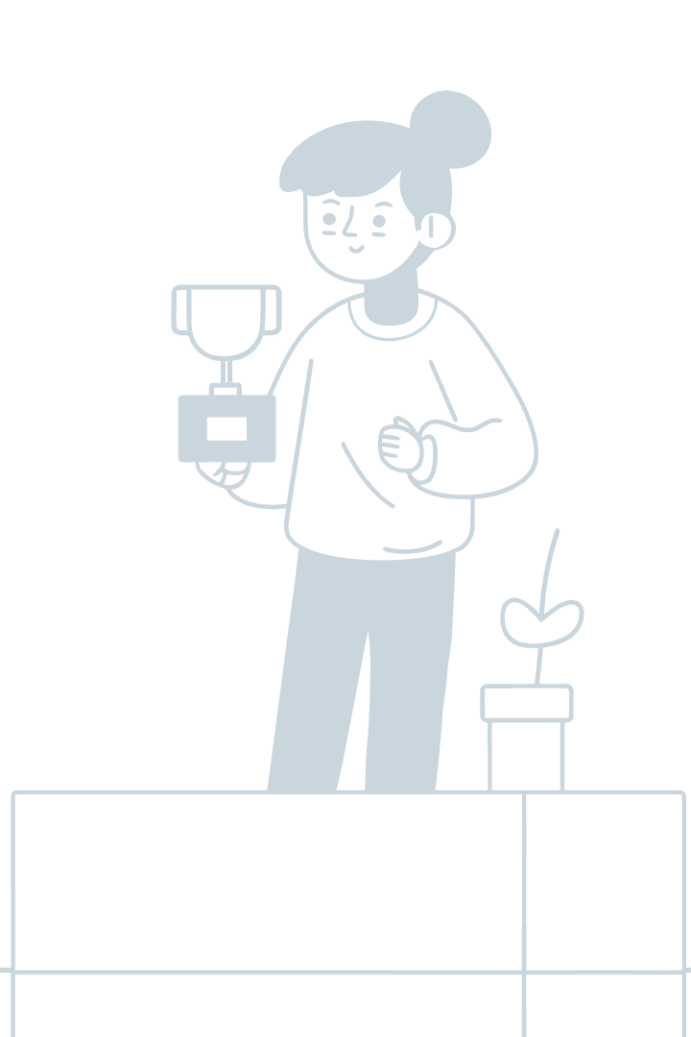
Code: Advancing Winners to Single Elimination
def advance_to_knockout(round_robin_results, group_size):
""" Advances winners from Round Robin to Single Elimination. """
knockout_participants = []
for group in round_robin_results:
# Sort participants by performance and pick top group_size players
sorted_group = sorted(group, key=lambda x: x["score"], reverse=True)
knockout_participants.append(sorted_group[:group_size])
return knockout_participants
Determines top players from each group based on scores. Prepares participant list for the knockout phase.

Slide 16
Code: Single Elimination Scheduler
Code Snippet:
Explanation:
- Matches participants in pairs.
def single_elimination_schedule(participants):
""" Creates a Single Elimination schedule. """
schedule = []
while len(participants) > 1:
round_matches = []
for i in range(0, len(participants), 2):
round_matches.append((participants[i], participants[i + 1]))
participants = [winner for winner, _ in round_matches]
# Placeholder winners schedule.
schedule.append(round_matches)
return schedule
- Winners proceed to the next round until only one remains.
- Optimized for practicality with minimal matches.

Slide 17
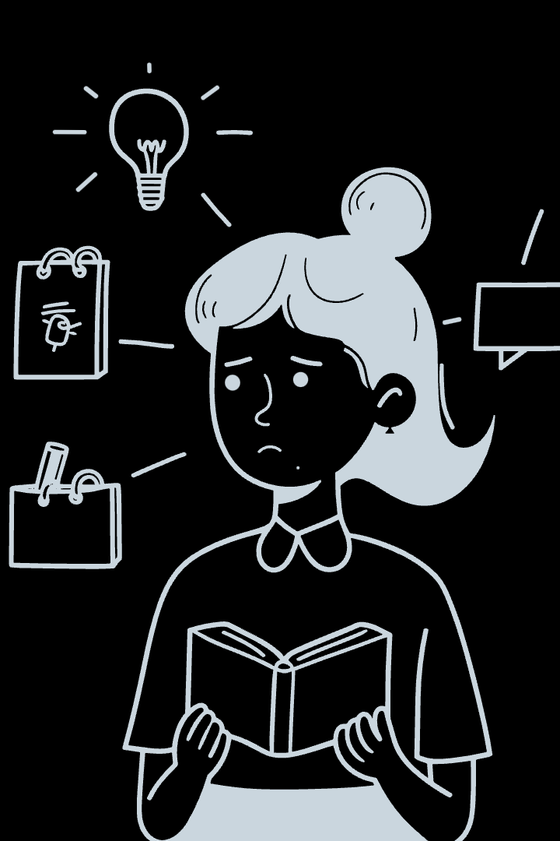
Conclusion: Does Fairness Truly Exist?
Fairness
Practicality
"Absolute fairness requires eliminating individuality and differences."
"Is a world without differences a desirable one?"
Our approach maximizes fairness and practicality, but perfect fairness is unattainable.

