Slide 1

Geometric Algebra
1. Geometric Algebra in 2 Dimensions
Dr Chris Doran
ARM Research

Slide 2
Introduction
Present GA as a new mathematical technique
Introduce techniques through their applications
Emphasise the generality and portability of GA
Promote a cross-disciplinary view of science
Rotations in arbitrary dimensions
Lorentz transformations
Lie groups
Analytic functions
Unifying Maxwell’s equations
Projective and conformal geometries
Coding with GA

Slide 3

Resources
geometry.mrao.cam.ac.uk
chris.doran@arm.com
cjld1@cam.ac.uk
@chrisjldoran
#geometricalgebra
github.com/ga

Slide 4
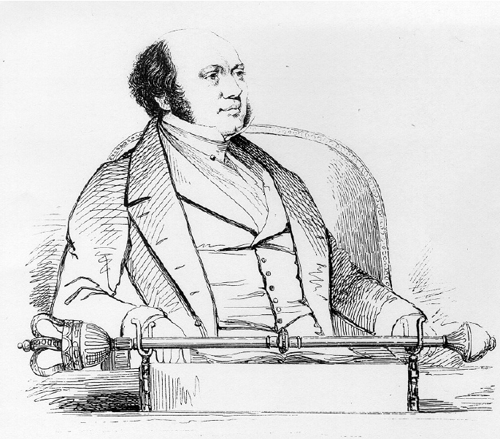
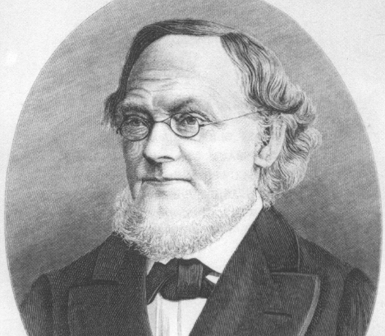

Some history
William Hamilton
Hermann Grassmann
William Clifford

Slide 5

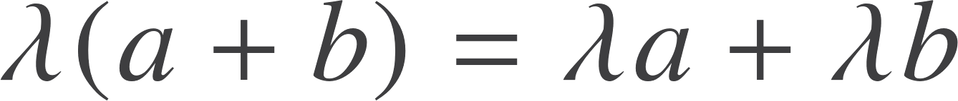
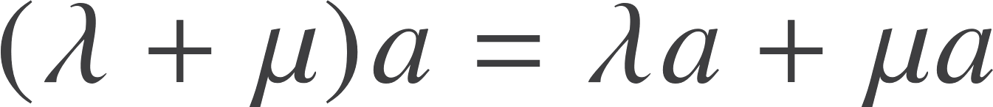
Vectors and Vector Spaces
b
b
c
b+c
a
a+b
a
a
a+b
a+b+c
b

Slide 6

What is a vector?
This is not a vector:
This is a vector:
For this course a grade-1 tensor and a vector are different.
We will usually focus on active transformations, not passive ones

Slide 7
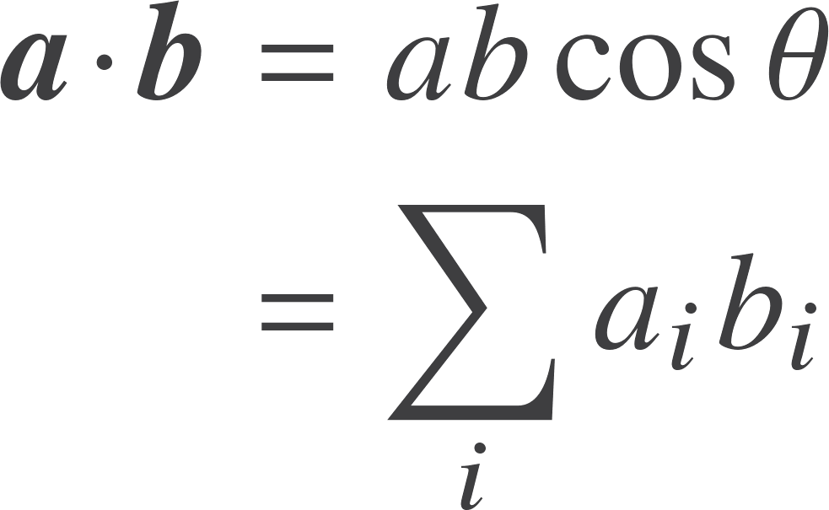

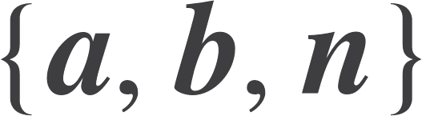
The problem
How do you multiply two vectors together?
Inner product
Cross product
Right-handed set

Slide 8
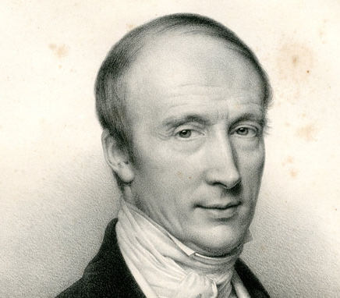
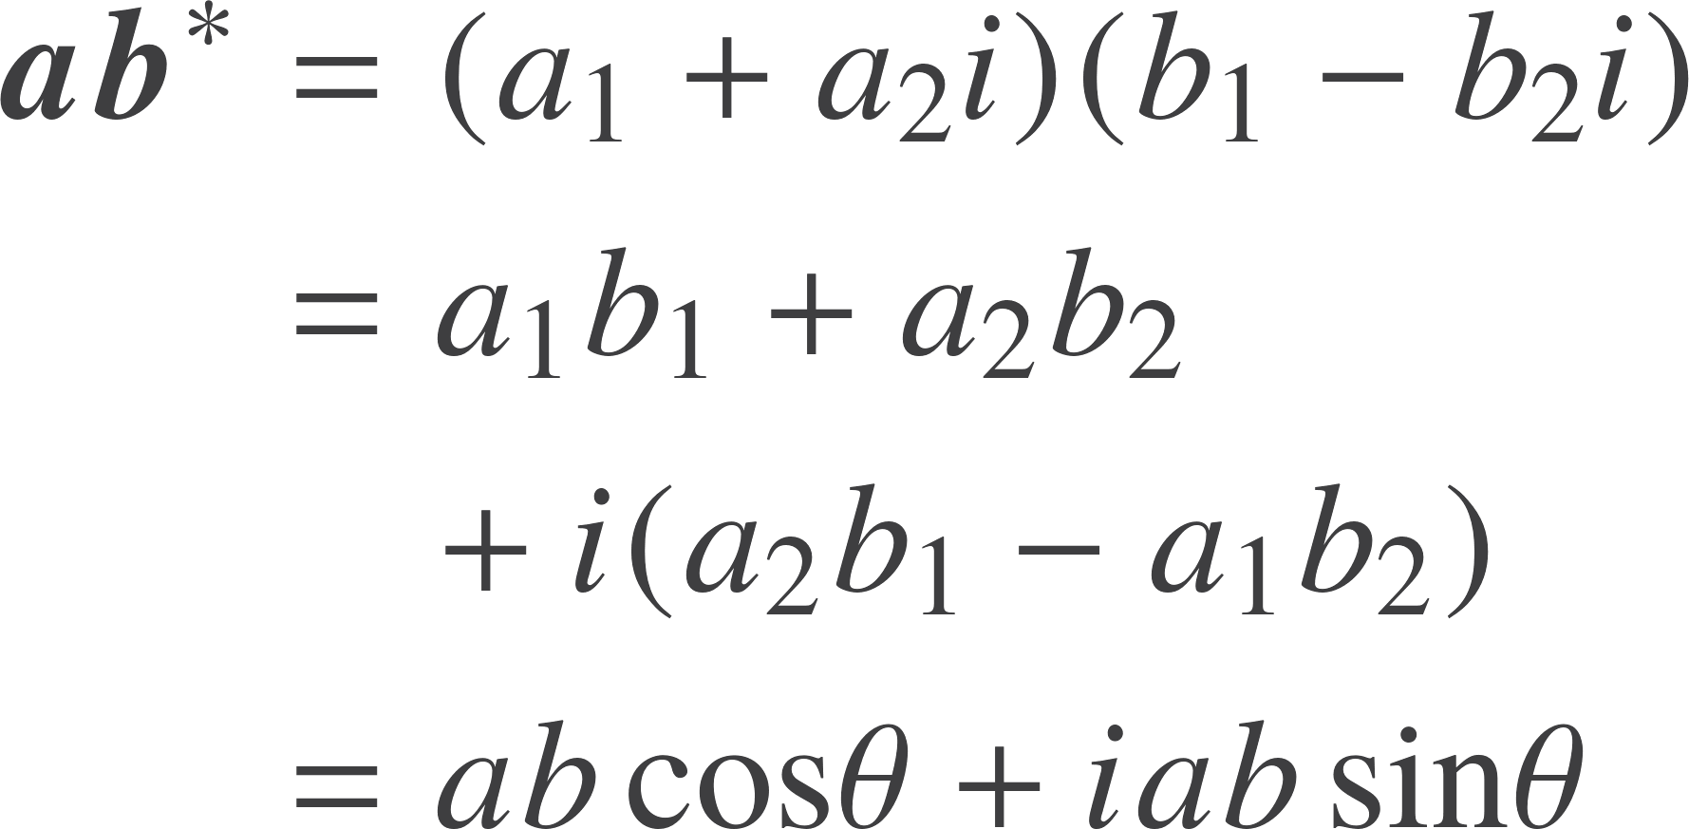
Complex numbers
Complex numbers give us a potential product in 2D. If we form aa* we get the length² of the vector.
This suggests forming ab*.
The result contains an inner product and an area term.
a
b

Slide 9


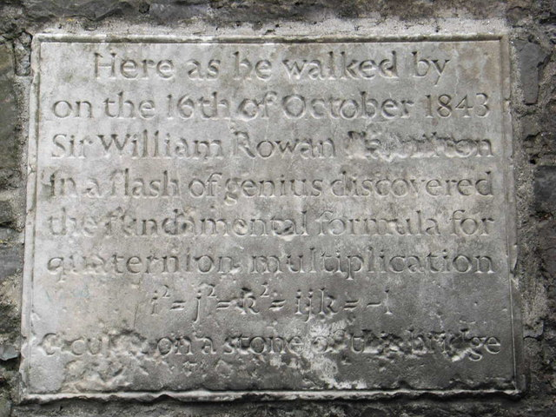
Quaternions
Generalises complex numbers, introduced the cross product and some notation still in use today.
Confusion over status of vectors, but quaternions are very powerful for describing rotations.
Notes:
Discovered by Hamilton in 1843 while out walking and carved onto Brougham Bridge

Slide 10
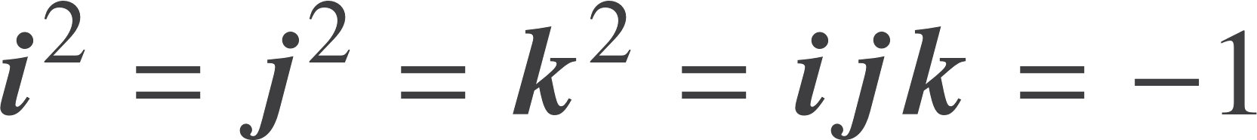
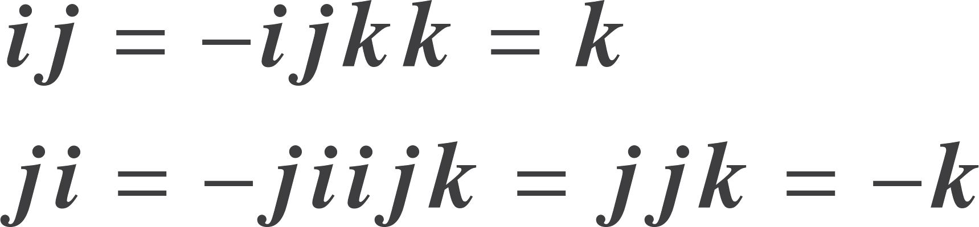
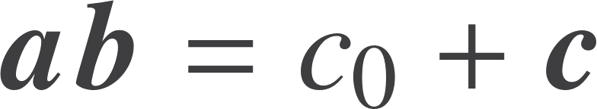
Quaternion properties
Generators anti-commute
The cross product

Slide 11

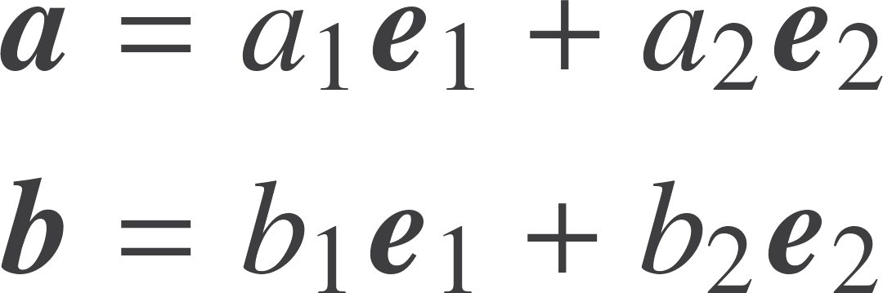
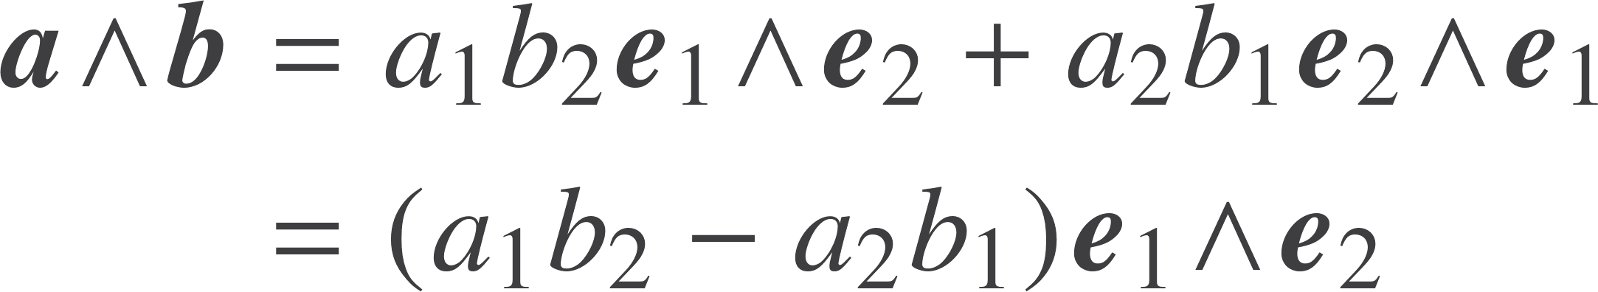
Grassmann algebra
German schoolteacher (1809-1877) who struggled for recognition in his own lifetime.
Published the Lineale Ausdehnungslehre in 1844.
Introduced a new, outer product that is antisymmetric.

Slide 12


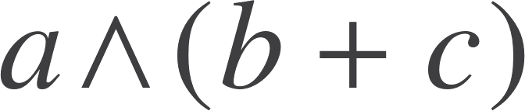
Properties of the outer product
a
The result of the outer product is a new object: a BIVECTOR
Bivectors form a linear space
We can visualise bivector addition in 3D
b
c
a
b+c

Slide 13


Geometric algebra
W.K. Clifford (1845 – 1879) introduced the geometric product of two vectors.
The product of two vectors is the sum of a scalar and a bivector.
Think of the sum as like the real and imaginary parts of a complex number.

Slide 14
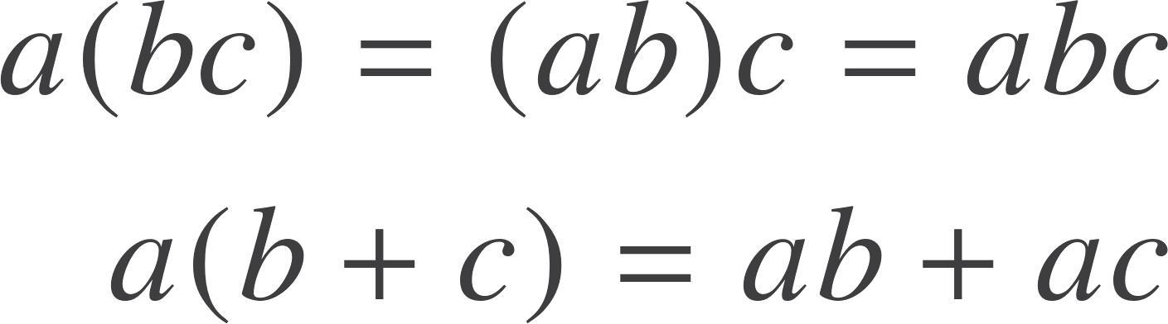
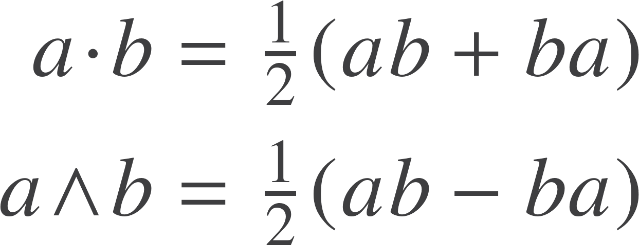
The geometric product
The geometric product is associative and distributive.
The square of any vector is a scalar. This makes the product invertible.
Define the inner (scalar) and outer products in terms of the geometric product.

Slide 15


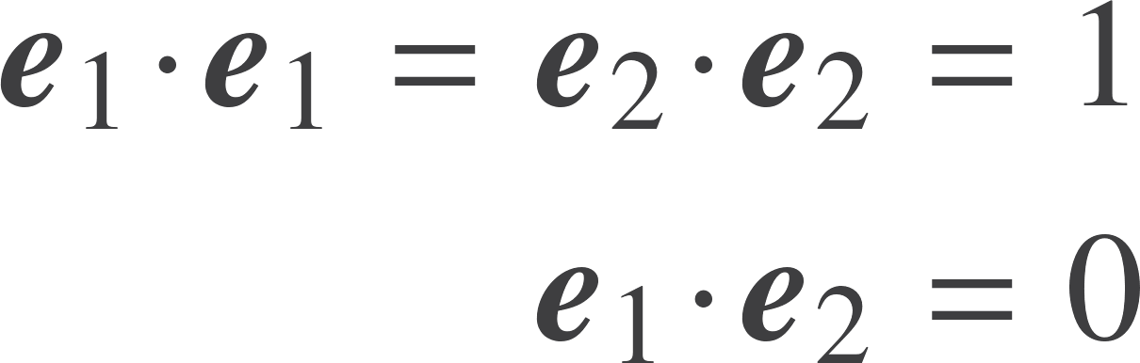
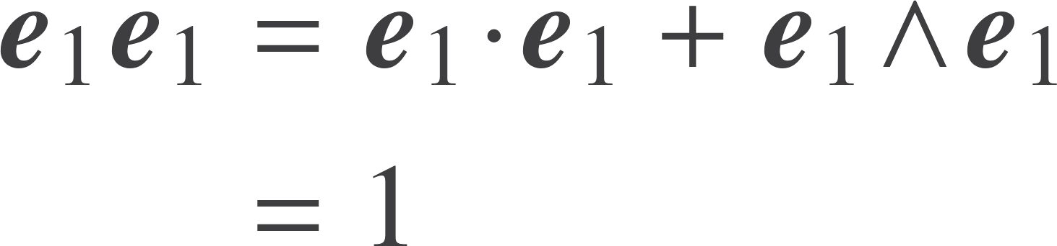
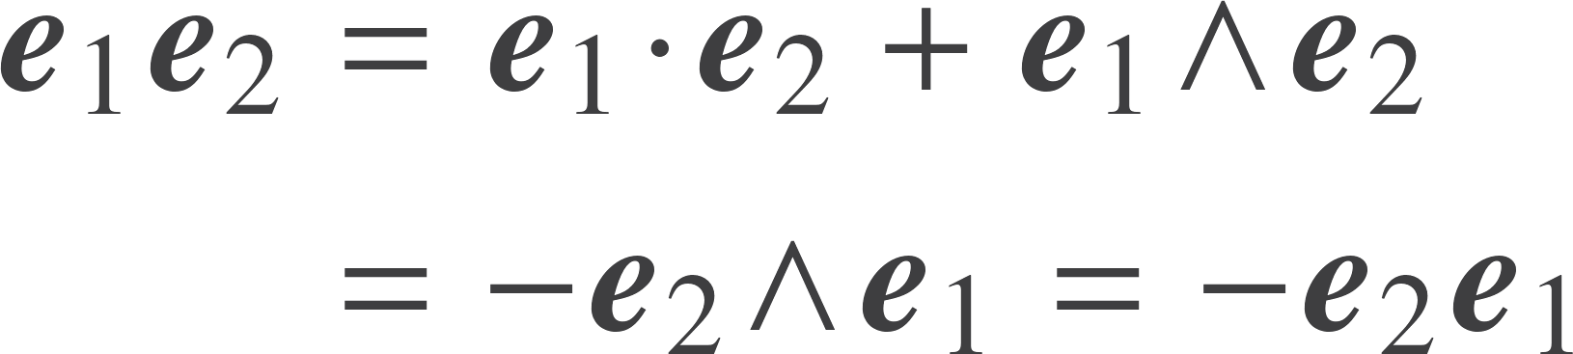
Two dimensions
2D sufficient to understand basic results. Construct an orthonormal basis.
Parallel vectors commute.
Orthogonal vectors anticommute.

Slide 16
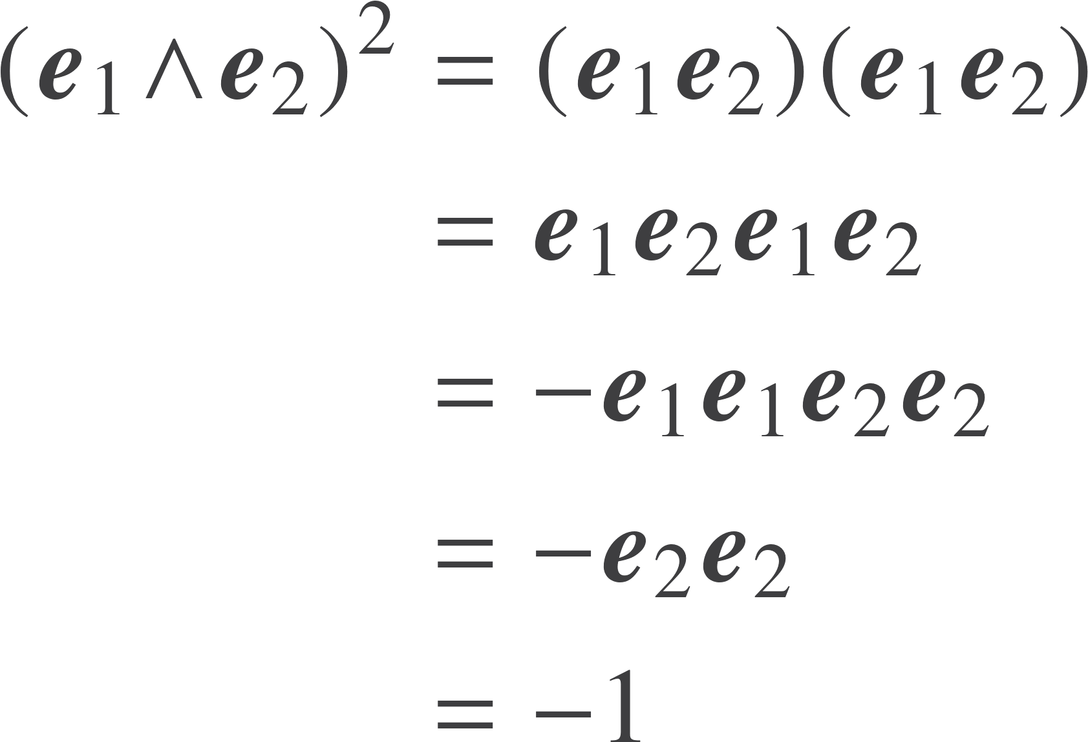
The bivector
The unit bivector has negative square.
Follows purely form the axioms of geometric algebra.
We have not said anything about complex numbers, or solving polynomial equations.
We have invented complex numbers!

Slide 17
Unification
Complex numbers arise naturally in the geometric algebra of the plane.

Slide 18
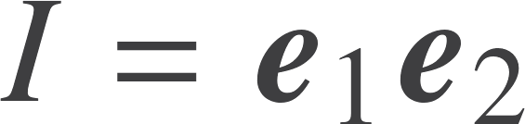
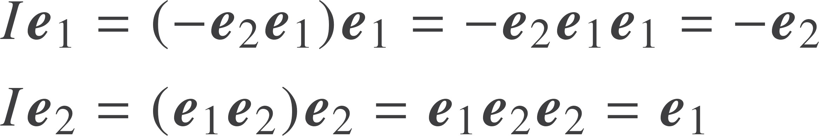
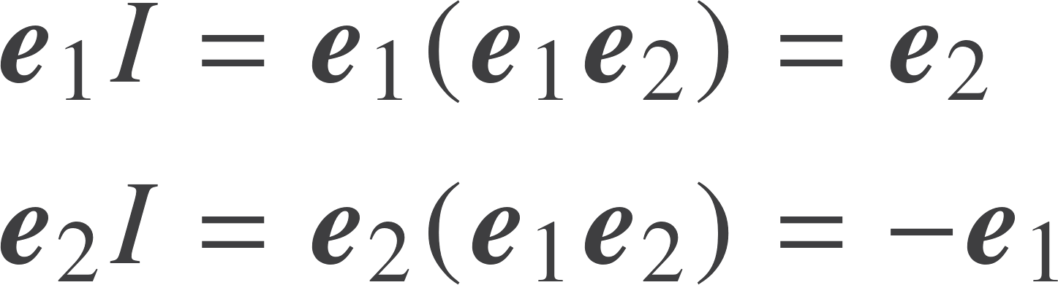
Products in 2D
Call the highest grade element the pseudoscalar:
A 90 degree rotation clockwise (negative sense)
A 90 degree rotation anti-clockwise (positive sense)
Rotating through 90⁰ twice is a 180 ⁰ rotation. Equivalent to multiplication by -1 in 2D.

Slide 19
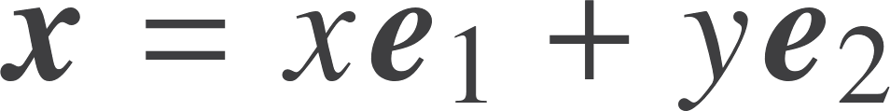
Complex numbers and vectors
y
z
Want to map between complex numbers and vectors
x
Answer is straightforward:
The real axis transforms between vectors and even elements in 2D GA
This only works is 2D

Slide 20


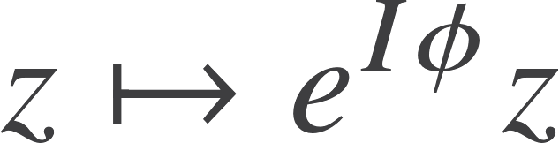
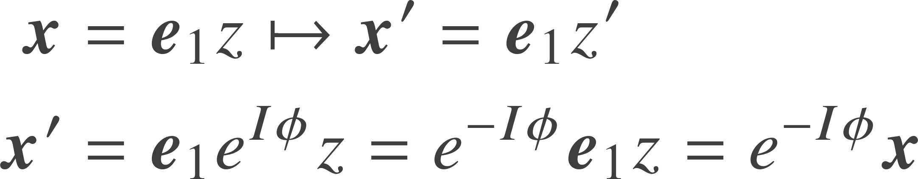

Rotations
Complex numbers are efficient for handling rotations in 2D
In terms of vectors:
NB anti-commutation of I with vectors puts minus sign in exponent. See next lecture.
First example of how rotations are handled efficiently in GA

Slide 21
Resources
geometry.mrao.cam.ac.uk
chris.doran@arm.com
cjld1@cam.ac.uk
@chrisjldoran
#geometricalgebra
github.com/ga

