Slide 1

Geometric Algebra
2. Geometric Algebra in 3 Dimensions
Dr Chris Doran
ARM Research

Slide 2

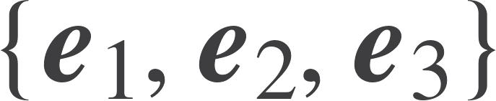



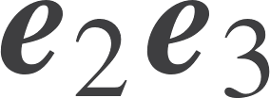

Three dimensions
Introduce a third vector.
These all anticommute.

Slide 3
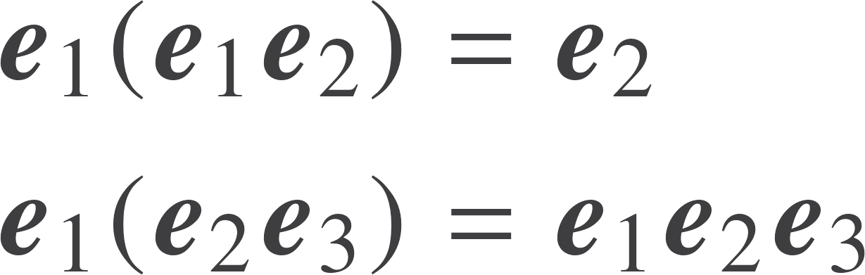
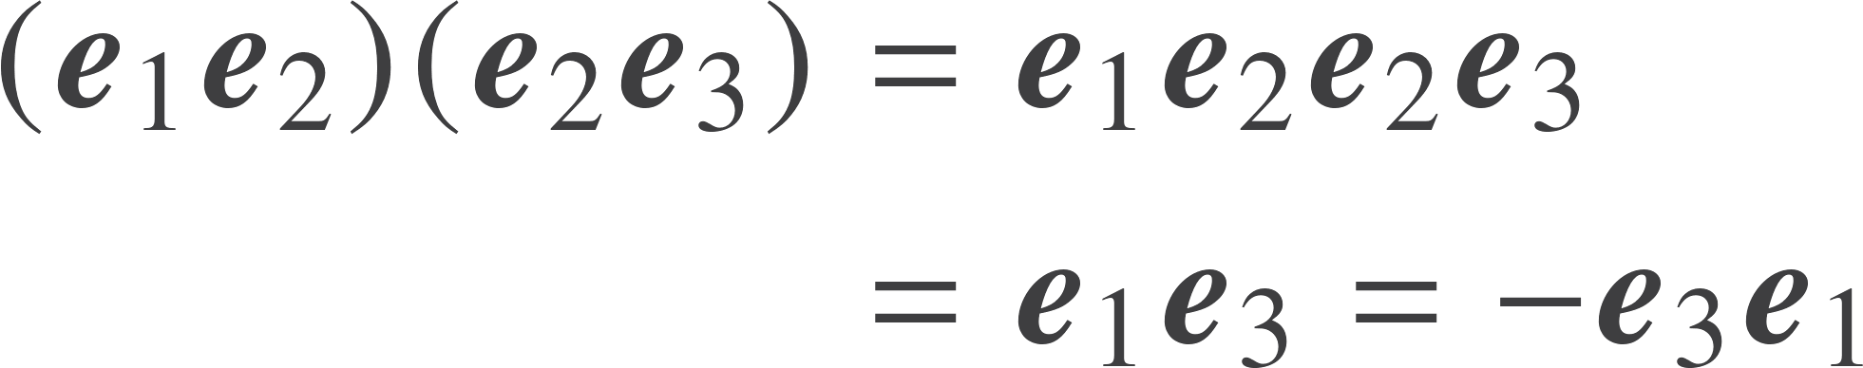
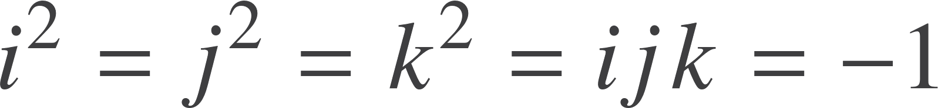
Bivector products
The product of a vector and a bivector can contain two different terms.
The product of two perpendicular bivectors results in a third bivector.
Now define i, j and k. We have discovered the quaternion algebra buried in 3 (not 4) dimensions

Slide 4
Unification
Quaternions arise naturally in the geometric algebra of space.

Slide 5

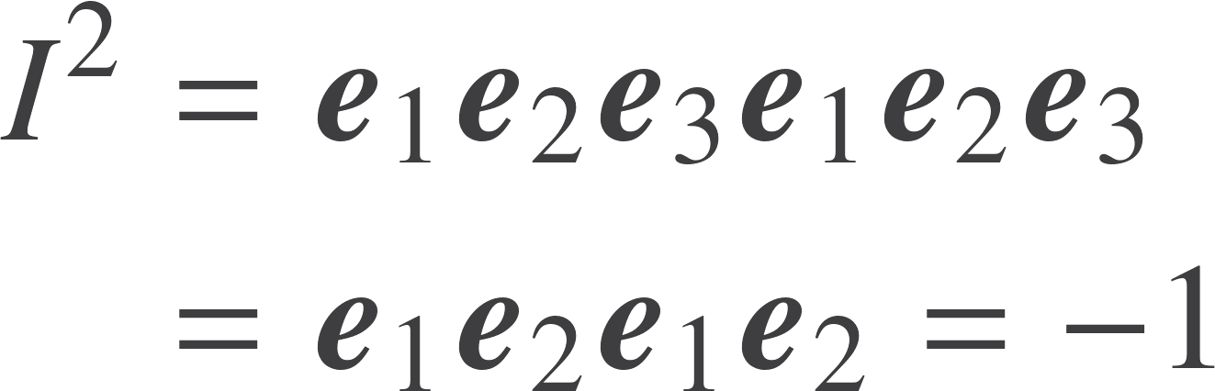
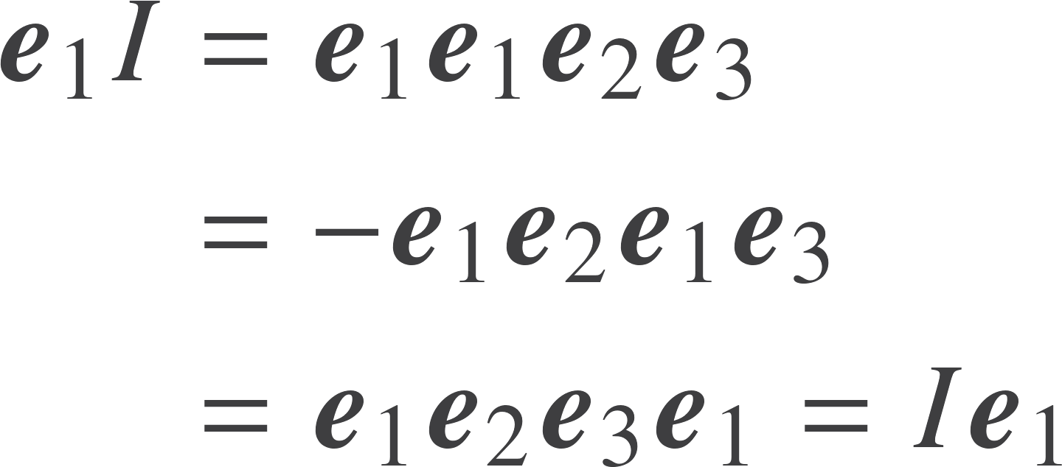
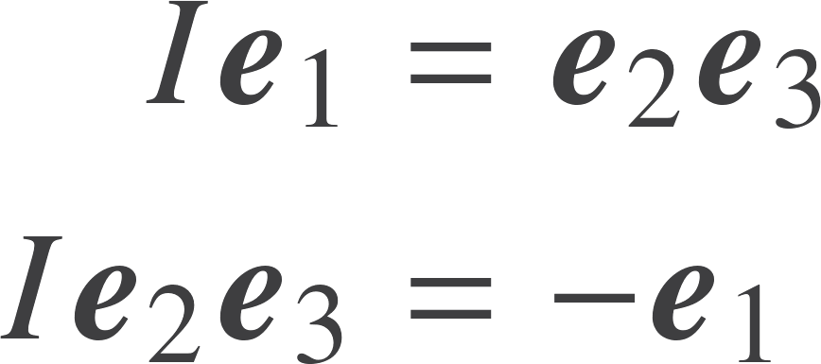
The directed volume element
Has negative square
Commutes with vectors
Swaps lines and planes

Slide 6


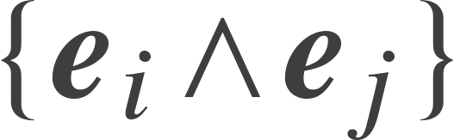

3D Basis
Grade 0
1 Scalar
Grade 1
3 Vectors
Grade 2
3 Plane / bivector
Grade 3
1 Volume / trivector
A linear space of dimension 8
Note the appearance of the binomial coefficients - this is general
General elements of this space are called multivectors

Slide 7
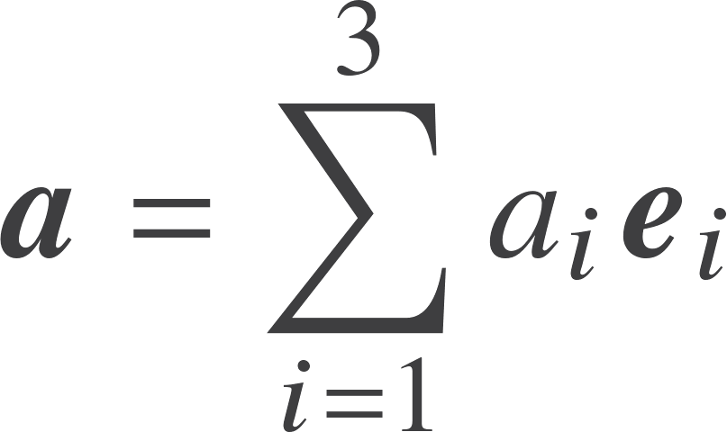
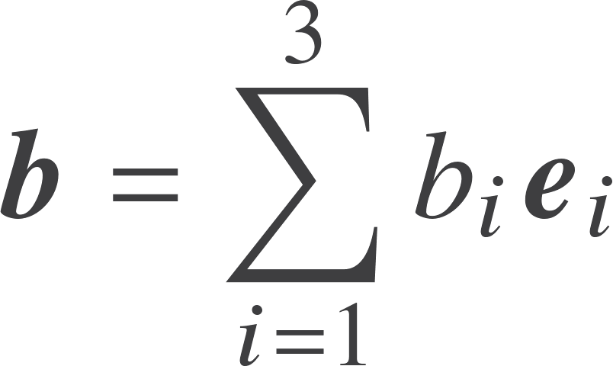

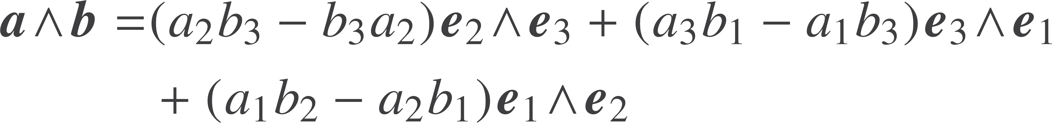

Products in 3D
We recover the cross product from duality:
Can only do this in 3D

Slide 8
Unification
The cross product is a disguised from of the outer product in three dimensions.

Slide 9


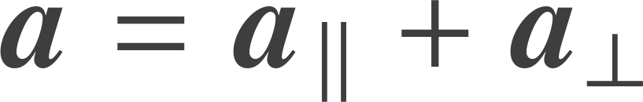

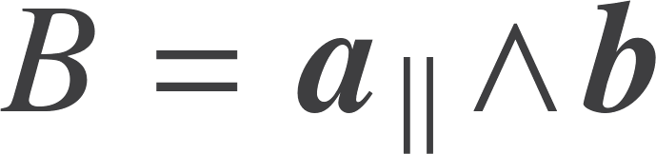


Vectors and bivectors
Decompose vector into terms into and normal to the plane
A vector lying in the plane
Product of three orthogonal vectors, so a trivector

Slide 10
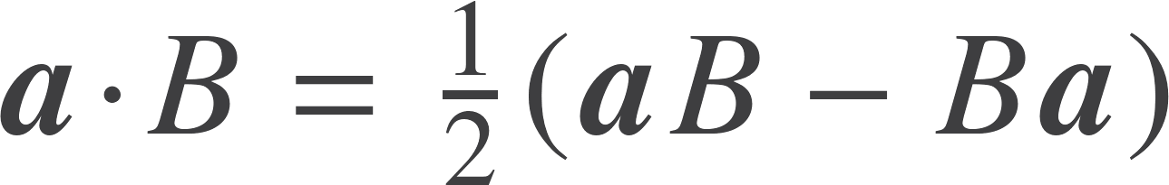
Vectors and bivectors
Write the combined product:
Lowest grade
Highest grade
With a bit of work, prove that
Inner product is antisymmetric, so define
A very useful result. Generalises the vector triple product.
This always returns a vector

Slide 11
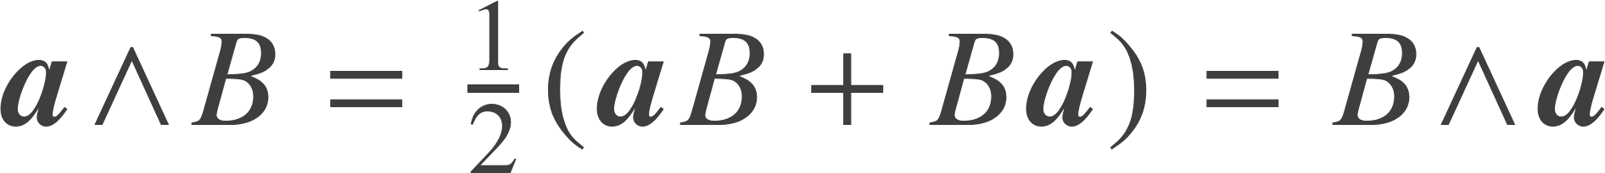




Vectors and bivectors
Symmetric component of product gives a trivector:
Can defined the outer product of three vectors
The outer product is associative
Vector part does not contribute

Slide 12
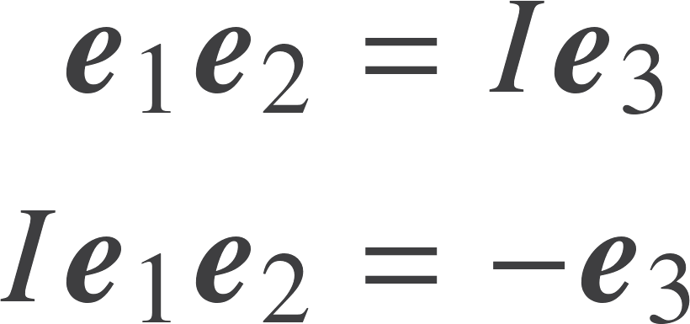


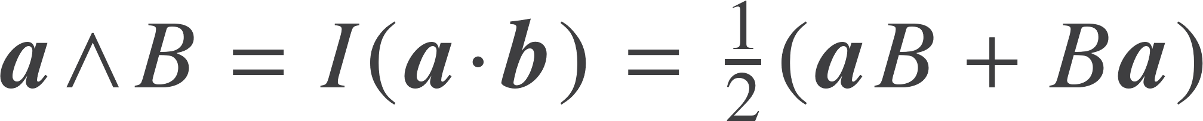
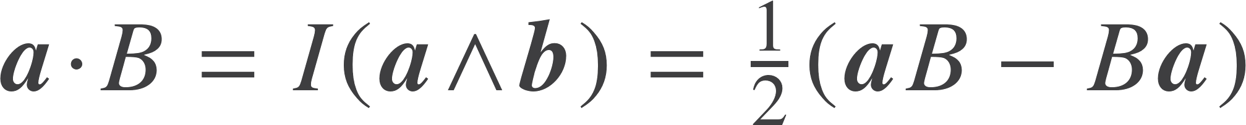
Duality
Seen that the pseudoscalar interchanges planes and vectors in 3D
Can use this in 3D to understand product of a vector and a bivector
Symmetric part is a trivector
Antisymmetric part is a vector

Slide 13



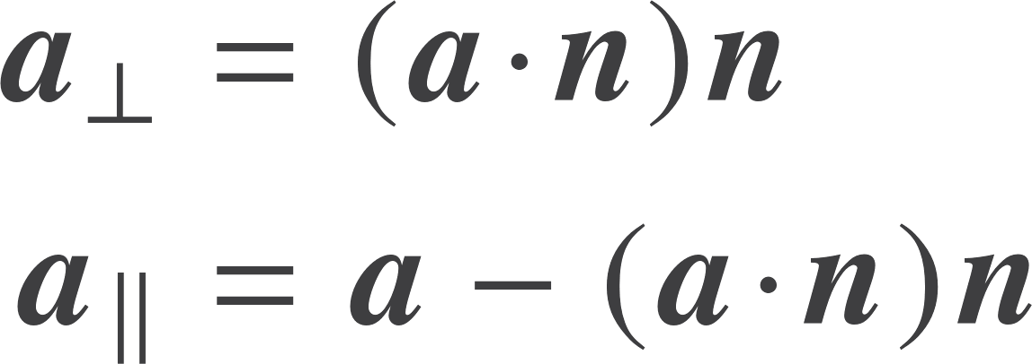
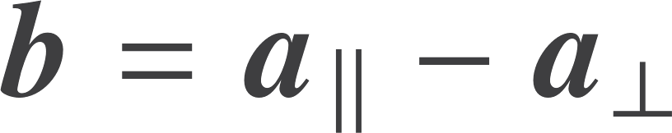
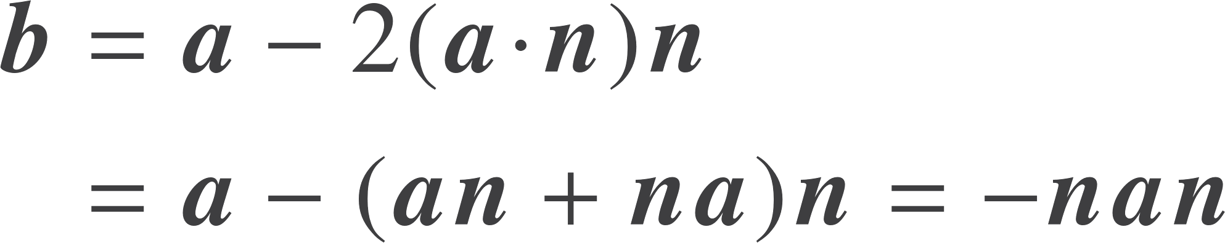
Reflections
See the power of the geometric product when looking at operations.
Decompose a into components into and out of the plane.
Form the reflected vector
Now re-express in terms of the geometric product.

Slide 14
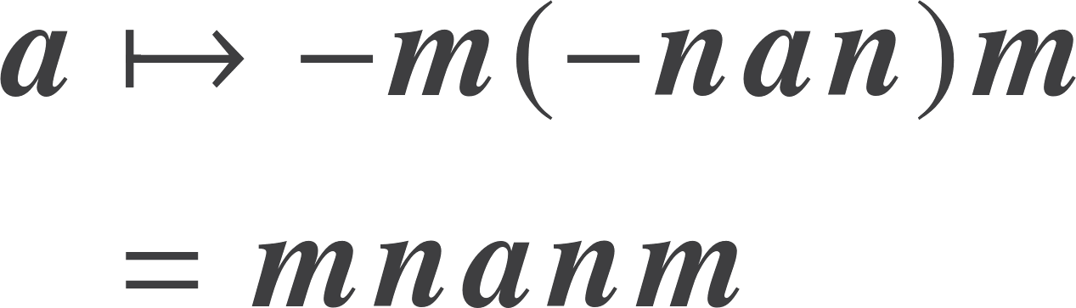



Rotations
Two reflections generate a rotation.
Define a rotor R. This is formed from a geometric product!
Rotations now formed by
This works for higher grade objects as well. Will prove this later.

Slide 15

Rotors in 3D
Rotors are normalised.
Reduces the degrees of freedom from 4 to 3.
This is precisely the definition of a unit quaternion.
Rotors are elements of a 4-dimensional space normalised to 1.
They live on a 3-sphere.
This is the GROUP MANIFOLD.
Rotors are even grade, so built out of a scalar and the three bivectors.
These are the terms that map directly to quaternions.

Slide 16
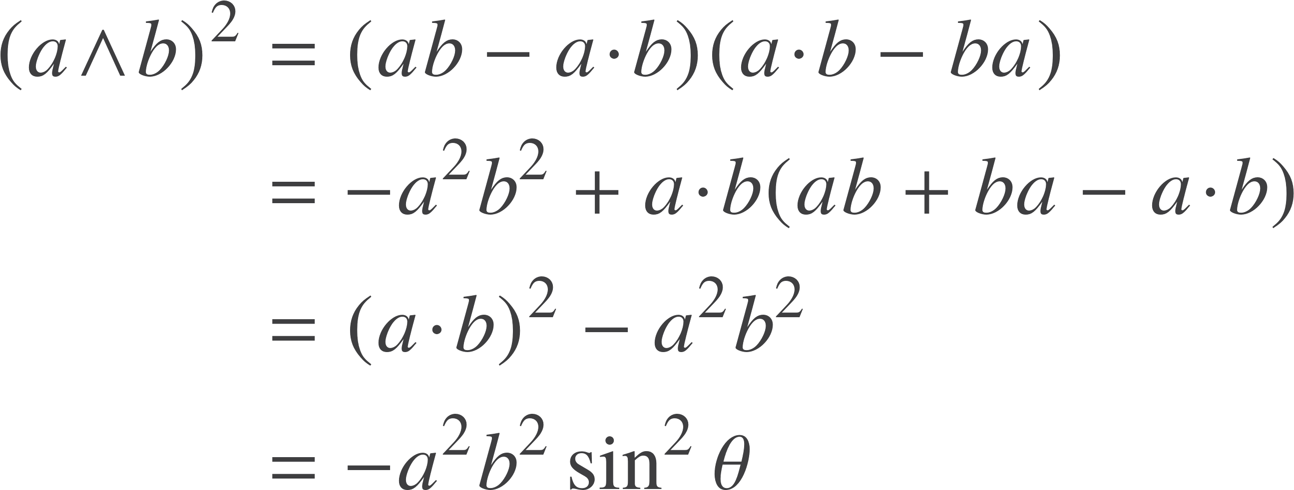

Exponential form
Use the following useful, general result.
Polar decomposition

Slide 17
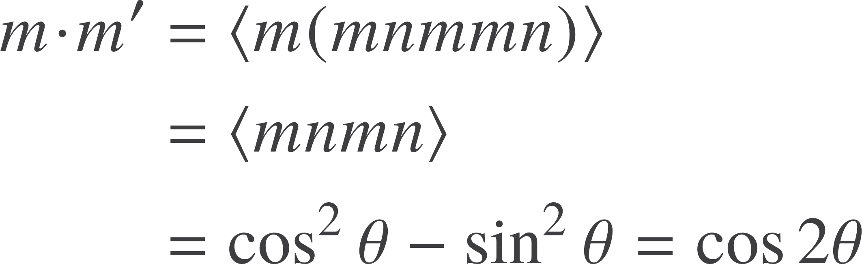

Exponential form
Sequence of two reflections gives a rotation through twice the angle between the vectors
Useful result when vector a lies in the plane B
Also need to check orientation

Slide 18


Rotors in 3D
The rotor for a rotation through |B| with handedness of B:
In terms of an axis:
Decompose a vector into terms in and out of the plane
Can work in terms of Euler angles, but best avoided:

Slide 19


Unification
Every rotor can be written as
Rotations of any object, of any grade, in any space of any signature can be written as

Slide 20
Unification
Every finite Lie group can be realised as a group of rotors.
Every Lie algebra can be realised as a set of bivectors.

Slide 21

Resources
geometry.mrao.cam.ac.uk
chris.doran@arm.com
cjld1@cam.ac.uk
@chrisjldoran
#geometricalgebra
github.com/ga

