Slide 1

Geometric Algebra
3. Applications to 3D dynamics
Dr Chris Doran
ARM Research

Slide 2

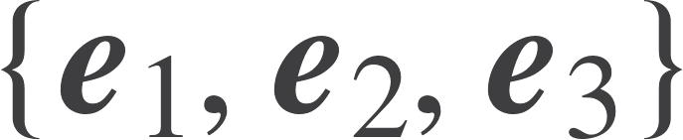
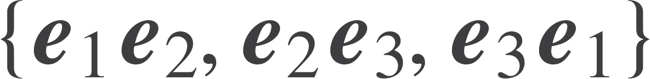



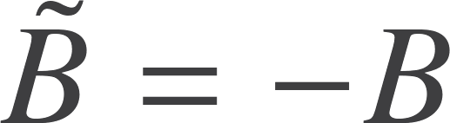
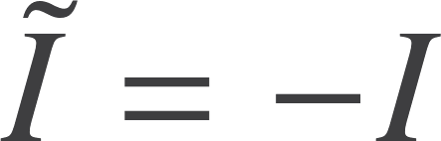


Recap
Even grade = quaternions
Grade 0
1 Scalar
Grade 1
3 Vectors
Grade 2
3 Plane / bivector
Grade 3
1 Volume / trivector
Rotation
Rotor
Antisymmetric
Symmetric

Slide 3
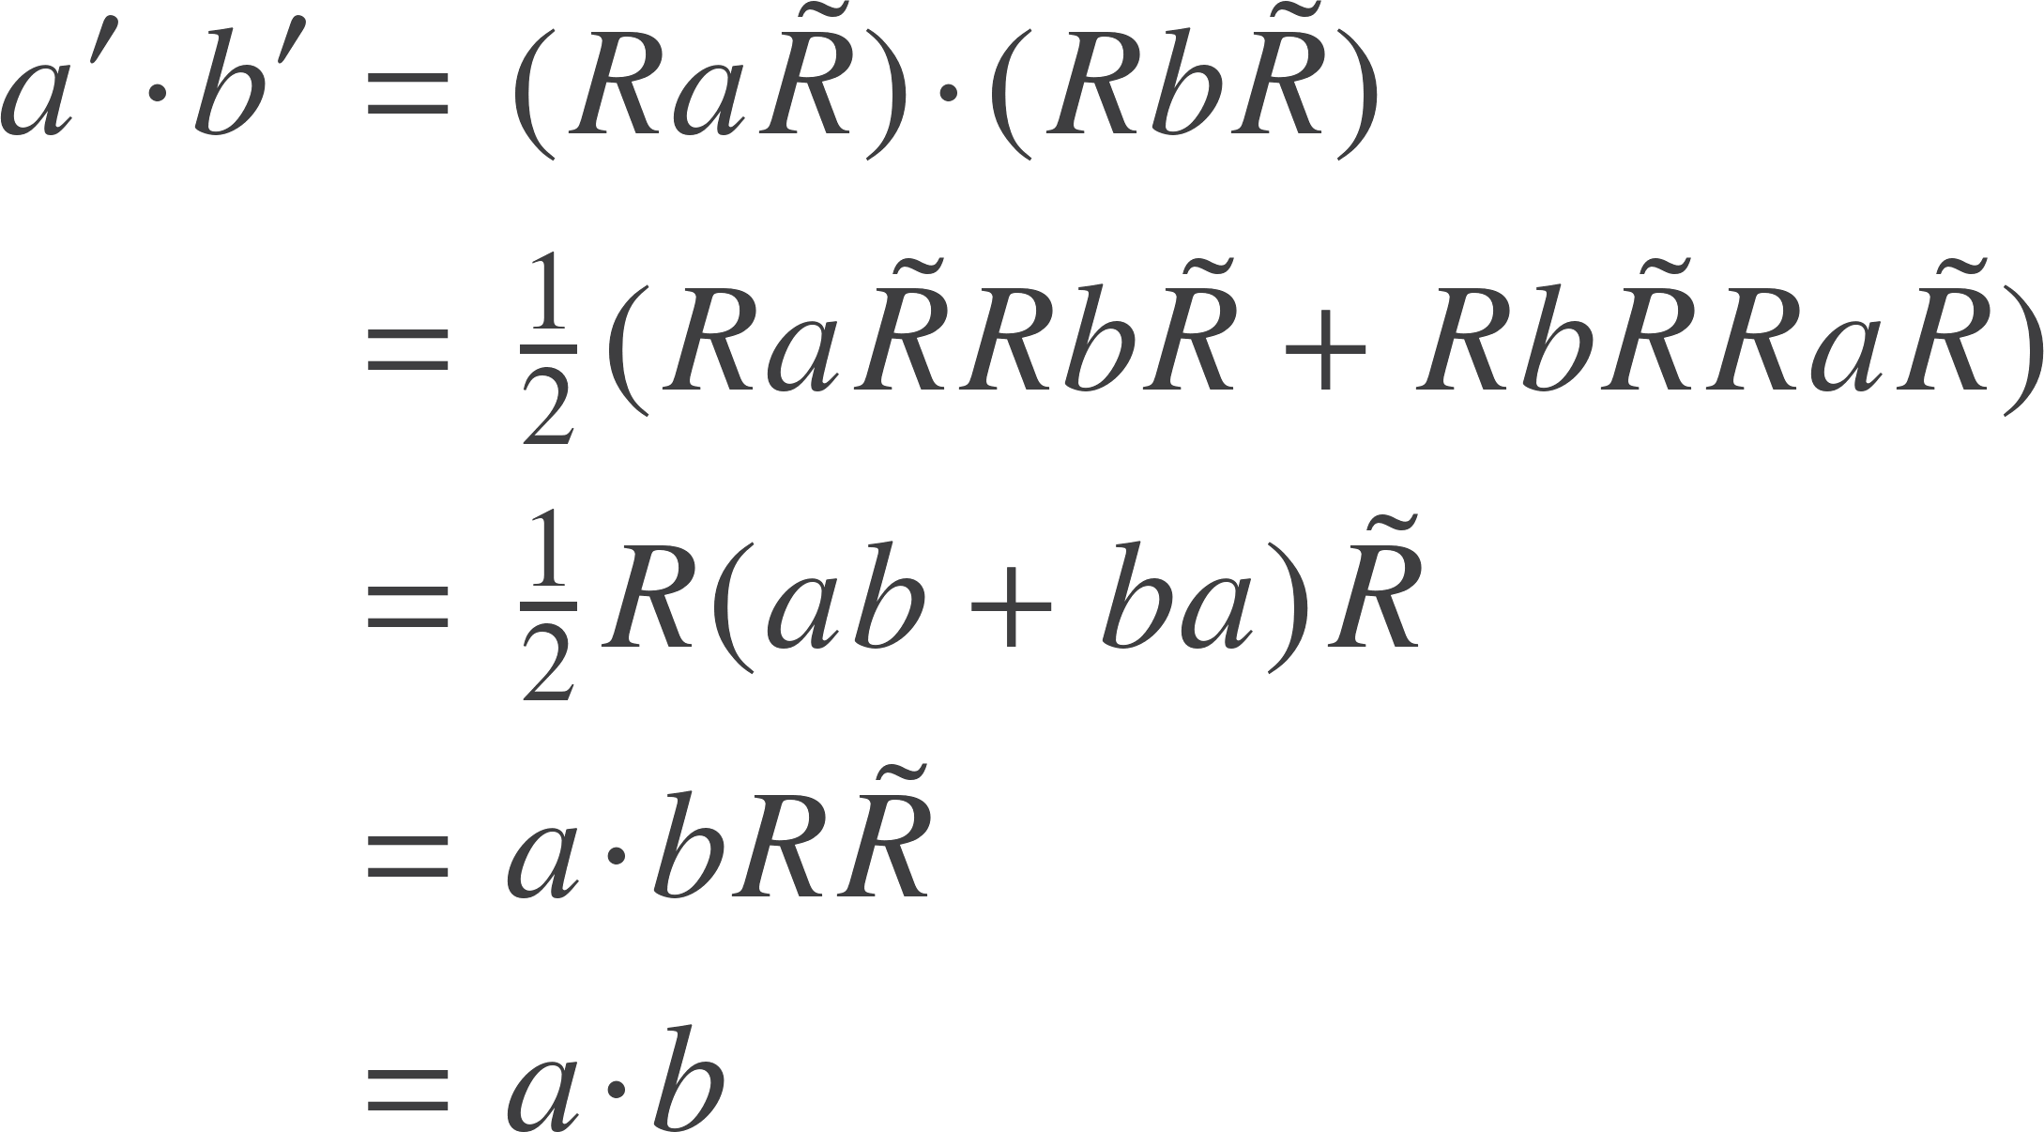
Inner product
Should confirm that rotations do indeed leave inner products invariant
Can also show that rotations do indeed preserve handedness

Slide 4
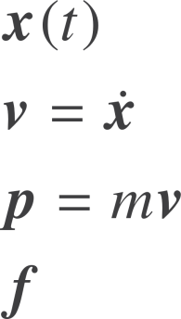



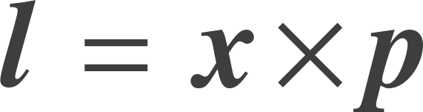

Angular momentum
Trajectory
Angular momentum measures area swept out
Velocity
Momentum
Force
Traditional definition
An ‘axial’ vector instead of a ‘polar’ vector
Much better to treat angular momentum as a bivector

Slide 5

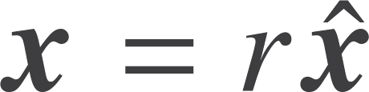
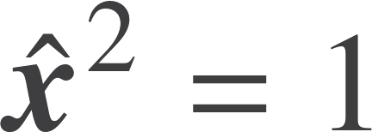
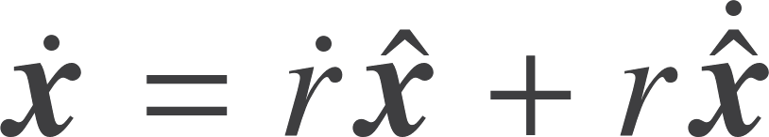
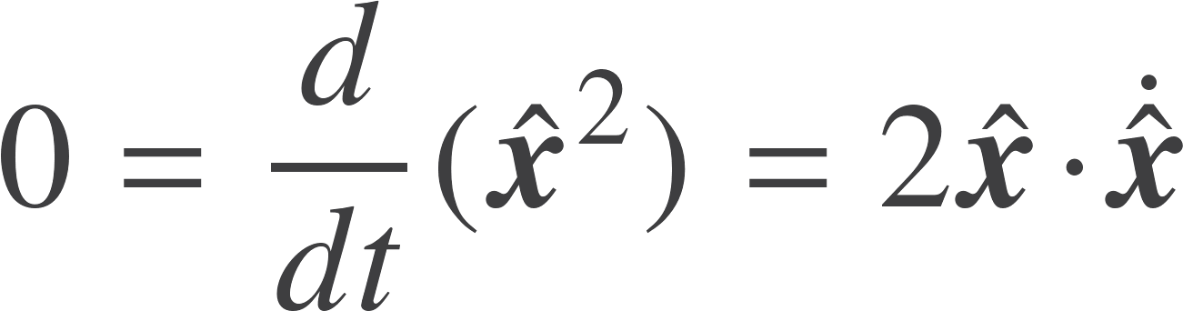
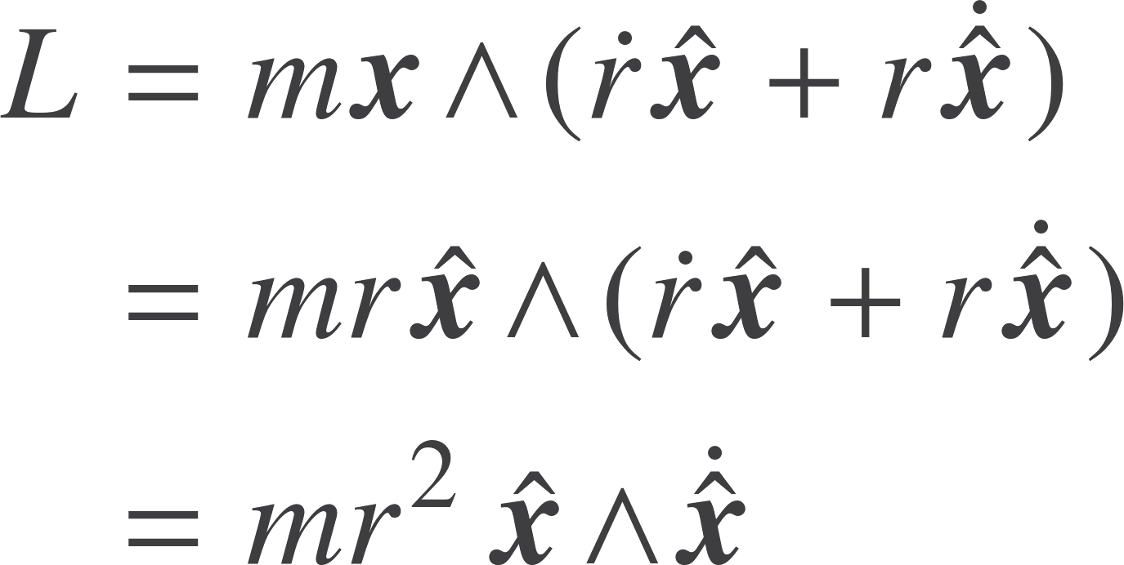

Torque
Differentiate the angular momentum
Define the torque bivector
Define
But
Differentiate
So

Slide 6
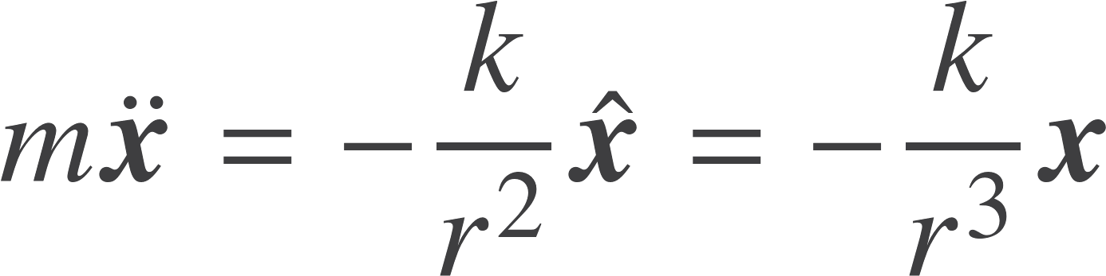
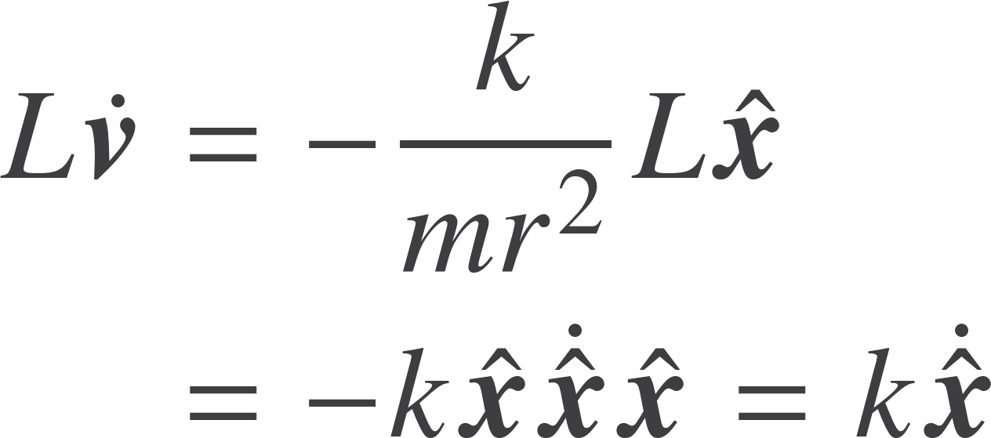

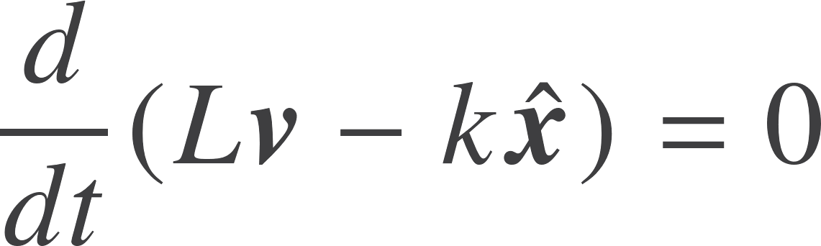

Inverse-square force
Simple to see that torque vanishes, so L is conserved. This is one of two conserved vectors.
Define the eccentricity vector
Forming scalar part of Lvx find
So

Slide 7


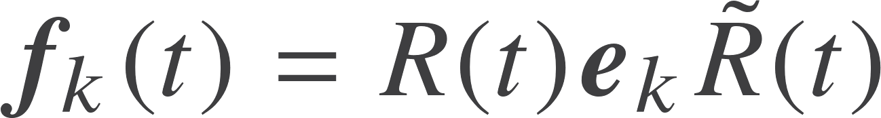
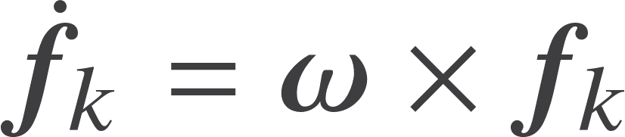

Rotating frames
Rotor R
Frames related by a time dependent rotor
Traditional definition of angular velocity
Replace this with a bivector
Need to understand the rotor derivative, starting from

Slide 8
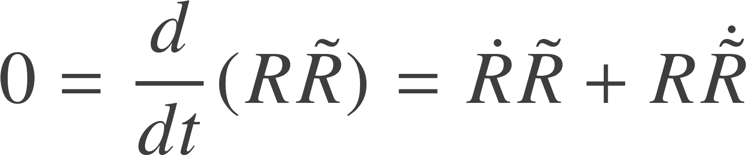

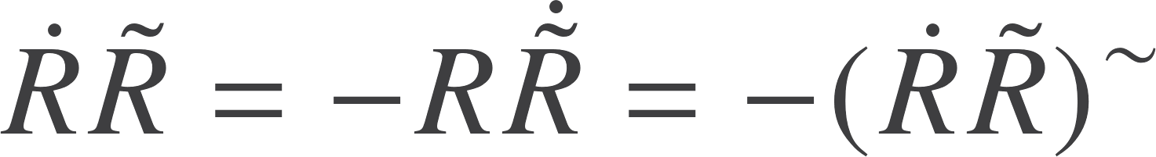


Rotor derivatives
Lie group
Lie algebra
An even object equal to minus it’s own reverse, so must be a bivector
As expected, angular momentum now a bivector

Slide 9
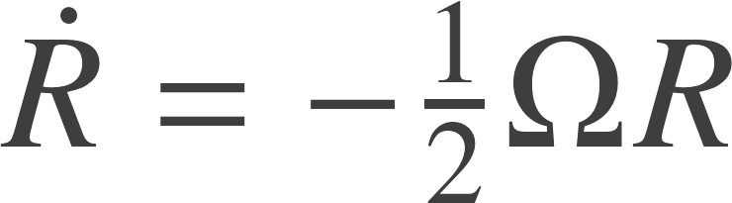
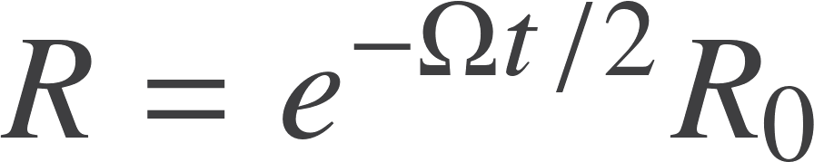

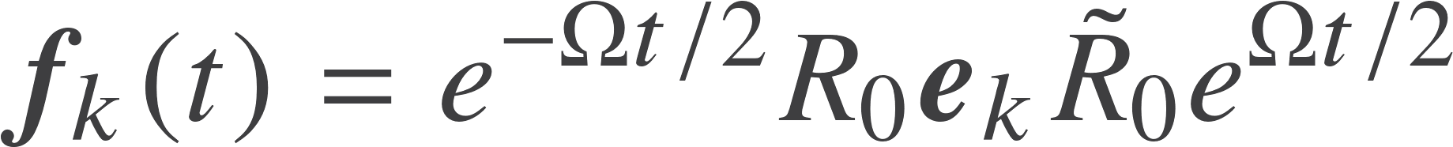

Constant angular velocity
Integrates easily in the case of constant Omega
Fixed frame at t=0
Example – motion around a fixed z axis:

Slide 10

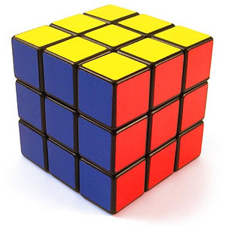



Rigid-body dynamics
Dynamic position of the centre of mass
Fixed reference copy of the object. Origin at CoM.
Dynamic position of the actual object
Constant position vector in the reference copy
Position of the equivalent point in space

Slide 11
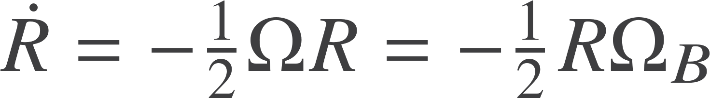
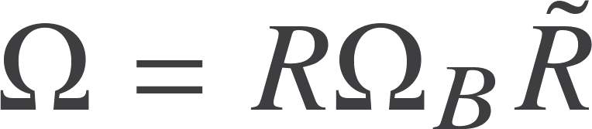
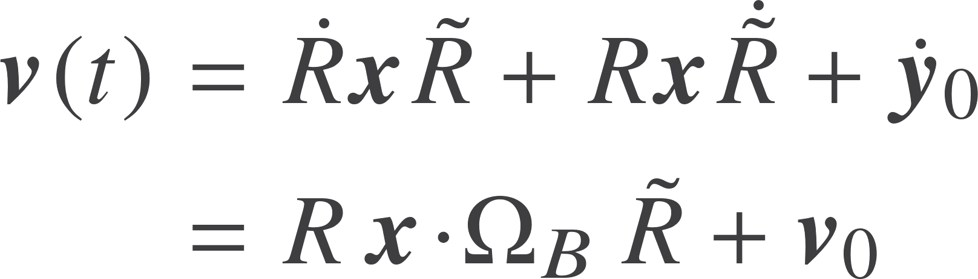
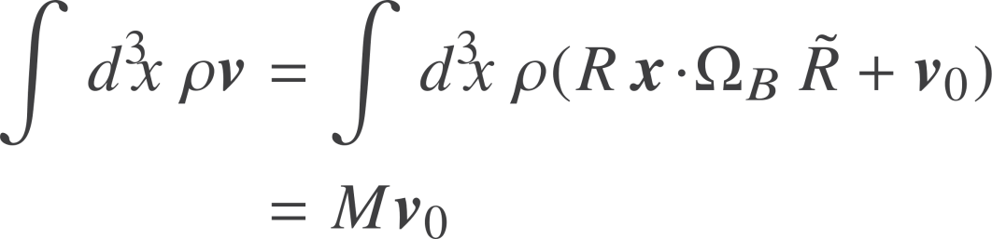
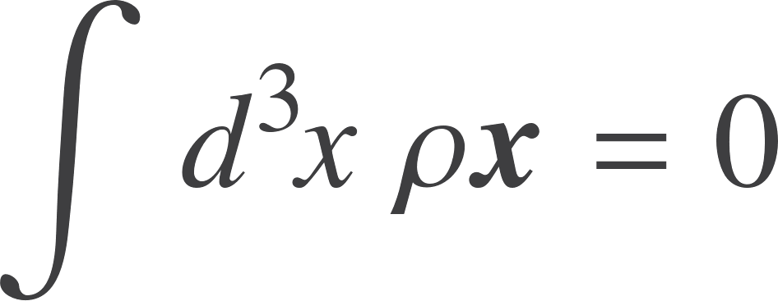
Velocity and momentum
Spatial bivector
Body bivector
True for all points. Have dropped the index
Use continuum approximation
Centre of mass defined by
Momentum given by

Slide 12
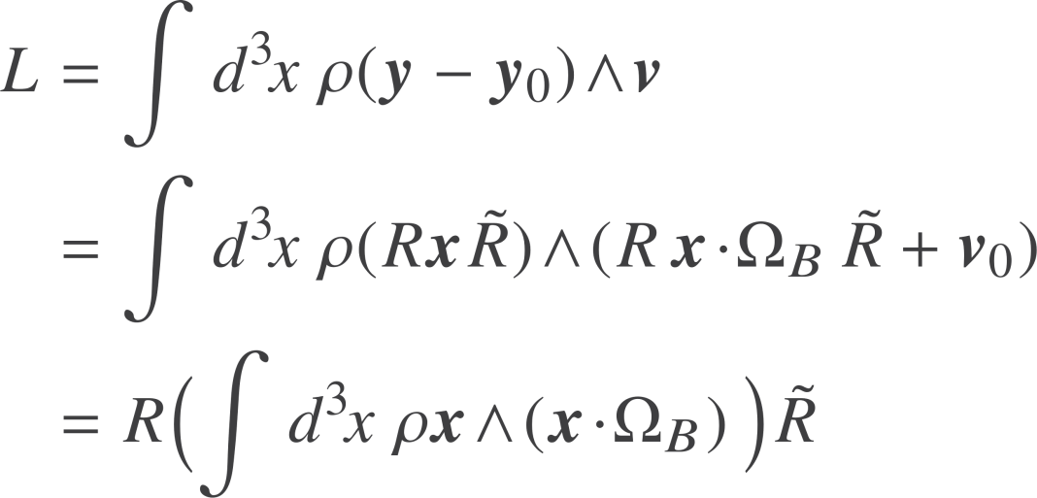


Angular momentum
Need the angular momentum of the body about its instantaneous centre of mass
Define the Inertia Tensor
This is a linear, symmetric function
Fixed function of the angular velocity bivector

Slide 13
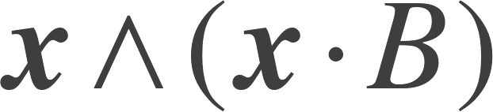


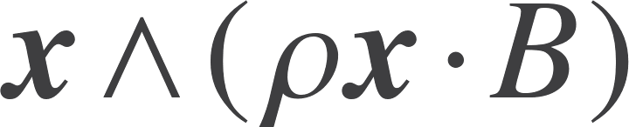
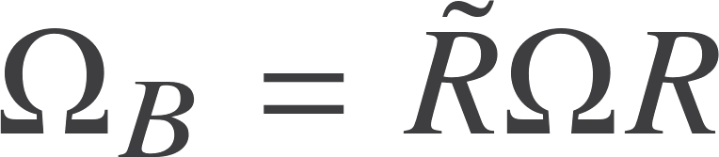
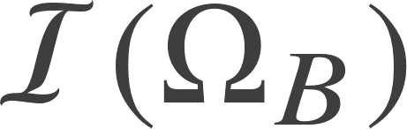

The inertia tensor
Inertia tensor input is the bivector B.
Body rotates about centre of mass in the B plane.
Angular momentum of the point is
Back rotate the angular velocity to the reference copy
Find angular momentum in the reference copy
Rotate the body angular momentum forward to the spatial copy of the body

Slide 14
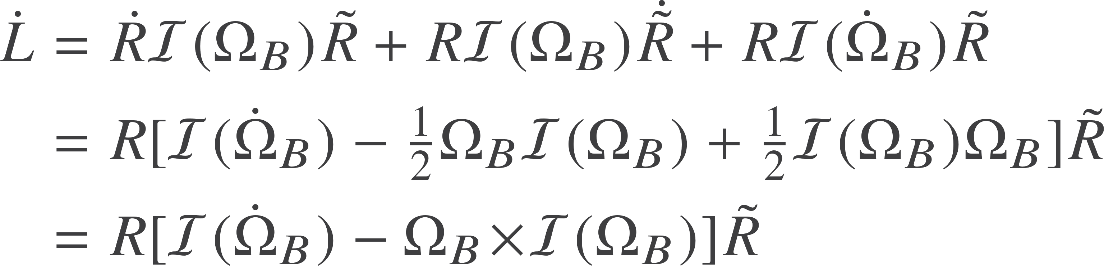
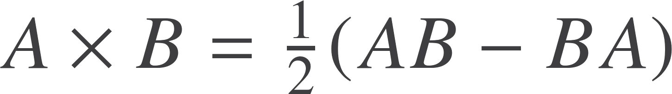

Equations of motion
From now on, use the cross symbol for the commutator product
Introduce the principal axes and principal moments of inertia
No sum
The commutator of two bivectors is a third bivector
Symmetric nature of inertia tensor guarantees these exist

Slide 15
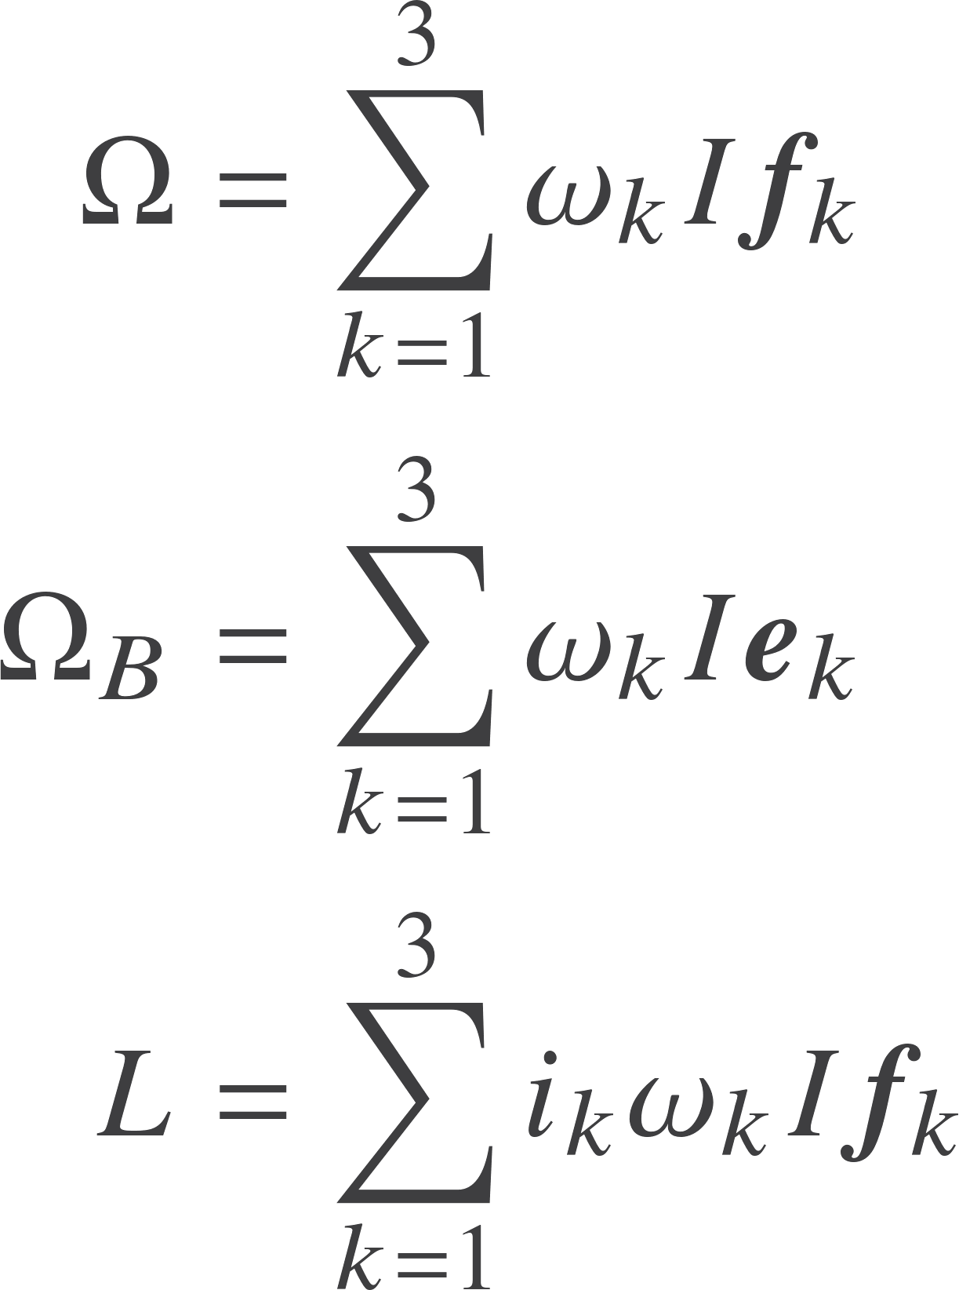

Equations of motion
Inserting these in the above equation recover the famous Euler equations
Objects expressed in terms of the principal axes

Slide 16
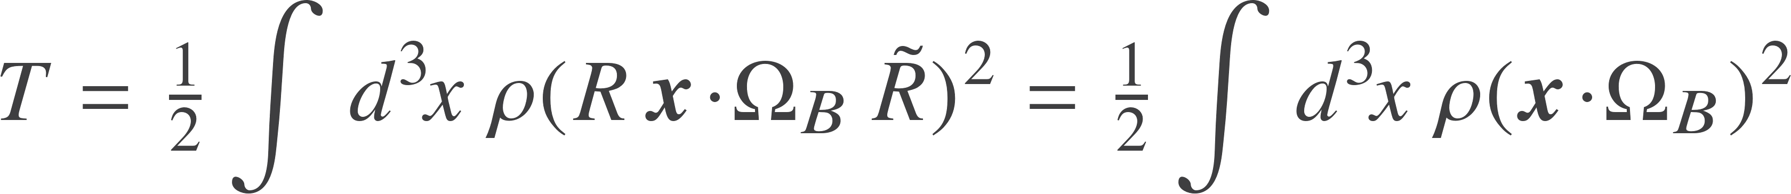
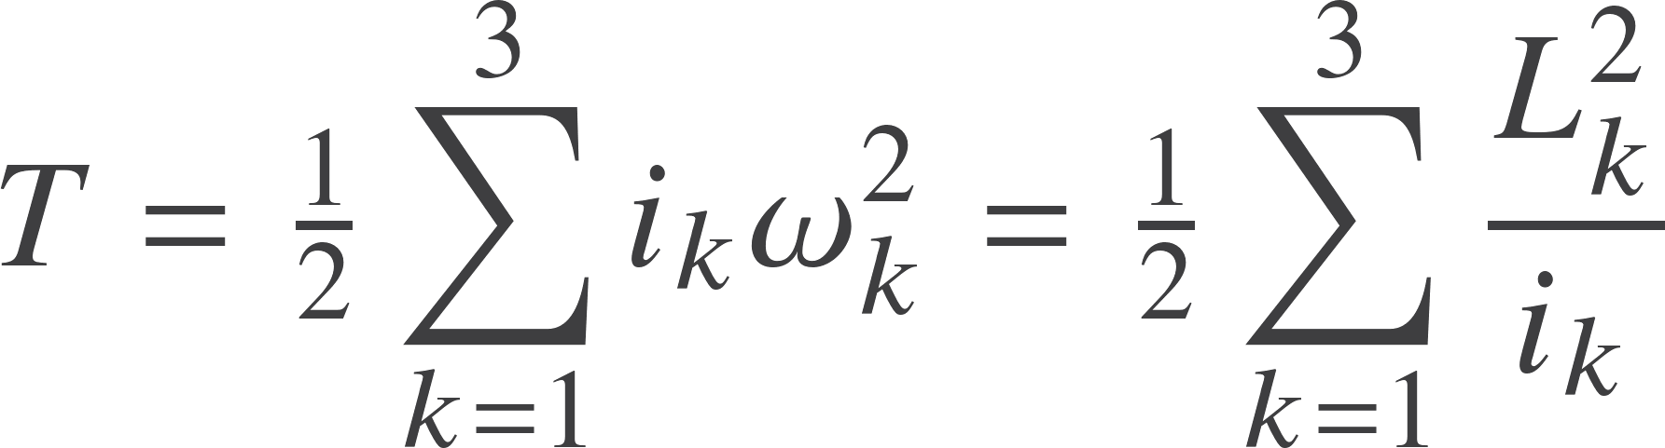
Kinetic energy
Use this rearrangement
In terms of components

Slide 17
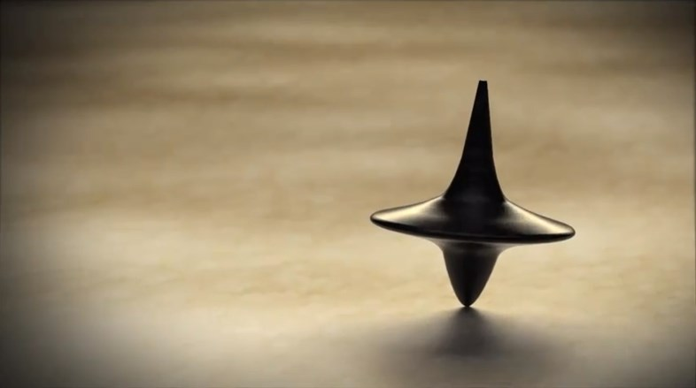

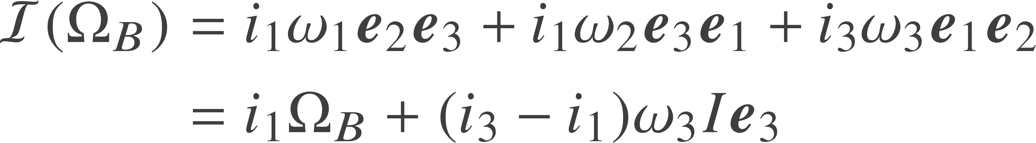
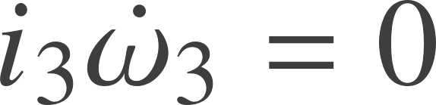
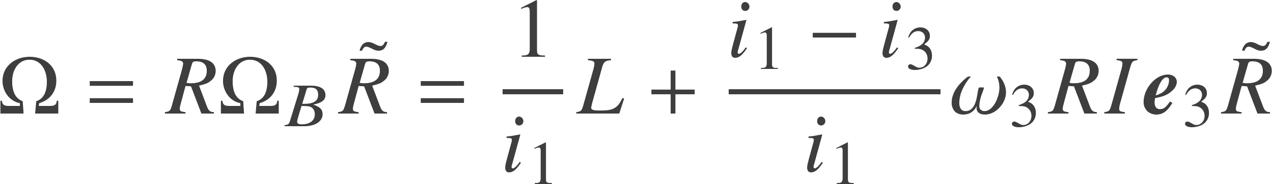
Symmetric top
Body with a symmetry axis aligned with the 3 direction, so
Action of the inertia tensor is
Third Euler equation reduces to
Can now write

Slide 18
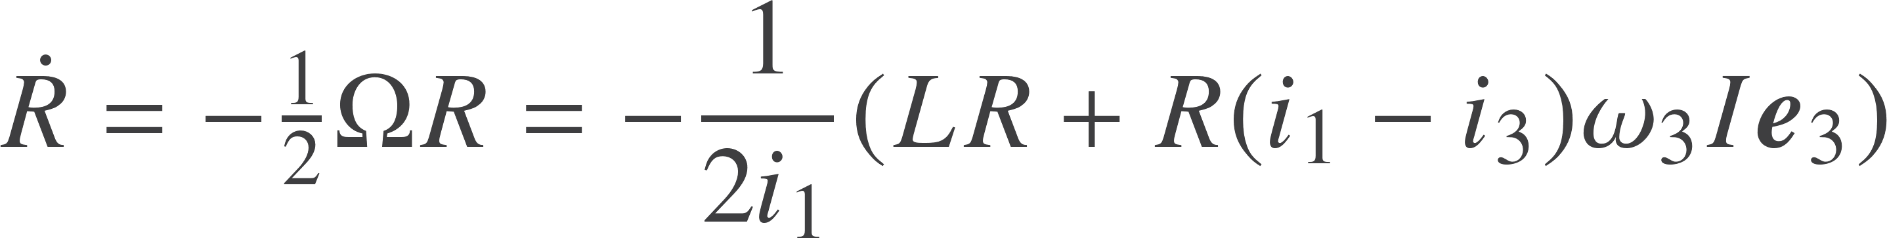
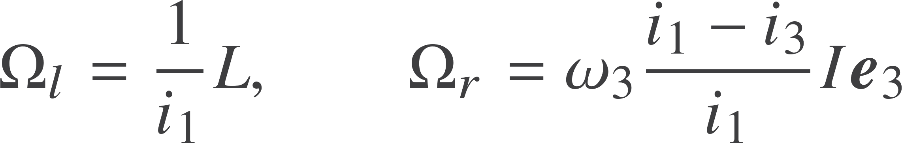
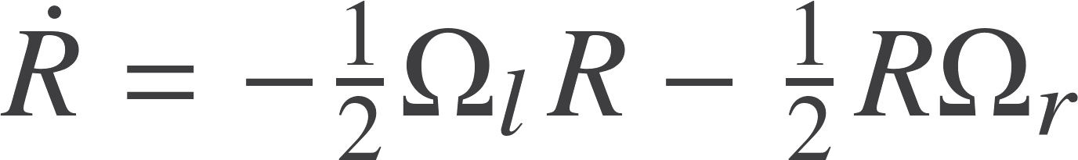
Symmetric top
Define the two constant bivectors
Rotor equation is now
Fully describes the motion
Internal rotation gives precession
Fixed rotor defines attitude at t=0
Final rotation defines attitude in space

Slide 19

Resources
geometry.mrao.cam.ac.uk
chris.doran@arm.com
cjld1@cam.ac.uk
@chrisjldoran
#geometricalgebra
github.com/ga

