Slide 1

Geometric Algebra
4. Algebraic Foundations and 4D
Dr Chris Doran
ARM Research

Slide 2





Axioms
Elements of a geometric algebra are called multivectors
Multivectors can be classified by grade
Grade-0 terms are real scalars
Grading is a projection operation
Space is linear over the scalars. All simple and natural

Slide 3

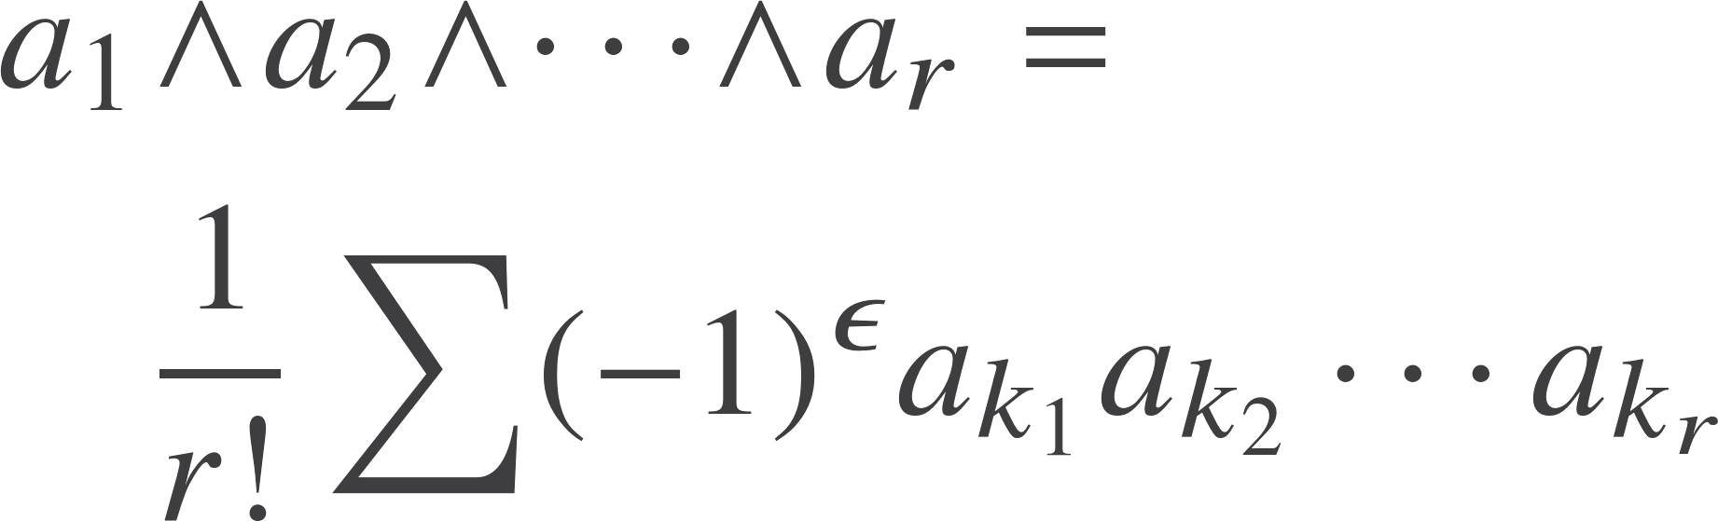

Axioms
The grade-1 elements of a geometric algebra are called vectors
The antisymmetric produce of r vectors results in a grade-r blade
Call this the outer product
So we define
Sum over all permutations with epsilon +1 for even and -1 for odd

Slide 4


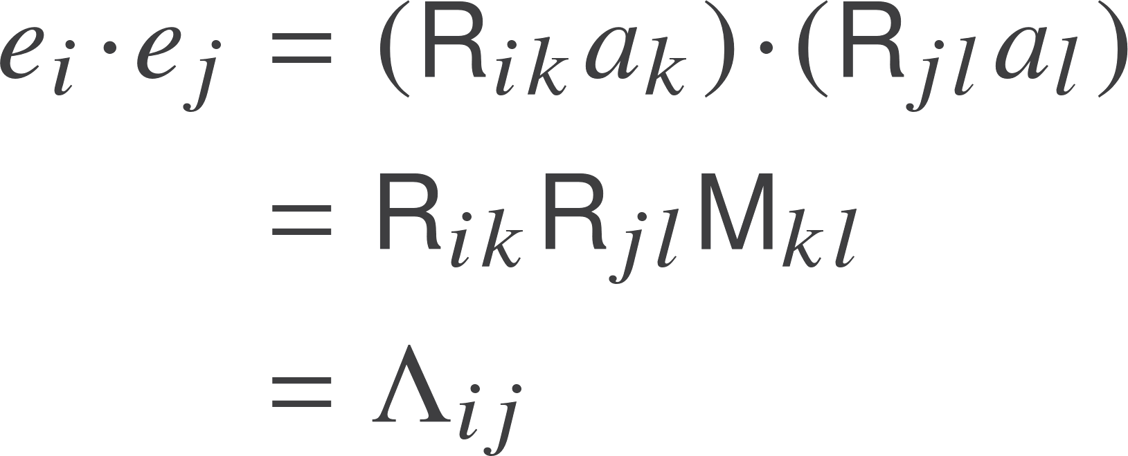


Simplifying result
Given a set of linearly-independent vectors
We can find a set of anti-commuting vectors such that
These vectors all anti-commute
Symmetric matrix
Define
The magnitude of the product is also correct

Slide 5

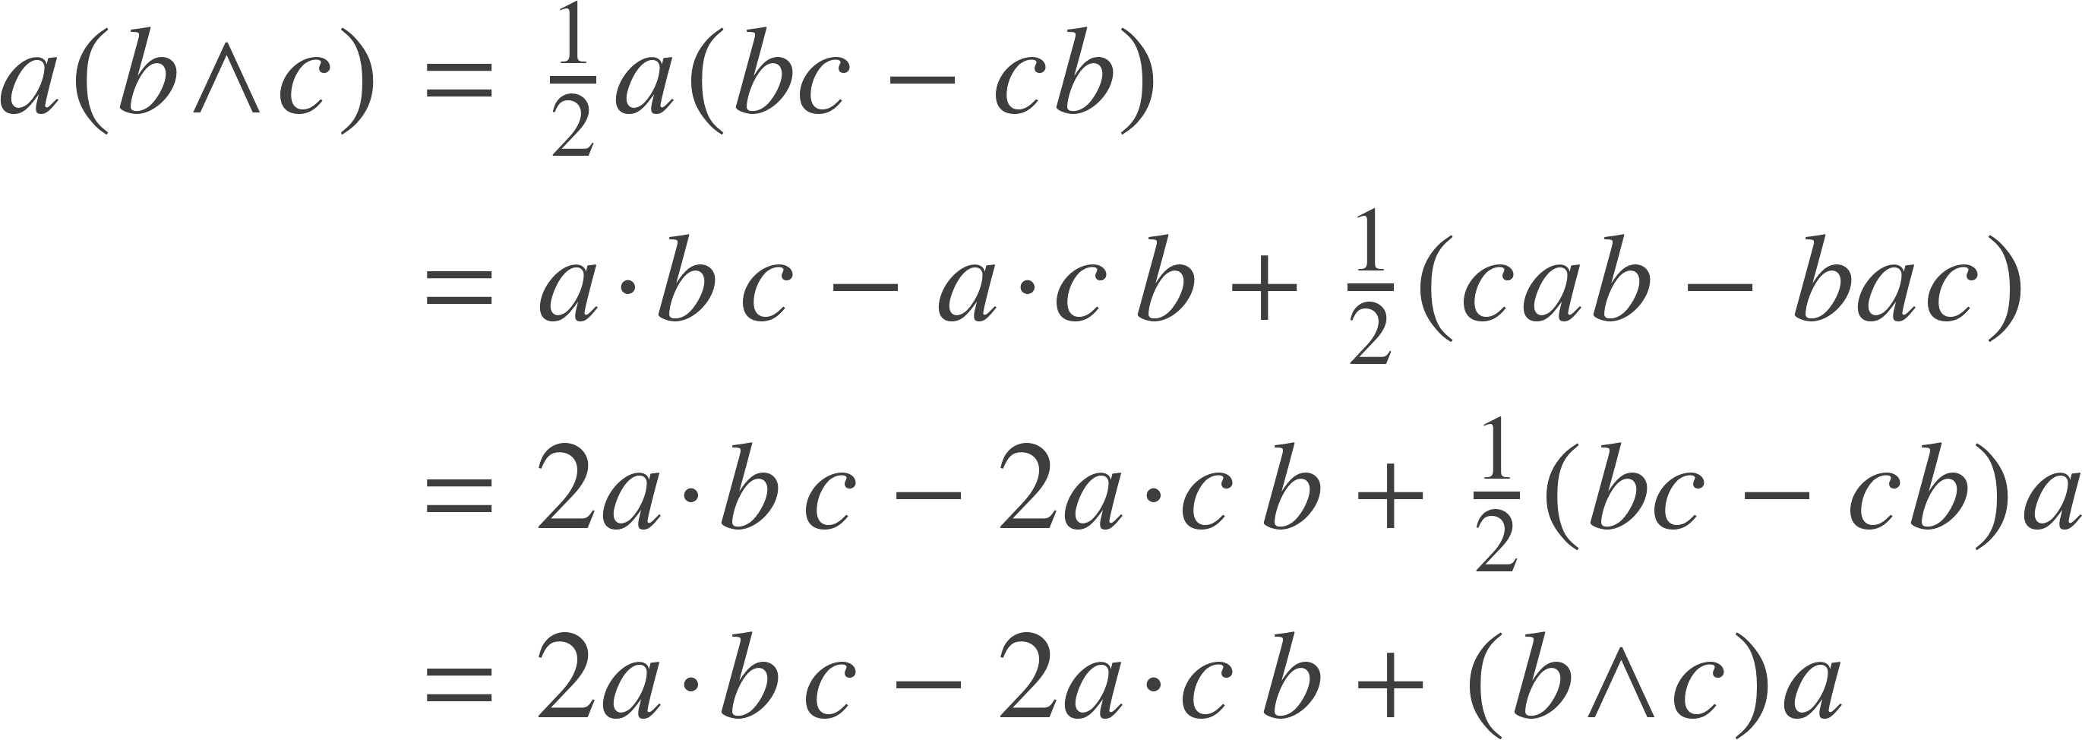

Decomposing products
Make repeated use of
Define the inner product of a vector and a bivector

Slide 6
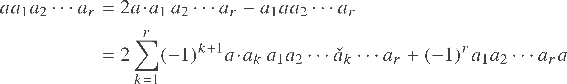
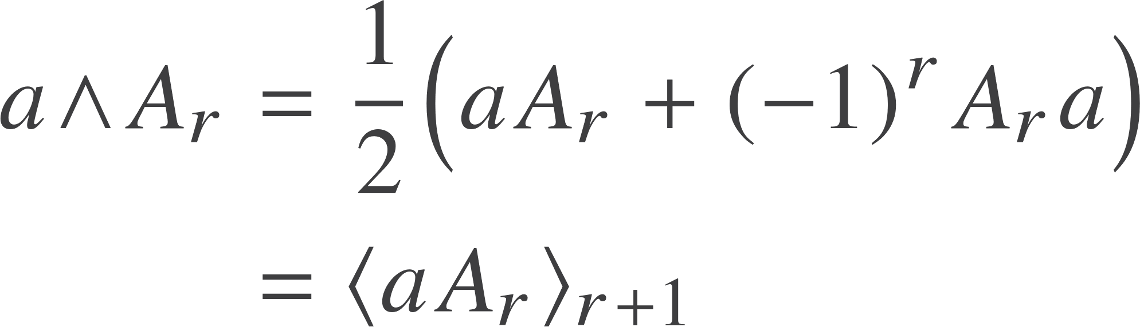

General result
Grade r-1
Over-check means this term is missing
Define the inner product of a vector and a grade-r term
Remaining term is the outer product
Can prove this is the same as earlier definition of the outer product

Slide 7
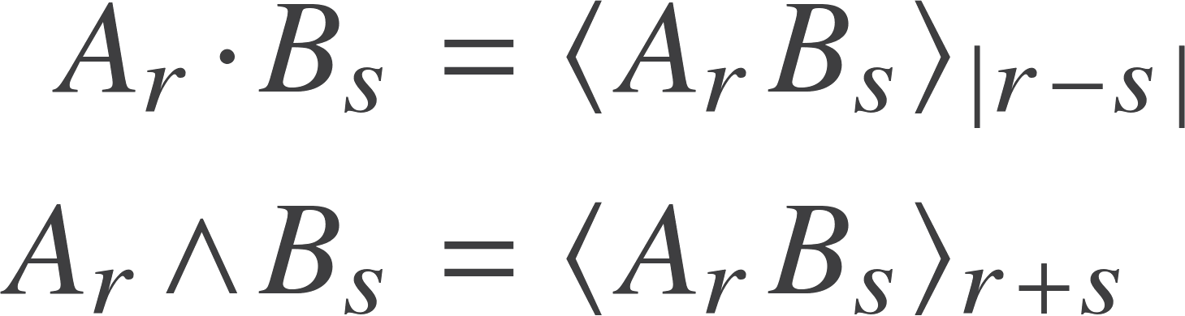
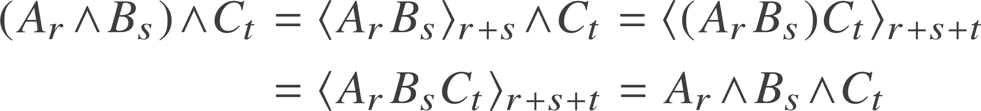
General product
Extend dot and wedge symbols for homogenous multivectors
The definition of the outer product is consistent with the earlier definition (requires some proof). This version allows a quick proof of associativity:

Slide 8


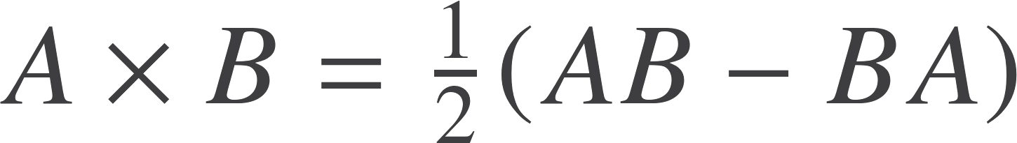



Reverse, scalar product and commutator
The reverse, sometimes written with a dagger
Useful sequence
Write the scalar product as
Occasionally use the commutator product
Useful property is that the commutator with a bivector B preserves grade
Scalar product is symmetric

Slide 9




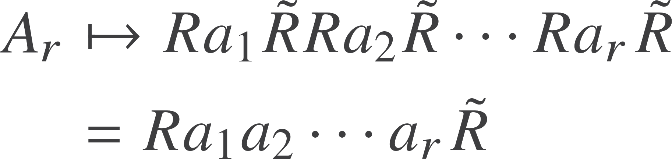



Rotations
Combination of rotations
Suppose we now rotate a blade
So the product rotor is
So the blade rotates as
Rotors form a group

Slide 10


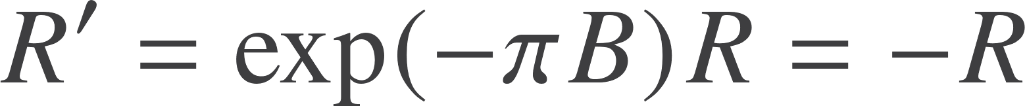

Fermions?
Take a rotated vector through a further rotation
The rotor transformation law is
Now take the rotor on an excursion through 360 degrees. The angle goes through 2$π$, but we find the rotor comes back to minus itself.
This is the defining property of a fermion!

Slide 11
Unification
One of the defining properties of spin-half particles drops out naturally from the properties of rotors.

Slide 12
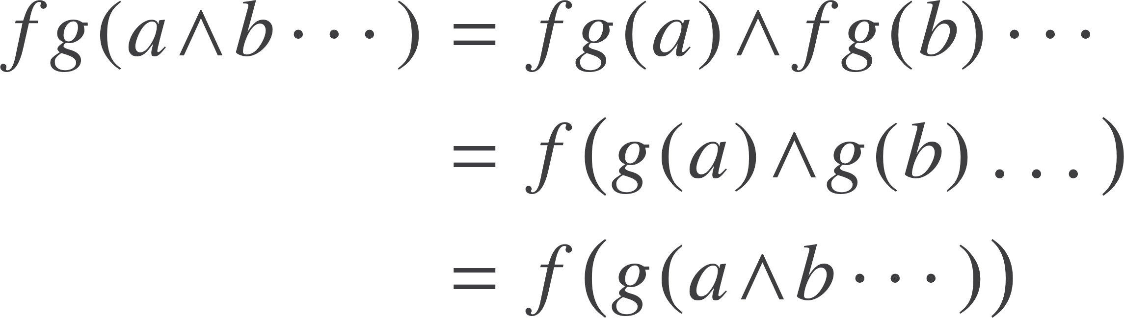

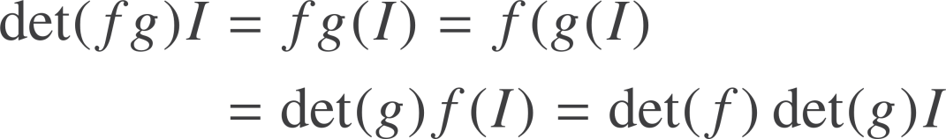
Linear algebra
Linear function f
Extend f to multivectors
Form the product function fg
This a grade-preserving linear function
The pseudoscalar is unique up to scale so we can define
Quickly prove the fundamental result

Slide 13
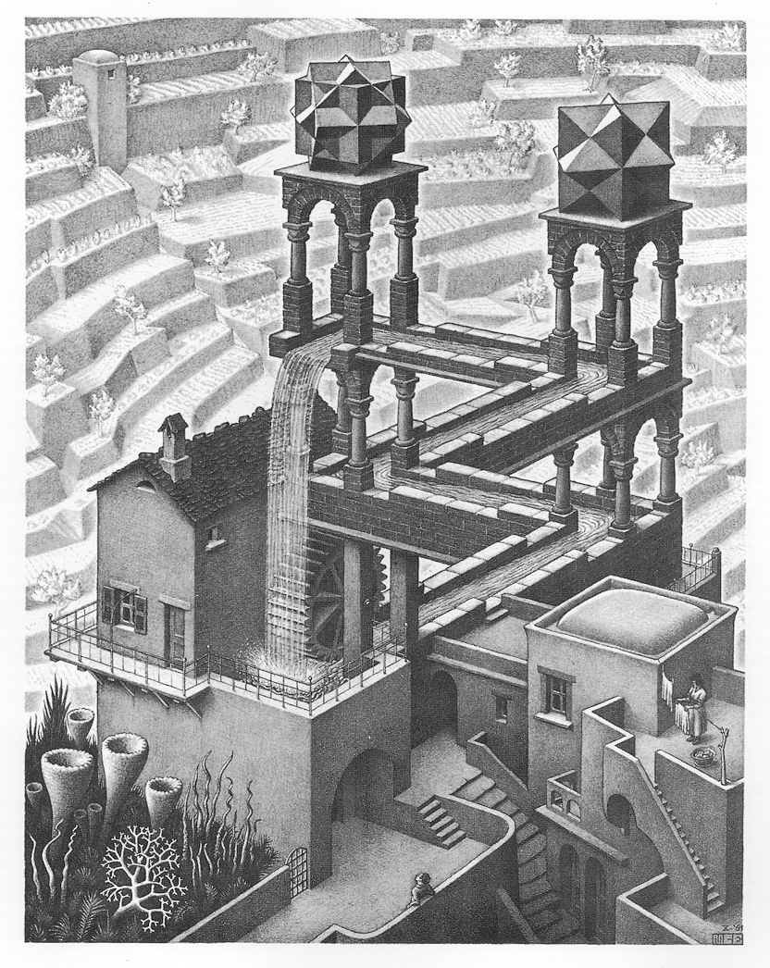
Projective geometry
Use projective geometry to emphasise expressions in GA have multiple interpretations
Closer to Grassmann’s original view
Our first application of 4D GA
Core to many graphics algorithms, though rarely taught

Slide 14
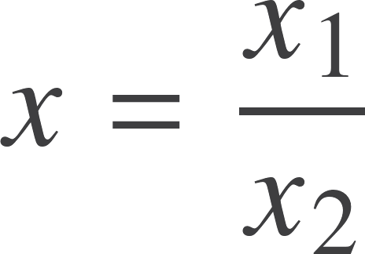
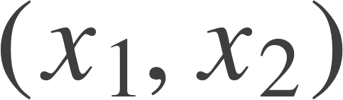

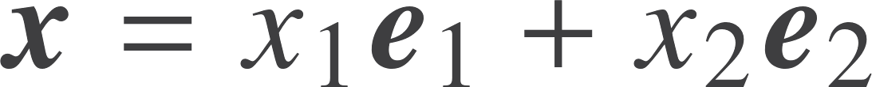


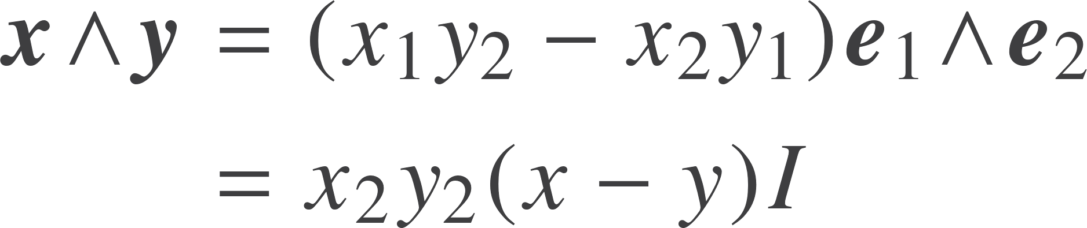

Projective line
Point x represented by homogeneous coordinates
A point as a vector in a GA
Outer product of two points represents a line
This representation of points is homogeneous
Scale factors
Distance between the points

Slide 15
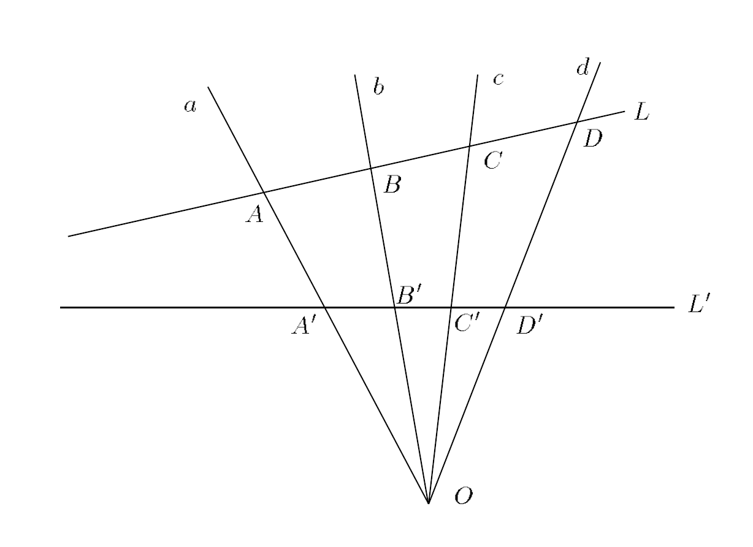
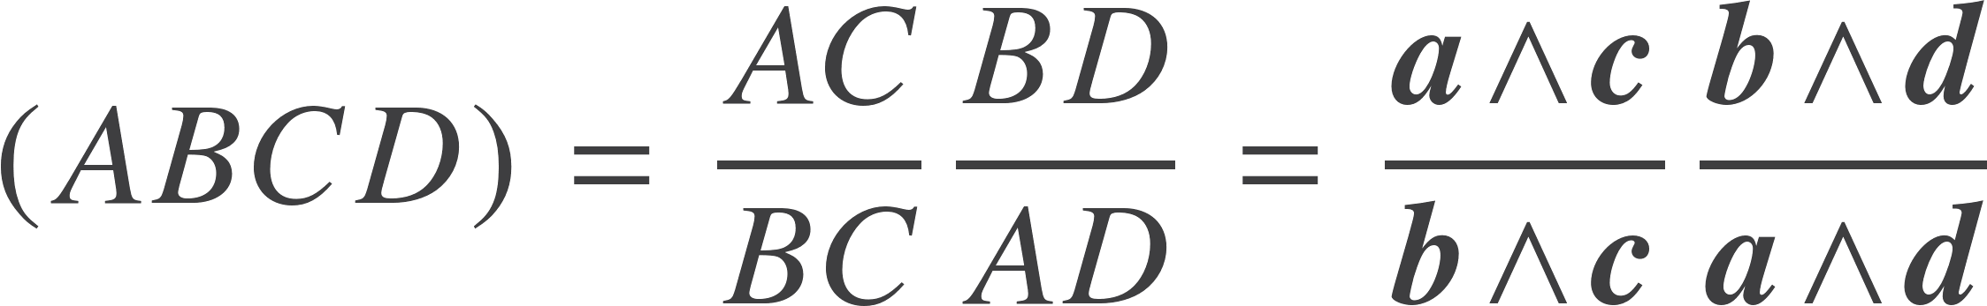
Cross ratio
Distance between points
Invariant quantity
Can see that the RHS is invariant under a general linear transformation of the 4 points
Ratio is invariant under rotations, translations and scaling

Slide 16








Projective plane
Points on a plane represented by vectors in a 3D GA. Typically align the 3 axis perpendicular to the plane, but this is arbitrary
Interchange points and lines by duality. Denoted *
Point
Line
Plane
Intersection (meet) defined by
For 3 lines to meet at a point
For 2 lines
Reduces to simple statement

Slide 17
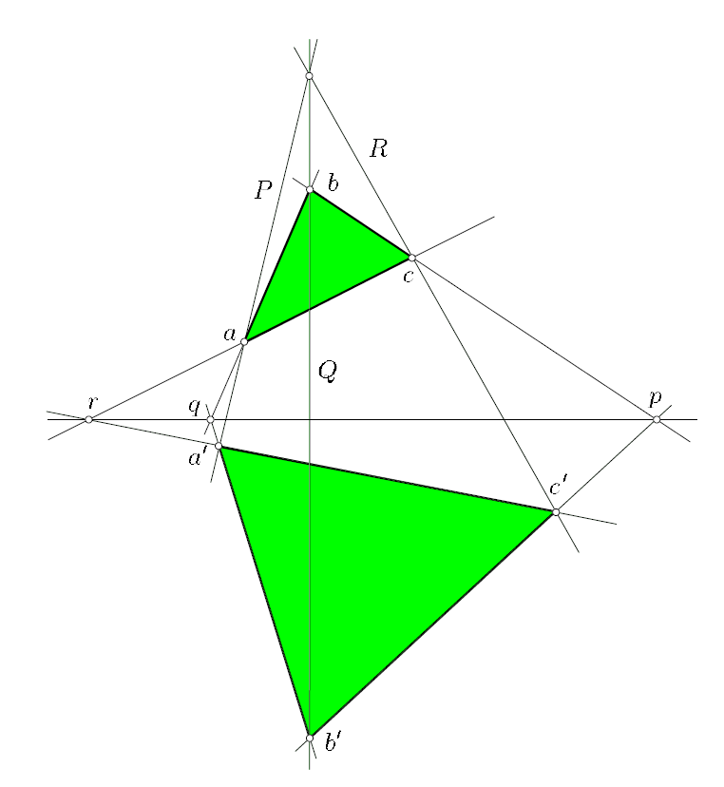
Example
Can prove the algebraic identity
These 3 points are collinear iff these 3 lines meet at a point
This is Desargues theorem. A complex geometric identity from manipulating GA elements.

Slide 18
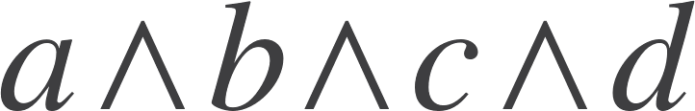


Projective geometry of 3D space
Point
Line
Plane
Volume
Interchange points and planes by duality. Lines transform to other lines
In 4D we can define the object
Bivectors form a 6 dimensional space
Blades represent lines
Test of intersection is
This is homogenous, but NOT a blade. Also satisfies
2 Bivectors with non-vanishing outer product are 2 lines missing each other

Slide 19



Plucker coordinates and intersection
Condition that a bivector B represents a line is
Write
Plucker’s condition
A linear representation of a line, with a non-linear constraint
Suppose we want to intersect the line L with the plane P

Slide 20

Resources
geometry.mrao.cam.ac.uk
chris.doran@arm.com
cjld1@cam.ac.uk
@chrisjldoran
#geometricalgebra
github.com/ga

