Slide 1

Geometric Algebra
5. Spacetime Algebra
Dr Chris Doran
ARM Research

Slide 2
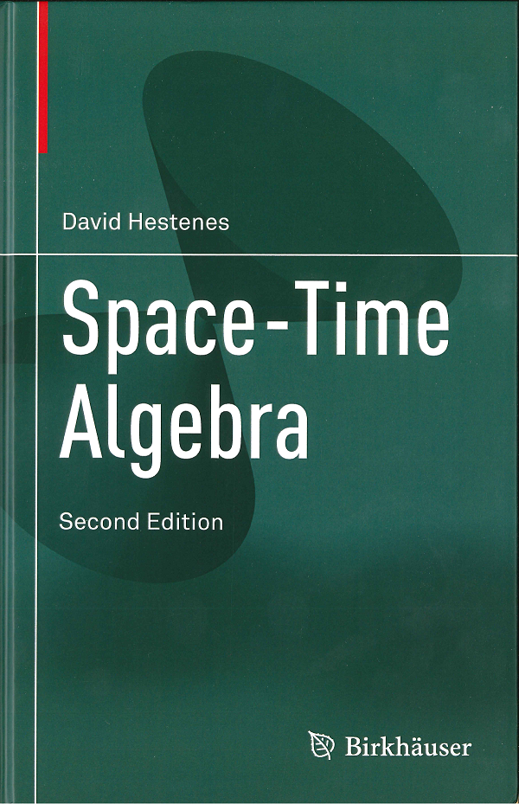
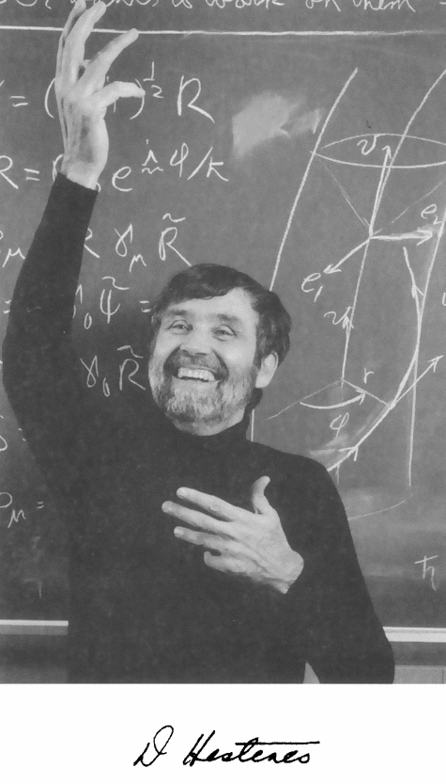
History

Slide 3
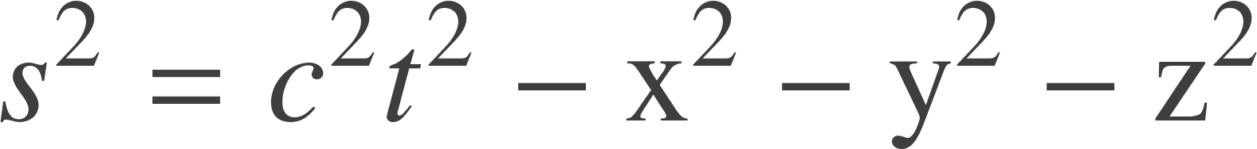


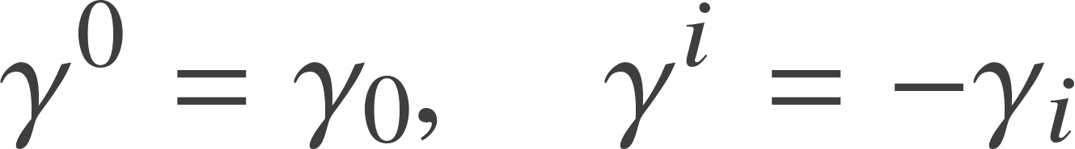
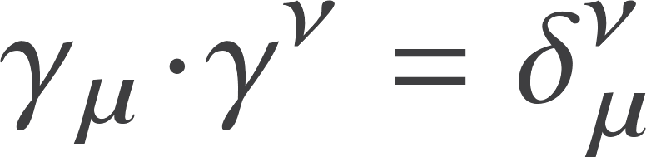

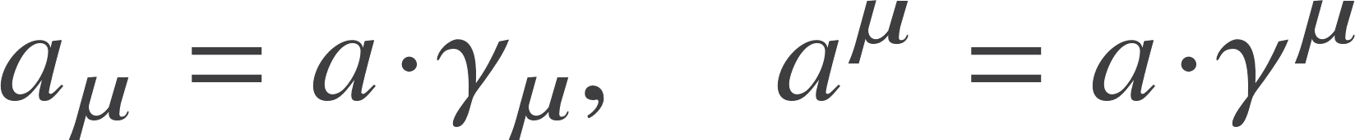
A geometric algebra of spacetime
The “particle physics” convention
Invariant interval of spacetime is
Need 4 generators
Sometimes use the reciprocal frame
So
Position vector
Recover components of a vector

Slide 4


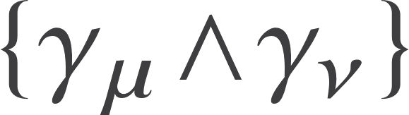




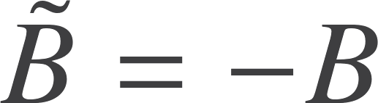




Spacetime algebra
1
scalar
4 vectors
6 bivectors
4 trivectors
1 pseudoscalar
The pseudoscalar is defined by
This satisfies

Slide 5



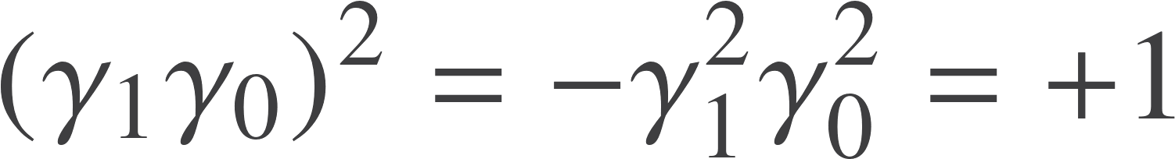
The bivector algebra
Space-like
Time-like
Generate rotations in a plane
Form a closed algebra
Same behaviour as the bivectors we have met already
A new type of bivector, with positive square
Generate boosts
Commutator of two time-like bivectors is a space-like one

Slide 6
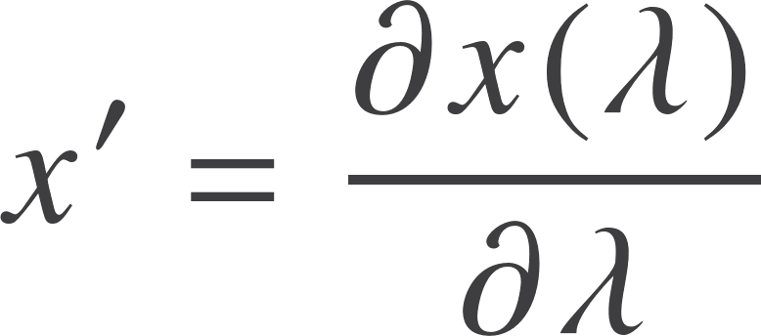

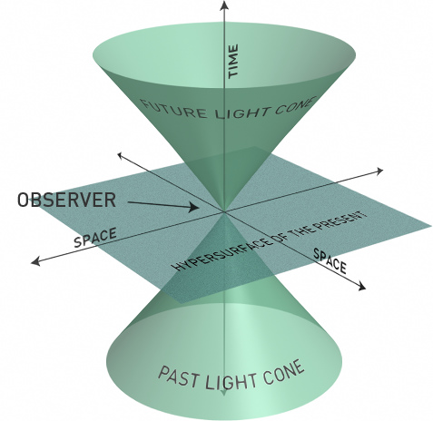

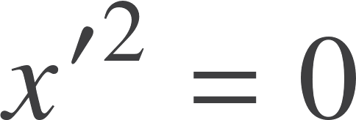


Observers and trajectories
NB will set c=1 from now on
Timelike
Null
Introduce the proper time τ:
Photons follow null trajectories
No concept of proper time for photons.
They are ‘timeless’
Observers and massive particles follow timelike paths

Slide 7



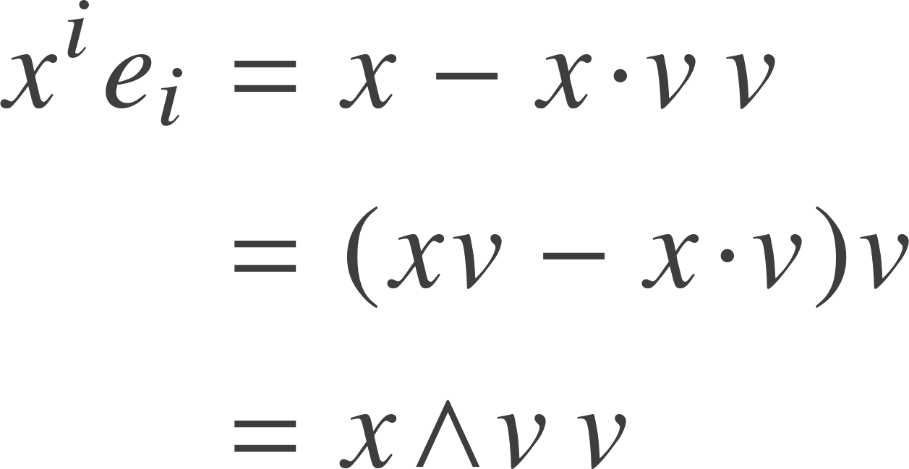

Coordinate systems
Special relativity focuses on how different observers perceive the same events – passive transformations
Set
Construct frame
General event can be written
Spatial part is the remainder
Time coordinate is
Measures time on observer’s clock
Focus on the bivector part

Slide 8

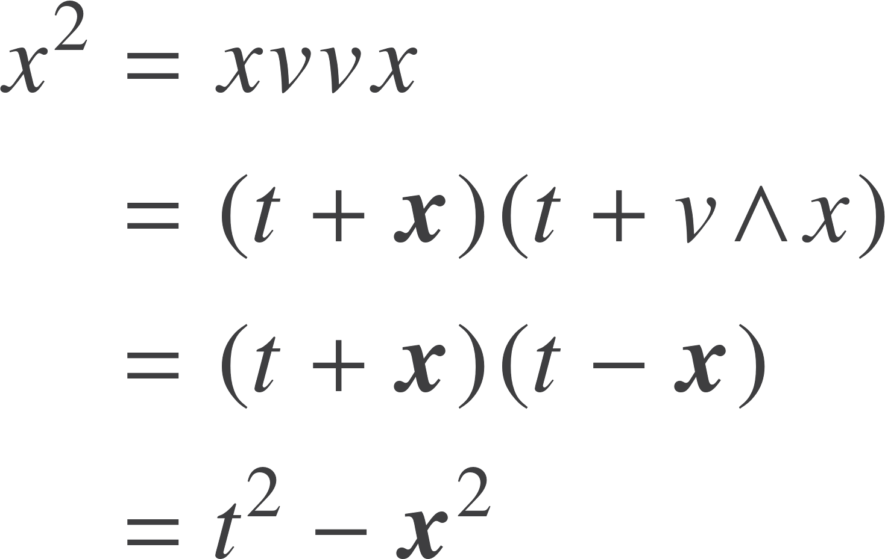

Observer bivectors
Write
Spatial generators
Recover the spacetime metric by writing
Satisfy
Generate a spatial GA. The algebra of the relative space
Metric properties flow naturally from the split

Slide 9

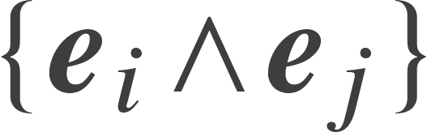
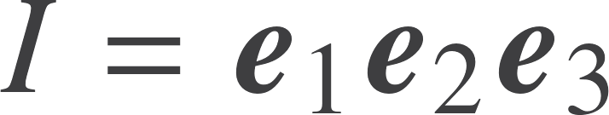

Observer splits
Relative space and spacetime share the same pseudoscalar
This projective split between spacetime and relative space is observer-dependent.
A very useful technique

Slide 10


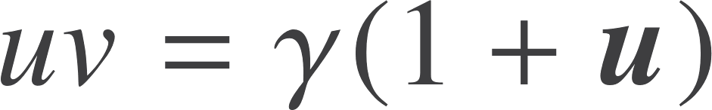
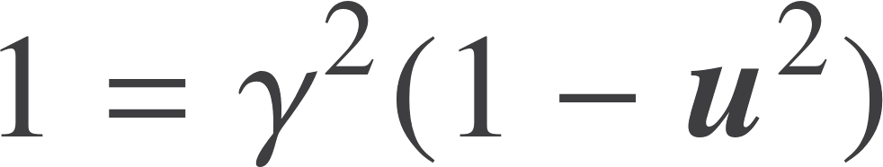
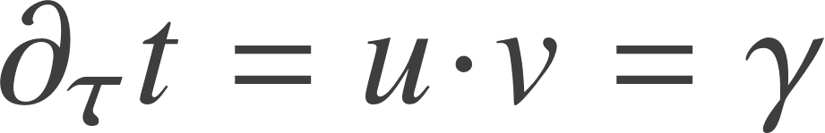
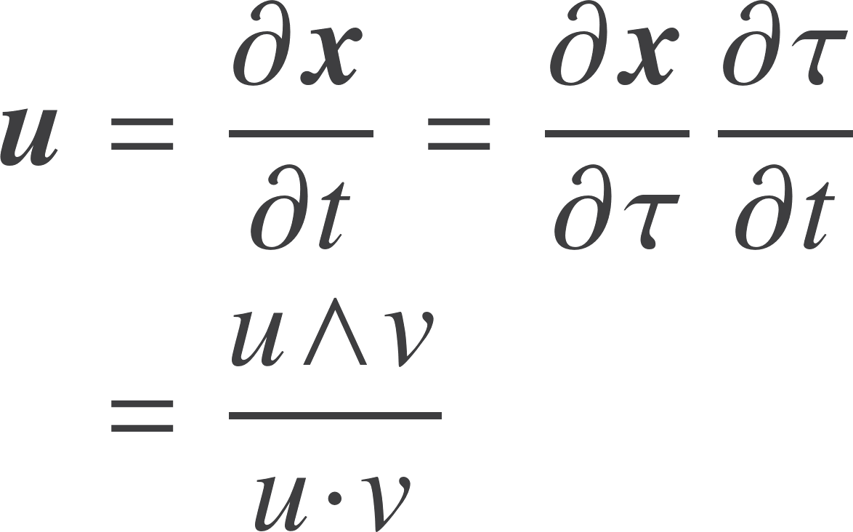
Relative velocity
Time
Observer with velocity
Observes a trajectory
Note this is ‘textbook’ relativity
In reality you should focus on experiments and photon trajectories, not coordinate systems.
Relative velocity

Slide 11
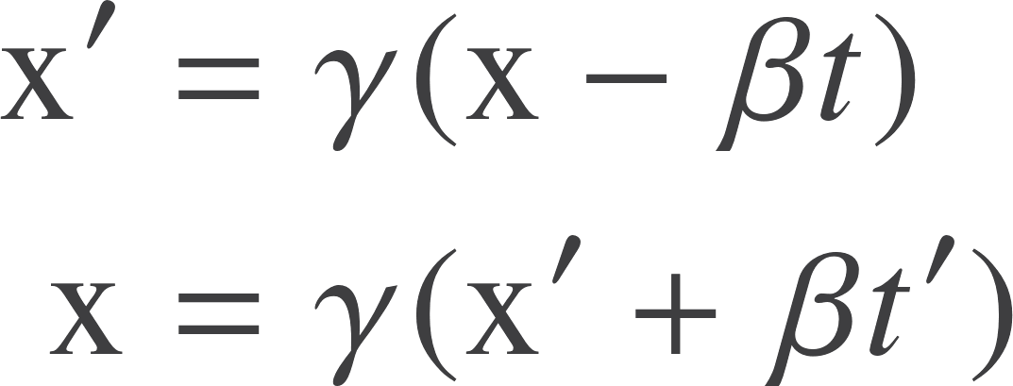
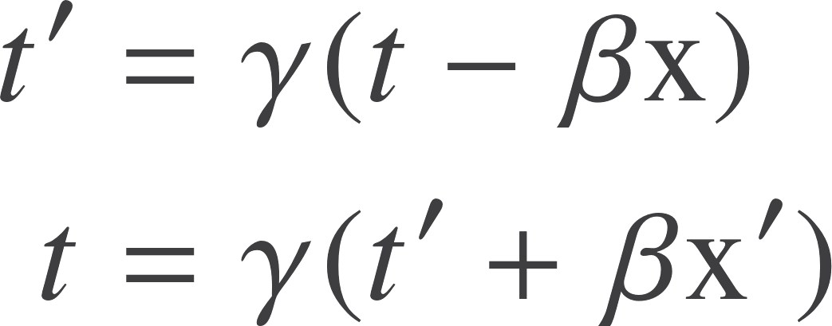
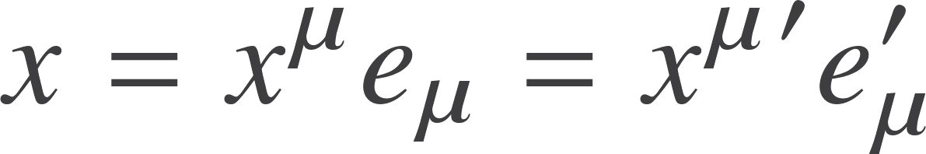

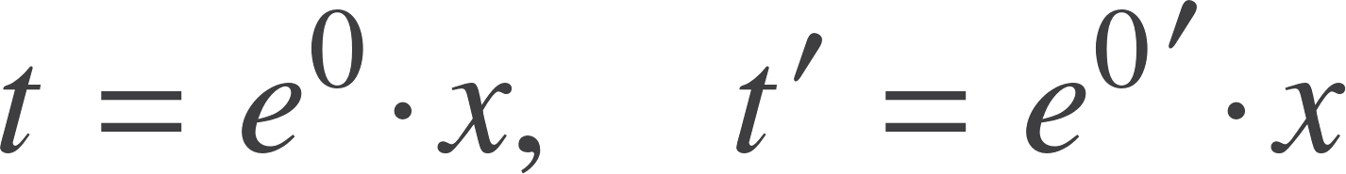

Lorentz Transformations
Expressed in terms of coordinate transformations
These are passive. The same event expressed in two different coordinate systems
Focus on the 0,1 components
Understand the transformation in terms of the frame transforming

Slide 12

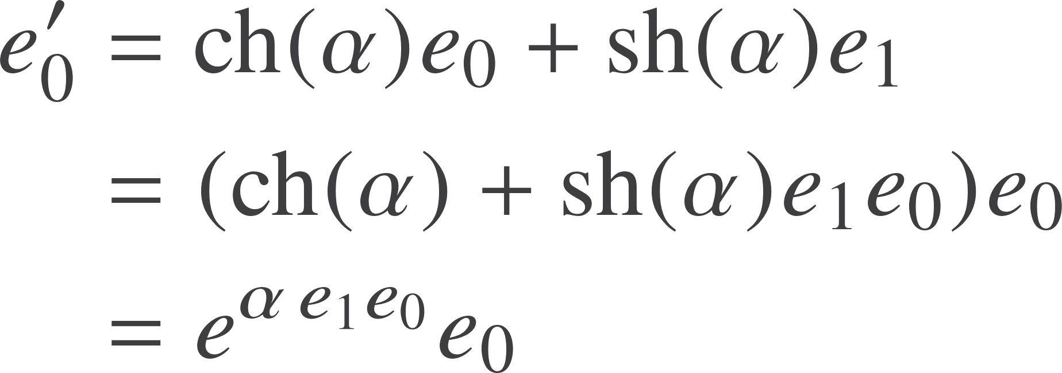


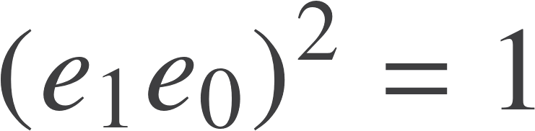

Hyperbolic geometry
Introduce the hyperbolic angle
Also find
Other two directions unaffected
Power series still works for exponential, but now

Slide 13

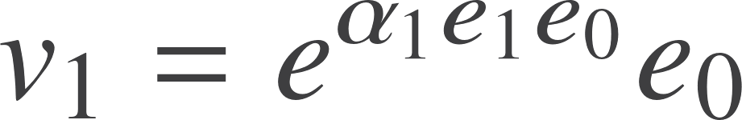
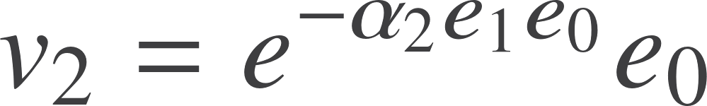
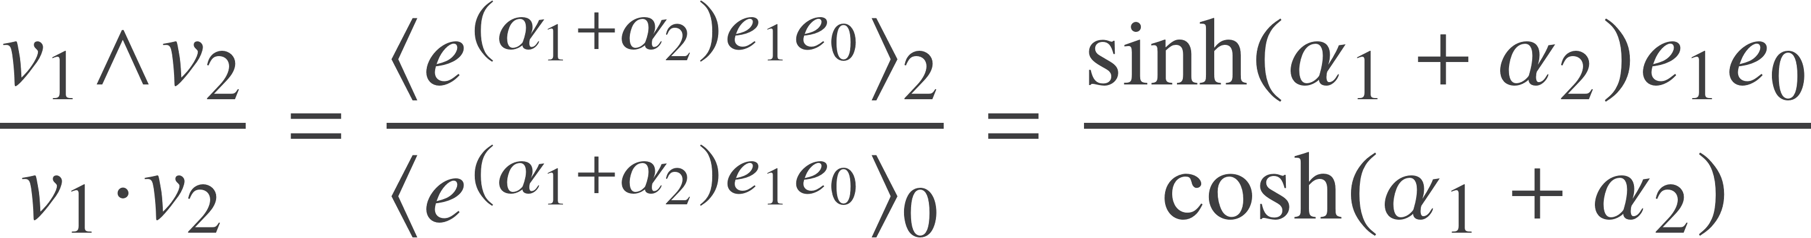
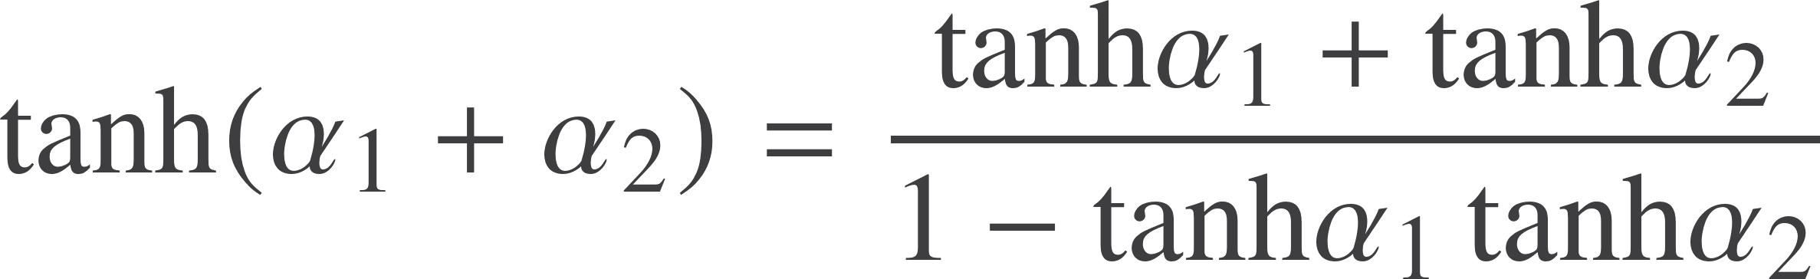
Addition of velocities
What is the relative velocity between the trains that the drivers agree on?
Relative velocity is hyperbolic addition

Slide 14


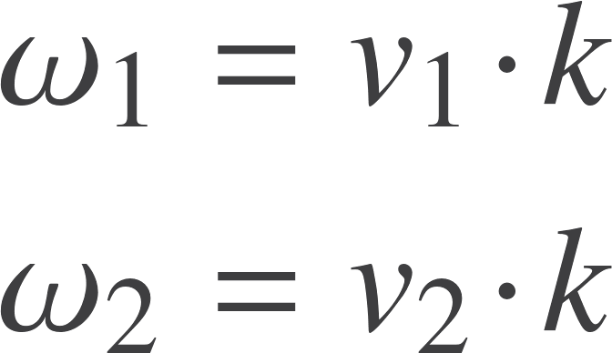

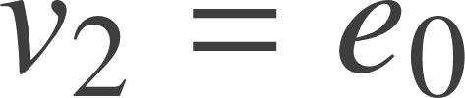
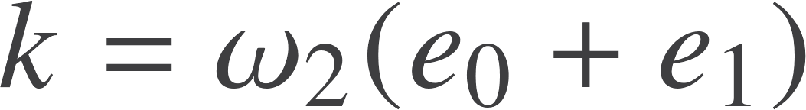

Photons and redshifts
Particle 1 emits a photon which is received by particle 2
Frequency for particle 1
Frequency for particle 2
Assume
Unique form of null vector
Particle 1 is receding
Compact expression for redshift

Slide 15
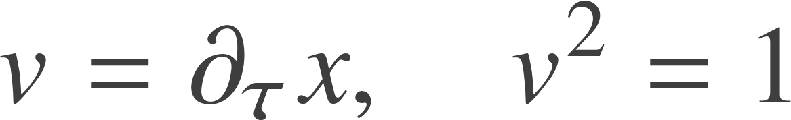

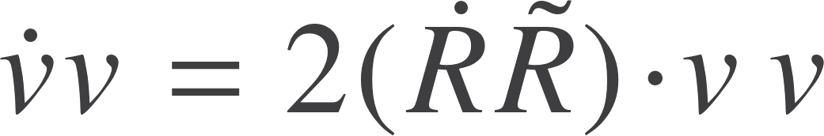

Spacetime rotor dynamics
Trajectory
Future-pointing velocity
Put the dynamics into a rotor
Define the acceleration bivector
Bivector projected into the instantaneous rest frame
Determines bivector up to a pure rotation in the IRF

Slide 16
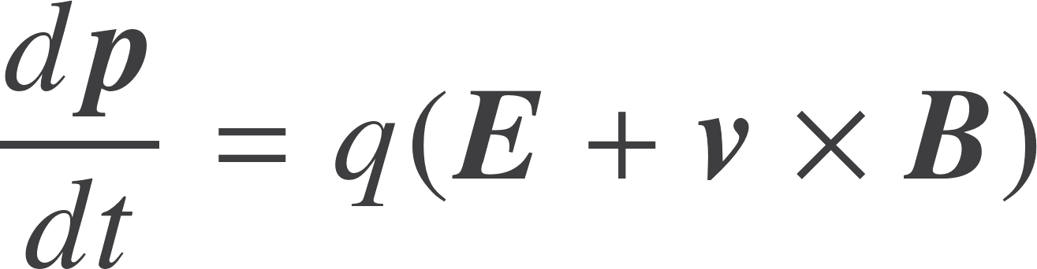



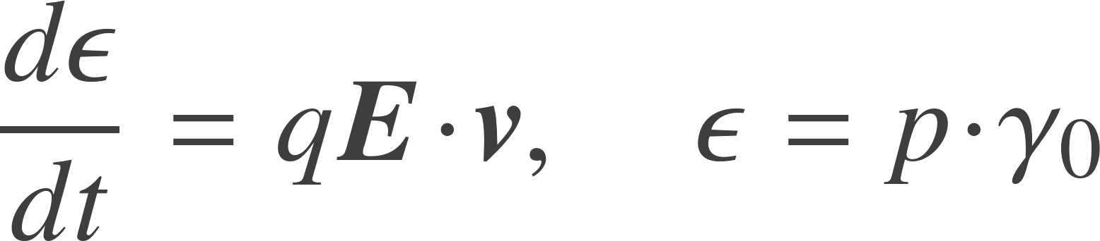
Motion in an electromagnetic field
Famous equation in 3D, using the cross product. Quantities all in some rest frame
Also have the energy equation
Now think of both E and IB as spacetime bivectors
Note, this is the GA commutator now

Slide 17
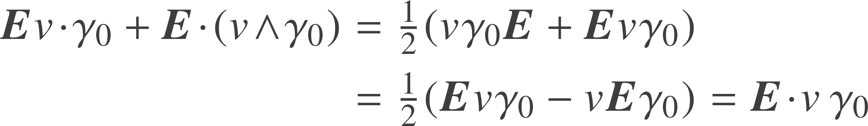
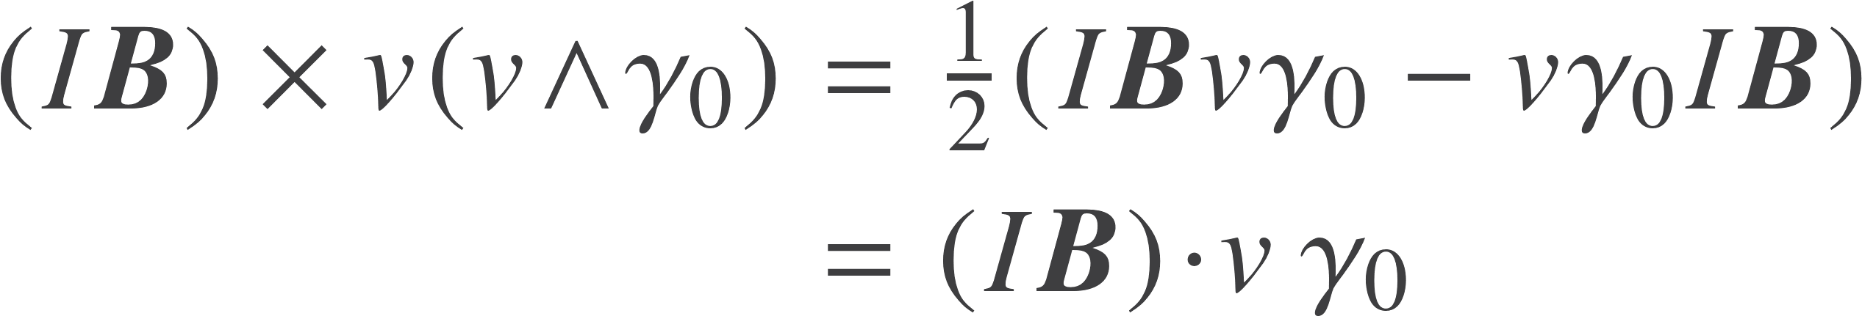

Motion in an electromagnetic field
Electric term
Magnetic term
Define the Faraday bivector
A true spacetime quantity

Slide 18


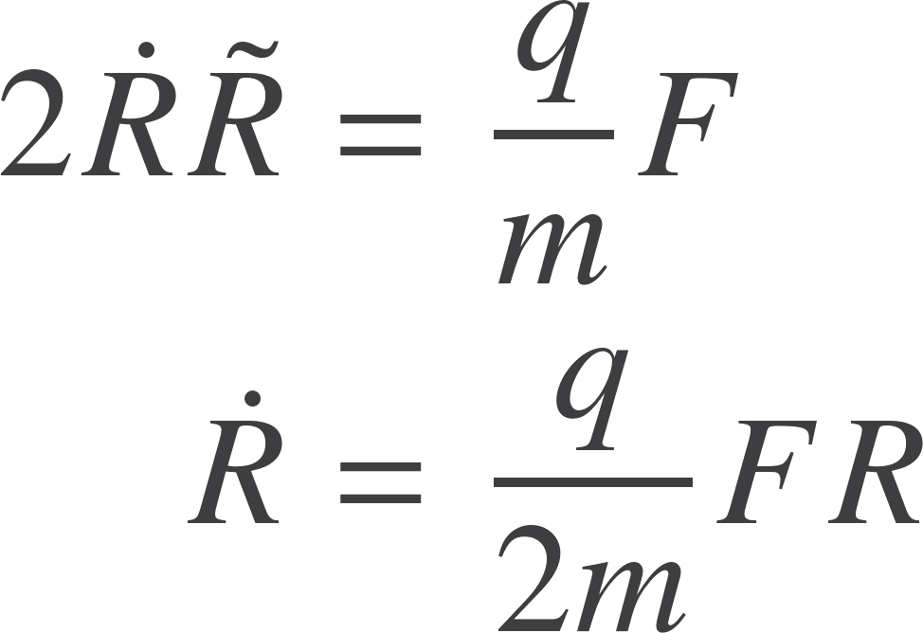

Motion in an electromagnetic field
Now have
Remove the observer dependence to get a spacetime equation
Most natural to set
A particle responds to the electric field in its instantaneous rest frame
The Lorentz force law
Acceleration bivector is
Spacetime dynamics in one simple equation!

Slide 19
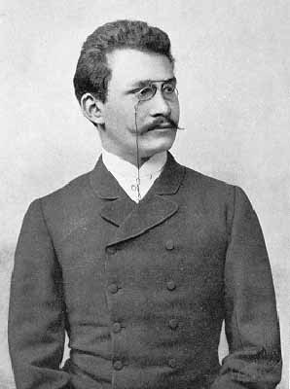
Unification
The natural form of the relativistic rotor equation for a particle in an electromagnetic field predicts a gyromagnetic ratio of 2

Slide 20

Resources
geometry.mrao.cam.ac.uk
chris.doran@arm.com
cjld1@cam.ac.uk
@chrisjldoran
#geometricalgebra
github.com/ga

