Slide 1

Geometric Algebra
6. Geometric Calculus
Dr Chris Doran
ARM Research

Slide 2
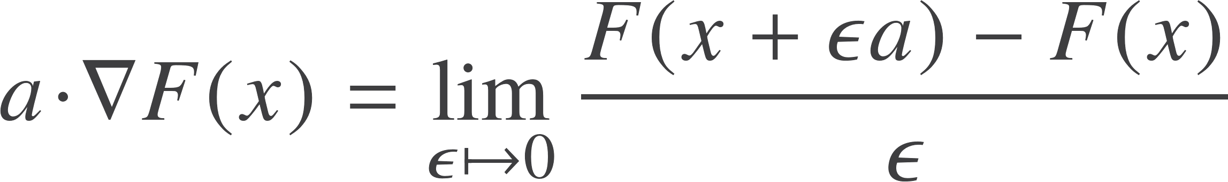
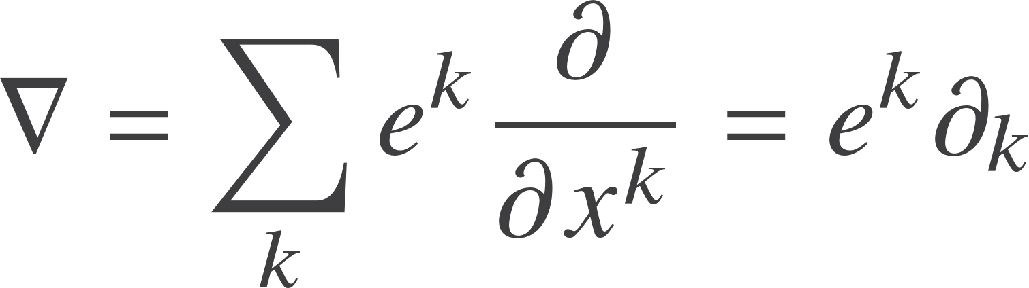
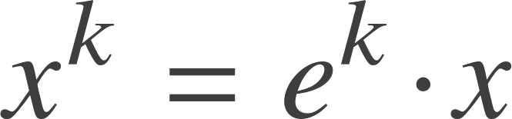
The vector derivative
Define a vector operator that returns the derivative in any given direction by
Define a set of Euclidean coordinates
This operator has the algebraic properties of a vector in a geometric algebra, combined with the properties of a differential operator.

Slide 3
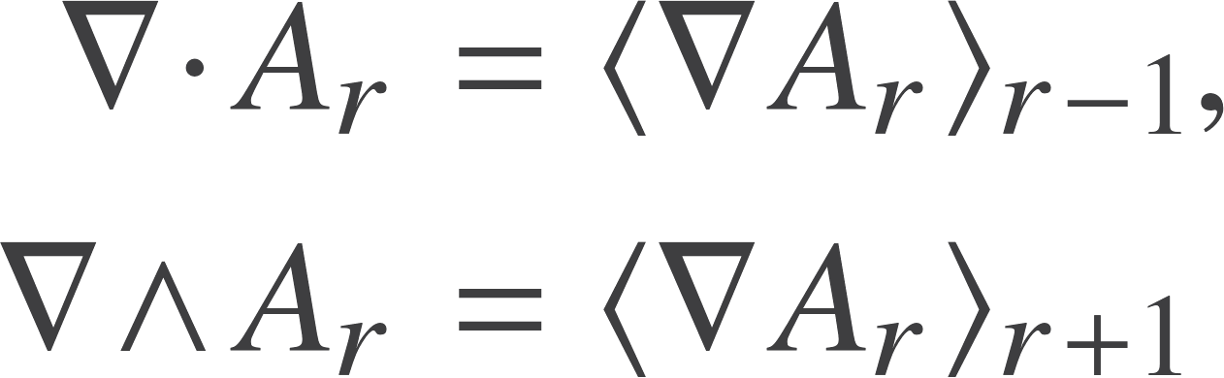



Basic Results
Extend the definition of the dot and wedge product
The exterior derivative defined by the wedge product is the d operator of differential forms
The exterior derivative applied twice gives zero
Leibniz rule
Where
Overdot notation very useful in practice
Same for inner derivative

Slide 4
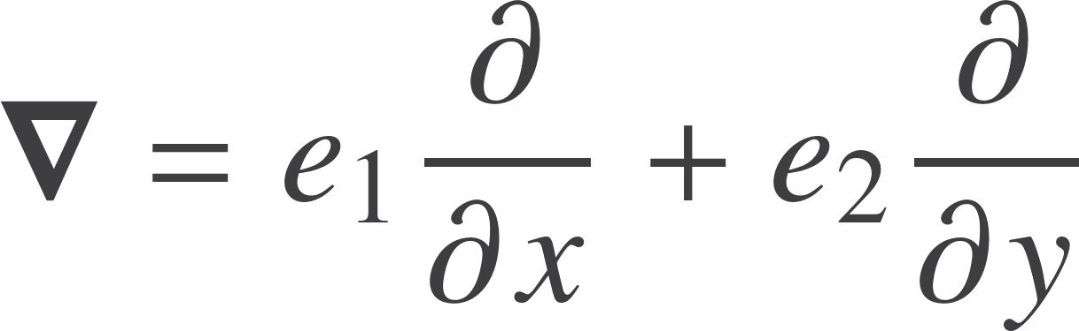



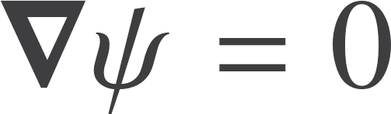
Two dimensions
Now suppose we define a ‘complex’ function
These are precisely the terms that vanish for an analytic function – the Cauchy-Riemann equations

Slide 5
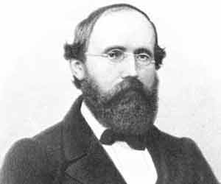
Unification
The Cauchy-Riemann equations arise naturally from the vector derivative in two dimensions.

Slide 6

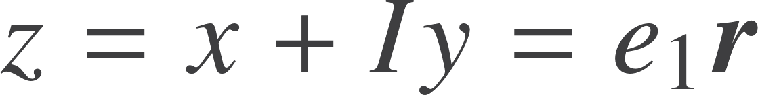
Analytic functions
Any function that can be that can be written as a function of z is analytic:
The CR equations are the same as saying a function is independent of z*.
In 2D this guarantees we are left with a function of z only
Generates of solution of the more general equation

Slide 7
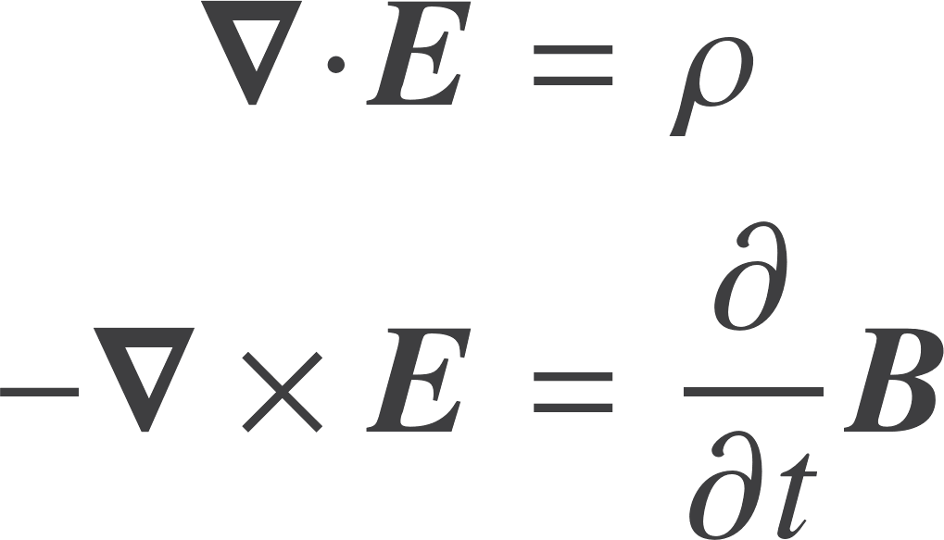
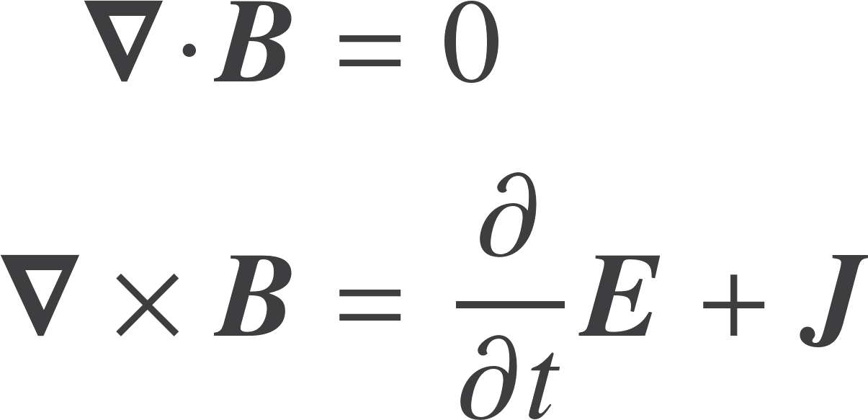
Three dimensions
Maxwell equations in vacuum around sources and currents, in natural units
Remove the curl term via
Find
All 4 of Maxwell’s equations in 1!

Slide 8
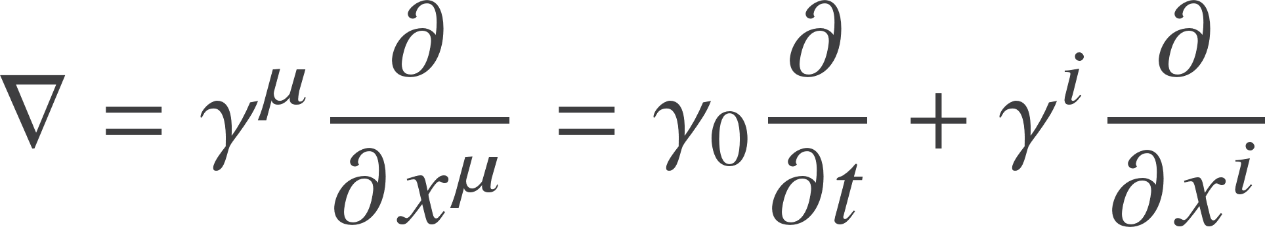



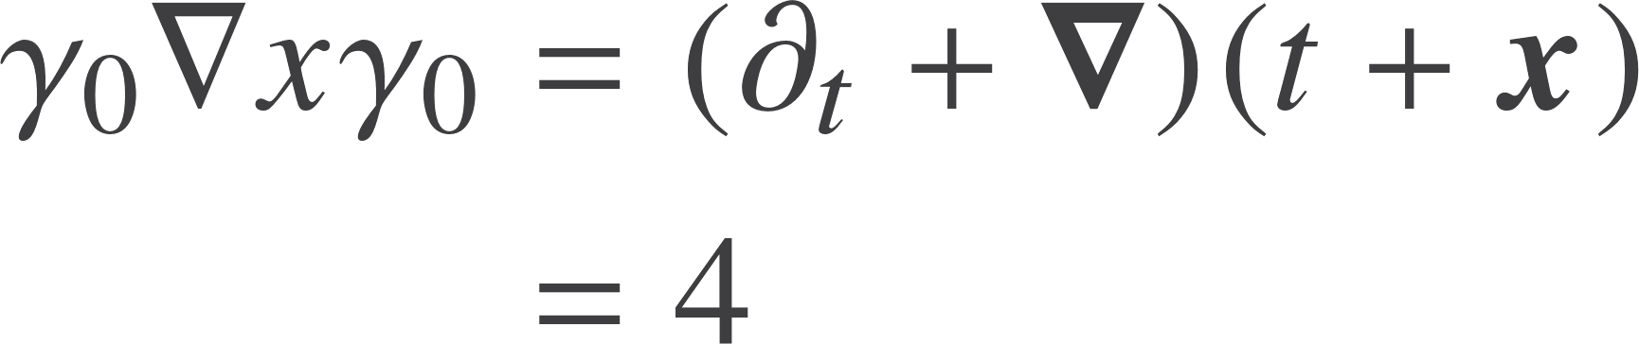

Spacetime
The key differential operator in spacetime physics
Form the relative split
Recall Faraday bivector
Or
So
So finally

Slide 9
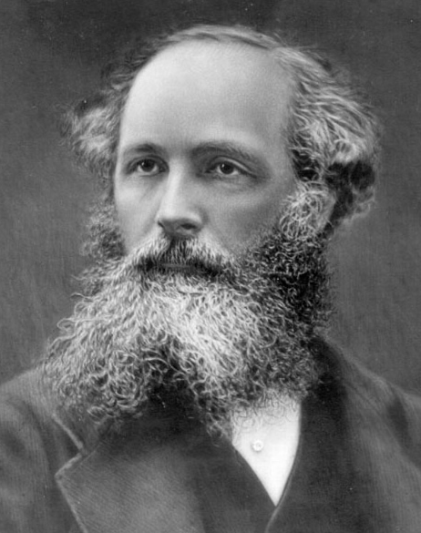
Unification
The most compact formulation of the Maxwell equations. Unifies all four equations in one.
More than some symbolic trickery. The vector derivative is an invertible operator.

Slide 10
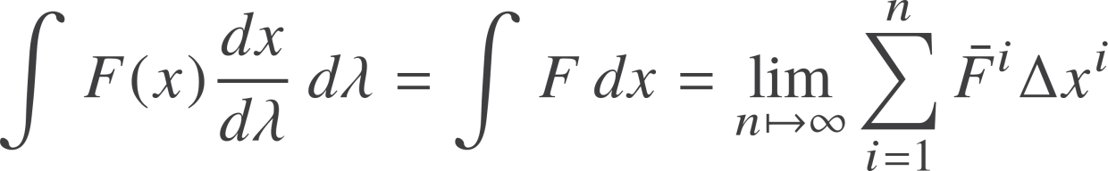

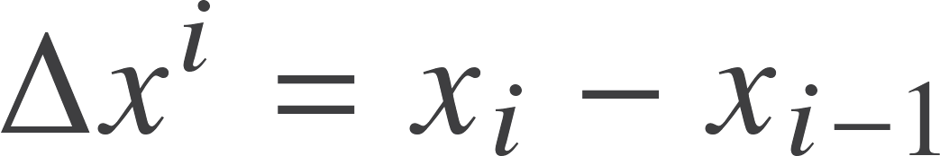
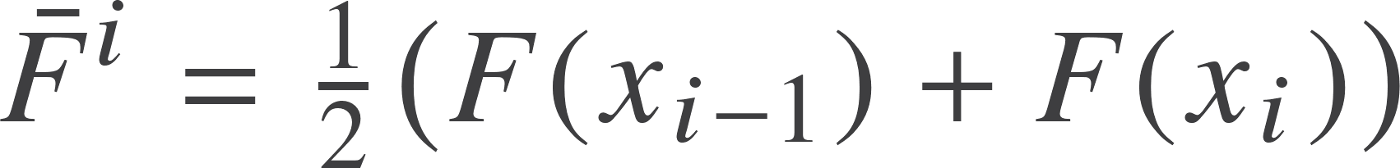
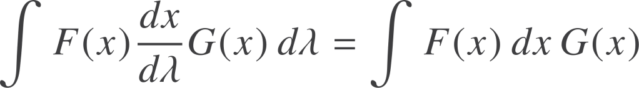

Directed integration
Start with a simple line integral along a curve
Key concept here is the vector-valued measure
More general form of line integral is

Slide 11
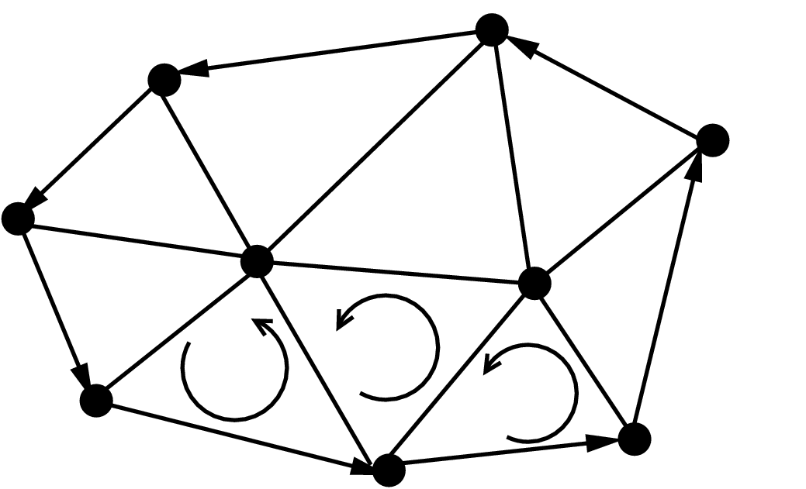
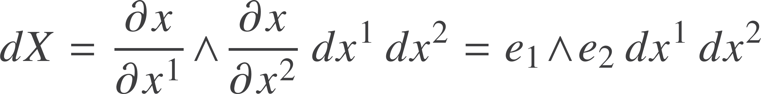
Surface integrals
Now consider a 2D surface embedded in a larger space
Directed surface element
This extends naturally to higher dimensional surfaces
The surface element is a blade
It enters integrals via the geometric product

Slide 12
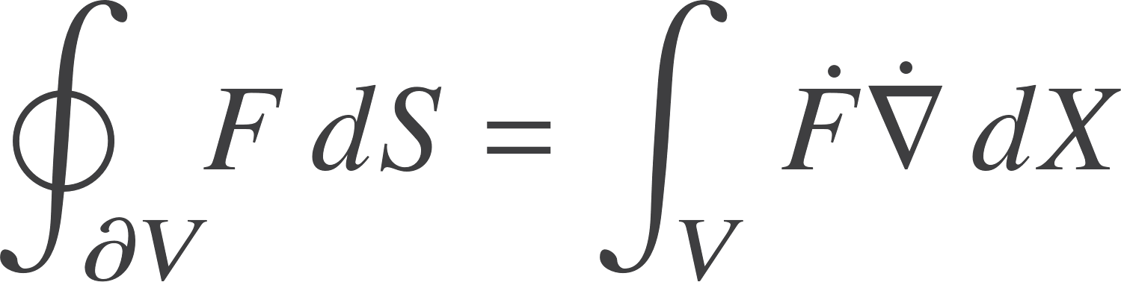
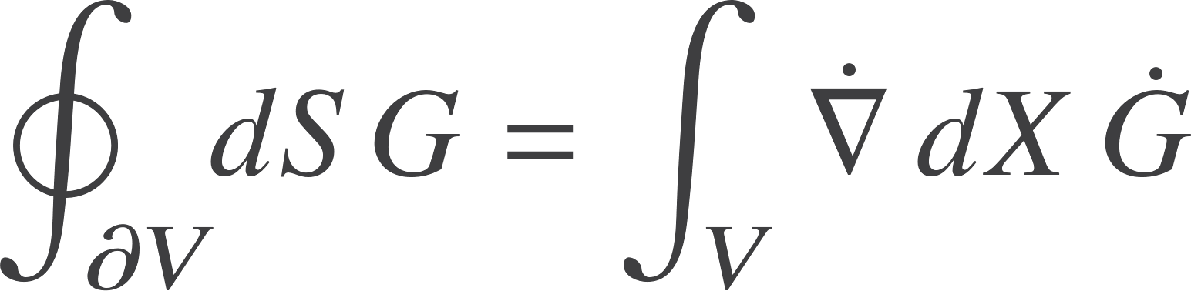

Fundamental theorem
Overdots show where the vector derivative acts
Left-sided version
Right-sided version
L is a multilinear function
General result

Slide 13
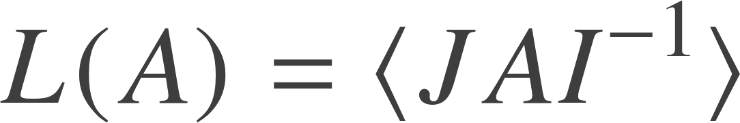
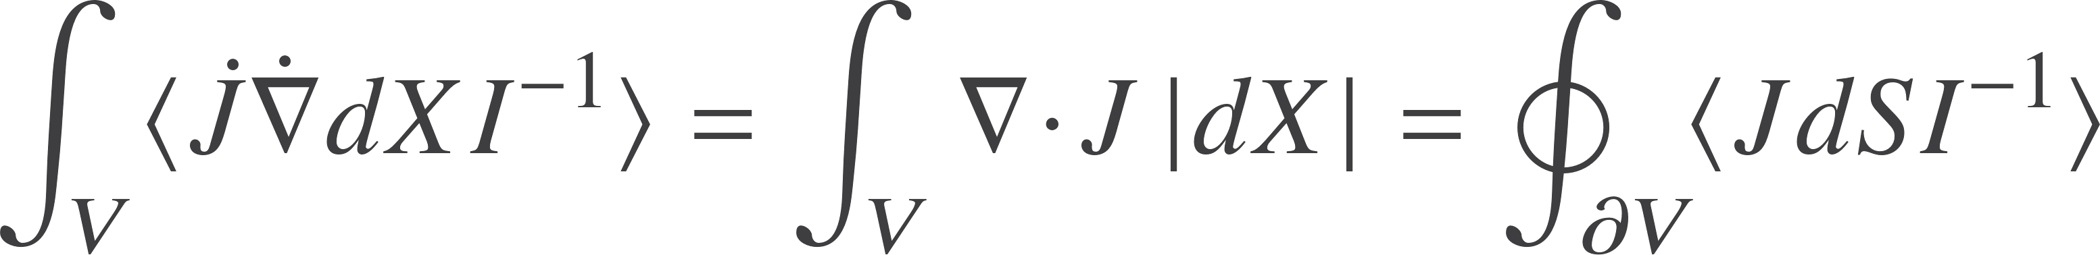
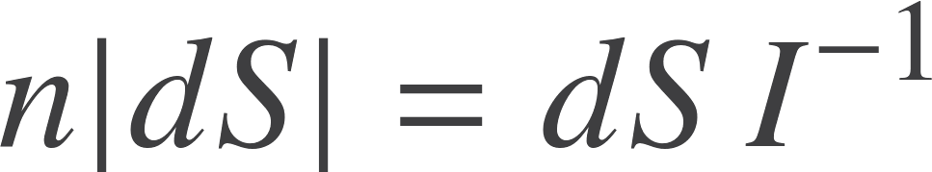

Divergence theorem
L is a scalar-valued linear function of A
Set
Vector
Grade n-1
Constant Grade n
Scalar measure
The divergence theorem

Slide 14

Cauchy integral formula
One of the most famous results in 19th century mathematics
Knowledge of an analytic function around a curve is enough to learn the value of the function at each interior point
We want to understand this in terms of Geometric Algebra
And extend it to arbitrary dimensions!

Slide 15
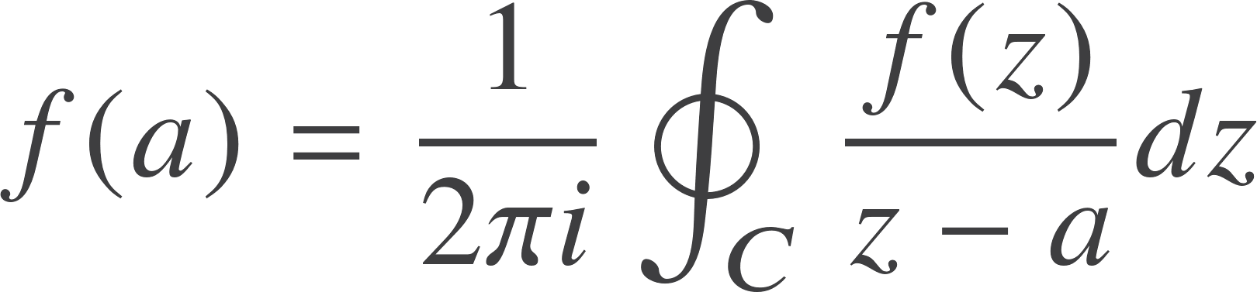
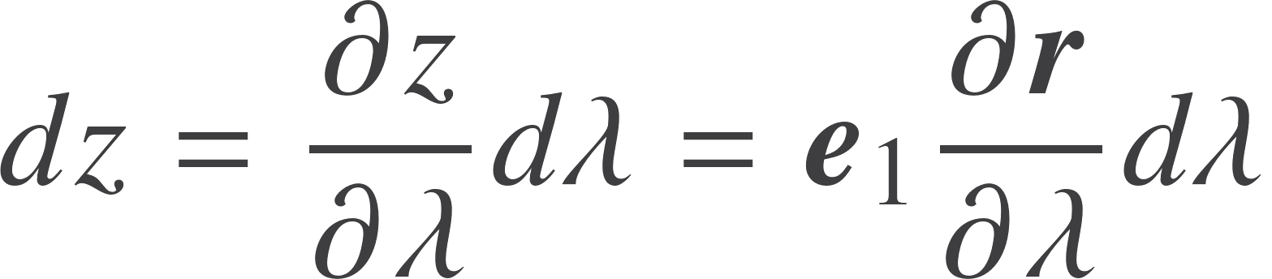


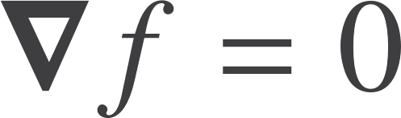
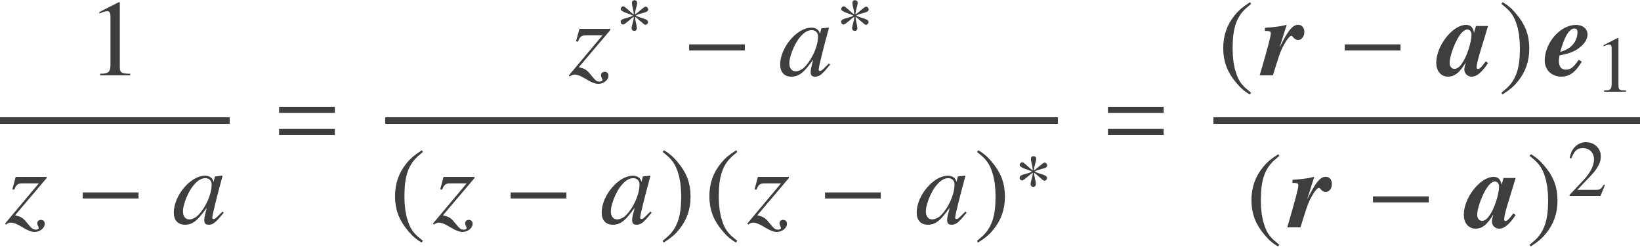
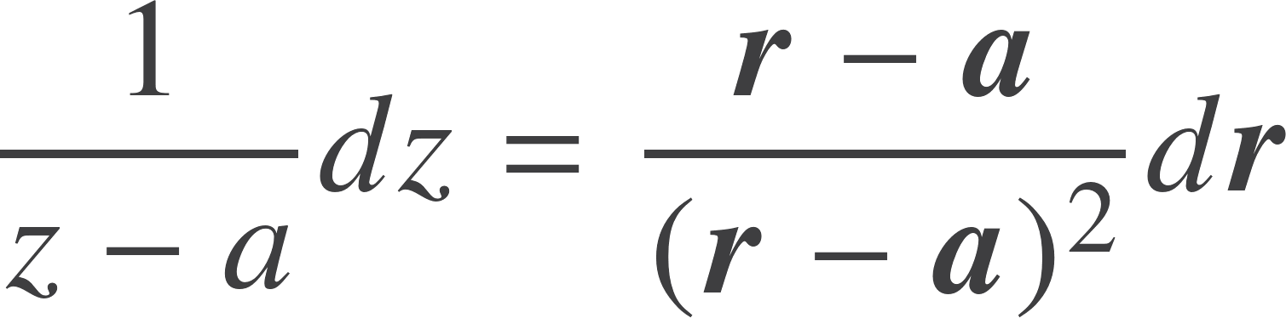
Cauchy integral formula
Translate the various terms into their GA equivalents
Find the dependence on the real axis drops out of the integrand

Slide 16
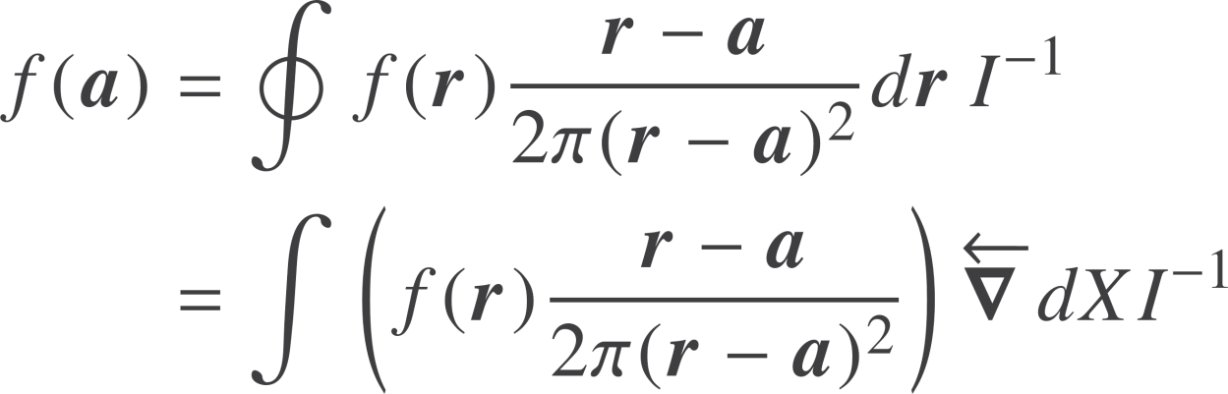

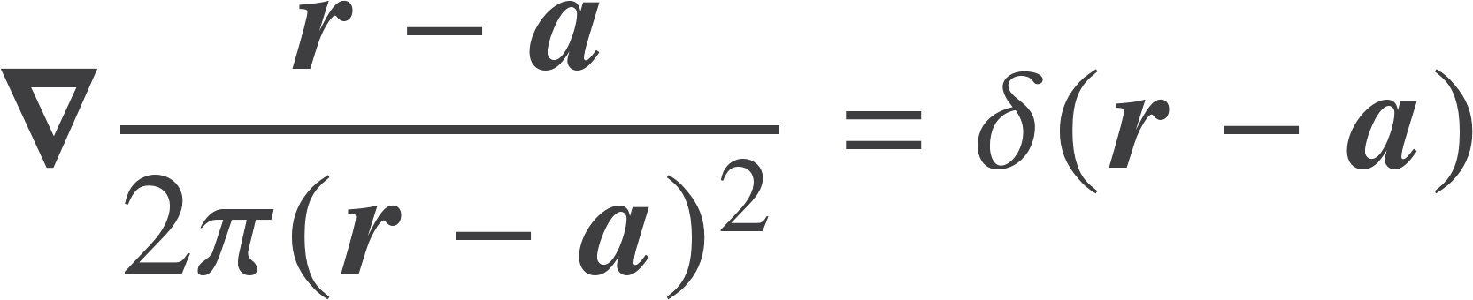

Cauchy integral formula
Applying the fundamental theorem of geometric calculus
Scalar measure
Function is analytic
The Green’s function for the vector derivative in the plane

Slide 17
Cauchy integral formula
dz encodes the tangent vector
Complex numbers give a geometric product
The integrand includes the Green’s function in 2D
The I comes from the directed volume element

Slide 18


Generalisation
This extends Cauchy’s integral formula to arbitrary dimensions

Slide 19
Unification
The Cauchy integral formula, the divergence theorem, Stoke’s theorem, Green’s theorem etc. are all special cases of the fundamental theorem of geometric calculus

Slide 20

Resources
geometry.mrao.cam.ac.uk
chris.doran@arm.com
cjld1@cam.ac.uk
@chrisjldoran
#geometricalgebra
github.com/ga

