Slide 1

Geometric Algebra
7. Implementation
Dr Chris Doran
ARM Research

Slide 2
Implementation
What is the appropriate data structure?
How do we implement the geometric product?
Symbolic computation with Maple
Programming languages

Slide 3
Large array
Type: [Float]
Vectors in 3D
Bivector in 4D
For
Against
Arrays are a hardware friendly data structure
Objects are fairly strongly typed
Do not need a separate multiplication matrix for each type
Very verbose and wasteful
Need to know the dimension of the space up front
Hard to move between dimensions
Need a separate implementation of the product for each dimension and signature

Slide 4
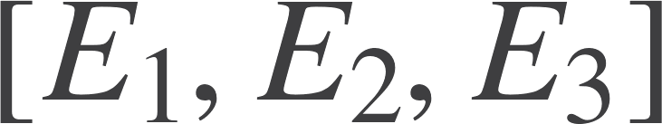
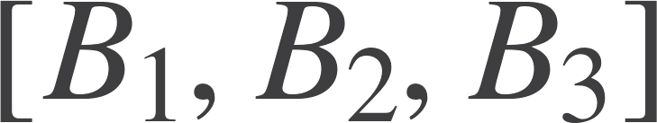
Compact array
Type: [Float]
Vectors in 3D
Bivector in 3D
For
Against
Arrays are a compact data structure – hardware friendly
Most familiar
Difficult to imagine a more compact structure
Objects are no-longer typed
Size of the space needed up front
Hard to move between dimensions
Separate implementation of the product for each dimension, signature and grade
Sum of different grades?

Slide 5
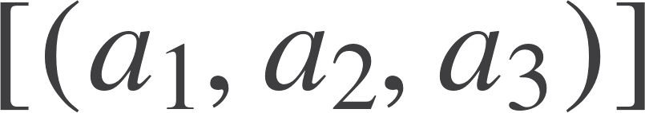
Intrinsic Representation
Vectors in 3D
As a sum of blades
a1*e[1]+a2*e[2]+a3*e[3]
For
Against
Strongly typed
Dense
Only need to know how to multiply blade elements together
Multiplication is a map operator
Don’t need to know dimension of space…
Relying on typography to encode blades, etc.
Still need to compile down to a more basic structure
Need a way to calculate basis blade products

Slide 6

Symbolic algebra
Range of Symbolic Algebra packages are available:
Maple
Mathematica
Maxima
SymPy
A good GA implementation for Maple has existed for 20 years:
http://geometry.mrao.cam.ac.uk/2016/11/symbolic-algebra-and-ga/
SA (Euclidean space)
STA (Spacetime algebra)
MSTA (Multiparticle STA)
Default (e[i] has positive norm, and e[-i] has negative norm)
Multivectors are built up symbolically or numerically
Great for complex algebraic work (gauge theory gravity)

Slide 7
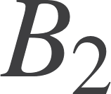




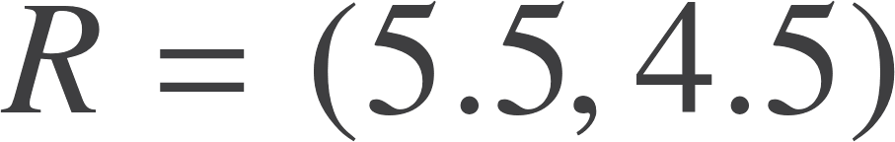
Examples
Intersection of two lines
res = 11*e[1]+9*e[2]+2*e[3]
Case of parallel lines
res = -e[1]

Slide 8
Examples
vderiv2 := proc(mvin)
local tx, ty, res;
tx := diff(mvin,x);
ty := diff(mvin,y);
res := e[1]&@tx + e[2]&@ty;
end:
Maple procedure for 2d vector derivative for multivector function of x and y
Boosting a null vector:
n := e[0] + e[1];
res := psi&@nn&@reverse(psi)
4*e[0]+4*e[1]

Slide 9
GA Code
Want a representation where:
Multivectors are encoded as dense lists
We carry round the blade and coefficient together (in a tuple)
We have a geometric product and a projection operator
The geometric product works on the individual blades
Ideally, do not multiply coefficients when result is not needed
All expressed in a functional programming language

Slide 10
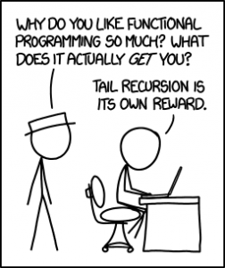
Why Haskell?
Functional
Functions are first-class citizens
The can be passed around like variables
Output of a function can be a function
Gives rise to the idea of higher-order functions
Functional languages are currently generating considerable interest:
Haskell, Scala, ML, Ocaml, F#
Immutable data
(Nearly) all data is immutable: never change a variable
Always create a new variable, then let garbage collector free up memory
No messing around with pointers!
Linked lists are the natural data type

Slide 11
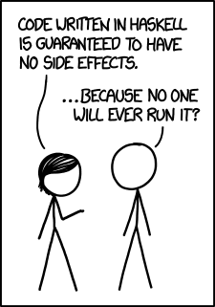
Why Haskell?
Purity
Functions are pure
Always return same output for same input
No side-effects
Natural match for scientific computing
Evaluations are thread-safe
Strong typing
Haskell is strongly typed, and statically typed
All code is checked for type integrity before compilation
A lot of bugs are caught this way!
Strongly typed multivectors can remove ambiguity
Are 4 numbers a quaternion?
or a projective vector …

Slide 12


Why Haskell?
Recursion
Recursive definition of functions is compact and elegant
Supported by powerful pattern matching
Natural to mathematicians
Laziness
Haskell employs lazy evaluation – call by need
Avoids redundant computation
Good match for GA
Higher-level code
GA is a higher-level language for mathematics
High-level code that is clear, fast and many-core friendly
Code precisely mirrors the mathematics
“Programming in GA”
learnyouahaskell.com
haskell.org/platform
wiki.haskell.org

Slide 13
Bit vector representation of blades
Details depend on whether you want to use mixed signature space
Best to stay as general as possible
Blade | Bit vector | Integer
1 | 0 | 0
e1 | 1 | 1
f1 | 01 | 2
e2 | 001 | 4
f2 | 0001 | 8
e1f1 | 11 | 3
e1e2 | 101 | 5
Geometric product is an xorr operation
Careful with typographical ordering here!
Have to take care of sign in geometric product
(Num a, Integral n) => (n,a)

Slide 14
Linked list
Type: [(Int,Float)] or [(Blade)]
Vectors in 3D
As an ordered list
(1,a1):(2,a2):(8,a3):[]
For
Against
Strongly typed
Dense
Only need to know how to multiply blade elements together
Multiplication is a map operator
Don’t need to know dimension of space…
Linked-lists are not always optimal
Depends how good the compiler is at managing lists in the cache
May need a look-up table to store blade products (though this is not always optimal)

Slide 15
Conversion functions
int2bin :: (Integral n) => n -> [Int]
int2bin 0 = [0]
int2bin 1 = [1]
int2bin n
| even n = 0: int2bin (n `div` 2)
| otherwise = 1: int2bin ((n-1) `div` 2)
bin2int :: (Integral n) => [Int] -> n
bin2int [0] = 0
bin2int [1] = 1
bin2int (x:xs)
| x ==0 = 2 * (bin2int xs)
| otherwise = 1 + 2 * (bin2int xs)
Note the recursive definition of these functions
A typical idiom in Haskell (and other FP languages)
These are other way round to typical binary

Slide 16
Currying
bladeGrade :: (Integral n) => n -> Int
bladeGrade = sum.int2bin
g :: (a,b) -> c
f :: a -> b -> c
f :: a-> (b -> c)
Suppress the argument in the function definition.
Haskell employs ‘currying’ – everything is a function with 1 variable.
Functions with more than one variable are broken down into functions that return functions
f takes in an argument and returns a new function

Slide 17
Blade product
bladeProd (n,a) (m,b) = (r,x)
where (r,fn) = bldProd n m
x = fn (a*b)
The bldProd function must (in current implementation)
Convert integers to bitvector rep
Compute the xorr and convert back to base 10
Add up number of sign changes from anticommutation
Add up number of sign changes from signature
Compute overall sign and return this
Can all be put into a LUT
Or use memoization
Candidate for hardware acceleration

Slide 18
Blade Product
bldProd :: (Integral n, Num a) => n -> n -> (n, a->a)
bldProd n m = ((bin2int (resBld nb mb)),fn)
where nb = int2bin n
mb = int2bin m
tmp = ((countSwap nb mb) + (countNeg nb mb)) `mod` 2
fn = if tmp == 0 then id else negate
Returns a function in second slot
Counts the number of swaps to bring things into normal order
Counts number of negative norm vectors that are squared

Slide 19

Geometric product
[Blades]
[Blades]
A*B=simplify([bladeprod(a,b) | a <- A, b <- B])
Form every combination of product from the two lists
Sort by grade and then integer order
Combine common entries
Build up everything from
Multivector product
Projection onto grade
Reverse
Use * for multivector product

Slide 20
Abstract Data Type
newtype Multivector n a = Mv [(n,a)]
mv :: (Num a, Eq a) => [(a,String)] -> Multivector Int a
mv xs = Mv (bladeListSimp (sortBy bladeComp (map blade xs)))
longMv :: (Num a, Eq a) => [(a,String)] -> Multivector Integer a
longMv xs = Mv (bladeListSimp (sortBy bladeComp (map blade xs)))
Type class restrictions are put into the constructors.
Two constructors to allow for larger spaces (Int may only go up to 32D)

Slide 21
Class Membership
Want to belong to Num class
instance (Integral n, Num a, Eq a) => Num (Multivector n a) where
(Mv xs) * (Mv ys) = Mv (bladeListProduct xs ys)
(Mv xs) + (Mv ys) = Mv (bladeListAdd xs ys)
fromInteger n = Mv [(0,fromInteger n)]
negate (Mv xs) = Mv (bldListNegate xs)
abs (Mv xs) = Mv xs
signum (Mv xs) = Mv xs
Can now use + and * the way we would naturally like to!

Slide 22
Other resources (GA wikipedia page)
GA Viewer Fontijne, Dorst, Bouma & Mann
http://www.geometricalgebra.net/downloads.html
Gaigen Fontijne. For programmers, this is a code generator with support for C, C++, C# and Java.
http://www.geometricalgebra.net/new.html
Gaalop Gaalop (Geometic Algebra Algorithms Optimizer) is a software to optimize geometric algebra files.
http://www.gaalop.de/
Versor, by Colapinto. A lightweight templated C++ Library with an OpenGL interface
http://versor.mat.ucsb.edu/

Slide 23

Resources
geometry.mrao.cam.ac.uk
chris.doran@arm.com
cjld1@cam.ac.uk
@chrisjldoran
#geometricalgebra
github.com/ga

