Slide 1

Geometric Algebra
8. Conformal Geometric Algebra
Dr Chris Doran
ARM Research

Slide 2
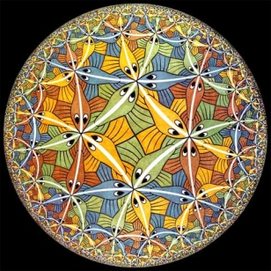
Motivation
Projective geometry showed that there is considerable value in treating points as vectors
Key to this is a homogeneous viewpoint where scaling does not change the geometric meaning attached to an object
We would also like to have a direct interpretation for the inner product of two vectors
This would be the distance between points
Can we satisfy all of these demands in one algebra?

Slide 3
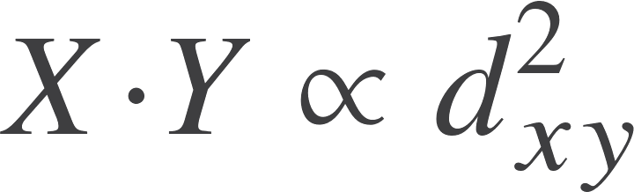
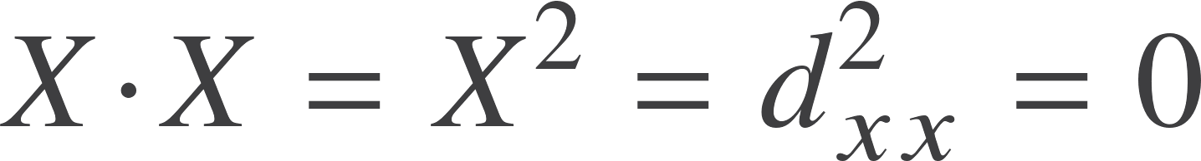
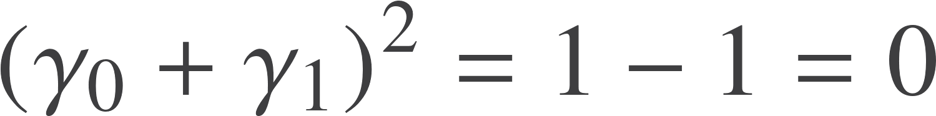

Inner product and distance
Suppose X and Y represent points
Would like
Quadratic on grounds of units
Immediate consequence:
Represent points with null vectors
Borrow this idea from relativity
Key idea was missed in 19th century
Also need to consider homogeneity
Idea from projective geometry is to introduce a point at infinity:

Slide 4
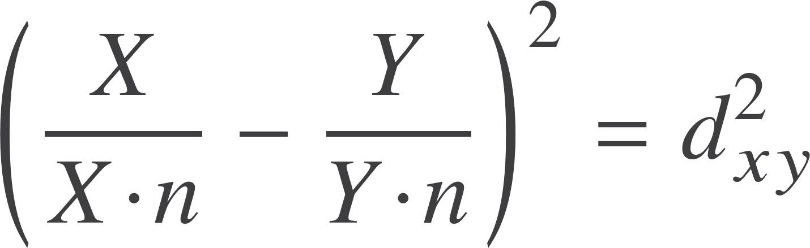
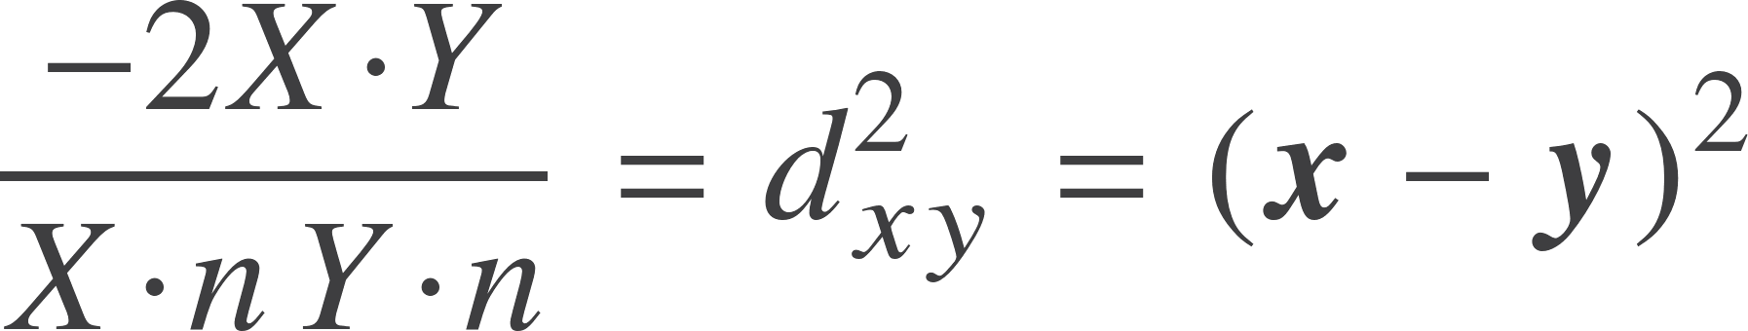

Inner product and distance
Natural Euclidean definition is
But both X and Y are null, so
As an obvious check, look at the distance to the point at infinity
We have a concept of distance in a homogeneous representation
Need to see if this matches our Euclidean concept of distance.

Slide 5
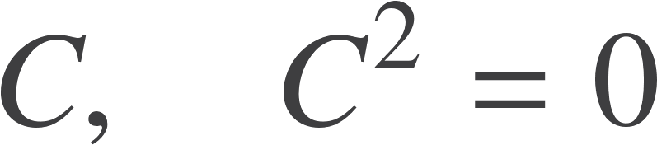
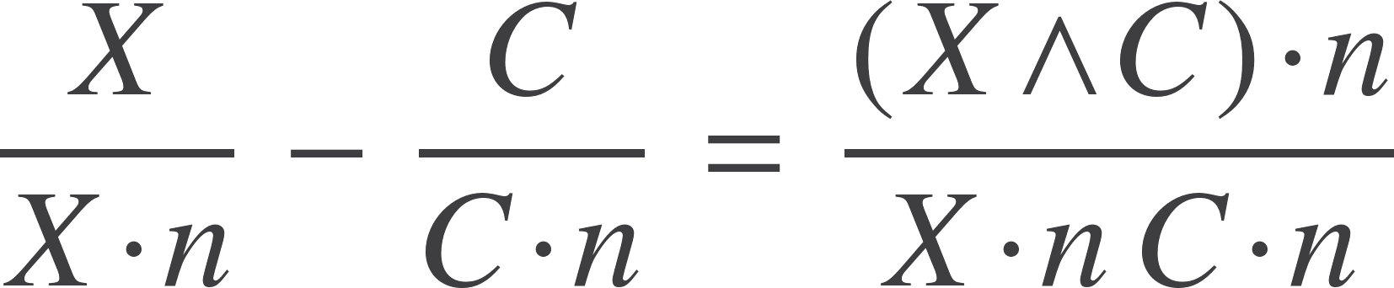
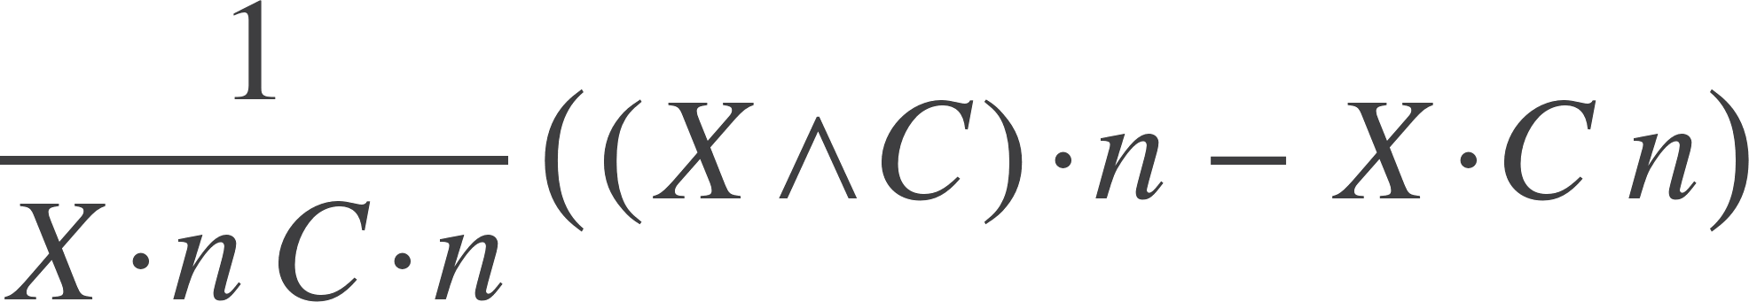

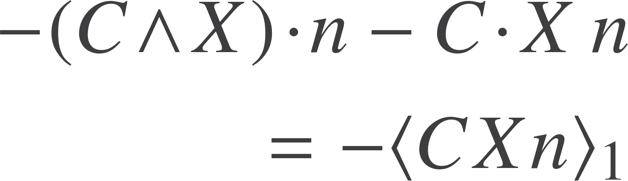
Origin and coordinates
Pick out a preferred point to represent the origin
Look at the displacement vector
Would like a basis vector containing this, but orthogonal to C
Add back in some amount of n
Get this as our basis vector:

Slide 6
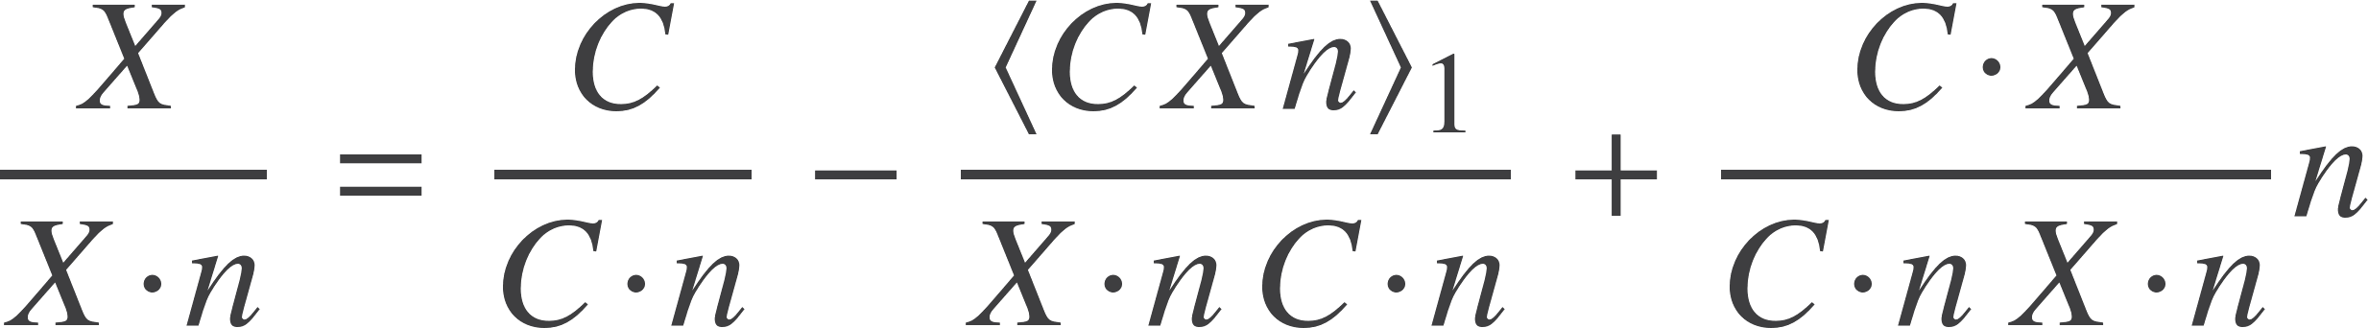
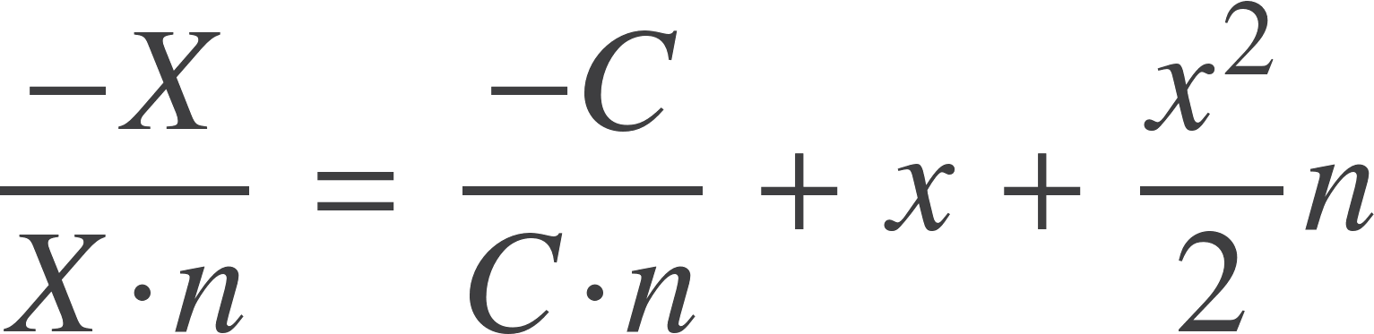

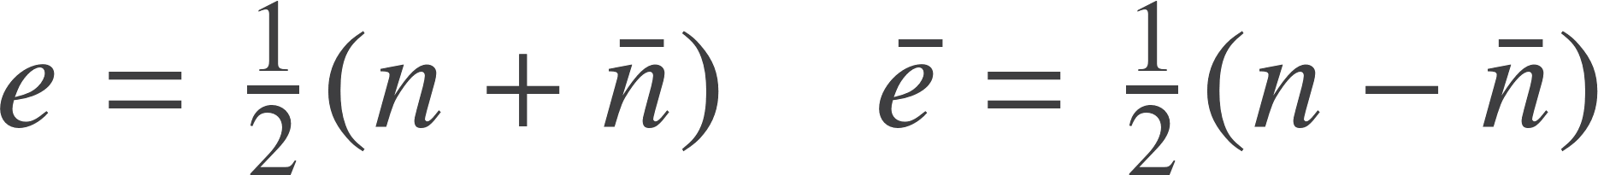

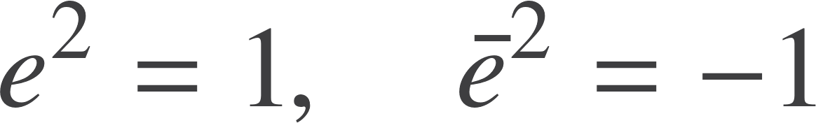
Origin and coordinates
Now have
Write as
is negative
Euclidean vector from origin
Historical convention is to write

Slide 7
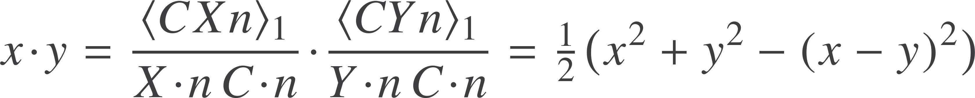

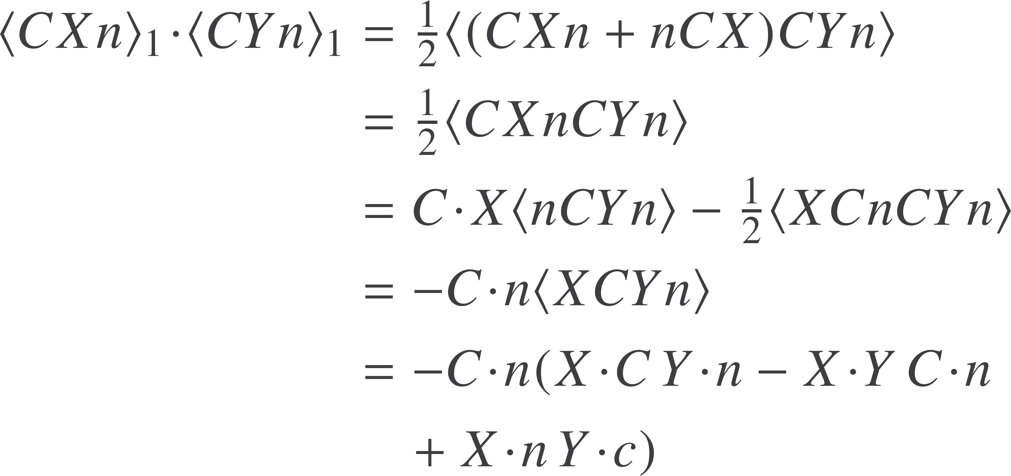
Is this Euclidean geometry?
Look at the inner product of two Euclidean vectors
Checks out as we require
The inner product is the standard Euclidean inner product
Can introduce an orthonormal basis

Slide 8



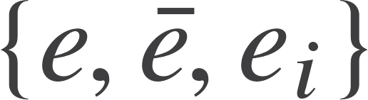

Summary of idea
Represent the Euclidean point x by null vectors
Distance is given by the inner product
Normalised form has
Basis vectors are
Null vectors

Slide 9
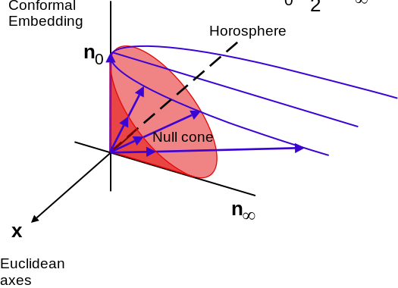





1D conformal GA
Basis algebra is
NB pseudoscalar squares to +1
Simple example in 1D

Slide 10



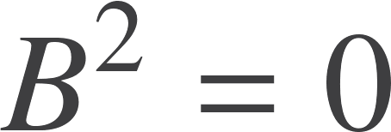
Transformations
Any rotor that leaves n invariant must leave distance invariant
Rotations around the origin work simply
Remaining generators that commute with n are of the form

Slide 11
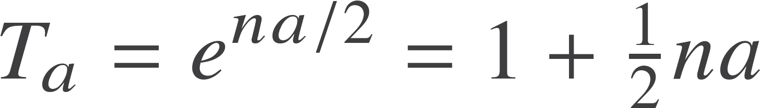
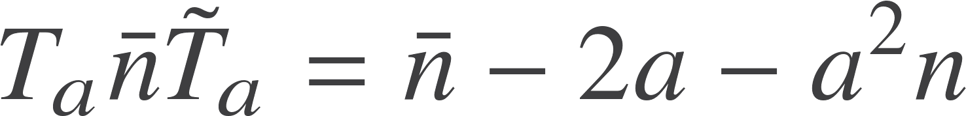

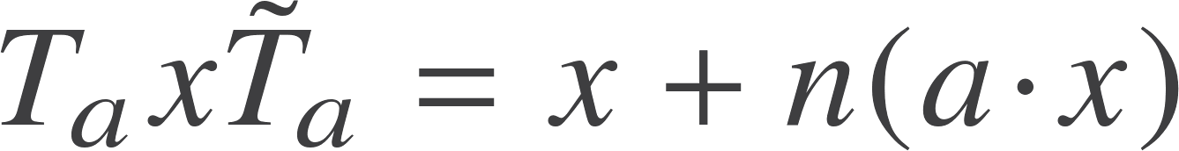
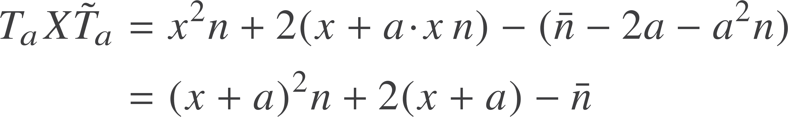
Null generators
Taylor series terminates after two terms
Since
Conformal representation of the translated point

Slide 12
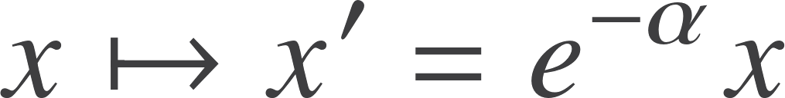


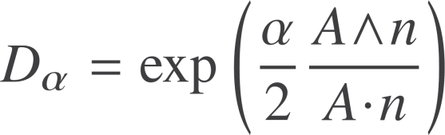

Dilations
Suppose we want to dilate about the origin
Have
Generate this part via a rotor, then use homogeneity
To dilate about an arbitrary point replace origin with conformal representation of the point
Define
Rotor to perform a dilation

Slide 13
Unification
In conformal geometric algebra we can use rotors to perform translations and dilations, as well as rotations
Results proved at one point can be translated and rotated to any point

Slide 14
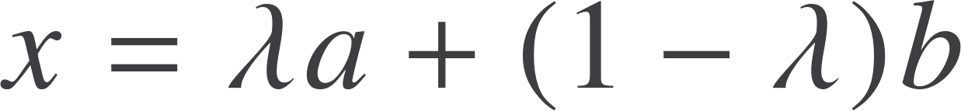
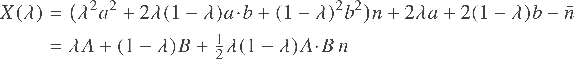
Geometric primitives
Find that bivectors don’t represent lines. They represent point pairs.
Look at
Point a
Point b
Point at infinity
Points along the line satisfy
This is the line

Slide 15
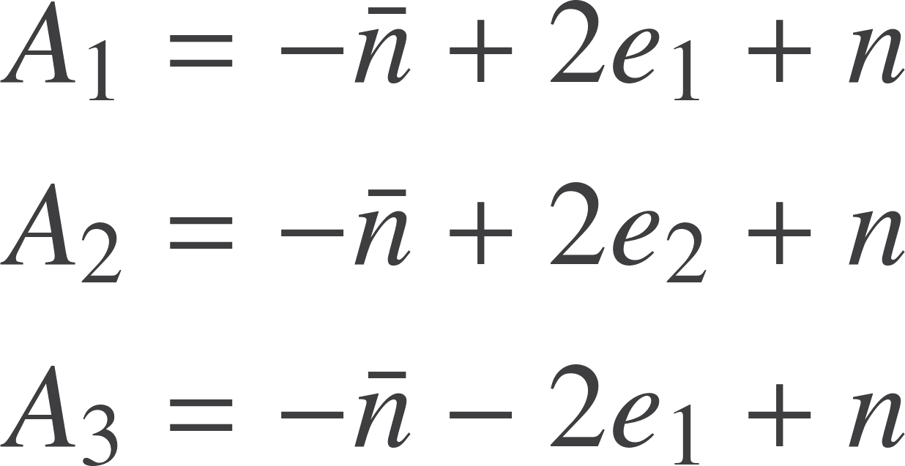
Lines as trivectors
Suppose we took any three points, do we still get a line?
Need null vectors in this space
Up to scale find
The outer product of 3 points represents the circle through all 3 points.
Lines are special cases of circles where the circle include the point at infinity

Slide 16
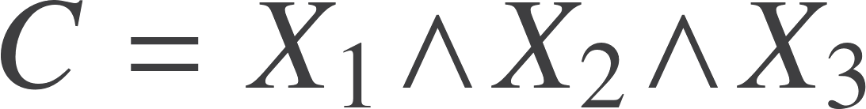

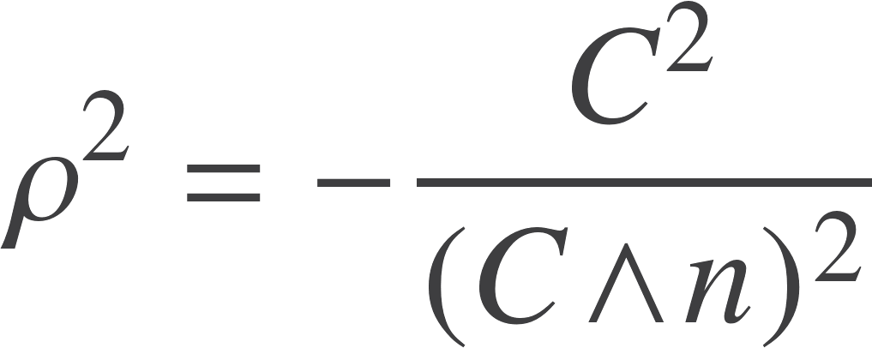



Circles
Everything in the conformal GA is oriented
Objects can be rescaled, but you mustn’t change their sign!
Important for intersection tests
Radius from magnitude.
Metric quantities in homogenous framework
If the three points lie in a line then
Lines are circles with infinite radius
All related to inversive geometry

Slide 17




4-vectors
4 points define a sphere or a plane
If the points are co-planar find
So P is a plane iff
Unit sphere is
Radius of the sphere is
Note if L is a line and A is a point, the plane formed by the line and the point is

Slide 18
5D representation of 3D space
Object | Grade | Dimension | Interpretation
Scalar | 0 | 1 | Scalar values
Vector | 1 | 5 | Points (null), dual to spheres and planes.
Bivector | 2 | 10 | Point pairs, generators of Euclidean transformations, dilations.
Trivectors | 3 | 10 | Lines and circles
4-vectors | 4 | 5 | Planes and spheres
Pseudoscalar | 5 | 1 | Volume factor, duality generators

Slide 19
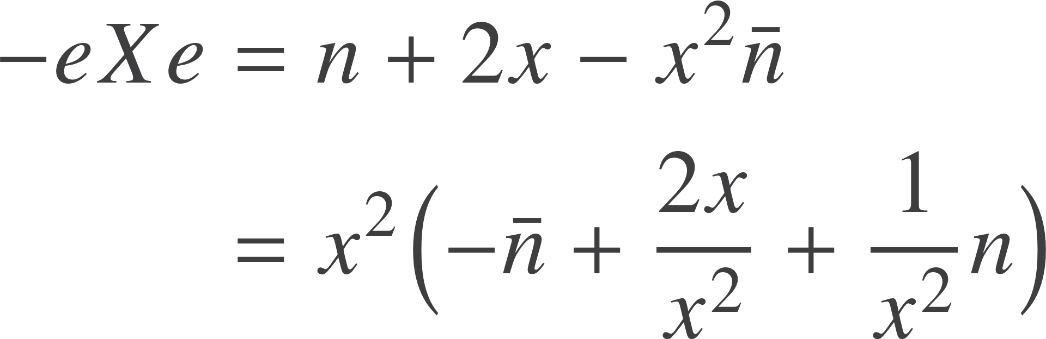

Angles and inversion
Angle between two lines that meet at a point or point pair
Reflect the conformal vector in e
Works for straight lines and circles!
All rotors leave angles invariant – generate the conformal group
The is the result of inverting space in the origin.
Can translate to invert about any point – conformal transformations

Slide 20
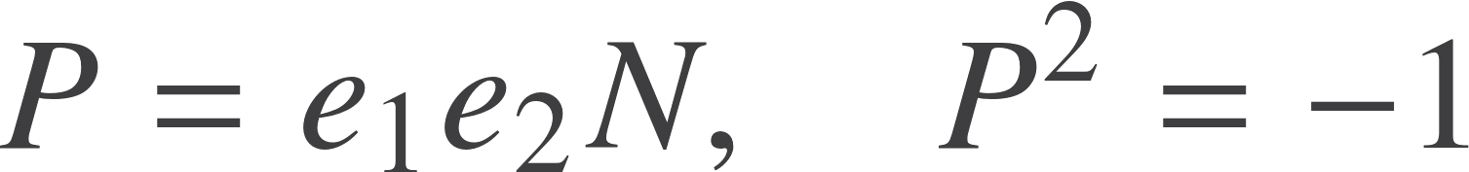





Reflection
1-2 plane is represented by
In the plane
Out of the plane
So if L is a line through the origin
The reflected line is
But we can translate this result around and the formula does not change
Reflects any line in any plane, without finding the point of intersection

Slide 21
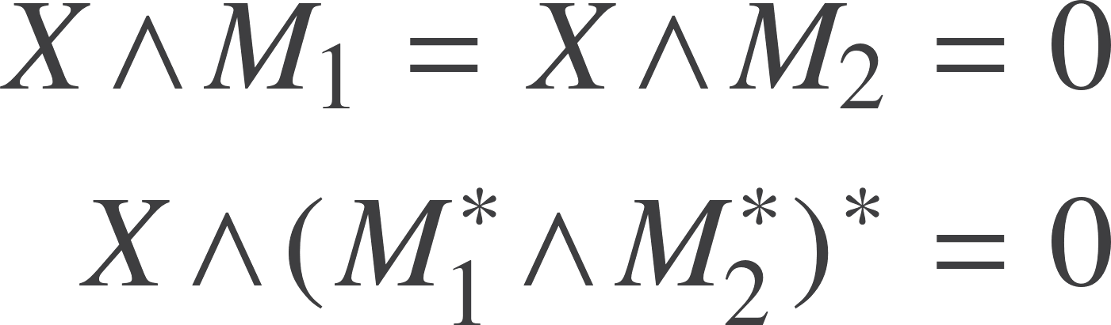
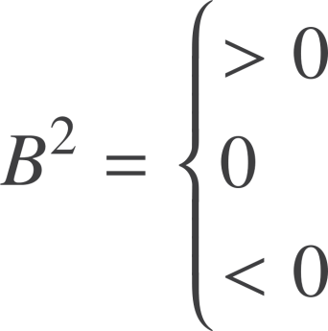
Intersection
Use same idea of the meet operator
Duality still provided by the appropriate pseudoscalar (technically needs the join)
Example – 2 lines in a plane
2 points of intersection
1 point of intersection
0 points of intersection

Slide 22
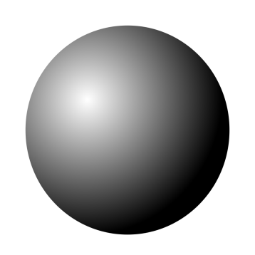

Intersection
Circle / line and sphere / plane
2 points of intersection
1 point of intersection
0 points of intersection
All cases covered in a single application of the geometric product
Orientation tracks which point intersects on way in and way out
In line / plane case, one of the points is at infinity

Slide 23
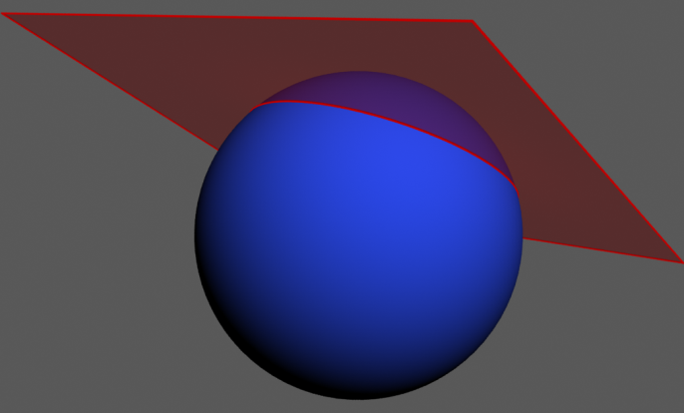
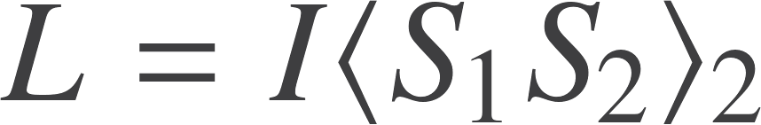
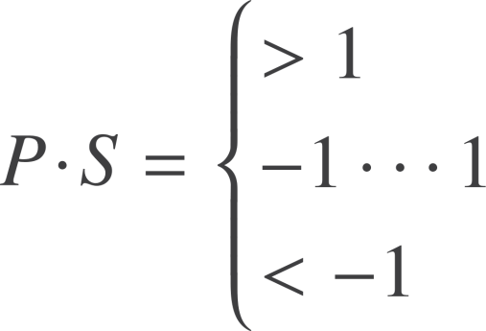
Intersection
Plane / sphere and a plane / sphere intersect in a line or circle
Norm of L determines whether or not it exists.
If we normalise a plane P and sphere S to -1 can also test for intersection
Sphere above plane
Sphere and plane intersect
Sphere below plane

Slide 24

Resources
geometry.mrao.cam.ac.uk
chris.doran@arm.com
cjld1@cam.ac.uk
@chrisjldoran
#geometricalgebra
github.com/ga

