Slide 1

Geometric Algebra
9. Unification
Dr Chris Doran
ARM Research

Slide 2


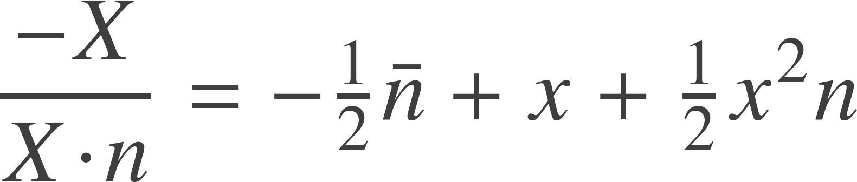
Euclidean geometry
Represent the Euclidean point x by null vectors
Distance is given by the inner product
Read off the Euclidean vector
Depends on the concept of the origin

Slide 3
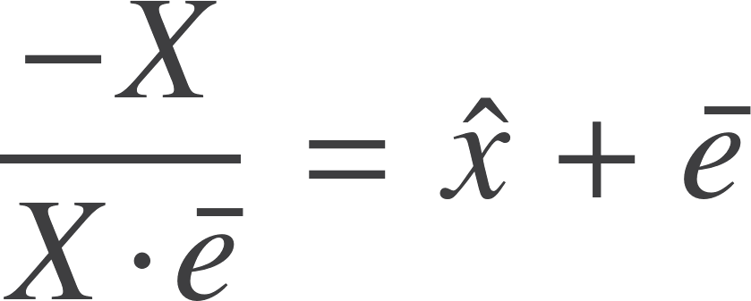
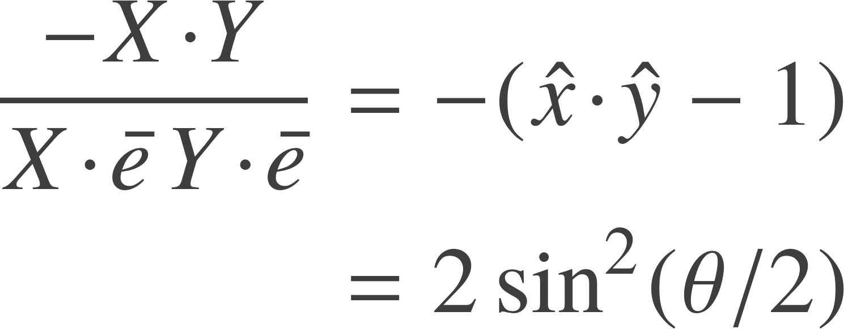
Spherical geometry
Suppose instead we form
Unit vector in an n+1 dimensional space
Instead of plotting points in Euclidean space, we can plot them on a sphere
No need to pick out a preferred origin any more

Slide 4
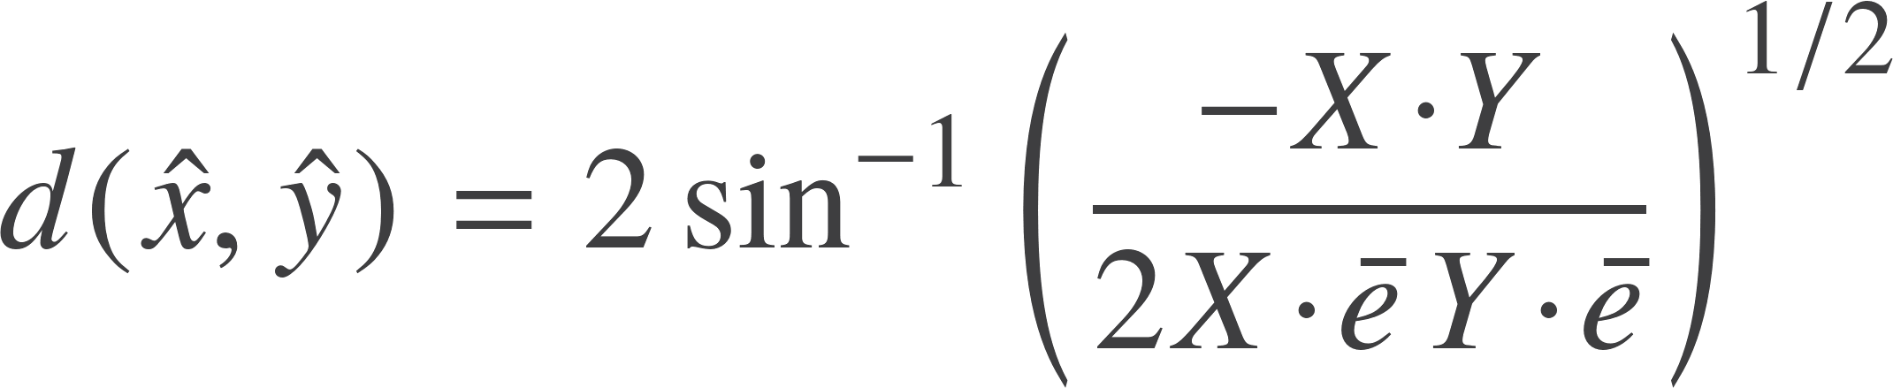




Spherical geometry
Spherical distance
Same pattern as Euclidean case
‘Straight’ lines are now
Invariance group are the set of rotors satisfying
Generators satisfy
The term now becomes essentially redundant and drops out of calculations
Left with standard rotors in a Euclidean space. Just rotate the unit sphere

Slide 5
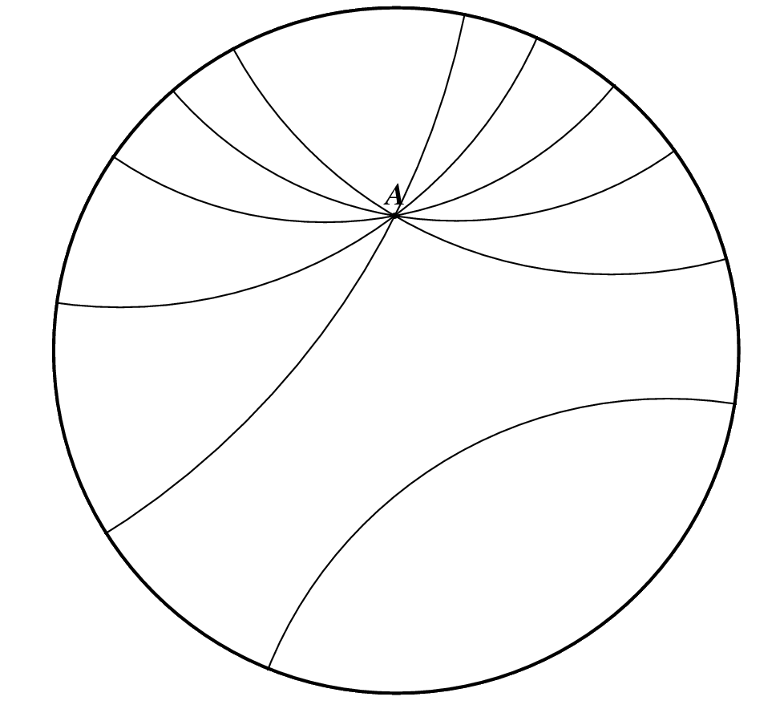





non-Euclidean geometry
Historically arrived at by replacing the parallel postulate
‘Straight’ lines become d-lines. Intersect the unit circle at 90º
Model this in our conformal framework
Unit circle
d-lines
d-line between X and Y is
Translation along a d-line generated by
Rotor generates hyperbolic transformations

Slide 6
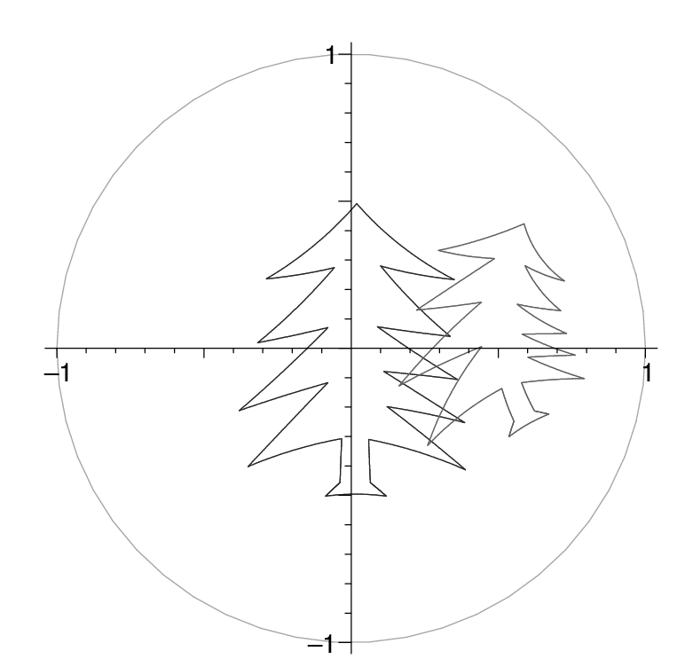
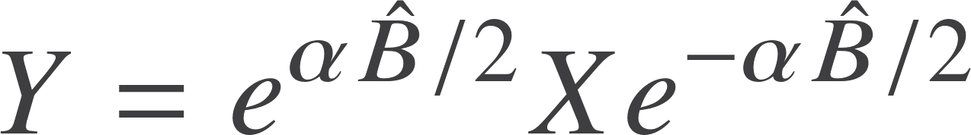
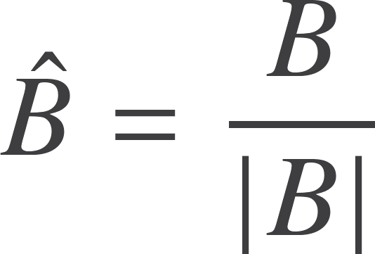
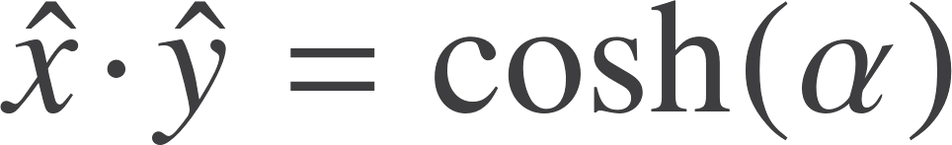


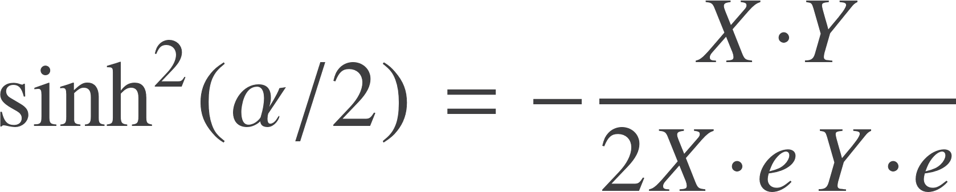
non-Euclidean geometry
Generator of translation along the d-line. Use this to define distance.
Write
Unit time-like vectors
Boost factor from special relativity
Distance in non-Euclidean geometry

Slide 7
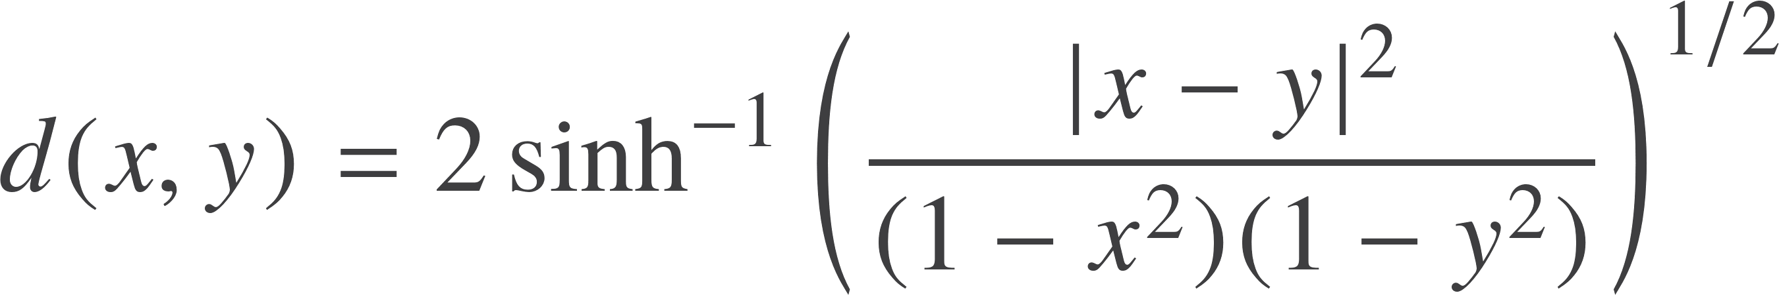
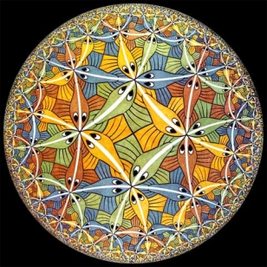
non-Euclidean distance
Distance expands as you get near to the boundary
Circle represents a set of points at infinity
This is the Poincare disk view of non-Euclidean geometry

Slide 8
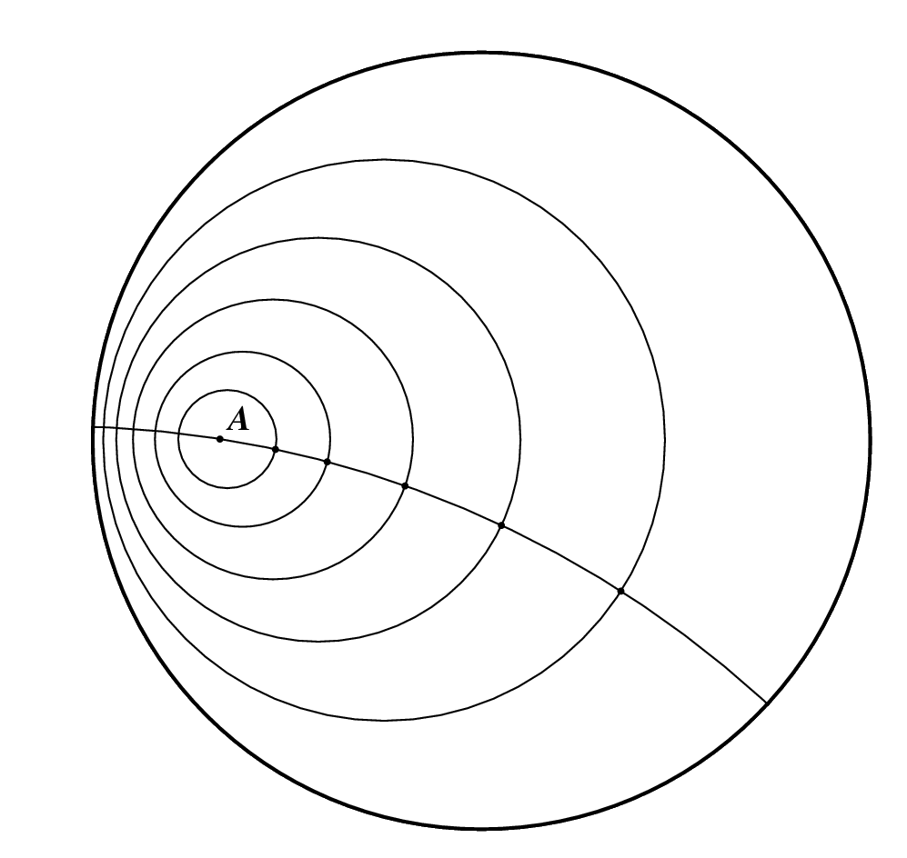
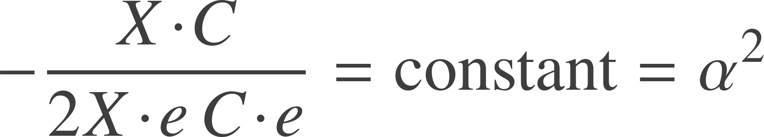
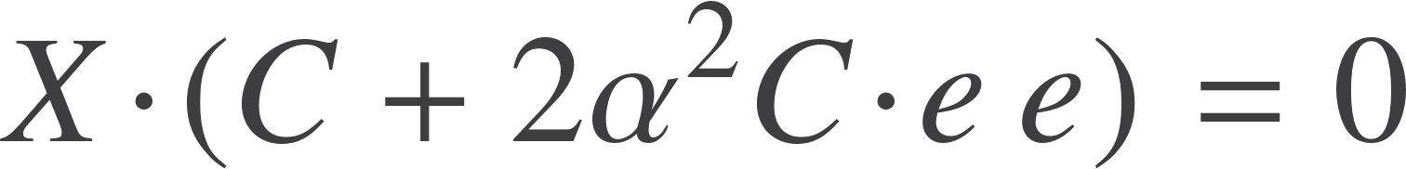






non-Euclidean circles
Formula unchanged from the Euclidean case
Still have
Non-Euclidean circle
Definition of the centre is not so obvious. Euclidean centre is
Reverse the logic above and define

Slide 9
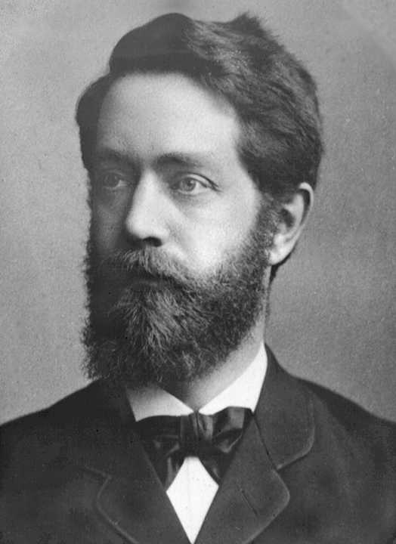
Unification
Conformal GA unifies Euclidean, projective, spherical, and hyperbolic geometries in a single compact framework.

Slide 10
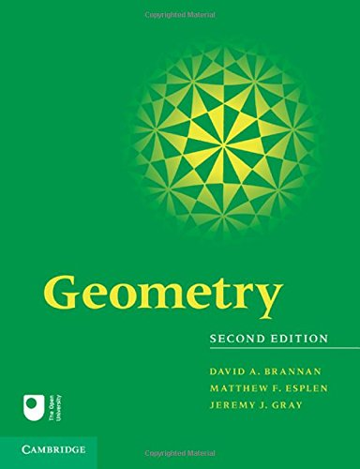


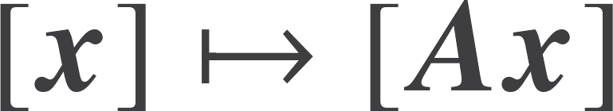

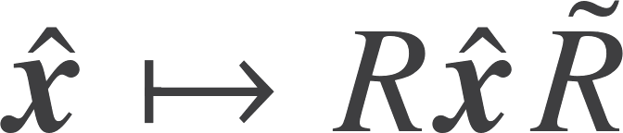

Geometries and Klein
Understand geometries in terms of the underlying transformation groups
Euclidean
Affine
Projective
Conformal
Mobius /Inversive
Spherical
non-Euclidean

Slide 11
Geometries and Klein
Projective viewpoint
Conformal viewpoint
Euclidean
Euclidean
Affine
Spherical
Projective
non-Euclidean
Conformal
Conformal
Euclidean
Affine

Slide 12




Groups
Have seen that we can perform dilations with rotors
Every linear transformation is rotation + dilation + rotation via SVD
Trick is to double size of space
Null basis
Define bivector
Construct group from constraint
Keeps null spaces separate. Within null space give general linear group.

Slide 13
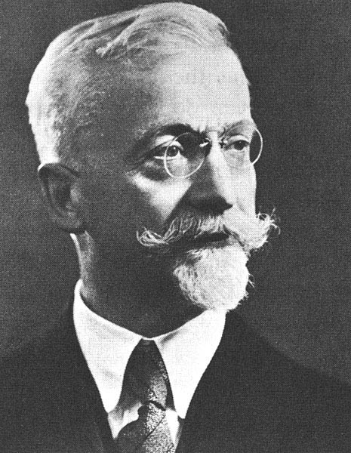
Unification
Every matrix group can be realised as a rotor group in some suitable space. There is often more than one way to do this.

Slide 14
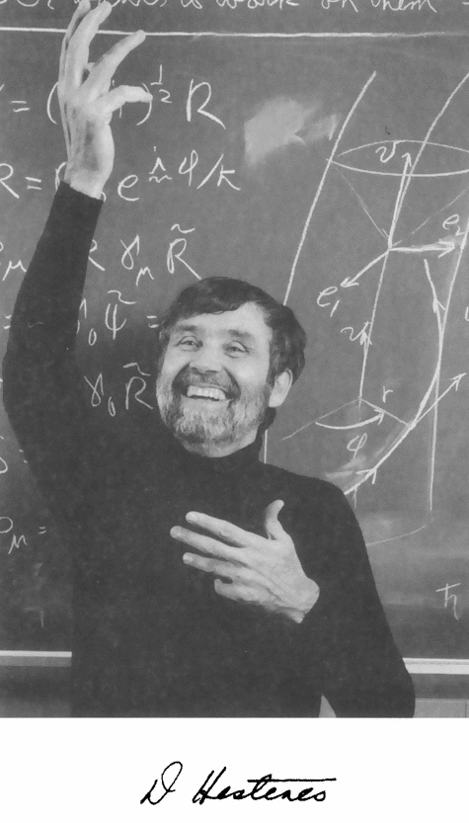
Design of mathematics
Coordinate geometry
Complex analysis
Vector calculus
Tensor analysis
Matrix algebra
Lie groups
Lie algebras
Spinors
Gauge theory
Grassmann algebra
Differential forms
Berezin calculus
Twistors
Quaternions
Octonions
Pauli operators
Dirac theory
Gravity…

Slide 15



Spinors and twistors
Spin matrices act on 2-component wavefunctions
These are spinors
Very similar to qubits
Roger Penrose has put forward a philosophy that spinors are more fundamental than spacetime
Start with 2-spinors and build everything up from there

Slide 16
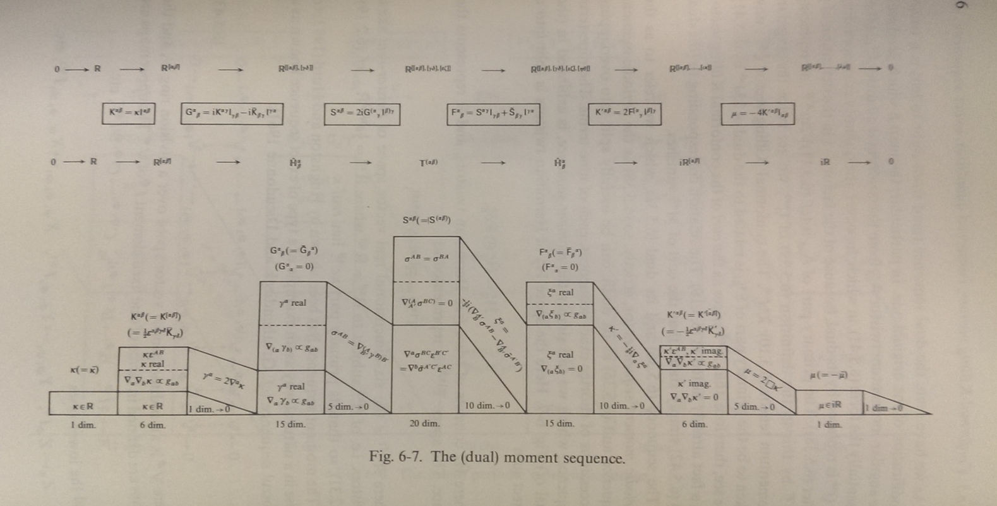
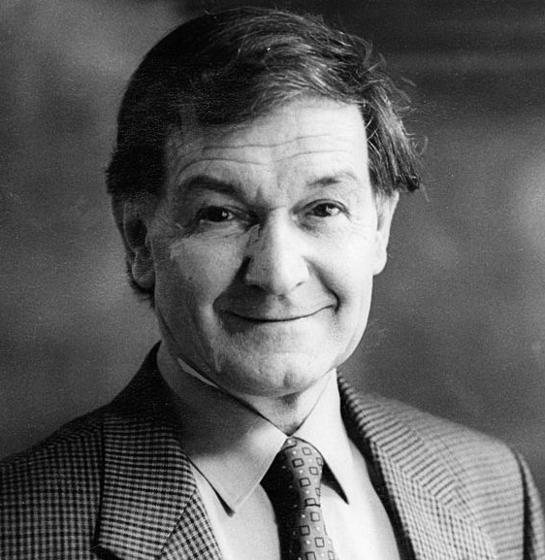
Twistors
Look at dimensionality of objects in twistor space
Conformal GA of spacetime!

Slide 17
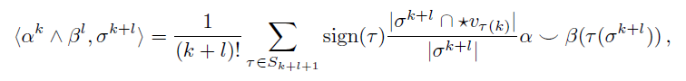
Forms and exterior calculus
Working with just the exterior product, exterior differential and duality recovers the language of forms
Motivation is that this is the ‘non-metric’ part of the geometric product
Interesting development to track is the subject of discrete exterior calculus
This has a discrete exterior product
Challenge – can you do better?
This is associative! Hard to prove.

Slide 18

Resources
geometry.mrao.cam.ac.uk
chris.doran@arm.com
cjld1@cam.ac.uk
@chrisjldoran
#geometricalgebra
github.com/ga

