Slide 1

AI in Medical Imaging Diagnosis
Artificial intelligence is transforming medical imaging by enhancing diagnostic precision and efficiency. This presentation explores key advancements,
JS
John Smith
2026-01-04
Notes:
Introduce the presentation on AI in medical imaging, emphasizing its transformative role in improving diagnostic accuracy and speed. Highlight that this is the first of eight parts.

Slide 2




AI in Medical Imaging Diagnosis
CNNs Match Radiologist Accuracy
Abnormality Detection in Scans
Used in X-ray, CT, and MRI analysis for faster diagnosis.
Notes:
Deep learning models, especially CNNs, are now capable of detecting abnormalities in medical images with accuracy comparable to human radiologists. Recent studies highlight their effectiveness in analyzing X-rays, CT scans, and MRIs, improving early病

Slide 3

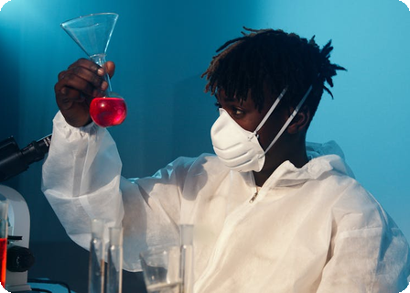
AI in Medical Imaging Diagnosis (3/8)
AI models in medical imaging are improving diagnostic accuracy and efficiency, with proven results in large-scale studies and live healthcare settings
Google Health Study Results
Reduced false positives by 5.7% and false negatives by 9.4% in breast cancer screening.
Enhanced Detection Accuracy
AI tools improve detection accuracy and reduce radiologist workload.
Real-World Implementation
Deployed in hospitals for real-time prioritization of critical cases.
Notes:
Google Health's AI model has shown significant improvements in breast cancer screening by reducing false positives and negatives across diverse populations. Tools like Aidoc and Zebra Medical Vision are already in clinical use, demonstrating real-wo

Slide 4

AI in Drug Discovery: Accelerating Development Timelines
Traditional Cost
Discovery Time with AI
$2.6B
12-18mo
Average cost of developing a new drug using traditional methods.
Reduction in early discovery time enabled by AI technologies.
Notes:
AI is transforming drug discovery by significantly cutting down the time and cost of bringing new treatments to market. Traditional methods are slow and expensive, but AI-driven approaches can identify promising drug candidates in months instead of几年

Slide 5
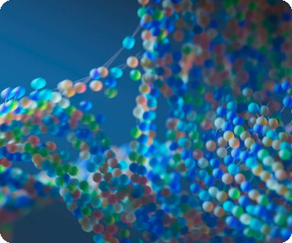
AI Accelerating Drug Discovery
BenevolentAI ALS Breakthrough
Identified a promising ALS treatment using AI-driven target discovery, now in clinical trials as of 2024.
150+ AI Drug Candidates in Pipeline
More than 150 AI-designed or AI-optimized drug candidates are in preclinical or clinical stages globally.
Notes:
BenevolentAI used artificial intelligence to identify a potential ALS treatment now in clinical trials. Over 150 AI-driven drug candidates are in development worldwide, showing AI's growing role in accelerating drug discovery and improving success in

Slide 6
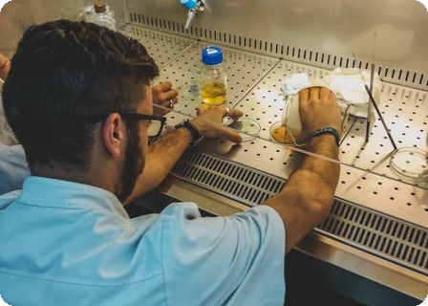
Personalized Treatment Plans Through AI
AI synthesizes diverse datasets including genomics and EHRs to create individualized treatment strategies, enhancing therapeutic precision and patient
Integrated Data Sources
Combines genomic, clinical, and lifestyle data for precise therapy design.
Evidence-Based Recommendations
Watson analyzes 30M+ medical documents to match treatments with evidence.
Precision Medicine Outcomes
Enables targeted therapies improving efficacy and reducing side effects.
Notes:
AI enables personalized treatment by analyzing genomic data, EHRs, lifestyle factors, and biomarkers. Tools like IBM Watson for Oncology process vast medical evidence to support clinical decisions, improving accuracy and patient outcomes in complex病例

Slide 7
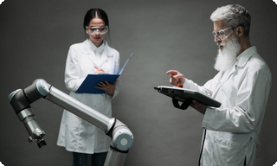
Personalized Treatment Plans (Cont.)
01
Oncology Data Enhancement
02
Cardiology Risk Prediction
Tempus and Flatiron Health analyze real-world cancer data to improve survival outcome predictions by up to 22% using AI-driven insights.
AI in cardiology evaluates individual patient data to forecast heart attack risk with 85% accuracy, supporting timely clinical decisions.
Notes:
AI platforms like Tempus and Flatiron Health leverage real-world oncology data to enhance survival predictions by up to 22%. In cardiology, AI models assess patient-specific factors to predict heart attack risk with 85% accuracy, enabling earlier,个性化

Slide 8
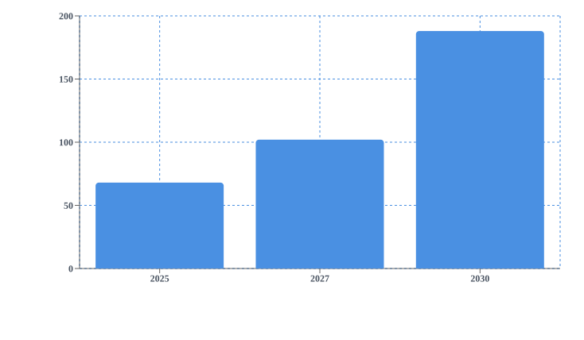
Future Trends in AI Healthcare
Federated Learning
AI healthcare market to hit $188B by 2030, driven by privacy-preserving and multimodal technologies.
Enables collaborative AI training across institutions without sharing sensitive patient data.
200
Multimodal Models
150
Integrates diverse data types like medical images, genomics, and EHRs for comprehensive insights.
100
50
Real-Time Diagnostics
AI systems will increasingly support real-time clinical decision-making at the point of care.
0
2025
2027
2030
Notes:
The global AI in healthcare market is expected to grow significantly by 2030, reaching $188B. Key advancements include federated learning, which enables model training across decentralized data while preserving patient privacy, and multimodal AI that

