Slide 1
Introduction of FBTUG Commander

Slide 2
Outline
Farmbot structure
Motivation
Introduction of FBTUG Commander
Summary

Slide 3
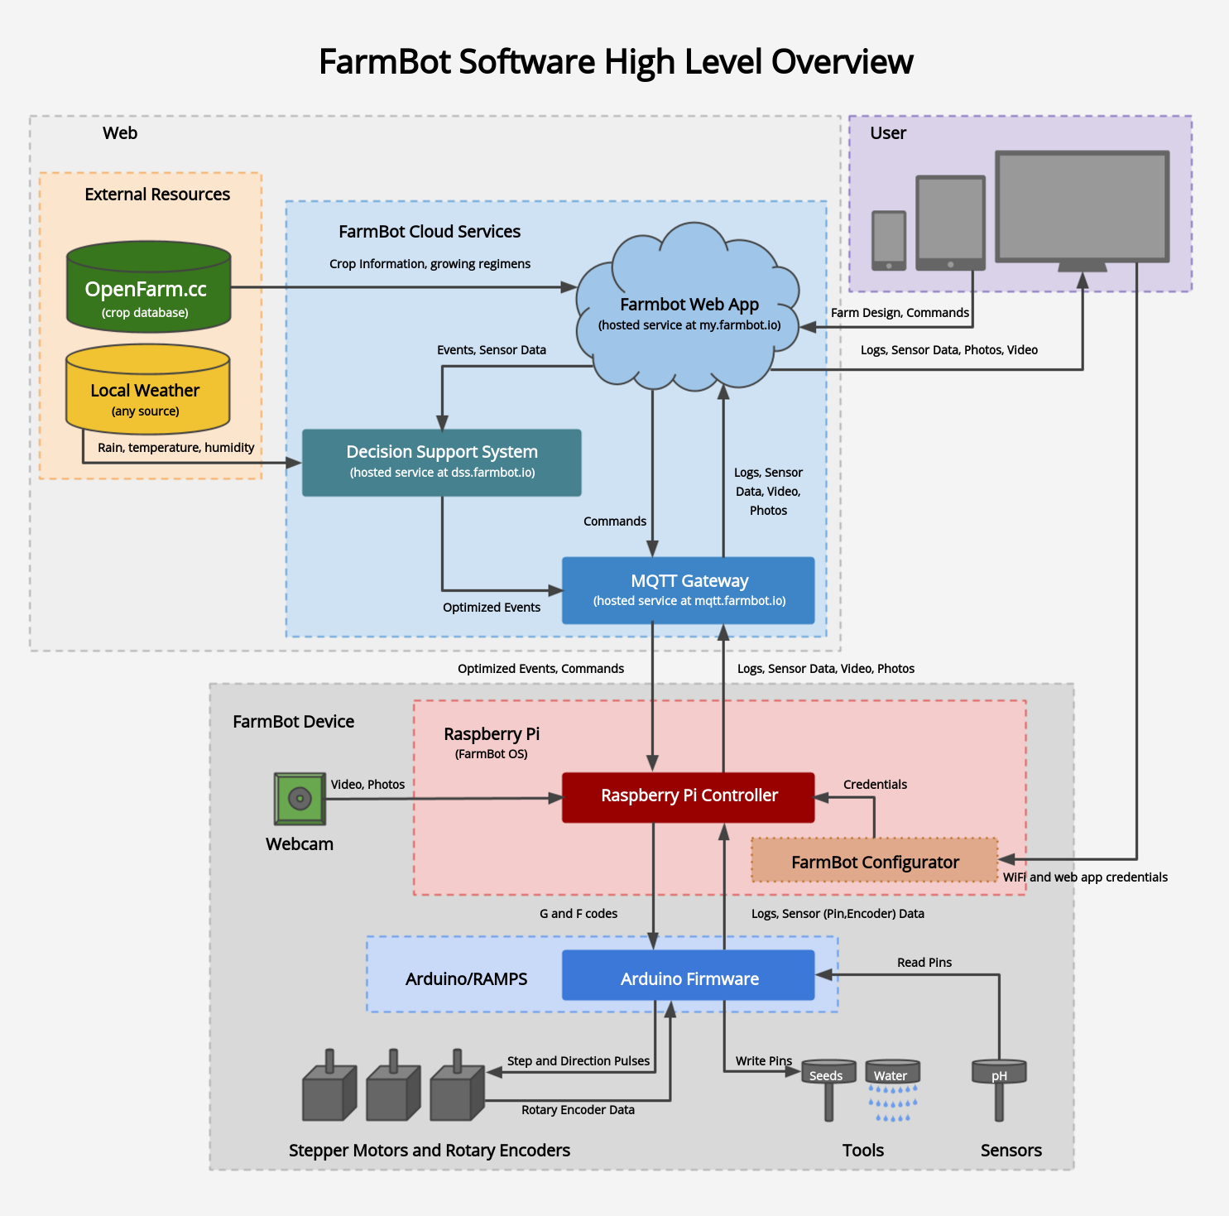
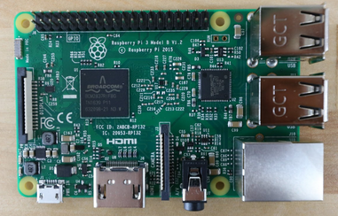
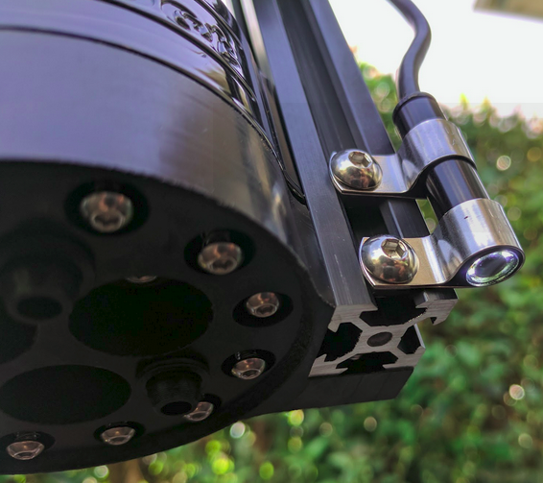
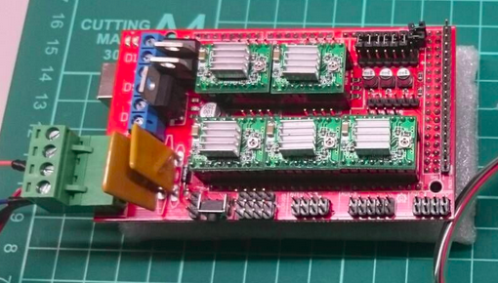
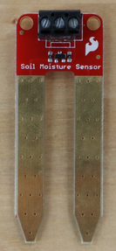
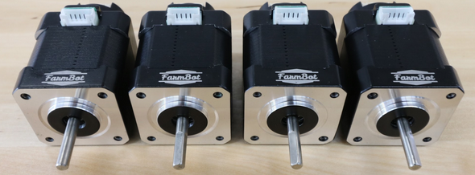
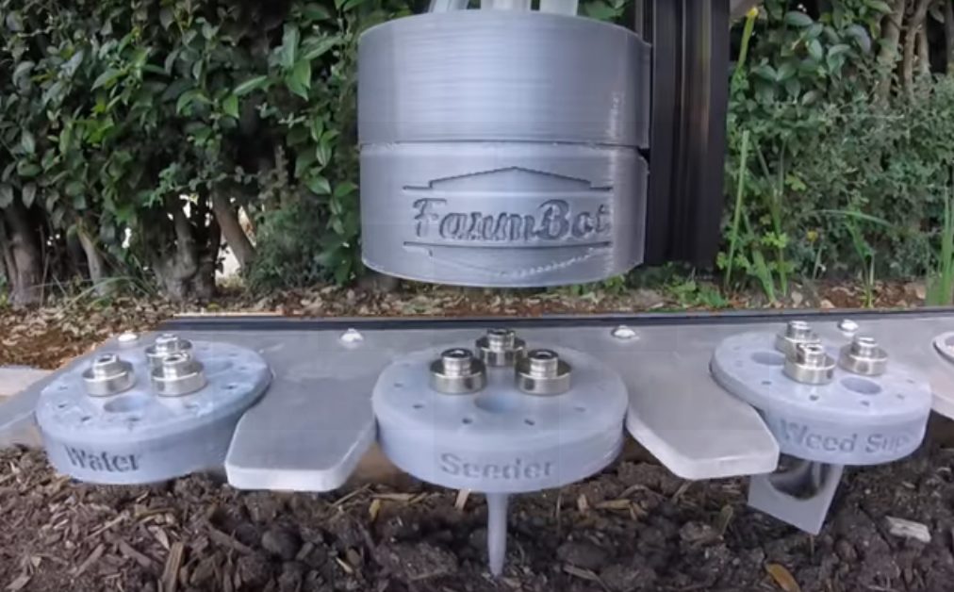

Slide 4
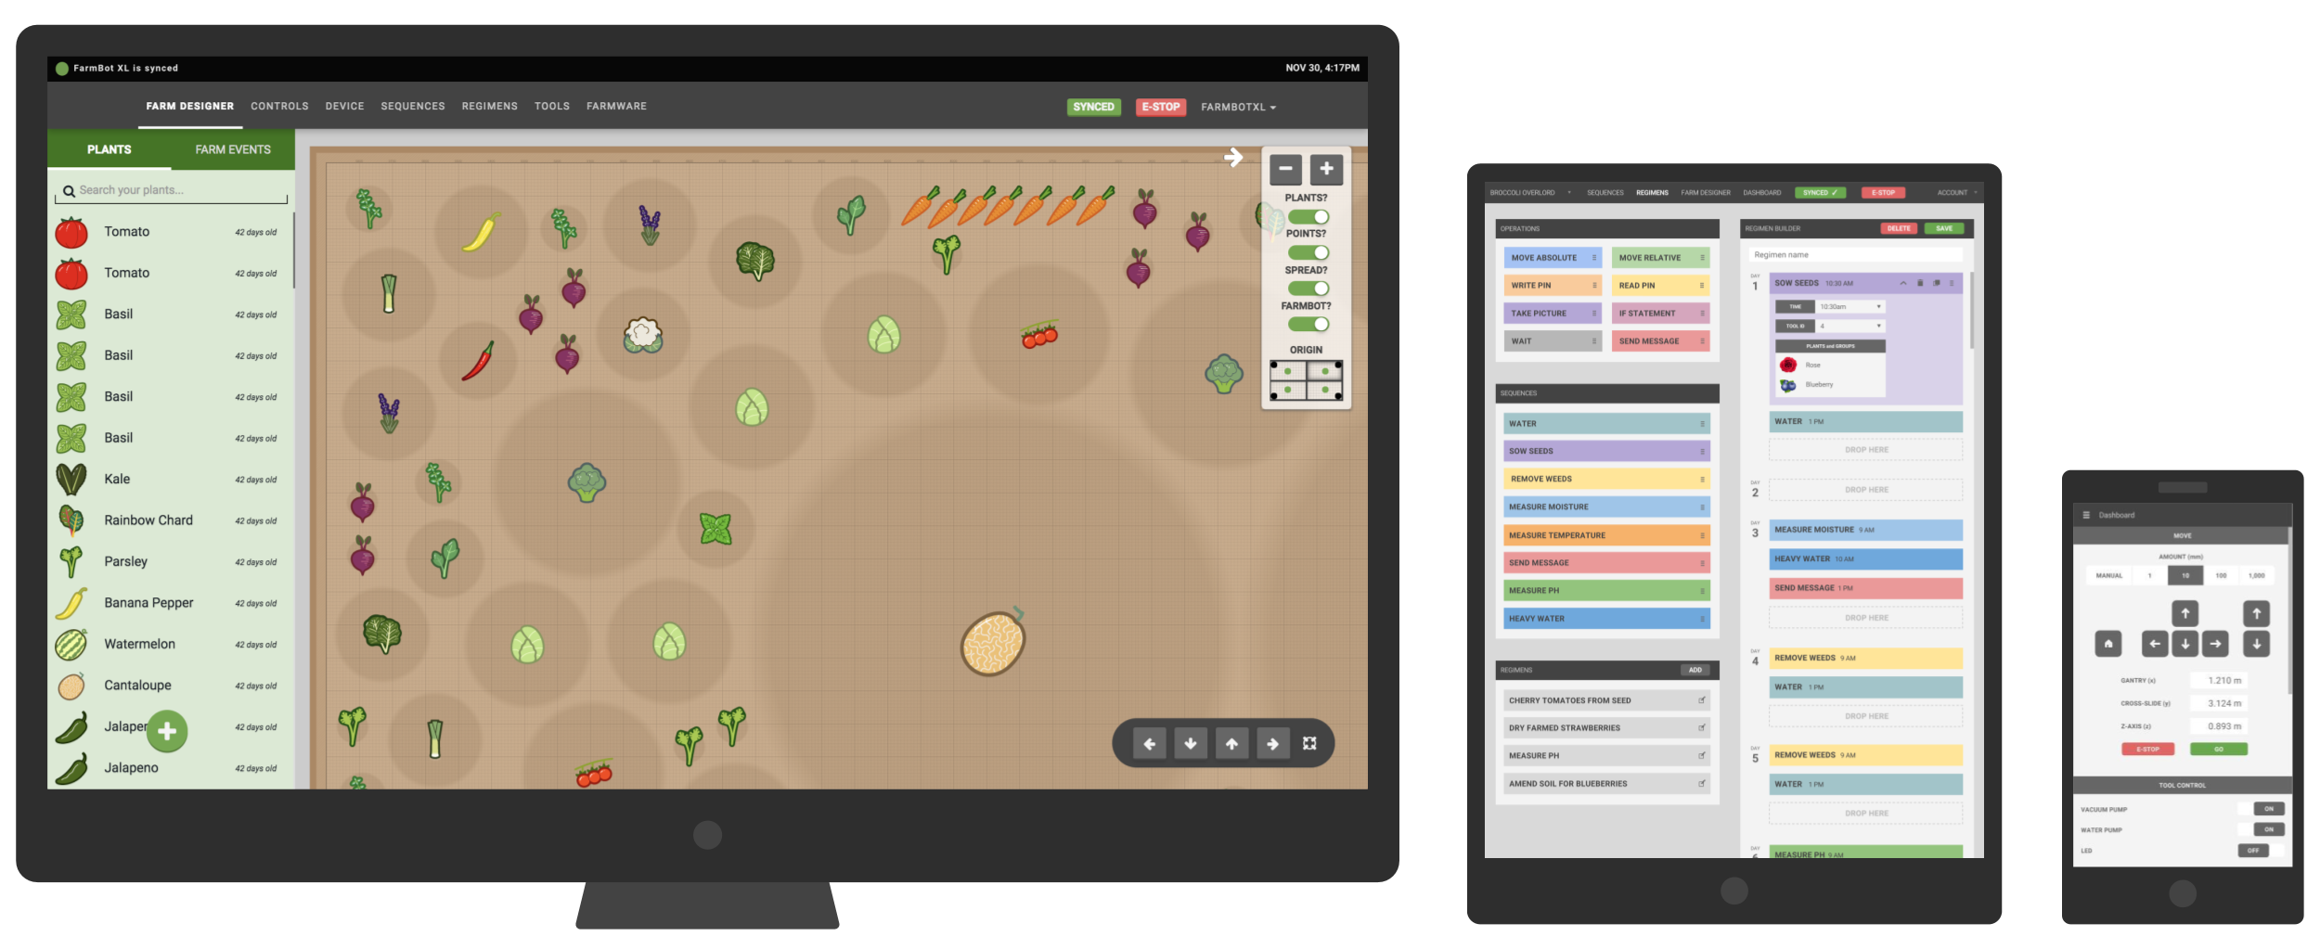

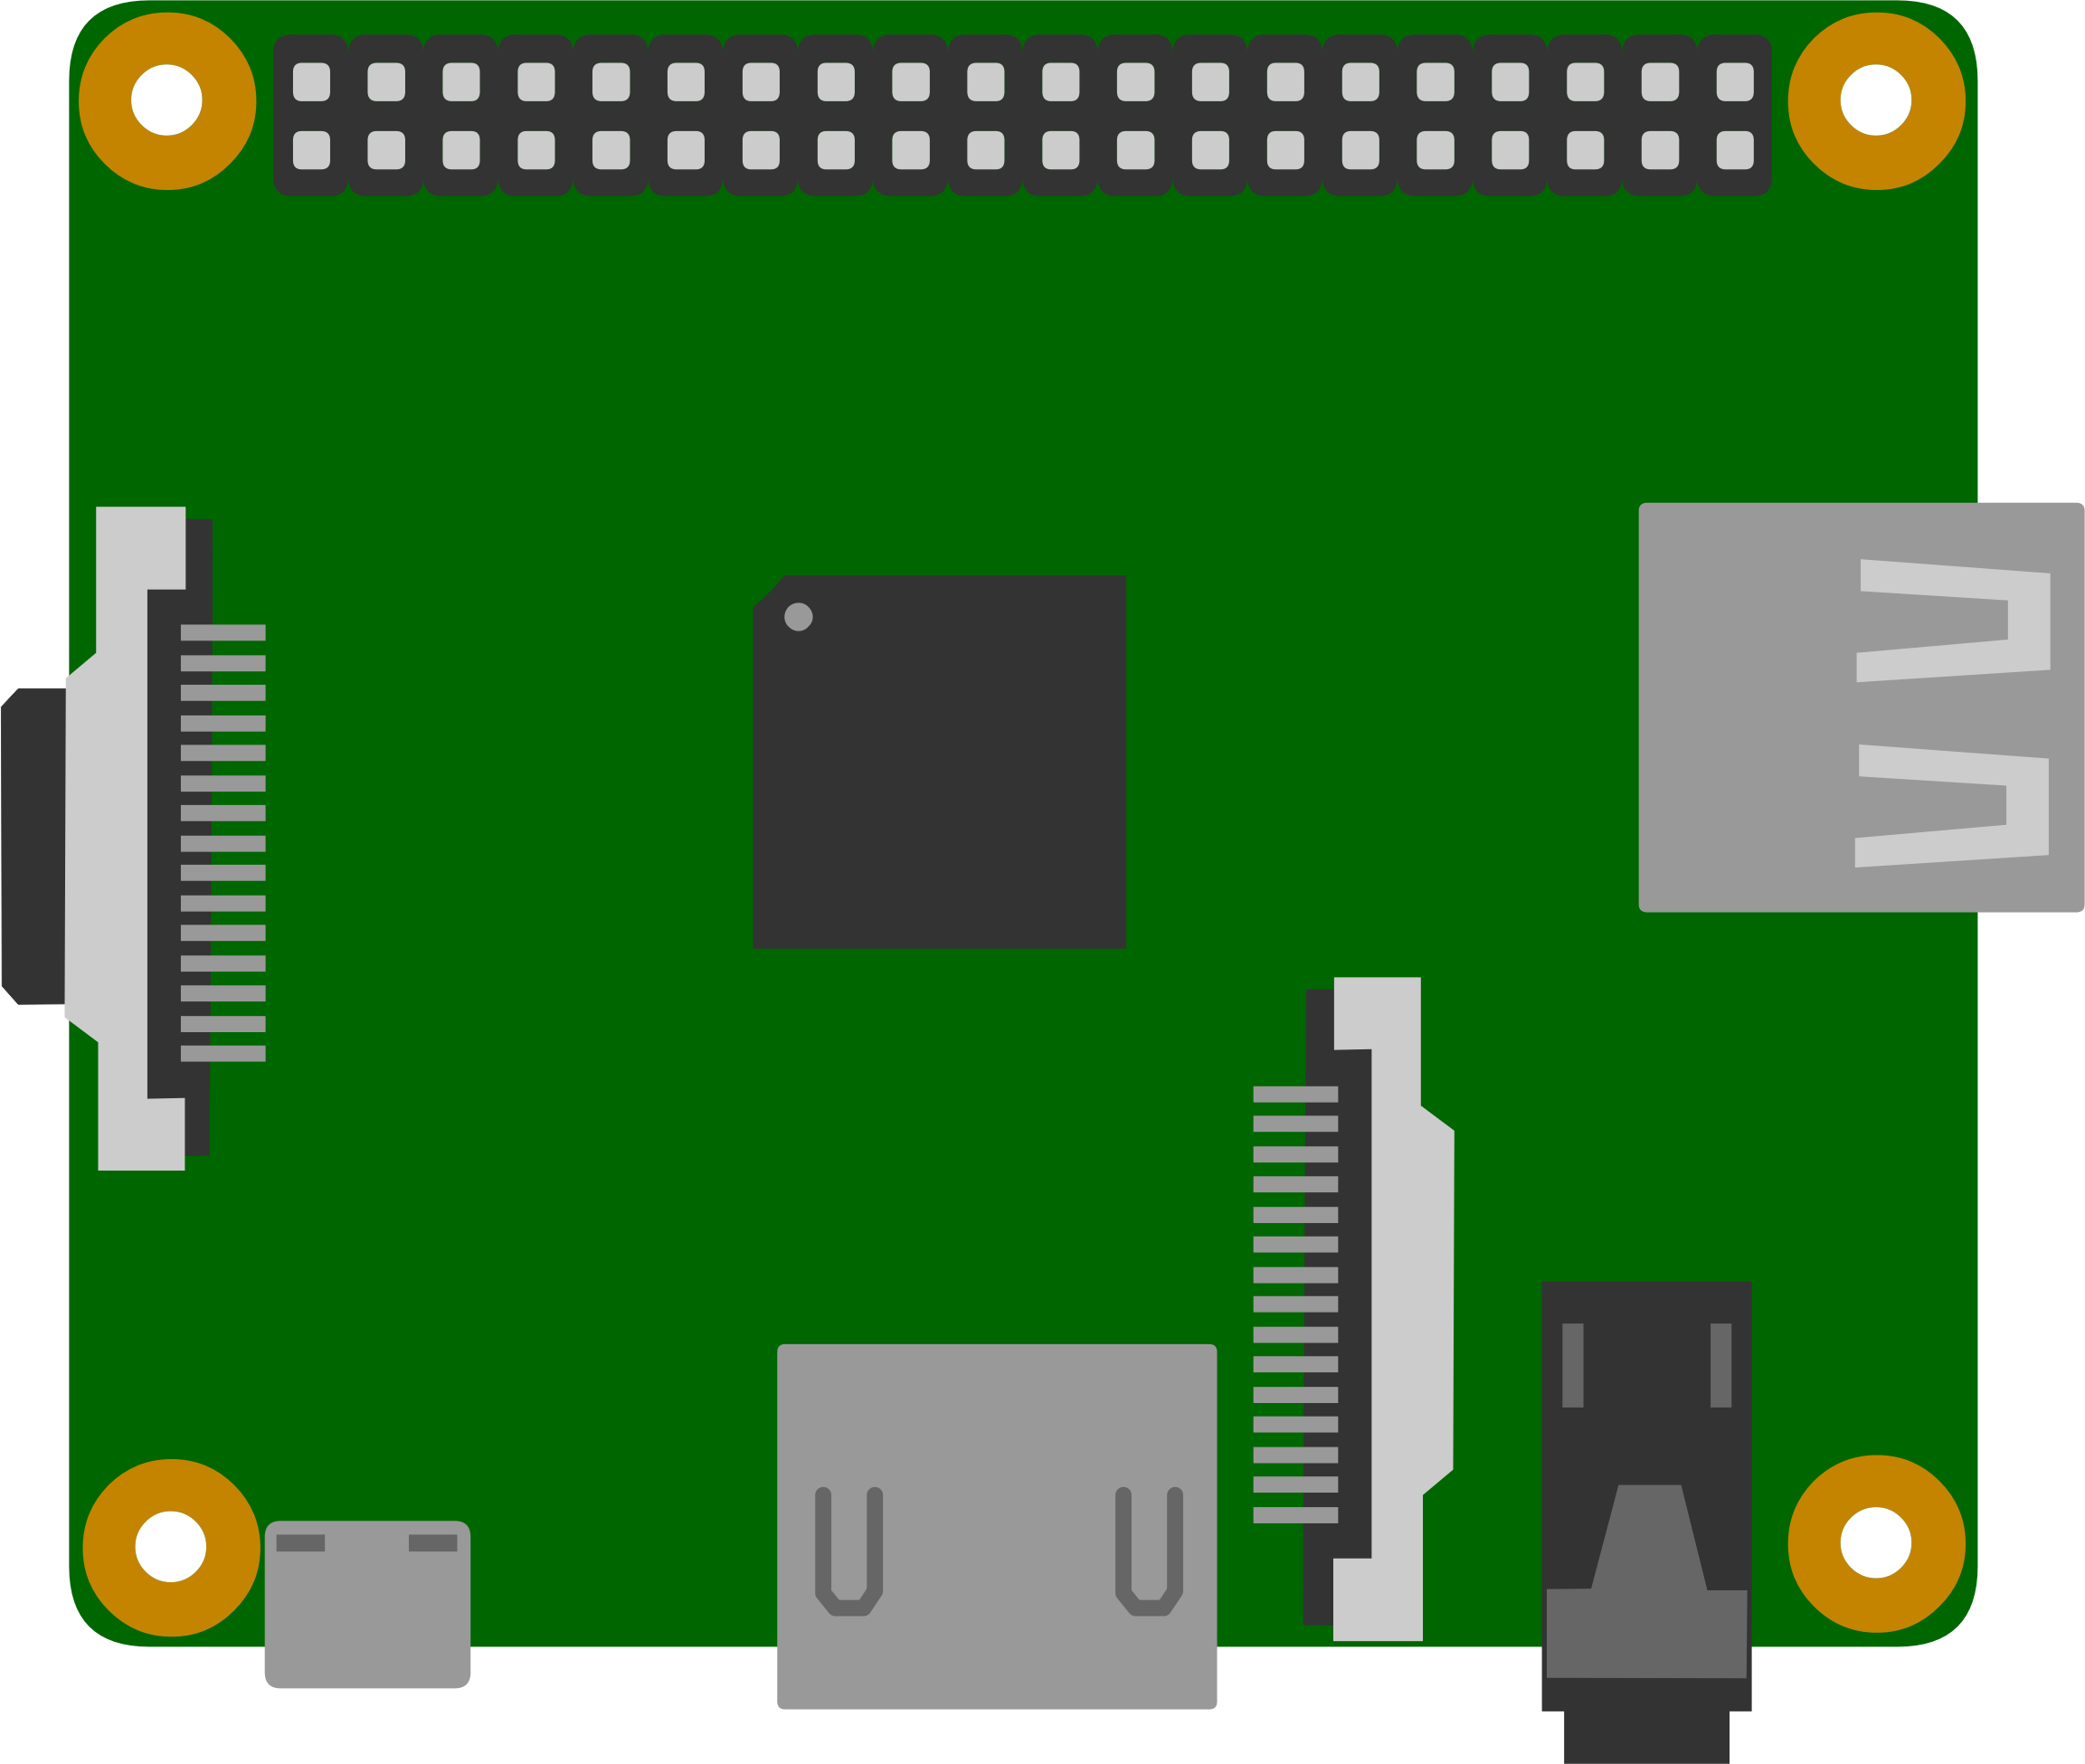

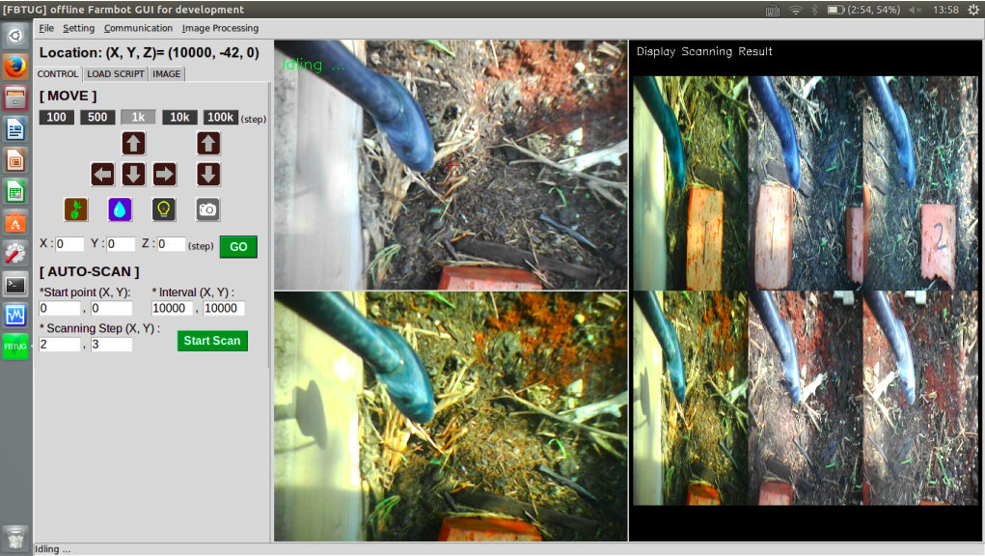
Farmbot Concept Structure
Webcam
Stepper Motors
UTM
Sensors
PC, Pad,
Smart Phone
Server
Raspberry Pi
FBTUG Commander Concept Structure
Webcam
Stepper Motors
Directly Control
UTM
Sensors
PC, Raspberry Pi, ...

Slide 5

FBTUG Commander
Control
Webcam
Stepper Motors
UTM
Sensors
Raspberry Pi
FBTUG Commander
Movement Control
Camera Control
Sequence Command

Slide 6
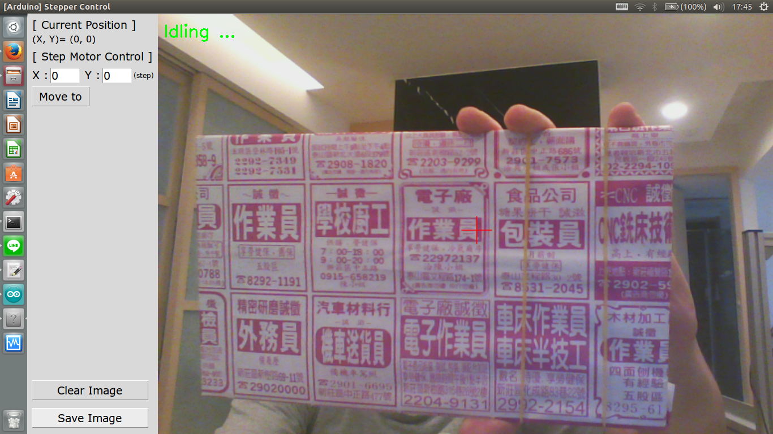
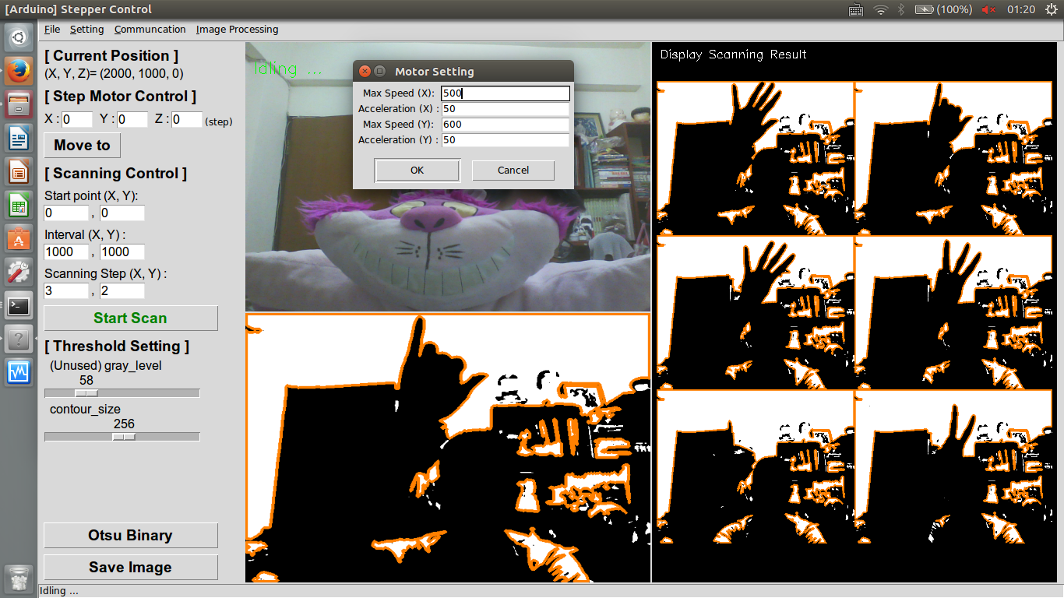
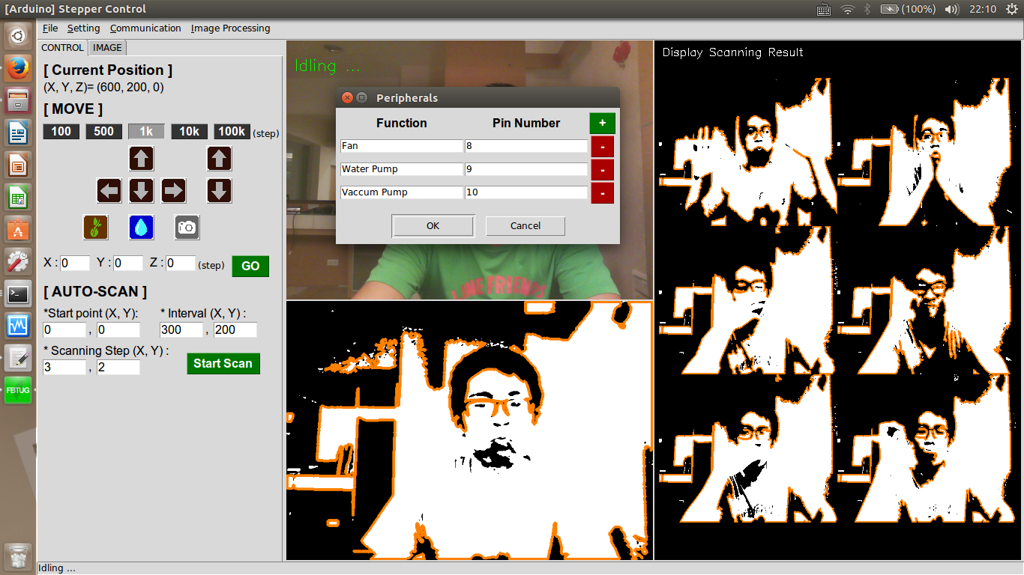
FBTUG Commander
Ver 0.0
Ver 1.0
Ver 2.0
Ver 3.0

Slide 7
FBTUG Commander
Real-time Image
Main Function
Process Result
Scanning Result

Slide 8
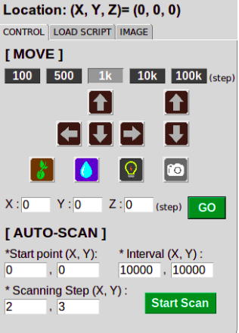
FBTUG Commander – General Control
Basic function to control farmbot
Relative movement
Moving Interval: 100, 500, 1k, 10, 100k (step)
Moving Direction: +/-X, +/-Y, +/-Z
Seeding, Watering, Lighting, Grabbing image
Absolute movement
X, Y, Z position
Auto-Sacnning Setting
Start Point (X,Y)
Scanning interval (X, Y)
Scanning Step (X, Y)

Slide 9
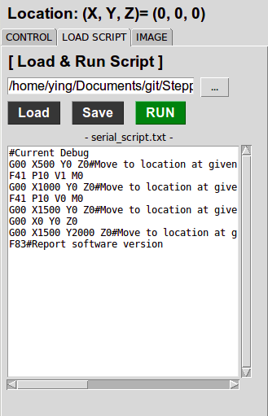
FBTUG Commander – G,F code Script
Basic function to control farmbot
Relative movement
Moving Interval: 100, 500, 1k, 10, 100k (step)
Moving Direction: +/-X, +/-Y, +/-Z
Seeding, Watering, Lighting, Grabbing image
Absolute movement
X, Y, Z position
Auto-Sacnning Setting
Start Point (X,Y)
Scanning interval (X, Y)
Scanning Step (X, Y)

Slide 10
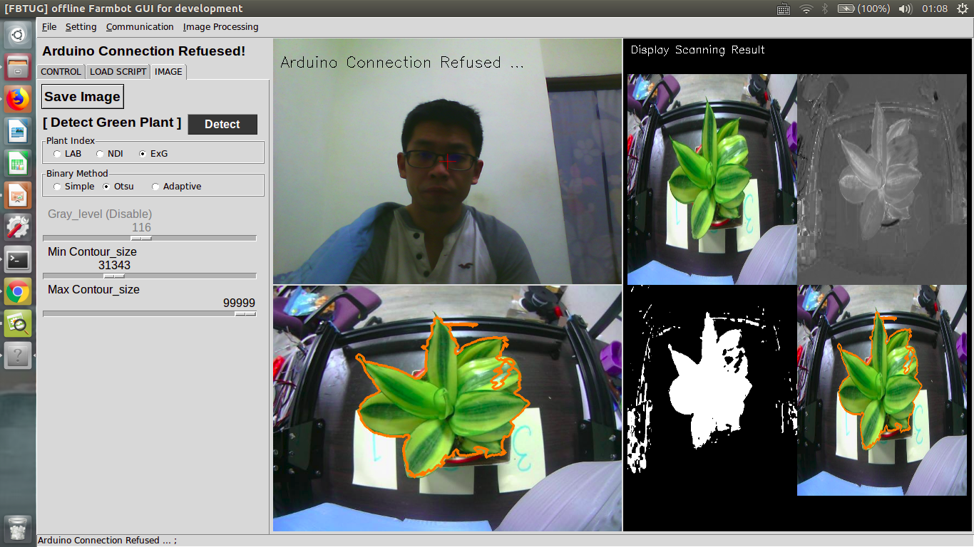
FBTUG Commander – Green Plant Detection

Slide 11





FBTUG Commander – Green Plant Detection
Normalized Difference Index (NDI)
Excess Green Index (ExG)
Reference: http://agri.ckcest.cn/ass/NK006-20160808005.pdf

Slide 12
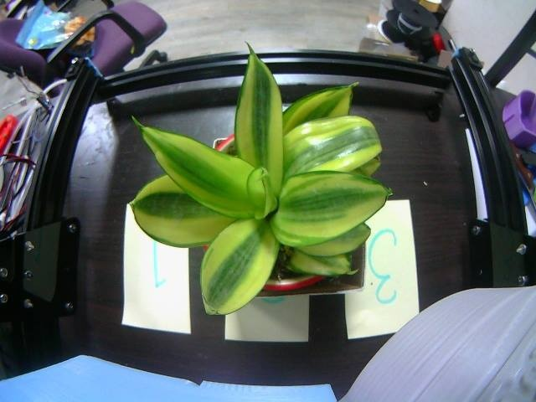
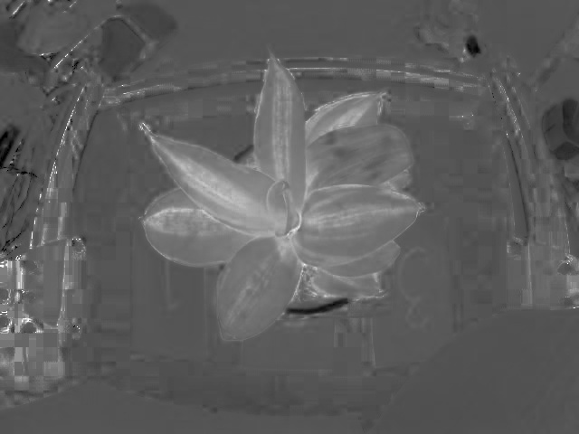

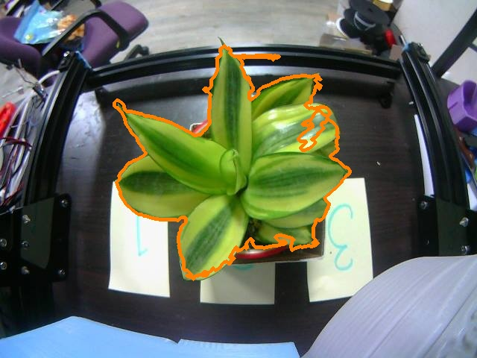
FBTUG Commander – Green Plant Detection

Slide 13
Summary

Slide 14
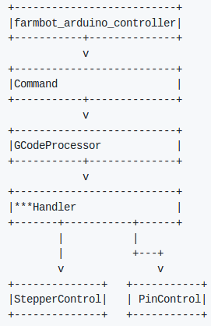
Appendix: Farmbot Firmware
Farmbot firmware:
https://github.com/FarmBot/farmbot-arduino-firmware
Firmware overview

