Slide 1

TABLEAU

Slide 2
Data science lifecycle
Collection
Exploration
Cleaning
Modeling
Validation
Modeling
Reporting

Slide 3
What is Tableau? (as per the company)
Harness the power of your data.
Unleash the potential of your people.
Choose the analytics platform that disrupted the world of business intelligence.
Choose Tableau

Slide 4
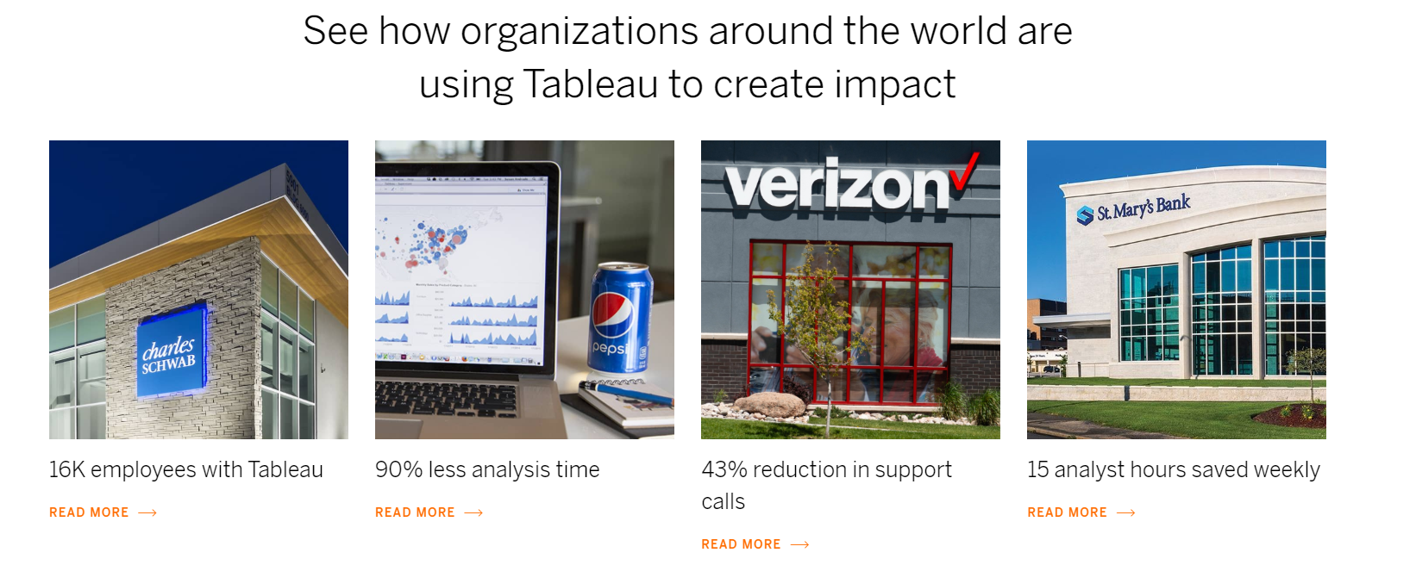
What we can infer: A tool which allows users to make sense of their data with the help of interactive charts and diagrams.
One of many good fit for the Exploration and Visualization steps
Source: www.tableau.com

Slide 5
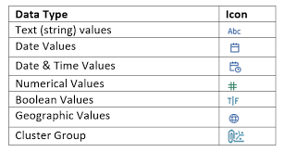
Tableau divides the data in two main types: dimensions and measures.
Dimensions
Fields that cannot be aggregated.
They add value to the measure values
Usually text
Measures
Fields that can be measured, aggregated, or used for mathematical operations.
Usually numbers

Slide 6

Generated Fields
Measure Names
Measure Values
Number of Records
Lat and Long

Slide 7
Type Conversion
Int(column)
Float()
Str()

Slide 8
Level of Detail (LOD)
TABLEAU’s calculations help address detailed queries directly.
Eg:
Country
state
City
As we go further down the granularity increases and aggregation decreases.
INCLUDE
EXCLUDE
FIXED

Slide 9
Some of the tasks
Joins
Unions
Sort
Forecast
Highlight
Design for various devices

Slide 10
Plots
Bar
Line
Bubble
Pie
Heat Map (covered in prev sessions)
Pareto Chart (2 charts on 1 plot)
Text Table (Value against different dimensions)
Area
TreeMap

Slide 11
What is the relation between Quantity and Discount?

Slide 12
Can you find insights of sub_category vs profit?
Question

Slide 13
View Enhancement
Filters
SQL Custom Filters (sql query)
Context: used to make the data for sheet small
Traditional: Easy but slow
Hierarchy
High to low level Country to state to city

Slide 14
Question: Which category has maximum discount(avg)?

Slide 15
Functions
Number Functions
Avg
log
Ceiling
Asin Cos etc
Pi
Power (number,power)
Max/Min
Round
Sqrt/square

Slide 16
Plot the Purchase counts grouped by State.

Slide 17
String Functions
ASCII,char
Contains, endswith : func_name(string,substring)
Find(string,substring,start) Note: index starts at 1
Len
Lower , upper
Ltrim rtrim
Max, min
Mid
Left, right
Split split(string,delim)

Slide 18
Date Functions
Now (returns current date time)
Dateadd(‘part’,interval,’col’)
DATEDIFF(‘part’,date1,date2,week_start)
Datepart (returns int)
Datename(returns string)
Isdate
Max,min
Month (returns month as int)
year

Slide 19
Find the relation between Profits and location(state) with filtering based on year.
Question

Slide 20
Aggregate Functions
Sum (default)
Attr
Avg
Corr (col/expr1, col/expr2)
Stdev
variance

Slide 21
Logical Functions
Isnull(expr/col)
Ifnull(expr1,expr2)
IIF(test,then,else)

Slide 22
IF,ELSE IF, and ELSE
If(condition)
Then something
End
--------------------------
If(condition)
Then something
Elseif (condition)
Then elif_thing
Else something_else
End

Slide 23
Question
Plot relation between profit ,sales for categories performing good / bad for each state.
(Good -> in profit)

Slide 24

Question
Find relation between Shipment Type and number of days it takes to ship

Slide 25
Hands On
IMDB Dataset
https://www.kaggle.com/stefanoleone992/imdb-extensive-dataset?select=IMDb+movies.csv
Load Data: Use of Join

Slide 26
Question
Plot the number of Movies released as per year

Slide 27
Question
I want to make a film and am wondering what the avg. movie duration trends are. Can you help me out?
What have the trend been for worldwide earnings for movies.

Slide 28
Question
Can you find the distribution of movies in different genre?

Slide 29
Additional (HW) Question
Find the distribution of good and bad movies.
Let’s say Good has rating>=4 in US ratings
Add on distribution wrt to the category.
Next find the trend with years

Slide 30

Thank You
Feedback:link
Contact: datasciencebootcamp@nyu.edu

