Slide 1

Machine Learning Part -2

Slide 2
Agenda
K Means Clustering (Unsupervised)
K Nearest Neighbor (Supervised)
SVM

Slide 3
K Means Clustering
Use Cases
Fake News Identification
Spam Filtering
Market Segmentation
Fraud Detection
Delivery Store Optimization
If cluster is unstable
Measure distance of all points from the cluster heads
Reposition cluster head/centroid
Start
With randomly selected cluster heads
Assign each point to the nearest cluster head
Voila,
Clustering is complete!
Stable Cluster

Slide 4

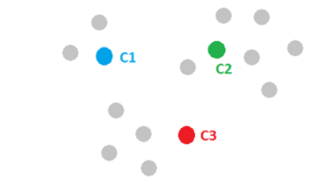
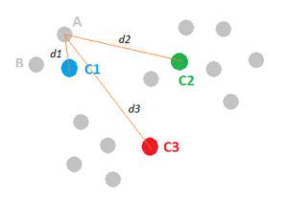
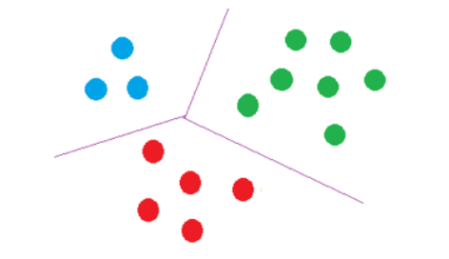
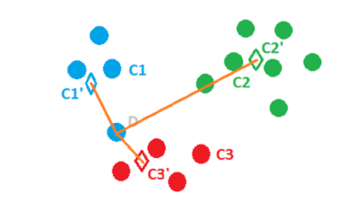
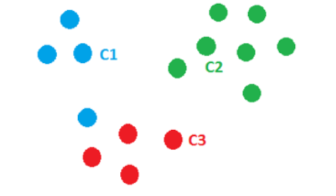
Process

Slide 5
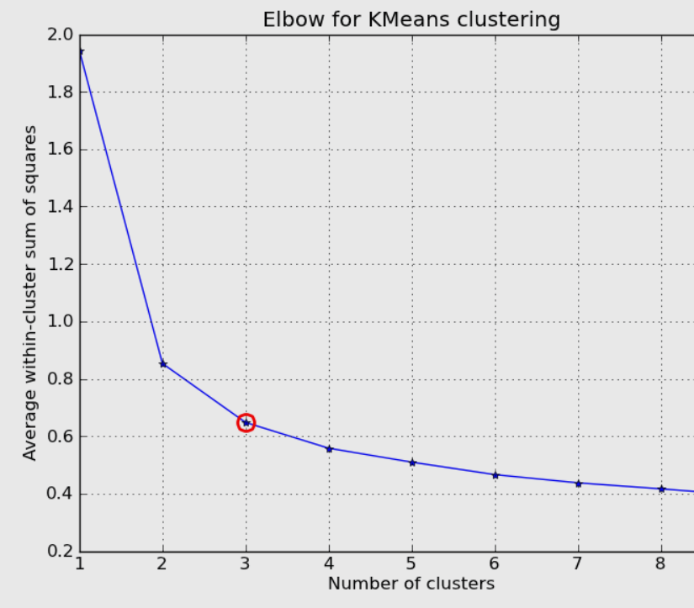

Choosing K
No direct formula to choose a K Value.
Iterate over various K Values and plot the relation between WSS (within cluster sum of squares) vs Number of clusters.
Choose K which is the elbow point of graph
(from where the change is ~linear)
WSS $=∑$(x_{i} - $\overline{x})2$

Slide 6
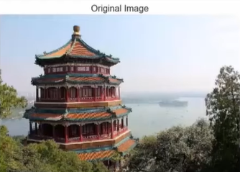
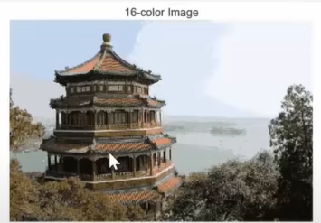
Image Compression (using K Means)

Slide 7
K Nearest Neighbors
Supervised Machine Learning Algorithm
Used for Classification
Data does not need to be linear
Based on the concept of Feature Similarity.
Predicts class that is of the nearest neighbors.
K is the number of Neighbors to be used for voting.
(generally between 3 to sqrt(n))

Slide 8
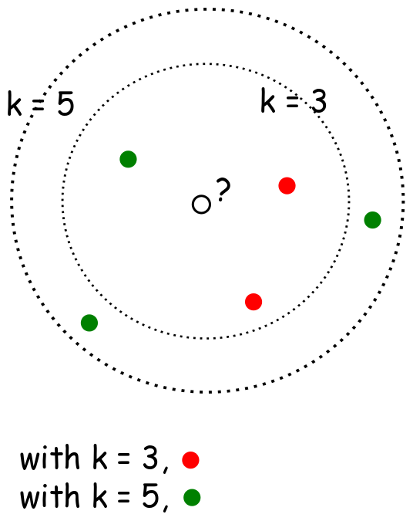
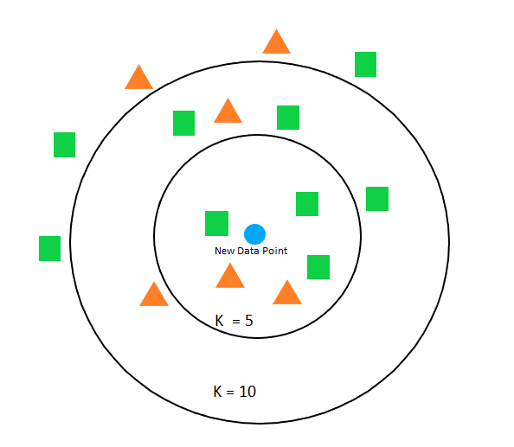
Choosing K
Too low value like 1 or 2: Adds a lot of variance/noise
Too high K Value: Lot of processing time
Best K Value is a trade off between the 2 extremes.
Tip: Choose K to be odd to avoid ambiguity
Img source: internet

Slide 9
When to prefer KNN
Dataset is small/subset is being used (Everything is stored in memory)
Data has less Noise/Outliers
Labels provided (Supervised algorithm)

Slide 10

Cross Validation
source: https://scikit-learn.org/stable/modules/cross_validation.html

Slide 11
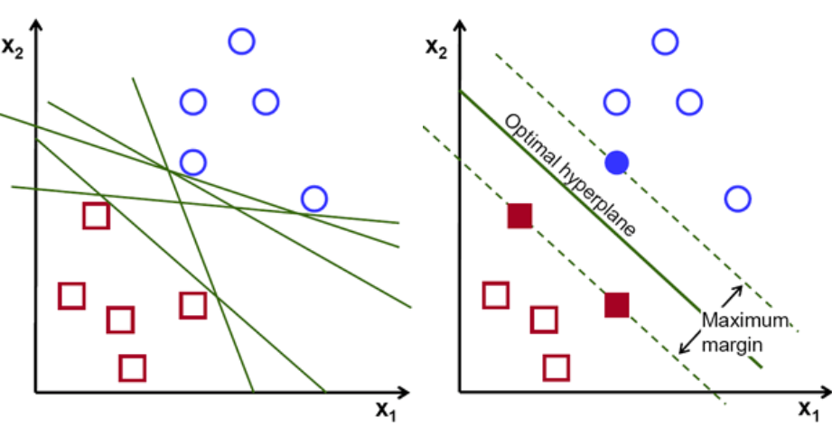
Support Vector Machine (SVM)
Use Case:
Face Detection
Text Processing (handles large features easily)
Margin: Distance between hyperplane and the closest point of any class.
Soft/Hard (on paint)

Slide 12
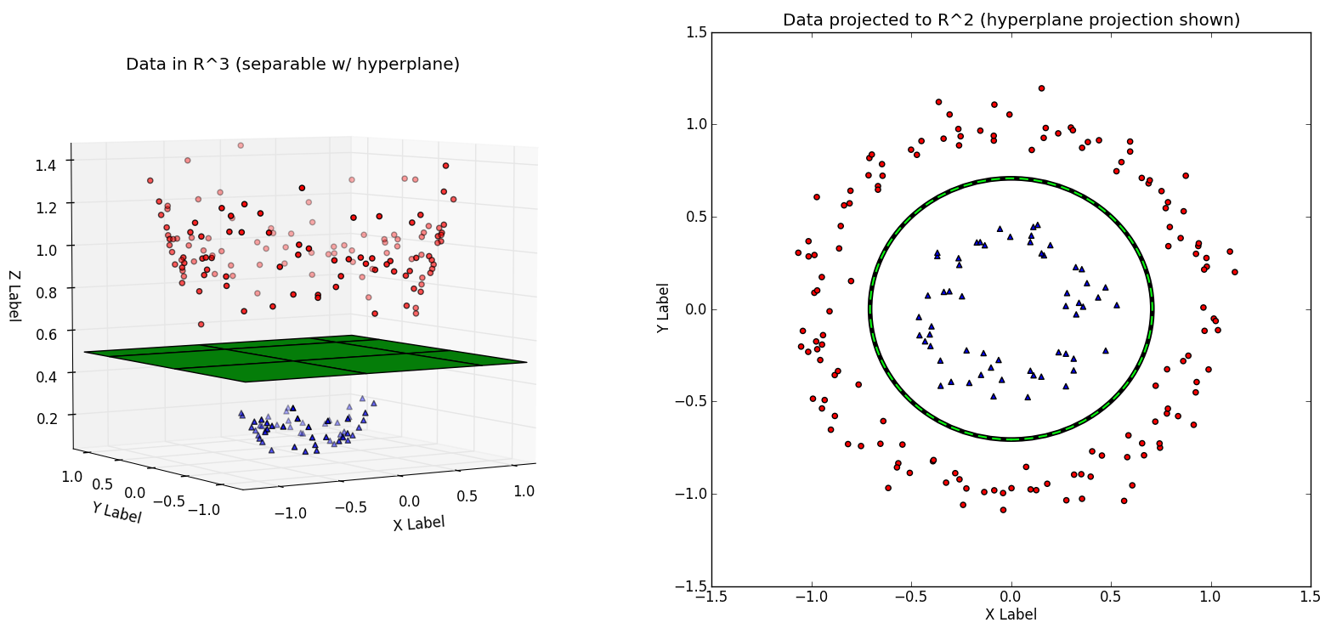
For 1D data a point,
for 2D data a 1D Line,
for 3D data a 2D plane,
for 4D or more we call it Hyperplane.
Kernels
Polynomial: (a.b + r)^{d}
Radial: e^{-γ(a-b)2}

Slide 13
Thank You ☺
Feedback: Link
Project presentation (optional): Link
Contact: datasciencebootcamp@nyu.edu

