Slide 1

IF YOU BUILD IT, THEY WILL SPONSOR IT
July 2018
www.sponsy.org

Slide 2
EXECUTIVE SUMMARY
Hard Cap
USD 14M
Solving problems of
Businesses aiming to either raise sponsorship funding or sponsor other parties
Key Risks
Corporate world prefers to keep their sponsorship deals off the grid
Market Opportunity
USD 90Bn sponsorship industry + USD 70Bn untapped SME sponsorships market
Thesis 1
SME are deprived of sponsorship opportunities, presenting untapped market for Sponsy
Thesis 2
Our partnership with Adidas proves the presence of product-market fit
Thesis 3
Experienced team with background of Experian, Credit Suisse, Microsoft
Thesis 4
Redefining industry by application of assets tokenization and artificial intelligence
Thesis 5
First mover advantage: no competition in decentralization of sponsorship industry

Slide 3
SPONSORSHIP INDUSTRY: THE PAIN
1
Sponsorship industry is opaque
4
Industry is inflexible
Offline
Potential sponsors and sponsees are unaware of market prices and trends.
Due diligence and intellectual rights management is slow
Working with every single sponsor one-by-one takes a lot of time
No easy way to discretely allocate sponsorship funding
Sponsors are limited in ability to purchase structured sponsorship opportunities
2
SME has no access to the market
Sponsorship brokers are unwilling to work with small businesses.
3
Agencies charge big fees
Intermediaries take up to 35% of the funding amount

Slide 4






SPONSY SOLUTION
Eliminating the middleman
INTRODUCING SPONSORSHIP ASSETS
Physical items
Virtual items
Sponsorship asset is a unit that sponsors are willing to pay for in sponsorship business; backed by sponsee’s audience/clients attention.
Sponsees offer assets to thousands of sponsors simultaneously instead of pitching manually
Sponsors can discretely allocate funding
Branded water bottles, meeting rooms, badges.
Mentioning sponsor’s brand during speech
FAST WORKFLOW
SPONSYMATCH AI
Ability to mint custom tokens in minutes and start selling them to sponsors immediately.
One single convenient platform for sponsors, sponsees and experts.
Sponsors connect directly to sponsees bypassing the middleman
Custom-built neural network intended for matching businesses that are most likely to have successful sponsorship collaboration
Will filter up to 85% potential partners

Slide 5
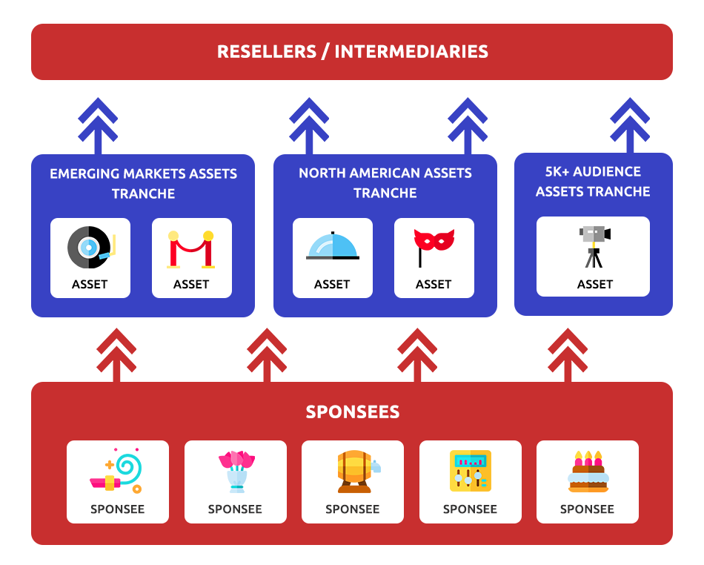
BUSINESS OVERVIEW
MAKING INDUSTRY TRANSPARENT
Each sponsorship asset ever created with information pertaining to it is stored on blockchain.
Any potential sponsor is free to examine each asset’s history, learn the price that was paid for it before, and make an independent decision based on real facts
By making historical prices of sponsorship assets available to everyone, we eliminate market inefficiency
Storage of legal data, including intellectual property rights, on blockchain reduces the time spent on due diligence.
SPONSORSHIP DERIVATIVES ECOSYSTEM
Sponsorship assets can be packaged in secondary products and sold to sponsors in bulk: tranches structured by location, industry, audience size, etc.
Potential for assets securitization
DECENTRALIZATION OF DECISION-MAKING
Users leverage target audience opinion

Slide 6

INDUSTRY OVERVIEW
Sponsorship industry market size will exceed $90Bn by 2019
Most sponsees prefer to outsource their sponsorship efforts to agencies
Sponsorship industry is the fastest growing marketing segment
SMALL AND MID-SIZED BUSINESS WANT TO GET IN
ESTIMATED SME SPONSORSHIP MARKET SIZE
SME are deprived of sponsorship opportunities.
USD 73.6Bn

Slide 7
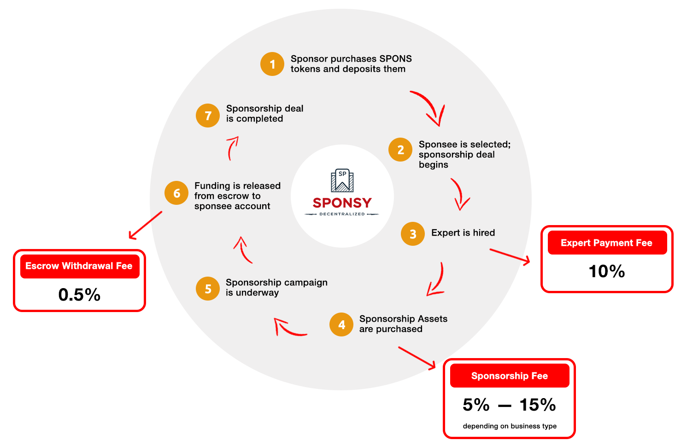
BUSINESS CYCLE

Slide 8







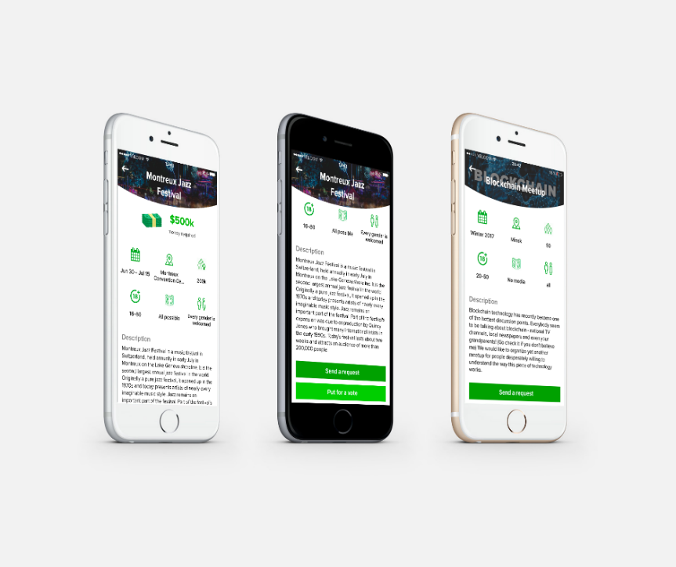


TRACTION
Adidas — large worldwide sportswear brand — signed MOU with Sponsy regarding our mutual intentions to enter into a partnership.
Bosch will use Sponsy to run some of its sponsorship campaigns.
ICO PROJECTS PARTNERS
WORKING MVP
MVP: https://sponsy.org/sponsy_login.html
iOS Mobile App : https://itunes.apple.com/us/app/sponsy/id1295314583?mt=8
MVP Video Demo: https://youtube.com/watch?v=wxECRwScHxs

Slide 9
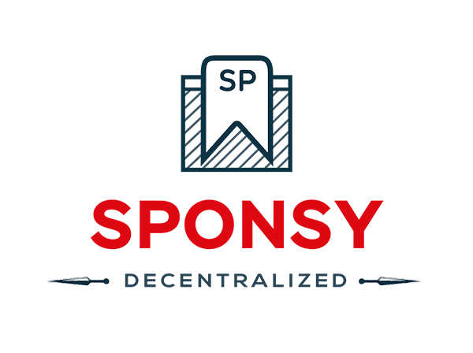
WHY SPONSY?
1
SME are deprived of sponsorship opportunities. Untapped USD 70Bn market
6
First mover advantage: no competition in decentralization of sponsorship industry
2
Partnership with Adidas proves the presence of product-market fit
4
Combining innovative technologies of assets tokenization and artificial intelligence to redefine sponsorship industry.
3
Experienced team (20+ years) behind the project with background of Experian, Credit Suisse, Microsoft.

Slide 10
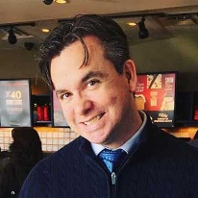

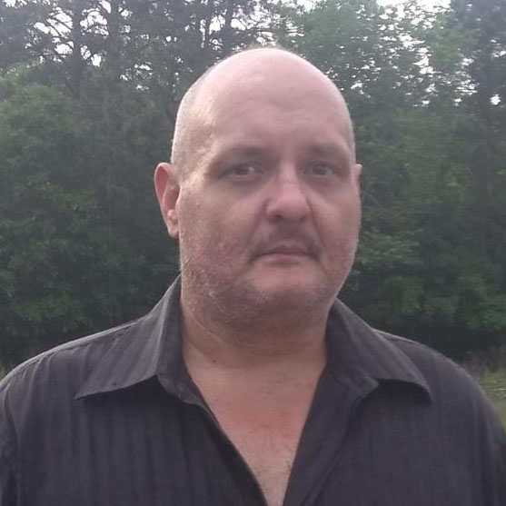


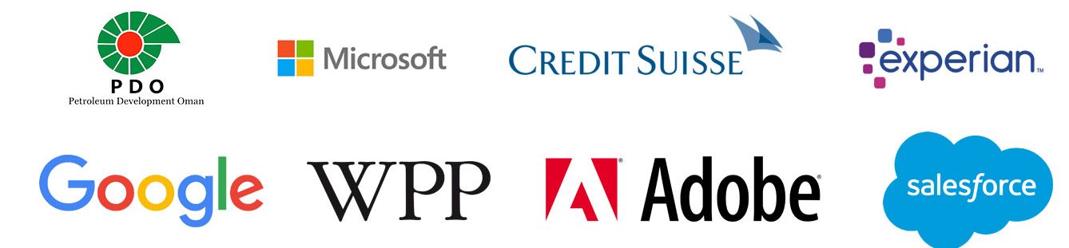
TEAM
D.C. Noye
Ivan Komar
Dan Vail
Chris Bouchard
Co-Founder,
Head of Software Development
Co-Founder,
Chief Executive Officer
Chief Technology Officer
Business Development Officer
5 years of software architecture experience. A few business exits
20+ years of software development and CIO experience
8 years of marketing and sponsorship experience.
10+ years of IT experience
Frontend developers, Mobile developers, Machine Learning expert, Data Science expert, 2 Blockchain developers
Team Experience

Slide 11
TOKEN SALE
We are accepting private placements
HARD CAP
SOFT CAP
BASE PRICE
SALE STAGE
USD 14M
USD 2M
USD 0.10
PRIVATE SALE
Use of Proceeds
Team & Management: 44.5%
General Administrative Costs: 15.5%
Further Platform Development: 7.2%
Business Development: 10.6%
Rewards Pool: 5%
Sales & Marketing: 13.6%
Experts Recruitment: 3.6%
Tokens Allocation
Pre-sale: 7.1%
Public sale: 42.9%
Sponsy Ecosystem Funds: 21%
Legal & Compliance Funds: 7%
Reserve Fund: 5%
Team: 15%
Advisors: 2%

