Slide 1

CAPSTONE PROJECT
Tracking Maternal Health Progress Toward SDG 3.1: A Global Data Analysis
Presented By:
Student Name- Mohd Sheeban Khan
College Name- Invertis University
Department- Computer Applications

Slide 2
OUTLINE
Problem Statement
Proposed System/Solution
System Development Approach
Algorithm & Deployment
Result
Conclusion
Future Scope
References

Slide 3
Problem Statement
The Sustainable Development Goal 3.1 aims to reduce the global maternal mortality ratio to less than 70 per 100,000 live births by 2030. Monitoring progress towards this goal requires analyzing country-wise data on maternal mortality and associated health indicators such as antenatal care coverage, births attended by skilled personnel, adolescent birth rates, and healthcare expenditures. Despite global efforts, maternal health outcomes vary drastically between regions and income groups, raising the need for data-driven insights into the factors influencing maternal health.

Slide 4
Proposed Solution
This project proposes a machine learning-driven approach to analyze global maternal health data using IBM Cloud Lite services.
Key components include:
Preprocessing country-wise datasets on maternal health.
Using supervised learning models to predict health indicators.
Providing visual insights and performance metrics.
Hosting model deployment using IBM Watson Studio & Cloud services.
🔗 GitHub Repository: https://github.com/Spoofy23/IBM-SkillsBuild-Internship-on-AI-Cloud-Technologies-Project/tree/main

Slide 5
System Approach
Data Source: Publicly available WHO & UN maternal health datasets
Cleaning: Handled nulls, outliers, standardized column names
Pivoting: For subgroup-based indicator analysis
Modelling: Linear Regression using Scikit-Learn
Tools Used:
IBM Watson Studio
IBM Cloud Lite
Jupyter Notebook
Python (Pandas, Scikit-learn)

Slide 6
Algorithm & Deployment
Algorithm Selection: Linear Regression
In our case, it was used to predict DataValue, such as antenatal care coverage or births attended by skilled personnel.
Data Input (Target Variable): DataValue
Represents the numeric value of maternal health indicators such as:
Antenatal care coverage
Births attended by skilled health personnel
Adolescent birth rate
Input Features:
TimePeriod (e.g., 2015-16)
Indicator (e.g., Antenatal care coverage)
Subgroup (e.g., Urban, Rural)
✅ These features were one-hot encoded to convert categorical values into numerical form for machine learning.
Training Process:
Used train-test split (80/20) to divide data for training and testing.
Achieved a very low Mean Squared Error (MSE), indicating accurate predictions.
Prediction Process:
The trained Linear Regression algorithm predicts future maternal health indicator values based on encoded historical data inputs like TimePeriod, Indicator, and Subgroup, without requiring real-time data during prediction using model which was trained and saved within IBM Watson Studio.

Slide 7
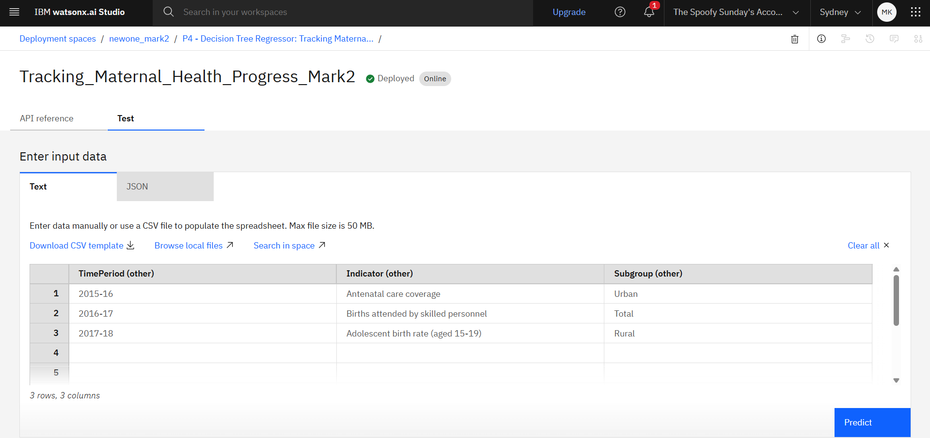
Result

Slide 8
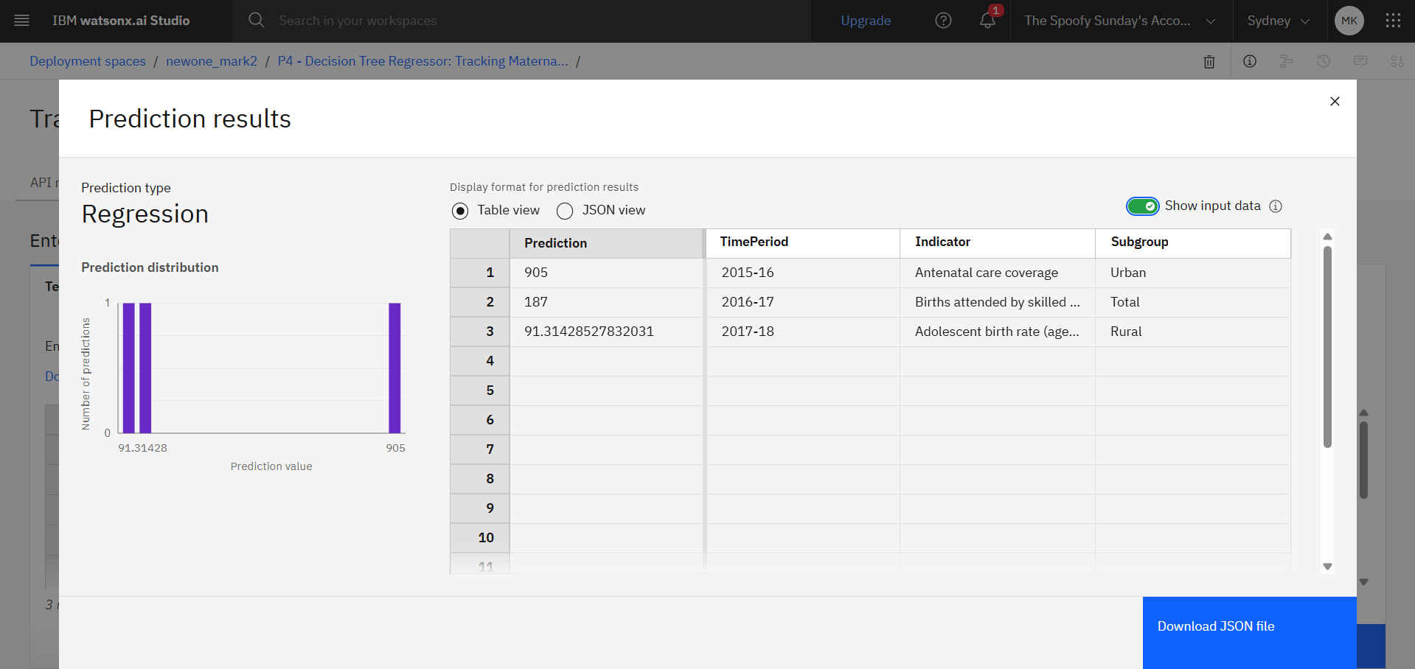
Result

Slide 9
Conclusion
The project successfully showcases the use of IBM Cloud in addressing a real-world health goal (SDG 3.1).
It demonstrates how machine learning models can uncover key trends in maternal health.
While some indicators showed high variance, the project establishes a strong foundation for scalable analysis.

Slide 10
Future scope
Integrate real-time WHO API data
Use more advanced models like XGBoost or LSTM
Develop an interactive dashboard using IBM Cloud Functions
Collaborate with health organizations for deeper validation
Extend model to SDG 3.2 and other healthcare goals

Slide 11
References
WHO Global Health Observatory
United Nations SDG 3.1 Tracker
Scikit-learn Documentation
IBM Cloud Lite & Watson Studio Docs
Dataset: Maternal Mortality Indicators (country-wise)

Slide 12
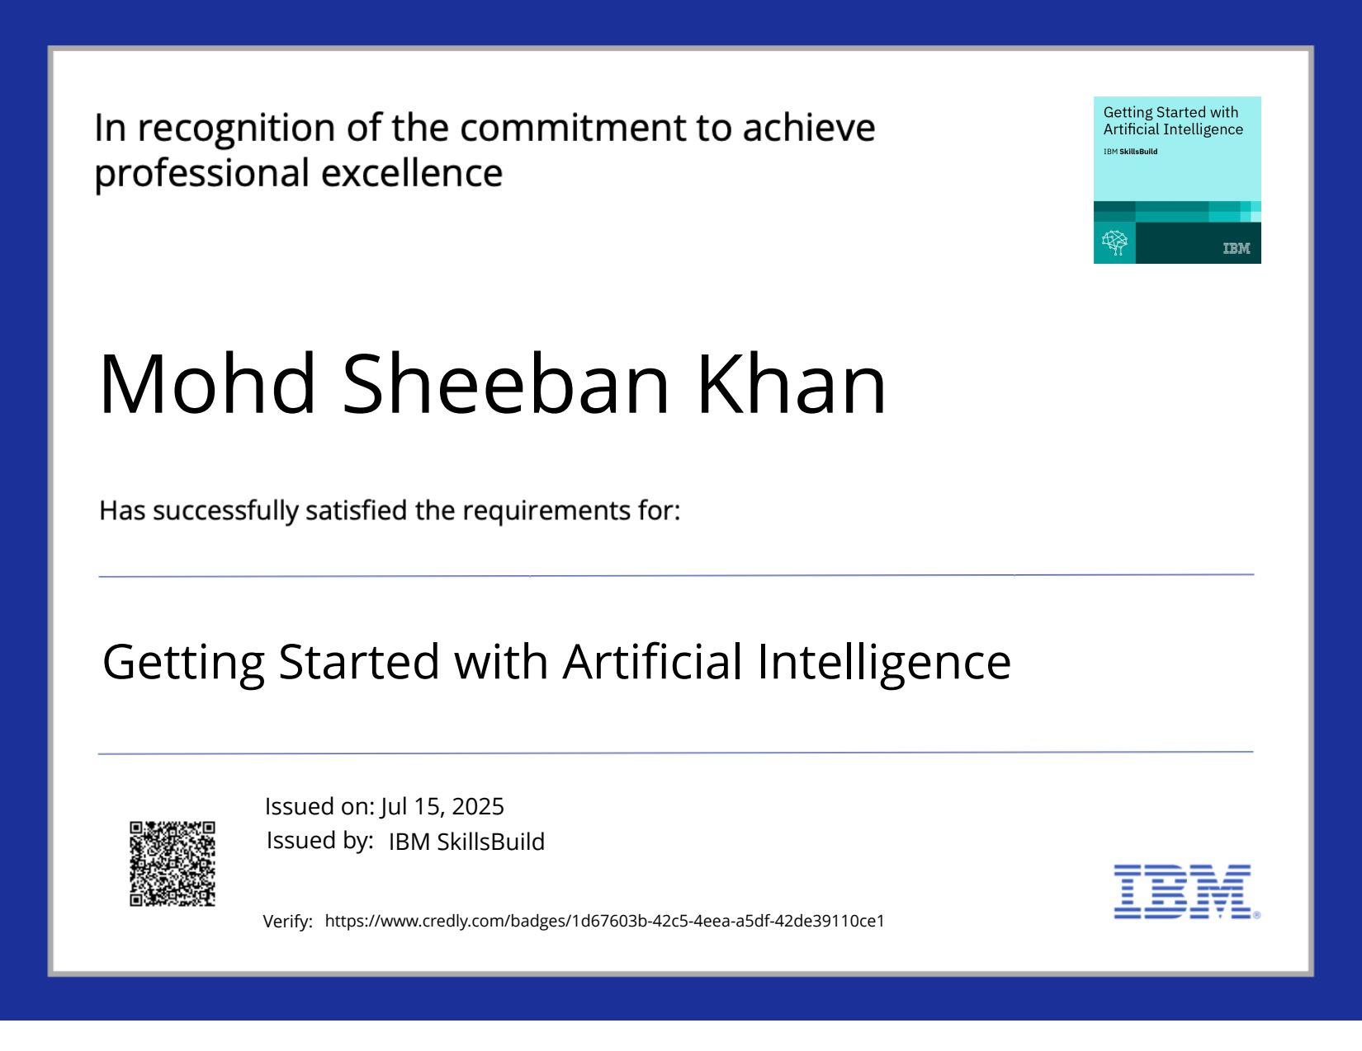
IBM Certifications
credly certificate( getting started with AI)

Slide 13

IBM Certifications
credly certificate( Journey to Cloud)

Slide 14
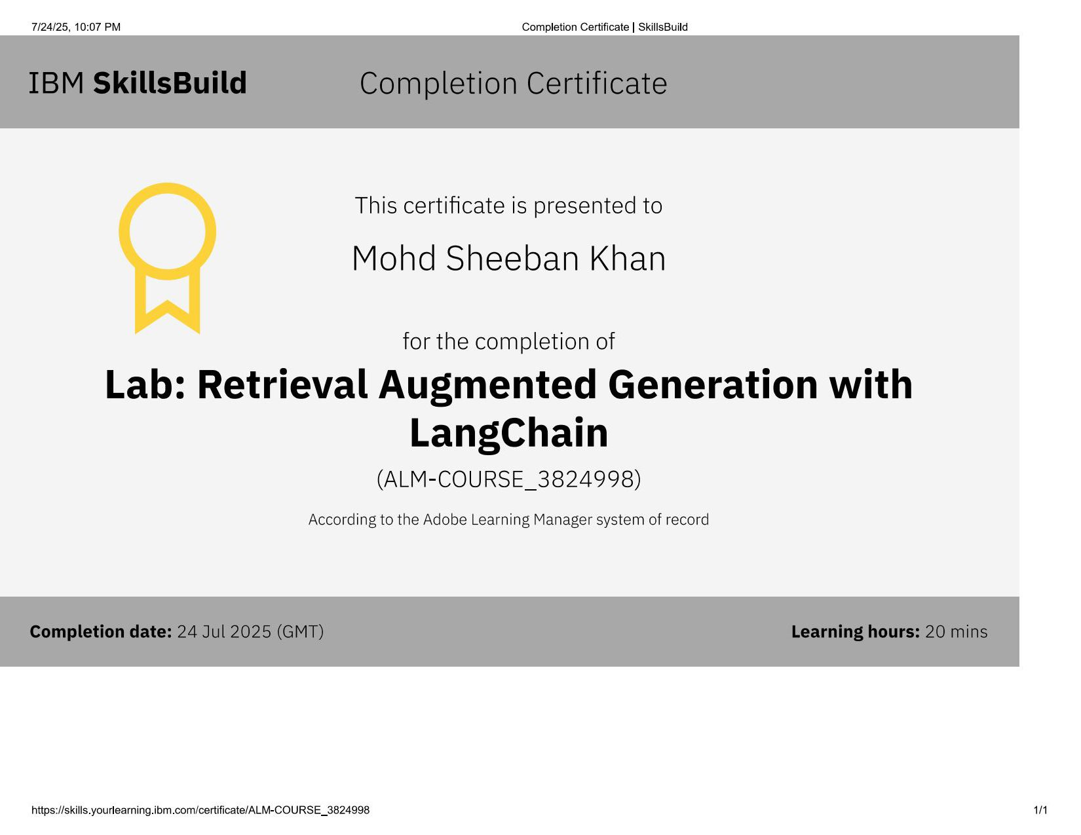
IBM Certifications
credly certificate( RAG Lab)

Slide 15
THANK YOU

