Slide 1
Synthetic Diabetes Prediction Data Analysis
Group 5: Adrian Aldridge, Eman Dweik, and Sarah Robinson

Slide 2
Introduction- The big "What & Why"
What is our dataset about?
The Source: We are using a Synthetic Diabetes Prediction Dataset sourced from Kaggle.
The Content: It simulates health data for thousands of individuals including features like Age, Gender, BMI, and Glucose levels.
The Nature of the Data: It is a synthetic or designed dataset. Meaning that it was computer-generated to mimic a real-world patterns for research and education rather than being gathered from actual patients.
What questions are we trying to answer?
Relationship Discovery: What is the statistical relationship between diabetes status and different physical traits?
Correlation Significance: Are common indicators, such as BMI or Glucose, as significant in this synthetic environment as they are in the real world?

Slide 3
Introduction- The big "What & Why" Continued
What questions are we trying to answer?
Predictive Ability: Can we build a machine learning model that accurately predicts diabetes status even when individual correlations appear weak?
Why is this important to study?
Educational Value: Synthetic datasets are vital tools for practicing data cleaning, statistical methodology, and visualization without the privacy constraints of using real medical records.
Understanding Data Limitations: This study teaches us how to identify the "artificial" nature of the data when expected clinical relationships, such as high BMI leading to glucose, are missing.
Methodological Rigor: It forces us to move beyond simple univariate analysis and apply more sophisticated multivariate techniques to find hidden patterns.

Slide 4
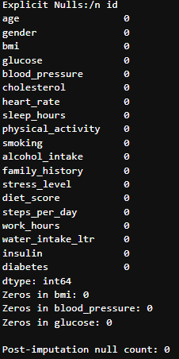
Data Cleaning & Standardization
Null-Value Audit
Action: We performed a comprehensive scan across all features to detect missing data points.
Explanation: In data science, missing values can act like "holes" in a blueprint; if they aren't addressed, the final structure (our model) could collapse or be inaccurate.
Justification: By confirming a 0% null rate, we avoid the need for "imputation"—the practice of guessing or filling in gaps—which keeps our data as authentic as possible.

Slide 5
Data Cleaning & Standardization Continued
Redundancy & Duplicate Removal
Action: We identified and removed identical row entries within the dataset.
Explanation: Duplicates act like an echo, making the computer believe a specific pattern is more common than it actually is.
Justification: Removing these ensures that our statistical averages and percentages reflect a true population rather than a repeated one.
Structural Standardization
Action: We moved the raw CSV into a dedicated /data directory and standardized filenames with underscores.
Explanation: This is the digital equivalent of an organized filing cabinet.
Justification: It ensures "Reproducibility," meaning any teammate or the professor can run our code immediately without having to manually fix file paths.

Slide 6
Exploratory Analysis: First Insights
Target Class Distribution (The 50/50 Split)
Action: We calculated the ratio of diabetic to non-diabetic outcomes.
Explanation: We found that our dataset is "Balanced," meaning we have an equal number of examples for both categories.
Justification: A balanced dataset is ideal for training a computer; it's like teaching a student about both "A" and "B" equally so they don't become biased toward one answer.
Distribution Overlap (The "Signal" Challenge)
Action: We compared traits like Glucose and BMI across both groups using histograms.
Explanation: We noticed that the charts for healthy and diabetic people sit almost directly on top of each other.
Justification: This "High Overlap" was a major discovery. It proved that there is no single "smoking gun" variable. It justified our choice to move beyond simple observations and use advanced modeling to find hidden, multi-variable patterns.

Slide 7
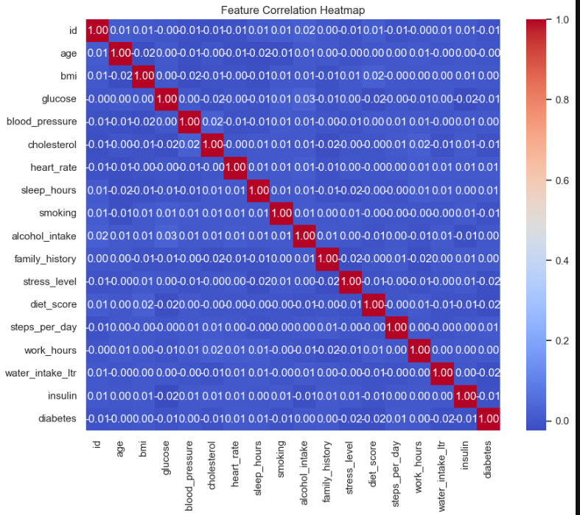
Correlation Heat MAP
Feature Correlation: We generated a correlation heat map to help identify strong signals that will be used later in the predicting task. Interestingly, the heatmap revealed very low correlation coefficients between the predictions and target variable.

Slide 8
Summary of Eda results
Feature Relationships: The correlation heatmap indicates that features are weakly correlated with the target variable diabetes, and each other. Suggesting that no single clinical factor stands out and our future model will likely need to capture complex, non-linear interactions between multiple variables.
Data Integrity: We successfully identified and handled "hidden zeros" in BMI and blood pressure. These were treated as missing data and resolved using grouped median imputation based on age, ensuring our clinical ranges are reasonable.

Slide 9
Summary of Eda results Continued
Outlier Management: Extreme values in BMI were detected using the IQR method. To preserve data volume while reducing variance, these values were capped at the calculated upper and lower bounds rather than being removed.
Target Balance: The dataset is balanced, with approximately 50% of instances representing diabetic outcomes. This simplifies our future modeling phase as we won't need to apply specialized sampling techniques.

Slide 10
Statistical Analysis & Hypothesis Testing
What is the importance of statistical testing?
Asking questions and finding patterns within the data
Are there relationships between variables?
Are the relationships meaningful?
Rules for every test:
Null Hypothesis – typically assuming that there is no relationship
Alternate Hypothesis – assuming whatever relationship we are testing for
Significance level – every test here is a 0.05 significance level, meaning we accept a 5% chance of being wrong about our test
Correlation Scale:
+1 = Strong positive relationship
0 = No relationship
-1 = Strong negative relationship

Slide 11
Test 1 – T-Test (Glucose vs. Diabetes)
Question
Do people with diabetes have different average glucose levels than those without?
Why this Test
We are comparing average values between two unrelated groups to check if those values change significantly with each other.
Hypotheses
Null: There is no difference in glucose levels.
Alternate: There is a difference in glucose levels.
Results
T-Statistic: -0.6286
P-Value: 0.53
Interpretation
0.53 P-Value means there’s a 53% chance that any relationship between glucose and diabetes is random.
Decision
0.53 > 0.05, we fail to reject the null hypothesis. Meaning there is no significant difference in glucose levels between diabetics and non-diabetics in this dataset.

Slide 12
Test 2 – Chi-Square (Gender vs. Diabetes)
Question
Does gender affect diabetes status?
Why this test
We are checking if there is a relationship between two categorical (non-numerical) variables.
Hypotheses
Null: Gender and diabetes are not related.
Alternate: Gender and diabetes are related.
Results
Chi-Square: 2.3265
P-Value: 0.13
Degrees of Freedom: 1
Interpretation
0.13 P-Value means there’s a 13% chance that any relationship between gender and diabetes is random.
Decision
0.13 > 0.05, fail to reject the null hypothesis. Gender and diabetes are not significantly related in this dataset.

Slide 13
Test 3 – Correlation (BMI vs. Glucose)
Question
Do glucose and BMI levels have a linear relationship (increase or decrease together)?
Why this Test
We are comparing two numerical variables to see how strongly (or weakly) they are related.
Hypotheses
Null: No correlation (correlation = 0)
Alternate: There is a correlation (correlation ≠ 0)
Results
Correlation: 0.0025
P-Value: 0.93
Interpretation
0.0025 is very close to zero, implying basically no correlation. 0.93 P-Value means that if there is any correlation there is a 93% chance it is random.
Decision
0.93 > 0.05, we fail to reject the null hypothesis. There is no correlation between BMI and Glucose.

Slide 14
Statistical Analysis Final Insights
Test Results:
Test 1 – No difference
Test 2 – No association
Test 3 – No correlation
Conclusions:
Everything was statistically insignificant
No real relationships are shown between any of the variables
This lines up with the exploratory analysis conducted
Why this could have happened:
The dataset used is synthetic (randomly generated)
Diabetes is complex and multiple variables effect it, and in the future tests that examine more than one or two variables at a time would need to be used.

Slide 15
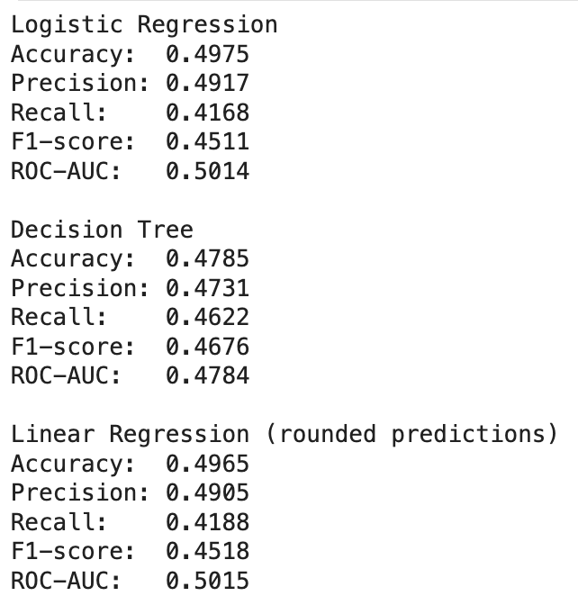
Data Modeling
Baseline models:
All three were performed to see which one would yield better results.
logistic regression is the most suitable baseline model due to the higher accuracy and precision
Accuracy
Overall correctness
Proportion of all predictions that are correct
Precision
Exactness of positive predictions
From all predicted "diabetes" cases, how many have diabetes?
Recall
Completeness of positive predictions
From all actual diabetes cases, how many did we catch?
F1-score
Harmonic mean of precision and recall
Looks at both false positives and false negatives.
ROC-AUC
Ability to separate classes
Probability that a random diabetic has a higher predicted score than a random non‑diabetic

Slide 16
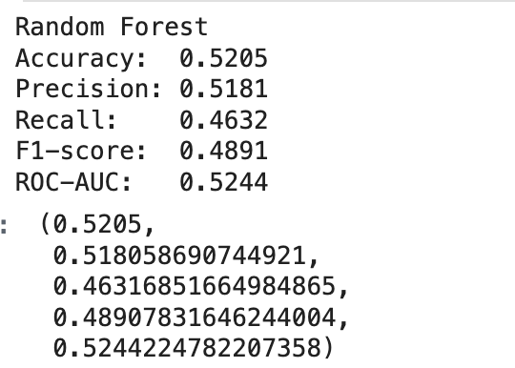
Data Modeling
Advanced Model
Random Forest was chosen due to it capturing non-linear interactions, and its ability to reduce generalizations and overfitting.
100 Trees were used in this model, simply because it is a standard number.
Accuracy
About 52% of predictions are correct – only slightly better than random guessing
Precision
Predictions are correct around 52% of the time
Accuracy
The model catches only about 46% of actual diabetes cases
F1‑score
The harmonic mean of precision and recall is below 0.5, indicating poor balance.
ROC‑AUC
The model distinguishes diabetics from non‑diabetics only 52% of the time

Slide 17
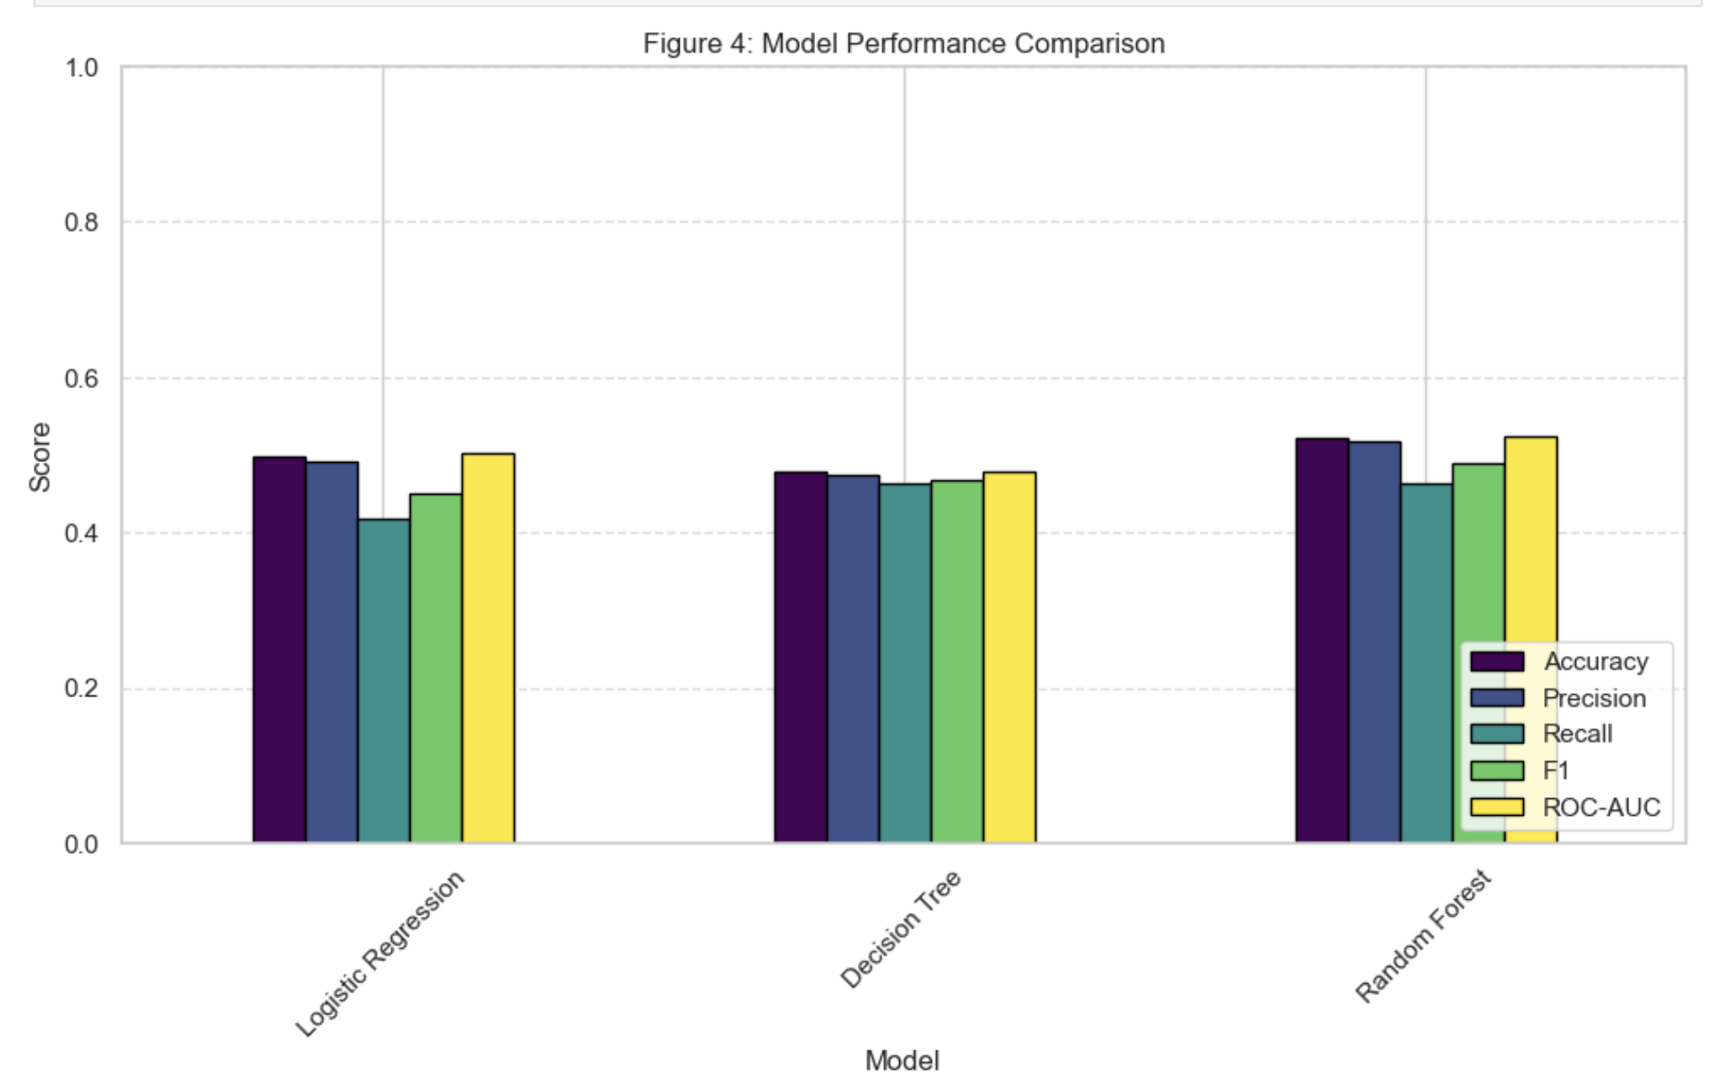
Data Visualization
Model Performance Comparison
Baseline Models
Logistic Regression was chosen due to it being the preferred baseline model while Decision Tree was chosen due to it showing poorer performance when compared to the others.
The purpose of this graph is to further visualize the differences between the different models discussed above. Based on this, we can see that the differences between Logistic Regression and Random Forest are not significant. However, we can see that Logistic Regression misses the highest number of diabetic cases when compared to the rest. It should be noted that the difference between Random forest and random guessing is very marginal

Slide 18
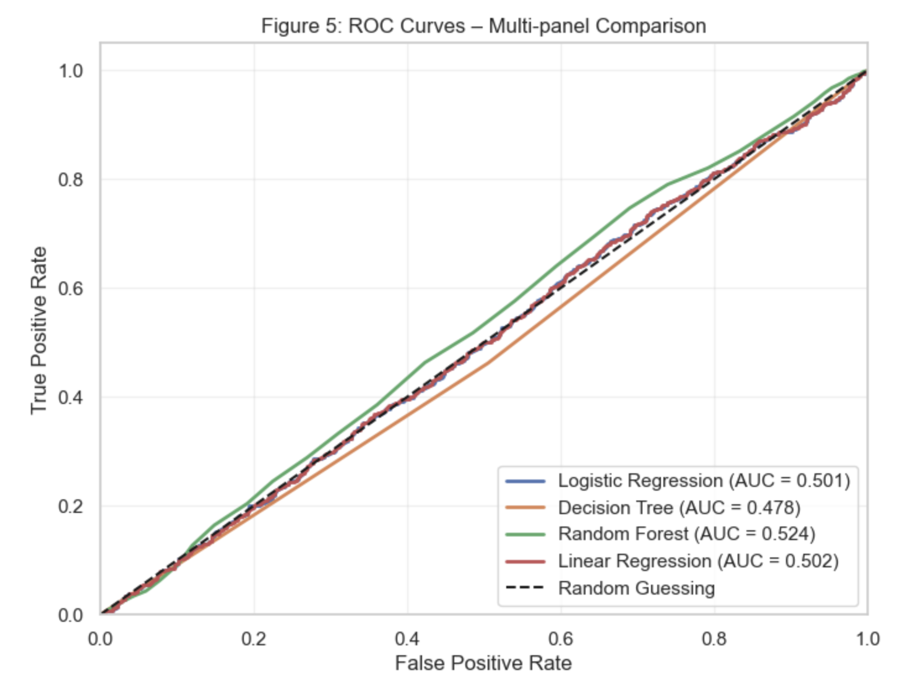
Data Visualization
ROC Curves a Multi-panel Comparison
ROC curves for Baseline models and the advanced model. There is also a random guessing diagonal to act as a reference for comparison.
This specific graph was chosen due to it being a straightforward way to visualize the differences between the models.
None of the models are distinctly better or worse, only slight differences can be observed. All curves lie close to the diagonal. None significantly surpass random guessing.
This dataset lacks any meaningful ability for predictions related to diabetes.

Slide 19
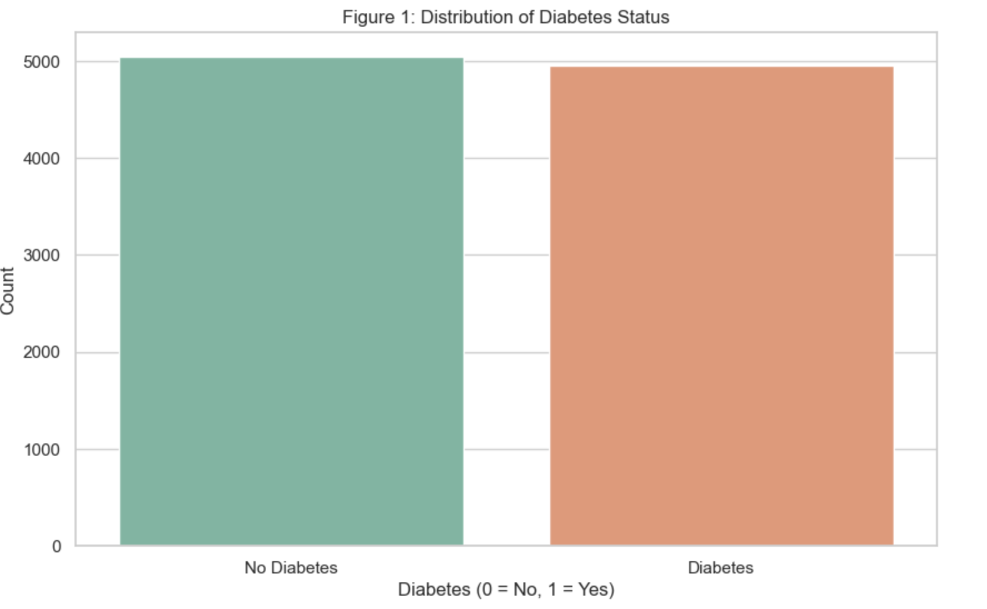
Data Visualization
Distribution of Diabetes Status
A bar chart was used because it's a familiar and effective count plot.
The dataset is generally balanced, both categories (diabetic and non-diabetic) have around the same number of people.
This may contribute to lack of correlations found in the statistical analysis section

Slide 20
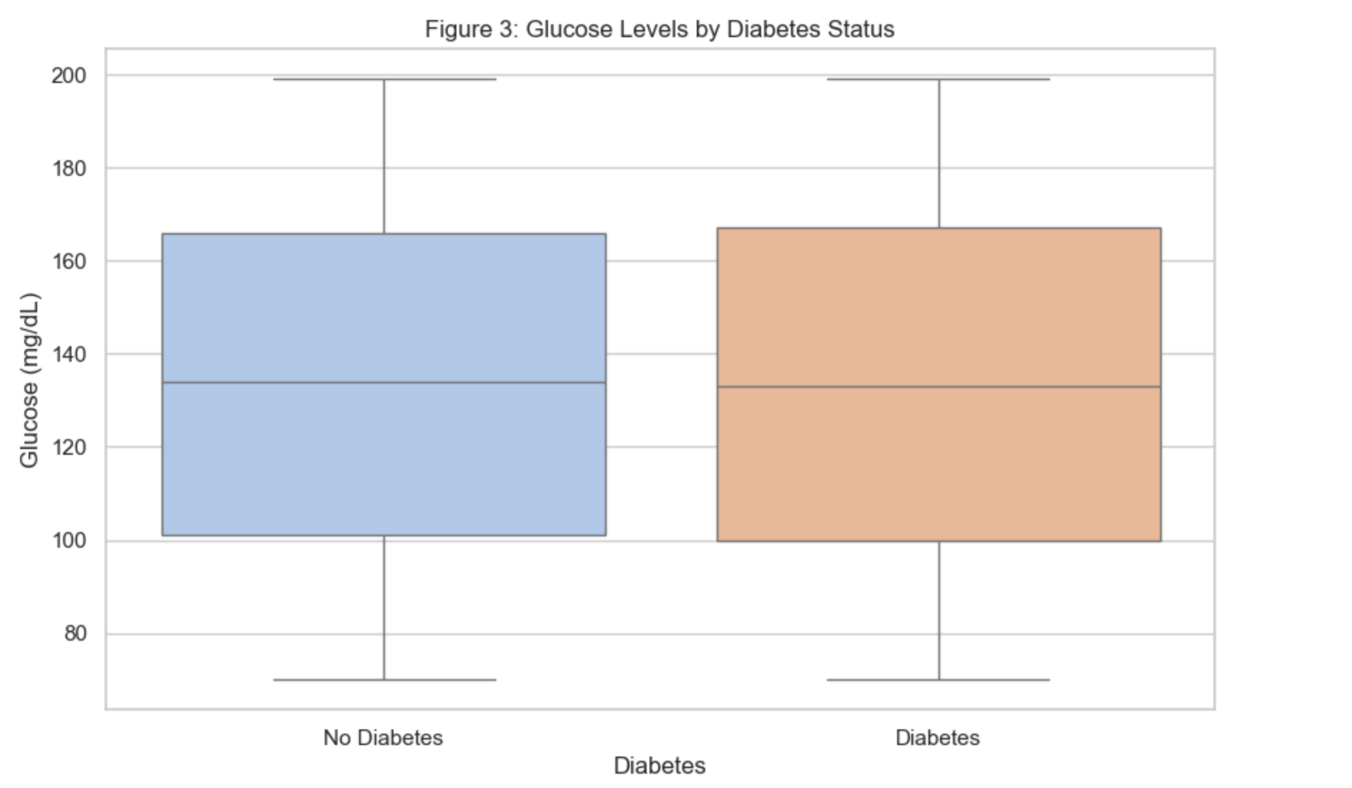
Data Visualization
Glucose levels by Diabetic Status
Medians are very close, the ranges overlap
This aligns with the T-Test performed in the statistical analysis section
Glucose alone is not a reliable predictor which explains poor model performance
This specific graph was chosen because boxplots are excellent at representing the difference between a continuous variable across two categories.

Slide 21
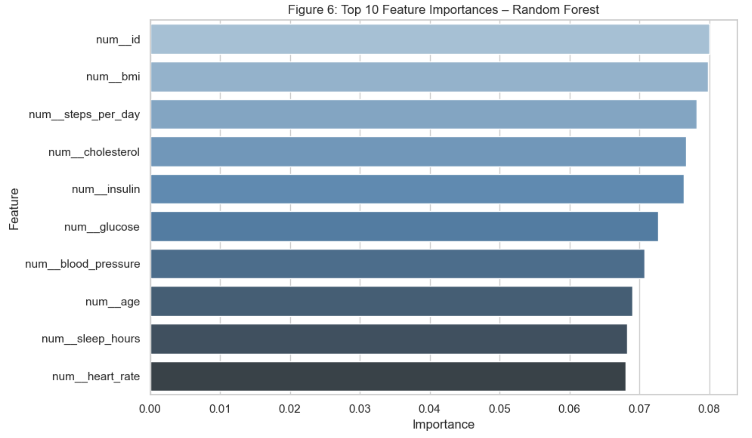
Data Visualization
Top 10 Feature Importance, based on Random Forest
Ranks the most key features based on Random Forest
Num_id is ranked as the most important, this suggests that the model is overfitting to noise instead of learning meaningful relationships
This suggests that the synthetic data is unreliable.
This specific graph was chosen because Feature importance is a unique output of Random Forest. Horizontal bars are also easy to read.

Slide 22
Conclusions and Final Insights
Research Questions
We were aiming to find relationships between variables, particularly any correlations between variables and diabetes status within the dataset.
We used statistical tests, models, and visualizations to examine these correlations.
We wanted to examine the importance of synthetic data even if it does not align with real-world data.
Insights
Upon analysis and visualization, we found no significant relationships or correlations between any variables.
This is likely due to the synthetic and randomly generated nature of the dataset.
It could also be due to the complex nature of diabetes as a disease.
Despite finding no real correlations, studying and conducting tests on synthetic datasets such as this is a good educational tool and can inform our actions on real-world data.
However, this means this dataset is likely not a good diagnostic tool and if one wanted to train recognition algorithms or medical students a real-world dataset should be chosen.
Overall, this project was a wonderful learning opportunity and informed how we would conduct tests on real datasets in the future.

