Slide 1
MOTION ESTIMATION
An Overview
BY: ABHISHEK GIROTRA
Trainee Design Engineer

Slide 2
In Video Coding for Compression, the basic idea is to exploit redundant data.
2 types of Redundancy in Moving Picture:
a) Spatial Redundancy b) Temporal Redundancy
Cause for Temporal redundancy:
Frame to Frame in a moving picture the picture elements have a motion.
Objects of one frame move within in frame to form object of other frame.
Motion can be in form of Zoom , Rotation, and Translation motion
In Video Coding : 2 stage process followed
a) Processing for reducing Temporal Redundancy
b) Processing for reducing Spatial Redundancy

Slide 3
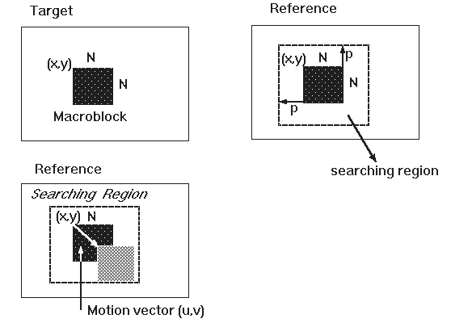
TECHNIQUES USED FOR REDUCING TEMPORAL REDUNDANCY
Motion Compensation :
Division of frames into macroblocks ( motion in frame will cause pixels within block to move consistently in a consistent direction
Form of Vector Quantization, Codebook comprises of macroblocks in reference frames, with the codewords of motion vectors used to predict values of macroblocks to be compressed.
Process of determining motion vectors is MOTION ESTIMATION TECHNIQUE
MOTION ESTIMATION

Slide 4
BROAD CLASSIFICATION OF MOTION ESTIMATION TECHNIQUE
Block Based Motion Estimation Algorithms
Mesh Based Motion Estimation Algorithms
Time-domain Algorithms
Frequency-domain Algorithms
Matching Algorithms
Gradient Based Algorithms
Block-matching
Feature-matching
Pel-recursive
Block-recursive
Phase-correlation (DFT)
Matching in (DCT) domain
Matching in wavelet domain

Slide 5
Most of the fast motion estimation schemes are based on matching algorithms, which are composed of one or more of these basic strategies.
Distance criterion:distortion criterion for measuring distance between previous block and search area block.Various Criterions are:
CCF(Cross-Correlation Function)
MSE(Mean Square Error Function)
MAE(Mean Absolute Error)
SAD(Sum of Absolute Difference)
PDC(Pixel Difference Classification)
MAE(or MAD,SAD are commonly employed due to their simplicity in hardware implementation)
Search Strategy:The fastness of the algorithm depends on the search strategy used.
All fast motion estimation search algorithms use search area sub-sampling technique, where whole integer-pel are not used.
Secondly, search area is again divided into two types: 1) Fixed Search Area 2)Adaptive Search Area

Slide 6
VARIOUS ALGORITHMS PRESENT
FIXED SEARCH AREA ALGORITHMS:
2DLOG,TSS,CDS, OTS, NTSS,4SS,Cross Search,ODFS,PHODS,OSA,SES,Cost reduction of 3SS
SCENE ADAPTIVE SEARCH AREA ALGORITHMS:
DSRA,DSWA,BBGS,Global/Local incompensability analysis
HIERARCHICAL AND MUTIRESOLUTION FAST BLOCK MATCHING ALGOS:
HPDS,HBMA,Pel Decimation Technique, Adaptive Pel Decimation Technique
FEATURE MATCHING ALGO:
PTSS,HPM,SEA,BFM,BPM,BBM
PREDICTIVE MOTION ALGO:
SBMA,New Prediction Search Algorithm
MESH BASED ME ALGO:
HMMA,EBMA

Slide 7
FREQUENCY - DOMAIN TECHNIQUES
This technique is based on relationship between transformed coefficients of shifted images, and they
are not widely used for image sequence coding. In this, the motion estimation is done by taking the
transform of the block first in frequency domain ( e.g. by DCT or by wavelet )
FEATURE MATCHING
Feature matching is different from Block Matching.
Matching of meta information extracted from the current block and search area picture elements.
Performed by morphological filters and projection methods.
BLOCK MATHCHING
Matching of (all/some) pixels of current block with the candidate block in search area is performed
according to distance criterion described.
PREDICTIVE MOTION ESTIMATION
Prediction of Motion Vectors is usually performed to gain an initial guess of next motion vector.
This reduces the computational burden.

Slide 8
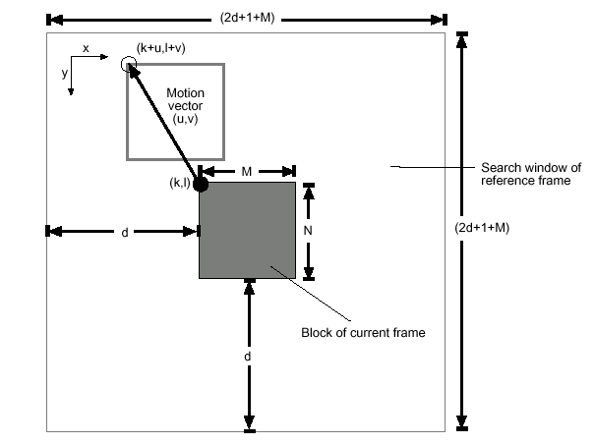
EXHAUSTIVE SEARCH
Simplest algorithm, but computationally most expensive
Evaluates cost function at every location in the search area
For MAD or MSD cost function, it evaluates it (2p+1)^2 times.
For d=6, Search Range Parameter it gives 169 iterations for each macroblock.
For d=8 it gives 289 iterations.

Slide 9
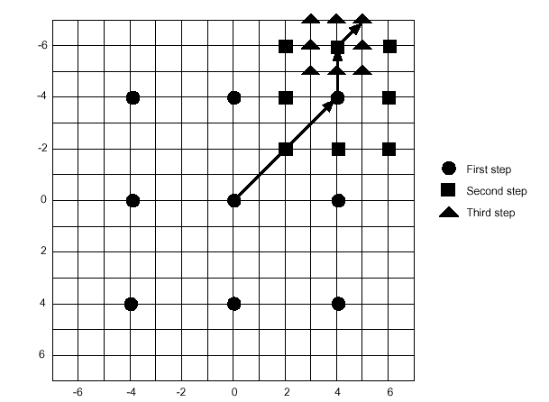
THREE STEP SEARCH
The three-step search algorithm (3SS) is proposed by Koga et. al. in 1981 [6].
This algorithm is based on a coarse-to-fine approach with logarithmic decreasing in
step size as shown. The initial step size is half of the maximum motion displacement d .
For each step, nine checking points are matched and the minimum BDM point of that step is chosen as the starting center of the next step. For d = 7, the number of checking points required is(9 + 8 + 8)=25. For larger search window (i.e. larger d), 3SS can be easily extended to n-steps using the same searching strategy with the number of checking points required equals to [1 + 8 log2(d + 1) ].

Slide 10
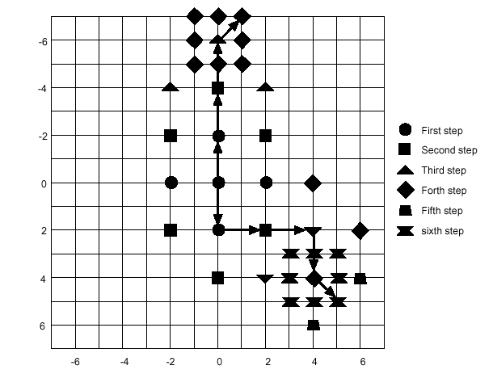
2D LOGARITHMIC SEARCH
2D-logarithmic search (2DLOG) is proposed by Jain et. al. in 1981 [8]. It
uses a (+) cross search pattern in each step. The initial step size is [d/4]
The step size is reduced by half only when the minimum BDM point of previous step is
the center one or the current minimum point reaches the search window boundary.
Otherwise, the step size remains the same. When the step size reduced to 1,
all the 8 checking points adjacent to the center checking point of that step are
searched. Two different search paths are shown. The top search path requires (5 +3 +3 +8) = 19 checking points. The lower-right search path requires (5+3+2+3+2+8) =23 checking points.

Slide 11
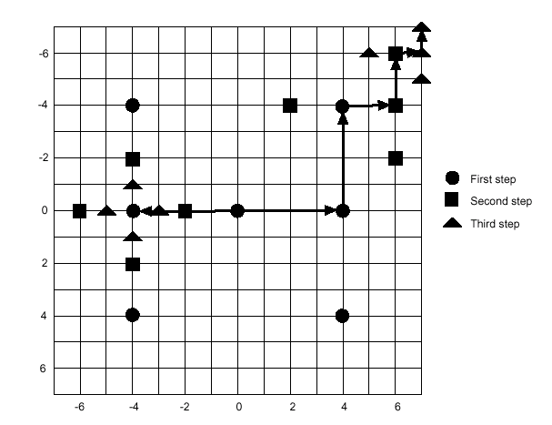
ORTHOGONAL SEARCH ALGORITHM
The orthogonal search algorithm (OSA) is proposed by A. Puri et. al. In 1987 [19]. It consists of pairs of horizontal and vertical steps with a logarithmic
decreasing in step size and its initial step size is f(d/2)
where it is the lower integer truncation function. The search paths of OSA are shown in Starting from the horizontal searching step, three checking points in the horizontal direction are searched. The minimum checking point then becomes the center of the vertical searching step which also consists of three checking points. Then the step size decreases by half and using the same searching strategy. The algorithm ended with step size equals to one. For d = 7, the OSA algorithm requires a total of (3 + 2 + 2 +2 + 2 +2)=13 checking points. For the general case, the OSA algorithm requires (1 + 4 log2(d + 1) ) checking points.

Slide 12
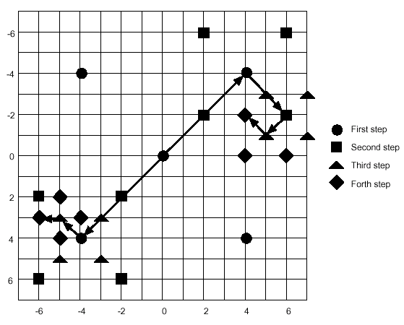
CROSS SEARCH ALGORITHM
The cross search algorithm (CSA) is proposed by Ghanbari in 1990 [9]. It is also a logarithmic step search algorithm using a (X) cross searching patterns in each step. Figure shows two search paths of CSA. As shown, there
are five checking point placed in a cross pattern in each step. The initial step size
is half of d. As the step size decreased to one, a (+) cross search pattern (as shown in lower-left side of figure) is used if the minimum BDM point of the previous step is either the center, upper-left or lower-right checking point. Otherwise, (X) cross search pattern (as shown in upper-right side of figure) is used. For d = 7,
the number of checking points required is (5+ 4 +4 +4)=17. For the general case, the number of checking points required is (5 + 4 log2d).

Slide 13
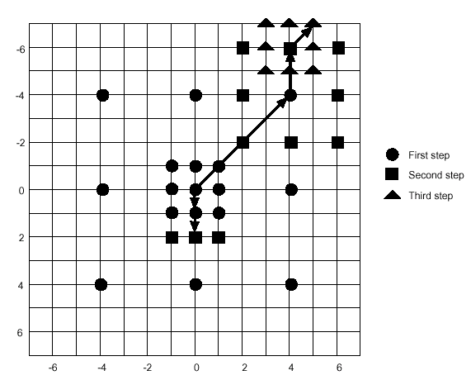
NEW THREE STEP SEARCH ALGORITHM
For those video sequences where the motion vector distribution is highly centre biased, an additional 8 neighbor checking points are searched in the first step of N3SS as shown in . Figure shows two search paths with d = 7.The center path shows the case of searching small motion. In this case, the minimum BDM point of the first step is one of the 8 neighbor checking points. The search is halfway-stopped with matching three more neighbor checking points of the first step's minimum BDM point. The number of checking points required is (17 + 3) = 20. The upper-right path shows the case of searching large motion. In this case, the minimum BDM point of the first step is one of the outer eight checking points. Then the searching procedures proceed the same as the 3SS algorithm.The number of checking points required is(17 + 8 + 8)=33.

Slide 14
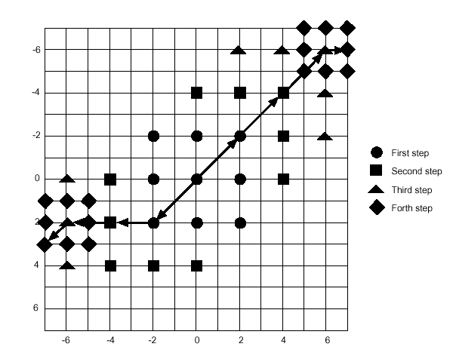
4 STEP SEARCH ALGORITHM
The four-step search algorithm (4SS) is proposed by L.M. Po and W. C. Main 1996 [11]. This algorithm also exploits the center-biased characteristics of the
real world video sequences by using a smaller initial step size compared with 3SS.The initial step size is fourth of the maximum motion displacement d (i.e. d/4). Due to the smaller initial step size, the 4SS algorithm needs four searching steps to reach the boundary of a search window with d = 7. Same as the small motion case in the N3SS algorithm, the 4SS algorithm also uses a halfway-stop technique
in its second and third step's search. Figure shows two search paths of 4SS for searching large motion. For the lower-left path, it requires (9+5+3+8)=25
checking points. For the upper-right path, it requires (9+5+5+8)=27checking points that is the worse case of the algorithm for d = 7.

Slide 15
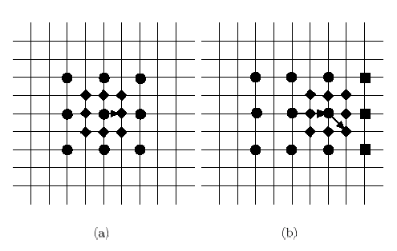
Figure shows two search paths of 4SS for searching small motion. For the left path, it requires (9 + 8) = 17 checking points. For the right path, it requires (9+ 3+ 8)=20 checking points. As shown in last fig. and this, there are either three or five checking points required in the second or third searching step. Moreover, if the minimum BDM checking point of that searching step is the center one, the step size
is reduced by half and jump to the forth step. For the general case, the algorithm can be extended as follows. If the step size of the forth step is greater than one, then another four-step search is performed with the first step equals to the last
step of the previous search. The number of checking points required for the worse case is
(18 log2 [(d+1)/4] + 9).

Slide 16
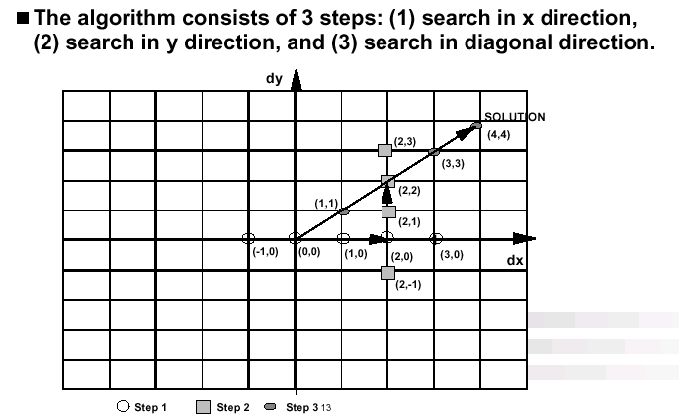
CONJUGATE DIRECTION SEARCH ALGORITHM
The CDS is an adaptation of the traditional iterative conjugate direction search method as shown in figure. The computational cost of CDS algorithm is given as
(2*(2*p+1))

Slide 17
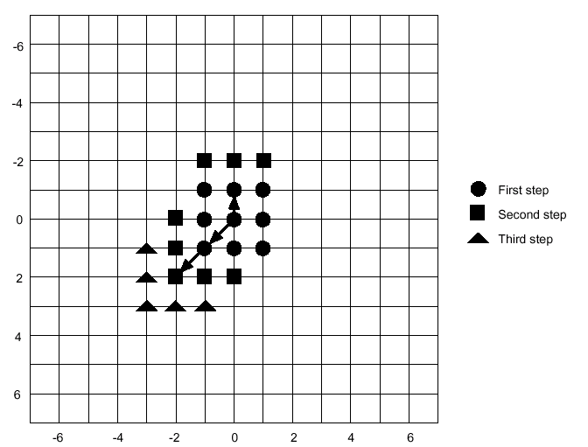
BLOCK BASED GRADIENT DESCENT SEARCH
The Block-based gradient descent search algorithm (BBGDS) is proposed by L. K. Liu and E. Feig in 1996 [20]. This algorithm uses a very center-biased search patterns of 9 checking points in each step with step size of one. It does not restrict the number of searching steps but it is stopped when the minimum checking point of the current step is the center one or it is reached the search
window boundary. There are also overlapped checking points between adjacent steps. The BBGDS algorithm performs better in searching small motions. Two small motion search paths of BBGDS are shown.

Slide 18
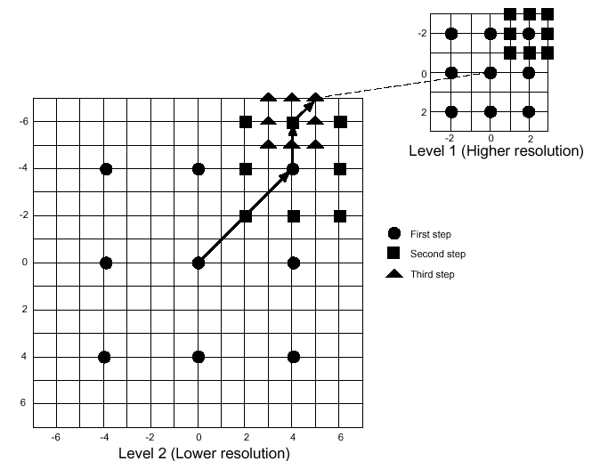
HIERARCHICAL BLOCK MATCHING ALGORITHM
The hierarchical block matching algorithm (HBMA) is proposed by M. Bier-ling at 1988 [21]. The basic idea of hierarchical (multiresolution) block matching is to perform motion estimation at each level successively, starting with the lowest resolution level as shown. The estimate of the motion vector at a lower resolution level is then passed onto the next higher resolution level as an initial estimate. The motion estimation at higher level refine the motion vector of the lower one. At higher levels, relatively smaller search window can be used as it starts with a good initial estimate. For each level, one could use fast BMAs such as 3SS, 4SS and 2DLOG for fast motion estimation. Suppose there is a HBMAwith two levels as shown. The lower level is formed by sub-sampling the higher level by a factor of two in both horizontal and vertical directions. One pixel displacement at the lower level corresponds to two pixels displacement at the higher level. That is, the search window size in pixel is fourth of the one at higher level. The HBMA can be applied to video codec with spatial scalability such as MPEG-2 and H.263+ [22], in which the video sequence can be divided into layers of different spatial resolutions.

Slide 19
MESH BASED ESTIMATION
In mesh-based motion, unlike BMA, the computation of a motion vector is affected by the neighboring vectors. This interdependence necessitates a costly iterative approach to the computation of motion. The computational cost of mesh-based motion has been a main drawback of this otherwise powerful technique.
So, in a mesh based model :
Step 1: The current frame is divided into picture elements ( which may be any polygon) such that a mesh or control grid is formed .
Step 2: Then the nodes of each mesh is searched for in the previous reference frame.
Step 3: After knowing the displacement vectors of the nodes of the picture element the displacement vectors of the rest of the pixels are obtained by interpolating the known motion vectors.

Slide 20
NODE SEARCHING TECHNIQUES
1. Hierarchical mesh based matching algorithm. (HMMA).
2. Hierarchical block based matching algorithm (HBMA).
In HMMA the corners of blocks are taken as nodes while in HBMA the centers of blocks are taken as nodes.
While in terms of PSNR values : The coding gain of HMMA is not significant
But incase of prediction accuracy mesh based models tend to give more pleasing prediction, especially in the presence of non-translational motions, like rotation and turning.
So, by using HBMA we can certainly exploit lower complexity advantage of BMAs in mesh based models as well.

Slide 21
MESH BASED TECHNIQUE Vs BMA
ADVANTAGES:
Since the mesh based models employ interpolation for obtaining motion vectors of the picture elements within a given range , this gives in general a more continuous effect than BMAs .
So, in terms of prediction accuracy, mesh based models can give visually more pleasing prediction, specially in the presence non-translational motions, such as head rotation and turning.
DISADVANTAGES:
While in terms of computational complexity the BMAs certainly have an edge over Mesh based ME , since mesh based models involve interpolation of motion vectors which requires more complex architecture.

Slide 22
WHICH ALGORITHM TO USE ?
As Motion estimation has various promises in applications like video telephony,HDTV,automatic video tracker and computer vision etc. Thus, Extensive research is has been done over years to develop new algorithms and designing cost - effective and massively parallel hardware architecture suitable for current VLSI technology.
So, till now there are unlimited number of algorithms being claimed by different researchers in world .
From all the previous types of algorithms discussed, Block Matching Algorithms are the simplest way for motion estimation in terms of hardware and software implementations.
Following table highlights the important characteristic of each algo:

Slide 23
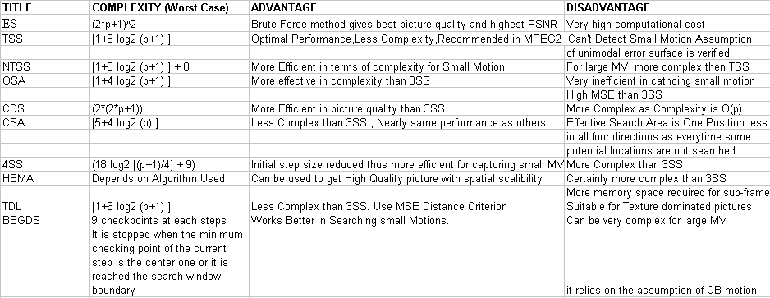
CONCLUSION

