Slide 1
An introduction to source code analysis and transformation with Spoon
Authors: the contributors of Spoon.
Feel free to remix and extend.
Pull requests welcome at https://github.com/INRIA/spoon/
Latest version at http://www.monperrus.net/martin/lecture-slides-source-code-analysis-and-transformation.pdf

Slide 2
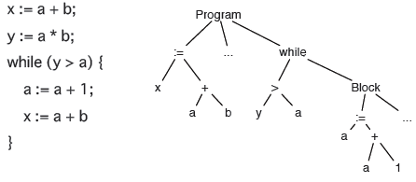
Astract Syntax Tree
An Abstract Syntax Tree is a data structure representing source code.
Libraries exist to compute and manipulate ASTs.

Slide 3
Astract Syntax Tree
There can be many different ASTs for he same programming language
  Typed vs untyped nodes
  Use enum instead of classes
  Different ways to traverse the AST
  Read-only or read-write?

Slide 4
Example: SrcML
SrcML provides XML-based ASTs that can be analyzed with any DOM technology
<unit>
<comment type="line">// copy the input to the output</comment>
<while>while
<condition>(<expr><name><name>std</name>::<name>cin</name></name> &gt;&gt; <name>n</name></expr>)</condition>
<expr_stmt><expr><name><name>std</name>::<name>cout</name></name> &lt;&lt; <name>n</name> &lt;&lt; '\n'</expr>;</expr_stmt></while>
</unit>
Pro: toString is valid code
Pro: Can be loaded in any XML ready library
Con: no complete AST (very fine grain expressions are not handled)

Slide 5
Tools for analyzing Astract Syntax Trees
There are many tools for extracting and analyzing ASTs. They depend on the language to be parsed.
  Spoon (Java)
  SrcML (Java/C++)
  JDT (Java)
  AST (Python)
  Clang (C)

Slide 6
Example: Spoon
Spoon provides Java ASTs:
That can be analyzed
That can be transformed
With a powerful API

Slide 7
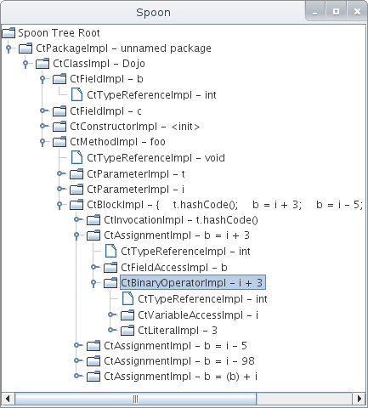
Navigating an AST
java spoon.Launcher -g -i srcDir
public class Dojo {
public int b;
public double c;
void foo(Object t, int i) {
t.hashCode();
b=i+3;
b=i-5;
b=i-98;
b=b+i;
}
}

Slide 8
Source Code Analysis

Slide 9
AST analysis
AST analysis is useful is a number of different use cases:
For implementing Lint tools / bad smells detection
  (your own, specialized Lint, FindBugs, PMD, Checkstyle, JLint)
Verification of contracts
  Only use constructor through factory
  e.g. no explicit exception reaches the main
Visualization

Slide 10
Basics of AST Analysis with Spoon
// navigation
class.getFields()
field.getDefaultExpression()
if.getThenBranch();
method.getBody();
...
// queries
list1 = methodBody.getElements(new TypeFilter(CtAssignment.class));
// collecting all deprecated classes
list2 = rootPackage.getElements(new AnnotationFilter(Deprecated.class));
// creating a custom filter to select all public fields
list3 = rootPackage.getElements(
new AbstractFilter<CtField>(CtField.class) {
public boolean matches(CtField field) {
return field.getModifiers.contains(ModifierKind.PUBLIC);
}});

Slide 11
Spoon Analysis #1: Detecting empty catch blocks
public class CatchProcessor extends AbstractProcessor<CtCatch> {
public void process(CtCatch element) {
if (element.getBody().getStatements().size() == 0) {
getFactory().getEnvironment().report(this, Severity.WARNING,
element, "empty catch clause");
}
}
}
$ java -cp spoon.jar spoon.Launcher -i sourceFolder -p CatchProcessor

Slide 12
Spoon Analysis #2: Detecting public fields
public class PublicFieldProcessorWarning extends AbstractProcessor<CtField<?>>{
@Override
public void process(CtField<?> arg0) {
if (arg0.hasModifier(ModifierKind.PUBLIC)) {
getEnvironment().report(this, Severity.WARNING, arg0,
"Found a public field");
}
}
}

Slide 13
Source Code Transformation

Slide 14
API for code transformation
A source code transformation tool provides you with an API.
Scope | Name | Description
generic | replace(element) | replaces an element by another one.
generic | insertBefore(element) | inserts the current element ("this") before another element in a code block.
generic | insertAfter(element) | inserts the current element ("this") after another element in a code block.
block | insertBegin(element) | adds an element at the begin of a code block.
block | insertEnd(element) | appends an element at the end of a code block.
throw | setThrownExpression(e) | sets the expression returning a throwable object.
assignment | setAssignment(e) | sets the expression to be assigned in a variable.
if | setElseStatement(stmt) | sets the "else" statement of an if/then/else.
Excerpt of Spoon's transformation API

Slide 15
Spoon Transformation #1: adding not-null checks
public class NotNullCheckAdderProcessor extends
AbstractProcessor<CtParameter<?>> {
@Override
public boolean isToBeProcessed(CtParameter<?> element) {
return !element.getType().isPrimitive();// only for objects
}
public void process(CtParameter<?> element) {
// we declare a new snippet of code to be inserted
CtCodeSnippetStatement snippet = getFactory().Core().createCodeSnippetStatement();
// this snippet contains an if check
snippet.setValue("if(" + element.getSimpleName() + " == null "
+ ") throw new IllegalArgumentException(
\"[Spoon inserted check] null passed as parameter\");");
// we insert the snippet at the beginning of the method boby
element.getParent(CtMethod.class).getBody().insertBegin(snippet);
}
}

Slide 16
Spoon Transformation #2 (driven by annotations)
public @interface Bound {
double min();
}
public void openUserSpacePort(@Bound(min = 1025) int a) {
// code to open a port
}
public class Bound2Processor extends
AbstractAnnotationProcessor<Bound, CtParameter<?>> {
public void process(Bound annotation, CtParameter<?> element) {
// we declare a new snippet of code to be inserted
CtCodeSnippetStatement snippet = getFactory().Core()
.createCodeSnippetStatement();
// this snippet contains an if check
snippet.setValue("if("
+ element.getSimpleName() + " < " + annotation.min() + ")"
+" throw new RuntimeException(\"[Spoon check] Bound violation\");");
// we insert the snippet at the beginning of the method boby
element.getParent(CtMethod.class).getBody().insertBegin(snippet);
} // end process
}

