Slide 1

Spoon

Slide 2
Based on “700 Tons of Code Later”
License: Creative Commons Attribution 4.0 International (CC-BY v4.0)
Initial presentation by Alexander Shopov
E-mail: ash@kambanaria.org
LinkedIn: https://www.linkedin.com/in/alshopov
SlideShare: https://www.slideshare.net/al_shopov
GitHub: https://github.com/alshopov
Web: Just search “al_shopov”

Slide 3
Spoon At a Glance
Site: http://spoon.gforge.inria.fr
Development: https://github.com/INRIA/spoon
License: MIT/CeCILL-C
Distributed via maven, thin/fat (library/utility) versions
Started in 2005, currently at v7.4, going to v7.5
Developed at INRIA (Lille), part of OW2, used in academia and industry

Slide 4
Two Sides of The Polyhedron
Code analysis
  Static checks
  Get metrics
  Architecture
Code generation
  Annotation processing
  Instrumentation
  Reflection substitute

Slide 5
When You Do That:
Code Transformation

Slide 6
AKA Most of Programming
Refactor
Upgrade dependencies
Replace dependencies
Bug fixing
Maintenance
Most mundane things

Slide 7
Spoon’s Metamodel — Java AST
Based on the Java LANGUAGE
Java ≠ Java bytecode ≠ JVM
Programmers ≠ compilers, reflection
  nested classes — synthetic members
  covariant return, type erasure — bridge methods

Slide 8
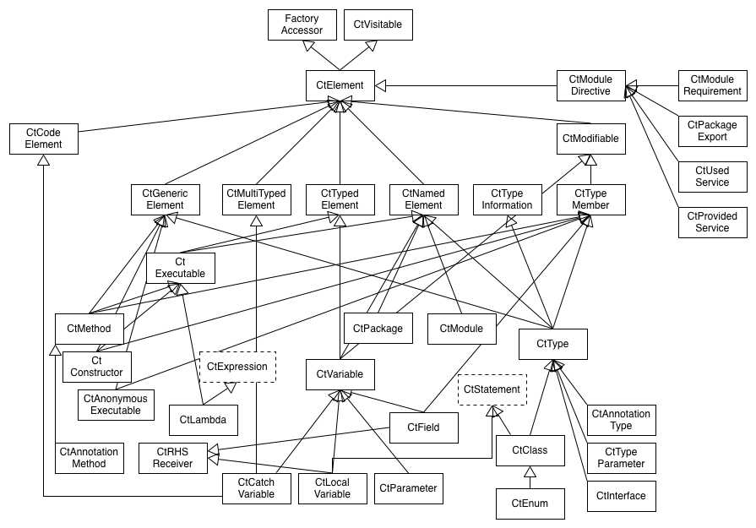
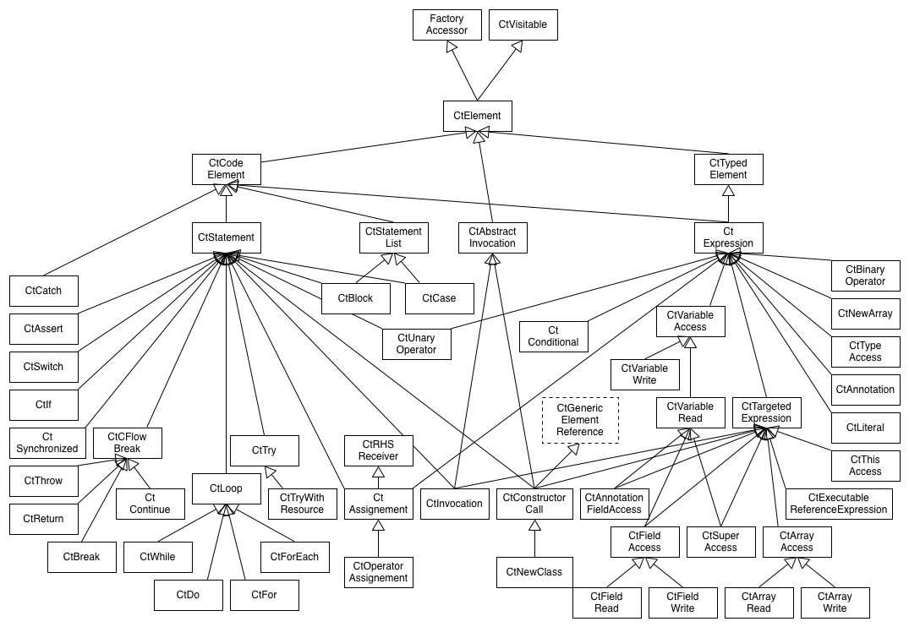
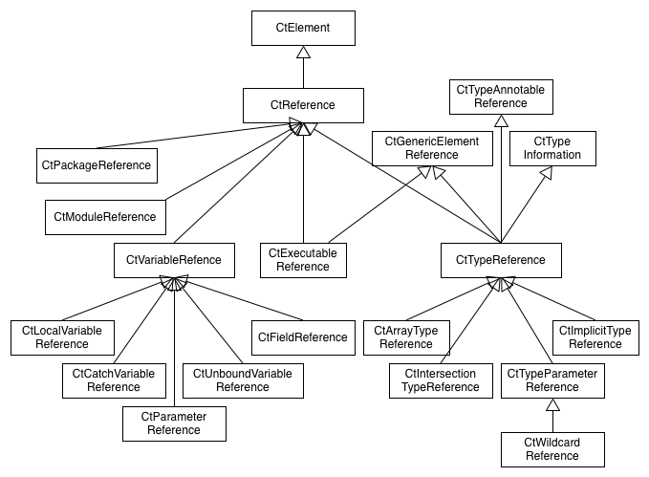
Legion
Structure (declarations, roughly what can be outside methods)
Code (executable statements and expressions, roughly inside methods)
References (names, roughly cross-references, may shortcut/terminate)

Slide 9
Everything is CtElement
Ct = Compile Time
Presents tree model on top of source (DOM for Java)
  children, parents, siblings
  queries
  paths
Instances are CtVisitable-able - accept(CtVisitor) that can visitCtSomeThing (CtSomeThing<?> thing)

Slide 10
The Fab Four
Elements are created via Factory-s
Elements are searched via Query-es
Analyses are done via Processor-s
Transformations are done via Template-s

Slide 11
Let’s Do a Realistic Example
Many modules that have lots of unit tests (hooray!) (jUnit 4.x)
For every one of the modules – introduce a common base class for unit tests
Inconsistent naming – there are TestFooBar, FooBarTest, even Bug123BeGone – whatever people liked
Some of the above names represent utility classes
Some of the test classes already extend others
There are inner classes as well

Slide 12
new
Spoonerism()
.readClasses()
.display()
.enumerateTestingClasses()
.determineBaseTestingClassPackage()
.createBaseTestingClass()
.extendTestingClasses()
.writeTransformedClasses();

Slide 13
new
Spoonerism()
.readClasses()
.display()
.enumerateTestingClasses()
.determineBaseTestingClassPackage()
.createBaseTestingClass()
.extendTestingClasses()
.writeTransformedClasses();

Slide 14
// Command line launcher. There are more for
// launching via maven, gradle...
spoonUniverse = new Launcher();
// Call it many times if needed - on directories
// and files
spoonUniverse.addInputResource(IN_DIR);
// Build and wait - but generally fast enough.
spoonUniverse.buildModel();

Slide 15
new
Spoonerism()
.readClasses()
.display()
.enumerateTestingClasses()
.determineBaseTestingClassPackage()
.createBaseTestingClass()
.extendTestingClasses()
.writeTransformedClasses();

Slide 16
// Will not work:
// System.out.println(spoonUniverse);
// Get a graphical overview, constructing is enough
SpoonModelTree tree = new SpoonModelTree(
spoonUniverse.getFactory());
/* You get the same via command line:
java -jar spoon-core-...-with-dependencies.jar -g -i src/test/java
*/

Slide 17
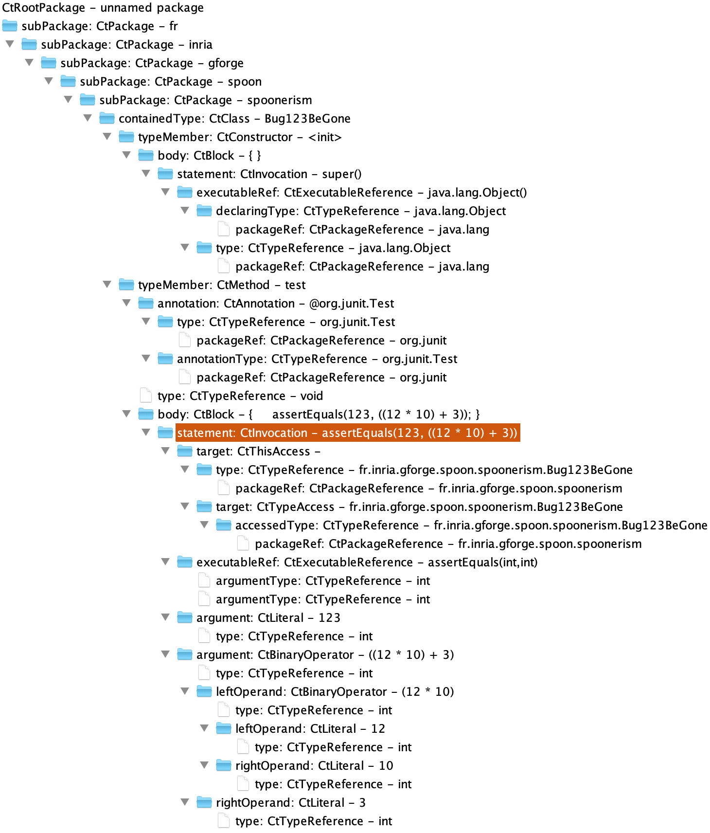
package fr.inria.gforge
.spoon.spoonerism;
import org.junit.Assert;
import org.junit.Test;
public class Bug123BeGone
extends BaseTest {
@Test
public void test() {
Assert.assertEquals(123,
((12 * 10) + 3));
}
}

Slide 18
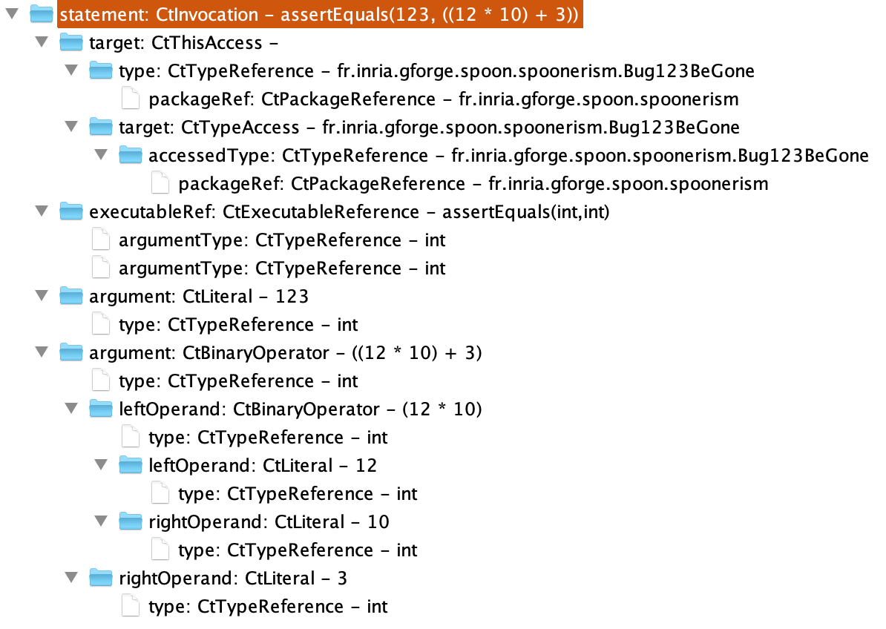
Assert
.assertEquals(
123,
((12 * 10) + 3));

Slide 19
new
Spoonerism()
.readClasses()
.display()
.enumerateTestingClasses()
.determineBaseTestingClassPackage()
.createBaseTestingClass()
.extendTestingClasses()
.writeTransformedClasses();

Slide 20
// This will only filter classes - not enough
TypeFilter<CtClass<?>> isClass =
new TypeFilter<>(CtClass.class);

Slide 21
// If we need something - we obtain it via factory
Factory factory = spoonUniverse.getFactory();
// Create a reference to what we need
CtTypeReference<?> juTestRef =
factory.Type() .createReference("org.junit.Test");
// can also use class literal:
// factory.Type().createReference(org.junit.Test.class);
// however beware that then you need the class due to static linking
// Now lets try to get classes with methods annotated with org.junit.Test
// still not enough
TypeFilter<CtClass<?>> isWithTestAnnotatedMethods =
new TypeFilter<CtClass<?>>(CtClass.class) {
@Override
public boolean matches(CtClass<?> ctClass) {
return super.matches(ctClass) &&
!ctClass
.getMethodsAnnotatedWith(juTestRef)
.isEmpty();
}
};

Slide 22
// The proper way - the annotated method may come from an extended class
TypeFilter<CtClass<?>> isRealTestingClass =
new TypeFilter<CtClass<?>>(CtClass.class) {
@Override
public boolean matches(CtClass<?> ctClass) {
// First step is to reuse standard filtering
if (!super.matches(ctClass)) {
return false;
}
CtTypeReference<?> current = ctClass.getReference();
// Walk up the chain of inheritance and find whether
//there is a method annotated as test
do {
if (!current.getTypeDeclaration()
.getMethodsAnnotatedWith(juTestRef).isEmpty()) {
return true;
}
} while ((current = current.getSuperclass()) != null);
return false;
}
};
testingClasses = new HashSet<>(spoonUniverse.getModel().getRootPackage()
.getElements(isRealTestingClass));

Slide 23
new
Spoonerism()
.readClasses()
.display()
.enumerateTestingClasses()
.determineBaseTestingClassPackage()
.createBaseTestingClass()
.extendTestingClasses()
.writeTransformedClasses();

Slide 24
// Find the package to place it - basically package covering all tests
// Get one of the classes to start, first one will do
CtClass<?> firstClass = testingClasses.iterator().next();
String qualifiedName = firstClass.getPackage().getQualifiedName();
List<String> commonComponents = Arrays.asList(
qualifiedName.split("[.]"));
// For all the testing classes find the common subsequence of package names
for (CtClass<?> ctClass: testingClasses) {
List<String> currentComponents = Arrays.asList(
ctClass.getPackage().getQualifiedName().split("[.]"));
int max = Math.min(currentComponents.size(), commonComponents.size());
for (int i = 0; i < max; i++ ) {
if (!currentComponents.get(i).equals(commonComponents.get(i))) {
commonComponents = commonComponents.subList(0, i);
break;
}
}
}
baseTestingClassPackage = String.join(".", commonComponents);

Slide 25
A.B.C.D.E
A.B.F.G
A.B.H
A.B.I.J.K
A.B.L
A.B.M.N
—————————
A.B

Slide 26
new
Spoonerism()
.readClasses()
.display()
.enumerateTestingClasses()
.determineBaseTestingClassPackage()
.createBaseTestingClass()
.extendTestingClasses()
.writeTransformedClasses();

Slide 27
// Creating a class - again use a factory
String baseClassFqn = baseTestingClassPackage +
".BaseTest";
baseTestingClass = spoonUniverse.getFactory().createClass(baseClassFqn);

Slide 28
new
Spoonerism()
.readClasses()
.display()
.enumerateTestingClasses()
.determineBaseTestingClassPackage()
.createBaseTestingClass()
.extendTestingClasses()
.writeTransformedClasses();

Slide 29
// Now we need to extend the classes.
CtTypeReference<?> baseTestingClassRef =
baseTestingClass.getReference();
for (CtClass<?> ctClass: testingClasses) {
if (ctClass.getSuperclass() == null) {
ctClass.setSuperclass(baseTestingClassRef);
}
}

Slide 30
new
Spoonerism()
.readClasses()
.display()
.enumerateTestingClasses()
.determineBaseTestingClassPackage()
.createBaseTestingClass()
.extendTestingClasses()
.writeTransformedClasses();

Slide 31
// And now just write the transformed classes
Environment env = spoonUniverse.getEnvironment();
// replace FQN with imports and short names
env.setAutoImports(true);
// include comments - source is for human consumption
env.setCommentEnabled(true);
// where to write
spoonUniverse.setSourceOutputDirectory(OUT_DIR);
// default printing, can use a different printer
spoonUniverse.prettyprint();

Slide 32
new
Spoonerism()
.readClasses()
.display()
.enumerateTestingClasses()
.determineBaseTestingClassPackage()
.createBaseTestingClass()
.extendTestingClasses()
.writeTransformedClasses();

Slide 33
Spoon Me Further
2016, Gérard Paligot, slides
2017, Benjamin Danglot, YouTube, slides
2018, Simon Urli, YouTube, slides

Slide 34
Fork Off
Eclipse JDT (Java Development Tools)
IntelliJ PSI (Program Structure Interface)
Try with Spoon first:
  It is for Java, based on Java and in Java
  Roots in academy, targeting industry and practitioners

Slide 35
Why Such Title And Names
Peter J. Landin —
The Next 700 Programming Languages
Bessey, et.al —
A few billion lines of code later: using
static analysis to find bugs in the real world
Spoonerism — changing sounds between words,
“Is it kisstomary to cuss the bride?”

