Slide 1
Digital Literacy

Slide 2
Digital literacy is about understanding how to operate and use digital applications, devices and the internet safely.It enables us to learn, connect and achieve tasks online and use the internet safely.Having digital literacy ensures we are not vulnerable to dangers while using the internet.

Slide 3
Secure Online Practices

Slide 4
se secure passwords with two-factor authentication turned on.Never open or download links or files from a website that seems suspicious.Do not give your personal details over the internet.Keep your antivirus software updated along with any applications you use.

Slide 5
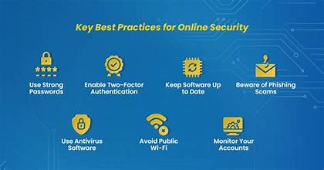

Slide 6
Electronic Mail Etiquette

Slide 7
Be polite and formal.Proofread messages for spelling and grammar mistakes before sending them.Always use a clear and appropriate subject for your message. Respond promptly when a reply is necessary.

Slide 8
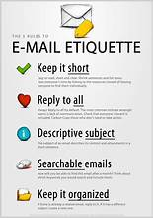

Slide 9
Helpful Digital Applications

Slide 10
Canva-Design and presentations.Google Drive-Online storage and sharing.GitHub-Coding projects and version control.Grammarly-grammar and spelling checker.

